Slide 1
Introduction to Database Technologies
Introduction to SQL
Lecture 7
Dr. Victoria Mukami
Notes:
Introduction to databases
The Database Environment
Database Analysis and Design
Entity-Relationship Modelling Service-Oriented Architectures
The Relational Model
Normalization

Slide 2
Overview
Focus on Structured Query Language (SQL).
History of SQL
Importance of SQL in database creation.
Data definition languages (DDL) and data manipulation languages (DML).
SQL syntax while outlining the various rules.
Install an SQL instance

Slide 3
Learning Outcomes
Understand the importance of the Structured Query Language (SQL)
Outline the difference between Data Definition Languages (DDL) and Data Manipulation Languages (DML)
Understand the syntax of the SQL language

Slide 4
Recap
Done a thorough introduction to databases.
Lecture five focused on the entity relationship modelling
Lecture 6 focused on normalization
Two focused on the design phase
This lecture will focus on the development of the database

Slide 5
Recap Cont.
Understanding the inner workings of the database through the various life cycle phases.
Once design is completed the we create the database
We then insert data into it.
Mainly done by a database administrator
Also, in charge of the maintenance of the database
SQL is used to create a database, insert records, and even query the records

Slide 6
Introduction to SQL
SQL - Structured Query language
Came about due to the relational model development in the 70s’.
Started off as SEQUEL - Structured English Query Language.
Revised version of SEQUEL by IBM in 1974 led to the development of SQL
Also, led to numerous other extensions by other companies.
Extension - feature or features that are provided on top of the existing standard by other vendors
Notes:
IBM produced a prototype DBMS based on SEQUEL/2 called System R (Astrahan et al., 1976). The purpose of this prototype was to validate the feasibility of the relational
model.
SQL are in the language SQUARE (Specifying Queries As Relational Expressions), which predates the System R project.
SQUARE was designed as a research language to implement relational algebra with English sentences
1970s, the database system Oracle was produced by what is now called the Oracle Corporation, and was probably the first commercial implementation of a relational DBMS based on SQL.
INGRES followed shortly afterwards, with a query language called QUEL, which although more “structured” than SQL, was less English-like.
INGRES was converted to an SQL-based DBMS
IBM produced its first commercial RDBMS, called SQL/DS,
Features that are provided on top of the standard by the vendors are called extensions.

Slide 7
Why SQL is important?
SQL is widely accepted as a standard database language
Great progress in the development of SQL
Has led to wide acceptance and the normal standard used in databases.
SQL is a very easy language to learn.
SQL helps to describe structured data while allowing users to secure the database using permissions.

Slide 8
Advantages of SQL
No programming knowledge is needed
Provides high-speed processing of queries
Standardized language that works on any platform
Portable language that can be used on any device
Allows for multiple views of the database to various users

Slide 9
Disadvantages of SQL
Some platforms and versions of SQL are costly
Some companies have created versions of SQL that are proprietary.
Some platforms are complex making it difficult for novice users.

Slide 10
Database Objectives
It should allow a user to create the database and relation structures
Should perform basic data management tasks such as insertion, manipulation, modification, and deletion of data
The language should allow for simple and complex queries
A database language should be relatively easy to learn.
SQL as a database language satisfies all the requirements.

Slide 11
Data Manipulation Language
Allows for various manipulation commands.
SQL includes commands:
  INSERT
  UPDATE
  DELETE
  RETRIEVE
DML include
  SELECT
  INSERT
  UPDATE
  DELETE

Slide 12
Data Definition Language
DDL are commands that are used to define the structure of the database.
SQL includes commands to create database objects
Objects: Tables, Indexes, and Views
DDL commands include
  CREATE
  ALTER
  DROP

Slide 13
Additional Manipulation Languages
Transaction Control Language
TCL commands that are executed within a transaction
Data Control Language
DCL are commands used to control access to data objects, such as giving users permission to objects

Slide 14
SQL Syntax
Language that is easy to learn
Vocabulary is less than 100 words
Also known as a procedural language
Procedural language - where the user commands what is to be done and does not concern themselves on how it will be done

Slide 15
SQL Syntax
SELECT * FROM teachers;
Two keywords:
  SELECT
  FROM
SQL is not case sensitive
SELECT and select can be used interchangeably
We will use all capital letters for SQL reserved keywords to differentiate them from user-defined names.
A semicolon is used at the end of every statement.

Slide 16
SQL Installation
Many versions of SQL that one can use when creating and developing a database.
  SQL Server
  SQL Lite
  MySQL Workbench
  phpMyAdmin
We focus on MySQL Workbench

Slide 17
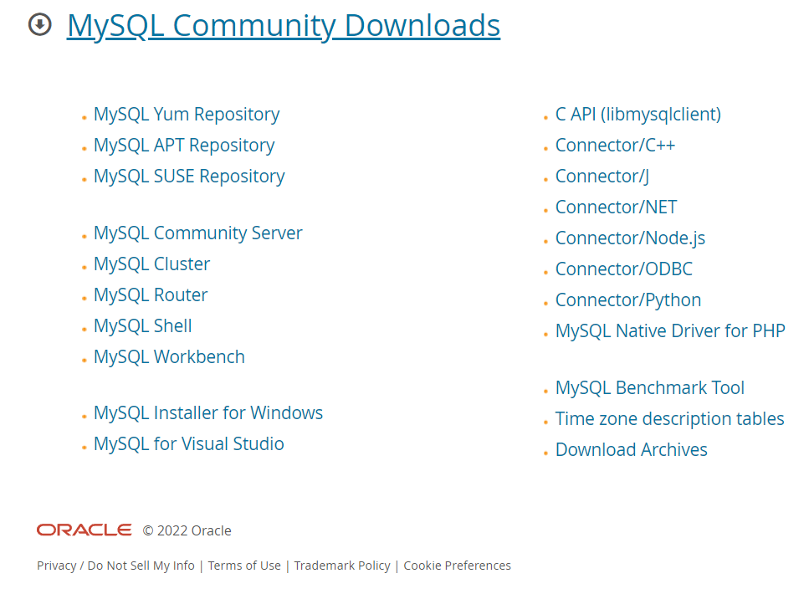
Step 1
The first step is to visit the MySQL Workbench by Oracle website
https://dev.mysql.com/downloads/
Download the MySQL installer for Windows.
Notes:
MySQL Community (GPL) Downloads »

Slide 18
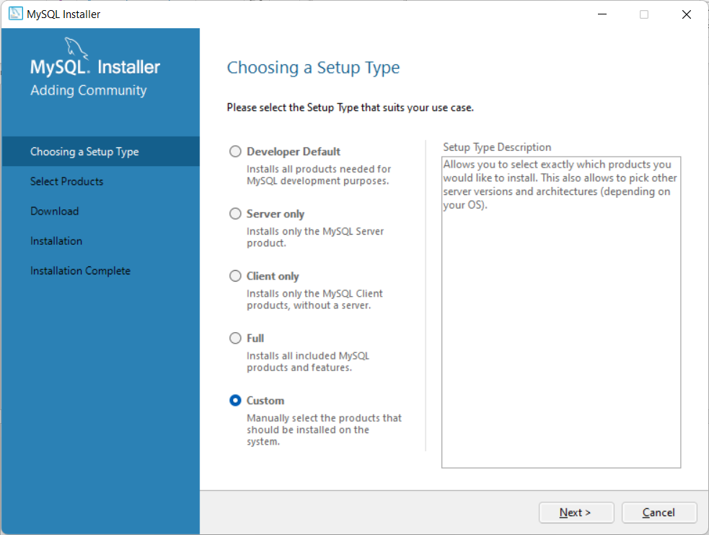
Step 2
Go ahead and open it from the downloads folder and run it.
Select a custom installation.

Slide 19
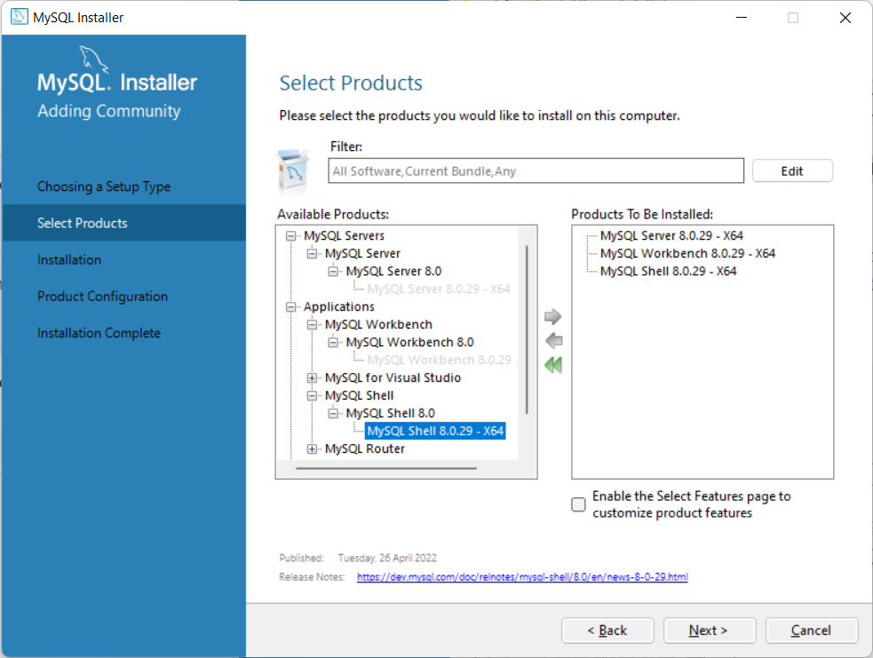
Step 3
Select the following
MySQL server
MySQL Workbench
MySQL shell

Slide 20
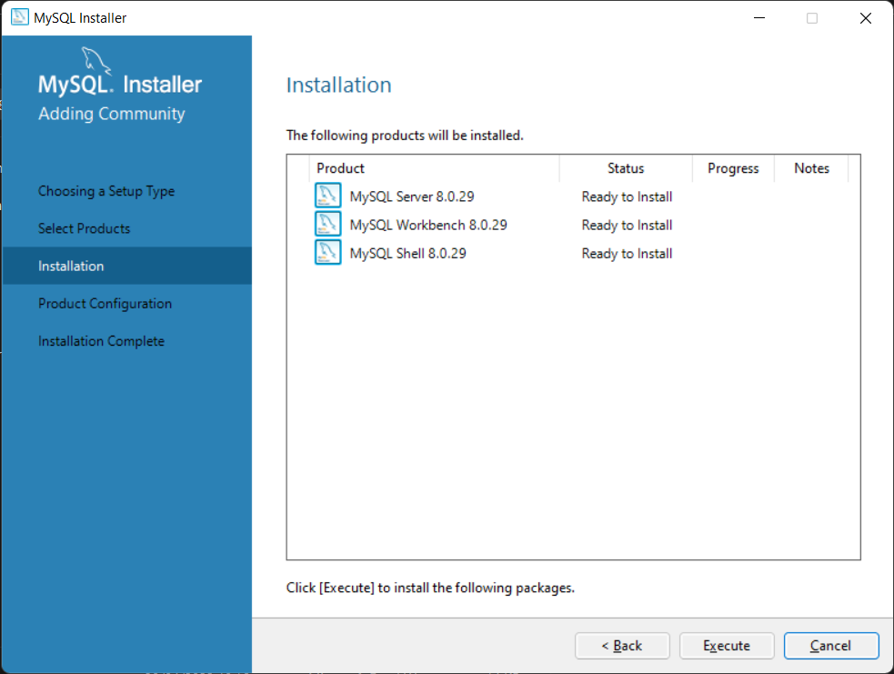
Step 4
Click execute to install.

Slide 21
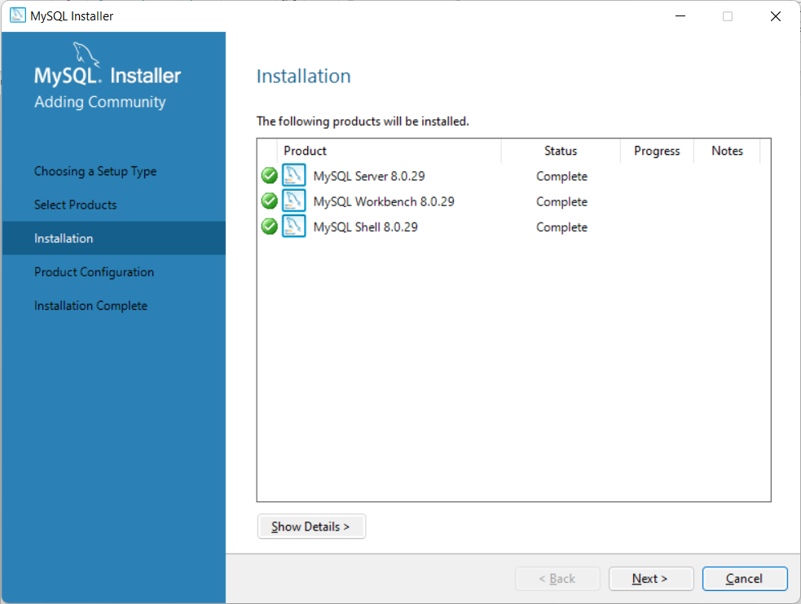
Step 5
Once it executes the status will change to completed.
Once it is executed you will click next
Leave the defaults and click next

Slide 22
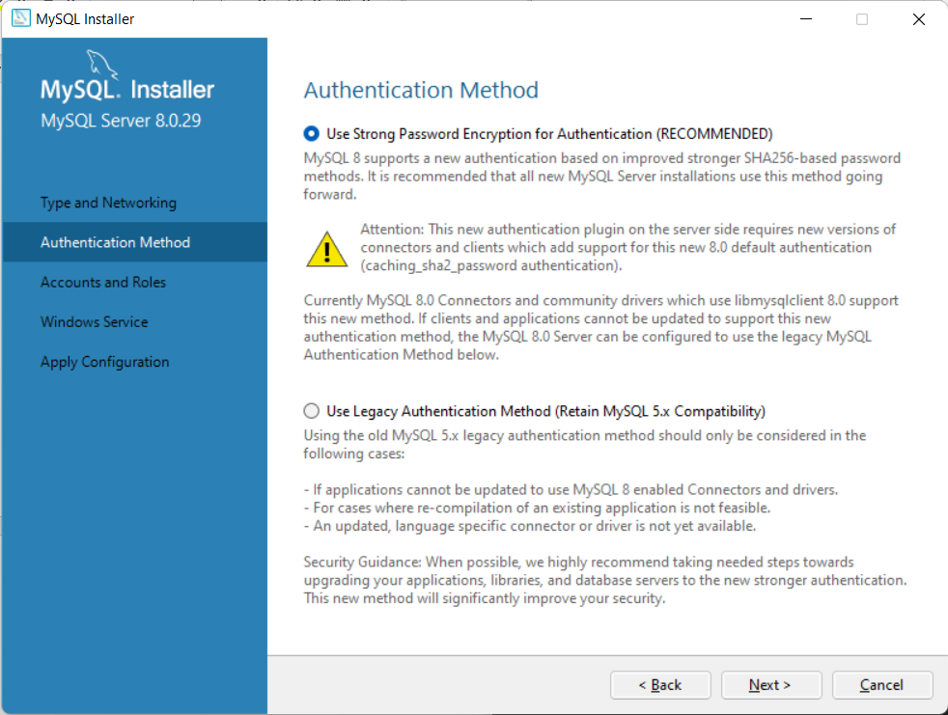
Step 6
Select Use Strong Password Encryption for Authentication (RECOMMENDED)

Slide 23
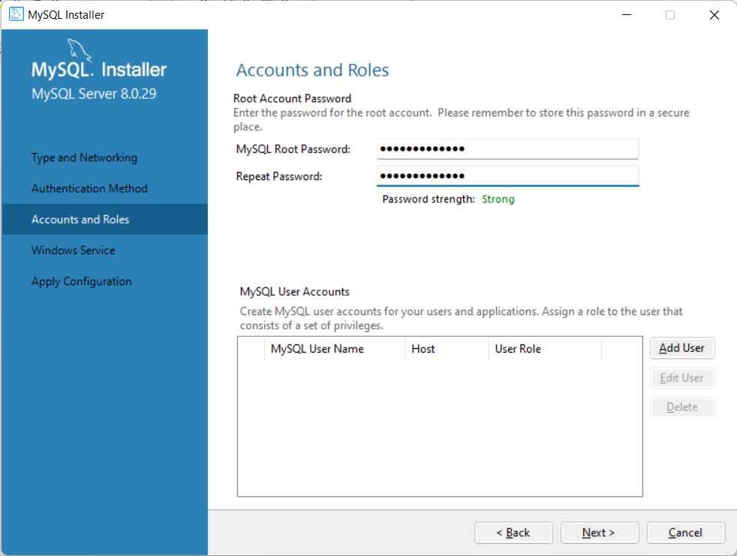
Step 7
Type in your MySQL root password and click next

Slide 24
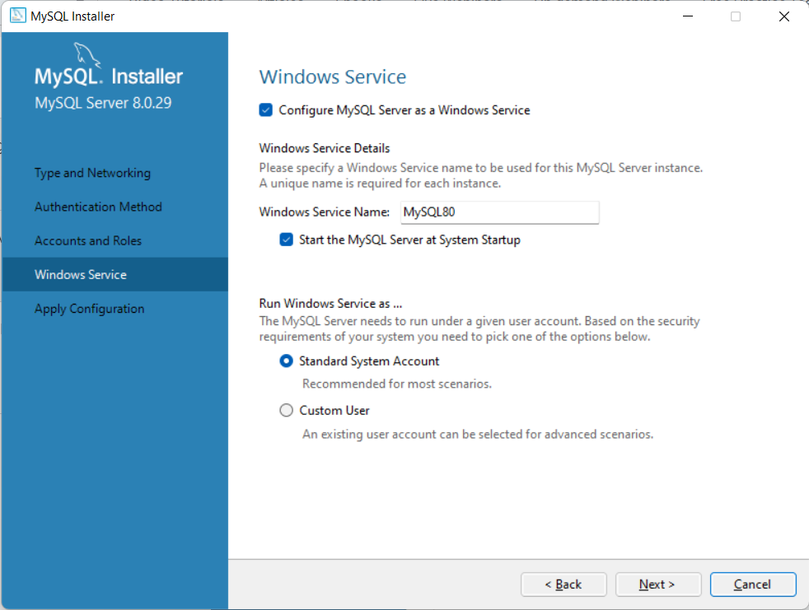
Step 8
Leave the default settings and click next
Click Execute then Finish

Slide 25
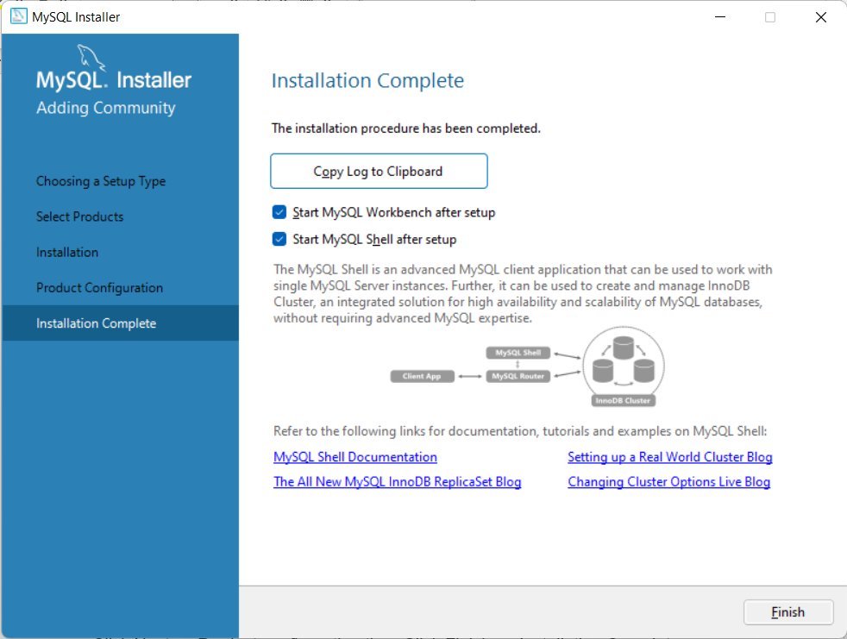
Step 9
Click Next on Product configuration
Click Finish on Installation Complete screen.

Slide 26
Using MySQL Command Line
When you complete the installation, the MySQL workbench and MySQL Shell will open.
For the unit we will work with the MySQL 8.0 Command Line Client

Slide 27
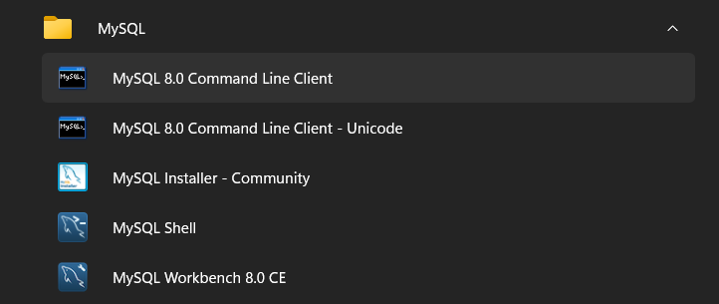
Open MySQL 8.0
To access, you click on the MySQL folder from the start menu
Select MySQL 8.0 Command Line Client as shown below.

Slide 28
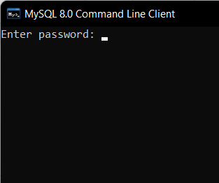
MySQL Command Line
Once open the screen will request for the root password.
We will create our databases directly on root.
We will focus on creating other users during the database administration unit.

Slide 29
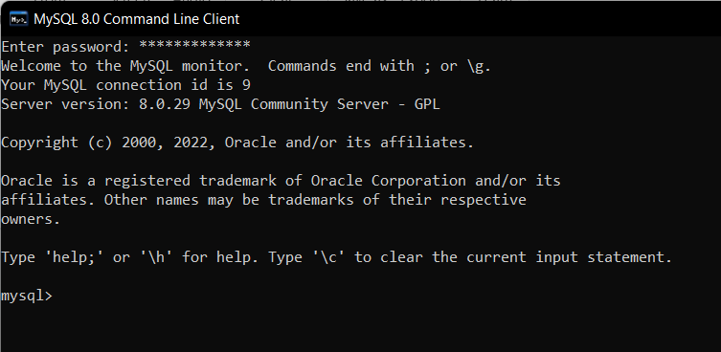
Final Coding Screen

Slide 30
Summary
Introduced SQL.
Defining the term SQL
The history of SQL
Advantages of SQL
General syntax of SQL.
Install MySQL Workbench
Disadvantages of SQL

Slide 31
Discussion Topic
This lecture will not have a discussion topic, however, each student will be required to install MySQL Workbench on their computers in readiness for the next lecture on SQL where we will be writing queries.

Slide 32
References
[1] Database systems: design, implementation, and management, Coronel, C., & Morris, S, Cengage Learning, 2019.
[2] Database Systems: A Practical Approach to Design, Implementation, and Management, Connolly, T., & Begg, C., Pearson, 2015.
[3] Fundamentals of database systems, Elmasri, R., & Navathe, S. B., Pearson Education Limited, 2016.

Slide 33
Next lesson will cover
Introduction to Data Definition Languages

