Slide 1
Introduction to Database Technologies
Introduction to Data Definition Language
Lecture 8
Dr. Victoria Mukami

Slide 2
Overview
Writing SQL statements
Begin with data definition statements.
Creation of a database
Creation of tables
Manipulate and modify existing tables
and their structures.

Slide 3
Learning Outcomes
Understand the role of ERD diagrams when creating a database
Create a database and its various tables

Slide 4
RECAP
Previously we have created an ERD for Bustani College
The ERD diagram could then be used to create a database.
Dealt with design previously now on the development of the database.
Create some tables from the ERD diagram.
Previously installed MySQL Workbench.
Lecture will include screenshots of where to type code and a view of the results.

Slide 5
Introduction to DDL
DDL stands for Data Definition Language.
Statements that are used to create database objects
Focus on the creation of tables and views.
Statements used to create tables include CREATE and DROP.

Slide 6
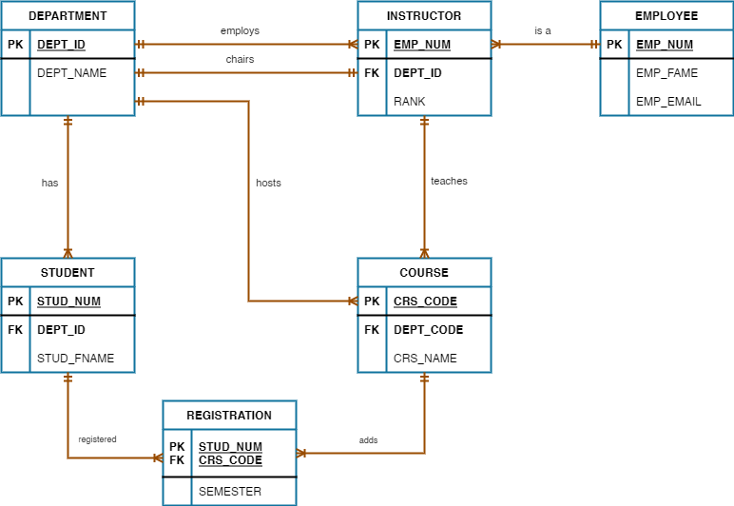
Introduction
Review the Bustani ERD we created from Lecture 5.
The ERD diagram has 6 tables.

Slide 7
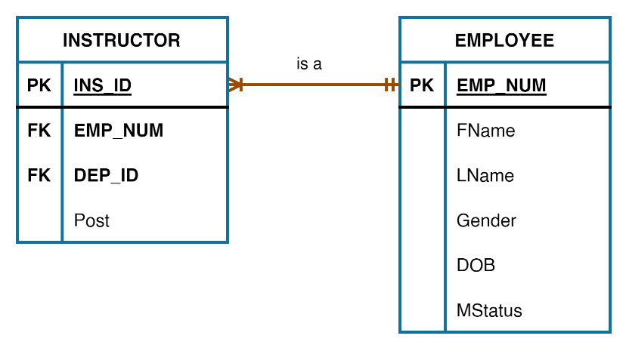
Introduction
We cannot work with all the tables.
Create the instructor and employee tables.
Simplified ERD is shown

Slide 8
Employee Table
Emp_Num | FName | LName | Gender | DOB | MStatus
EMP001 | Agnes | Njue | F | 12/09/1997 | Single
EMP002 | Will | Omondi | M | 24/08/1989 | Married
EMP003 | Carol | Njagi | F | 09/01/1993 | Single
EMP004 | Mary | Munene | F | 06/08/1998 | Married
EMP005 | Cathy | Resley | M | 16/04/1989 | Married
EMP006 | Abdul | Muita | M | 30/07/1988 | Single
EMP007 | Steve | Kimuri | M | 02/03/1999 | Married
EMP008 | Ruth | Kimuli | F | 07/04/1996 | Single
Employee table has 6 fields
Shorter one-word names have been used within the table.

Slide 9
Instructor Table
ID | Emp_Num | Dep_ID | Post
1 | EMP001 | CIT | Lecturer
2 | EMP002 | MTH | Chairman
3 | EMP003 | CIT | Dean
4 | EMP004 | CIT | Lecturer
5 | EMP005 | CIT | Lecturer
6 | EMP006 | CIT | Senior Lecturer
7 | EMP007 | MTH | Lecturer
8 | EMP008 | MTH | Senior Lecturer
The instructor table has 4 fields namely

Slide 10
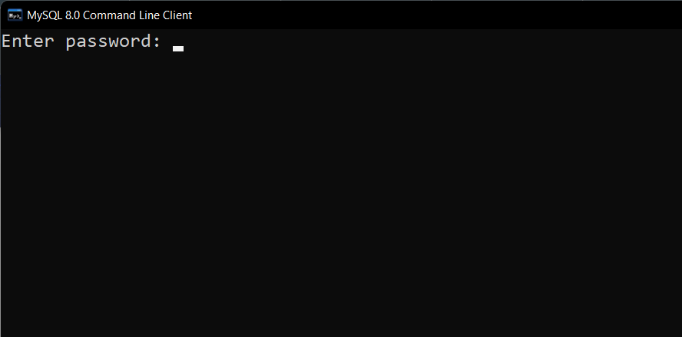
MySQL Command Line
Log in to MySQL Command Line Client.
Click on the MySQL folder from the Start menu.
Insert the password

Slide 11
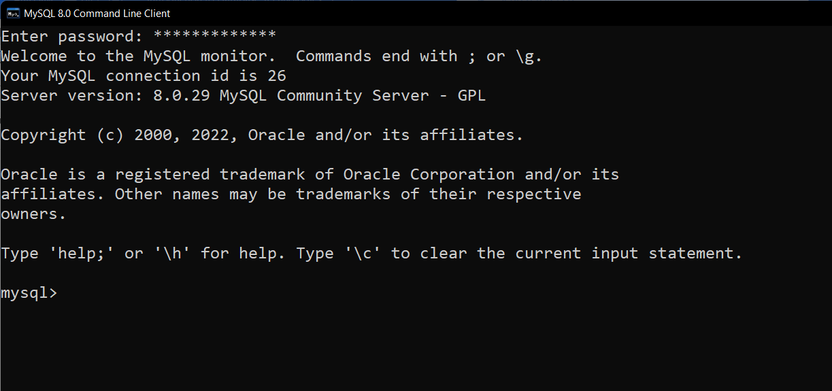
MySQL Command Line
Where to type all our SQL commands.

Slide 12
Create Database
We start by first creating a database.
Syntax
CREATE DATABASE databasename;

Slide 13
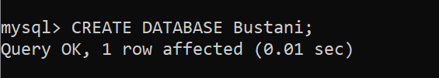
Create Database
CREATE DATABASE databasename;
Database name is Bustani.
Code to create
CREATE DATABASE Bustani;

Slide 14
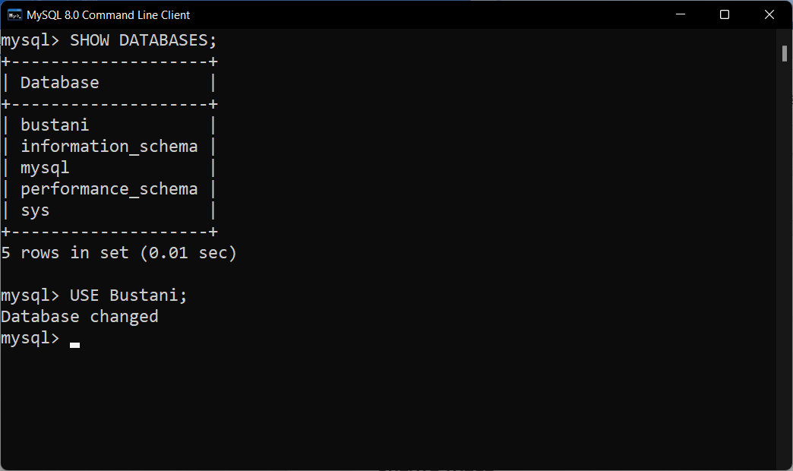
Show Databases
To see the databases created
Syntax
SHOW DATABASES;
Default databases
  information_schema
  mysql
  performance_schema
  sys

Slide 15
Use Databases
Need to select the database
Helps to create tables within the database.
Syntax
USE Bustani;

Slide 16
Create Table
Syntax for creating a table
CREATE TABLE tablename (
fieldname1 datatype constraint(s),
fieldname1 datatype constraint,
PRIMARY KEY (fieldname)
);

Slide 17
Create Table
tablename: User-defined table names like employee or instructor
fieldname1: Fields or column headers. For instance, the employee table contains 6 fields e.g., Emp_Num
datatype: A valid data type definition. The data types used are listed in table 3.
Constraint: This are valid constraints..

Slide 18
SQL Data Types
DATA TYPE | DESCRIPTION
CHAR( ) | A string that can contain letters, numbers, and special characters. Length is 0 to 255 and is placed inside the brackets
VARCHAR( ) | Like a CHAR but has a longer size. The length is 0 to 65535 and is placed inside the brackets
INT( ) | This is a medium-sized integer. Allows for a max of 255 digits and this is placed inside the brackets
FLOAT( ) | This is a floating-point number. This is similar to a fraction in mathematics. The length is placed inside the brackets
DECIMAL( ) | This is a fixed-point number. Within the brackets, the size of the digits are placed and the number of decimal points i.e., (25, 2) where a max of 25 digits with 2 decimal points
DATE | This is a date that has the format starting with year then month then day (YYYY-MM-DD)
YEAR | This is a 4-digit year e.g., 2022

Slide 19
SQL Constraints
CONSTRAINT | DESCRIPTION
NOT NULL | A column cannot be empty. Some data has to be input
UNIQUE | Makes sure that all the values are not repeated
PRIMARY KEY | A primary key from previous lectures is not empty nor repeated
FOREIGN KEY | This shows the column as being a primary key from a different table

Slide 20
Employee Table
Emp_Num | FName | LName | Gender | DOB | MStatus
EMP001 | Agnes | Njue | F | 12/09/1997 | Single
EMP002 | Will | Omondi | M | 24/08/1989 | Married
EMP003 | Carol | Njagi | F | 09/01/1993 | Single
EMP004 | Mary | Munene | F | 06/08/1998 | Married
EMP005 | Cathy | Resley | M | 16/04/1989 | Married
EMP006 | Abdul | Muita | M | 30/07/1988 | Single
EMP007 | Steve | Kimuri | M | 02/03/1999 | Married
EMP008 | Ruth | Kimuli | F | 07/04/1996 | Single
The Employee table had 6 fields
Emp_Num, FName, LName, Gender, DOB, MStatus
CREATE TABLE Employee (
  Emp_Num CHAR (6) NOT NULL UNIQUE,
  FName VARCHAR (25) NOT NULL,
  LName VARCHAR (25) NOT NULL,
  Gender CHAR (1) NOT NULL,
  DOB DATE NOT NULL,
  MStatus VARCHAR(15) NOT NULL,
  PRIMARY KEY (Emp_Num)
);

Slide 21
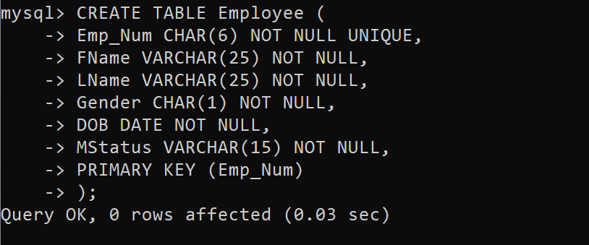
Employee Table
Output

Slide 22
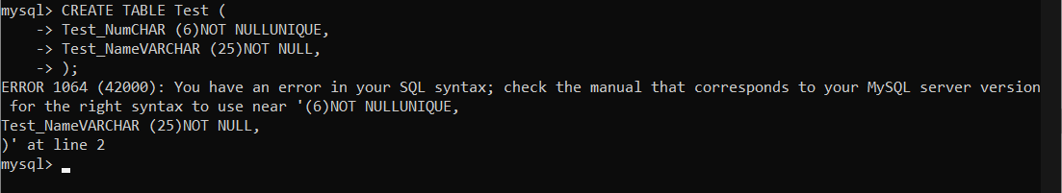
Employee Table
Place each code on its line for readability
Identify any errors that may come up.
To view the table that has been created you use
SHOW COLUMNS FROM Employee;
DESCRIBE Employee;

Slide 23
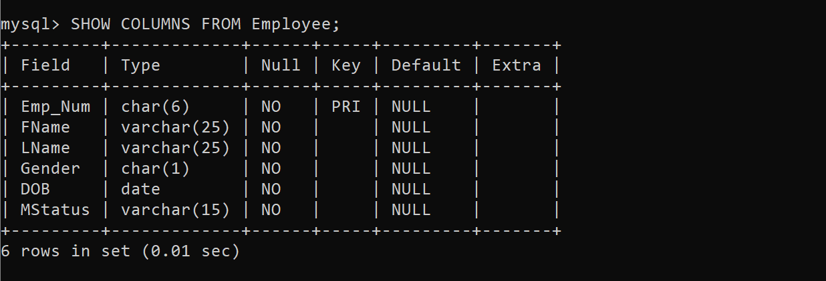
Describe Tables
Output

Slide 24
Instructor Table
Instructor table has a foreign key
Emp_Num from the Employee table
Dep_ID from Department table
Fields are four
  ID, Emp_Num, Dep_ID and Post.
The Dep_ID Foreign Key link cannot be added - it is a foreign key for a table that does not exist.

Slide 25
Instructor Table
ID | Emp_Num | Dep_ID | Post
1 | EMP001 | CIT | Lecturer
2 | EMP002 | MTH | Chairman
3 | EMP003 | CIT | Dean
4 | EMP004 | CIT | Lecturer
5 | EMP005 | CIT | Lecturer
6 | EMP006 | CIT | Senior Lecturer
7 | EMP007 | MTH | Lecturer
8 | EMP008 | MTH | Senior Lecturer
The instructor table has 4 fields namely

Slide 26
Instructor Table
ID | Emp_Num | Dep_ID | Post
1 | EMP001 | CIT | Lecturer
2 | EMP002 | MTH | Chairman
3 | EMP003 | CIT | Dean
4 | EMP004 | CIT | Lecturer
5 | EMP005 | CIT | Lecturer
6 | EMP006 | CIT | Senior Lecturer
7 | EMP007 | MTH | Lecturer
8 | EMP008 | MTH | Senior Lecturer
Syntax
CREATE TABLE Instructor (
  Ins_ID INTEGER NOT NULL UNIQUE,
  Emp_Num CHAR (6),
  Dep_ID CHAR (3),
  Post VARCHAR (15) NOT NULL,
  PRIMARY KEY (INS_ID),
  FOREIGN KEY (Emp_Num) REFERENCES Employee(Emp_Num),
);

Slide 27
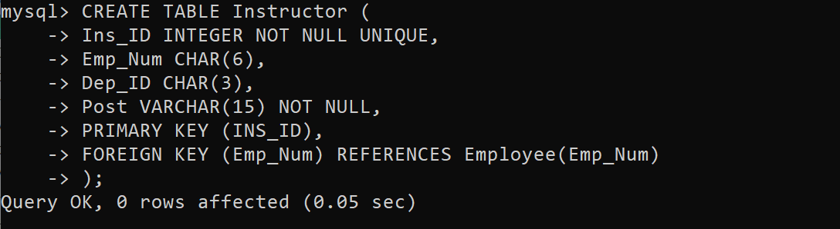
Instructor Table
Output

Slide 28
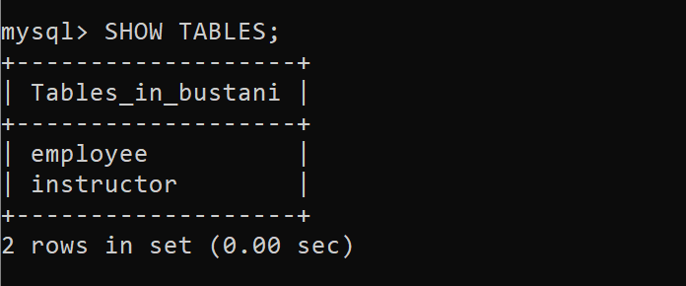
Show Tables
Output

Slide 29
Summary
How to log in to MySQL Command-Line.
How to create a database
How to show the databases that exist
Created various tables
Updated table relationships

Slide 30
Discussion Topic
During Lecture 5, we produced an ERD for the Lands Office. Using the Entity Relationship Diagram, create a database called Shamba that will hold all the tables that you identified in your ERD diagram. Ensure that you create all the relationships. Take into consideration the data types to be used and the primary keys.
Ensure to engage your instructor if you get stuck.

Slide 31
References
[1] Database systems: design, implementation, and management, Coronel, C., & Morris, S, Cengage Learning, 2019.
[2] Database Systems: A Practical Approach to Design, Implementation, and Management, Connolly, T., & Begg, C., Pearson, 2015.
[3] Fundamentals of database systems, Elmasri, R., & Navathe, S. B., Pearson Education Limited, 2016.

Slide 32
Next lesson will cover
Advanced Data Definition Language

