Slide 1
Introduction to Database Technologies
Advanced Data Definition Language
Lecture 9
Dr Victoria Mukami

Slide 2
Overview
Work on updating some fields within tables
Altering various field constraints and data types.
Deleting fields or tables from the database.
Notes:
Assume, Bustani college has undergone some changes and now needs to capture additional employee data.
Necessary for the administrator to update the tables either to add fields or to update existing ones.

Slide 3
Learning Outcomes
Alter the table structure
Drop tables and various fields

Slide 4
Recap
Used a simplified ERD
Previously worked on CREATE database
CREATE Tables
Assigned relationships and Primary Keys

Slide 5
Introduction
ALTER and the DROP commands used.
Necessary to make changes to the structure of the database or tables.
Might be necessitated by some oversight

Slide 6
Introduction
Assume, Bustani college has undergone some changes
Needs to capture additional employee data.
Necessary for the administrator to update the tables
Either to add fields or to update existing ones.

Slide 7
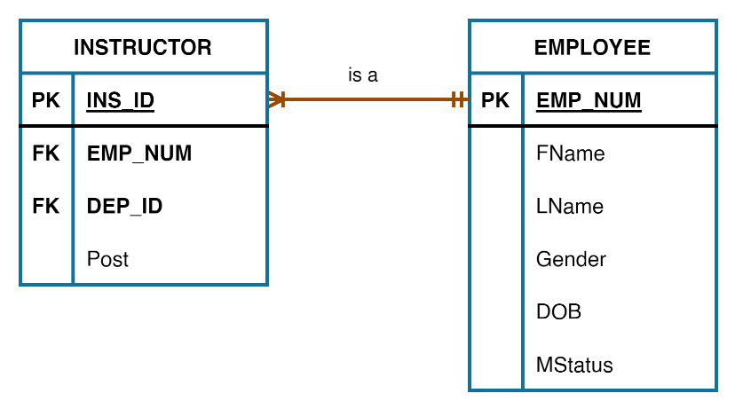
Introduction
Last Lecture, we created two tables using the CREATE command
Final ERD is shown
Make some changes to this initial ERD
Adding a table
Updating some fields within the instructor field

Slide 8
ALTER Table
We have created two tables
  Employee
  Instructor
For the Instructor table, we could not add Dep_ID as a foreign key.

Slide 9
ALTER Table
Dep_ID | Dep_Name
CIT | Computing and Information Technology
MTH | Statistics and Mathematics
We need to create a department table
Has the following fields:
  Dep_ID and Dept_Name

Slide 10
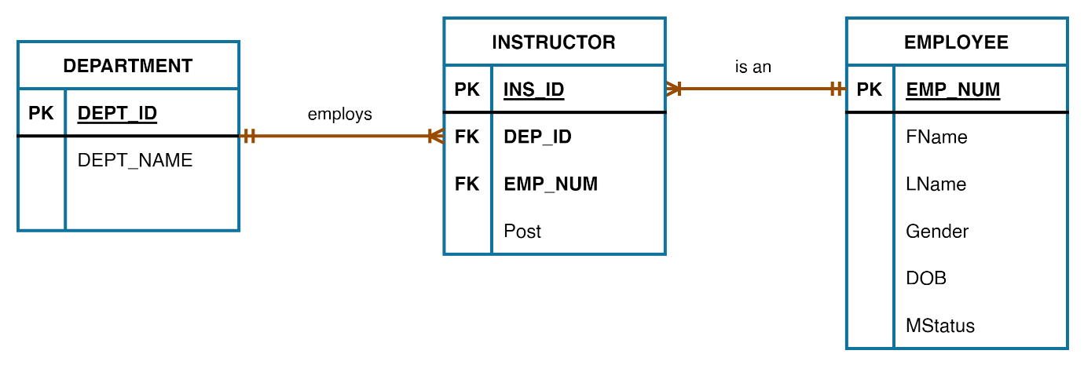
ALTER Table
Updated ERD

Slide 11
Department Table
Statement to create the table
CREATE TABLE Department (
  Dep_ID CHAR(3) NOT NULL UNIQUE,
  Dep_Name VARCHAR (45) NOT NULL,
  PRIMARY KEY (Dep_ID)
);

Slide 12
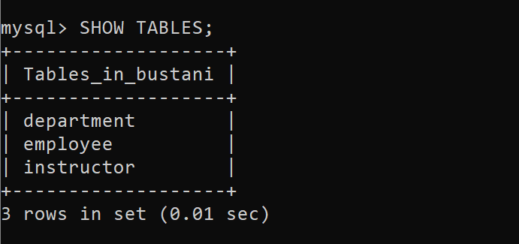
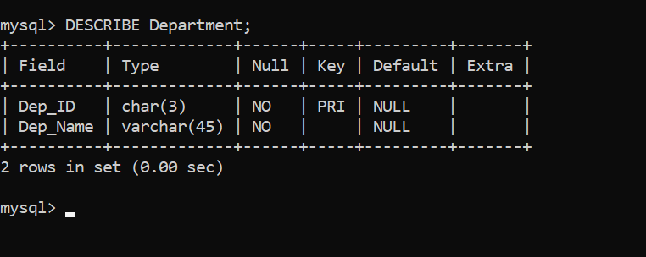
Department table
Output

Slide 13
ALTER Table
Syntax
ALTER TABLE tablename(
ADD fieldname datatype constraint,
MODIFY (fieldname datatype),
ADD PRIMARY KEY (fieldname),
ADD FOREIGN KEY (fieldname) REFERENCES tablename(fieldname),
DROP fieldname
);

Slide 14
ALTER Table
Add is used to input
  new field names
  primary keys
  foreign keys.
Modify is used to update existing columns by changing the datatype
DROP is used to delete a column.

Slide 15
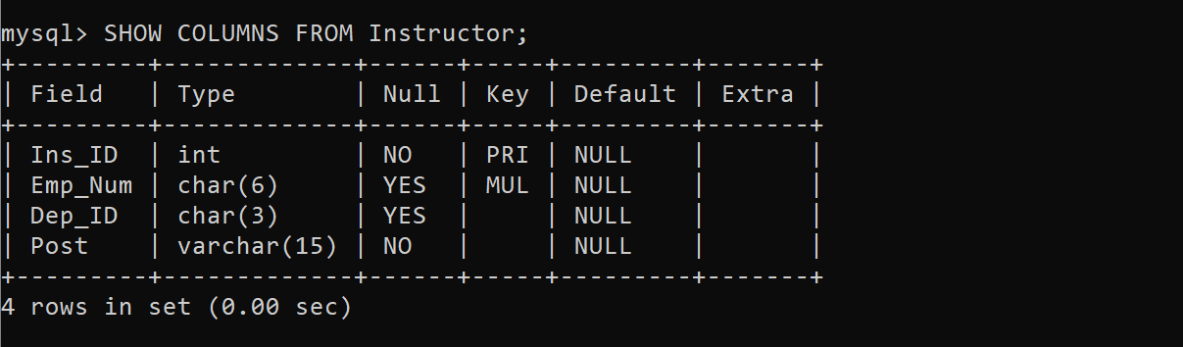
ALTER Table
Update the Dep_ID field in the instructor table
Make it a foreign key from the department table.
Dep_ID was not set to not null

Slide 16
Instructor Table
Combine the statements
ALTER TABLE Instructor
MODIFY Dep_ID CHAR(3) NOT NULL,
ADD FOREIGN KEY (Dep_ID) REFERENCES Department(Dep_ID);

Slide 17
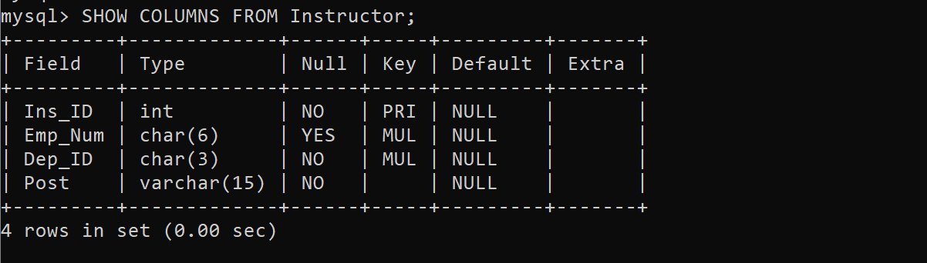
Instructor Table
Output

Slide 18
ALTER Column
We can alter a column's data type.
We refer to the data types from the three tables created so far

Slide 19
Data Types
Table | Field Name | Datatype
Instructor | Ins_ID | INTEGER
 | Emp_Num | CHAR (6),
 | Dep_ID | CHAR (3),
 | Post | VARCHAR (15)
Employee | Emp_Num | CHAR (6)
 | FName | VARCHAR (25)
 | LName | VARCHAR (25)
 | Gender | CHAR (1)
 | DOB | DATE
 | MStatus | VARCHAR(15)
Department | Dep_ID | CHAR(3)
 | Dep_Name | VARCHAR (45)
Three Tables
  Instructor
  Employee
  Department

Slide 20
Employee Table
Change the employee Gender field from CHAR to a VARCHAR
Have a length of 10
ALTER TABLE Employee
MODIFY Gender VARCHAR(10);

Slide 21
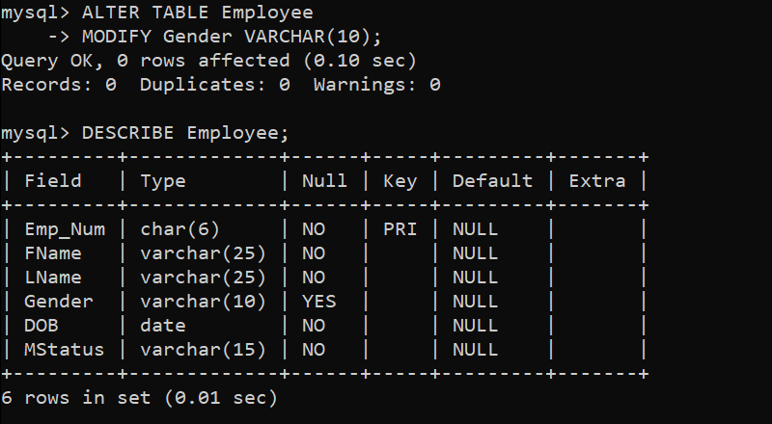
Employee Table
Output
The datatype for Gender is changed from a CHAR to VARCHAR.

Slide 22
Instructor Table
Add a column to our Instructor table called School.
New column
ALTER TABLE Instructor
ADD School VARCHAR(35) NOT NULL;

Slide 23
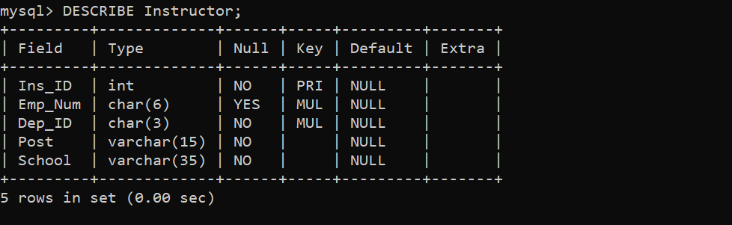
Instructor Table
Output

Slide 24
DROP Statement
Made a mistake - school table was meant to be added to the department,
Need to delete the School field
ALTER TABLE tablename
DROP columnname;
Actual statement
ALTER TABLE Instructor
DROP School;

Slide 25
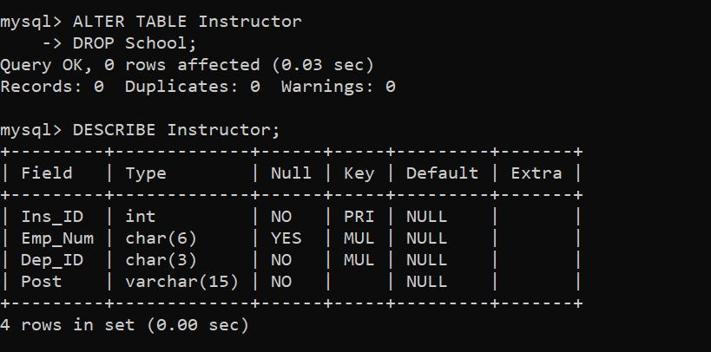
Drop Statement
Output

Slide 26
Department Table
Add School to Department
ALTER TABLE Department
ADD School VARCHAR(35) NOT NULL;

Slide 27
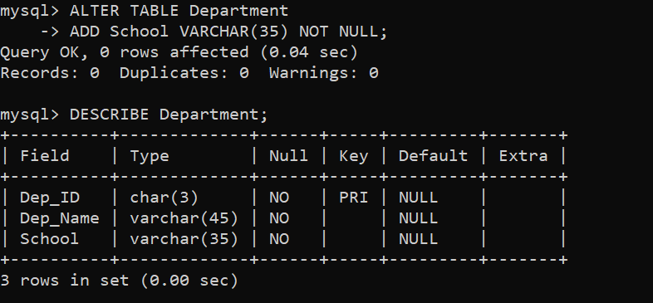
Department Table
Output

Slide 28
DROP Table
Used to delete a table and is used in the following format
Table can only be deleted if it does not have a relationship with any other table
DROP statement can also be used to delete a column.
DROP TABLE tablename;

Slide 29
Summary
ALTER and DROP statements
CREATE command to add a table
ALTER command to add a foreign key
ALTER command to add a field, drop a field and change the data type
DROP command to delete a table.

Slide 30
Discussion Topic
This discussion topic is a continuation of lecture 8 during which we created tables for the Lands Office. Try to think of other tables than can be added to your database and the kind of relationships they will have with your already existing tables.
Create the tables within the database then use the ALTER key to add the new foreign keys to the existing tables. Look for guidance from your instructor.

Slide 31
References
[1] Database systems: design, implementation, and management, Coronel, C., & Morris, S, Cengage Learning, 2019.
[2] Database Systems: A Practical Approach to Design, Implementation, and Management, Connolly, T., & Begg, C., Pearson, 2015.
[3] Fundamentals of database systems, Elmasri, R., & Navathe, S. B., Pearson Education Limited, 2016.

Slide 32
Next lesson will cover
Introduction to Data Manipulation Language

