Slide 1
Introduction to Database Technologies
Advanced Data Manipulation Languages
Lecture 11
Dr Victoria Mukami

Slide 2
Overview
SELECT and the VIEW statement.
SELECT statement focus on the WHERE, statement.
CREATE VIEW statement that will be used to generate views.

Slide 3
Learning Outcomes
Understand the SELECT statement when querying data
Use the SELECT statement in combination with the WHERE clause
Create a VIEW

Slide 4
RECAP
Learnt the INSERT and UPDATE statements.
Statements were used to insert data into the tables
Core objectives of a database is to allow the database administrator or other users to query data.

Slide 5
RECAP
Various reasons why one might want to query data.
Able to make various decisions within an organization.
Bustani registrar might want to know how many students are expected to graduate
Human resource manager might want to know how many instructors have completed a higher degree.
Queries that can be done to a database and will return values.

Slide 6
Introduction
We have referred to the tables that were used to create
Employee Table
Instructor Table
Department table.
We will refer to the table data to run our SELECT statements.

Slide 7
Table Details
Employee Table
Emp_Num | FName | LName | Gender | DOB | MStatus
EMP001 | Agnes | Njue | Female | 12/09/1997 | Single
EMP002 | Will | Omondi | Male | 24/08/1989 | Married
EMP003 | Carol | Njagi | Female | 09/01/1993 | Single
EMP004 | Mary | Munene | Female | 06/08/1998 | Married
EMP005 | Cathy | Resley | Male | 16/04/1989 | Married
EMP006 | Abdul | Muita | Male | 30/07/1988 | Single
EMP007 | Steve | Kimuri | Male | 02/03/1999 | Married
EMP008 | Ruth | Kimuli | Female | 07/04/1996 | Single

Slide 8
Table Details
Instructor Table
ID | Emp_Num | Dep_ID | Post
1 | EMP001 | CIT | Lecturer
2 | EMP002 | MTH | Chairman
3 | EMP003 | LAW | Dean
4 | EMP004 | CIT | Lecturer
5 | EMP005 | BUS | Lecturer
6 | EMP006 | EDU | Senior Lecturer
7 | EMP007 | MTH | Lecturer
8 | EMP008 | PSY | Senior Lecturer

Slide 9
Table Details
Department Table
Dep_ID | Dep_Name | School
CIT | Computing and Information Technology | SPAS
MTH | Statistics and Mathematics | SPAS
BUS | Business | Business
EDU | Education | Education
PSY | Psychology | Humanities
LAW | Law | Law

Slide 10
SELECT
Used to query data within a database
Is a complex statement that has several clauses that can be used within the statement.
Focus on the
  WHERE
  ORDER BY

Slide 11
SELECT
Syntax
SELECT fieldname1
FROM tablename;
SELECT statement that uses the wildcard (*) symbol.
Wildcard symbol allows us to return all the columns.
To show all the records from the department table
SELECT *
FROM Department;

Slide 12
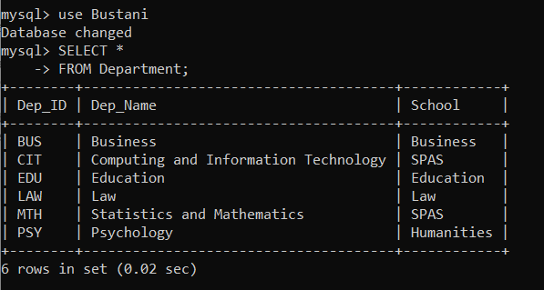
SELECT
Output
All the table contents are listed in tabular form

Slide 13
SELECT Statement
We want to show only the following from the Employee table
Employee Number
DOB
Gender
SELECT Emp_Num, Gender, DOB
FROM Employee;

Slide 14
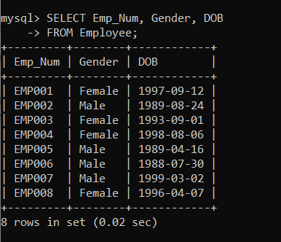
Employee Table
Output

Slide 15
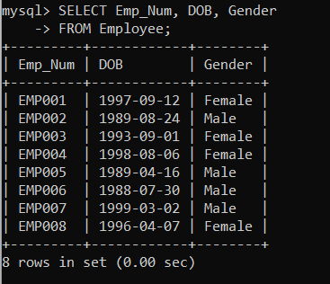
Employee Table
Output – re-ordering

Slide 16
SELECT: DISTINCT
Select statement has a DISTINCT clause
Allows for unique values to be returned
SELECT DISTINCT columnname
FROM Tablename;

Slide 17
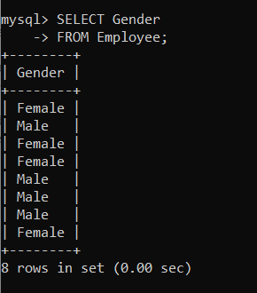
Gender Records
SELECT Gender
FROM Employee;

Slide 18
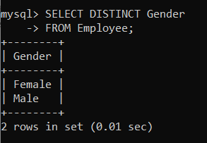
Gender: DISTINCT
DISTINCT clause to select unique
SELECT DISTINCT Gender
FROM Employee;

Slide 19
NATURAL JOIN
Clause used together with the SELECT statement
Used to connect two tables and return the query results.
Tables require a relationship that had previously been created.
Statement will load Emp_Num, FName, LName and Dep_ID from two tables, the employee and instructor tables.

Slide 20
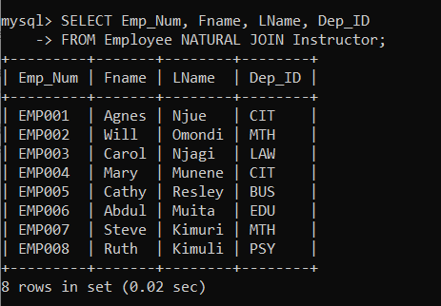
NATURAL JOIN
SELECT Emp_Num, Fname, LName, Dep_ID
FROM Employee NATURAL JOIN Instructor;
Output returns values from both tables

Slide 21
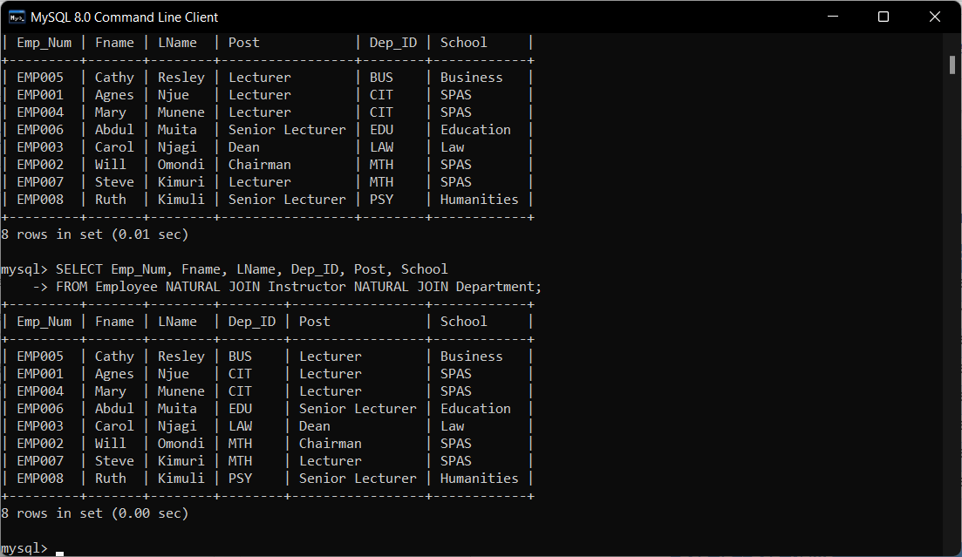
NATURAL JOIN 3 Tables
SELECT Emp_Num, Fname, LName, Dep_ID, Post, School
FROM Employee NATURAL JOIN Instructor NATURAL JOIN Department;
Output

Slide 22
WHERE Clause
WHERE clause used in combination with the SELECT clause
Used to filter out the records based on a specific condition.
Syntax
SELECT fieldname
FROM tablename
WHERE condition;

Slide 23
WHERE CLAUSE
Condition could be criteria that you are only interested in.
Like to list all the male employees at Bustani College.
SELECT EMP_Num, FName, Gender
FROM Employee
WHERE Gender = “Male”;

Slide 24
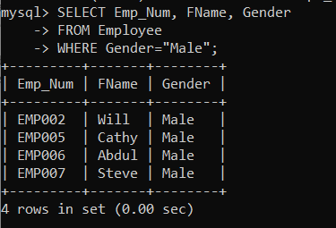
WHERE CLAUSE
Output

Slide 25
ORDER BY Clause
Used to sort data in either an ascending or descending manner.
By default, ORDER By will sort data in an ascending manner
Syntax
SELECT fieldname
FROM tablename
ORDER BY fieldname;

Slide 26
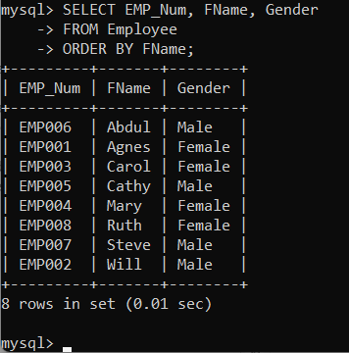
ORDER BY Clause
SELECT EMP_Num, FName, Gender
FROM Employee
ORDER BY FName;

Slide 27
VIEW CLAUSE
Used to create a virtual table that has columns and rows just like a normal table has. Based on the SELECT statement
Can contain a combination of columns and one to many tables
Syntax
CREATE VIEW viewname AS
SELECT query;

Slide 28
VIEW STATEMENT
Create a view from one of our previous SELECT statements.
SELECT Emp_Num, Fname, LName, Dep_ID
FROM Employee NATURAL JOIN Instructor;
Using SELECT query above we create a view called Bustani_Employees
CREATE VIEW Bustani_Employees AS
SELECT Emp_Num, Fname, LName, Dep_ID
FROM Employee NATURAL JOIN Instructor;

Slide 29
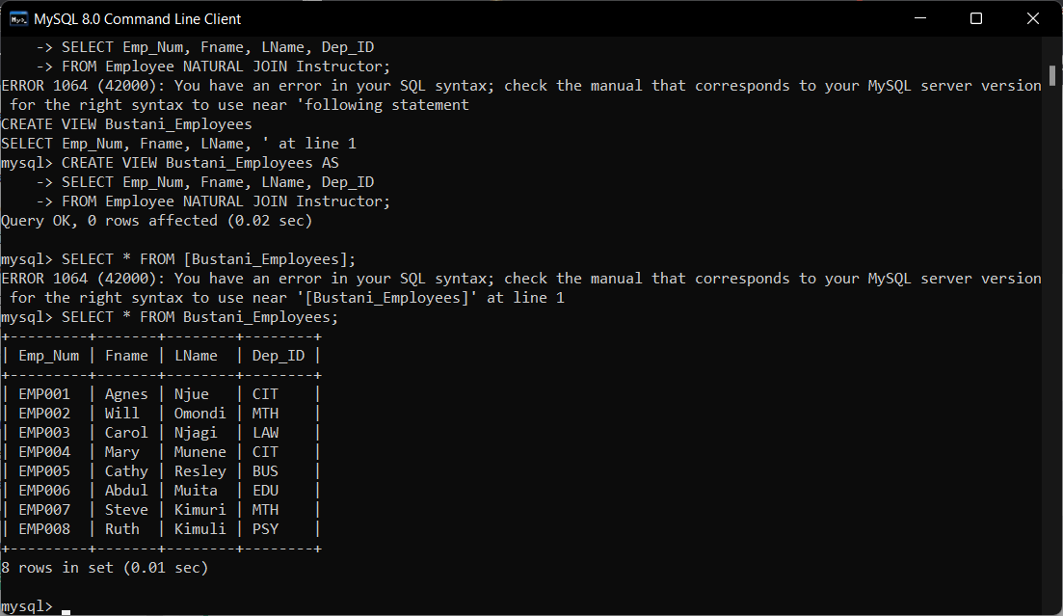
VIEW Statement
Output

Slide 30
Show Views
Display results
SELECT * FROM Bustani_Employees;

Slide 31
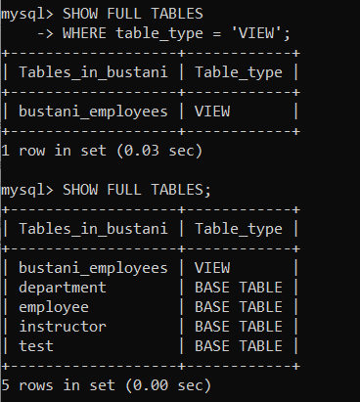
See all Views
See all the views that have been created within the databases
SHOW FULL TABLES
WHERE table_type = 'VIEW';
First statement shows only the VIEWS
Second shows all the tables and views
To delete a VIEW one would use the DROP command

Slide 32
Summary
SELECT statement was reviewed
The FROM clause was used to pick the tables which the query would be displayed from.
DISTINCT was used to show only the unique values.
NATURAL JOIN was used to return values from tables that had a relationship
CREATE VIEW statement was explored and a VIEW was created
The WHERE clause was used to filter out the query results

Slide 33
Discussion Topic
Following through with the Lands Office case study, we will go ahead and run some queries within our data. Use the tables you have created to come up with Surveyors from a specific region, the various services offered by a specific agent and list all the surveyors in your database.
Finally, create a VIEW of the surveyors from a specific region.

Slide 34
References
[1] Database systems: design, implementation, and management, Coronel, C., & Morris, S, Cengage Learning, 2019.
[2] Database Systems: A Practical Approach to Design, Implementation, and Management, Connolly, T., & Begg, C., Pearson, 2015.
[3] Fundamentals of database systems, Elmasri, R., & Navathe, S. B., Pearson Education Limited, 2016.

Slide 35
Next lesson will cover
Database Security and Administration

