Slide 1
Introduction to Database Technologies
Database Administration and Security
Lecture 11
Dr Victoria Mukami

Slide 2
Overview
Focus on maintenance and security.
Why database security is important
Types of threats that face databases
How to protect databases.
Review the DBMS approach for security
Data and data administration.

Slide 3
Learning Outcomes
Describe concepts related to database administration.
Identify the technical role of a database administrator
Describe the security threats and preventive relating to databases.
Understand how MySQL Workbench (DBMS Visual tool) works

Slide 4
RECAP
Worked on introducing databases and associated concepts.
Reviewed how to create a database and its elements using SQL.
Administration and Security are integral processes of any database
Handled by a database administrator.

Slide 5
Introduction
What exactly is data?
Raw facts or unprocessed information.
Core ingredient of a database.
An integral part of any organization.

Slide 6
Introduction cont.
Organizations collect massive amounts of data
The data needs to be stored and retrieved securely.
When data is converted into information it becomes an asset within an organization.
Like all assets, data is valuable and must therefore be secured.

Slide 7
Intro cont.
Loss of data can result in catastrophic consequences.
Database administration arose from the decentralized file system.
The database brought a new view on the way data is managed
Due to the complexities, several users and functionalities
Led to the database administrator (DBA) role.
The DBA has various roles but mainly a technical role

Slide 8
DBA Role
Roles of the database administrator include:
Installation
Upgrading
Maintenance
Security oversight

Slide 9
DBA Role
Evaluating, selecting, and installing the DBMS and related utilities
Involves selecting and installing an appropriate DBMS
Depends on organization needs.
Relooking at the database lifecycle the DBA could oversee the planning, design and implementation.

Slide 10
DBA Role
Testing and evaluating databases and applications
Happens after a DBMS has been selected
DBA tests that it is working appropriately
Tests that the applications are all integrated properly.

Slide 11
DBA Role
Operating the DBMS, utilities, and applications
Involves overseeing all the functions of the database.
Involves ensuring that data is not lost
Users are assigned appropriate roles with relevant permissions
Database performs as per the expectations.

Slide 12
DBA Role
Training and supporting users
After the setup of the DBMS
Requirement that the users get trained.
Could involve the creation of tutorials and walkthroughs of using the database.
Maintaining the DBMS, utilities, and applications
DBA oversees the maintenance of the database
Upgrades database when needed
Installing any additional components

Slide 13
Data and Database Administration
Data Administration: management of the data resource
Database administration: management of the physical realization of a database system

Slide 14
SECURITY
Refers to the activities and measures that ensure three main security goals are met
  Confidentiality
  Integrity
  Availability
Securing a database involves an entire organization
The role of the end-user as it is the management.

Slide 15
Confidentiality
Ensuring that data is protected against unauthorized users.
Example of Bustani college.
Students may be allowed to see their grades once they have been released.
No authorization to see other students’ grades
Nor can they change or manipulate their grades.
Notes:
The same can be said about the kind of data a finance officer within Bustani can access versus what an examinations officer can access. The finance officer can check the student’s payment status and can update records relating to finances. On the other hand, the exam officer could easily issue examination cards based on updates by the finance office. However, the exam officer cannot make changes concerning finance.

Slide 16
Integrity
Concerned with keeping records or data that is error-free
Data does not contain any anomalies
Data anomaly: occurs when data changes must occur in several places.
Exists due to data redundancy within a database.
Integrity ensures that the data that is captured within the database does not contain any errors
Also ensures that the data is only updated within a single point.
Key components of ensuring data integrity is during the design process.

Slide 17
Accessibility
Refers to the availability of data whenever a user requires it
Means that a user would need to have the correct authorizations before data can be availed to them.
Means that security must be factored
Ensure that the database is free or protected from internal and external attacks.

Slide 18
Vulnerability
Defined as a weakness within a system component
Weakness can be exploited to allow unauthorized access that may then cause severe disruptions
Vulnerabilities are considered as either
  Technical
  Managerial
  Cultural
  Procedural

Slide 19
Vulnerability
Technical vulnerability happens due to a flaw in the system
Managerial vulnerability happens due to user errors within the organization
Cultural vulnerabilities arise due to user ignorance
Procedural vulnerabilities occur due to a lax in company policies

Slide 20
Threats
Areas an organization should aim to reduce risk or prevent the possibility of loss and damage
  Theft and fraud
  Loss of confidentiality
  Loss of privacy
  Loss of integrity
  Loss of availability

Slide 21
Threats
Theft and Fraud
A student at Bustani college uses another student's account
Measures:
Ensure that a student is required to change their password
Loss of confidentiality
Disgruntled former employee who was an IT technician hacks into the college
Measures:
Ensure security authorization updates to ensure no unauthorized access.
Notes:
Without their knowledge to access an online system.
From the system default as soon as they log in.
System intending to access and make unauthorized changes.
Ensure that policies are in place to retract permission of former employees.

Slide 22
Threats
Loss of privacy
A malicious employee views data regarding other employees and discloses it
Measures
Ensuring that there are separate levels of access and audits
Loss of integrity
Student logs into the exams system and makes changes to grades
Measures
Separate levels of access and audits to ensure data is secure from unauthorized access.
Notes:
to ensure data is secure from unauthorized access.
Ensuring file system security is implemented.

Slide 23
Threats
Loss of availability
Bustani database is attacked by a virus leading to the loss of critical information.
Measures
Use of antiviruses and firewalls to prevent attacks.
Performing regular backup and recovery - ensure continuity.

Slide 24
MySQL Workbench
Created the database using the mysql command line
Review of MySQL Workbench is a visual IDE.
Work toward reviewing different administrative procedures of a database

Slide 25
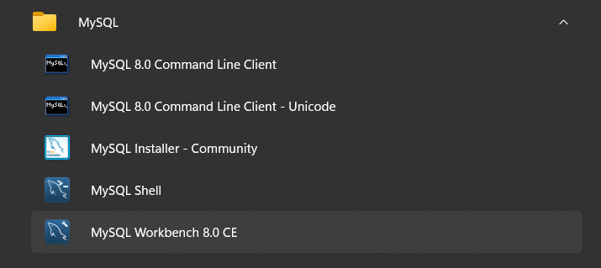
Open MySQL WorkBench
Selecting the MySQL Workbench 8.0 CE from all apps under the Start Menu.

Slide 26
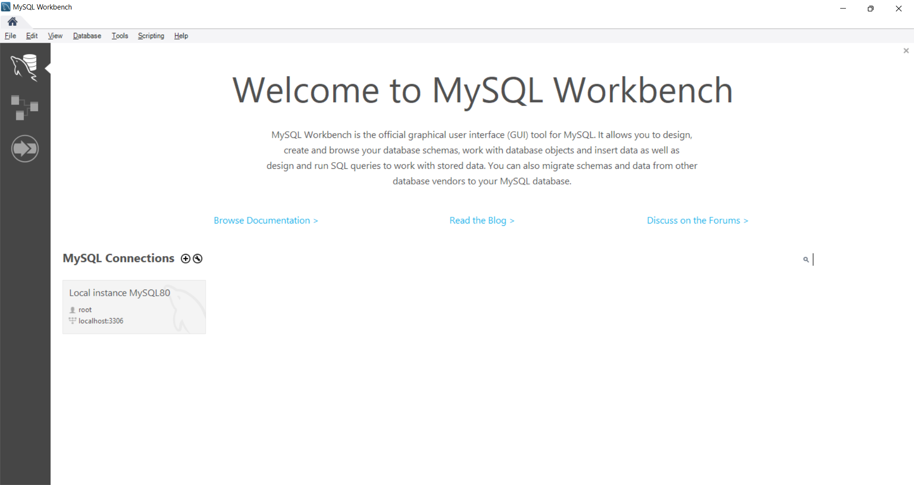
MySQL WorkBench
Home Screen

Slide 27
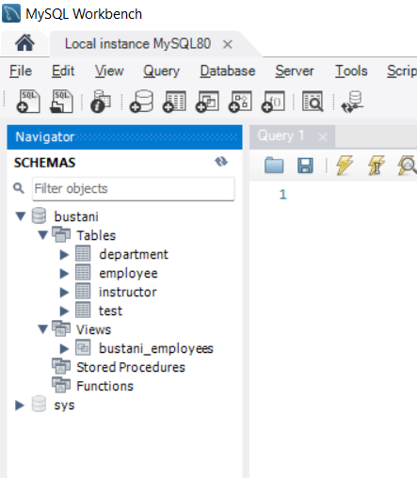
Root Account
Root account that you can log in with to
Shows the Bustani database created.

Slide 28
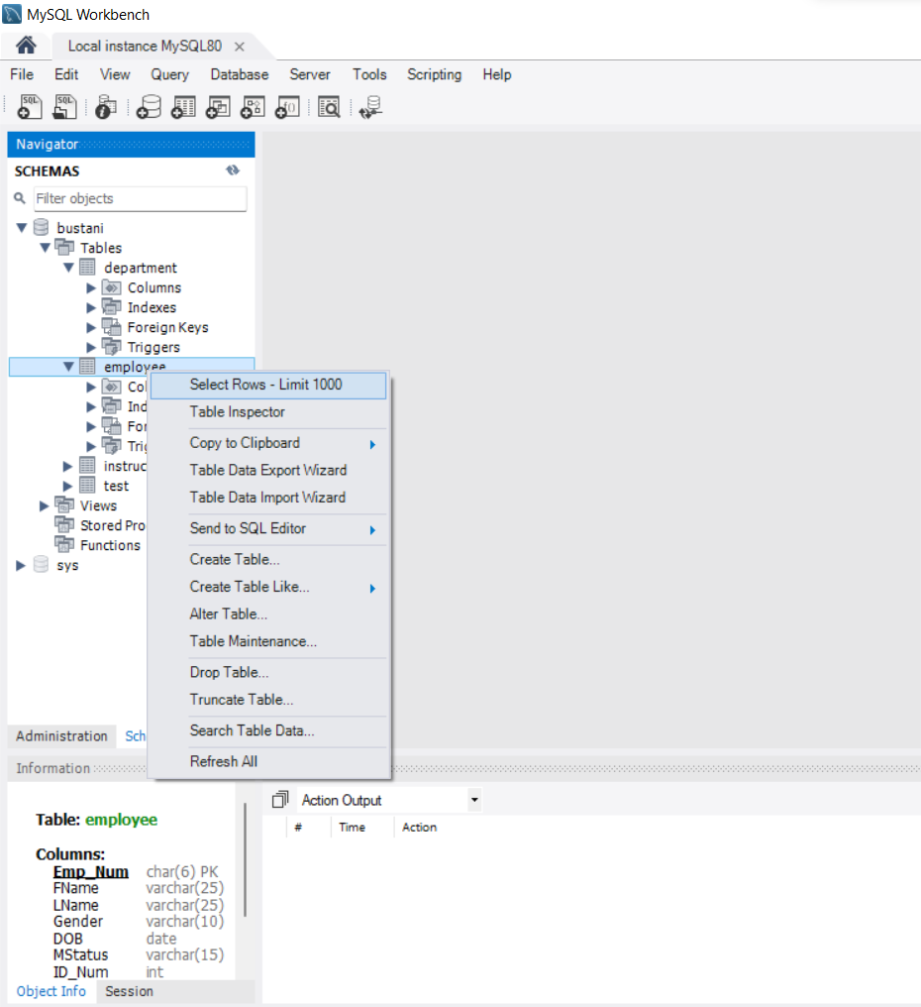
Table Review
Shows the Bustani databases, the tables and the views.
You can right-click on the employee table
Select Rows – Limit 1000 then you can review the details in the table

Slide 29
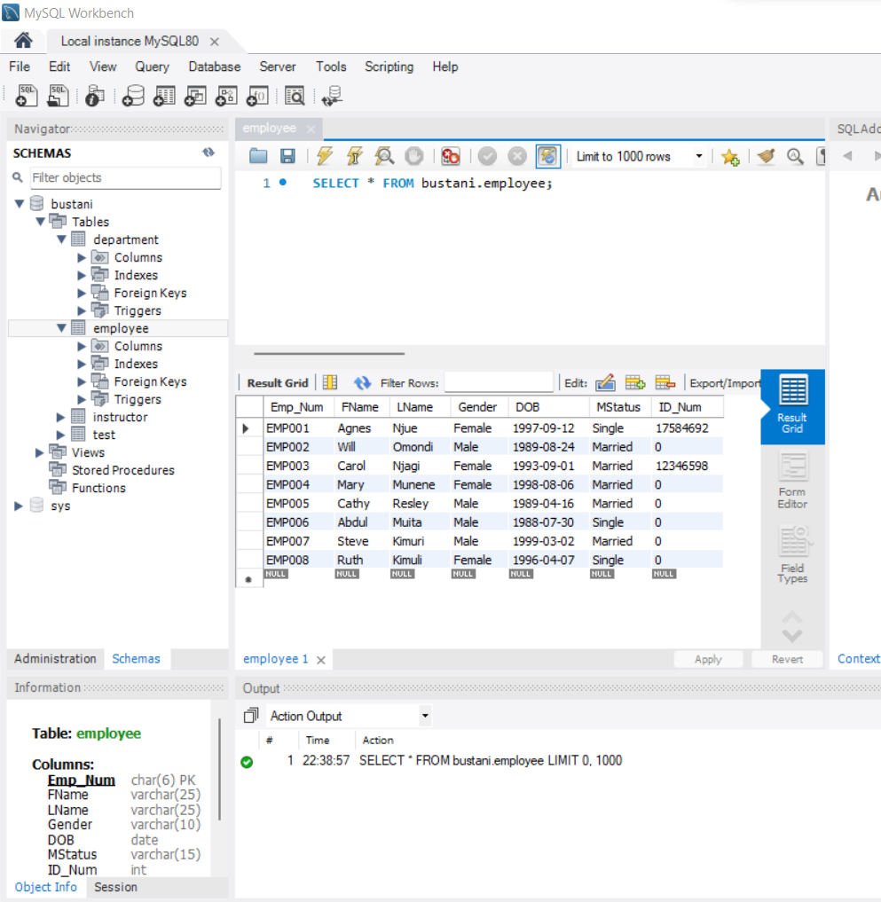
Table: Employee
The bottom information contains the details of the table including the datatypes.

Slide 30
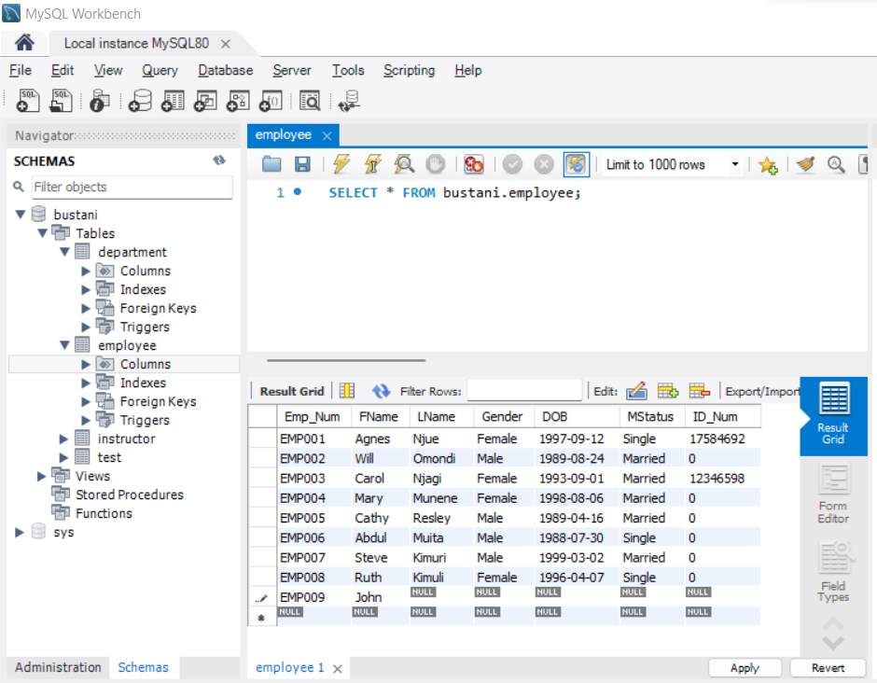
Add Details
Allows for various activities to be done using the user interface and using simple commands.
To add a new record, you would add the record by clicking on the null row
Directly under EMP008 and typing in

Slide 31
Summary
Reviewing the database administrator role, especially their technical role.
Difference between data administration and database administration
Security and security goals.
Types of vulnerability
The types of threats and measures for each threat.
MySQL Workbench review

Slide 32
Discussion Topic
We have come a long way since we first started the discussion topic involving the land office database. For the final lecture, we will review the land database we created from the MySQL Command Line Client.
Review the database tables and the views as well as the data within each table.

Slide 33
References
[1] Database systems: design, implementation, and management, Coronel, C., & Morris, S, Cengage Learning, 2019.
[2] Database Systems: A Practical Approach to Design, Implementation, and Management, Connolly, T., & Begg, C., Pearson, 2015.
[3] Fundamentals of database systems, Elmasri, R., & Navathe, S. B., Pearson Education Limited, 2016.

Slide 34
Lecture Series Summary
Introduction to databases
The Database Environment
Database Analysis and Design
Entity-Relationship Modelling Service-Oriented Architectures
The Relational Model
Normalization
Notes:
Understand and describe the file-based system
Highlight the benefits of the database approach
Show the functions of the database management system (DBMS)
Describe the roles involved in the use and development of the DBMS
Identify the purpose of the three-level database architecture
Distinguish between the external, conceptual, and internal levels
Understand the evolution process of data models
Understand the basic data modelling building blocks
Identify the stages of the system development lifecycle
Understand the database lifecycle
Differentiate between conceptual, logical, and physical design
Distinguish between the centralized and decentralized design
Describe the relational model terminologies
Understand the purpose of keys in a database
Describe the role of relational algebra in a database
Describe the different relational algebra operators.
Distinguish the various entity types
Identify the various relation types and attributes
Determine the role of attributes on relationships
Understand structural constraints as related to connectivity and cardinality
Build and ERD diagram
Understand why normalization is necessary during database design
Review the functional dependencies before normalization
Determine the normalization process
Distinguish between INF, 2NF and 3NF

Slide 35
Lecture Series Summary
Introduction to Structured Query Language (SQL)
Introduction to Data Definition Language
Advanced Data Definition Language
Introduction to Data Manipulation Language (DML)
Advanced Data Manipulation Language
Database Administration and Security
Notes:
Understand the importance of the Structured Query Language (SQL)
Outline the difference between Data Definition Languages (DDL) and Data Manipulation Languages (DML)
Understand the syntax of the SQL language
Understand the role of ERD diagrams when creating a database
Create a database and its various tables
Alter the table structure
Drop tables and various fields
Understand the INSERT and UPDATE data manipulation commands.
Insert data into various tables
Update table row details
Understand the SELECT statement when querying data
Use the SELECT statement in combination with the WHERE clause
Create a table VIEW
Describe concepts related to database administration.
Identify the technical role of a database administrator
Describe the security threats and preventive relating to databases.
Understand how MySQL Workbench (DBMS Visual tool) works

