Slide 1
Great Civilizations of the Ancient World
Early Complex Societies in Europe

Slide 2
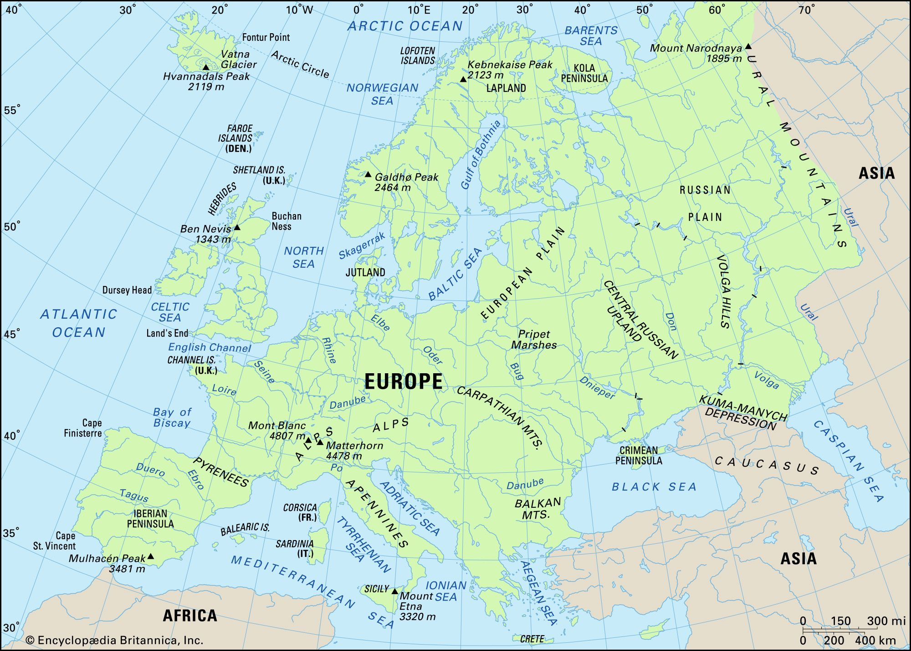
https://www.britannica.com/place/Europe/Land

Slide 3
the Holocene period of Europe:
---adoption of agriculture, introduced from other areas, not an independent invention in Europe
---in some areas, limited evidence for hereditary social ranking from burials, BUT horizontal social relationships also very important, large ritual sites
---fewer settlements clearly identifiable as cities
---both prestigious and utilitarian metal objects
---much cultural diversity as today and varieties of ways to manage social relations with respect to resources, economic activities, and religious activities
--- theories of large-scale monumentality

Slide 4
domesticated plants (wheat, barley, etc.) and animals (sheep, goats, pigs) brought to Europe later in time than the first domestication occurred in the Near East; clear pattern from C14 dates; some local hunter-gatherers adopted agriculture; earliest in Greece c. 6500 B.C.

Slide 5
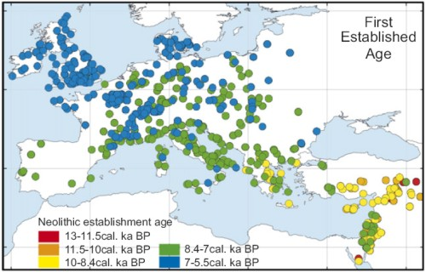
Tracing dates of domesticates in Europe
https://all-geo.org/highlyallochthonous/2007/11/the-black-sea-flood-and-the-rise-of-european-agriculture

Slide 6
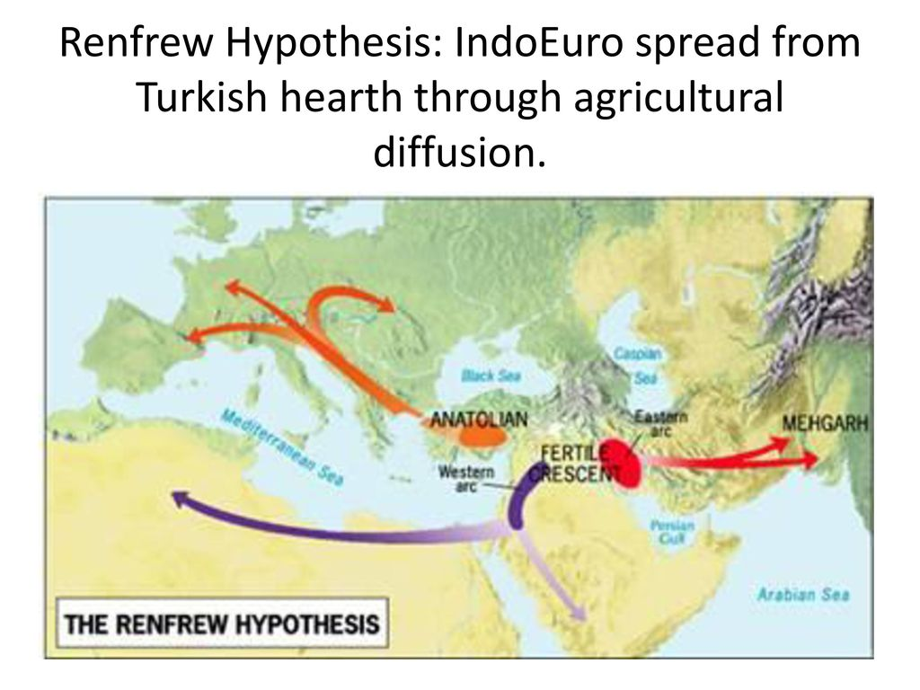
Early approaches on introduction of domesticates in Europe
https://slideplayer.com/slide/12989677

Slide 7
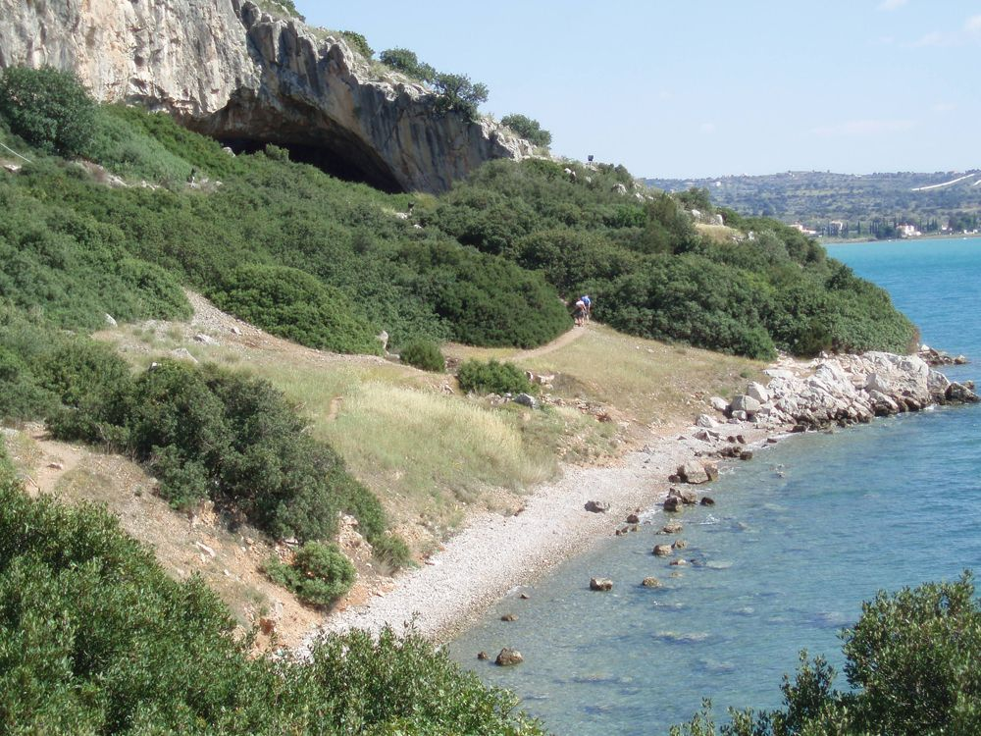
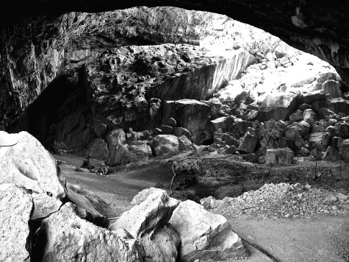
Franchthi cave, Greece, 11,000 years ago
Red deer
Cattle
Pigs
Snails
Shellfish
Obsidian from Melos island
Offshore fishing, tuna
https://www.pinterest.com/pin/418482990351771305
https://www.researchgate.net/figure/A-view-of-Franchthi-Cave_fig6_288874413

Slide 8
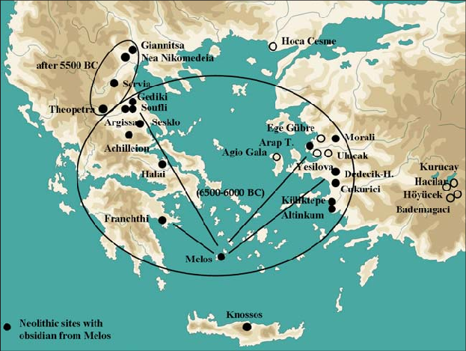
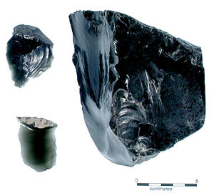
Early sea voyages
https://www.researchgate.net/figure/Distribution-of-obsidian-from-the-island-of-Melos-in-the-Neolithic_fig10_273356054
https://archaeologynewsnetwork.blogspot.com/2011/08/seafaring-traders-plied-aegean-15000.html

Slide 9
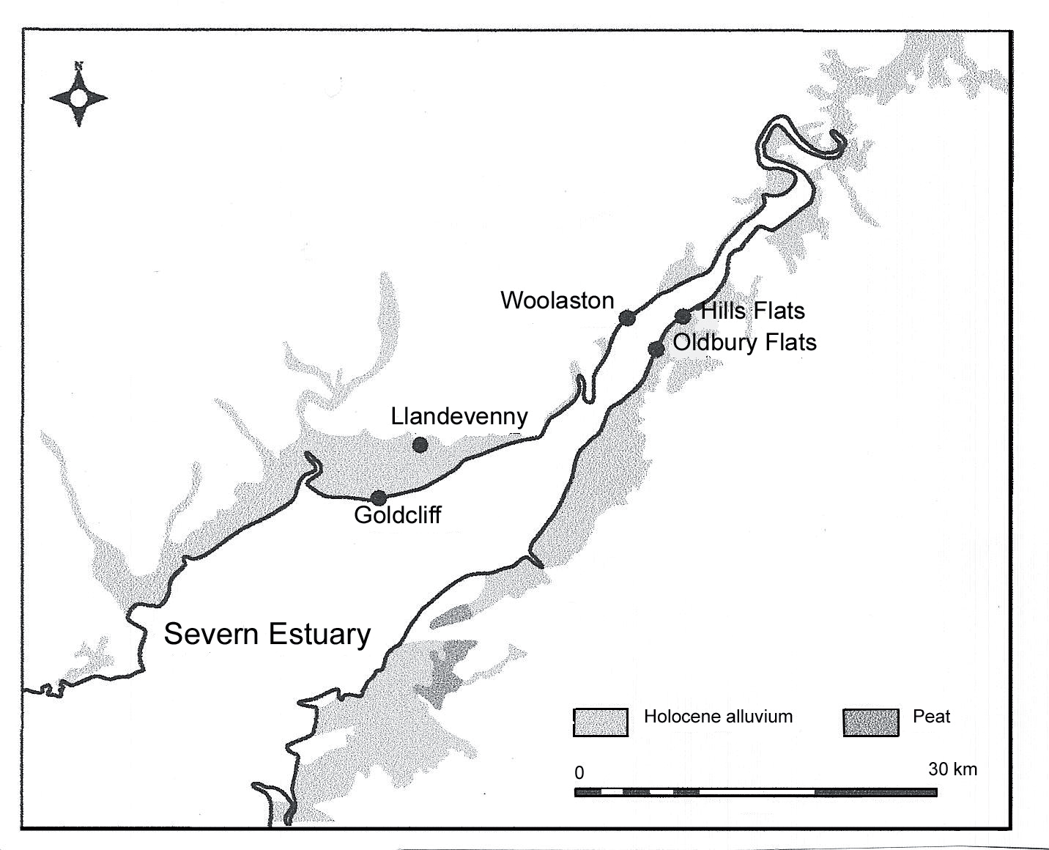
Coastal England
Brown, A. (2005). Wetlands and drylands in prehistory: Mesolithic to Bronze Age human activity and impact in the Severn Estuary, southwest Britain. PhD dissertation, University of Reading, Reading.

Slide 10
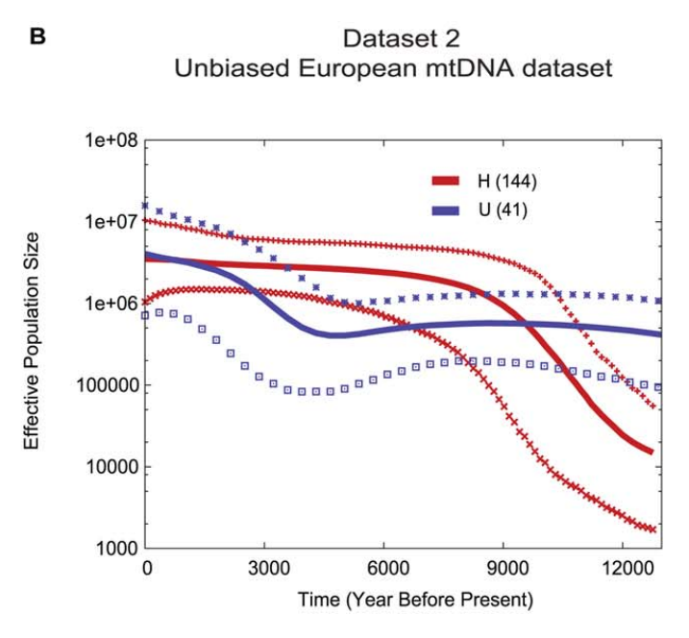
Who were the first farmers?
U – Mesolithic
H – Neolithic

Slide 11
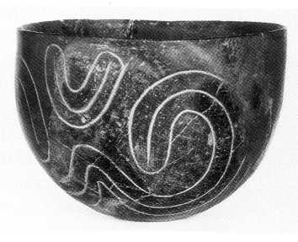
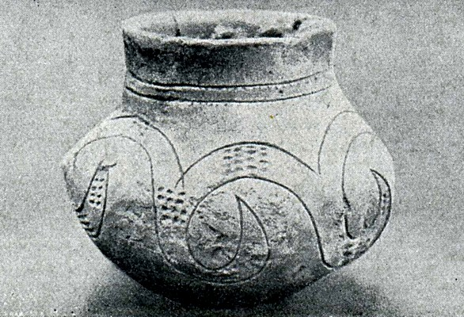
Earlier Neolithic of Central Europe
Banderamik culture, after c. 5200 B.C.
“Linear Band Keramik Culture, or LBK Culture”
starting in western Hungary then spreading to Austria and other parts of Europe
“linear pottery”
pottery with incised, banded decoration
https://commons.wikimedia.org/wiki/File:Schuchhardt_Bandkeramik_Brockow.jp

Slide 12
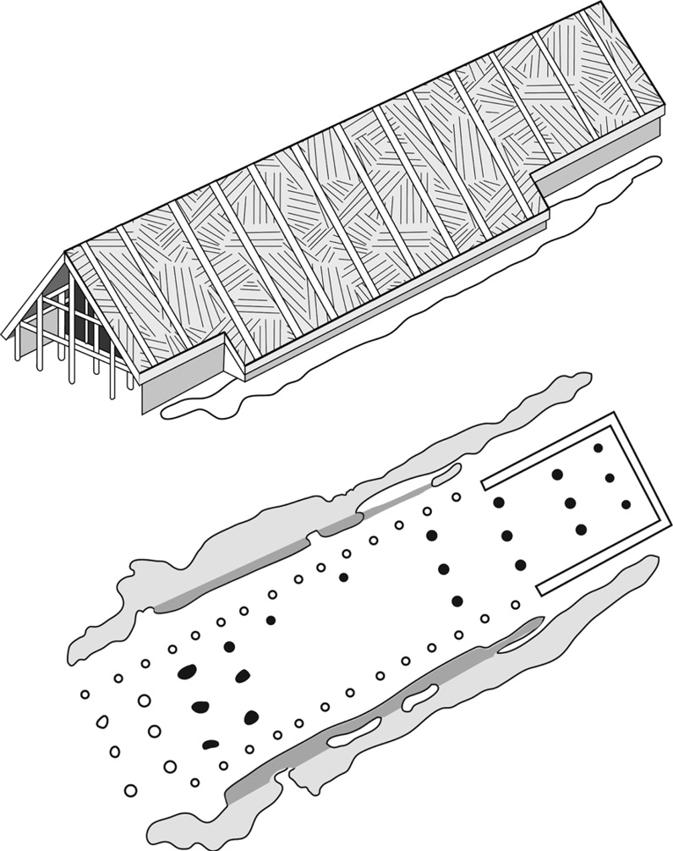
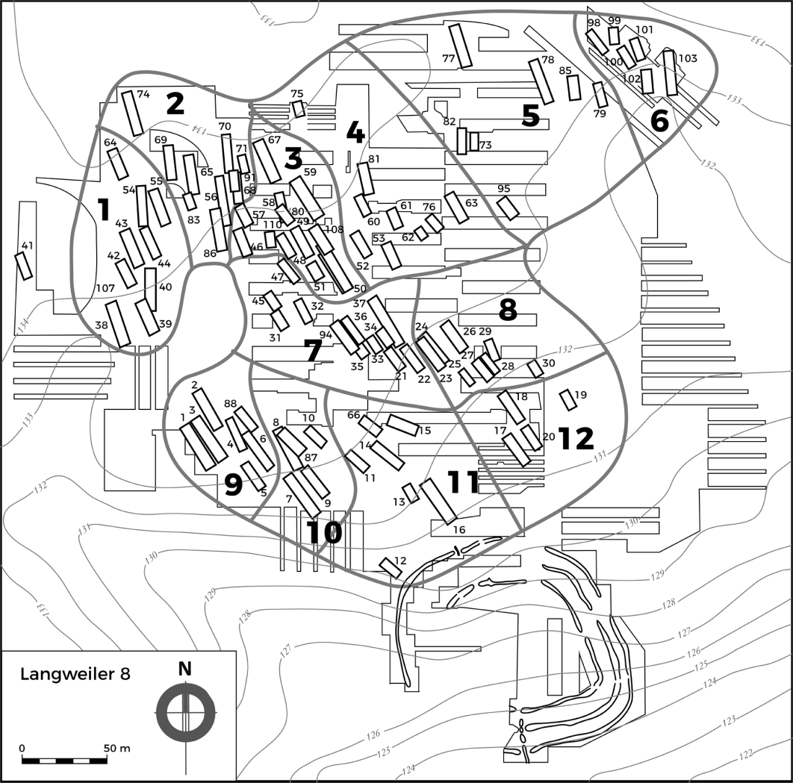
plan map of a Banderamik Culture site in Central Europe:
---huge longhouses in groups of two or three identified from patterns of post holes, some settlements had more houses
---interpretation: houses represent farmers moving into new areas with easily cultivable soils for the first time
https://www.cambridge.org/core/books/first-farmers-of-europe/spread-of-farming-into-central-europe/E4B612DF1E8CAE29218473816BEBD3F3

Slide 13
Banderamik settlements at Langweiler, western Germany
Large number of longhouses; show occupation for several generations, over 400 years; different sized communities—from 1 house to 11 in a settlement
Hypothesis: larger groups of people needed to begin settlement in new areas, collaborate to cut down trees for fields, etc.
possibly the houses were not permanent, just occupied over 1 or 2 seasons, people followed cattle to grazing areas in other seasons

Slide 14
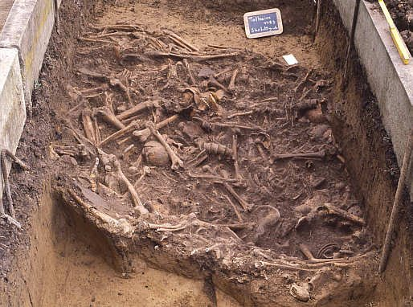
Peaceful and egalitarian Neolithic cultures of central Europe?
Talheim Death Pit of Germany, Banderamik culture:
18 adults, 16 children: most show marks on the head by striking using a stone adze—death while fleeing from a raid, no defensive wounds found
violence between the newly arrived farmers
and local hunter-gatherers? How widespread was raiding?
https://www.thesun.co.uk/tech/9970445/talheim-death-pit-first-ever-war-crime

Slide 15
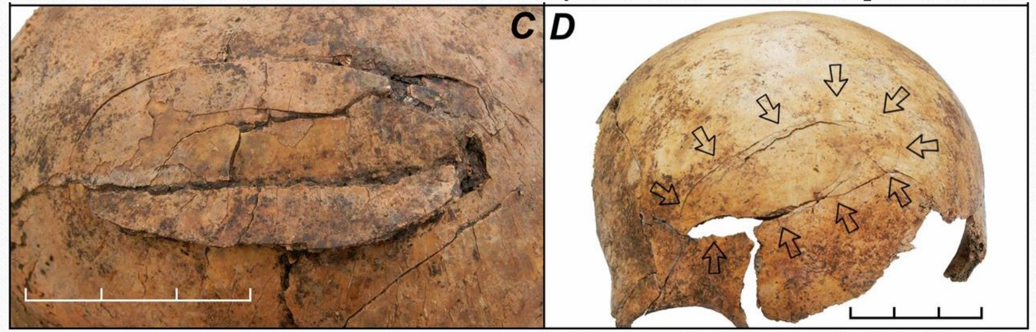
Mass grave of Schletz
https://www.researchgate.net/profile/Jan-Turek-6/publication/341344665_Archaeology_of_Death_121_Archaeology_of_violence_warfare_disease_magic_sacrifice/links/5ebbc8d7458515626ca5b096/Archaeology-of-Death-121-Archaeology-of-violence-warfare-disease-magic-sacrifice.pdf
Selective murder
Women were spared

Slide 16
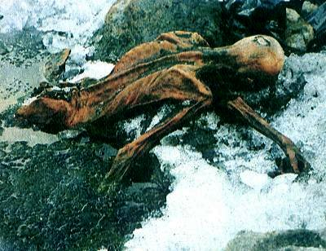
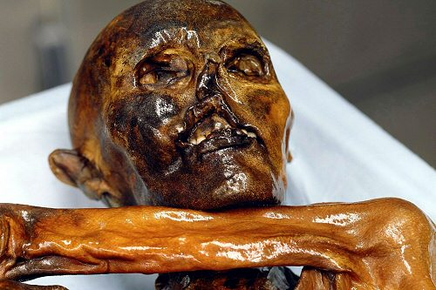
Later central Europe, c. 3300-3200 B.C:
discovery in 1991 of the “Ice Man or Otzi” by hikers in the Alps
about 45 years old, physical health problems evident
(arthritis, intestinal problems); evidence in stomach about his diet
https://www.bistecglobal.com/wp-readme.php?pg=dailymail_sciencetech/article-7631391/tzi-Icemans-path-final-resting-place-revealed-ancient-mosses-liverworts.html

Slide 17
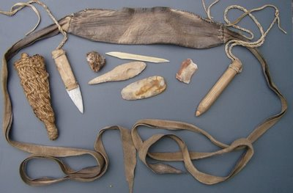
Objects included a copper axe in a wooden handle, unfinished deerskin quiver,
12 unfinished arrows hafts in a backpack made of larch plants and animal hide,
flint knife, fire starting kit etc.
debates about his social status
Why was he in the area, and why the unfinished tools?
https://www.pinterest.com/pin/490470215660210327

Slide 18
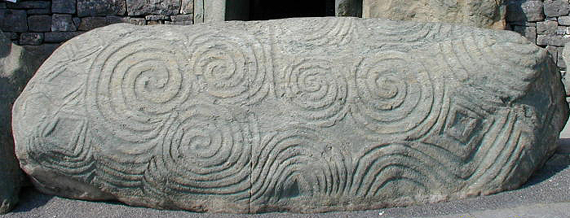
Atlantic Europe, after 4000 B.C.
farming spread to Britain and Ireland; regional cultural
identities being expressed, variation in ritual practices
Megalithic or large stone slabs used for ritual sites in several areas
(including Stonehenge later)—Newgrange, Ireland—large passage graves (3,200 BC)
https://edition.cnn.com/travel/article/newgrange-ireland-stone-age/index.html

Slide 19
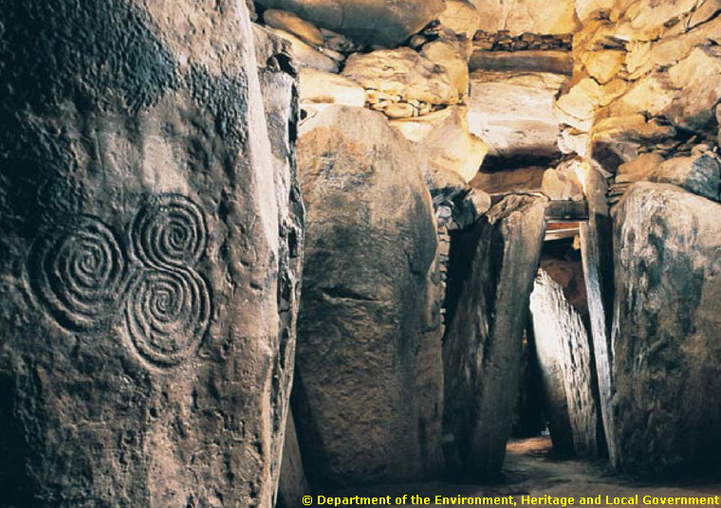
Internal view of Newgrange passage grave
https://edition.cnn.com/travel/article/newgrange-ireland-stone-age/index.html

Slide 20
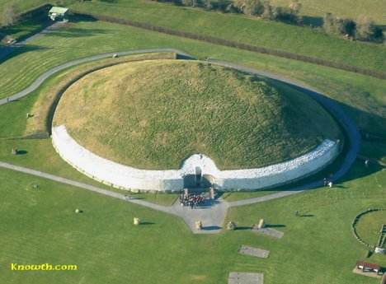
Newgrange, Ireland: what kind of social organization
was involved in the construction and buried their dead here?
tomb that seems to be oriented to receive light from the rising sun at the winter solstice

Slide 21
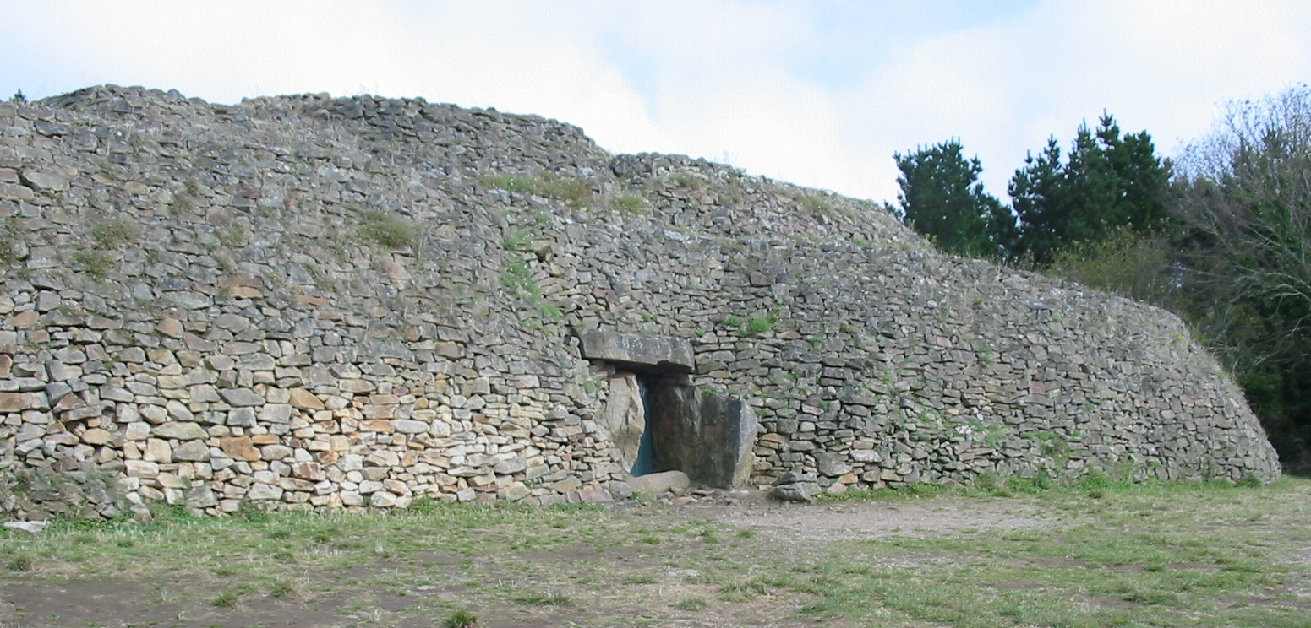
burials for social groups seem more important than for individuals, communal labor
http://generic.wordpress.soton.ac.uk/ditchedenclosures/who-built-neolithic-european-ditched-enclosures/megalithic-worlds-monumentalisation-neolithic

Slide 22
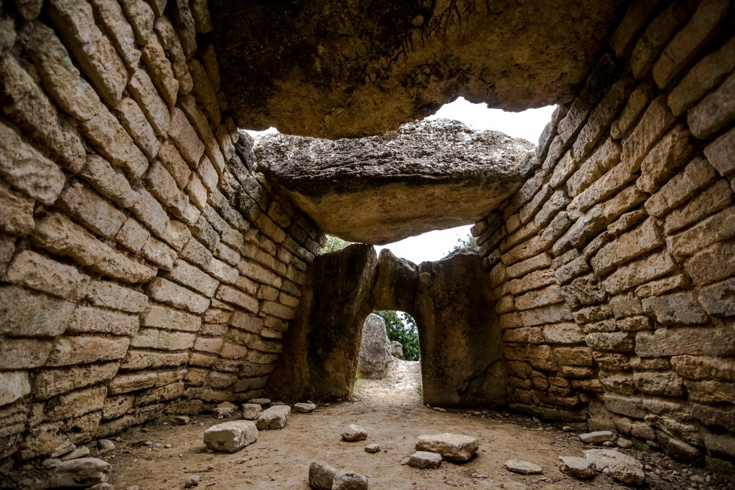
Neolithic dolmen, Le Pouget, France
http://generic.wordpress.soton.ac.uk/ditchedenclosures/who-built-neolithic-european-ditched-enclosures/megalithic-worlds-monumentalisation-neolithic

Slide 23
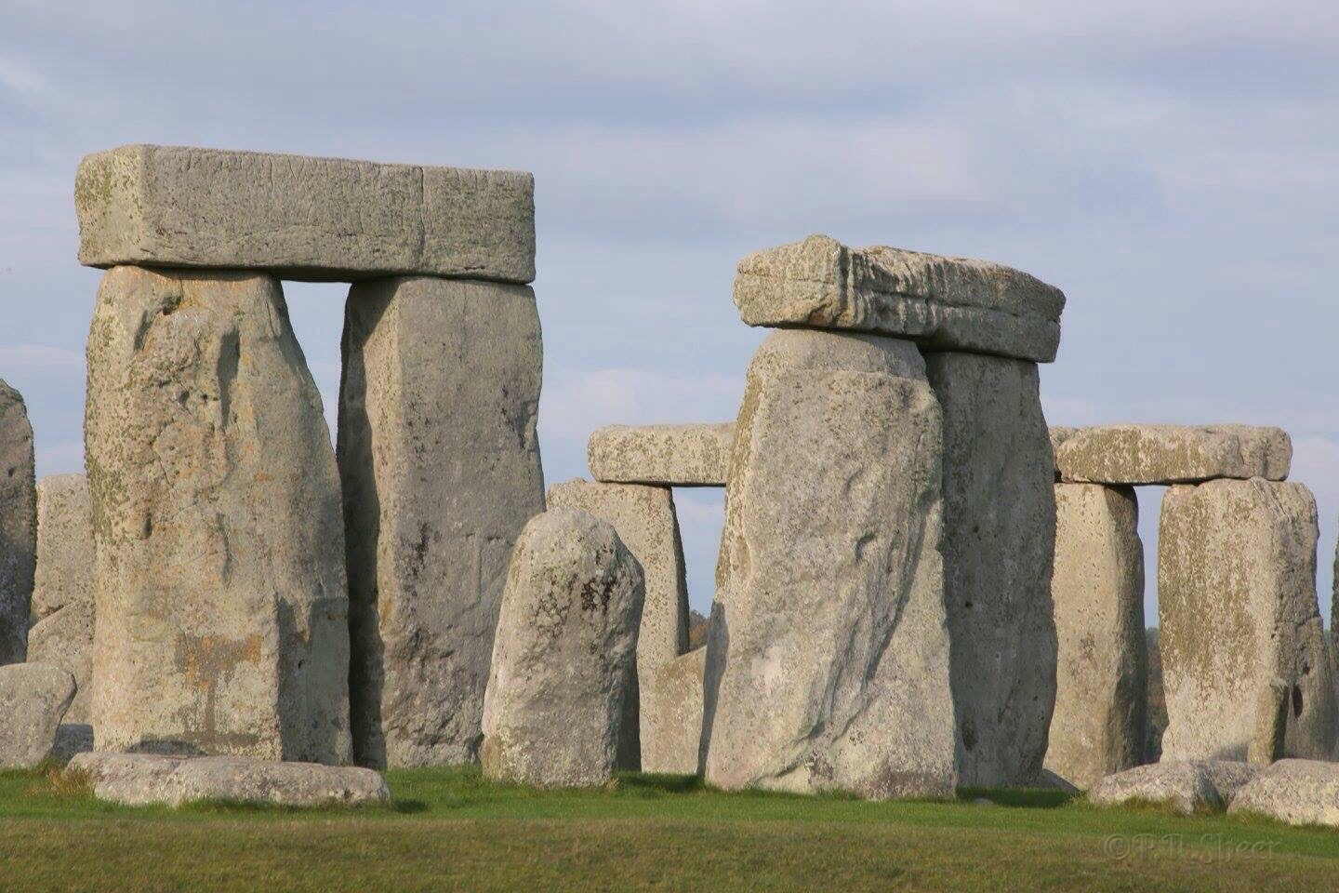
Reminders of the past
Monument - 'monere‘
Dursgal – dursakh
Pamyatnik - pamyat‘
https://www.worldhistory.org/stonehenge

Slide 24
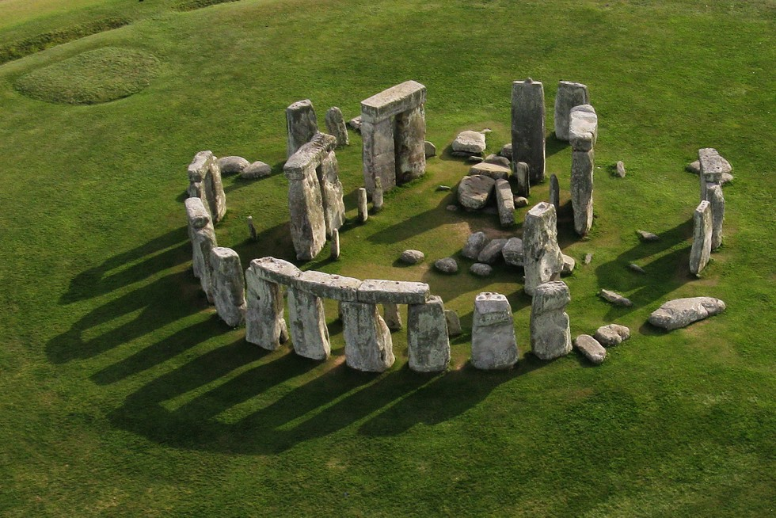
Stonehenge
https://www.historyextra.com/period/stone-age/10-facts-about-stonehenge

Slide 25
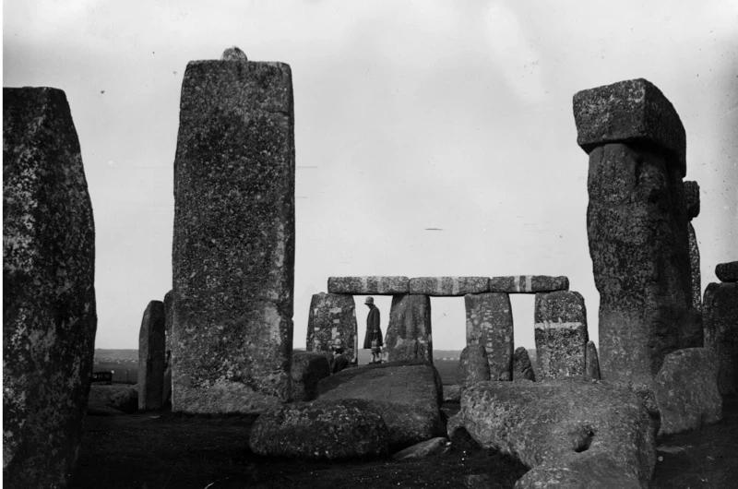
Social and economic context of Stonehenge?
https://www.historyextra.com/period/stone-age/10-facts-about-stonehenge

Slide 26
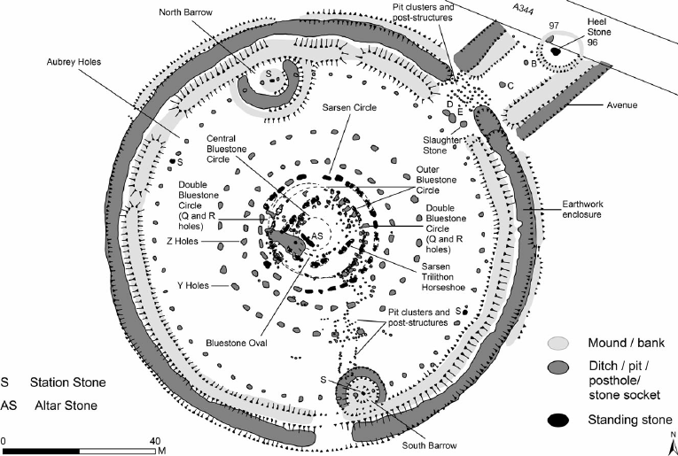
Main components of Stonehenge
(5,000-3,500 years ago)
https://www.researchgate.net/figure/Plan-of-Stonehenge-showing-the-principal-structural-features-after-Darvill-2006_fig1_265109189

Slide 27
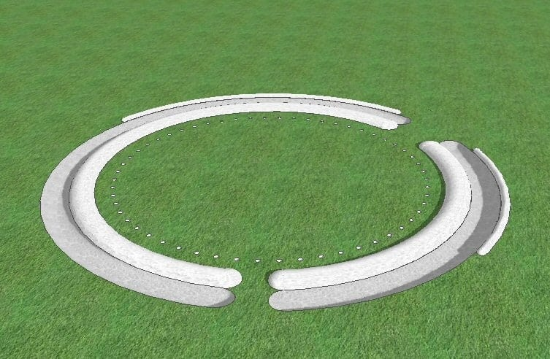
Phase 1: the earthwork circle and Aubrey holes
(5,000 years ago) – animal bones from ditch
https://evanevanstours.com/blog/how-was-stonehenge-built

Slide 28
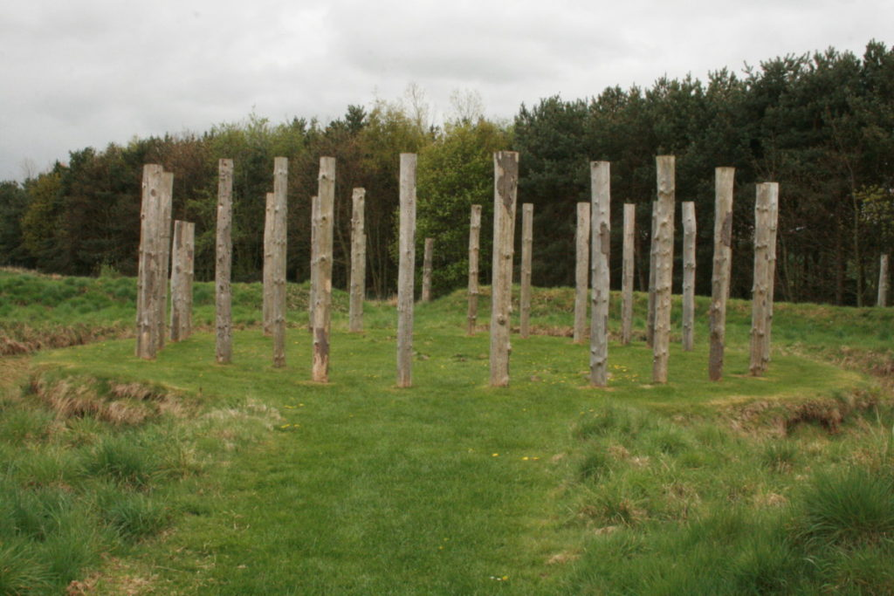
Phase 2: timber posts near the center, cremated burials from ditch and Aubrey holes (5,000-4,500 years ago)
https://evanevanstours.com/blog/how-was-stonehenge-built

Slide 29
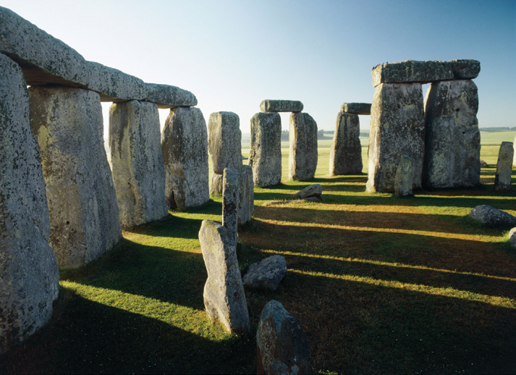
Phase 3a: the bluestones, 2-2,5 m high,
Chazan, M. (2021). World prehistory and archaeology: pathways through time. Routledge, New York.

Slide 30
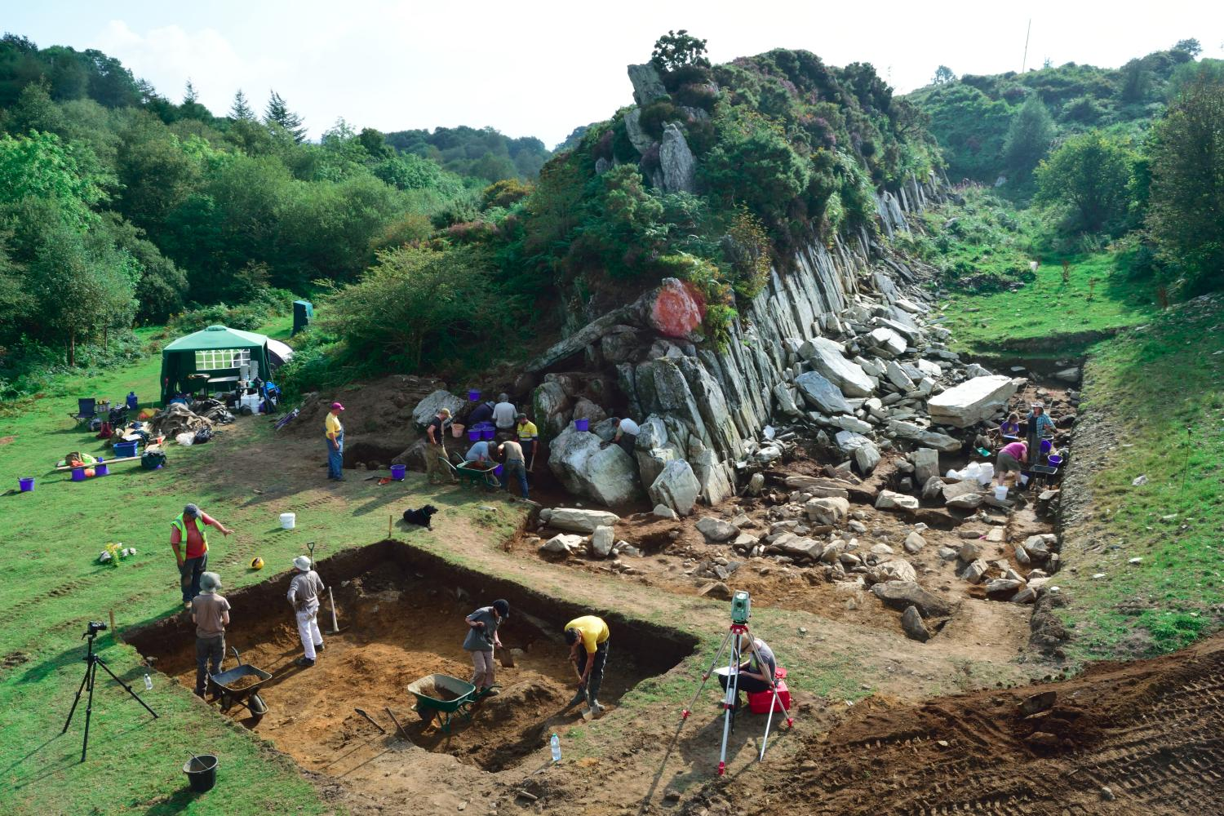
Quarrying site of bluestones, 240 km away from Stonehenge
https://evanevanstours.com/blog/how-was-stonehenge-built

Slide 31
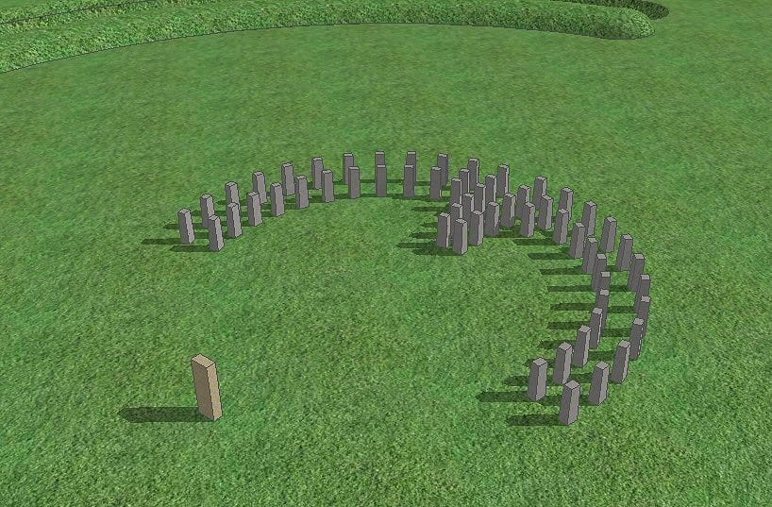
Original arrangement of bluestones
https://evanevanstours.com/blog/how-was-stonehenge-built

Slide 32
Arrival of 30 large stones: up to 50 tons each, brought from 30 km away (4,000 years ago)
Chazan, M. (2021). World prehistory and archaeology: pathways through time. Routledge, New York.

Slide 33
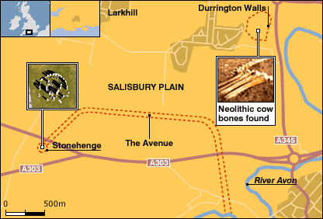
other recent work: looking at the sacred landscape and links to other nearby and roughly contemporary sites:
Durrington Walls (2.8 km from Stonehenge) and
2. Woodhenge
http://news.bbc.co.uk/2/hi/science/nature/6311939

Slide 34
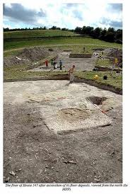
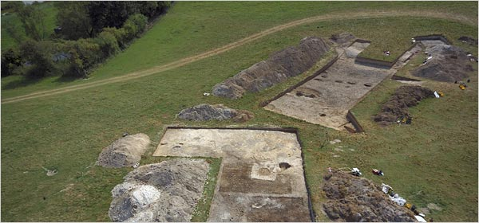
houses at Durrington Walls: about 8 excavated, 100 discovered by geophysical methods
a village for the laborers at
Stonehenge?
minimal evidence for social hierarchy
https://www.nytimes.com/2007/01/31/world/europe/31stonehenge.html

Slide 35
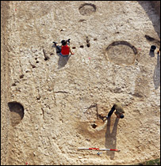
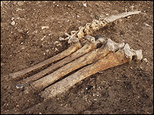
Durrington Walls:
1st hypothesis: houses of farmers (wheat, cattle), the laborers
**2nd hypothesis: village only occupied for the winter months when people came together for ceremonies with feasting at the winter solstice evidence: huge quantities of animal bone in structures, stone tools for butchering; no remains of daily subsistence production (crafts, farming)
https://www.nytimes.com/2007/01/31/world/europe/31stonehenge.html

Slide 36
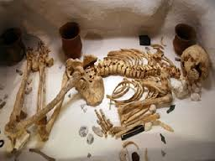
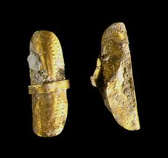
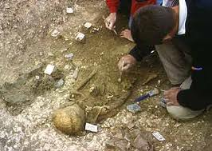
debates about social organization to organize the labor: social ranking?
“the Amesbury Archer” burial from a nearby area, dated to Phase 3C with gold “earrings/hair ornaments”, dating to AFTER construction of the Sarsen Circle
Should we cite this burial as evidence for social
hierarchy during the Stonehenge period (late Neolithic and
early Bronze Age)? isotopic analysis of skeletal remains—not a local
https://en.wikipedia.org/wiki/Amesbury_Archer

Slide 37
References
Bradley, R. (2007). The prehistory of Britain and Ireland. Cambridge University Press, Cambridge.
Brown, A. (2005). Wetlands and drylands in prehistory: Mesolithic to Bronze Age human activity and impact in the Severn Estuary, southwest Britain. PhD dissertation, University of Reading, Reading.
Chapman, R. (1995). Ten years after – megaliths, mortuary practices, and the territorial model. In Regional approaches to mortuary analysis, edited by A.Beck. Planum Press, New York.
Chazan, M. (2021). World prehistory and archaeology: pathways through time. Routledge, New York.
Craig et al. (2015). Feeding Stonehenge: cuisine and consumption at the Late Neolithic site of Durrington Walls. Antiquity, 89: 1096-109.
Duering, A. and Wahl, J. (2014). A massacred village community? Agent-based modelling sheds new light on the demography of the Neolithic mass grave of Talheim. Anthropologischer Anzeiger, 7: 447-68.
Fu, Q., Rudan, P., Pääbo, S. and Krause, J. (2012). Complete mitochondrial genomes reveal Neolithic expansion into Europe. PLoS ONE, 7: e32473.
Golitko, M. and Keeley, L. (2007). Beating ploughshares back into swords: warfare in the Linearbandkeramik. Antiquity, 81: 332-42.
Perlés, C. (2001). The early Neolithic in Greece: the first farming communities in Europe. Cambridge World Archaeology Series. Cambridge University Press, Cambridge.
Renfrew, C. (1990). Archaeology and Language: the puzzle of Indo-European origins. Cambridge University Press, New York.

