Slide 1
Great Civilizations of the Ancient World
Early Civilizations of Mesoamerica

Slide 2
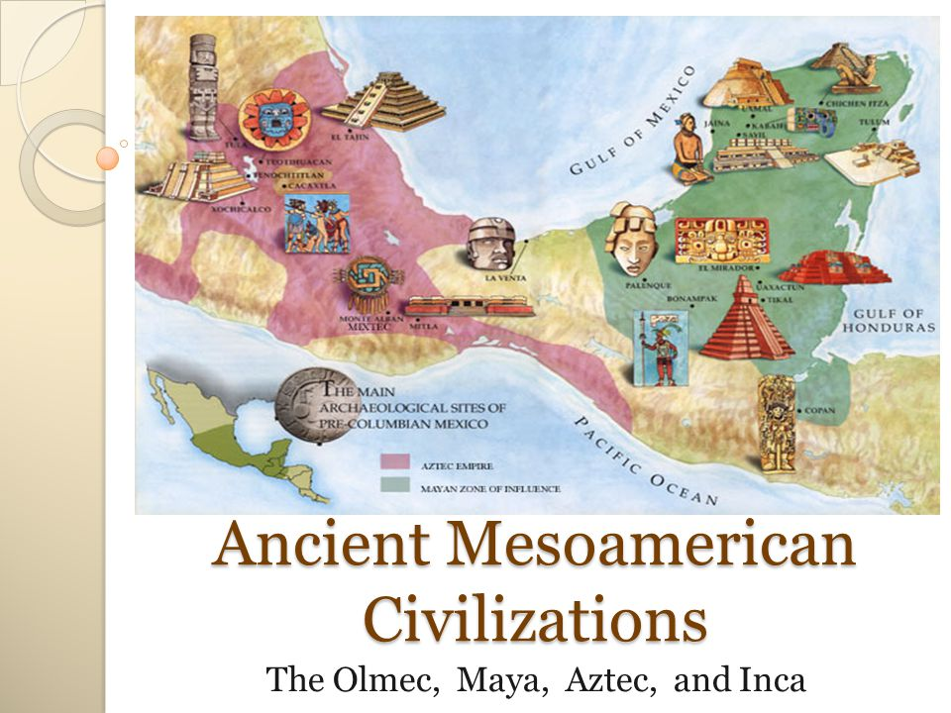
https://slideplayer.com/slide/4551913

Slide 3
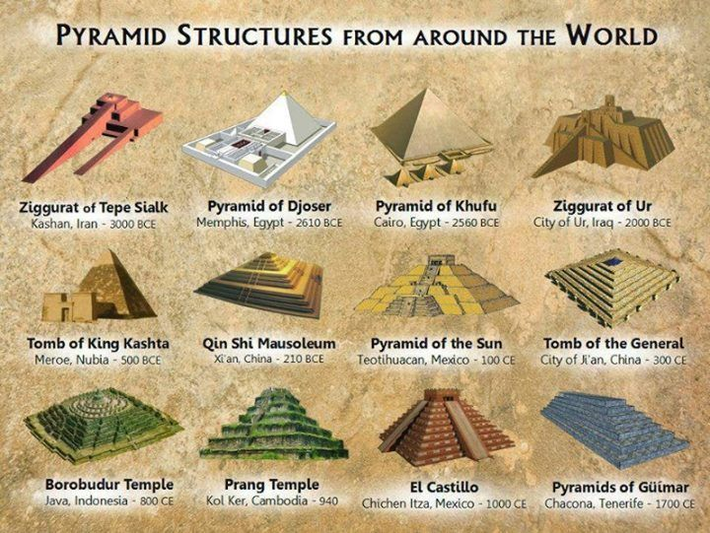
Archaeology and Diffusionism
https://www.quora.com/Why-are-there-pyramids-around-the-world

Slide 4
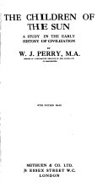
William Perry’s “The Children of the Sun”
1927
https://books.google.mn/books/about/The_Children_of_the_Sun.html

Slide 5
Major crops domesticated in Mesoamerica
Maize, corn
Squash
Beans

Slide 6
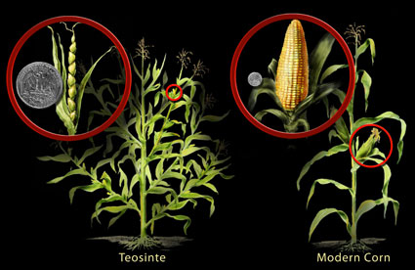
How do archaeologists recognize domestication?
domestication:
when plants and animals
are dependent on humans
for reproductive success
there are genetic and
physical changes
https://theconversation.com/did-the-first-farmers-deliberately-domesticate-wild-plants-77434
long time period required for genetic changes

Slide 7
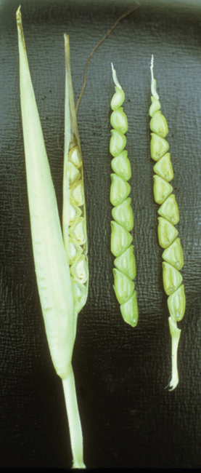
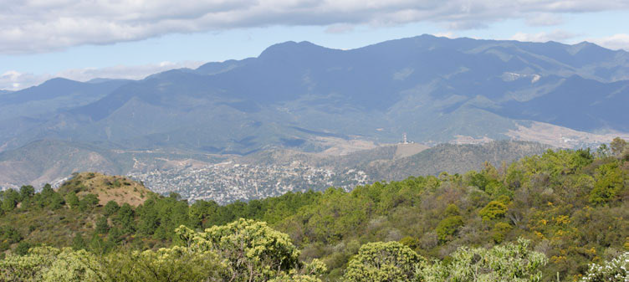
https://www.maizegenetics.net/copy-of-hybrid-vigor-1
Maize
https://alchetron.com/Oaxaca-Valley
Oaxaca Valley
Slow process : 12,700 – 7,800 BP
Wild Teosinte

Slide 8
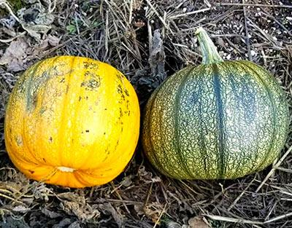
Squash: slow process, 10,000-8,000 BP
Cucurbita Pepo
https://www.growyourheirlooms.com/
Beans: earliest dates – 2,500 BP

Slide 9
Mesoamerica:
variation in the nature of urbanism,
political organization,
ritual centers,
regional economies,
evidence for writing; linguistic affiliation
development of calendars (Maya, Aztecs),
elite rituals (bloodletting, ball game) aimed to ensure stability;
also maize agriculture, no large domestic animals,
Shared cultural traits across vast region
Aspects of the development of state societies that do not fit well with general models for state formation.

Slide 10
https://slideplayer.com/slide/4551913

Slide 11
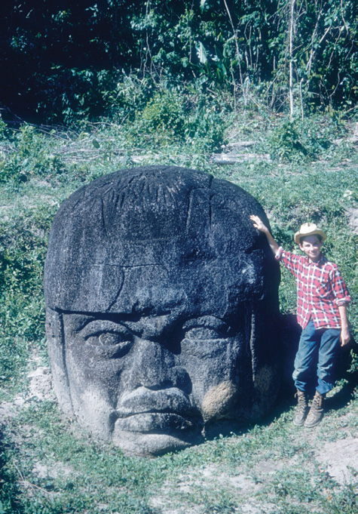
Olmec head at La Venta
Chazan, M. (2021). World prehistory and archaeology: pathways through time. Routledge, New York.

Slide 12
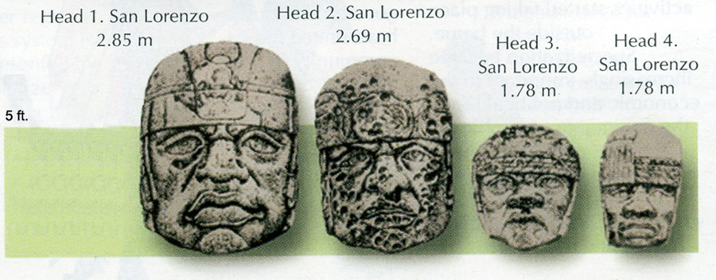
What were these large heads? Images of rulers? deities?
some at San Lorenzo over 9 feet tall and weighing many tons
helmets related to warfare? the ballgame? Coe found small figurines of ball players and a simple earthen ball court ; a rubber-like material from the
tropical forests used for balls
http://www.latinamericanstudies.org/olmec-colossal-heads-1.htm

Slide 13
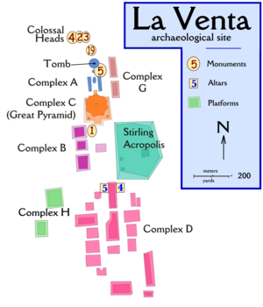
regional center
at La Venta
the site now largely destroyed by an oil refinery and an airstrip
linear complex of remains for 1.5 miles; originally on an island
Monumental architecture: large pyramid : first very tall one in Mesoamerica—estimated 800,000 days to build
Should this be described as a city?
https://en.wikipedia.org/wiki/La_Venta

Slide 14
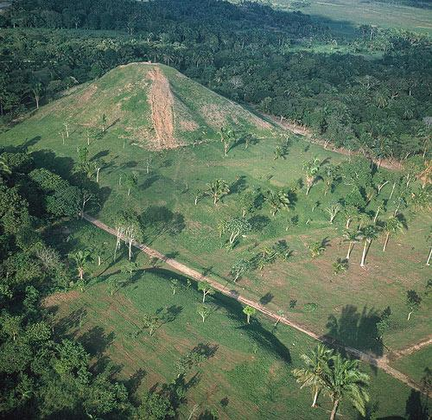
La Venta site before destruction
https://en.wikipedia.org/wiki/La_Venta

Slide 15
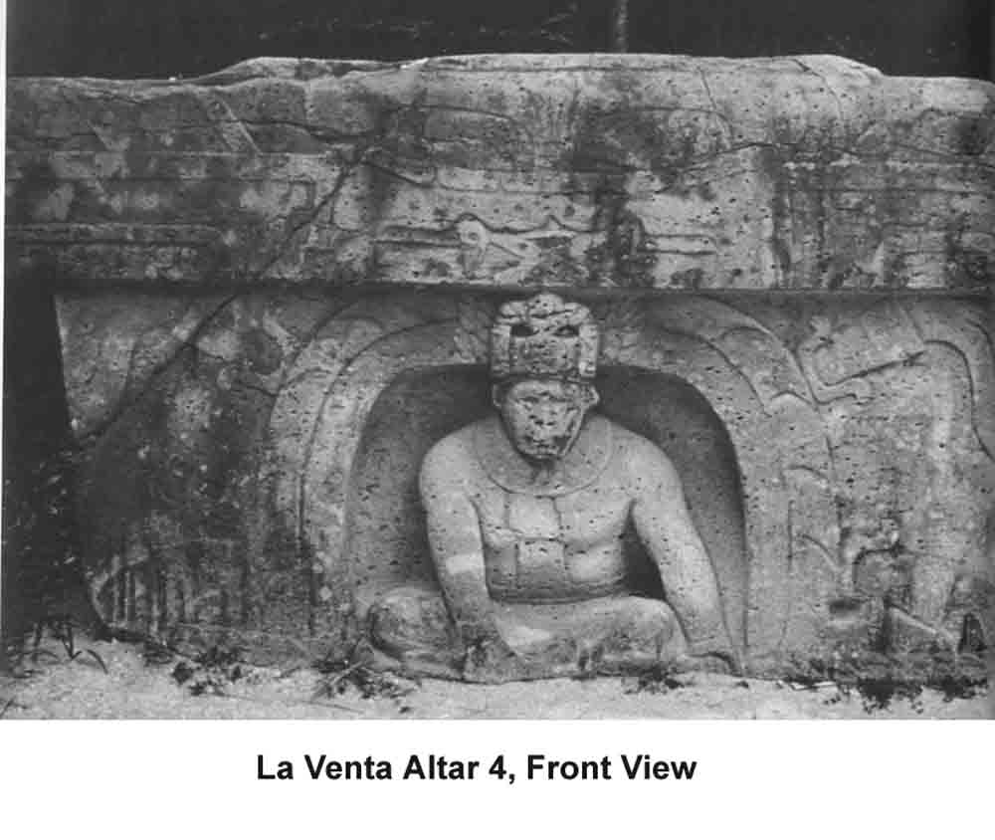
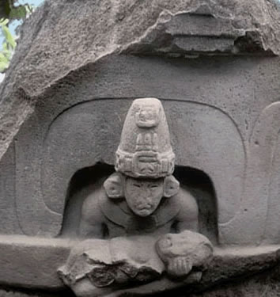
https://en.wikipedia.org/wiki/La_Venta
The “altars” here are huge basalt blocks weighing many tons, with niches in front showing figures interpreted as sacred rulers;
a second theme to display was war and
conquest—bound captives depicted
these could have been thrones

Slide 16
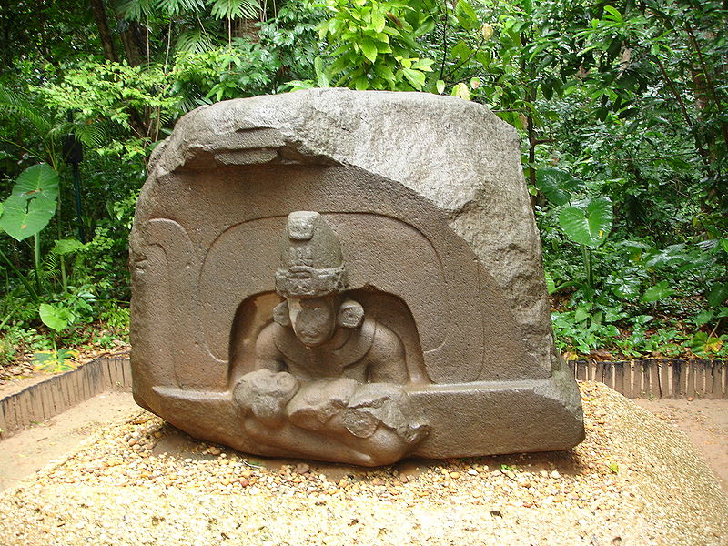
Altar 5 at La Venta
stone obtained from up to 60 miles away
https://en.wikipedia.org/wiki/La_Venta

Slide 17
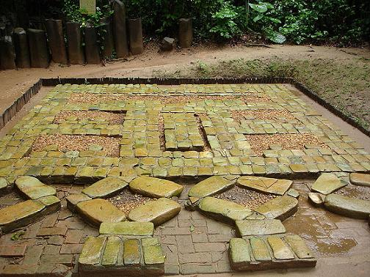
La Venta: reconstructed mosaic at other end of the large pyramid;
interpreted as a large jaguar mask; 3 found in total
mosaic pavements of serpentine blocks, then deliberately covered over
by possibly painted pink clay and a platform of adobe bricks—so the
whole thing was a kind of offering
https://en.wikipedia.org/wiki/La_Venta

Slide 18
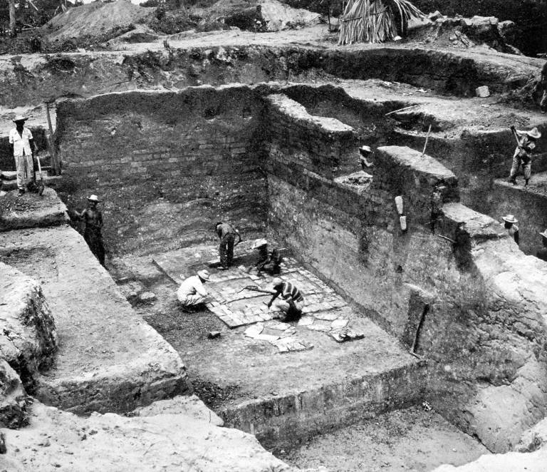
mosaic pavement of serpentine blocks: jaguar mask
https://en.wikipedia.org/wiki/La_Venta

Slide 19
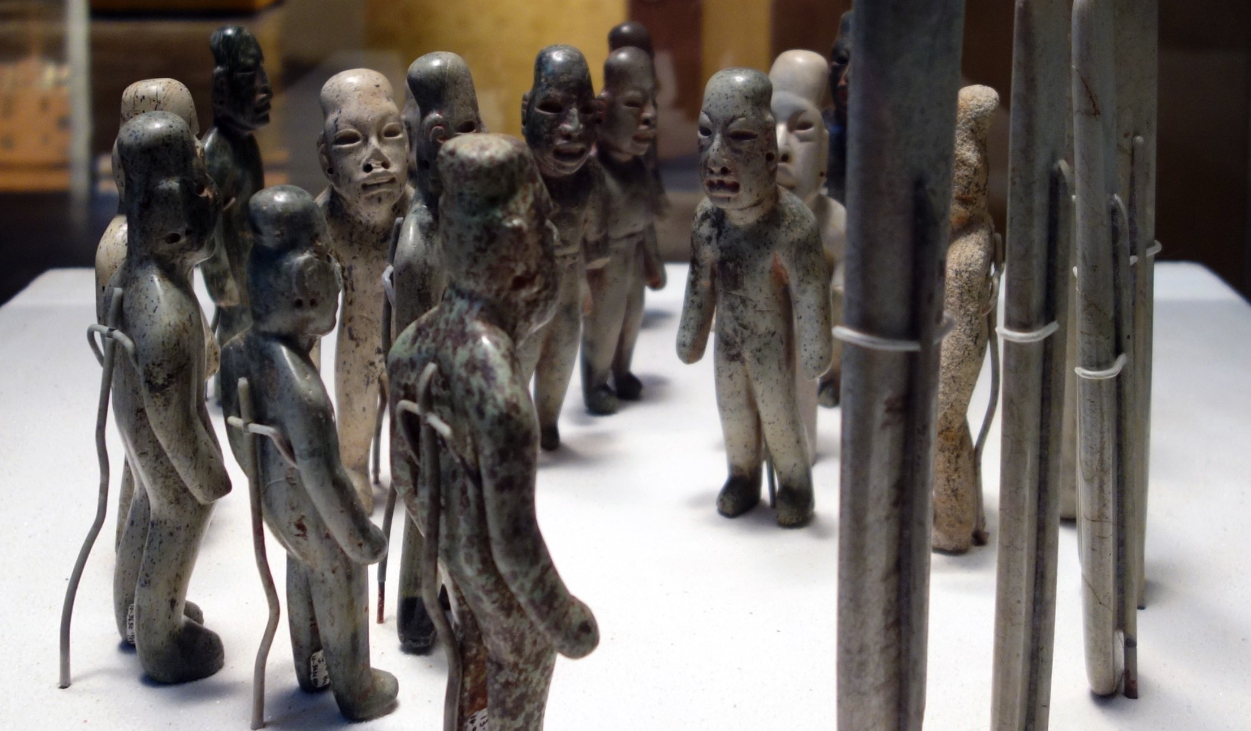
most famous offering at La Venta:
16 buried figurines (male) in a set, made from jade
and serpentine : does this represent a “town council”?
or a special ritual?
https://smarthistory.org/offering-4-la-venta

Slide 20
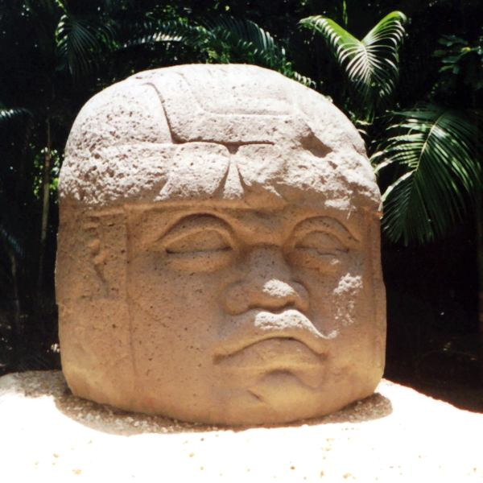
Debates about the organization of this complex society:
--evidence for powerful rulers
with sacred authority;
--some evidence for warfare;
--hints of an administration
--no writing
https://en.wikipedia.org/wiki/La_Venta

Slide 21
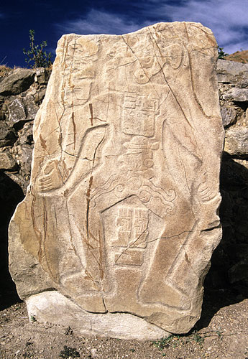
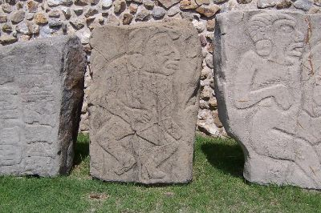
Monte Alban:
site regarded as an urban center of a state, with no writing
possible shared leadership roles/corporate
organization, no glorification of individual rulers
importance of warfare
https://uncoveredhistory.com/mexico/monte-alban-los-danzantes

Slide 22
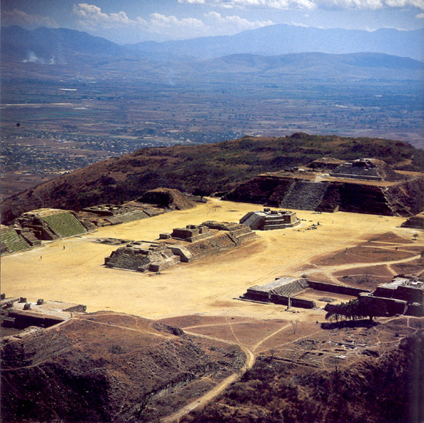
Beginning 350 BC, a defensive wall was built around the city
https://www.historyhit.com/locations/monte-alban

Slide 23
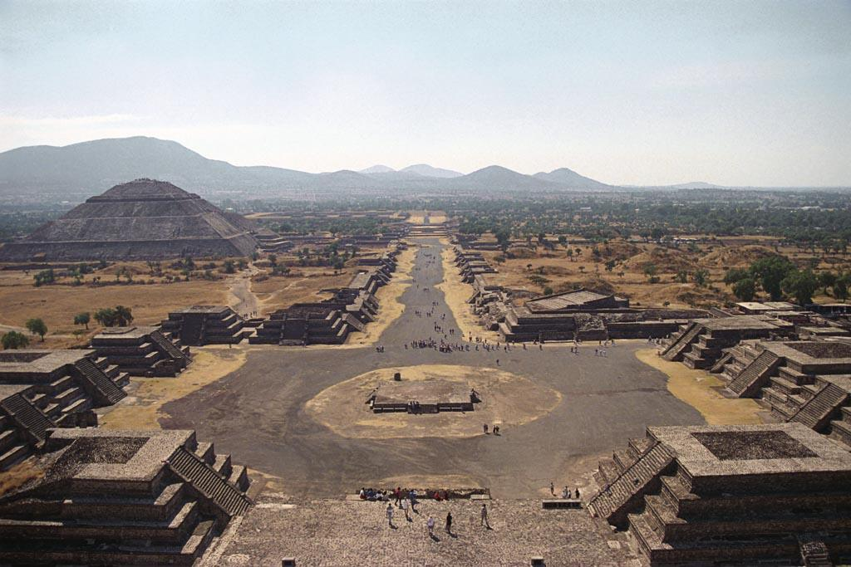
Teotihuacan: unusual concentration of people and power
a very densely populated city and center of a state
no writing
Chazan, M. (2021). World prehistory and archaeology: pathways through time. Routledge, New York.

Slide 24
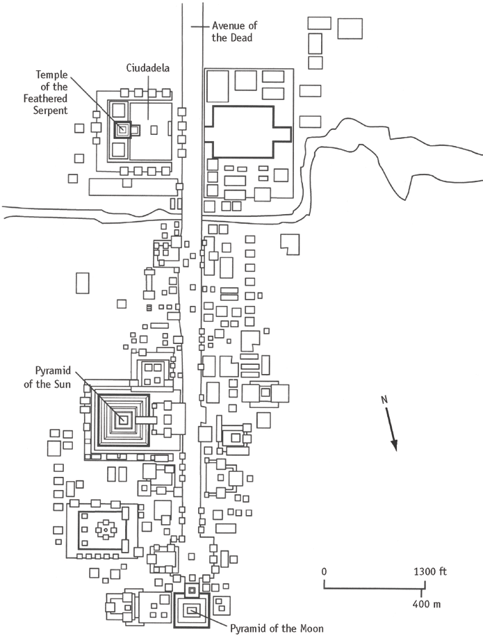
Map of Teotihuacan
Milton et al. (1973). Urbanization at Teotihuacan, Mexico. University of Texas Press, Texas.

Slide 25
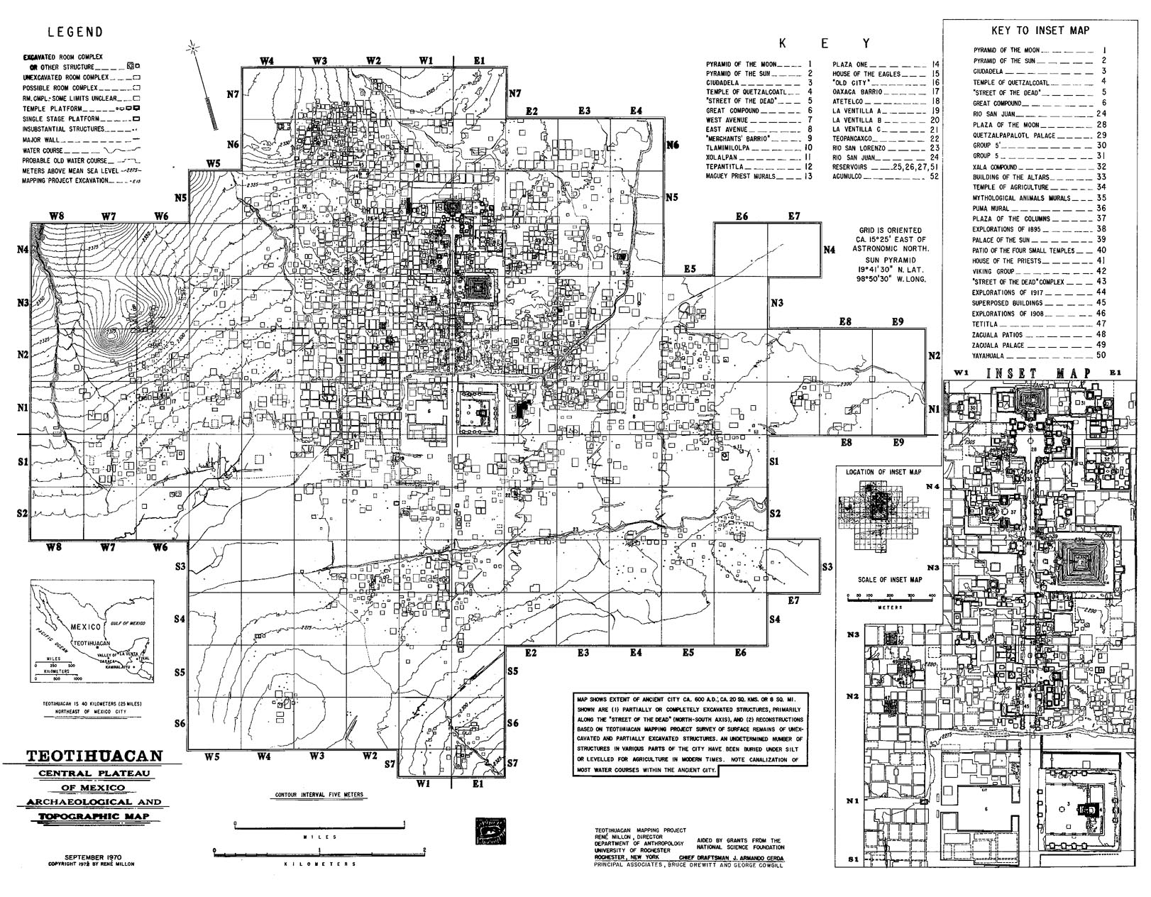
Milton et al. (1973). Urbanization at Teotihuacan, Mexico. University of Texas Press, Texas.

Slide 26
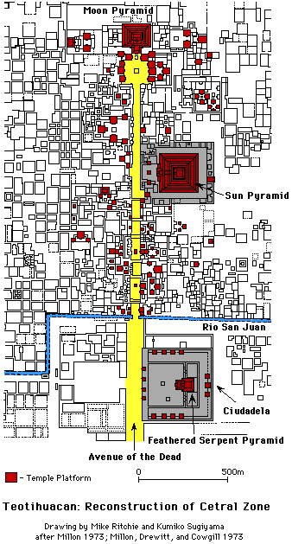
What kind of city was it?
Avenue of the Dead: ceremonial
center continually built for
about 200 years
including Pyramid of the Sun

Slide 27
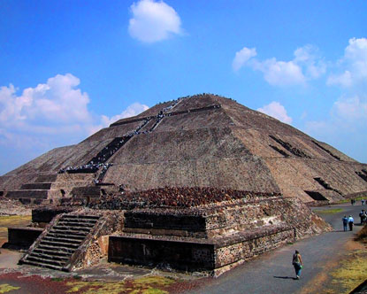
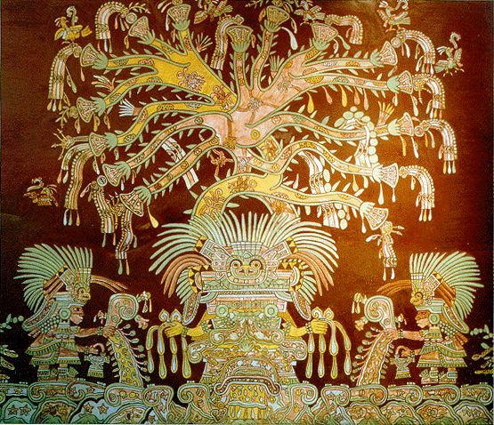
Pyramid of the Sun: as big as the pyramid of Khufu in Egypt at the base
hints about deities and powerful military rulers
https://www.discovermagazine.com/planet-earth/why-was-the-pyramid-of-the-sun-built

Slide 28
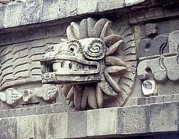
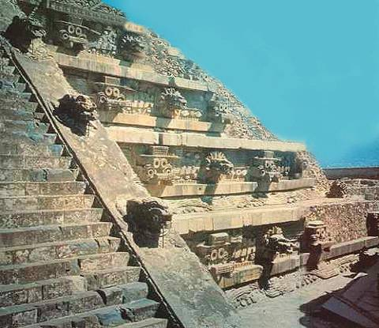
Pyramid of the Feathered Serpent
40 male, sacrificial victims found around the temple
interpreted as sacrificed soldiers on the basis of grave goods; possibly drafted into service from different areas
evidence for the importance of military power in this state
AND human sacrificial offerings to the gods
https://en.wikipedia.org/wiki/Temple_of_the_Feathered_Serpent,_Teotihuacan

Slide 29
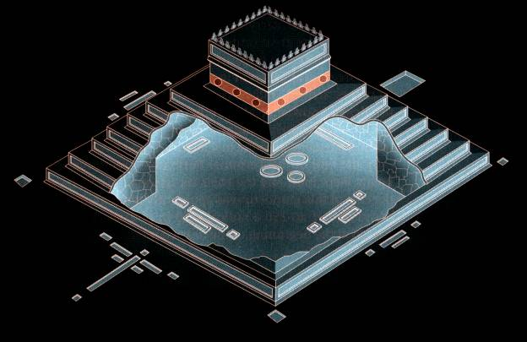
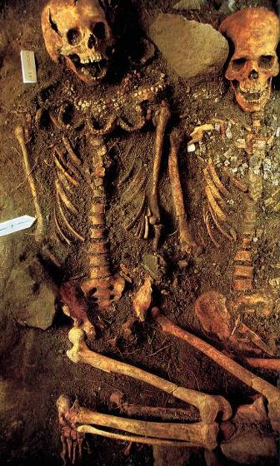
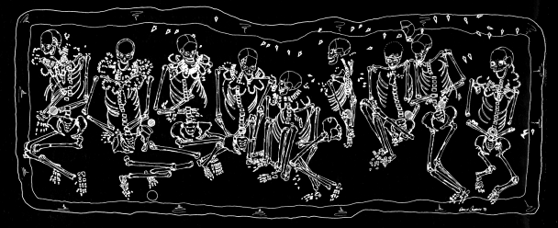
https://misfitsandheroes.wordpress.com/category/temple-of-the-feathered-serpent

Slide 30
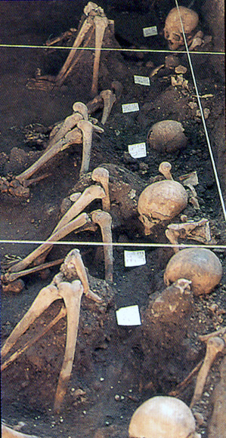
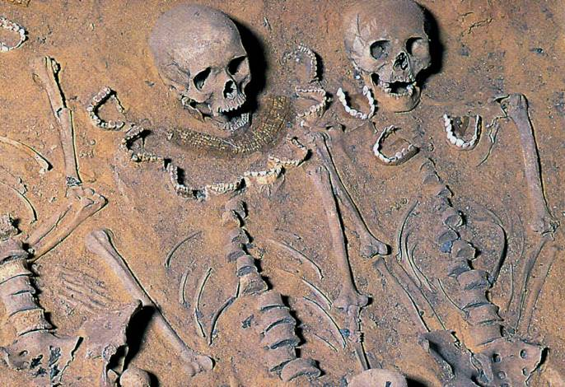
200 Sacrificial Individuals
Groups of 18 Individuals
Center, North, East, and South
Slain captives at 4 corners
https://misfitsandheroes.wordpress.com/category/temple-of-the-feathered-serpent

Slide 31
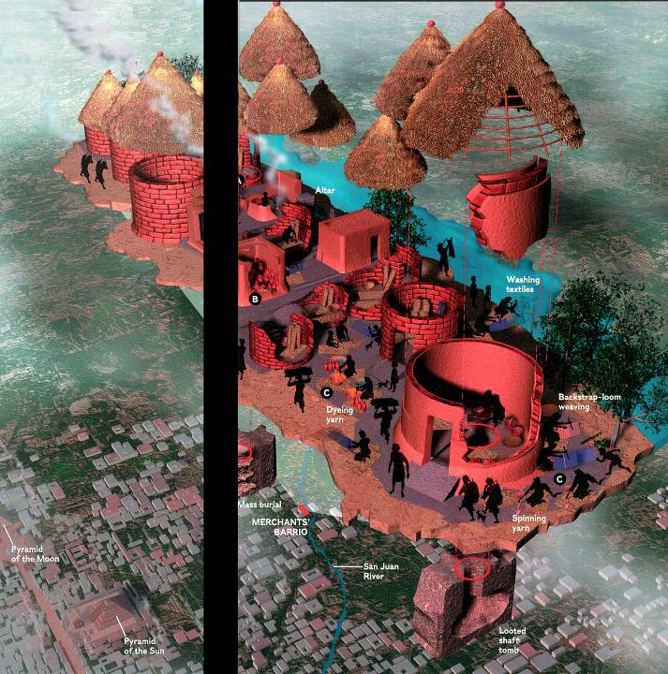
possible increased
autonomy of the barrio
neighborhoods over time reduced the power of the ruling elites
Destruction of the
Temple of the
Feathered Serpent
Ca. A.D. 400
Veracruzan
barrio
https://www.teotihuacanenlineadiario.com/2013/05/teotihuacan-sus-barrios.html

Slide 32
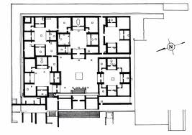
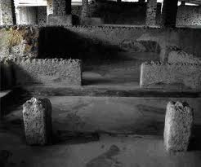
apartment dwellers involved
in craft production
Products traded to other areas
controlled by state, or independent?
ongoing debates about the structure of power over time at Teotihuacan—”corporate” or shared power strategies and/or “exclusionary” or hierarchical
https://www.teotihuacanenlineadiario.com/2013/05/teotihuacan-sus-barrios.html

Slide 33
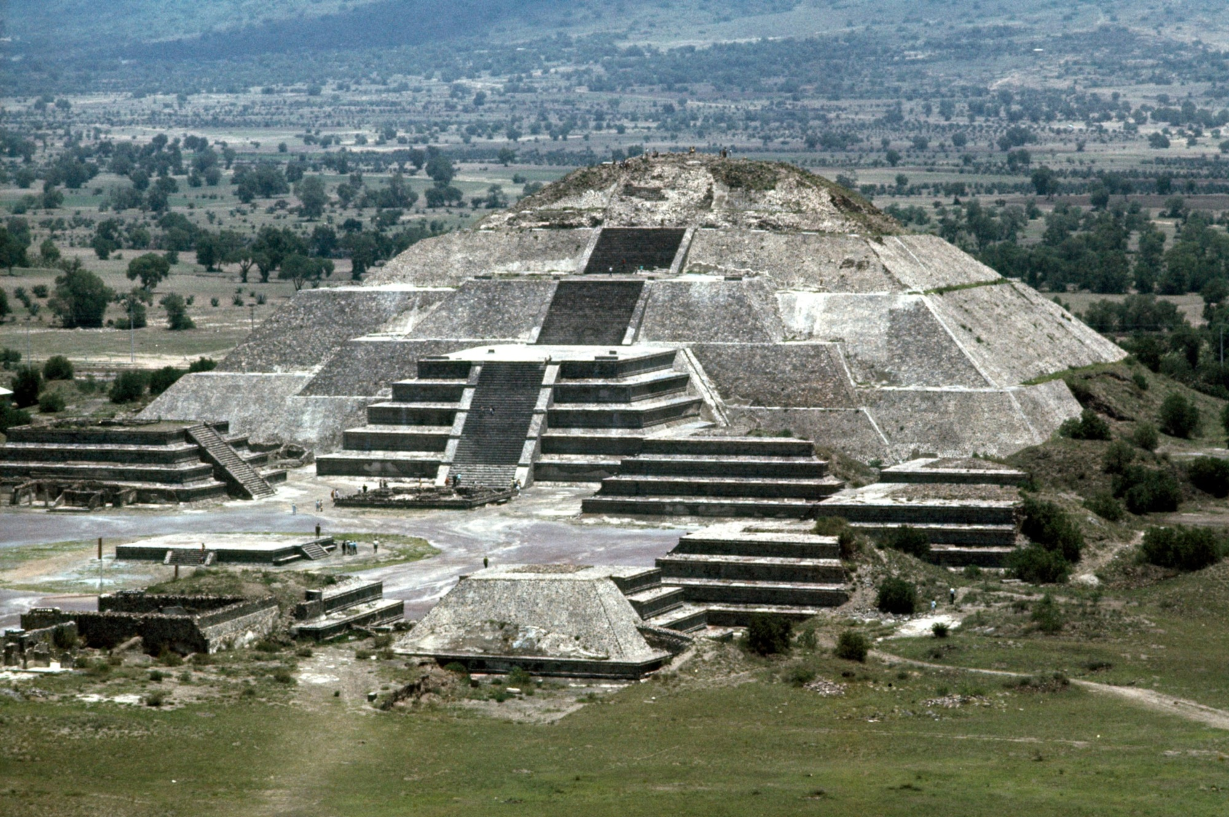
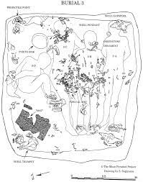
Pyramid of the Moon and human sacrifices
https://www.nationalgeographic.com/history/article/tunnel-pyramid-teotihuacan-Mexico-archaeology-spd

Slide 34
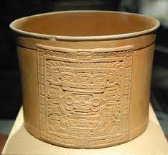
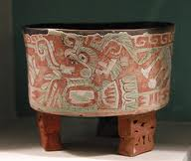
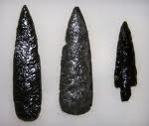
production of at least some obsidian points
likely controlled by the military: workshop found at the Pyramid of the Moon
“orange ware” has a wide distribution in the region
painted ceramics probably restricted to elites

Slide 35
To sum up the archaeological evidence:
Extensive urban planning and monumental construction:
centralized state
Different strategies implemented by rulers to legitimize their social status:
- representational iconography,
    religious ceremonies and rituals that involved human and animals sacrifice,
    controlled and strict production of prestige goods and items for power display

Slide 36
References
Carballo, D. (2007). Implements if state power: weaponry and martially themed obsidian production near the Moon Pyramid, Teotihuacan. Ancient Mesoamerica, 18: 173-90.
Chazan, M. (2021). World prehistory and archaeology: pathways through time. Routledge, New York.
Coe, M. (1995). The Olmec world: ritual and rulership. Princeton University Press, Princeton.
Matsuoka, Y. et al. (2002). A single domestication for maize shown by multilocus microsatellite genotyping. Proceedings of the National Academy of Sciences, 99.9: 6080-84.
Milton et al. (1973). Urbanization at Teotihuacan, Mexico. University of Texas Press, Texas.
Perry, W. (1927). The children of the sun: a study in the early history of civilization. Methuen & Co. Ltd., London.
Piperno, D. and Flannery, K. The earliest archaeological maize (Zea mays L.) from highland Mexico: new accelerator mass spectrometry dates and their implications. Proceedings of the National Academy of Sciences, 98.4: 2101-3.
Smith, B. (1995). The emergence of agriculture. Scientific American Library, New York.
Trigger, B. (1996). A history of archaeological thought, 2nd edition. Cambridge University Press, Cambridge.

