Slide 1
Great Civilizations of the Ancient World
Ancient Civilizations of the Mediterranean region

Slide 2
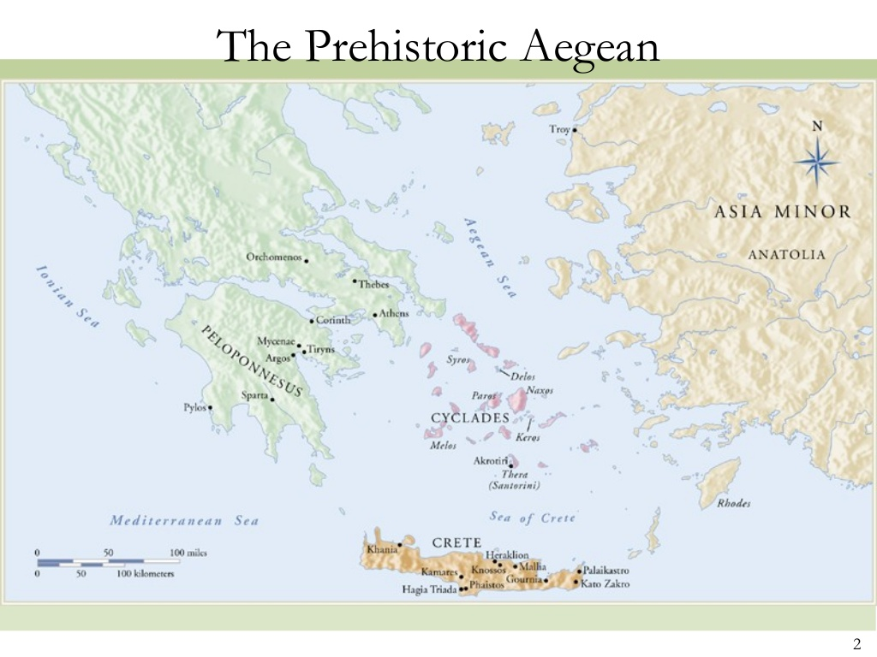
https://pt.slideshare.net/gastoncollegestory/chapter-4-the-prehistoric-aegean-57241937?ref

Slide 3
Mesolithic 9,000-7,000 BC
Sea level much lower than today
Evidence of significant sea fairing skills
Interaction between distant groups
Early interactions laid foundations to the spread of farming

Slide 4
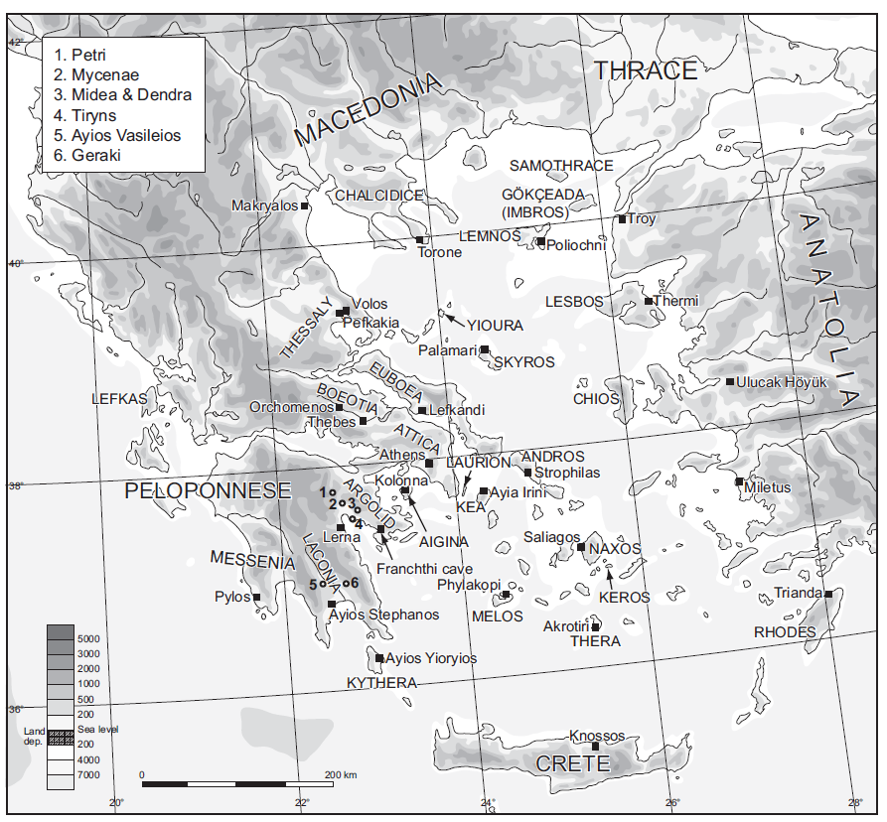
Chazan, M. (2021). World prehistory and archaeology: pathways through time. Routledge, New York.

Slide 5
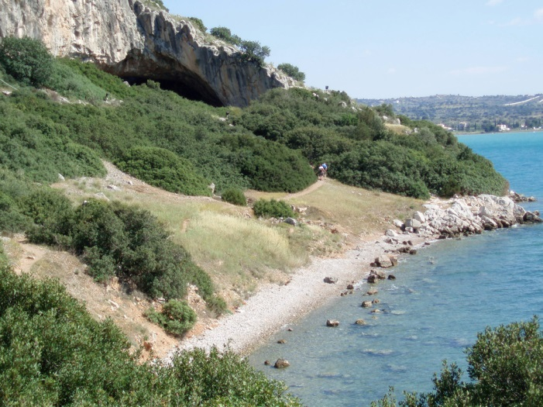
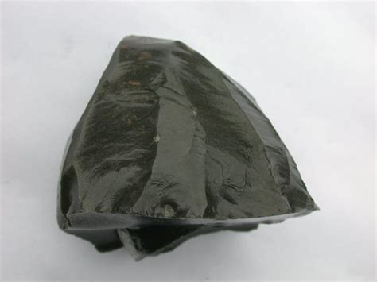
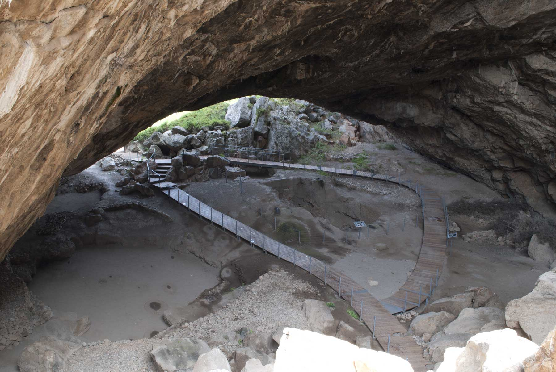
Franchthi Cave
https://www.pinterest.com/pin/418482990351771305

Slide 6
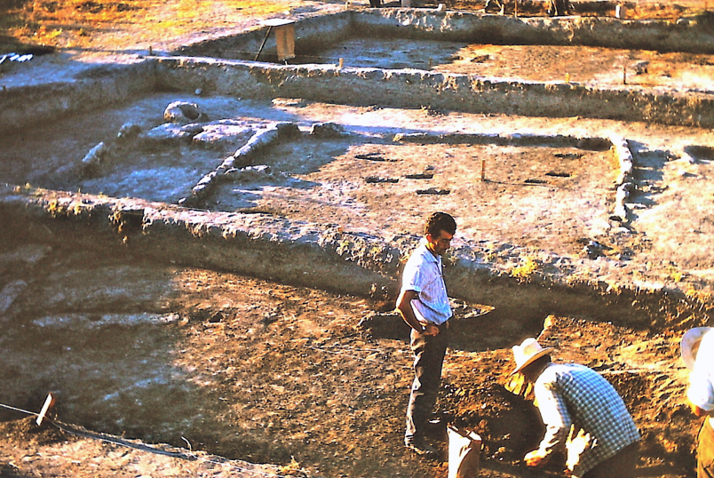
‘Deliberate’ colonization by ‘farmers’ from Central Anatolia?
Lifeways of the island population are altered towards settled villages and farming
Each hamlet (some lasted for millennia) occupied certain territory
Community-oriented activities such as building houses, boundary walls, and digging ditches
Part-time specialists: pottery, some as large as 85 litres
Onset of the Neolithic, 7,000-6,000 BC
Pigs
Cattle
Sheep
Goats
Deer, boar, fish, birds
https://en.wikipedia.org/wiki/Nea_Nikomedeia

Slide 7
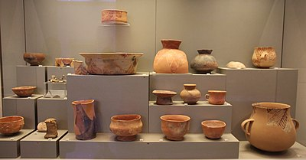
Neolithic pottery
https://www.wikiwand.com/en/Neolithic_Greece

Slide 8
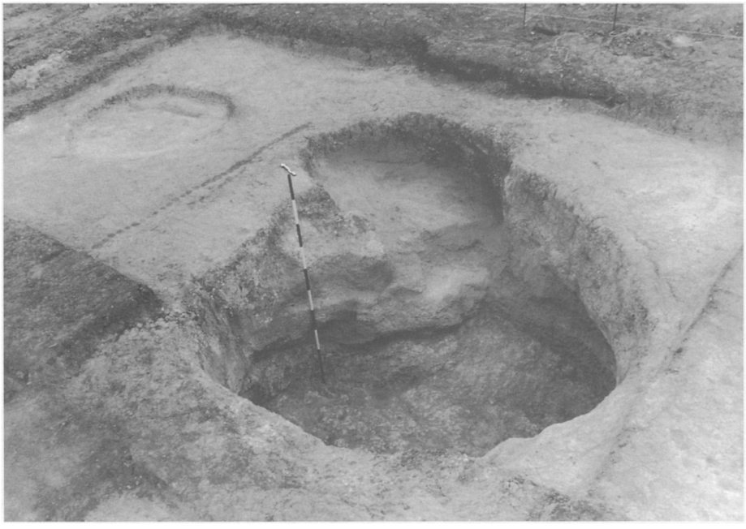
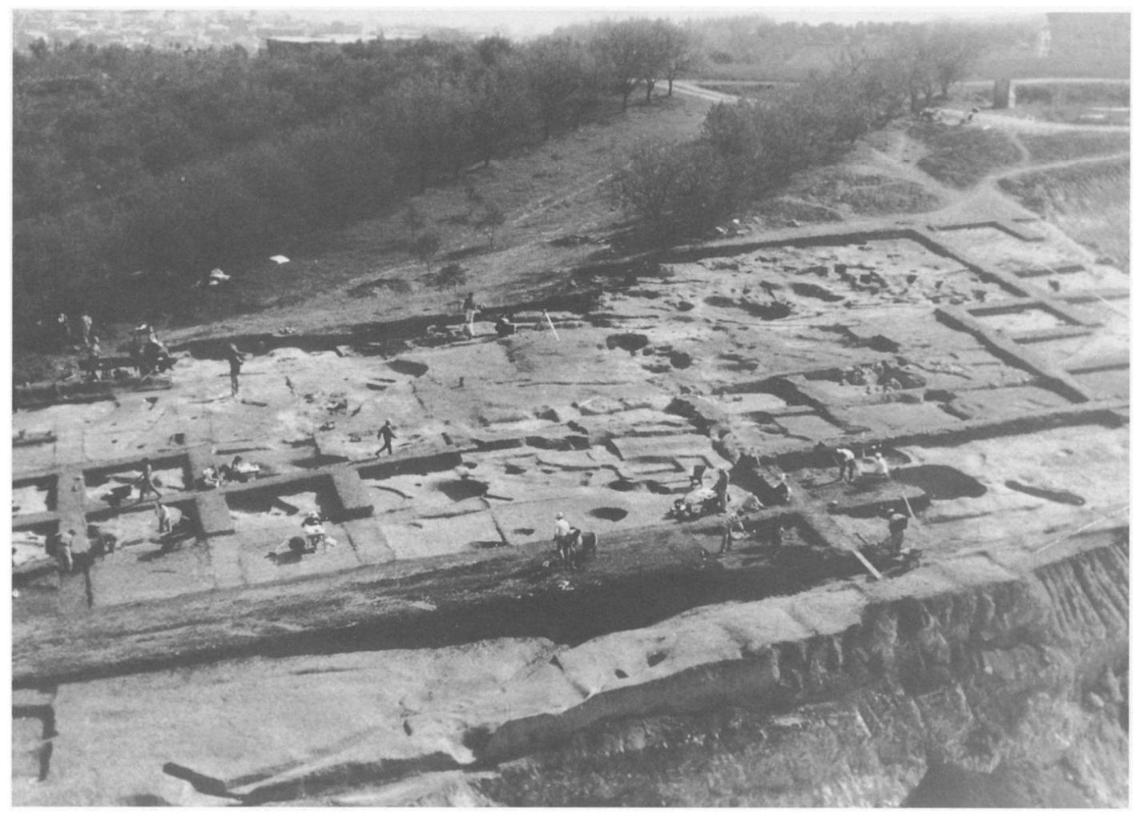
The Aegean Neolithic
Socialization patterns that favored ‘face-to-face relationships’ and included ceremonial and economic exchange
No social hierarchy detected
Presence of ‘big men’
Makriyalos pottery and animal bones: emergence of craft specialists
5th millennium - Minimum metal sources in the Aegean encouraged trade and exchange of gold, silver, copper items for symbolic significance (copper mining in the Balkans).
Pappa, M. and Besios, M. (1999). The Neolithic settlement at Makriyalos, northern Greece: preliminary report on the 1993-1995 excavations. Journal of Field Archaeology, 26: 177-95.

Slide 9
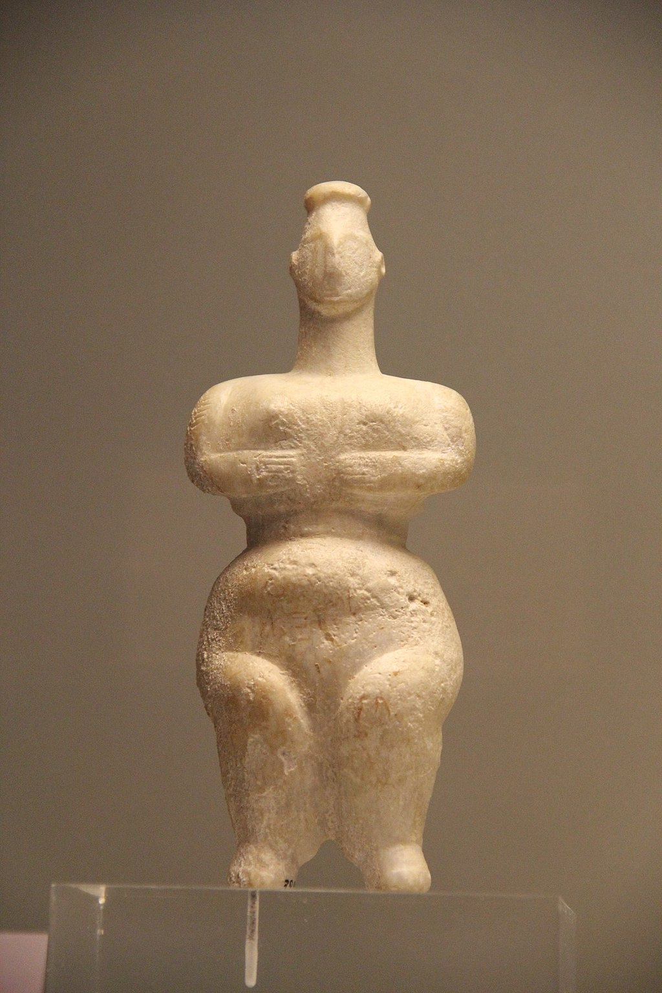
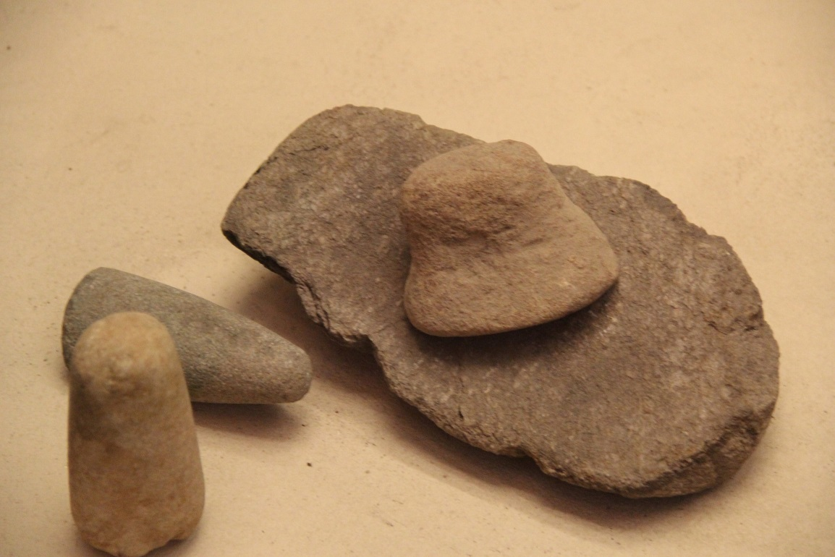
Stone tools and figurine of Neolithic Greece
https://www.wikiwand.com/en/Neolithic_Greece

Slide 10
The Bronze Age of the Aegean
3,300-1,100 BC
Minoan, Cycladic, Helladic Cultures
Minoan = Crete
Cycladic = Island Chains
Helladic = Mainland Greece
https://pt.slideshare.net/gastoncollegestory/chapter-4-the-prehistoric-aegean-57241937?ref

Slide 11
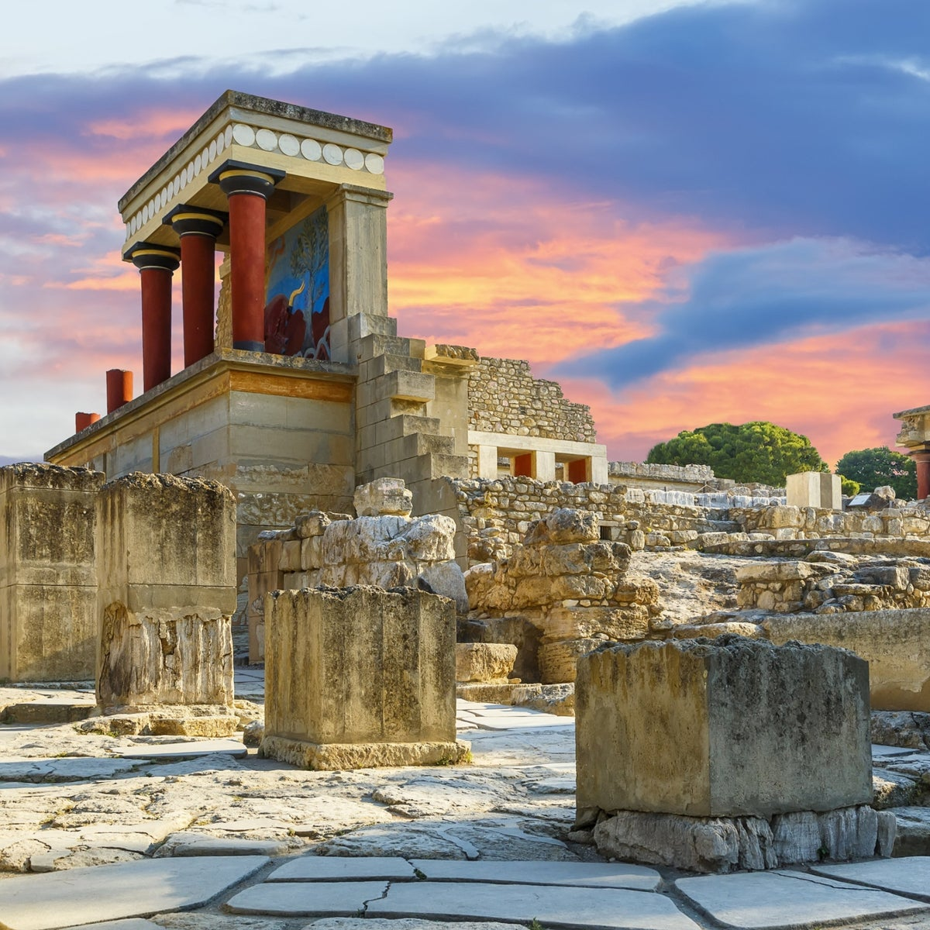
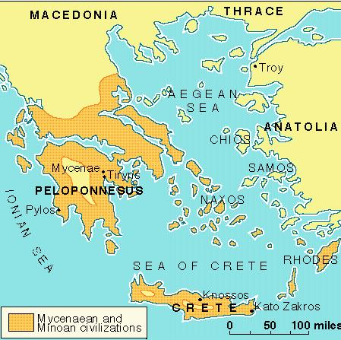
Emergence of centralized social institutions
Minoan civilization – 1900 BC
https://www.haaretz.com/world-news/2019-09-10/ty-article-magazine/.premium/ancient-tablets-may-reveal-what-destroyed-minoan-civilization/0000017f-e8c4-df5f-a17f-fbde98d3000
Mycenaean civilization – 1450 BC
https://wwnorton.com/college/history/ralph/resource/greece.htm

Slide 12
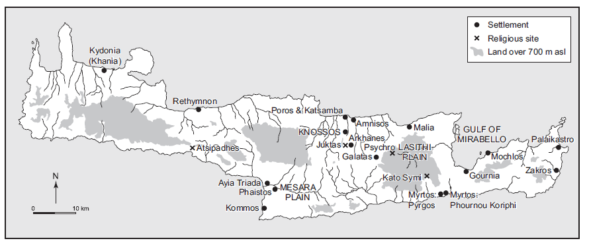
Beyond the Early Bronze Age
Middle Bronze Age c. 2,000-1,600 BC
Nucleation of villages
Rise of the Minoan Culture c. 2,000-1,450 BC
https://en.wikipedia.org/wiki/Minoan_civilization

Slide 13
Nature of social relationships between Minoan societies
Initially thought to be hierarchical
Later approaches consider it heterarchical
https://www.haaretz.com/world-news/2019-09-10/ty-article-magazine/.premium/ancient-tablets-may-reveal-what-destroyed-minoan-civilization/0000017f-e8c4-df5f-a17f-fbde98d3000

Slide 14
“the relation of elements to one another when they are unranked or when they possess the potential for being ranked in a number of different ways” (Crumley 1995)
https://www.haaretz.com/world-news/2019-09-10/ty-article-magazine/.premium/ancient-tablets-may-reveal-what-destroyed-minoan-civilization/0000017f-e8c4-df5f-a17f-fbde98d3000

Slide 15
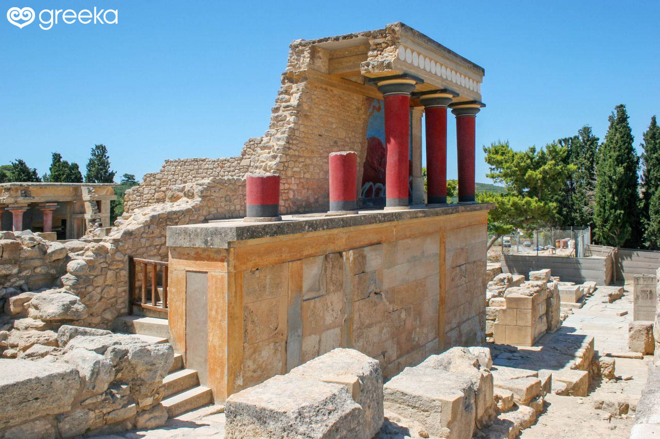
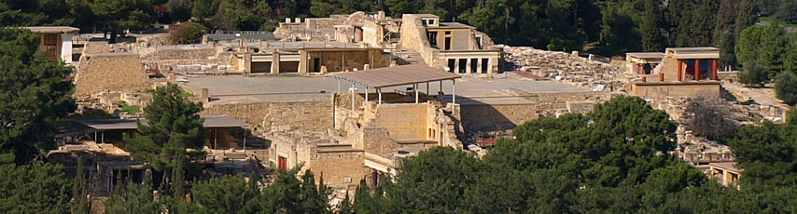
Role of palaces in Minoan culture
https://www.greeka.com/crete/heraklion/sightseeing/palace-knossos-heraklion

Slide 16
Minoan Civilization – Island of Crete from 2,000 – 1450 B.C.
  Cities - √
  Palaces - √
  Walled settlement – X Substantial Temples – X Overt Expression of leadership – X
https://www.greeka.com/crete/heraklion/sightseeing/palace-knossos-heraklion

Slide 17
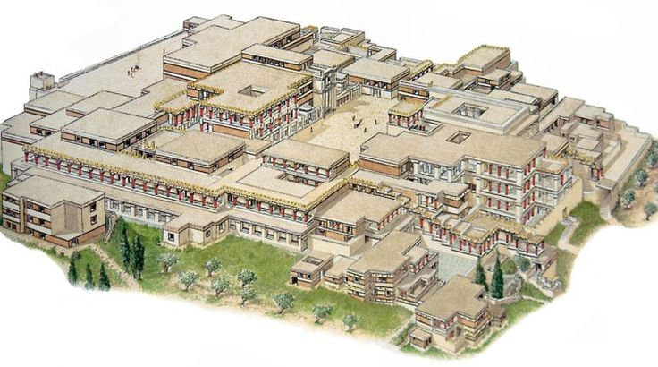
The role of palace: public venues and public activities.
Reconstructed palace at Knossos
https://www.pinterest.com/pin/464222674080291301

Slide 18
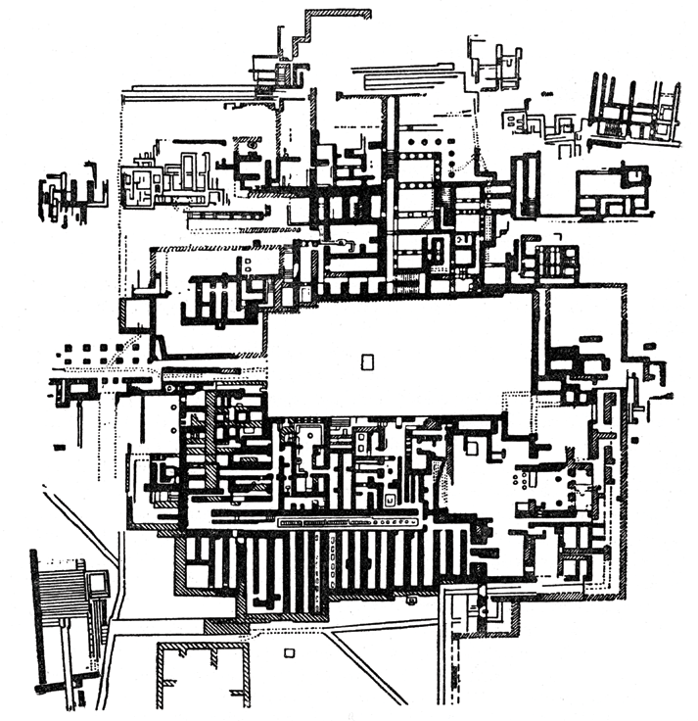
Plan of palaces at Knossos
Chazan, M. (2021). World prehistory and archaeology: pathways through time. Routledge, New York.

Slide 19
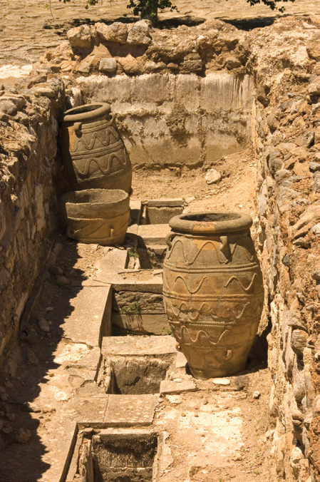
One of the storage rooms at Knossos palace
Chazan, M. (2021). World prehistory and archaeology: pathways through time. Routledge, New York.

Slide 20
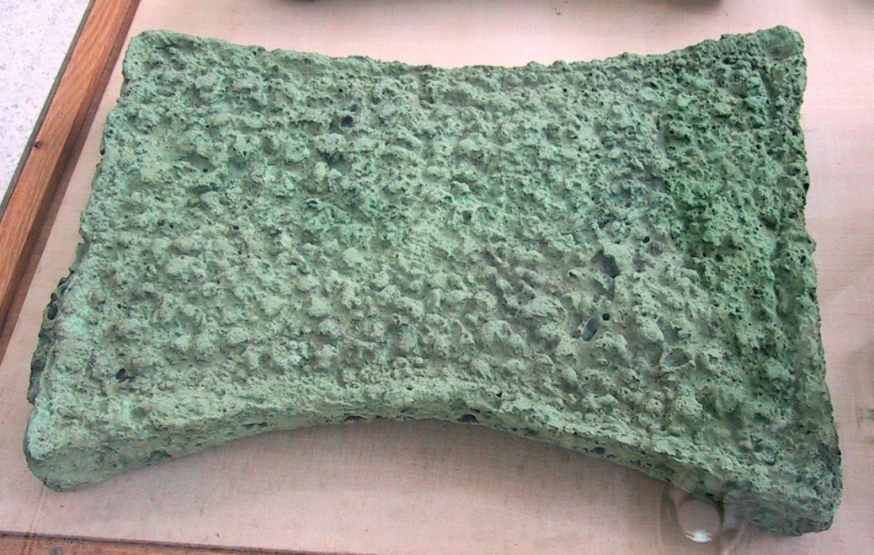
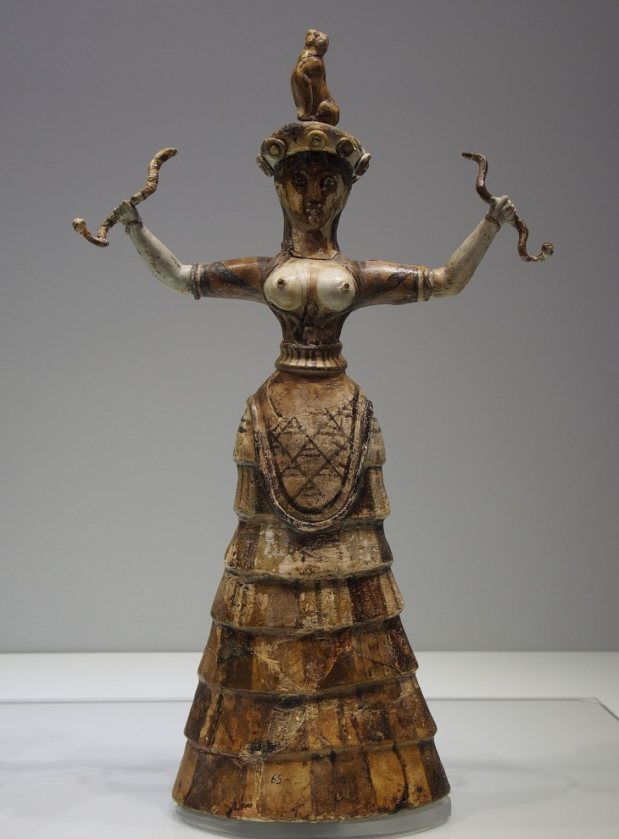
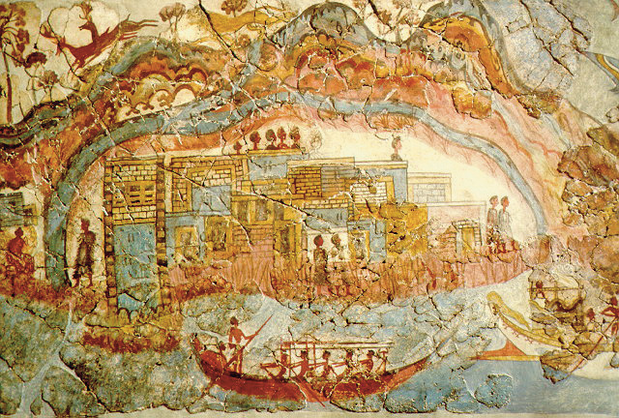
https://en.wikipedia.org/wiki/Minoan_civilization

Slide 21
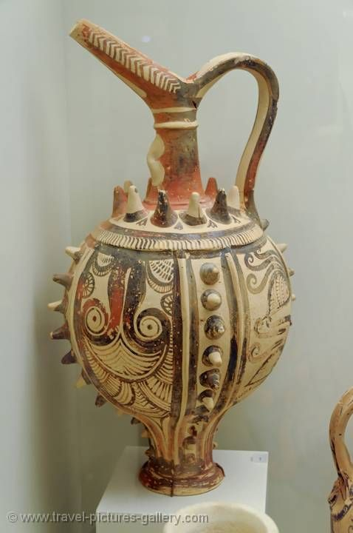
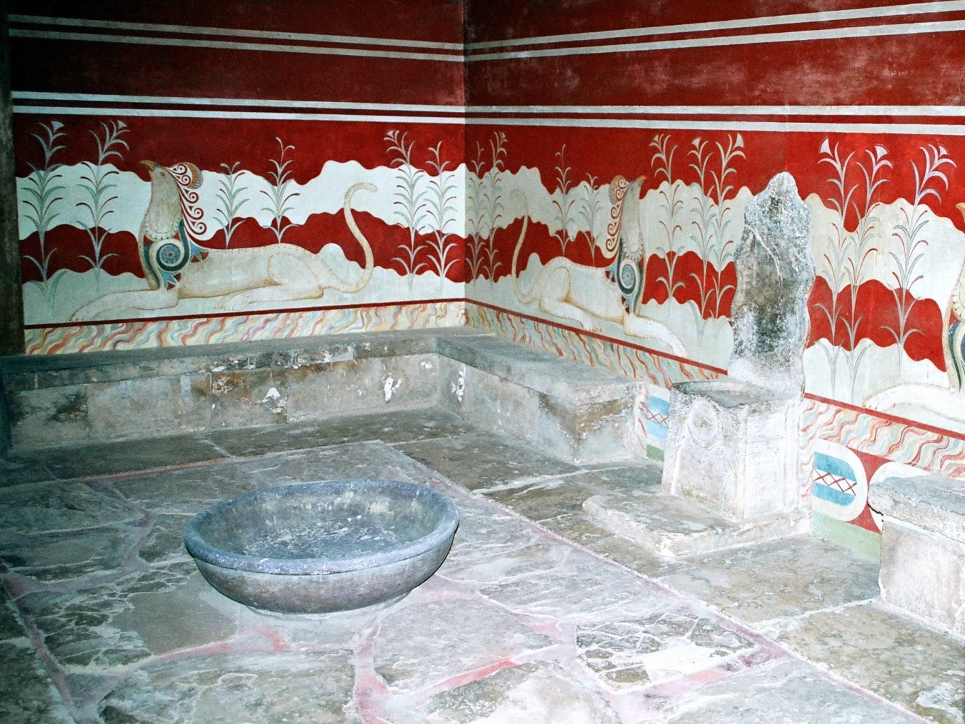
Elements of the Minoan culture
https://en.wikipedia.org/wiki/Minoan_civilization

Slide 22
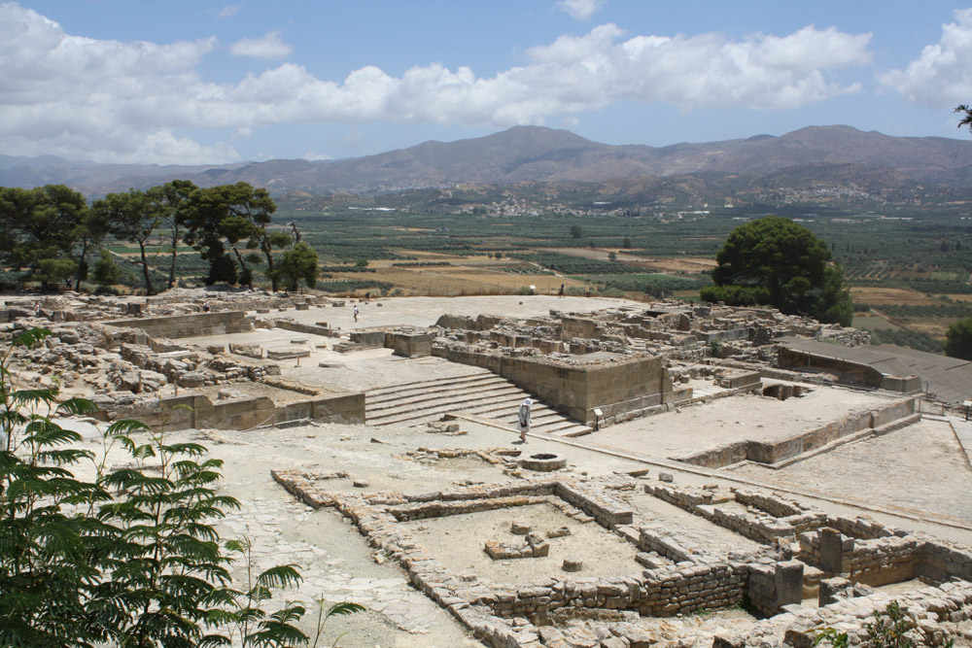
https://en.wikipedia.org/wiki/Minoan_civilization
Presence of open-air ceremonial centers and structures
No pan-Minoan religion is documented
Wide range of population is involved in these ceremonial activities
However, smaller settlements did not seem to be controlled politically and economically by the ‘palace’ polities

Slide 23
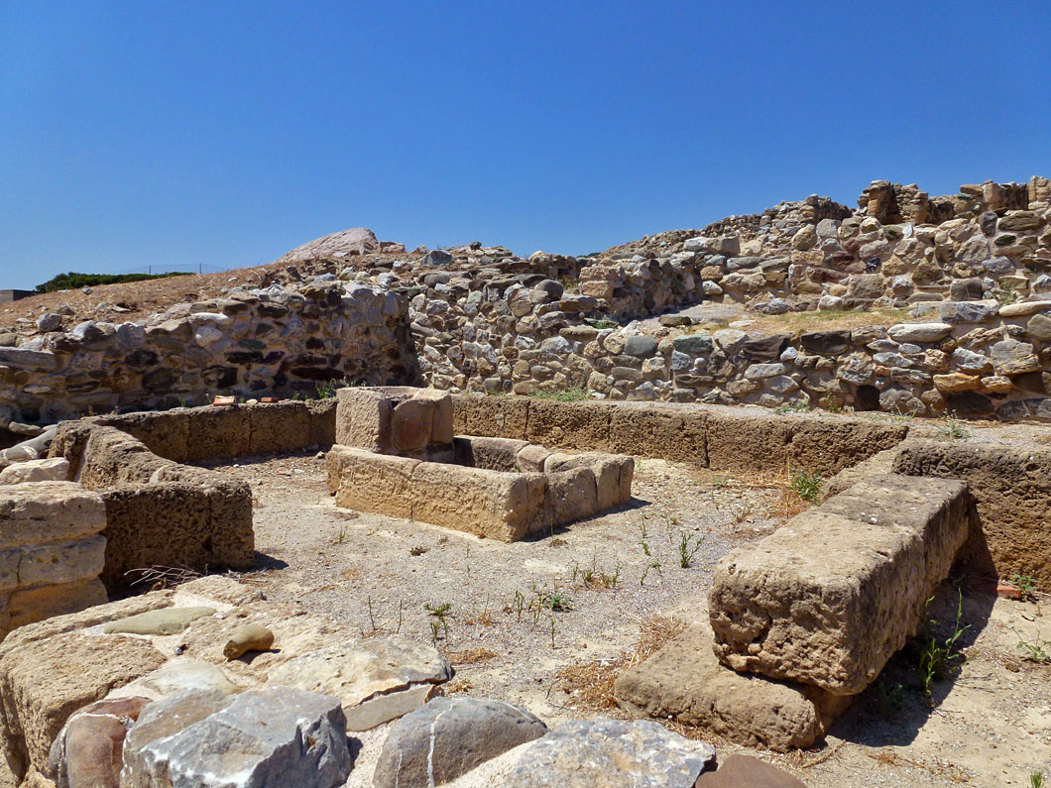
https://en.wikipedia.org/wiki/Minoan_civilization
Palaces might have functioned as focal points where leaders of small polities met and interacted
No simple vertical hierarchy but instead, horizontal systems of relationship and loyalty
Palaces were not in charge of trading or distributing exotic goods
Knossos yield evidence of a more dominant polity
Besides several ‘fortified posts’, there is not much evidence of conflict and violence

Slide 24
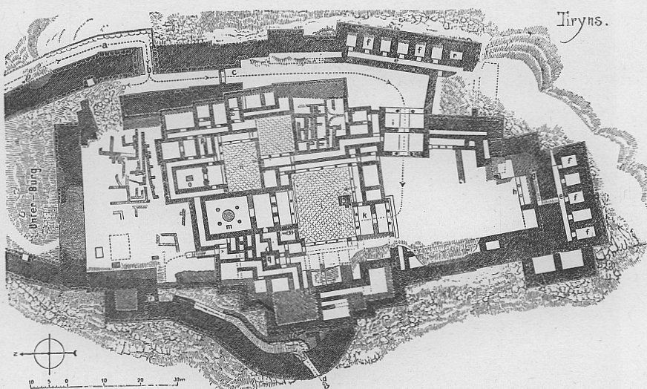
The Mycenaean civilization (1750-1050 BC)
Palace at Tiryns
https://en.wikipedia.org/wiki/Mycenaean_Greece

Slide 25
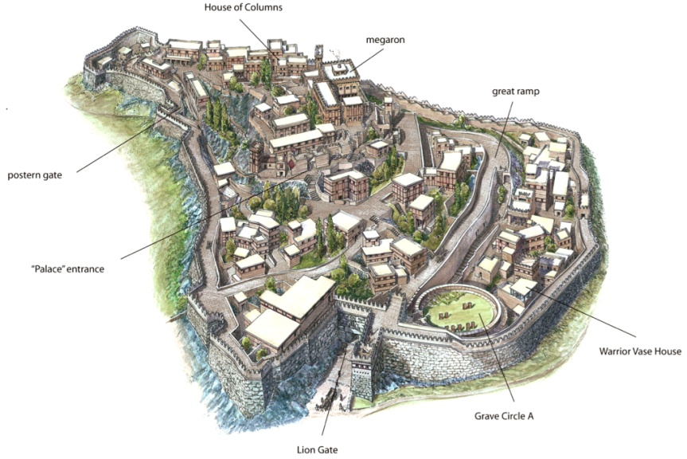
Mycenae
https://www.pinterest.com/pin/394065036124796903

Slide 26
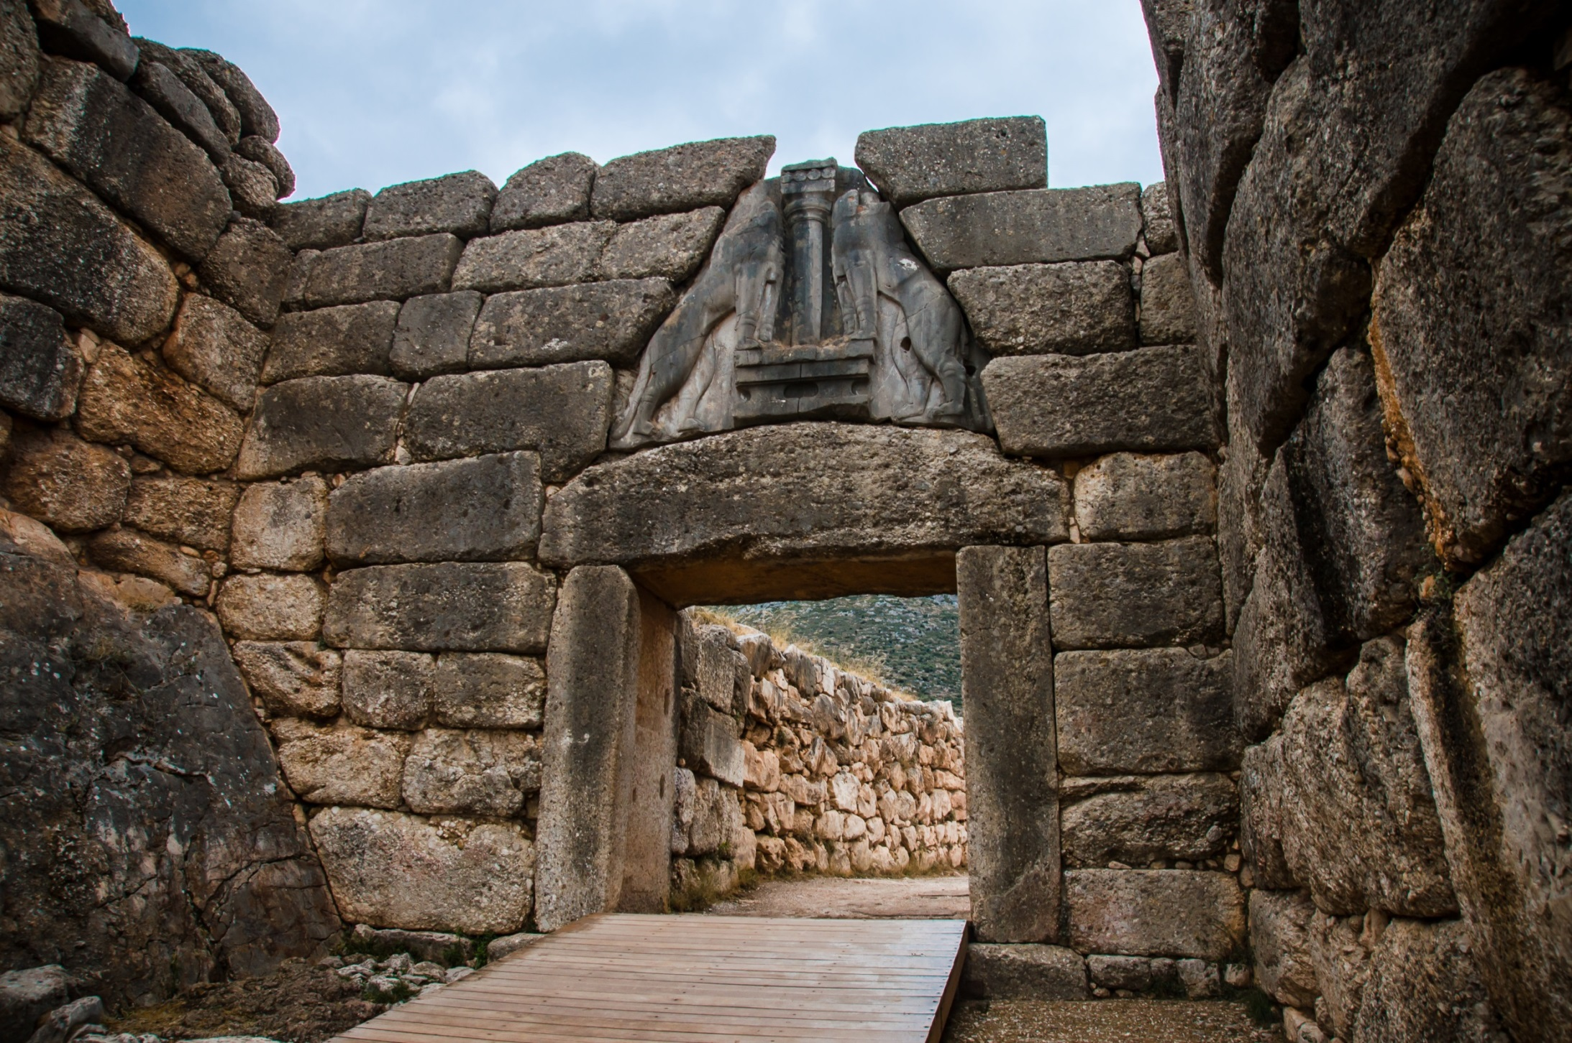
Gate of the Mycenae
https://depositphotos.com/96627788/stock-photo-lion-gate-in-mycenae-greece.html
https://depositphotos.com/96627788/stock-photo-lion-gate-in-mycenae-greece.html

Slide 27
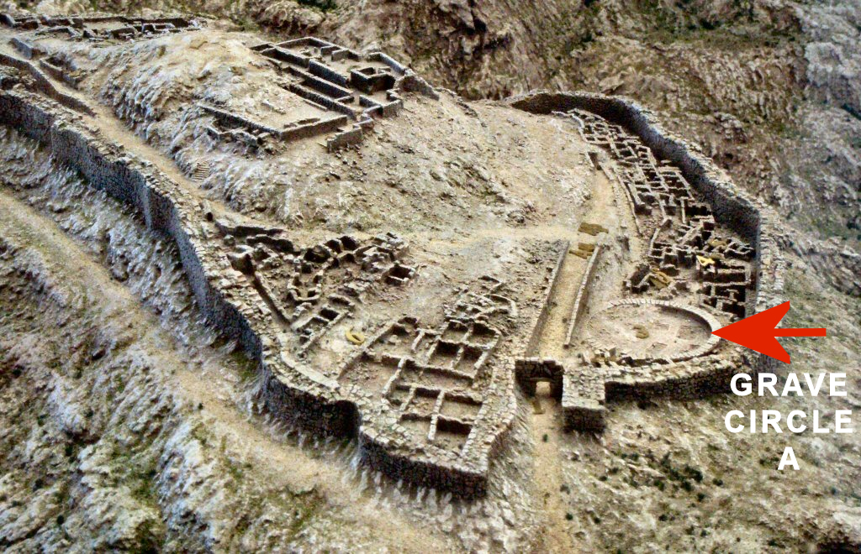
https://en.wikipedia.org/wiki/Grave_Circle_A,_Mycenae

Slide 28
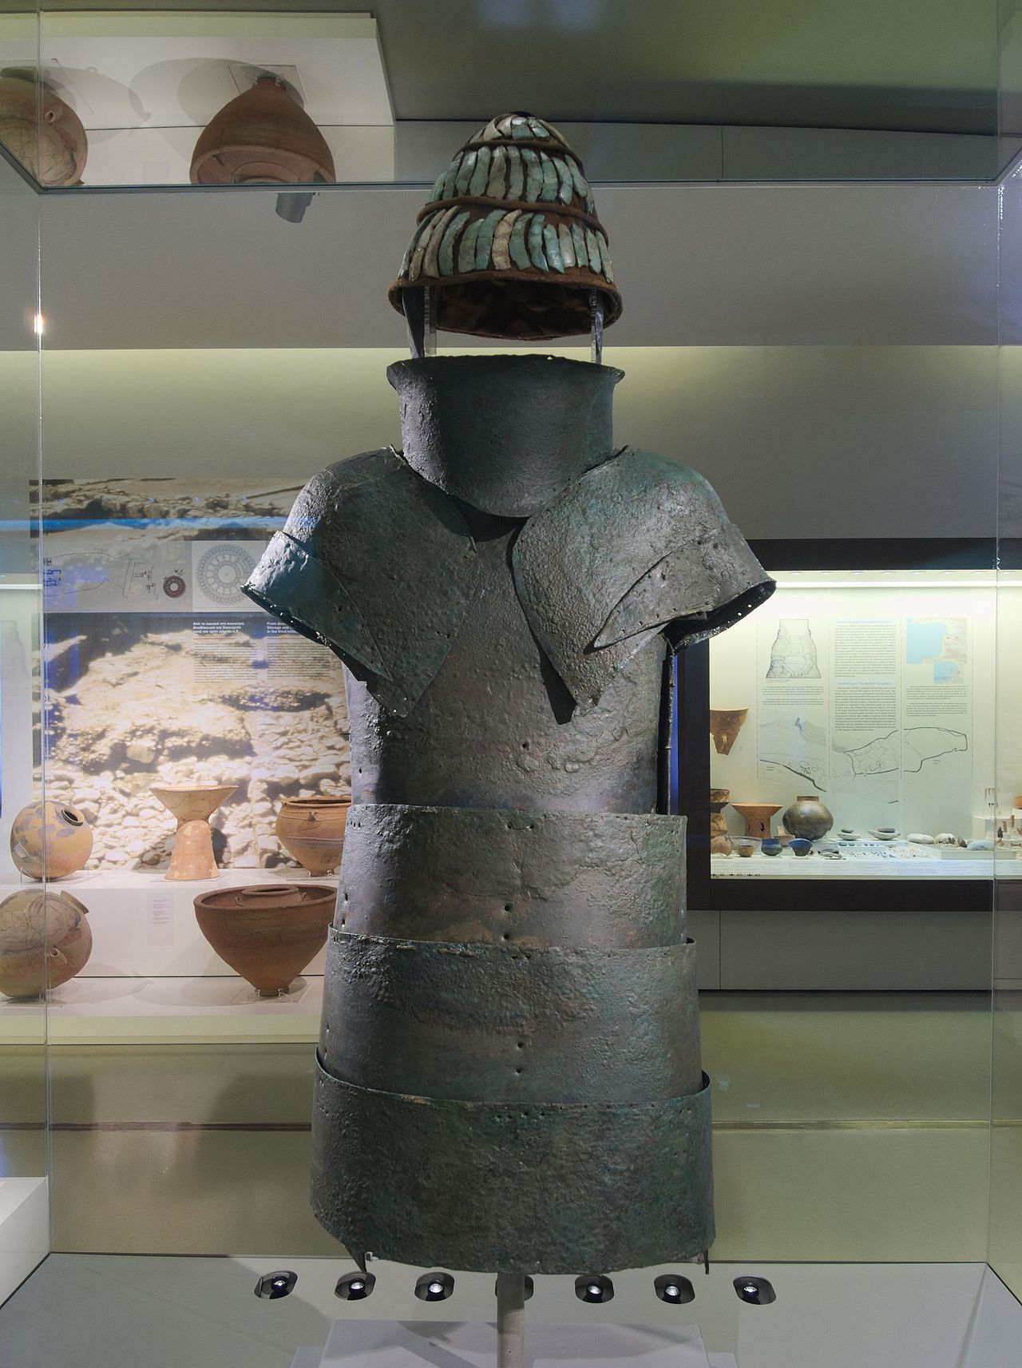
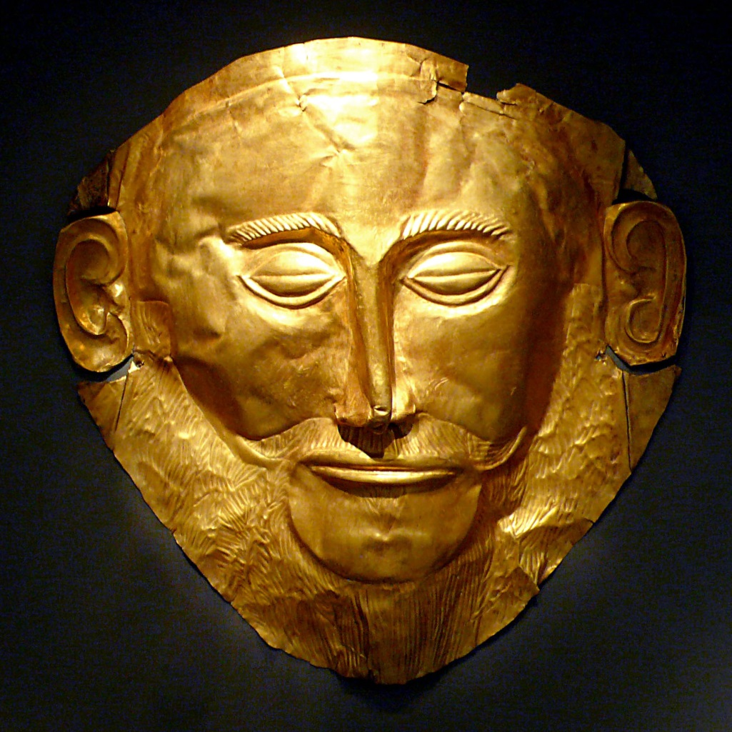
Full-body bronze armor and mask of the death
https://en.wikipedia.org/wiki/Mycenaean_Greece

Slide 29
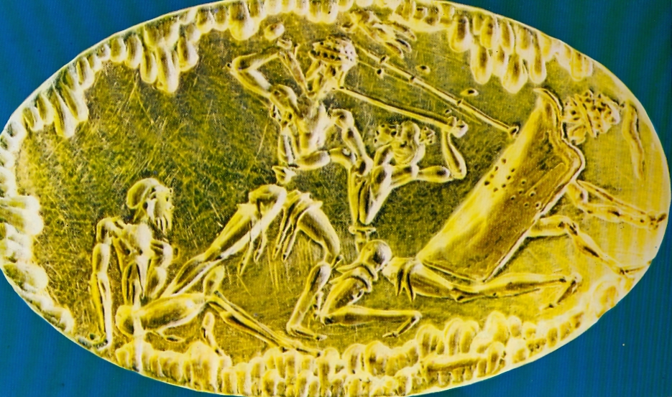
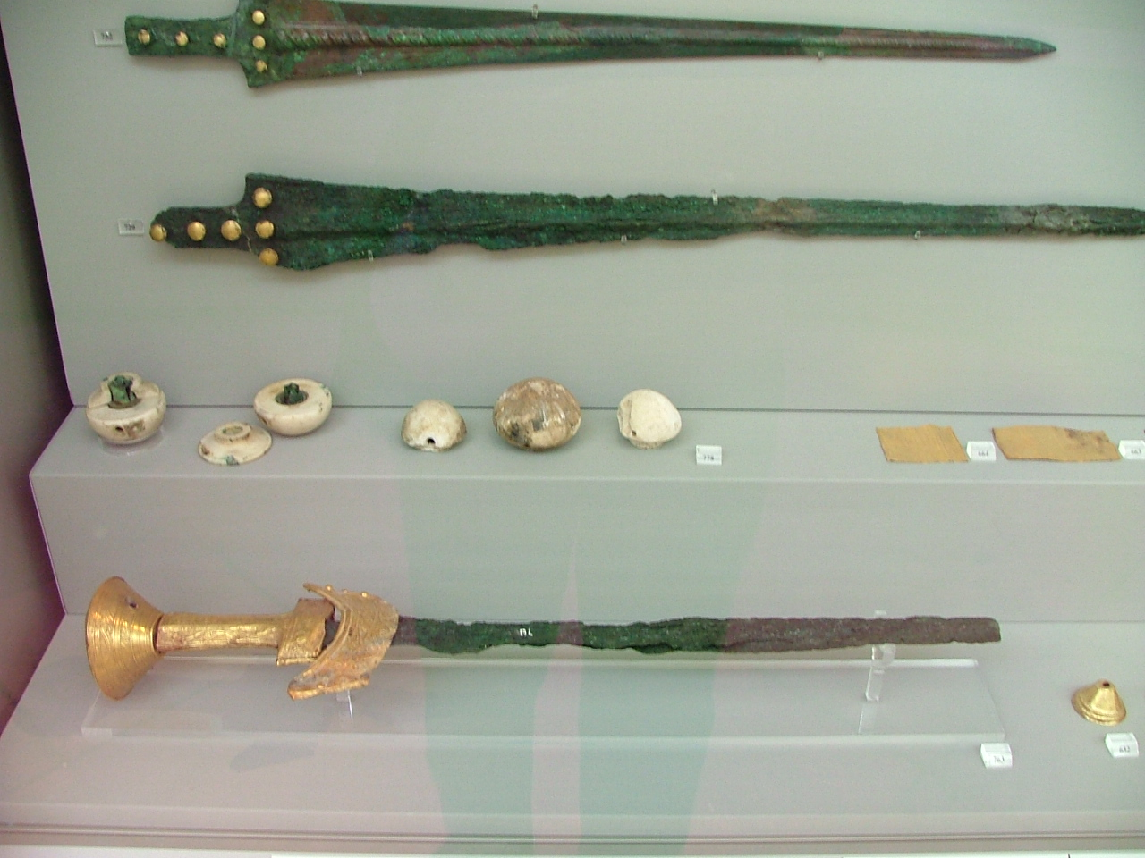
https://en.wikipedia.org/wiki/Mycenaean_Greece

Slide 30
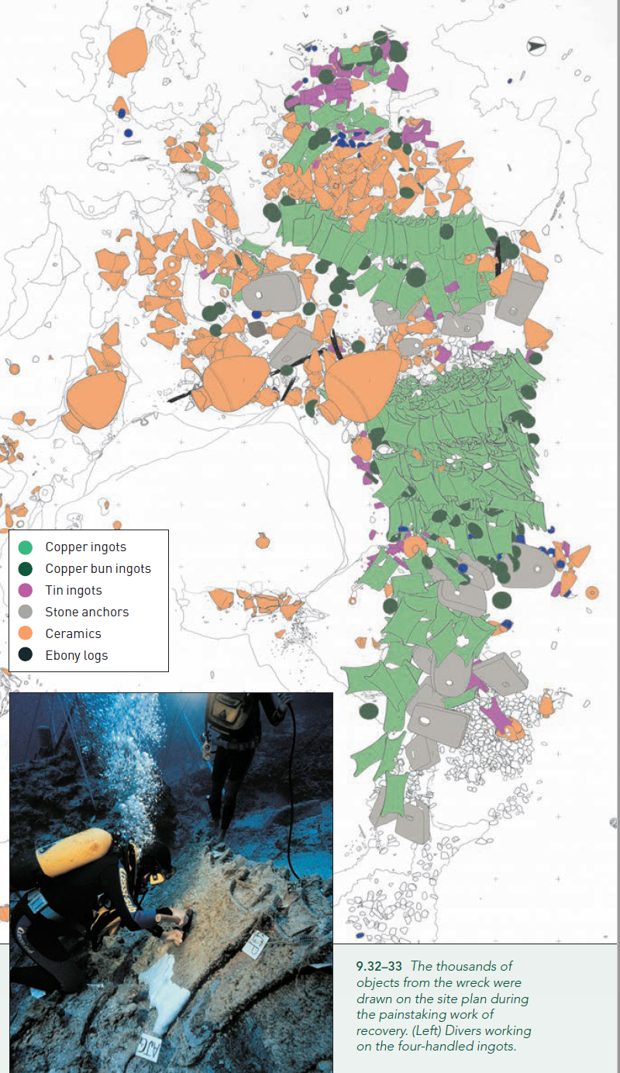
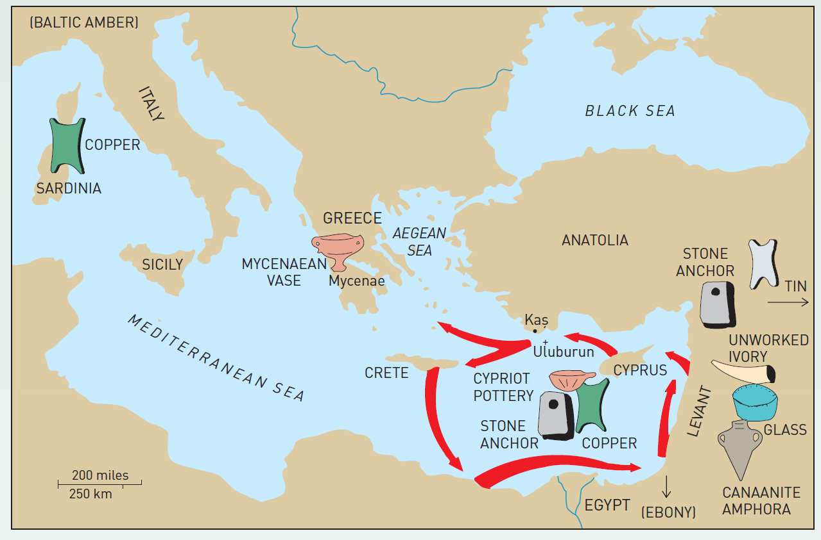
Evidence of active trading networks in the Aegean
Renfrew, C. and Bahn, P. (2020). Archaeology: theories, methods and practice. Thames and Hudson, London.

Slide 31
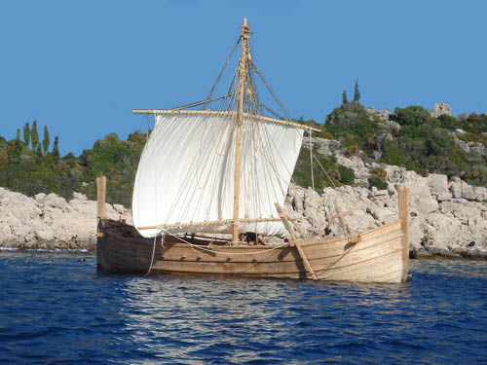
Reconstructed Mycenaean boat
https://commons.wikimedia.org/wiki/File:Megiste-Bronze_Reconstruction_of_a_Mycenaean_ship

Slide 32
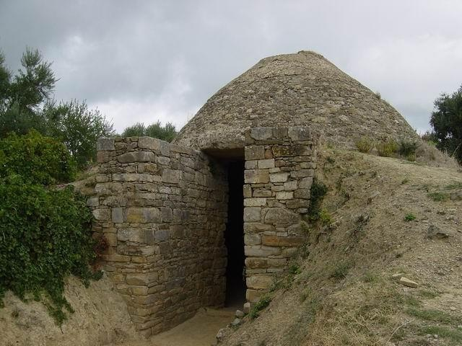
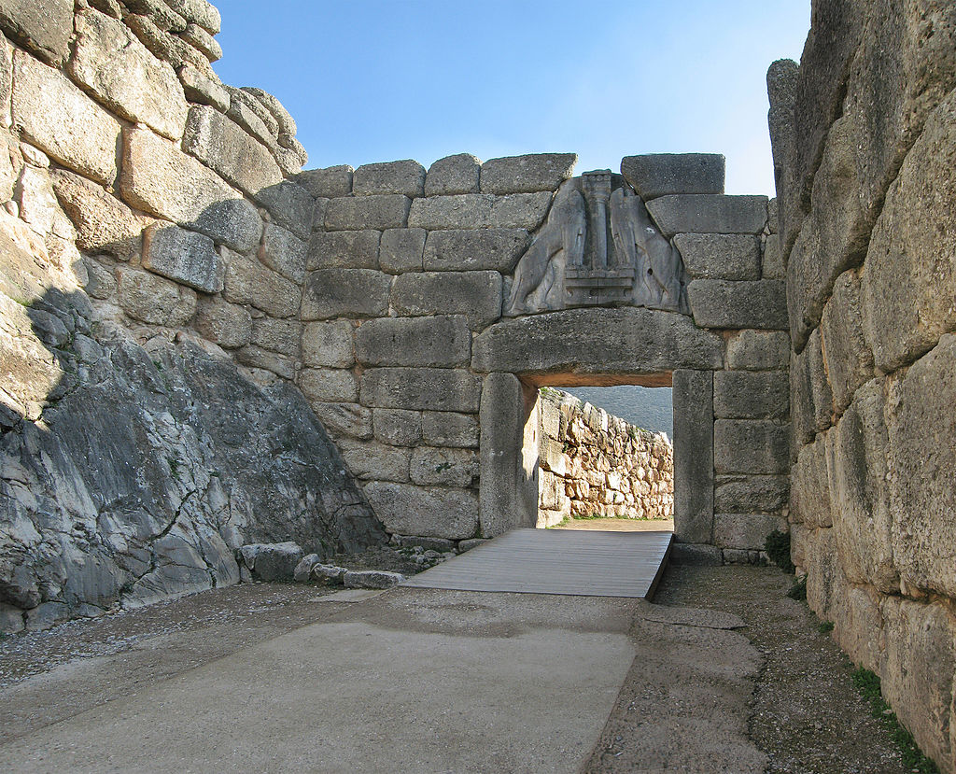
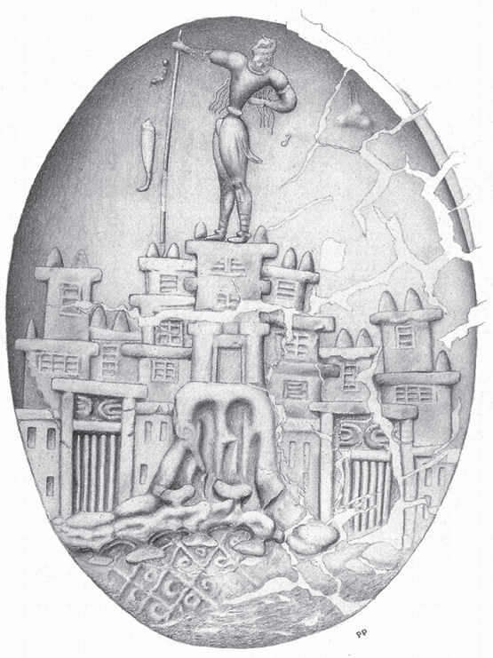
Tomb in Messenia
Several small polities are present
Status and wealth displayed in burials
Trade flourished between Mycenaean settlements and Crete, and the Near East
Some cultural influence by Minoan culture
Seal from Khania
https://en.wikipedia.org/wiki/Mycenaean_Greece
Mycenae shaft graves

Slide 33
References
Chazan, M. (2021). World prehistory and archaeology: pathways through time. Routledge, New York.
Crumley, C. (1995). Heterarchy and the analysis of complex societies. Archaeological Papers of the American Anthropological Association, 18: 1-5.
Pappa, M. and Besios, M. (1999). The Neolithic settlement at Makriyalos, northern Greece: preliminary report on the 1993-1995 excavations. Journal of Field Archaeology, 26: 177-95.
Renfrew, C. (1986). Introduction: peer polity interaction and sociopolitical change. In Peer polity interaction and socio-political change, edited by C.Renfrew and J.Cherry, pp. 1-18. Cambridge University Press, Cambridge.
Renfrew, C. and Bahn, P. (2020). Archaeology: theories, methods and practice. Thames and Hudson, London.
Stella, S. (2008). A social archaeology of households in Neolithic Greece: an anthropological approach. Cambridge University Press, Cambridge.

