Slide 1
Great Civilizations of the Ancient World
Complex societies in early China

Slide 2
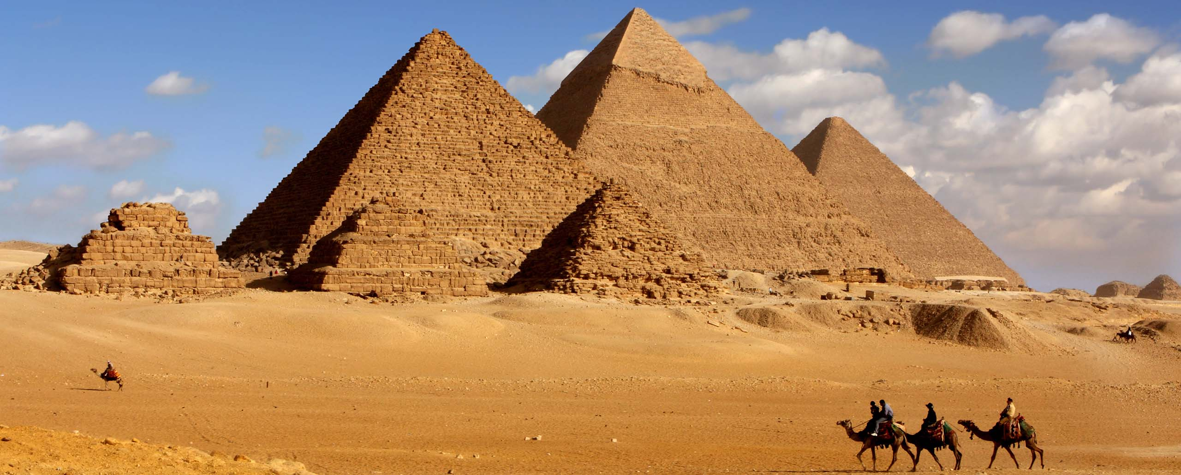
Pyramids at Giza
https://www.cazloyd.com/en/insiders-guide-egypts-pyramids-giza

Slide 3
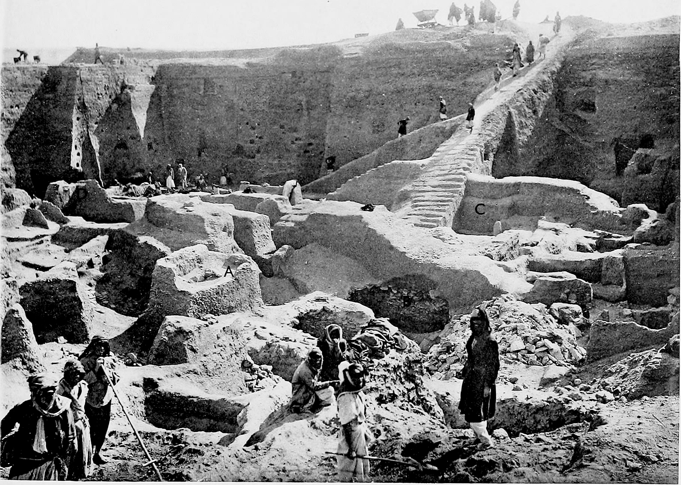
The Royal cemetery at Ur
https://en.wikipedia.org/wiki/Royal_Cemetery_at_Ur

Slide 4
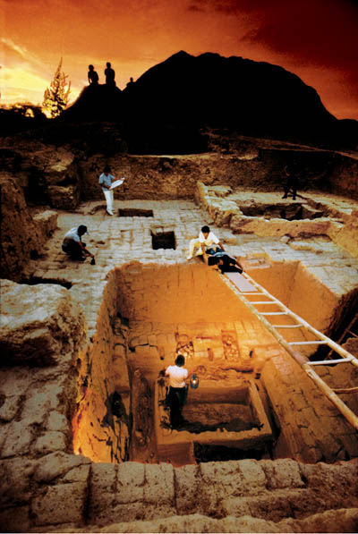
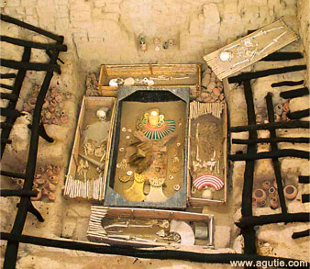
tomb of a Moche ruler found at Sipan
man in his 40’s, hammered gold mask, textile shroud, copper straps securing the lid of the
burial chamber,
sacrificial victims (men, women, children)
https://www.peruforless.com/blog/moche-civilization
diverse Andean metallurgy:
gold, silver, copper—often used together

Slide 5
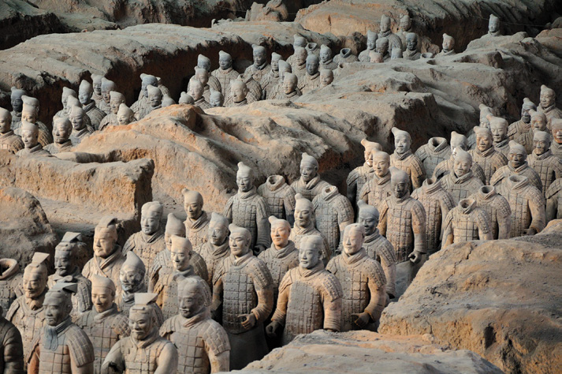
The Terracotta army at Xian
Chazan, M. (2021). World prehistory and archaeology: pathways through time. Routledge, New York.

Slide 6
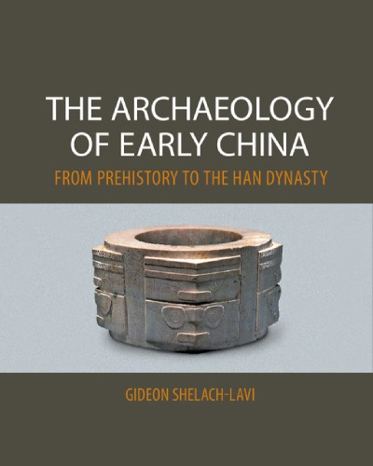
Most recent book that summarizes the prehistory of China
New approaches in Chinese archaeology
https://www.bookdepository.com/Archaeology-Early-China-Gideon-Shelach-Lavi/9780521145251

Slide 7
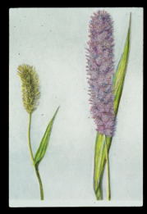
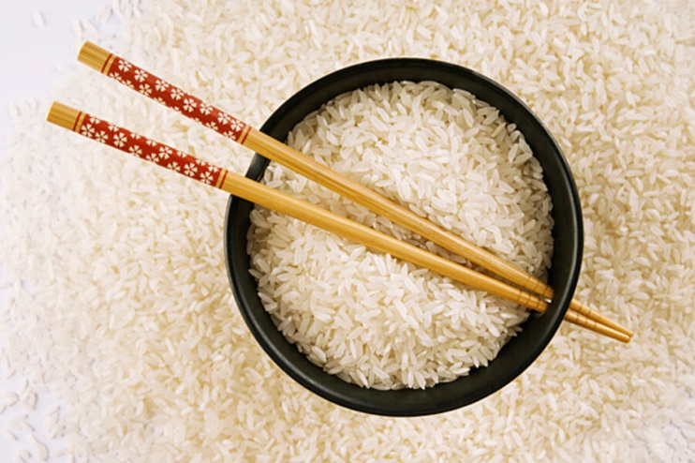
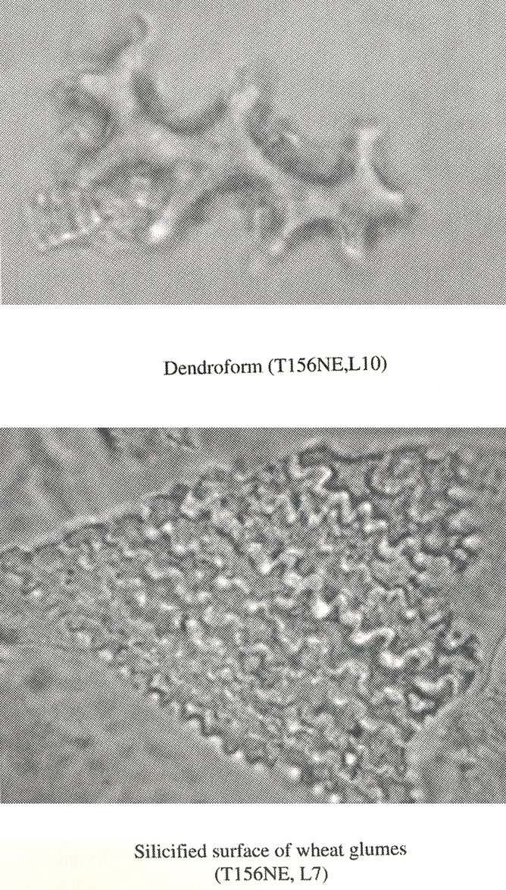
Archaeological evidence for domestication: plants (macrobotanical remains and phytoliths)
https://www.csmonitor.com/Science/2010/0601/Ancient-Chinese-secret-Yes.-Masons-used-sticky-rice-as-mortar
https://www.frontiersin.org/articles/10.3389/fpls.2018.00719
Main evidence for domestication
https://www.frontiersin.org/articles/10.3389/fpls.2018.00719

Slide 8
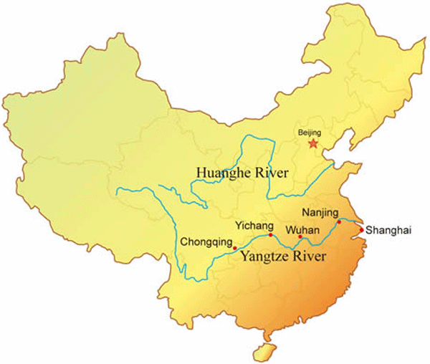
https://www.pinterest.com/pin/yangtze-river-map--317644579953257593

Slide 9
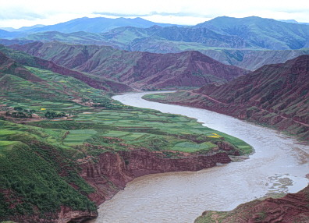
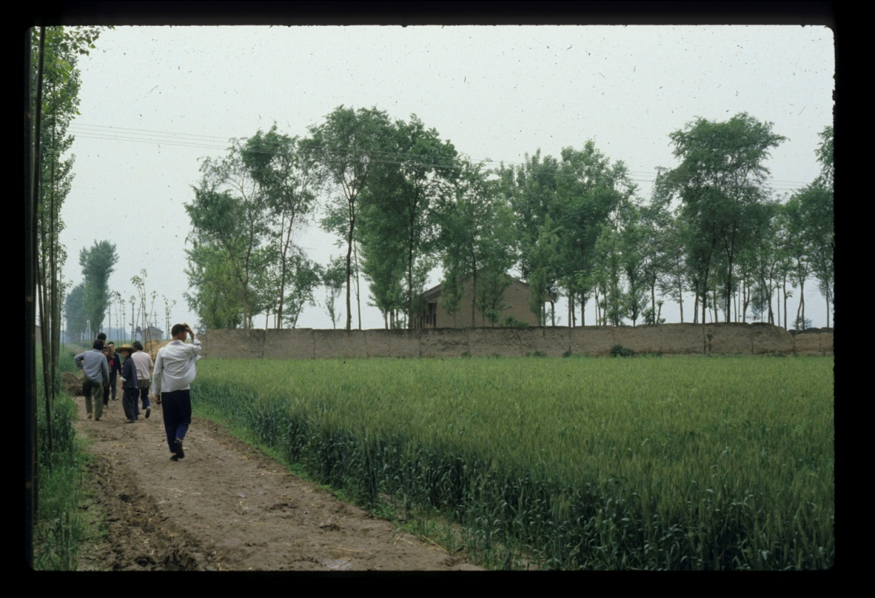
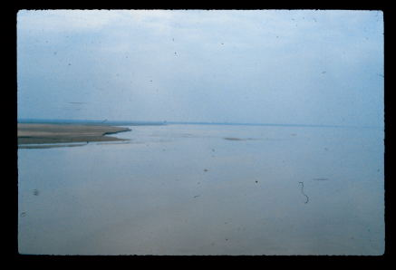
northern China: the origins of millet agriculture
Other domesticates in the north included pigs and possibly, chickens
Courtesy of Prof. Anne Underhill, Yale University

Slide 10
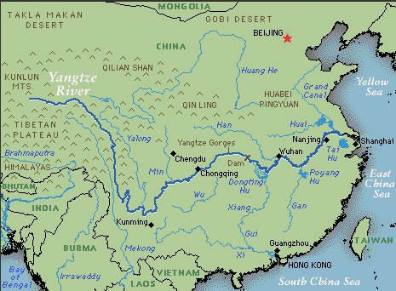
The Yangtze River Valley
Courtesy of Prof. Anne Underhill, Yale University

Slide 11
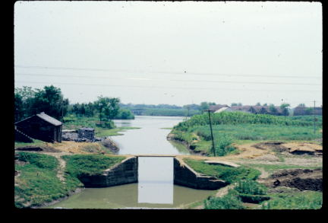
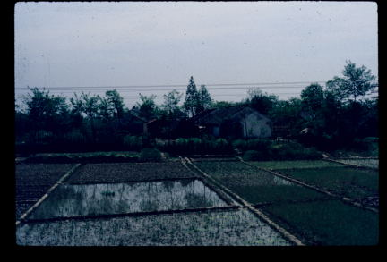
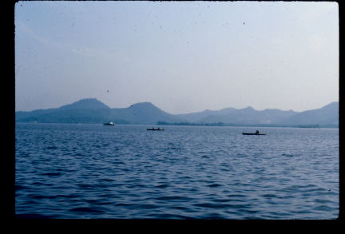
Lower Yangzi river valley
Courtesy of Prof. Anne Underhill, Yale University

Slide 12
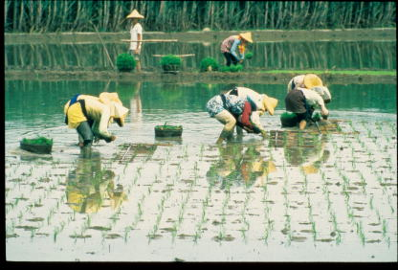
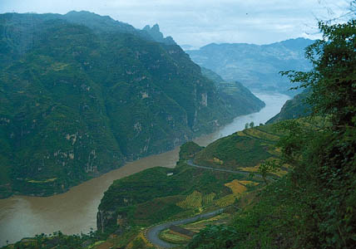
the origins of rice agriculture
in the middle Yangzi river valley
much research in areas of limestone mountains and caves
Oryza sativa japonica
and
Oryza sativa indica
Courtesy of Prof. Anne Underhill, Yale University

Slide 13
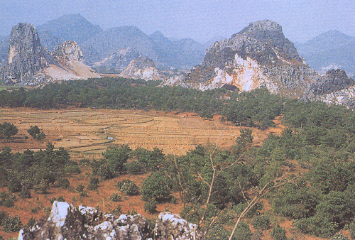
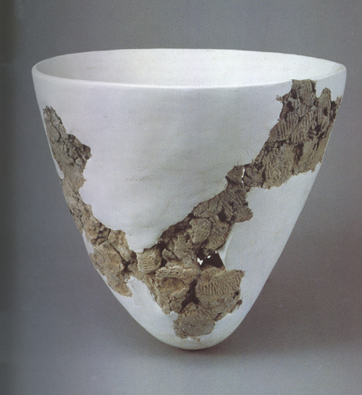
Cave sites such as Yuchanyan, Hunan; central Yangzi river valley (estimated c. 10,000 BC)
https://commons.wikimedia.org/wiki/File:Yuchanyan_Cave_Pottery.jpg
Diaotonghuan in Jiangxi province, c. 11,2000 B.C. and 8000-6000 B.C.; early pottery, sedentism,
cultivation of plants and beginnings of domestication; long process
debates about dating
now AMS results show Xianrendong, Jiangxi, pottery
c. 20,000 BP/18,000 BC

Slide 14
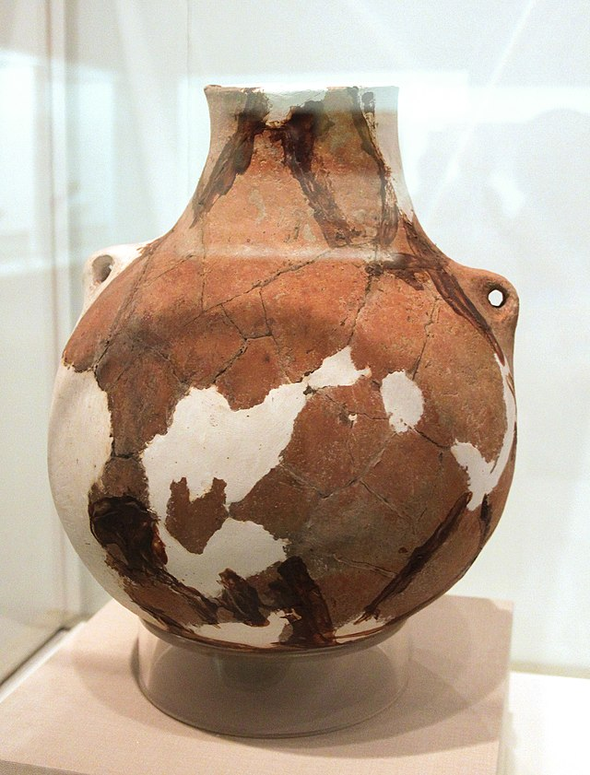
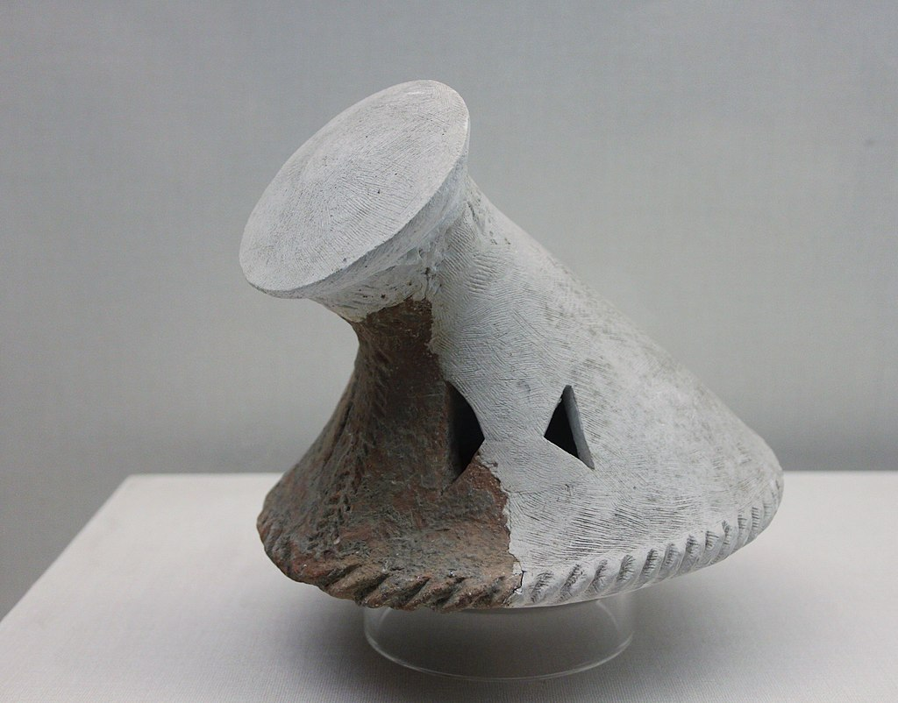
Early farmers
Pengtoushan (8000-6000 BC) and Bashidang (starting 7000 BC)
https://www.wikiwand.com/en/Pengtoushan_culture
Wide range of food remains, including bones of animal bones

Slide 15
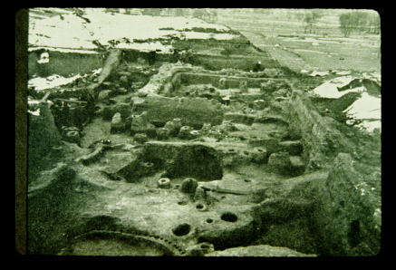
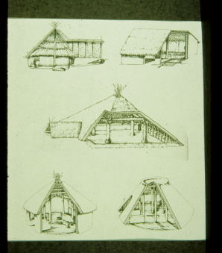
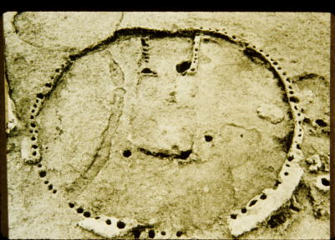
Middle Neolithic Banpo site, Yangshao culture, Shaanxi province; about 4500-3000 B.C.; substantial villages occupied for generations, many cultural layers; millet farmers
Farming communities in the north
Courtesy of Prof. Anne Underhill, Yale University

Slide 16
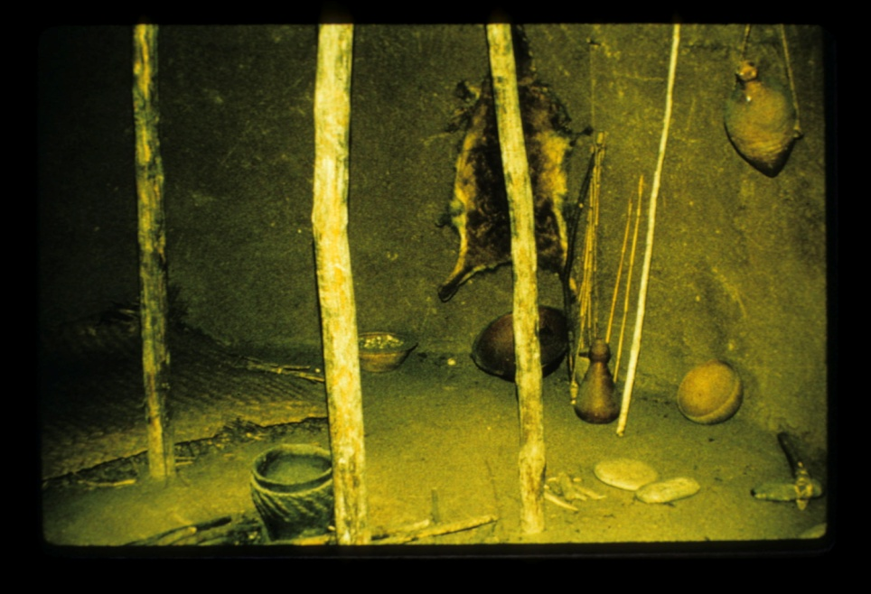
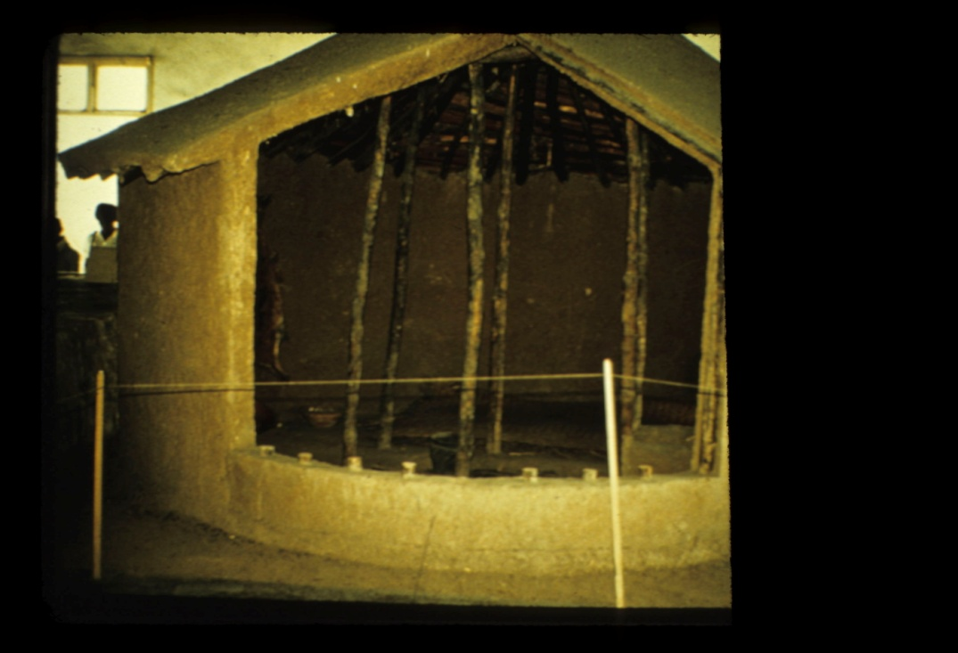
Banpo Museum reconstructed houses
Courtesy of Prof. Anne Underhill, Yale University

Slide 17
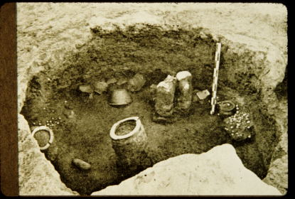
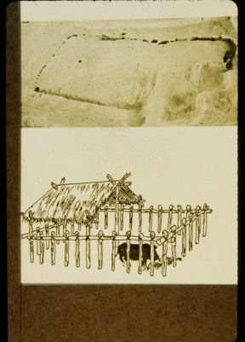
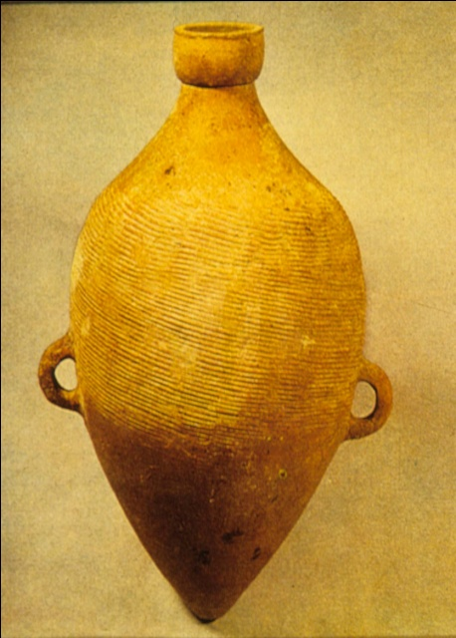
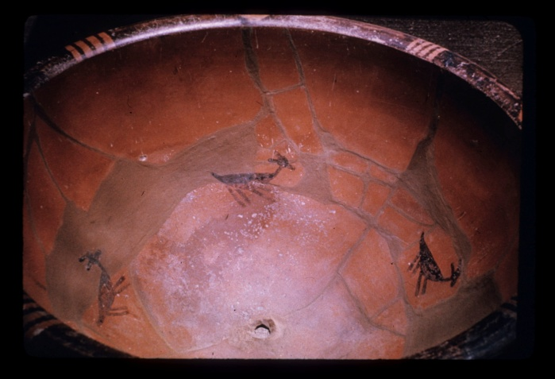
Banpo site, Yangshao culture
Courtesy of Prof. Anne Underhill, Yale University

Slide 18
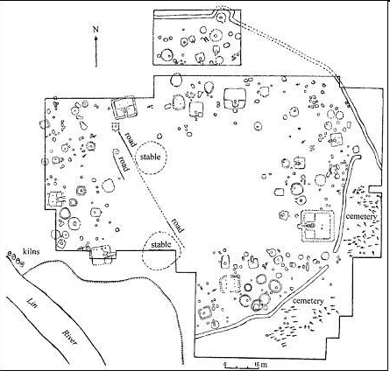
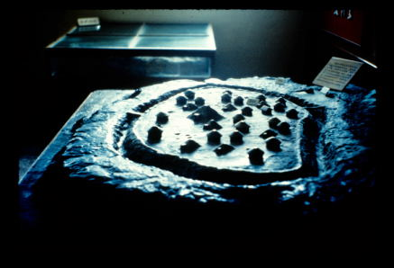
Jiangzhai village:
huge area excavated
1 large structure,
communal house,
surrounding ditch:
concerns with defense?
Courtesy of Prof. Anne Underhill, Yale University

Slide 19
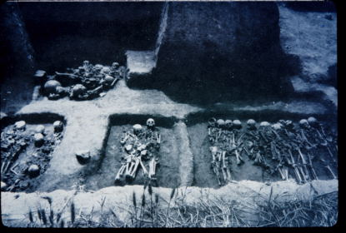
mostly multiple burials from Yangshao period
few differences in quality or quantity of grave goods;
a minority of relatively simple single graves
Courtesy of Prof. Anne Underhill, Yale University

Slide 20
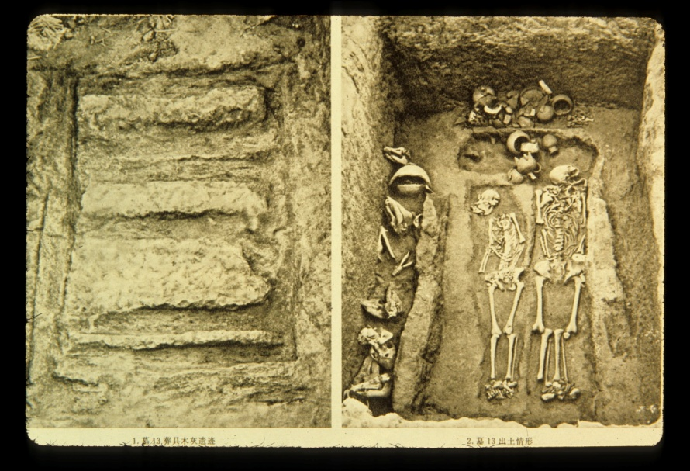
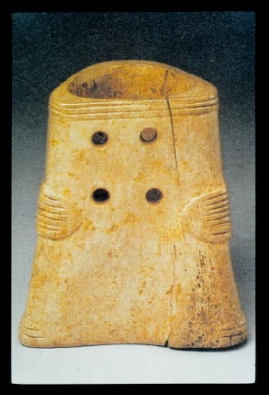
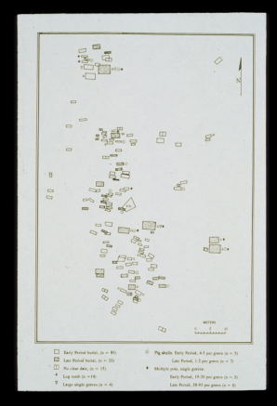
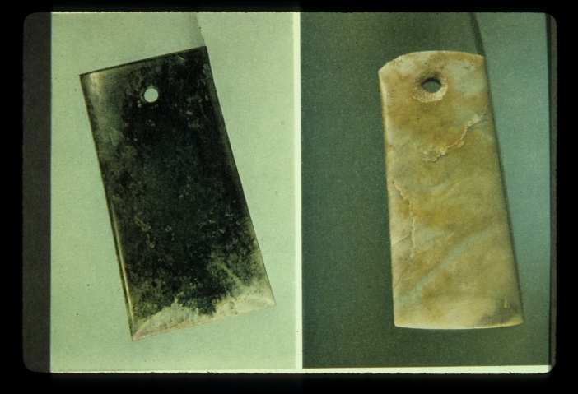
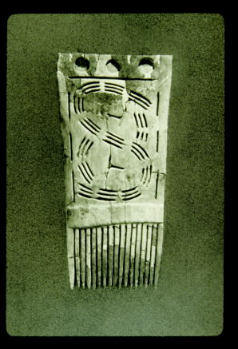
a minority of late Dawenkou burials c. 3000 B.C. especially rich, show differences in social ranking; prestigious goods (some show evidence of trade and craft specialization)
Courtesy of Prof. Anne Underhill, Yale University

Slide 21
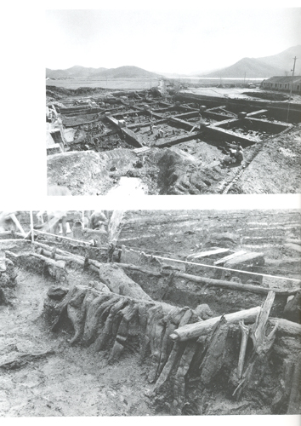
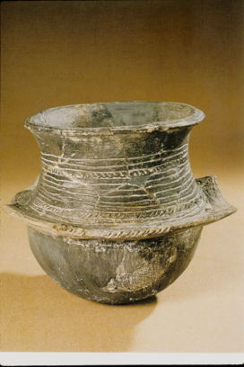
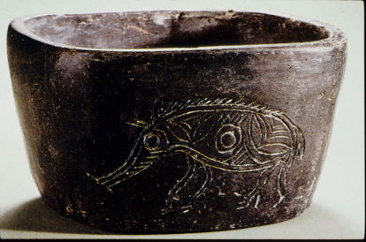
Southern China c. 6000-4000 B.C.
Hemudu site: waterlogged; lower Yangzi river valley, near modern Hangzhou city
Courtesy of Prof. Anne Underhill, Yale University

Slide 22
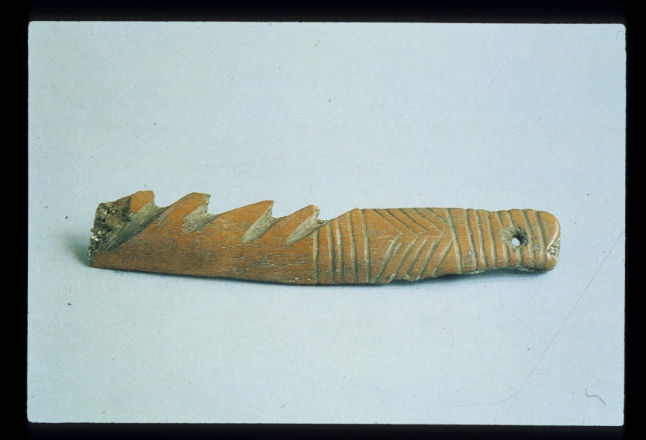
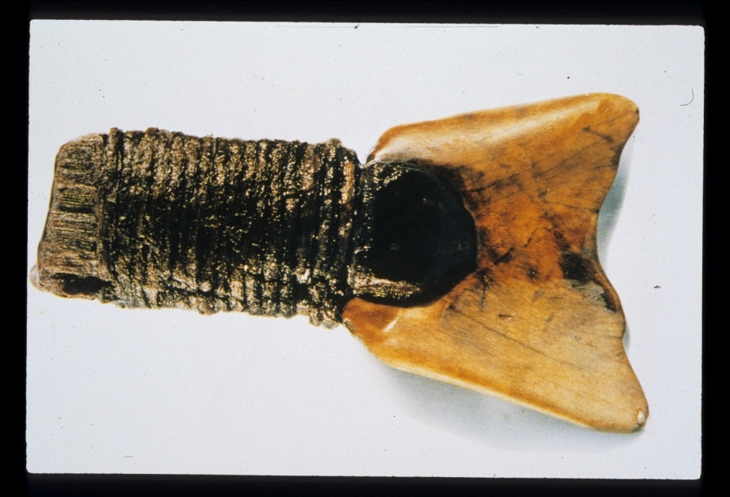
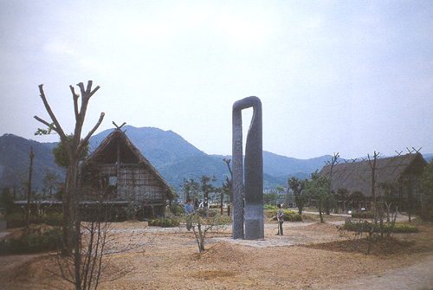
Hemudu site: rice farming tools
Courtesy of Prof. Anne Underhill, Yale University

Slide 23
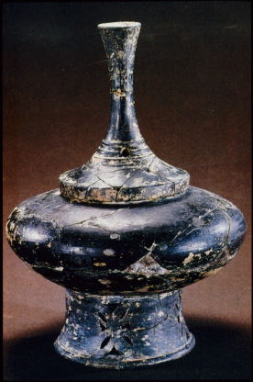
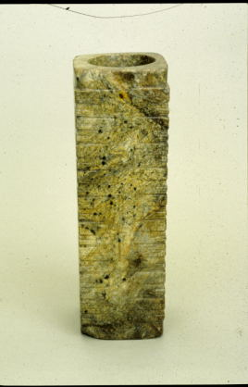
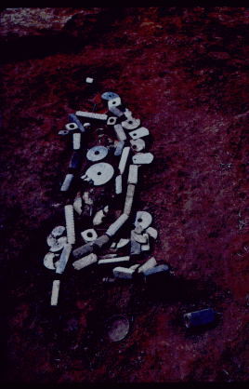
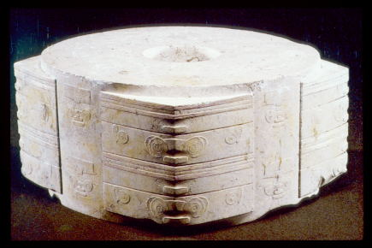
Liangzhu culture,
lower Yangzi river valley
c. 3500-2600 B.C.
marked differentiation among
burials, incredible craft goods showing
craft specialization
Courtesy of Prof. Anne Underhill, Yale University

Slide 24


the Longshan period (c. 2600-1900 BC): larger spheres of interaction, shared cultural traits such as pottery styles; settlement hierarchies identified from regional surveys, and large settlements surrounded by walls of rammed earth more common in northern China
Courtesy of Prof. Anne Underhill, Yale University

Slide 25



rammed earth walls in Chinese sites
Courtesy of Prof. Anne Underhill, Yale University

Slide 26


Longshan period (c. 2600-1900 BC) walled sites: Pingliangtai (planning, including roads); concern with defense
Courtesy of Prof. Anne Underhill, Yale University

Slide 27




Increased military power? Expectations from later historical texts, and archaeological evidence for warfare at Longshan period sites
Courtesy of Prof. Anne Underhill, Yale University

Slide 28
debates in interpretation of large settlement sites with rammed earth walls
---cities? many seem to have large populations in comparison to other contemporary sites
---residences for elites identified, possible rulers
---functions for their regions? Possible 1) economic functions (craft production and exchange—prestige goods (jades, fine pottery) and utilitarian goods),
2) military functions, 3) ideological—ritual centers
---are they city-states?

Slide 29


Was Taosi an early state? Was religious authority important?
Courtesy of Prof. Anne Underhill, Yale University

Slide 30






Taosi site: prestige goods in largest (male) graves (minority of 1000), social classes evident from tombs
Courtesy of Prof. Anne Underhill, Yale University

Slide 31






late prehistoric, Longshan period ca. 2600-1900 BC in northern China
What kinds of complex societies developed in Shandong?
Were Longshan period polities states?
Anne Underhill
Courtesy of Prof. Anne Underhill, Yale University

Slide 32

Erlitou site (starting 1800 BC): huge (300 ha), 34 building foundations in Palace Zone alone
Courtesy of Prof. Anne Underhill, Yale University

Slide 33

Map of the ‘palatial’ area at Erlitou
https://www.researchgate.net/figure/Palatial-complex-and-prestige-goods-production-area-at-Erlitou-Phases-II-IV_fig2_273293121

Slide 34


piece-mold casting method characteristic of ancient China
Courtesy of Prof. Anne Underhill, Yale University

Slide 35

newly discovered Phase II Burial M3 (male, 30-35) most intact burial in immediate palace area, turquoise-jade “dragon” and bronze bell
Courtesy of Prof. Anne Underhill, Yale University

Slide 36
References
Chazan, M. (2021). World prehistory and archaeology: pathways through time. Routledge, New York.
Londo et al. (2006). Phylogeography of Asian wild rice, Oryza rufipogen, reveals multiple independent domestications of cultivated rice, Oryza sativa. Proceedings of the National Academy of Sciences, 103: 9578-83.
Smith, B. (1995). The emergence of agriculture. Scientific American Library, New York.
Underhill, A. (2002). Craft production and social change in Northern China. Kluwer Academic Publisher, Norwell.
Wu et al. (2012). Early pottery at 20,000 years ago in Xianrendong Cave, China. Science, 336: 1696-700.

