Slide 1
Introduction to Database Technologies
Introduction Data Manipulation Language
Lecture 10
Dr Victoria Mukami

Slide 2
Overview
Introduction to data manipulation language (DML).
We look at two main DML commands:
INSERT command - put in data to the tables we created
UPDATE -update the details within the table

Slide 3
Learning Outcomes
Understand the INSERT and UPDATE data manipulation commands.
Insert data into various tables
Update table row details

Slide 4
RECAP
Created a database
Add tables to the database
Add fields to the various tables

Slide 5
Cont.
Input data into the tables we created.
Update some of the data inserted.
After a database administrator has finished creating the database and tables
Data needs to be inserted.
Lengthy process as all the data must be in the correct format

Slide 6
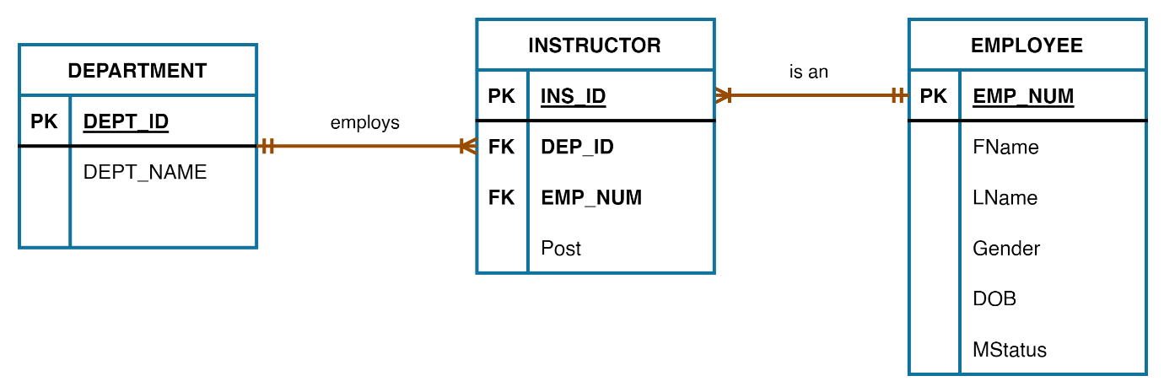
Introduction
The INSERT and UPDATE commands are data manipulation commands
Allow a user to input data into existing tables

Slide 7
Table Details
Employee Table
Emp_Num | FName | LName | Gender | DOB | MStatus
EMP001 | Agnes | Njue | Female | 12/09/1997 | Single
EMP002 | Will | Omondi | Male | 24/08/1989 | Married
EMP003 | Carol | Njagi | Female | 09/01/1993 | Single
EMP004 | Mary | Munene | Female | 06/08/1998 | Married
EMP005 | Cathy | Resley | Male | 16/04/1989 | Married
EMP006 | Abdul | Muita | Male | 30/07/1988 | Single
EMP007 | Steve | Kimuri | Male | 02/03/1999 | Married
EMP008 | Ruth | Kimuli | Female | 07/04/1996 | Single

Slide 8
Table Details
Instructor Table
ID | Emp_Num | Dep_ID | Post
1 | EMP001 | CIT | Lecturer
2 | EMP002 | MTH | Chairman
3 | EMP003 | LAW | Dean
4 | EMP004 | CIT | Lecturer
5 | EMP005 | BUS | Lecturer
6 | EMP006 | EDU | Senior Lecturer
7 | EMP007 | MTH | Lecturer
8 | EMP008 | PSY | Senior Lecturer

Slide 9
Table Details
Department Table
Dep_ID | Dep_Name | School
CIT | Computing and Information Technology | SPAS
MTH | Statistics and Mathematics | SPAS
BUS | Business | Business
EDU | Education | Education
PSY | Psychology | Humanities
LAW | Law | Law

Slide 10
INSERT
Used to place values into a table.
Input the values of the three tables.
Log in to the MySQL client
Select the Bustani database.

Slide 11
INSERT
Begin with the Employee Table,
Department table
Instructor Table
Ensure that the relationships within the tables are sequential.
Instructor table picks records from the department and the employee tables.
Prudent to start with the initial tables.

Slide 12
INSERT
Syntax
INSERT INTO tablename
VALUES (‘data1’, ‘data2’, ‘data3’,.....);
Will enter data in each cell depending on how many cells exist in the table.
Cell - intersection between a column and a row.
Value records are all separated by a comma and surrounded by single quotes.

Slide 13
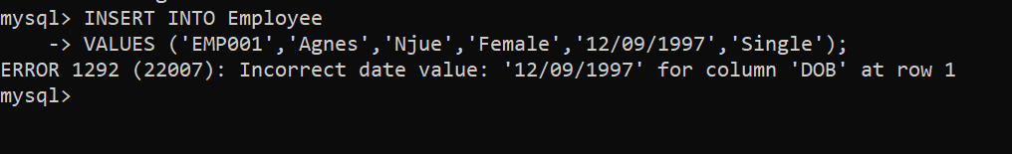
Employee Table
Employee table has 8 records.
First insert one of the records.
INSERT INTO Employee
VALUES ('EMP001','Agnes','Njue','Female','12/09/1997','Single’);

Slide 14
INSERT Error
Encounter an error.
Has to do with our date values
Not in the correct format.
MySQL the date data type is represented as YYYY-MM-DD.

Slide 15
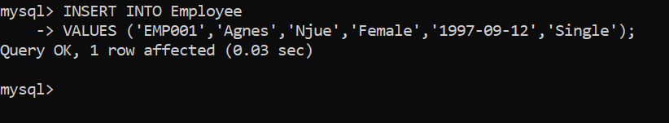
INSERT Corrected
INSERT INTO Employee
VALUES ('EMP001','Agnes','Njue','Female','1997-09-12','Single’);
Output

Slide 16
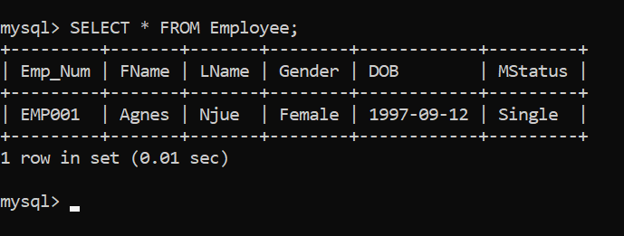
View Data
See the data within the table by using the SELECT statement.
Syntax
SELECT * FROM tablename;
Show contents of employee table
SELECT * FROM Employee;

Slide 17
INSERT All records
Insert several records at once is possible.
The records are all separated by brackets
INSERT INTO Employee
VALUES
('EMP003','Carol','Njagi','Female','1993-09-01','Single'),
('EMP004','Mary','Munene','Female','1998-08-06','Married'),
('EMP005','Cathy','Resley','Male','1989-04-16','Married'),
('EMP006','Abdul','Muita','Male','1988-07-30','Single'),
('EMP007','Steve','Kimuri','Male','1999-03-02','Married'),
('EMP008','Ruth','Kimuli','Female','1996-04-07','Single');

Slide 18
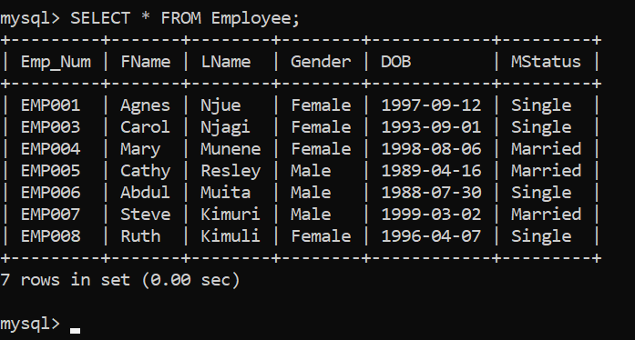
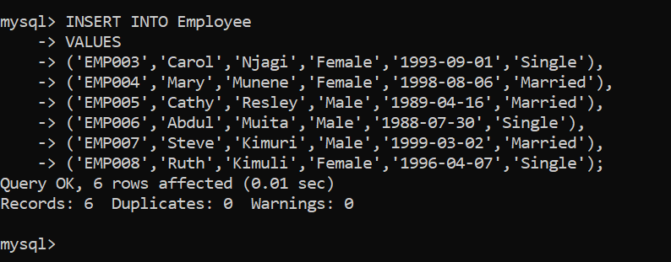
Output

Slide 19
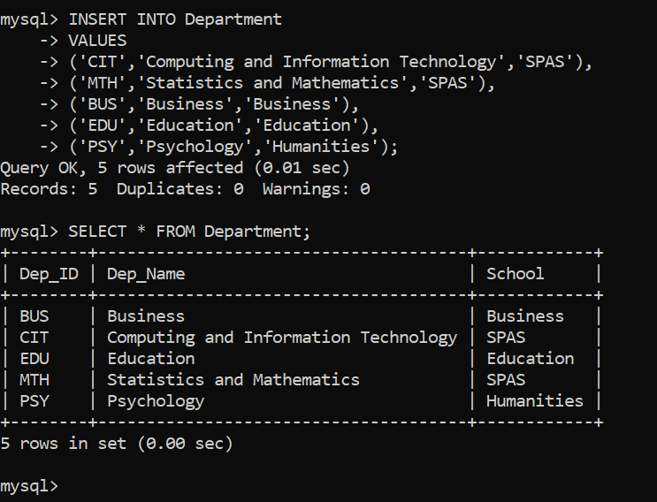
Department Table
Output

Slide 20
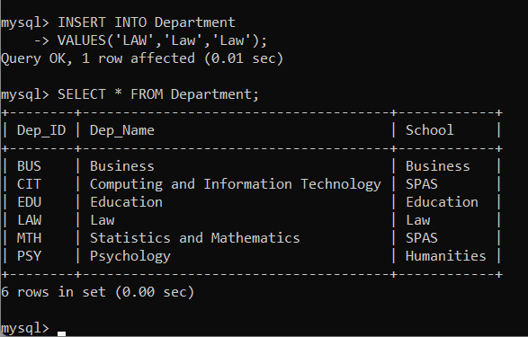
Omission
Missed adding the LAW department

Slide 21
Instructor Table
Before we can insert the values for the instructor table
Ins_ID is an incremental value.
Modify the column so that the numbers can be incrementally added.
Use the ALTER statement and add a constraint called AUTO_INCREMENT.
ALTER TABLE Instructor
MODIFY Ins_ID INT NOT NULL UNIQUE AUTO_INCREMENT;

Slide 22
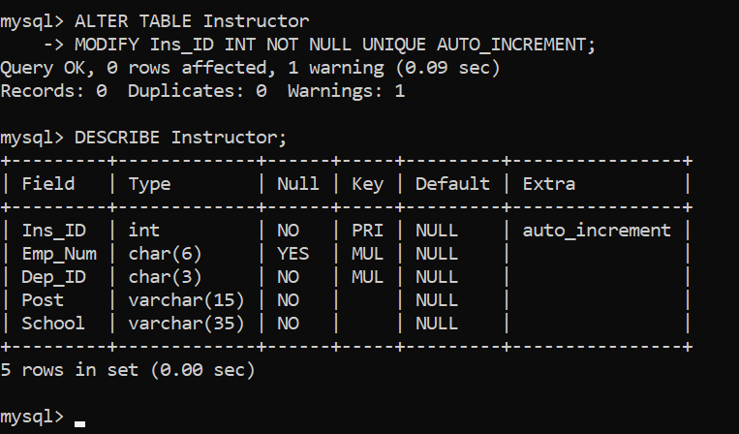
AUTO_INCREMENT
Output

Slide 23
Instructor Table
INSERT INTO Instructor(Emp_Num,Dep_ID,Post)
VALUES
('EMP001','CIT','Lecturer'),
('EMP002','MTH','Chairman'),
('EMP003','LAW','Dean'),
('EMP004','CIT','Lecturer'),
('EMP005','BUS','Lecturer'),
('EMP006','EDU','Senior Lecturer'),
('EMP007','MTH','Lecturer'),
('EMP008','PSY',’Senior Lecturer');

Slide 24
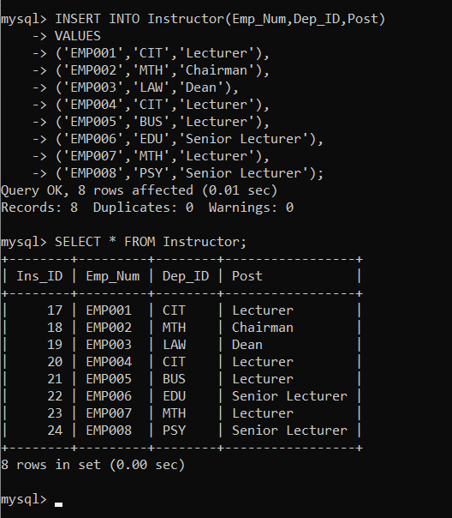
Instructor
First line of the code adds the column names.
Column names are added because the Ins_ID are incrementally being added.

Slide 25
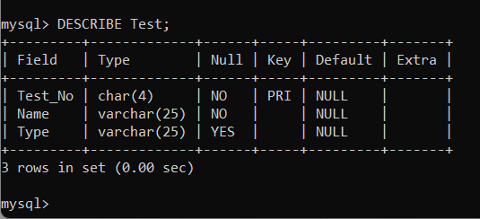
Null Values
Add values to one row that permits null values?
Assume that we create a table called Test
Fields: Test_No, Name, Type.
The Type column allows for null values as shown in the output below.

Slide 26
Null Values
Add three records with the third having a null record,
INSERT INTO Test
VALUES
('T001','Training Program 1','Monthly'),
('T002','Training Program 2','Weekly'),
('T003','Training Program 3',‘’);
Empty double quotes in the last statement would insert a blank record

Slide 27
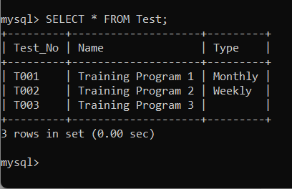
Null Values
Output

Slide 28
UPDATE
Used to modify data in a table
Syntax
UPDATE tablename
SET fieldname = datavalue, fieldname = datavalue, ...
WHERE conditon_to_be_met;

Slide 29
UPDATE
Can be used to add values to a specific field.
Assume that Bustani needs to start collecting Employee ID numbers.
Employee table does not have a field for collecting ID numbers.
Need to add the column for ID called ID_Numbers.
ALTER TABLE Employee
ADD ID_Num INT(8) NOT NULL;

Slide 30
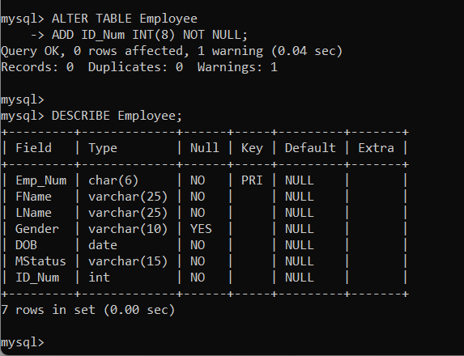
ALTER Table
Output

Slide 31
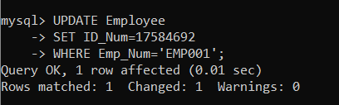
UPDATE Table
Add employee ID numbers to the added field
Single statement for each employee.
UPDATE Employee
SET ID_Num=17584692
WHERE Emp_Num='EMP001';

Slide 32
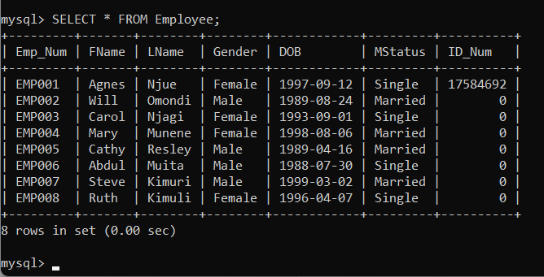
UPDATE
EMP001 has gotten a new ID number.
Same can be repeated until all the values are entered into the table.

Slide 33
UPDATE Multiple
Update multiple columns.
EMP003 got Married
Also updating their ID number
UPDATE Employee
SET ID_Num= 12346598, MStatus=”Married”
WHERE Emp_Num='EMP003';

Slide 34
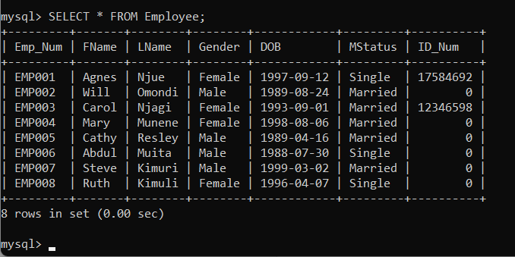
UPDATE Multiple
Output

Slide 35
Summary
Reviewed the INSERT and UPDATE statements.
INSERT statement was used to add values to a table.
INSERT statement to enter empty records.
UPDATE statement was used to add records
UPDATE used to make changes
to various data within columns.

Slide 36
Discussion Topic
This discussion topic is a continuation of lecture 9 during which we altered tables for the Lands Office. Add at least 10 records per table and ensure to consider where the main relationship exists so that you do not get integrity errors
Try and update some of the records within the tables. Look for guidance from your instructor.

Slide 37
References
[1] Database systems: design, implementation, and management, Coronel, C., & Morris, S, Cengage Learning, 2019.
[2] Database Systems: A Practical Approach to Design, Implementation, and Management, Connolly, T., & Begg, C., Pearson, 2015.
[3] Fundamentals of database systems, Elmasri, R., & Navathe, S. B., Pearson Education Limited, 2016.

Slide 38
Next lesson will cover
Advanced Data Manipulation Languages

