Slide 1
Lecture 4
Using Four Strands in Materials Design
Komila Tangirova,
UzSPIC

Slide 2
Outline:
Questions to consider when teaching English
Paul Nation
The four strands framework
Balancing the four strands
Applying the four strands to autonomous learning
Implications and Issues
An example for the Four strands based materials

Slide 3
Questions to consider
What do you take into consideration while designing your own materials?
How do you know whether the materials you have designed are effective or not?

Slide 4

Paul Nation
The principle of four strands is closely connected with the name of Paul Nation. Paul Nation is Emeritus Professor in Applied Linguistics at the School of Linguistics and Applied Language Studies (LALS) at Victoria University of Wellington, New Zealand. His specialist interests are the teaching and learning of vocabulary and language teaching methodology.
Paul Nation

Slide 5
The Four Strands
According to Nation a well balanced language course should consist of four equal strands.
They are:
The meaning focused input
The meaning focused output
The language focused learning
Fluency development

Slide 6

Meaning-focused input
Meaning-focused input strand involves learning through listening and reading.
This is largely incidental learning because the learners’ should be focused on comprehending what is being read or listened to.
Nation & Yamamoto (2011:167)

Slide 7
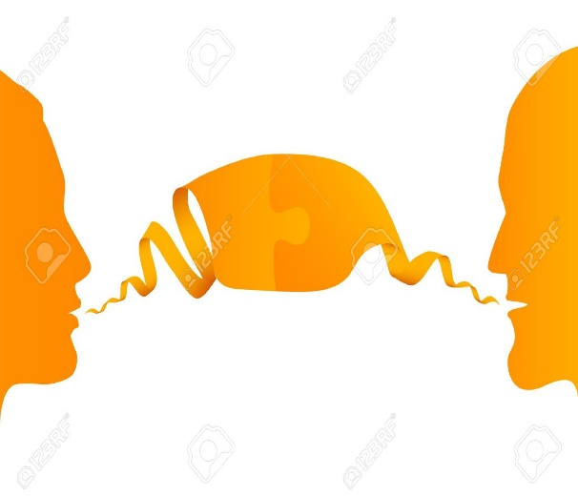

Meaning-focused output
Meaning focused output strand involves learning through speaking and writing and in common with the meaning-focused input strand involves incidental learning.
Nation & Yamamoto (2011:167)

Slide 8

Language Focused Learning
The language focused learning strand involves deliberate attention to language features, including spelling, pronunciation, vocabulary, multiword units, grammar, and discourse. It not only focuses on the form but also on the meaning and use and need not to be instruction but may be learning initiated by language learners.
Nation & Yamamoto(2011:167).

Slide 9

Fluency Development
Fluency development aims at helping the learners make the best use of what is already known. Fluency relates to being able to receive and produce language at a reasonable rate. It is also strongly message-focused. Thus, the four strands consist of three message focused or communicative strands, and one language.
Nation & Yamamoto (2011:167).

Slide 10
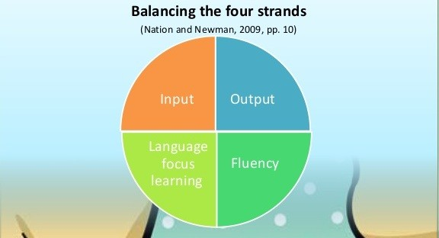
Balancing the Four Strands
A good language course should balance all these four strand and they should receive a roughly equal amount of time in a course. The role of a teacher is a planner and not a teacher according to the four strands principle. Nation and Newton (2009) and Nation (2009) show how the strands can be applied to the four skills of listening, speaking, reading, and writing.

Slide 11
APPLYING THE FOUR STRANDS TO AUTONOMOUS LEARNING
The four strands principle can be useful basis for answering questions, including:
1. How can I teach vocabulary? (We could replace vocabulary in that question with pronunciation, grammar, listening, speaking, reading, or writing). The question is better phrased as “How can I help the learning of vocabulary?”
2. What should a well balanced listening course contain? (We could replace listening in that question with speaking, reading. writing, extensive reading, vocabulary, grammar, pronunciation, or spelling)
3. How much extensive reading should we do? (We could replace extensive reading in that question with grammar teaching, spelling practice, work on vocabulary strategies, for example)
4. Is it worthwhile doing grammar translation? (We could replace grammar translation in that question with reading aloud, rote learning of vocabulary or dictogloss, for example)
5. How can I find out if I have a well balanced conversation course?

Slide 12
APPLYING THE FOUR STRANDS TO AUTONOMOUS LEARNING
Strands | Activities
Meaning focused Input | Reading graded readers containing some unfamiliar words Listening to a recorded story Listening to lessons on podcasts Exchanging emails with language exchange partners Browsing the Internet in the target language
Meaning focused Output | Keeping a diary and doing free writing Exchanging emails with language exchange partners
Language focused Learning | Learning from a language textbook Using a grammar reference book; Consulting a dictionary Consulting a phrase book Studying using a workbook Doing dictation of a recorded story or a movie scene; Memorizing words using word cards Using iPhone applications for pronunciation
Fluency Development | Speaking and writing using a phrase book Doing repetitive exercises in a workbook Reading an easy graded reader Listening to a recorded story Shadowing or repeating a recorded story or a movie scene
(Nation & Yamomoto, 2012)

Slide 13
Implications and Issues
It may seem that the role of the teacher is much more demanding in the strand of language focused learning than in the three remaining meaning-focused strands. However, the teacher has important things to do in the strands. There involve the following:
1. Making sure that the meaning focused strands truly exist in the course by ensuing that the input and output is at the right level for the student.
2. Setting up the important conditions of repetition, retrieval, creative use, and dual coding through the choice and design of the tasks (See Joe, Nation, and Newton, 1996; Nation,2008:41-56)
3. Making sure that the meaning focused strands are given appropriate amounts of time in the course.

Slide 14
Setting up conditions for the Four Strands
Repetition | To encourage repetition the teacher can design linked skill activities where the same content is dealt with in three different ways. for example. Read about it, talk about it. and write about. Tasks may also be repeated or involve reprocessing the same material as in pyramid activities (Jordan.1990) and the expert groups/family groups procedure.
Retrieval | Retrieval involves having to recall previously met language features. Tasks involving several steps, like linked skills tasks and procedures, can be designed so that the later steps are done with a reliance on retrieval. Information transfer activities (Palmer, 1982) can be designed so that retrieval is necessary.
Creative use | Creative use involves meeting or producing language features in ways in which they have not been met before. Graded readers typically involve the use of new vocabulary at a particular level reoccurring in varied contexts. Activities which include role play, retelling for a different purpose, reporting back, and linked skill activities involving time delay are likely toinclude creative use.
Dual coding | Dual coding (Paivio, I986) involves processing items both pictorially and linguistically. Information transfer activities are ideal for this. Drama activities. projects. and film and movie activities are also likely to result in dual coding.
Table 4. Examples of Setting up the Conditions for the Meaning Focused Strands. (Nation & Yamamoto, 2012:179)

Slide 15

An example of ESP Materials with the use of Four Strands Framework
A textbook B2 Ready has been designed on the basis of the four strands
It was produced by a group of Uzbekistan authors by the supervision of Dee Broughton- materials design specialist (U.S. Embassy, Department of States). It can be downloaded for free http://kitoblog.com/download-b2-ready/

Slide 16
References:
Joe, A., Nation, P., Newton, J. (1996). Vocabulary learning and speaking activities. English Teaching
Jordan, R.R. (1990). Pyramid discussions. ELT Journal, 44(1), 46-54.
Nation, I. S. P. (2007). The four stands. Innovation in Language Learning and Teaching, 1(1), 1-12
Nation, I. S. P. (2008). Teaching vocabulary: Strategies and techniques. Boston, MA: Heinle Cengage Learning.
Nation, I. S. P. (2009). Teaching ESL/EFL reading and writing. New York: Routledge.
Nation, I. S. P., and Newton, J. (2009). Teaching ESL/EFL listening and speaking. New York: Routledge.
Nation, I. S. P. , & Yamamoto, A. (2011). Applying the four strands to language learning. International Journal of Innovation in English Language Teaching and Research, 1 (2).
Paivio, A. (1986). Mental representations: A dual coding approach. Oxford: Oxford University Press.
Palmer, D. M. (1982). Information transfer for listening and reading. English Teaching Forum, 20(1), 29-33

Slide 17
Further Reading
Elgort, I. (2011). Deliberate learning and vocabulary acquisition in a second language. Language Learning, 61, 367-413.
Folse, K. S. (2006). The effects of type of written exercise on L2 vocabulary retention. TESOL Quarterly, 40(2), 27-93.
Joe, A. (1998). What effects do texts-based tasks promoting generation have on incidental vocabulary acquisition? Applied Linguistics, 19, 357-377.
Swain, M. (2005). The output hypothesis: theory and research. In E. Hinkel (Ed.), Handbook of research in second language teaching and learning (pp. 471-483). Mahwah, NJ: Lawrence Erlbaum.

Slide 18
Home assignment
Reflection task
Think about the input of your teaching and try to identify the proportion of each of the four skills (Listening, Reading, Writing, Speaking). Also based on what you have learnt, identify the elements of the four strands in your own teaching.
Question/Answer
1. What are the four strands proposed by Nation?
2. How can they be applied for teaching?
3. What should be the balance of the four strands
Practical Task
Read the “Study” and “Do” parts. Identify which of the four strands have been used and what effect they have on you as a language learner. http://kitoblog.com/download-b2-ready/
Try to create activities that are based on the four strands principle.

