Slide 1
Lecture 5.
Adapting and Supplementing Teaching Materials
Komila Tangirova,
UzSPIC

Slide 2
Outline:
Why adapt and supplement materials ?
A mode of language curriculum design
Reasons for adapting materials
Objectives and principles in making changes to materials
Techniques of adaptations
Supplementary teaching materials

Slide 3
Why adapt and supplement materials?
Adapting and supplementing materials come from the need for a teacher to fill the gaps or lacks in the published materials.
During planning stage, when preparing materials for a class, a teacher may make any of the following decisions in regards to materials to optimise the course:
Select
Reject
Adapt
Supplement

Slide 4
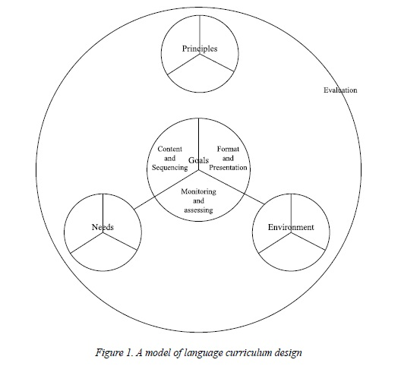
A model of language curriculum design
Outer circle:
Environment Analysis
Needs Analysis
Principle
Inner circle:
content and sequencing
format and presentation
monitoring and assessing
Azarnoosh et al., (2016:57-59)

Slide 5
A model of language curriculum design
The three segments may be seen as the answers for the following questions:
What will I teach, and in what order?
How will I teach it?
How will I know that learning is happening?

Slide 6
Reasons for adapting materials
Azarnoosh et al. (2016: 87) refers to McDonough and Shaw’s list of reasons for adaptation highlighting the possible necessities and lacks:
Not enough grammar coverage in general
Not enough practice of grammar points of particular difficulty to these learners
The communicative focus means that grammar is presented unsystematically
Reading passages contain too much unknown words
Comprehension questions are too easy, because the answers can be lifted
directly from the text with no real understanding
Listening passages are inauthentic, because they sound too much like written material being read out

Slide 7
Reasons for adapting materials
Not enough guidance on pronunciation
Subject matter inappropriate for learners of this age and intellectual level
Photographs and other illustrative material not culturally acceptable
Amount of material too great/too little to cover in the time allocated to lessons
No guidance for teachers on handling group work and role-play activities with
a large class
Dialogues too formal, and not really representative of everyday speech
Audio material difﬁcult to use because of problems to do with room size and
technical equipment
Too much or too little variety in the activities
Vocabulary list and a key to the exercises would be helpful
Accompanying tests needed

Slide 8
Reasons for adapting materials
According to Cunningsworth, A. (1984)., adaptation depends on factors such as:
The dynamics of the classroom
The personalities involved
The constraints imposed by syllabuses
The availability of resources
The expectations and motivations of the learners

Slide 9
Reasons for adapting materials
Azarnoosh et al. (2016:88) state that adaptation can be possible in the following cases:
Methods (e.g., an exercise may be too mechanical, lacking in meaning, too complicated).
Language content (e.g., there may be too much emphasis on grammar your students learn quickly or not enough emphasis on what they ﬁnd difﬁcult).
Subject matter (e.g., topics may not be interesting to students or they may be outdated or not authentic enough).
Balance of skills (e.g., there may be too much emphasis on skills in the written language or skills in the spoken language, or there may not be enough on integrating skills).
Progression and grading (order of language items may need to be changed to ﬁt an outside syllabus or the staging may need to be made steeper or more shallow).
Cultural content (cultural references may need to be omitted or changed)
Image (a coursebook may project an unfriendly image through poor layout, low quality visuals, etc.).

Slide 10
Purposes of adaption
According to McGrath (2002), there are two most frequently cited purposes for adaptation. They are as follows:
1. to make the material more suitable for the circumstances in which it is being used, i.e. to mould it to the needs and interests of learners, the teacher’s own capabilities and such constraints as time, or, as McDonough and Shaw (1993:85) put it: ‘to maximase the appropriacy of teaching materials in context, by changing some of the internal characteristics of a coursebook to better suit our particular circumstances’;
2. to compensate for any intrinsic deficiencies in the material, such as linguistic inaccuracies, out-of-datedness, lack of authenticity (Madsen and Bowen, 1978) or lack of variety (Tice, 1991).

Slide 11
Questions to be asked:
Based on Cunningsworth (1984) three questions can be suggested that a teacher might ask when adapting materials:
What does the material actually get the learner to do?
What do I what the learner to do?
How can I get the material to do what I want it to do for the learner?

Slide 12
Objectives and Principles
McGrath (2002) also suggests the following five objectives and relevant principles in making changes to materials:
Localisation
Personalisation
Individualisation
Modernisation
Simplification
In addition to the above objectives, Azarnoosh et al. (2016:89) expand the list with the following objectives:
Add real choice
Cater for all sensory learner styles
Provide for more learner autonomy
Encourage higher-level cognitive skills
Make the language input more accessible
Make the language input more engaging

Slide 13
Techniques of adaptation
McDonough and Shaw (1993) and Cunningsworth (1995) offer the following techniques of adapting materials:
Adding; extending and expanding
Deleting; subtracting and abridging
Simplifying
Reordering
Replacing material

Slide 14
Supplementing Teaching Materials
The need for supplementing teaching materials arises when the gaps in the main materials are identified. There is never a coursebook that can suit all the learner needs and each learning context. McGrath (2002) defines ‘supplementation’ as ‘adding something new’, which stems primarily from the recognition of a deficit: it is an attempt to bridge the gap between a coursebook and an official syllabus, or a coursebook and the demands of a public examination, or a coursebook and students’ needs. When the principal determining factor behind what you do is a syllabus – an official document or your own teaching plan based on an analysis of learner needs – this will have an obvious influence on your approach to the creation of supplementary material. If you know of something ready-made that will fit the bill, the problem is quickly solved. If not, you will need to design material specifically for that purpose. We can call this kind of orientation syllabus-driven materials design.

Slide 15
References:
Azarnoosh, M., Zeraatpishe, M., Faravani A., Kargozari H.R. (Eds.) (2016). Issues in Materials Development. Rotterdam: Sense Publishers.
Cunningsworth, A. (1984). Evaluating and Selecting EFL Teaching Materials. London: Heinemann.
Madsen, H. and Bowen, J. (1978). Adaptation in Language Teaching. Rowley, MA: Newbury House.
McDonough, J and Shaw, C. (1993). Materials and Methods in ELT. Oxford: Blackwell.
McGrath, I. (2002). Materials Evaluation and Design for Language Teaching. Edinburgh: Edinburgh University Press.
Nation, I.S.P., Macalister, J. (2010). Language curriculum design. New York, NY& London: Routledge/Taylor & Francis.
Tice, J. (1991). ‘The textbook straitjacket’, Practical English Teaching, 11.3:23
Tomlinson, B. (2014). (2nd Ed.) Developing Materials for Language Teaching. London: Bloomsbury.

Slide 16
Further Reading
Boon, A. (2011). Negotiated syllabuses: Do you want to? In Macalister & I.S.P. Nation (Eds), Case studies in the language curriculum design: Concepts and approaches in action around the world (pp.166-177). New York, NY: Routledge/Taylor & Francis.
Graves, K. (2000). Designing language courses: a guide for teachers. Boston, MA: Heinle & Heinle.

Slide 17
Home assignment
Reflection task
Based on what you have learnt from this lecture, write a one-page reflection focusing on your own reasons to develop your own teaching materials.
Question/Answer
1. Why do teachers need to adapt and supplement teaching materials?
2. What kind of changes can be made to materials?
3. What are the five principles in making changes to materials?
A Practical Task
Within the selected branch of ESP, make the necessary changes to your materials relying on the five principles.

