Slide 1
Lecture 8
Matching Teaching Materials to Learner Needs
Komila Tangirova,
UzSPIC

Slide 2
Outline:
Matching materials to learning styles
Different types of needs
How to match expectations
Research in the area
Important considerations
Designing ESP materials based on learner needs

Slide 3

Matching materials to learning styles
Learning styles can influence on the preferences students have for this or that type of materials and therefore, teachers should be responsive to learners’ needs when making decisions in preparing teaching materials.
Tomlinson (2011: xiii) provides the following overview to learning styles:
The way(s) that particular learners prefer to learn. Some language leaners have a preference for hearing the language (auditory learners), some for seeing it written down (visual learners), some for learning it in discrete bits (analytic learners), some for experiencing it in large chunks (global or holistic or experiential learners), and many prefer to do something physical whilst experiencing the language (kinesthetic learners). Learning styles are variable and people often have different preferences in different learning contexts.

Slide 4
Different types of needs
Needs vary according to who the stakeholder is. Each stakeholder may have their own views regarding what is important for the ESP course and what kinds of materials are to be used. Therefore, there are four views of needs:
A diagnostic view of needs
A discrepancy view of needs
A democratic view of needs
An analytic view of needs
(Brown, 2016)

Slide 5
A diagnostic view of needs
Here, needs correspond to language, genres, and skills that are considered necessities and essentials for success in the target setting. The key stakeholders in this situation are those who possess the direct knowledge and experience of the target settings:
Experienced ESP instructors
Course coordinators
Heads of department
Subject specialists future employers
Graduate alumni
(Brown, 2016)

Slide 6
A diagnostic view of needs
A diagnostic view of needs brings about ranking of learner objectives:
at the top
Those which must be achieved
in the middle
Those which are desirable but less important
at the bottom
Those that are irrelevant and can be ignored
Such approach allows prioritising the most important components of the teaching input and set the right sequence of materials
(Brown, 2016)

Slide 7
A discrepancy view of needs
Here, needs correspond to
“the lacks, discrepancies, or gaps between what learners can currently do in the language and what they will need to do in the target setting”.
The ESP instructors may divide learners according to particular ability groups and also consult the stakeholders so that the appropriate objectives are set.

Slide 8
Democratic view of needs
  Here, needs correspond to what the different stakeholders want, desire, expect, or request from the ESP course. The most important stakeholders in this case are the learners themselves.
  Learners certainly expect their ESP course to be:
  Interesting
  Enjoyable
  Manageable
  Relevant to their future goals

Slide 9
An analytic view of needs
Here, needs correspond to elements that Second Language Acquisition (SLA) theory and ELT research shows. Research and general practice in the area can inform of the most effective ways to match the teaching materials to learner needs.

Slide 10
How to match expectations
There are some additional points that we would like to mention:
a. Bear in mind the backgrounds of the teachers who will use the materials. How experienced are they? How much do they know about developments in ELT and ESP? How much do they know about the ESP specialism?
b. There should be a course syllabus which will indicate what kind and what amount of materials are needed. The entire syllabus may be prepared by a department, and may depend solely on materials developed by the staff. At the other extreme, the syllabus may be provided by a published textbook, and supplemented by in-house materials. Whatever the situation, materials should be developed according to guidelines which have been agreed upon by the staff.
c. Allow for personal preference and modification on the part of the teacher. Materials that can be used in a variety of ways are more likely to have a positive effect on a teacher's performance in class.

Slide 11
How to match expectations
d. Ideally, the course syllabus and class materials will be designed not only by a group of teachers who are conversant with the latest developments in ELT and ESP, but who share a similar approach to teaching, who can cooperate on collating and responding to feedback and who are supported by a sympathetic management As most teachers know, this type of situation is not always the norm.
e. Consider designing guides and templates to aid less experienced teachers to develop materials. For example, if listening material is needed, advice on the selection, editing, recording and re-recording of texts could be presented, together with a brief summary of current thinking in teaching listening skills. This could be supplemented by templates which allow teachers to 'slot in texts and exercises to produce usable materials.
f. Remember that syllabuses and materials have a limited lifespan. Wherever possible, design a syllabus that allows for partial changes to be made, thus avoiding wholesale changes to a programme that can be disastrous. Design materials that can be revised with a minimum of effort. Do not spend too much time developing materials that have a short shelf-life.
g. Encourage ongoing research into analysis of relevant source texts (written and spoken), and related textbooks. Organize regular meetings/workshops to exchange ideas.

Slide 12
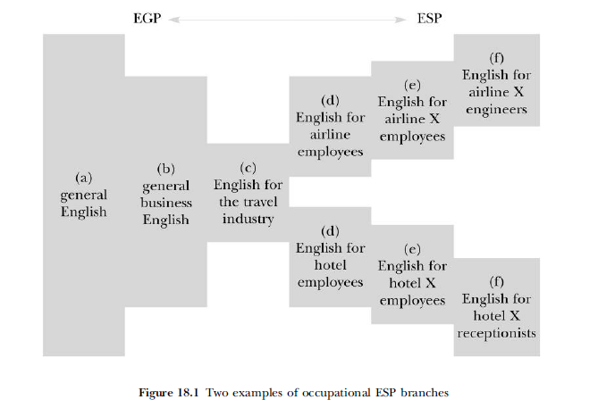
Research in the area
EGP-ESP continuum
(Barnard & Zemach, 2014:308).

Slide 13
Important considerations
Based on the continuum in the previous slide, the following points must be remembered by designers of ESP materials:
a. The more focused the course, the greater the knowledge of the specialism required by the course designer and the teacher.
b. The learners will very often know more than the teacher about the topic area of a lesson.
c. The greater the specialisation, the more obvious the differences in course content; however, all areas of ESP will share a common basis in general English.
d. In theory, it is easier to predict leaners’ specific language needs at the end of the continuum.
e. The position of a course on the continuum in no way dictates what approach, method or techniques should be used in class.
f. A course especially developed for a specific context and group of learners will not necessarily be limited to the language used in that context. Depending on the time available, apparently unrelated EGP content can used to develop fluency and provide variety.
g. The proficiency levels of learners may set limits on the level of specificity of a course. At lower levels, more attention will probably be given to proficiency in general English.

Slide 14
Research in the area
Statements from specialists:
Courses do not teach classes, teachers do
(Lansford,2014)
Learners do not learn what teachers teach, they learn what they need and want to learn (Tomlinson, 2015)

Slide 15
Designing ESP materials based on learner needs
In the same way activities in commercially available textbooks should also be carefully selected and modified for effective teaching. Below are the five most important criteria suggested by Tomlinson:
(1) expose the learners to a rich, recycled, comprehensible and meaningful input of language in use
(2) engage the learners affectively (i.e. involve the learners’ emotions and or contribute to self-esteem and positive feelings about the learning experience)
(3) engage the learners cognitively (i.e. stimulate the learners to think critically and creatively);
(4) pay attention to form during or after a meaning-focused activity;
(5) provide the learners with opportunities to use the target language for authentic communication.

Slide 16
References
Bao, D. (2018). Creativity and Innovations in ELT Materials Development: Looking Beyond the Current Design. Blue Ridge Summit, PA: Multilingual Matters.
Ellis, R. (2016). Language teaching materials as work plans: An SLA perspective. In B. Tomlinson (ed.) Second Language Acquisition Research and Materials Development for Language Learning (pp.203-2013). New York: Routledge.
Lansford, L. (2014, August 13). How to use coursebook: The art of pedagogy – Cambridge conversations. Retrieved June 16, 2016, from learning materials, http://www.Cambridge.org/elt/blog/2014/08/use-coursebooks-art-pedagogy
Brown, J.D. (2016). Introducing needs analysis and English specific purposes. Abingdon, UK: Routledge.

Slide 17
Further Reading
Brindley, G. (1989). The role of needs analysis in adult ESL programme design. In R. K. Johnson (Ed.), The Second Language Curriculum. Cambridge: Cambridge University Press.
Chovancová, B. (2014). Needs analysis and ESP course design: Self-perception of language needs among pre-service students. Studies in Logic, Grammar and Rhetoric, 38(1), 43-57.
Flowerdew, L. (2013). Needs analysis and curriculum development. In B. Paltridge & Starfield (Eds.), The handbook of English for specific purposes (pp.325-346). Oxford: Wiley-Blackwell.
Holliday, A. (1995). Assessing language needs within an institutional context: An ethnographic approach. English for Specific Purposes, 14(2), 115-126.
Hsu, W. (2014). Measuring the vocabulary load of engineering textbooks for EFL undergraduates. English for Specific Purposes, 33, 54-65.
Malmström, H., Pecorari, D., & Shaw, P. (2018). Words for what? Contrasting university students' receptive and productive academic vocabulary needs. English for Specific Purposes, 50, 28-39.
Serafini, E. J., Lake, J. B., & Long, M. H. (2015). Needs analysis for specialized learner populations: Essential methodological improvements. English for Specific Purposes, 40, 11-26.
Bosher, S., & Smalkovski, K. (2002). From needs analysis to curriculum development: Designing a course in health-care communication for immigrant students in the USA. English for Specific Purposes, 21, 59-79.

Slide 18
Home assignment
Reflection task
Based on what you have learnt from this lecture, write a one-page reflection focusing on how you match your teaching materials to your learner needs
Question/Answer
1. Which of the points covered in this lecture were new to you?
2. Which of the recommendations are the most relevant for your own teaching practice?
3. What are the four views of needs ?
A Practical Task
Within the selected branch of ESP, create your own criteria for matching teaching materials to your learner needs.

