Slide 1
COURSE TITLE
PROJECT ENGINEERING
Chapter 3 - (Week 5)
PROJECT PLANNING AND SCHEDULING
LECTURE – 5
Work breakdown structure (WBS), Introduction to scheduling & Bar chart.
Er. Ishwar Adhikari
Associate Professor
Kathmandu Engineering College, Nepal

Slide 2
Learning Objective
The main objective of this lecture is to understand about :
Work Breakdown Structure (WBS).
Introduction to Project Scheduling .
Bar chart/Gantt chart

Slide 3
WORK BREAKDOWN STRUCTURE
How many tasks does the project have?
How much detail should the project plan have?
This query is overcome by Work breakdown structure (WBS)
This is the first major step in the planning phase of the project life cycle after the formulation of the project.

Slide 4
WORK BREAKDOWN STRUCTURE (Cont’d…)
Most modern day projects are designed, organized and built by teams of specialized professionals.
To organize this process efficiently it is necessary to breakdown the project into specific parts that can be coordinated and controlled.
The manner in which this project is structured is termed as the project’s work break down structure (WBS).
The first major step in the planning process after project requirements definition is the development of work breakdown structure (WBS). [1]

Slide 5
WORK BREAKDOWN STRUCTURE (Cont’d…)
Successful completion of project (or program) requires a plan that defines all its components, assigns responsibility to a specially identified organizational element, and establishes schedules and budgets for its accomplishment.
WBS is a process by which the whole project is divided into various sub-projects, the sub-projects into various tasks, the tasks into various sub-tasks, and finally sub-tasks into work packages. [2]
The purpose of WBS is to identify terminal elements (the actual items to be done in a project); therefore WBS serves as the basis for much of project planning.

Slide 6
WORK BREAKDOWN STRUCTURE (Cont’d…)
Usually, the project manager is responsible for structuring a project into several components. The level of the smaller components should be such that each of which should be:
Manageable so that specific authority, and responsibility can be assigned
Independent so that there happens to be minimum interfacing with and dependence on other ongoing elements
Integratable so that the total package can be seen, and
Measurable in terms of progress

Slide 7
WORK BREAKDOWN STRUCTURE (Cont’d…)
Level of WBS (Family Tree)
Level Description
Total Program
Project
Task
Subtask
Work package
Level of effort

Slide 8
WORK BREAKDOWN STRUCTURE (Cont’d…)
The upper three levels of the WBS are normally specified by the project management office (customer), while the lower levels are generated by the contractor for in-house control.
Each level serves a vital purpose: level 1 is generally used for the authorization and release of all work, budgets are prepared at level 2, and schedules are prepared at level 3.
The reason for this subdivision of effort is simply ease of control.

Slide 9
Level 1
Project
Level 2
Task 1
Task 2
Level 3
Sub Task 1.1
Sub Task 1.2
Sub Task 2.1
Sub Task 2.2
Level 4
Work package 1.1.1
Work package 1.2.1
Work package 2.1.1
Work package 2.2.1
Fig: A typical WBS structure

Slide 10
WORK BREAKDOWN STRUCTURE (Cont’d…)
There is no hard and fast rule as to number of levels into which the project is to be breakdown.
The number of stages/ levels should be neither too few nor too large. If the project is broken down into only one or two levels, integration of activities may become difficult.
On the other hand if number of level are very high it will make analysis complex and unproductive.
So WBS should be carried on till such time that the work package (small element) available is capable of giving a good definition of work content, the resource required and the cost and time requirement.

Slide 11
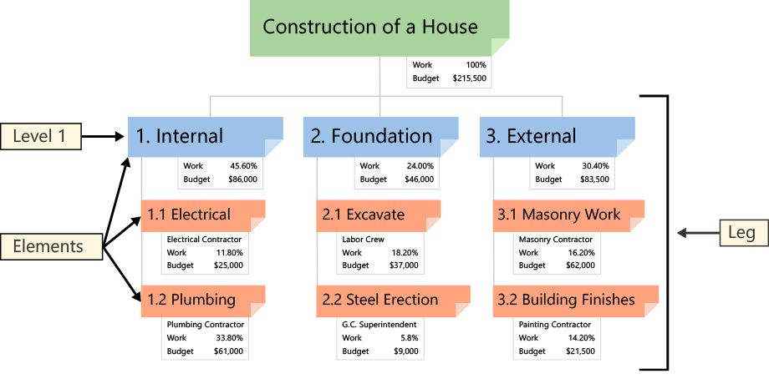
TYPES OF WBS
Deliverable-Based Work Breakdown Structure
Fig Source : [3]

Slide 12
TYPES OF WBS (Cont’d…)
A Deliverable-Based Work Breakdown Structure clearly demonstrates the relationship between the project deliverables (i.e., products, services or results) and the scope (i.e., work to be executed).
In Figure, the Level 1 elements are summary deliverable descriptions.
The Level 2 Elements in each Leg of the WBS are all the unique deliverables required to create the respective Level 1 deliverable.

Slide 13
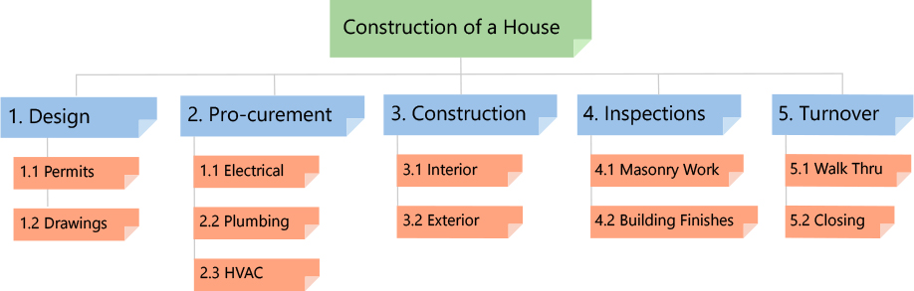
TYPES OF WBS (Cont’d…)
Phase-Based Work Breakdown Structure
Fig Source : [3]

Slide 14
TYPES OF WBS (Cont’d…)
In Figure, a Phase-Based WBS, the Level 1 has five Elements.
Each of these Elements are typical phases of a project.
The Level 2 Elements are the unique deliverables in each phase.
Regardless of the type of WBS, the lower Level Elements are all deliverables.
A Phase-Based WBS requires work associated with multiple elements be divided into the work unique to each Level 1 Element.
A WBS dictionary is created to describe the work in each Element.

Slide 15
ROLE OF WBS
The WBS is the single most important element because it provides a common framework from which: [1]
The total program can be described as a summation of subdivided elements.
Costs and budgets can be established.
Time, cost and performance can be tracked.
Objectives can be linked to a company resources in a logical manner.
The responsibility assignment for each element can be established.
Network construction and control planning can be initiated.

Slide 16
    CRITERIA FOR DEVELOPING WBS
The WBS and work description should be easy to understand.
All schedules should follow the WBS.
No attempt should be made to subdivide work arbitrarily to the lower possible level.
Since scope of effort can change during a program, every effort should be made to maintain flexibility in the WBS.
The WBS can act as tangible milestones.
The WBS can be used to segregate recurring from nonrecurring costs.
Most WBS elements (at the lowest control level) range from 0.5 to 2.0 percent of the total project budget.

Slide 17
PROJECT SCHEDULING
Projects are growing increasingly complex and costly; therefore attention must be paid to the control of both time and cost.
Improved management and scheduling of projects are imperative to the success of any project, particularly large scales ones.
Therefore it is necessary to schedule a project by using proper techniques.
A schedule is defined as “time phased” plan for performing the work necessary to complete the project.

Slide 18
PROJECT SCHEDULING (Cont’d..)
A schedule is graphical representation which shows the starting and completion dates of each activity and the sequential relationship among the various activities.
Project scheduling refers to the process of laying out all the actual activities of the project in the time order in which they are to be performed. [2]
The schedule development process must often be inter-related along with cost estimating prior to determination of the project schedule. [4]

Slide 19
PROJECT SCHEDULING (Cont’d..)
Scheduling is the process of listing a number of duties or events in the sequence that they will occur.
It is a time table and it formulates the activities that must be accomplished to reach a certain goal or objective. [5]
Schedule let people and organizations to know in advance when to expect a certain action to take place.
Now a days large project consist of innumerable activities interdependent to one another, it is necessary to make the schedule in a systematic way for easy understanding and reference. [6]

Slide 20
PROJECT SCHEDULING (Cont’d…)
Scheduling is done in the following steps [7]
CALCULATE : Detailed control information
ASSIGN : Timings to events and activities.
GIVE: Consideration to the resources. The manager is generally concerned with those resources whose availability is limited and may impose a constraint on the project.
ALLOCATE: The resources
Therefore scheduling also can be said as allocation of resources needed at each stages of production, along with the expected completion time of each activity.

Slide 21
WHY PROJECT SCHEDULE?
To predict project completion time and activity completion time.
To control financing and payment.
To serve as a record.
To support delay claim.
To manage changes and uncertainties

Slide 22
METHODS OF PROJECT SCHEDULING
Bar chart / Gantt chart
Linked Bar Chart
Milestone Chart
Network Analysis
Critical Path Method (CPM)
Program Evaluation Review Technique (PERT)
Precedence Diagramming Method (PDM)
Line of Balance Technique.

Slide 23
BAR CHART/GANTT CHART
The oldest formal planning tool is the bar chart.
It is developed as a production control tool in 1917 by Henry L. Gantt, an American mechanical engineer, hence also called Gantt chart in his respect.
It is a graphical or pictorial representation showing the various activities involved in a project.
The job/ activities are listed vertically as per their sequence and each of them is allotted a horizontal strip, denoting the estimated time to complete that particular activity as per calendar days/months. [6]
Used as scheduling tool for small and medium size project.

Slide 24
BAR CHART/GANTT CHART (Cont’d….)
Steps in Preparing Bar Chart
Breakdown the whole project into various activities or into sub activities.
Develop a logical sequence of the activities and also find out the activities that can be executed concurrently.
Decide the time duration for each activity for its completion.
Finally by using a number of bars, as required, the different activity to be performed are indicated on a chart.

Slide 25
BAR CHART/GANTT CHART (Cont’d….)
S.N. | Job/ Activity | Calendar month
 |  | Jan | Feb | Mar | Apr | May | June
1 | Foundation work
2 | R.C.C. work
3 | Door and windows work
4 | Interior Finish
5 | Sanitary works
6 | Electrical works
7 | Exterior finish
No defined relationship
Fig: Bar Chart for a typical building project [6]

Slide 26
BAR CHART/GANTT CHART (Cont’d….)
Advantages
The simple graphical form of bar chart results in relatively easy general comprehension. [8]
It gives the pictorial representation of the status of a project at any point of time, which is easily understood by the laymen.
The overall performance of the activity can be judged from chart without going through the status or detailed report. [6]
It is useful for reporting who are not involved in day to day management.
Bar chart is used as the preliminary planning tool.

Slide 27
BAR CHART/GANTT CHART (Cont’d….)
Limitation /Disadvantages
If too many activities are shown separately in a bar chart, then it becomes messed up. Hence it is not suitable for large and complicated project.
Lack of interrelationship and interdependencies among the activities.
It cannot be used as control tool for large projects.
Each activity receives the consideration with no indication where management attraction should be focused.
Critical activities are difficult to be identified and floats are unknown.

Slide 28
BAR CHART EXAMPLE
A project consist of 8 activities A,B,C,D,E,F,G,H with their time of completion as follows:
Activity A and B can be performed in parallel
Activity C and D cannot start until Activity A is complete.
Activity E cannot start until the half the work of Activity C is complete.
Activity F can start only after Activity D is complete.
Activity G succeeds Activity C
H is the last activity which should succeed activity E.
Activity | Duration (weeks)
A | 2
B | 4
C | 2
D | 4
E | 6
F | 4
G | 5
H | 4
Draw the bar chart and find out the completion time of the project.

Slide 29
BAR CHART EXAMPLE (Cont’d…)
Activity/week | 1 | 2 | 3 | 4 | 5 | 6 | 7 | 8 | 9 | 10 | 11 | 12 | 13
A
B
C
D
E
F
G
H
The completion time of the project is 13 weeks.

Slide 30
LINKED BAR CHART
One of the major limitation of bar chart is it does not show the inter relationship and inter dependencies among the activities.
So a linked bar chart is introduced which is a modified form to overcome some of the limitation of bar chart.
It shows the link between an activity and the preceding activities which have to be completed before this activity can start and the succeeding activities which are dependent on this activity.
Linked bar chart uses the links (arrow) to show the relationship between activities.

Slide 31
LINKED BAR CHART (Cont’d…)
Four Types of Link:
Type 1 Finish to Start (FS)
(Activity B cannot start until Activity A is finished)
Type 2 Start to Start (SS)
(Activity B should start when Activity A starts )
A
B
A
B

Slide 32
LINKED BAR CHART (Cont’d…)
Type 3 Finish to Finish (FF)
(Activity B should be finished when Activity A finishes)
Type 4 Start to Finish (SF)
(Activity B should be finished when Activity A starts)
A
B
A
B

Slide 33
MILESTONE CHART
It is a modification over the original bar chart.
When a particular activity represented by a bar on a bar chart is very long, the details lack.
A Chart that graphically depicts key events along a timescale, usually with triangles representing each event, is called milestone chart.
Milestones provide a sense of accomplishment and show project team how the work they’re doing contributes to the overarching project objective.
It only identify the scheduled start or completion of major deliverables and key external interfaces. [4]

Slide 34
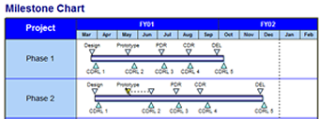
MILESTONE CHART (Cont’d…)
Fig Source: [9]

Slide 35
REFERENCES
[1] PROJECT MANAGEMENT A System Approach to Planning, Scheduling and Controlling : Harold Krezner, Second Edition, CBS publishers and distributors, New Delhi, India, 1987.
[2] Project Management: K. Nagarajan, New Age International (P) Ltd. Publishers, New Delhi, India, 2001.
[3] https://www.workbreakdownstructure.com
[4] A Guide to the Project Management Body of Knowledge (PMBOK): 2000 Edition, Project Management institute, Newton Square, Pennsylvania, USA.
[5] Managing the Construction Process, Estimating, Scheduling and Project Control : Second Edition, Frederick E. Gould, PE,CPC, Pearson Education, Inc., New Jersey, USA, 2002

Slide 36
REFERENCES (Cont’d…)
[6] Fundamentals of PERT/CPM and Project Management: S.K.Bhattacharjee, Second Edition, Khanna Publishers, New Delhi, India, 2002.
[7] Project Planning and Control with PERT and CPM: B.C. Punmia and K.K. Khandelwal, Third edition, Laxmi Publications (P) Ltd, New Delhi, India.
[8] Professional Construction management: Donald S. Barrie and Boyd C. Paulson Jr., Third Edition, McGraw Hill, Inc., 1992.
[9] https://www.differencebetween.info/difference-between-gantt-chart-and-milestone-chart

