Slide 1
COURSE TITLE
PROJECT ENGINEERING
Chapter 3 - (Week 7)
PROJECT PLANNING AND SCHEDULING
LECTURE – 7
Program evaluation and review technique(PERT), Difference between CPM and PERT, Project scheduling with limited resources and Multi project scheduling.
Er. Ishwar Adhikari
Associate Professor
Kathmandu Engineering College, Nepal

Slide 2
Learning Objective
The main objective of this lecture is to understand about :
Concept of Program evaluation and review technique (PERT).
Difference between CPM and PERT.
Project scheduling with limited resources.
Multiple project scheduling.

Slide 3
PROGRAM EVALUATION AND REVIEW TECHNIQUE (PERT)
Critical path method (CPM) is a deterministic approach for determining the duration of an activity in a project.
CPM is readily applicable to the projects comprising of known straight forward activities, stable technology using standard materials and known equipment. [1]
Although project manager tries to complete the project in minimum possible time, there are many factors, both internal and external to the organizations which have influence on the completion time of each activity in the project. [2]

Slide 4
PROGRAM EVALUATION AND REVIEW TECHNIQUE (PERT) (Cont’d..)
Therefore, there is an element of uncertainty in deciding upon the completion time of each activity and consequently the estimated project completion time. Example: Research and Development project.
To evaluate such type of project where there is some level of uncertainty PERT method is used for determining the duration of an activity as well as the project.
The special project office in the U.S. Navy, concerned with performance trends on large military development programs introduced PERT on its Polaris weapon system in 1958. [3]

Slide 5
PROGRAM EVALUATION AND REVIEW TECHNIQUE (PERT) (Cont’d..)
It is a probabilistic approach for estimating the duration of an activity and event oriented network diagram.
PERT is used in the completely newly developed project such as Research and design, space and aerospace industry where there may not be record of past experiences in the particular field.
PERT system is preferred for those projects in which correct time determination for various activities cannot be made.
PERT is a technique that statistically presents knowledge about the activities and the uncertainty related with activities. [4]

Slide 6
PROGRAM EVALUATION AND REVIEW TECHNIQUE (PERT) (Cont’d..)
In research and development project, where there is some extent of uncertainty, the exact estimation of time of completion of various activity is difficult.
Therefore, PERT uses three time estimates for each activity with a view to overcome uncertainty in time estimates.
(a) The most optimistic time (t_{o})
(b) The most pessimistic time (t_{p})
(c) The most likely time (t_{m})

Slide 7
PROGRAM EVALUATION AND REVIEW TECHNIQUE (PERT) (Cont’d..)
(a) The most optimistic time (t_{o})
It is the shortest possible time in which an activity can be completed under ideal conditions. [5]
This time assumes that everything will go according to plan and with a minimal amount of difficulties. [3]
(b) The most pessimistic time (t_{p})
It is the maximum possible time it would take to complete an activity under worst conditions.
In arriving at the pessimistic time, it is assumed that everything is unfavorable for completing the activity in time and every possible delay and difficult situation is encountered. E.g. Force Majeure

Slide 8
PROGRAM EVALUATION AND REVIEW TECHNIQUE (PERT) (Cont’d..)
(c) The most likely time (t_{m})
It is also called the most reliable time or the most probable time.
The most optimistic and pessimistic times are two ends of a spectrum denoting the range of variation in the activity duration. [1]
Somewhere in between the optimistic and pessimistic time, there lies the most probable time.
It is the time in which an activity can be completed under normal conditions which is neither favorable nor non favorable.

Slide 9
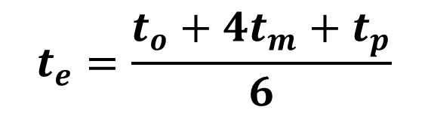
PROGRAM EVALUATION AND REVIEW TECHNIQUE (PERT) (Cont’d..)
Once these three time estimates are made for all the activities, the most expected time (t_{e}) is then calculated.
The most expected time (t_{e})
It is the average time required to complete an activity also known as the PERT weighted average time.
PERT assumes that the optimistic time (t_{o}) and the pessimistic time (t_{p}) are equally likely to occur while the most likely time (t_{m}) is four times more likely to occur than the others.
$$t_{e}=\frac{t_{o}+{4t}_{m}+t_{p}}{6}$$

Slide 10
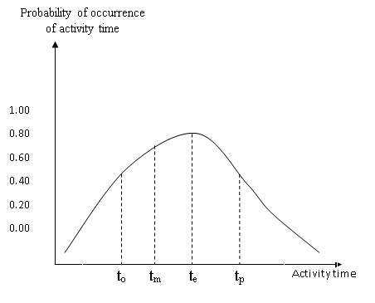
PROGRAM EVALUATION AND REVIEW TECHNIQUE (PERT) (Cont’d..)
Fig Source: [2]

Slide 11

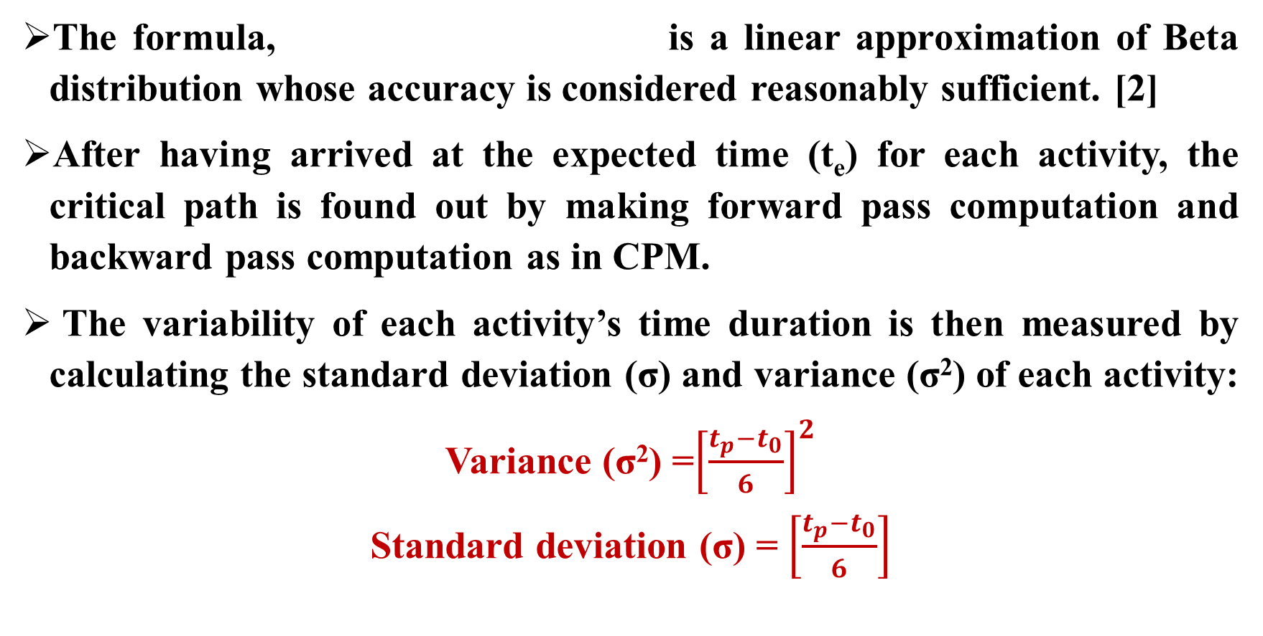
PROGRAM EVALUATION AND REVIEW TECHNIQUE (PERT) (Cont’d..)
$$t_{e}=\frac{t_{o}+{4t}_{m}+t_{p}}{6}$$
The formula, is a linear approximation of Beta distribution whose accuracy is considered reasonably sufficient. [2]
After having arrived at the expected time (t_{e}) for each activity, the critical path is found out by making forward pass computation and backward pass computation as in CPM.
The variability of each activity’s time duration is then measured by calculating the standard deviation (σ) and variance (σ²) of each activity:
Variance (σ²) =${\left[\frac{t_{p}−t_{0}}{6}\right]}^{2}$
Standard deviation (σ) = $\left[\frac{t_{p}−t_{0}}{6}\right]$

Slide 12
PERT NUMERICAL EXAMPLE
Consider the following activities in a network.
Determine expected completion time and critical path.
Variance and standard deviation of the critical path
3
t= 1,4,7
t= 3.5,4,4.5
t= 2,6.5,8
1
t= 1,2,3
5
6
2
t= 5,6,13
t= 3,4,11
4

Slide 13
PERT NUMERICAL EXAMPLE (Cont’d…)
PERT Average time / The most expected time
µ/t_{e} = (t_{o} + 4t_{m} + t_{p} )/6
For Activity 1-2 , t_{e} = (1+ 4*2+ 3) / 6 = 2
Standard deviation (σ) = t_{p}-t_{o}/6 = 2/6 =1/3
Variance = σ² = 1/9
Repeating the same process for all the activities.
S.N. | Activity | t₀ | t_{m} | t_{p} | t_{e} | σ | σ² | Remarks
1 | 1-2 | 1 | 2 | 3 | 2 | 1/3 | 1/9 | Critical
2 | 2-3 | 1 | 4 | 7 | 4 | 1 | 1
3 | 2-4 | 3 | 4 | 11 | 5 | 4/3 | 16/9 | Critical
4 | 3-5 | 3.5 | 4 | 4.5 | 4 | 1/6 | 1/36
5 | 4-5 | 5 | 6 | 13 | 7 | 4/3 | 16/9 | Critical
6 | 5-6 | 2 | 6.5 | 8 | 6 | 1 | 1 | Critical

Slide 14
PERT NUMERICAL EXAMPLE (Cont’d…)
Project Duration = Summation of expected time along critical path
= 2+5+7+6 = 20 days.
Variance of Project (σ²) = Summation of variance along CP
= 1/9 + 16/9 + 16/9 + 1 = 42/9
Standard Deviation (σ) = (42/9)^{1/2} = 2.16.

Slide 15
DIFFERENCE BETWEEN CPM AND PERT
CPM |  | PERT
1. 2. 3. 4. 5. 6. | Activity oriented network diagram Useful of cost evaluation Uses Only a single time estimates for activities. Includes relationship between activities time and cost. Doesn’t uses statistical tools Used for repetitive work such as construction, repair, maintenance etc. | 1. 2. 3. 4. 5. 6. | Event oriented network diagram Useful for time evaluation Uses 3-time estimates for activities. PERT analysis doesn’t include costs. It uses statistical tools. Used for completely new project involved with factor of uncertainty such as R&D project.

Slide 16
PROJECT SCHEDULING WITH LIMITED RESOURCES
A resource is a physical variable, such as men, materials, machines, space and money that is required for completing various activities of a project.
The network analysis (CPM and PERT) is valid only if the availability of resources is liberal or unlimited.
In a real life project, it is a very common experience that the resources are frequently in a limited supply causing delay in completion of project. [1]

Slide 17
PROJECT SCHEDULING WITH LIMITED RESOURCES (Cont’d…)
In some cases, particular material or some machinery may not be available in the middle of the project due to some reasons beyond the control of project manager.
Availability of skilled and unskilled labor and the equipment may be restricted as well as availability of fund may be restricted.
Usually activities of project are scheduled in such a way that the demand of various resources is more or less uniform all along the project duration. [4]
This is not always the case and the project has to be rescheduled considering the constraints of resources which is project scheduling with limited resources.

Slide 18
PROJECT SCHEDULING WITH LIMITED RESOURCES (Cont’d…)
Following constraints are imposed due to the limited resources:
Starting of an activity is delayed.
Non critical job may be critical due to delay in starting.
More than one type of resource may be scarce at a time.
Resource may be scarce in the middle of performance of a particular job etc.
These above mentioned constraints can be overcome by the proper allocation of the resources.

Slide 19
RESOURCE ALLOCATION
Resource allocation in project management involves identifying and assigning the best available best-fit resources to every project for a specific period of time.[6]
It also monitors the resource’s workload throughout the project life cycle and reassigns them if necessary.
Resource aggregation, or resource loading, is simply the summation, on a period-by-period basis, of the resources required to complete all activities based on the resource allocation carried out in the previous stage.

Slide 20
RESOURCE ALLOCATION (Cont’d…)
The requirements of various resources for a given network of the project are determined using the early start and late start schedule of each activity.
The resource usage profile are usually shown graphically as a histogram.
Such aggregation may be done on an hourly, daily, or weekly basis, depending on the time unit used to allocate resources.
Two methods are commonly used for the resource allocation:
(a) Resource Levelling
(b) Resource Smoothing

Slide 21
RESOURCE ALLOCATION (Cont’d…)
(a) Resource Levelling
It is an attempt to reduce peak resources requirement and smooth out period to period assignments within the constraints of project duration.
A project manager often comes across mismatch between the availability of resources and the requirement of resources. This means that there are surplus resources available on someday and there is deficit of resource on some other days. [2]
Resource leveling is the process that ensures resource demand does not exceed resource availability.

Slide 22
RESOURCE ALLOCATION (Cont’d…)
(b) Resource Smoothing
There is no constraint on project completion time. There is only constraint of resource availability.
However it doesn’t mean that the project duration can be stretched too far. Increase in project duration will lead to indirect expenses (overheads).
Hence the project duration can be extended to satisfy resource constraint.
It shall be done in such a way that the project duration is extended to the minimum possible extent and at the same time satisfying the resource constraints. [2]

Slide 23
RESOURCE ALLOCATION (Cont’d…)
Steps:
Draw the network diagram of the project from the provided data of activities and resources required for each activity.
Calculate the earliest occurrence time and latest occurrence time of each node and slack of each node.
Establish the critical path and float of each activity.
Again draw the time scaled network diagram assuming the early start schedule of each activity. Represent the critical path by horizontal line.

Slide 24
RESOURCE ALLOCATION (Cont’d…)
Steps:
Represent the float of the non critical activity by a dotted line in a time scaled network.
Mark the requirements of resources for each of the activity above or below the arrow of an activity.
Note down the total requirements of the resources for each day and show the resource usage profile using the resource histogram.
Resource usage profile provides the fluctuation of the resources each day and check if it exceeds the available resources.

Slide 25
RESOURCE ALLOCATION (Cont’d…)
Steps:
By using the hit and trail, shift the starting date of the non critical activity keeping in view that the required resources shall not exceeds the available resources.
If resource levelling is used, time is constraint and if resource smoothing is used, resource is constraint.
Again draw the network using late start schedule using the time scale.
Represent the resources usage profile graphically with the help of resource histogram.

Slide 26
RESOURCE ALLOCATION EXAMPLE [4]
Consider the following information of a project
Activity | Duration (days) | Mason per day
1-2 | 2 | 1
2-3 | 3 | 2
2-4 | 4 | 3
2-5 | 2 | 1
3-10 | 4 | 2
4-6 | 2 | 3
4-7 | 4 | 3
5-9 | 4 | 5
6-8 | 2 | 1
7-9 | 5 | 1
8-9 | 3 | 1
9-11 | 2 | 1
10-11 | 3 | 1
11-12 | 2 | 1
Draw the network diagram. Allocate the mason using early start schedule and late start schedule without extending the project duration if the manpower is limited to 10 numbers per day

Slide 27
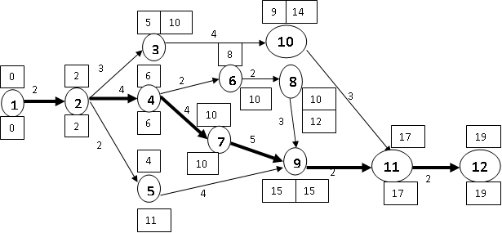
RESOURCE ALLOCATION EXAMPLE (Cont’d…)
Here the critical path is: 1-2-4-7-9-11-12, with the duration of 19 days.

Slide 28
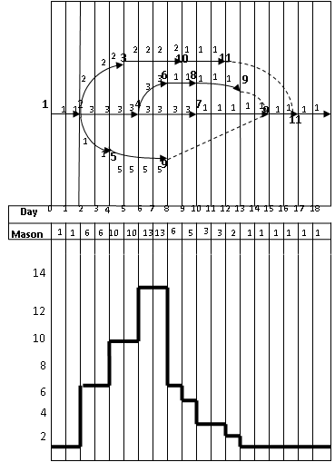
Using Early start
Resource Histogram
Fig: Time Scale Network

Slide 29
RESOURCE ALLOCATION EXAMPLE (Cont’d…)
Here the mason limitation per day is 10 numbers and we can see clearly in the above figure that the mason exceeds the limited number in the day 7 and 8.
To overcome this, we have to use the available float of the non critical activity suitably. We shift the activity 5-9 by seven days.

Slide 30
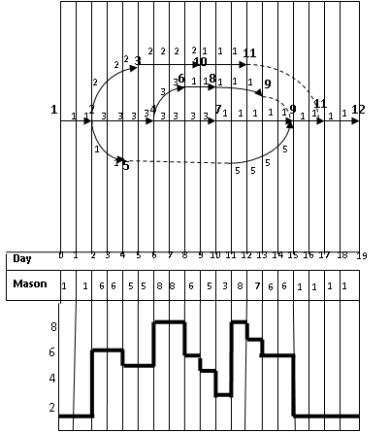
Using Late start
Fig: Time Scale Network .

Slide 31
MULTIPLE PROJECT SCHEDULING
Scheduling two or more projects simultaneously (i.e., starting at the same point in time and each continuing thereafter), such that the sum of weighted project delays is minimized. [7]
A large project is generally broken down into convenient sub-projects and each sub-subproject can be analyzed as an independent project.
However, situations may occur where the beginning or the end of a sub-project may depend on the beginning or the end of one or more different sub-projects.

Slide 32
MULTIPLE PROJECT SCHEDULING (Cont’d…)
As the resource allocation program involves allocation of resources to a number of sub-projects at a time, this is commonly known as multiple project scheduling.
Two types of situations arise during the multiple project scheduling.
A particular type of resource may be required at the same time for the execution of two sub projects, or entirely different project. In such case, scheduling should be so done that there is no time clash.
When a project is divided into several sub-projects, there are events common to more than one sub-project. Such common events are known as interface events because they act as linking elements between the sub projects.

Slide 33
REFERENCES
[1] Fundamentals of PERT/CPM and Project Management: S. K. Bhattacharjee, Second Edition, Khanna Publishers, New Delhi, India, 2002.
[2] Project Management: K. Nagarajan, New Age International (P) Ltd. Publishers, New Delhi, India, 2001.
[3] PROJECT MANAGEMENT A System Approach to Planning, Scheduling and Controlling : Harold Krezner, Second Edition, CBS publishers and distributors, New Delhi, India, 1987.
[4] Project Planning and Control with PERT and CPM: Dr. B.C. Punmia and K.K.Khandelwal, Third Edition, Laxmi Publications (P) Ltd, New Delhi, Inida, 1987.

Slide 34
REFERENCES (Cont’d….)
[5] Construction Management And Accounts: B.L.Gupta and Amit Gupta, Third Edition, Standard Publishers Distributors, New Delhi, India, 2000.
[6] https://www.saviom.com/blog/resource-allocation-a-guide-on-how-to-apply-it-on-project-management
[7] https://www.tandfonline.com/doi/abs/

