Slide 1
COURSE TITLE
PROJECT ENGINEERING
Chapter 4 - (Week 9)
PROJECT MONITORING AND CONTROLLING
LECTURE – 9
Project cost control, Project quality control and Project management information system.
Er. Ishwar Adhikari
Associate Professor
Kathmandu Engineering College, Nepal

Slide 2
Learning Objective
The main objective of this lecture is to understand about :
Project cost control.
Project quality control.
Project management information system(PMIS)

Slide 3
  PROJECT COST CONTROL
All activities of any project consume resources (i.e. material, labor, equipment) and hence incur cost.
For efficient and proper implementation of the project, it is as much necessary to have a check and control over the costs. [1]
Cost control may be broadly defined as the process of controlling the expenditure in a project at all stages from its inception through its development.
Cost control is not only monitoring of costs but also analyzing the data in order to take corrective action before it is too late. [2]

Slide 4
  PROJECT COST CONTROL (Cont’d…)
Cost control measure should start right from the inception of the project.
In the CPM/PERT system, costs are calculated for individual activity or group of activities i.e. work packages, as they appear in network.
Costs for these activities are broadly classified in two parts.
Direct Cost:
It includes the cost materials, labor, equipment etc. which are directly consumed to perform an activity.
Direct cost of a project is the sum total of direct costs of all the activities contained in the project. [3]

Slide 5
  PROJECT COST CONTROL (Cont’d…)
Indirect cost:
Includes overhead items such as staff salary, rentals, expenses for developing infrastructure facilities, traveling etc.
The nature of indirect costs is that they are spread over a group of activities of the project and cannot be calculated activity-wise. [3]
The direct cost together with indirect cost constitutes the basic cost unit for the work package and these costs are estimated simultaneously along with the activity durations in the planning and scheduling stage.

Slide 6
  PROJECT COST CONTROL (Cont’d…)
Cost control is mainly concerned with:
Influencing the factors which create changes to the cost baseline to ensure that changes are beneficial.
Determining that the cost baseline has changed and
Managing the actual changes as and when they occur.
Cost control implies good cost management, which must include:
Cost estimating
Cost accounting
Project cash flow
Company cash flow
  Direct labor costing
  Overhead rate costing
  Others, such as incentives, penalties and profit sharing

Slide 7
  PROJECT COST CONTROL (Cont’d…)
    Elements of cost control
S.N | Elements of cost control | Description
1 | Observation | Regular observation should be made on: Material consumed, manpower and equipment employed, other direct costs etc.
2 | Comparison | The observed data must be compared with design standard by calculating variances.
3 | Identify reasons for variance. | If the variance is large, it is important to know the reasons for the variance. For this it is important to check the purchase price of materials, quality, wastage, work condition etc.
4 | Corrective action | If the variance cannot be justified then the middle level or higher level management takes the necessary action for bringing the cost of the project in to the track. Corrective action should be worked out and implemented, which may include re-scheduling of the project.
Table: Elements of cost control and their descriptions

Slide 8
  PROJECT COST CONTROL (Cont’d…)
The effective cost control can also be achieved through:
  Thorough planning of the work items.
  Good estimate of time, labor, material and cost.
  Clear communication of the scope of required task.
  A disciplined budget and authorization of expenditure.
  Periodic assessment of time and cost of remaining work.
  Frequent comparison of actual progress and expenditure against plan.

Slide 9
  PROJECT COST CONTROL (Cont’d…)
Methods of cost control
Short term planning and control
Project cost models (S-curve or earned value analysis (EVA))
Accounting method of control
  Overall profit/loss account
  Profit –loss on valuation date
  Unit costing

Slide 10
Methods of cost control (Cont’d….)
Short term planning and control
In this method, the project is broken down in much smaller components and short terms plans for weeks and days are prepared. Such plans are easy to evaluate and monitor.
Accounting method of control
  a) Overall profit/loss account
Profit/loss account is prepared after the project is completed.
Profit / loss are determined and the reasons are analyzed.
This information is used for the next project. This system is generally used for small projects only.

Slide 11
Methods of cost control (Cont’d….)
  b) Profit –loss on valuation date
In this method profit/loss accounts are prepared for various periods after the project is started. This principle is used for large projects.
Profit and loss for every month is calculated and plotted against time to note trend. This helps to access profitability of the project.
  c) Unit costing
In this method, unit cost of each item is checked and compared with planned (or quoted by the contractor) cost of item, to determine if the items yield profit or not.

Slide 12
Methods of cost control (Cont’d….)
3. Project cost models (S-curve or earned value analysis (EVA)
It is also called the earned value management system(EVMS).
If your budget spend plan shows you over spending and your schedule shows milestones slipping, you can know you may be in trouble.
But you will have no way to make a quantitative assessment of how bad the trouble is?
EVMS solves this problem by providing an accurate picture of spending and accomplishments related to a baseline plan.

Slide 13
Earned Value Analysis
Earned Value Analysis (EVA) is a method that allows the project manager to measure the amount of work actually performed on a project beyond the basic review of cost and schedule reports. [4]
“EVA is a standard method of measuring a project’s progress (performance) at any given point in time, forecasting its completion date and final cost and analyzing variances in the schedule and budget as the project proceeds”.
It compares the planned amount of work with what has actually been completed, to determine if the cost, schedule and work accomplished are progressing in accordance with the plan.

Slide 14
Earned Value Analysis (Cont’d….)
EVA compares three pieces of Information
Budgeted Cost of Work Scheduled (BCWS) / Planned Value
  It is the budgeted amount of cost of the work scheduled to be accomplished in a given time period (including support and allocated overhead)
Actual cost of work performed (ACWP) /Actual Value
  It is the amount actually expended in completing the particular work accomplished within a given time period.
  Budgeted cost of work performed (BCWP)/Earned value
  The value, in terms of your baseline budget, of the work accomplished by now (in dollars or hours), called the Earned Value.

Slide 15
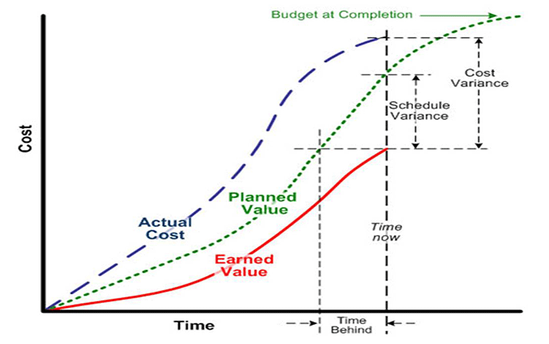
Earned Value Analysis (Cont’d….)
Source: [5]

Slide 16
Earned Value Analysis (Cont’d….)
Some Derived Metrics in EVA (parameters in EVA)
1. Variances | Formula | Interpretation
Cost Variance | CV = BCWP - ACWP | If CV is +ve, cost under run (actual budget expense is less than planned) If CV is -ve, cost overrun (actual budget expense is greater than planned) If CV is 0 No cost variance (actual expense is equal to planned)
Schedule Variance | SV = BCWP - BCWS | If SV is +ve, Schedule under run (actual schedule is ahead of planned) If SV is -ve, Schedule overrun (actual schedule is behind of planned) If SV is 0 No Schedule variance (actual Schedule is equal to planned)

Slide 17
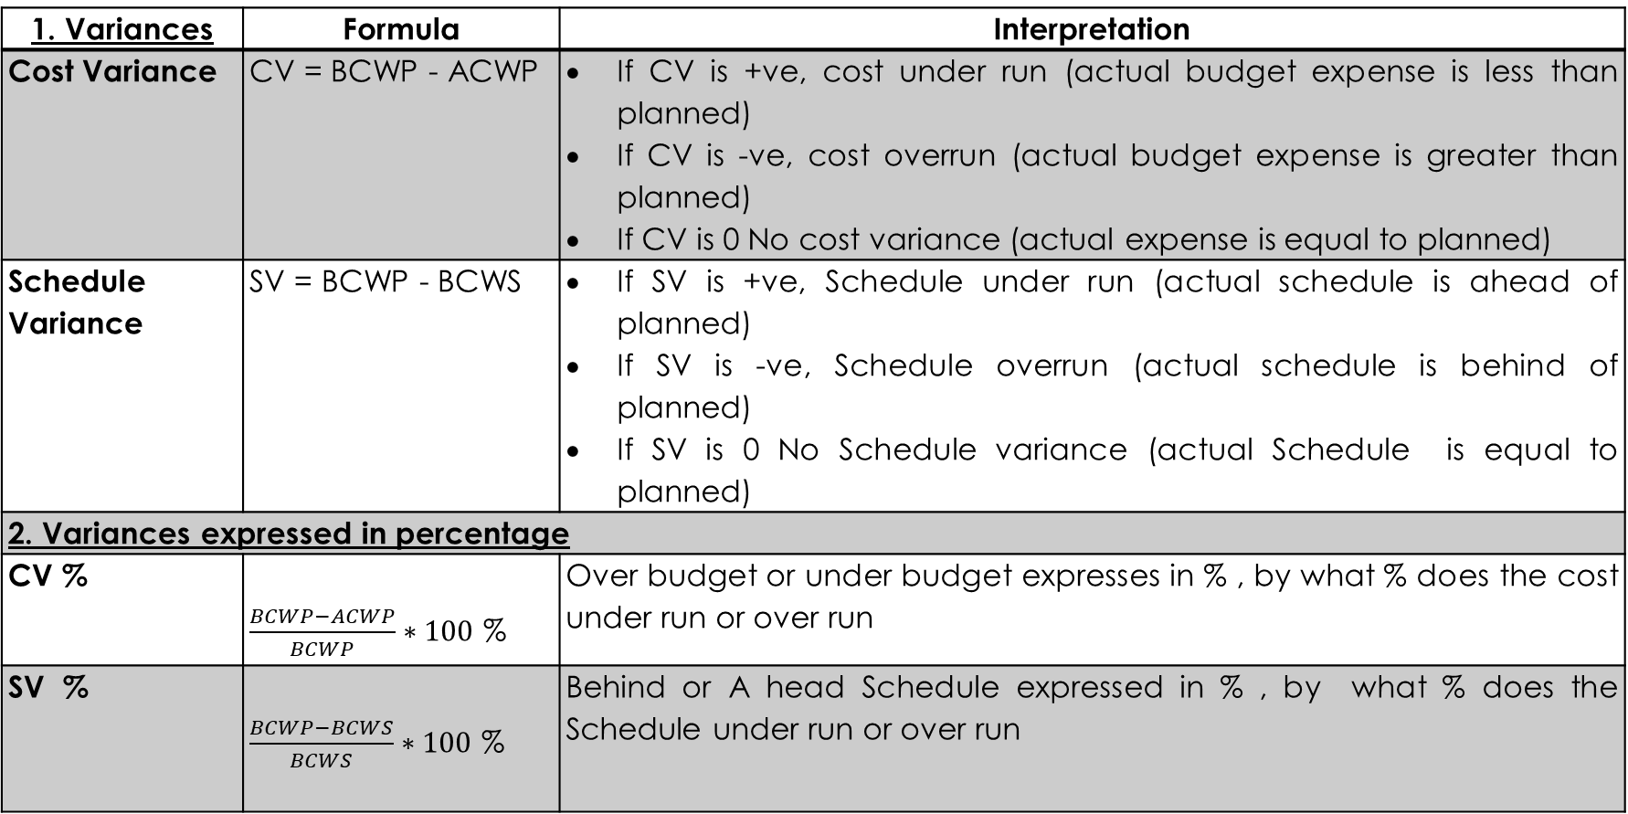
Earned Value Analysis (Cont’d….)
2. Variances expressed in percentage
CV % |  | Over budget or under budget expresses in % , by what % does the cost under run or over run
SV % |  | Behind or Ahead Schedule expressed in % , by what % does the Schedule under run or over run
3. Indices
Cost performance index | CPI = BCWP / ACWP | If CPI ≥ 1, Better Performance for Cost, less budget If CPI < 1, Poor Performance for Cost, more budget
Schedule Performance Index | SPI = BCWP / BCWS | If SPI ≥ 1, Better Performance in Schedule, ahead of schedule If SPI < 1, Poor Performance in Schedule, behind of schedule

Slide 18
Earned Value Analysis (Cont’d….)
4. Trends & Fore Cast
Estimate at Completion |  | EAC = Total project Cost / CPI
Schedule at Completion |  | SAC = Original project duration / SPI

Slide 19
Earned Value Analysis Example
Suppose that an activity had 5-day duration and was expected to cost $10, 000. Set into the project, and prior to finishing an activity, the following data were obtained about the progress done to that activity:
    Have so far worked for 3.5 days on activity.
    60% of an activity has been accomplished
    $ 8000 already spent on activity.
Perform the earned value analysis (EVA).

Slide 20
Earned Value Analysis Example (Cont’d…)
The following quantities can be easily computed:
ACWP = 8000
BCWP = 60%*10000 = 6000
BCWS = 3.5*10000/5 = 7000
Cost variance = BCWP – ACWP
= 6000-8000 = - 2000(over budget)
Schedule variance = BCWP – BCWS
= 6000 - 7000 = -1000 (behind the schedule)
Similarly,
CPI = BCWP/ACWP = 6000/8000 = 0.75(<1)
SPI = BCWP/BCWS = 6000/ 7000 = 0.86 (<1)

Slide 21
Earned Value Analysis Example (Cont’d…)
% overrun/under run = (8000-6000) / 6000
= 33.33% (+ve) (cost overrun)
From above, a new activity duration estimate can be computed using the following method:
New activity duration = original time estimate/ SPI
= 5/0.86
= 5.8 (i.e. 6 days)
New cost estimate = original cost estimate/CPI
= 10000/0.75
= $ 13333.33

Slide 22
CONCEPT of QUALITY
Quality is a perceptual, conditional, and somewhat subjective attribute and may be understood differently by different people.
Quality is
Degree of goodness
Conformance to requirements or specification
Zero defects
Fitness for use
Consistent conformance to expectation
Doing things right first time
Doing the right things

Slide 23
CONCEPT of QUALITY (Cont’d….)
Quality may be defined as “The totality of features and characteristics of a product or services which bear on its ability to satisfy stated or implied need”.
Quality Concept moves through different stages such as inspection, quality assurance, quality control, and total quality to reach the quality concept called Total Quality Management (TQM).
Quality is not grade.
Quality costs more but lack of quality costs even more.
Process quality is more than product quality.

Slide 24
CONCEPT of QUALITY (Cont’d….)
Quality Related Process
Process | Description | References
Quality Planning | Involves identifying the quality standards that are relevant to the project and determining how to ensure conformance to these standards. | ISO 8402:3.5
Quality Assurance | All the planned and systematic activities implemented within the quality system and demonstrated as needed, to provide adequate confidence that an entity will fulfil requirement for quality, | ISO 8402:3.5
Quality Control | The operational techniques and activities which together sustain the product, service or quality to specific requirements. | ISO 8402:3.5
Quality Inspection | It determines the acceptability of a product or a service or stages of construction. Includes measuring, examining and testing of product. | ISO 8402:2.15
Quality Audit | A systematic and independent examination to determine whether quality activities and related results comply with planned arrangements. | ISO 8402:4.9
Quality Improvement | Actions taken throughout the organization to increase the effectiveness and efficiency of activities. | ISO 9004-1:5.6
Source: [6]

Slide 25
Factors affecting quality in a project:
PROJECT QUALITY CONTROL
Quality in a project is :
The fulfillment of project responsibilities in the delivery of products and services in a manner that meets or exceeds the stated requirements and expectations of the owner, design professional, and constructor.
Design.
Drawings.
Specifications.
Bid document.
Selection of contractor.
Socio-economic factors.
Environmental factors.

Slide 26
PROJECT QUALITY CONTROL (Cont’d….)
The aim of quality control is to ensure the production of items for their intended use with defects and variations from their prescribed standards within limits prescribed. [7]
It also aims to avoid wastage of time, materials and money by highlighting the point at which a production process is becoming defective.
The cornerstone of quality control is specification.
Objectives
To maintain quality standards.
To ensure customer satisfaction.
To reduce costs associated with defective goods.

Slide 27
PROJECT QUALITY CONTROL (Cont’d….)
The process of quality control includes: [8]
Setting specific standards for construction performance, usually through plans and specifications.
Measuring variances from the standards.
Taking action to correct or minimize adverse variances and
Planning for improvements in the standards themselves and in conformance with the standards.

Slide 28
COST of QUALITY
Cost of quality is a combination of following costs:
Costs to control quality (prevention and appraisal)
Costs of failure to control quality (internal and external failures)
Cost of quality becomes the cost to the company of doing things wrong, of not conforming to the specification.
Qualities costs can be divided into four major categories the first two include the costs to try to control quality and the second two include the costs that result from failure to control quality.

Slide 29
COST of QUALITY (Cont’d…..)
Prevention costs:
The cost of preventing defective work is usually extended before the product is made or service rendered. These costs include:
Design reviews and drawing checks
Quality orientation program, education and training
Process control
Process orientations
Suppliers evaluation and presentation
Workers training

Slide 30
COST of QUALITY (Cont’d…..)
Appraisal costs:
The cost of appraisal is incurred for auditing service procedure to make sure they conform to prescribed work practices. These include
Process capability measurement (e.g. control charts)
Tests, gauges and test equipment
Prototype inspection and tests
In process and final inspection and tests
Checking material furnished by suppliers
Work in process goods testing and inspections

Slide 31
COST of QUALITY (Cont’d…..)
Internal failure costs:
Internal failure cost is applicable when the product is in factory and not been sold. These costs include:
Expenses for producing items that are scrapped
Redesign and reworking and downtime
Retesting defective items
Lost value of items sold as seconds
Cost of delays and administration time to review non conforming materials for disposition.

Slide 32
COST of QUALITY (Cont’d…..)
External failure costs:
These costs are applicable to goods when product has been sold. These costs include:
Warranty cost
Product liability (insurance and settlements)
Consumers affairs (dealing primarily with customer complaints about quality)
Field service (mostly repairs of what should have worked)
Product returns, recalls.

Slide 33
PROJECT MANAGEMENT INFORMATION SYSTEM (PMIS)
Project operates in a dynamic environment, the project manager at every level require information with speed, precision and economy.
PMIS is a database for the project which is designed for processing and systematizing the massive data generated in a project and feeding it to every level. [9]
PMIS collects, analyses, stores, retrieves and disseminates project information for making project decisions. [10]
It is a prerequisite of project control and vital for managing stakeholder expectations.

Slide 34
PROJECT MANAGEMENT INFORMATION SYSTEM (PMIS) (Cont’d…)
Requirements of PMIS
Project forms are filled – in periodically based on the measurement of progress of each activity.
The forms are entered in the PMIS and analysed to prepare a report for dissemination to all the concerned project personnel.
Corrective actions are taken by the project manager based on performance deviations identified by PMIS reports.
PMIS reports should identify critical points so that corrective actions can be taken.

Slide 35
OBJECTIVE OF PMIS
The main objective of the PMIS is to provide information to managers and supervisors of a firm in order to maximize its benefits through optimization of resources uses. Following are some of the specific objectives.
to reduce project duration
to make better use of resources
to increase resources productivity
to decrease cost/price
to bring the new facts to the knowledge
to reduce uncertainty in decision making

Slide 36
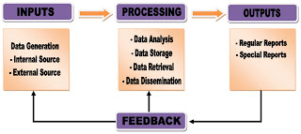
PROJECT MANAGEMENT INFORMATION SYSTEM (PMIS) (Cont’d…)
Source:[11]

Slide 37
REFERENCES
[1] Fundamentals of PERT/CPM and Project Management: S.K.Bhattacharjee, Second Edition, Khanna Publishers, New Delhi, India, 2002.
[2] PROJECT MANAGEMENT A System Approach to Planning, Scheduling and Controlling : Harold Krezner, Second Edition, CBS publishers and distributors, New Delhi, India, 1987.
[3] Project Management: K. Nagarajan, New Age International (P) Ltd. Publishers, New Delhi, India, 2001.
[4] https:/www.pmi.org/learning/library/earned-value-management-systems-analysis-8026
[5] https://dreamcivil.com/earned-value-analysis/

Slide 38
REFERENCES (Cont’d….)
[6] Text Book of Construction Management: S.K.Shrestha, Ram Kumar Shrestha and Subash Bhattarai, First Edition, Heritage Publisher and Distributor Pvt. Ltd, Kathmandu, Nepal, 2014.
[7] Construction Management And Accounts: B.L.Gupta and Amit Gupta, Third Edition, Standard Publishers Distributors, New Delhi, India, 2000.
[8] Professional Construction management: Donald S. Barrie and Boyd C. Paulson Jr., Third Edition, McGraw Hill, Inc., 1992.
[9] Project Management : Dhurba P. Rizal, First Edition, Ratna Pustak Bhandar, Kathmandu, Nepal, 2001.

Slide 39
REFERENCES (Cont’d….)
[10]Project Management in Nepal: Dr. Govinda Ram Agrawal, M.K. Publishers and Distributors, Kathmandu, Nepal, 2006 edition.
[11]https:/analysisproject.blogspot.com/2012/08/project-management-information-system.html

