Slide 1
COURSE TITLE
PROJECT ENGINEERING
Chapter 5 - (Week 10)
PROJECT RISK MANAGEMENT
LECTURE – 10
Introduction to Project Risk, Nature and Types of Project Risk. Analysis of Major Source of Risk and Effective Risk Management.
Er. Ishwar Adhikari
Associate Professor
Kathmandu Engineering College, Nepal

Slide 2
Learning Objective
The main objective of this lecture is to understand about :
Project risk.
Nature of project risk
Types of project risk.
Analysis major source of risks.
Effective management of project risk

Slide 3
INTRODUCTION TO PROJECT RISK
Resources /Risk
Resources
Risk
Start
End
Initiation
Planning
Implementation
Engineering and design
Termination
Fig: Project Life Cycle

Slide 4
INTRODUCTION TO PROJECT RISK (Cont’d…)
Initially the risks and uncertainties level of the project are high.
As project proceeds its phases the risk and uncertainties decreases.
However, the project risk is never defined as zero. Effective Risk Management is essential in project to avoid failure.
Every project is risky, meaning there is a chance things won't turn out exactly as planned.
Project outcomes are determined by many things, some that are unpredictable and over which project managers have little control.

Slide 5
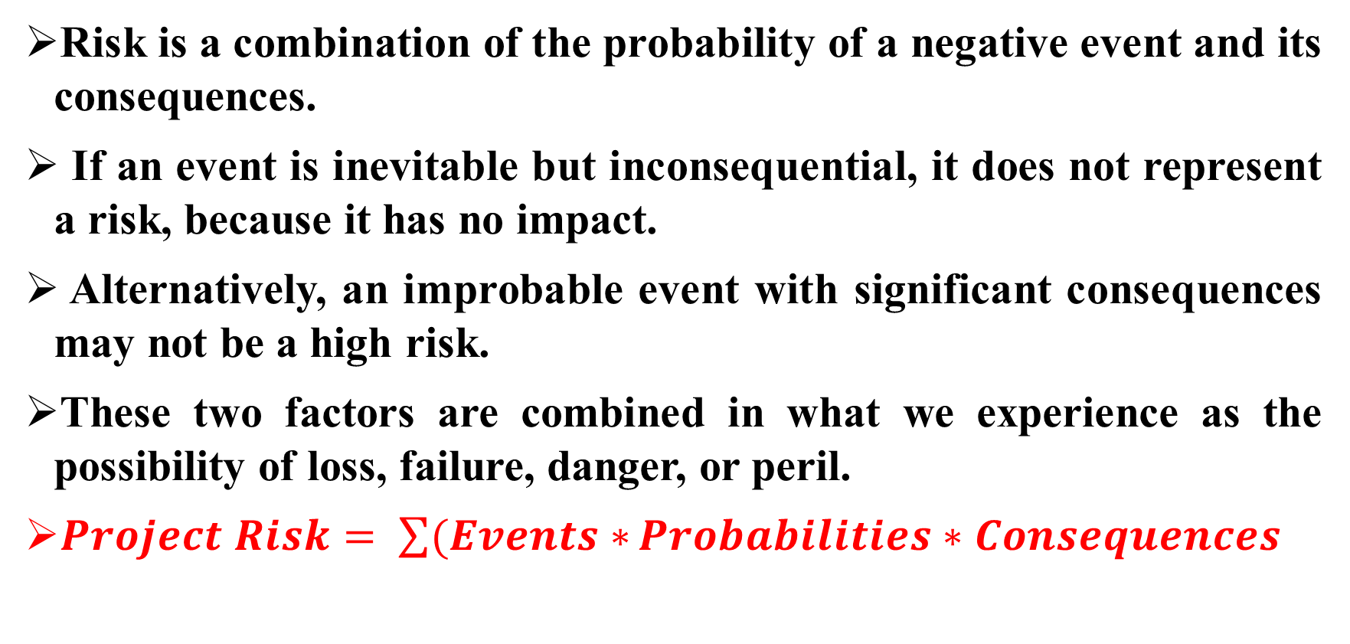
INTRODUCTION TO PROJECT RISK (Cont’d…)
Risk is a combination of the probability of a negative event and its consequences.
If an event is inevitable but inconsequential, it does not represent a risk, because it has no impact.
Alternatively, an improbable event with significant consequences may not be a high risk.
These two factors are combined in what we experience as the possibility of loss, failure, danger, or peril.
$Project Risk= \sum{(Events∗}Probabilities∗Consequences$

Slide 6
INTRODUCTION TO PROJECT RISK (Cont’d…)
Project risk is an uncertain event or condition that, if it occurs, has a positive or negative effect on a project objective. [1]
A risk has a cause and, if it occurs, an impact.
For example, the cause may be having limited personnel assigned to the project.
The risk event is that may take longer than planned or the personnel may not be adequate for the task.
Project risk includes both threats to the project’s objectives and opportunities to improve on those objectives.

Slide 7
INTRODUCTION TO PROJECT RISK (Cont’d…)
The risk concept is broken down into two main criteria: [2]
the probability, which is the possibility of an undesirable occurrence, such as a cost overrun, and
the impact, which is the degree of seriousness and the scale of the impact on other activities if the undesirable thing happens.
Using a mathematical description, a risk is described as follows:
R=P×I
Where R is the degree of risk, within [0,1] P is the probability of the risk occurring, within [0,1], I is the degree of impact of the risk, which is defined as being within [0,1]".

Slide 8
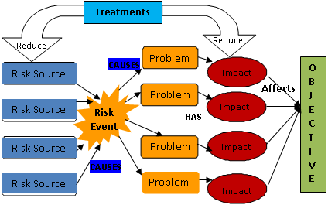
INTRODUCTION TO PROJECT RISK (Cont’d…)
Fig: Risks have sources and impact objectives if untreated
Source: [3]

Slide 9
NATURE OF PROJECT RISK
1. Nation/Region
Political situation- war, revolution, civil disorders inconsistency of government policy.
Economical and Financial Situation – GNP decreases, incompatible GNP, per capita, interest rate fluctuation, Inflation rate increasing, Currency exchange rate fluctuation, tax rate increasing.
Social Environment- Language barrier, Religious inconsistency, Culture tradition differences, insecurity and crime, Pestilence, Bribe and corruption, Popular in informal relationships, brotherhood.

Slide 10
NATURE OF PROJECT RISK (Cont’d…)
      2. Construction industry
Market fluctuations- demanding decreasing structure changes.
Law and Regulations- Incompatible arbitration system, complex planning approval and permit procedures, Import/export restrictions constraints on employment and materials availabilities, monetary restrictions.
Standards and codes- inconsistencies in design/construction, Differences in safety and health care, Pollutions and nuisances.
Contract system- Nonstandard contract form, difference in legal relationship between partners, Unfamiliar with contract conditions for claims and litigations, differences in defective liabilities, special local requirements.

Slide 11
NATURE OF PROJECT RISK (Cont’d…)
3. Company
Employer/Owner- Unclear requirements, funding shortages, disadvantaged contracts
Architect- Unclear detail design or specifications, Unfamiliar with local standards and codes, Lack of interaction with construction method
Labor and Sub contractors- Direct labor disturbances, Unfavorable sub contractors.

Slide 12
NATURE OF PROJECT RISK (Cont’d…)
4. Internal
Cash flow unbalance, Human resources shortages, affecting other projects productivity decreases.
5. Materials and Equipment
Unfavorable sub-suppliers, default supply of materials, equipment and plants.
6. Force Majeure
Earthquake, fire, flood, bad weather and other events which are very difficult to predict.

Slide 13
NATURE OF PROJECT RISK (Cont’d…)
7. Project
Defective physical works – natural force, poor design, lack of proper construction techniques, damages by human errors, defective materials, difficulty in quality control.
Schedule delay- incomplete design, late construction site possession, bad weather, unforeseen ground conditions, disturbances in labor, materials supplying, inefficient communications/ coordination.
Cost Overrun- - unclear boundaries of works, inaccurate estimation, inadequate insurances, labor/materials/ price fluctuations.

Slide 14
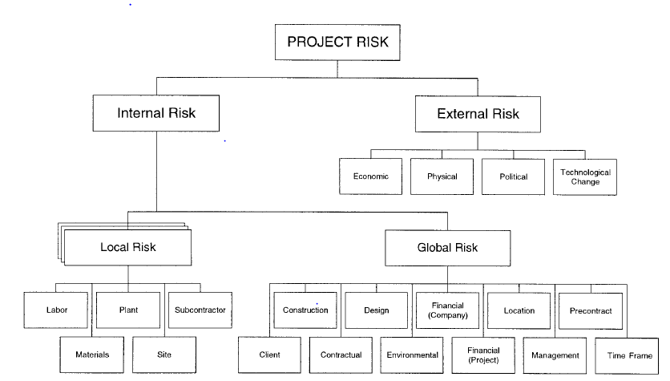
TYPES OF PROJECT RISKS
Source: [4]

Slide 15
TYPES OF PROJECT RISKS (Cont’d….)
Every project is different and it is not possible to compile an exhaustive list of risks or to rank them in order of priority.
What is a major risk for one project may be quite minor for another.
In a vacuum, one can just discuss the risks that are common to most projects and possible avenues for minimizing them.
However, it is helpful to categorize the risks according to the phases of the project within which they may arise:
(1) The design and construction phase;
(2) The operation phase; or
(3) Either phase.

Slide 16
TYPES OF PROJECT RISKS
1. Construction Phase Risk
Completion Risk
This phase carries the greatest risk for the financier.
Construction carries the danger that the project will not be completed on time, on budget or at all because of technical, labor, and other construction difficulties.
The elements which restricts project to be completed can be financial, contractual, operational, and environmental and can be caused by both internal and external sources.

Slide 17
TYPES OF PROJECT RISKS (Cont’d….)
Common risks in completion include: [5]
Safety hazards that lead to worker accidents and injuries
Managing change orders
Incomplete drawings and poorly defined scope
Unknown site conditions and poorly written contracts
Unexpected increases in material costs
Labor shortages and damage or theft to equipment and tools
Natural disasters and issues with contractor and suppliers.
Availability of building materials and poor project management

Slide 18
TYPES OF PROJECT RISKS (Cont’d….)
2. Operation Phase Risk
(a) Resource/Reserve Risk
The risk that a firm or organization will be unable to operate at the same level of capacity and/or operate profitably in the future due to the decline (or exhausting) of the quantity and/or quality of the economic reserves of a core product or commodity. [6]
This is the risk that for a mining project, rail project, power station or toll road there are inadequate inputs that can be processed or serviced to produce an adequate return.

Slide 19
TYPES OF PROJECT RISKS (Cont’d….)
(b) Operating Risk
Operational risk is the risk of loss resulting from ineffective or failed internal processes, people, systems, or external events that can disrupt the flow of business operations. The losses can be directly or indirectly financial. [7]
These are general risks that may affect the cash-flow of the project by increasing the operating costs.
Operating risks include, for example, the level of experience and resources of the operator, inefficiencies in operations or shortages in the supply of skilled labor.

Slide 20
TYPES OF PROJECT RISKS (Cont’d….)
(c) Market/Off-Take Risk
Market risk is the risk that a buyer cannot be found for the product at a price sufficient to provide adequate cash-flow to service the debt.
The best mechanism for minimizing market risk before lending takes place is an acceptable forward sales contact entered into with a financially sound purchaser.

Slide 21
TYPES OF PROJECT RISKS (Cont’d….)
3. Construction and Operation Phase Risk
(a) Participants /Credit Risk
These are the risks associated with the sponsors or the borrowers themselves.
The question is whether they have sufficient resources to manage the construction and operation of the project and to efficiently resolve any problems which may arise.
To minimize these risks, the financiers need to satisfy themselves that the participants in the project have the necessary human resources, experience in past projects of this nature and are financially strong.

Slide 22
TYPES OF PROJECT RISKS (Cont’d….)
(b) Technical Risk
Technical risks are those events or issues associated with the scope definition, research and development (R&D), design, construction, and operation that could affect the actual level of performance vs. that specified in the project mission need and performance requirements documents. [8]
Examples of technical risks include new and changing technology and changing regulatory requirements.
Financiers usually minimize this risk by preferring tried and tested technologies to new unproven technologies.

Slide 23
TYPES OF PROJECT RISKS (Cont’d….)
(c) Political Risk
This is the danger of political or financial instability in the host country caused by events such as insurrections, strikes, suspension of foreign exchange, creeping expropriation and outright nationalization.
(d) Force Majeure Risk
This is the risk of events which render the construction or operation of the project impossible, either temporarily (eg. minor floods) or permanently (e.g. complete destruction by fire).

Slide 24
ANALYSIS OF MAJOR SOURCE OF RISK
1. Change in project scope and requirements
As a project progresses, a project team may later find that a planned project scope and requirements need to be revised due to changes in user requirements, more information gathered, and technical feasibility.
As the project needs to be revised according to new scope and requirements, the impacts are typically in form of inefficiency, disruption, delay and increased cost.
This source of project risk often occurs in later stage of the project.

Slide 25
ANALYSIS OF MAJOR SOURCE OF RISK (Cont’d….)
2. Design errors and omissions
In any project, it is possible that someone does unintentional errors or omits to implement the project as planned.
Due to the complex of the project and tight time frame, a project team may misunderstand due to ineffective communication.
The examples of this source of risk are deficiency design document, improperly sized equipment, design calculation errors. Therefore, the impact includes delay of the project and additional costs.

Slide 26
ANALYSIS OF MAJOR SOURCE OF RISK (Cont’d….)
3. Inadequately defined roles and responsibilities
This source of project risk is deemed a common source in any typical project because of changes in project management structure and ambiguous roles and responsibility.
Inadequately defined roles and responsibilities can cause substantial and various project risks at any stage from the starting of the project to the ending of the project.
The noticeable examples of this source of risk are ineffective project communication, different expectation, and lack of common direction. The impact includes overall project inefficiency, disruption and delay.

Slide 27
ANALYSIS OF MAJOR SOURCE OF RISK (Cont’d….)
4. Inaccurate cost and schedule estimates
This source of risk results from ineffective project planning at the early stage of the project.
If the cost and schedule of the project are not accurately planned and estimated, the entire project will be in the wrong direction and many issues will be escalated.
The example of risk resulting from inaccurate cost and schedule estimates includes incorrect from project timeline and budget.
The impact includes poor coordination, ineffective use of resources, delay of the project and increased project cost.

Slide 28
ANALYSIS OF MAJOR SOURCE OF RISK (Cont’d….)
5. Force majeure
This is the source of risk that is uncontrollable.
Force majeure includes Acts of God, insurrection or civil disorder, war or military operations, national or local emergency, acts or omissions of Government or any competent authority, industrial disputes of any kind, fire, lightning, explosion, flood, subsidence, and inclement weather.
All of these will adversely affect that project. In worst case, the impact is the complete stoppage of work.

Slide 29
EFFECTIVE MANAGEMENT OF PROJECT RISK
Risk management is the systematic process of planning for, identifying, analysing, responding to, and monitoring project risk. [1]
It involves processes, tools, and techniques that will help the project manager maximize the probability and consequences of positive events and minimize the probability and consequences of adverse events.
Project risk management is most effective when first performed early in the life of the project and is a continuing responsibility throughout the project.

Slide 30
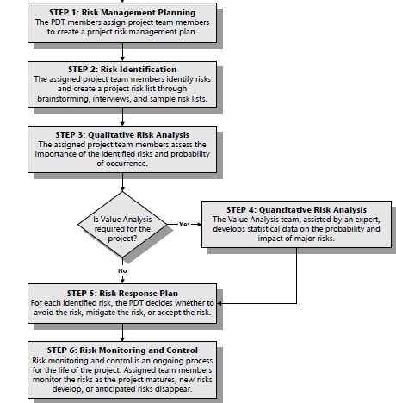
EFFECTIVE MANAGEMENT OF PROJECT RISK
Source:[9]

Slide 31
EFFECTIVE MANAGEMENT OF PROJECT RISK (Cont’d….)
Risk Management Planning
As part of work plan development, project development team (PDT) members assign project team members to create a project risk management plan.
At this point, the assigned project team members begin to create the risk management plan.
The risk management plan identifies and establishes in the project plan the activities of risk management for the project.
To prepare the risk management plan, the assigned project team members use a spreadsheet that shows the risks and responses in an abbreviated form.

Slide 32
EFFECTIVE MANAGEMENT OF PROJECT RISK (Cont’d….)
2. Risk Identification
Risk identification is identifying and defining potential risks that could impact the success of a project.
The risk identification process includes defining the project scope, identifying potential risks, assessing the likelihood and impact of each risk, and developing mitigation plans for the most critical risks. [10]
Risk management plan and risk break down structures are required for the risk identification process.
The various sources are analyzed in order to identify the associated risk with the project through risk identification.

Slide 33
EFFECTIVE MANAGEMENT OF PROJECT RISK (Cont’d….)
There are several techniques organizations can use to identify risks including brainstorming, root cause analysis, SWOT analysis, and expert judgment.
Risk Register (RR)
Risk register is a record to document the results of the risk management process. It contains the following information.
  List of identified risks with description
  List of potential responses
  Root causes of risk
  Updated risk categories

Slide 34
EFFECTIVE MANAGEMENT OF PROJECT RISK (Cont’d….)
3. Qualitative and Quantitative Risk Analysis
Qualitative risk analysis assesses the importance of the identified risks and develops prioritized lists of these risks for further analysis or direct mitigation.
The team assesses each identified risk for its probability of occurring and its impact on project objectives.
Team members sort the identified risks into high, moderate, and low risk categories for each project objective (time, cost, scope).
Qualitative risk analysis is quick but subjective.

Slide 35
EFFECTIVE MANAGEMENT OF PROJECT RISK (Cont’d….)
On the other hand, Quantitative risk analysis is a way of numerically estimating the probability that a project will meet its cost and time objectives.
Quantitative analysis is based on a simultaneous evaluation of the impact of all identified and quantified risks.
Quantitative risk analysis involves statistical techniques that are most easily used with specialized software.
Quantitative risk analysis is objective and has more detail, contingency reserves and go/no go decisions, but it takes more time and is more complex. [11]

Slide 36
EFFECTIVE MANAGEMENT OF PROJECT RISK (Cont’d….)
4. Risk Response Planning
Risk response planning addresses the matter of how to deal with risk.
Risk response must be proportional to the severity of the risk, cost effective, timely, realistic and accepted as well as owned by all concerned parties of the risk management.
Risk response planning focuses on the high-risk items evaluated in the qualitative and/or quantitative risk analysis.
It identifies and assigns parties to take responsibility for each risk response.

Slide 37
EFFECTIVE MANAGEMENT OF PROJECT RISK (Cont’d….)
Avoid
Transfer
For Threat
Mitigate
Risk Response Planning
Accept
Exploit
Share
For opportunity
Enhance
Accept

Slide 38
EFFECTIVE MANAGEMENT OF PROJECT RISK (Cont’d….)
Avoidance:
The team changes the project plan to eliminate the risk or to protect the project objectives from its impact.
The team might achieve this by changing scope, adding time, or adding resources.
Transference:
The team transfers the financial impact of risk by contracting out some aspect of the work.
Transference reduces the risk only if the contractor is more capable of taking steps to reduce the risk and does so.

Slide 39
EFFECTIVE MANAGEMENT OF PROJECT RISK (Cont’d….)
Mitigation:
The team seeks to reduce the probability or consequences of a risk event to an acceptable threshold.
They accomplish this via many different means that are specific to the project and the risk.
Acceptance:
The project manager and the project team decide to accept certain risks.
They do not change the project plan to deal with a risk, or identify any response strategy other than agreeing to address the risk if and when it occurs.

Slide 40
EFFECTIVE MANAGEMENT OF PROJECT RISK (Cont’d….)
5. Risk Monitoring and Controlling
Risk monitoring and control keeps track of the identified risks, residual risks, and new risks.
It also ensures the execution of risk response plans, and evaluates their effectiveness.
Risk monitoring and control continues for the life of the project. The list of project risks changes as the project matures, new risks develop, or anticipated risks disappear.
Risk monitoring and control is carried out by Risk Reassessment, Risk audits, Reserve Analysis and Status meetings.

Slide 41
REFERENCES
[1] A Guide to the Project Management Body of Knowledge (PMBOK): 2000 Edition, Project Management institute, Newton Square, Pennsylvania, USA.
[2] Risk management for overseas construction projects: Zhi. H, International Journal of Project Management 13 (1995) 231-237.
[3] Project Risk Management Guideline: Department of Commerce, Office of information and communications technology, Issue No 3.1, Sep 2004, NSW, Australia .
[4] KNOWLEDGE-BASED APPROACH TO CONSTRUCTION PROJECT RISK MANAGEMENT: J. H. M. Tah and V. Carr, Journal of computing in civil engineering, July 2001.

Slide 42
REFERENCES (Cont’d…)
[5] https://www.constructconnect.com/blog/identifying-managing-construction-project-risks
[6] https://www.52risks.com/strategic-risks/reserves-risk/
[7] https://www.auditboard.com/blog/operational-risk-management/
[8] Probabilistic Risk and Hazards Analysis Group: John P. Kindinger and John L.Darby, Los Alamos National Laboratory, Proceedings of the Project Management Institute Annual Seminars & Symposium, September 7–16, 2000,USA
[9] Project Risk Management Handbook: First Edition, Revision 0, Office of Project Management Process Improvement, June 26, 2003.

Slide 43
REFERENCES (Cont’d…)
[10] www.wallstreetmojo.com/risk-identification
[11] www.isaca.org/resources/news-and-trends/isaca-now-blog/2021/qualitative-vs-quantitative-risk-assessment

