Slide 1
COURSE TITLE
PROJECT ENGINEERING
Chapter 7 - (Week 12)
PROJECT MAINTENANCE
LECTURE – 12
Maintenance basics, Types of Maintenance. Planning and Scheduling Maintenance, Estimating Maintenance and Management of maintenance and financing.
Er. Ishwar Adhikari
Associate Professor
Kathmandu Engineering College, Nepal

Slide 2
Learning Objectives:
The main objective of this lecture is to understand about :
Maintenance Basics
Types of Maintenance
Planning and Scheduling Maintenance
Estimating Maintenance
Management of Maintenance and Financing

Slide 3
MAINTENANCE BASICS
After the project is handed over to the customer in the termination phase of the project, the role of maintenance comes into play.
Maintenance plays an important role for the smooth operation of the project or making the facility to run without any disturbances.
Maintenance includes the repair or preservation of an existing facility to prevent that facility’s deterioration to an unsafe or irreparable state, or which involves the treatment of an existing facility to meet acceptable standards of operation or aesthetic quality.

Slide 4
MAINTENANCE BASICS (Cont’d…)
Maintenance Management is an orderly and systematic approach of administrative, financial, and technical framework for assessing, planning, organizing, monitoring and evaluating maintenance and operation activities and their costs on a continual basis. [1]
Maintenance management indicates all those activities and efforts which ensure a continuous good working production flow by utilizing maximum capacity of plant and process. [2]

Slide 5
MAINTENANCE BASICS (Cont’d…)
Project maintenance means all activities to maintain, repair, and replace the project, and any parts thereof after the project is completed. [3]
Project maintenance is the process of tracking and enabling project activities in accordance with the project plan.
Project maintenance means to perform the activities required for regular and smooth running or operation of project after it has been put into work.
Maintenance management is the overall process of getting works done related with maintenance of plants, machineries or systems.

Slide 6
MAINTENANCE BASICS (Cont’d…)
A project may keep on functioning well for its design period unless any defects or problems come before it.
Some activity may be to bring back the system to its original functional status from that of undesirable nonfunctional one.
So the maintenance of a project is the activity required to check the probable damages or to correct any deficiencies cropped upon in the system.
Within the context of maintenance, 'Failure' is defined as an inability to produce works in an appropriate manner.

Slide 7
OBJECTIVE OF MAINTENANCE
To ensure product and service quality and satisfaction to customers.
To increase the economic life of the infrastructure/system and to provide easy operation with optimum service/ production /supply. Also to reduce risk and mitigates the disaster.
To maximize the availability and reliability of all assets, especially a system plant, equipment and machinery and to obtain a maximum possible return on investment.
To extend the life of assets by minimizing wear and tear and deterioration.

Slide 8
OBJECTIVE OF MAINTENANCE (Cont’d…)
To ensure the safety of personnel using equipment/facilities.
To minimize the frequency and severity of interruptions to the operating process.
To plan and schedule maintenance work
To increase the reliability of the system.
To ensure operational readiness of all equipment required for emergency use at all time such as standby units, firefighting units, and rescue units.

Slide 9
IMPORTANCE OF MAINTENANCE
In any engineering project, the errors and problems are accumulated unless regular and timely maintenance is carried out. The maintenance prevents the following consequences:
System deterioration
Structural failure: The whole or part of a structure may fail or collapse due to various reasons which are termed as structural failure.
Mechanical failure: Some mechanical devices in a project when used under the continuous operation may reduce its effective size and failure occurs which is mechanical failure.

Slide 10
IMPORTANCE OF MAINTENANCE (Cont’d…)
Reduces services and problems in management
To achieve the adequacy, reliability, efficiency, an effective and regular maintenance is essential.
Poor project operation
The project which has poor management does increase in cost for rehabilitation than repair.
Frequent and costly rehabilitation
A small repair in time would save costly rehabilitation in the future. It is cheaper to carry out preventive works than the extended rehabilitation.
5. Long production time

Slide 11
TYPES OF MAINTENANCE
Source: [4]

Slide 12
TYPES OF MAINTENANCE (Cont’d…)
Planned maintenance
Maintenance works organized and carried out with forethought, control and use of records to a predetermined plan.
Planned maintenance is the studied evaluation of all plant with the intention of carrying out any maintenance before it is actually needed through breakdown or obvious deterioration in performance, with the aim of reducing emergency maintenance and associated costs in machine stoppage. [4]

Slide 13
TYPES OF MAINTENANCE (Cont’d…)
Planned maintenance can help you avoid the high costs associated with responding to breakdowns while decreasing the risk of accidents, and keeping production at an optimal rate.
The idea behind planned maintenance is to minimize the need for unplanned maintenance and reduce the overall cost of maintenance over the lifespan of the equipment.
This can save money and improve operational efficiency by reducing asset downtime and maximizing productivity.

Slide 14
TYPES OF MAINTENANCE (Cont’d…)
Preventive maintenance
Based on principle ‘prevention is better than cure’.
This type of maintenance is used in those cases where deterioration and failure patterns of an item are known.
The routine inspections and servicing are designed to detect potential failure conditions and suggest action, which may range from minor or major repairs to replacing parts.
Preventive maintenance can be carried out on machines either when running or during the shutdown.
Time Based Maintenance
Work Base Maintenance
Opportunity Base Maintenance
Condition Base Maintenance

Slide 15
TYPES OF MAINTENANCE (Cont’d…)
Preventive Maintenance can be classified as
Running Maintenance
Maintenance which can be done when the item is in service. This maintenance is carried out in a project so as to keep and efficient daily operation.
Examples: lubrication, tightening of loose nut and bolts, adjustment of nut and screw.
Shutdown Maintenance
Maintenance, which is carried out when the project is out of service.
These are generally performed after 3 or 6 months.

Slide 16
TYPES OF MAINTENANCE (Cont’d…)
Corrective Maintenance
Corrective maintenance is done after the plant, machinery or the system is out of the order to bring them in a satisfactory operating condition.
In this type, action such as repair, replacement or restore will be carried out after the occurrence of the failure in order to eliminate the source of the failure and reduce the frequency of its occurrence. [5]
This is carried out to restore an item to the acceptable standard where replacement is not advisable.

Slide 17
TYPES OF MAINTENANCE (Cont’d…)
Corrective Maintenance can be further classified as
Breakdown Maintenance
Breakdown maintenance is maintenance performed on a piece of equipment that has broken down, faulted, or otherwise cannot be operated. [6]
The goal of breakdown-maintenance is to fix something that has malfunctioned.
Maintenance work implemented only when facilities or equipment fail to operate.

Slide 18
MAINTENANCE PLANNING AND SCHEDULING
Maintenance planning and scheduling are key elements that influence the true success of any organization.
Objectives:
Minimizing the idle time of maintenance workers.
Maximizing the efficient use of work time, material, and equipment.
Maintaining the operating equipment at a responsive level to the need for production in terms of delivery schedule and quality.
An essential part of planning and scheduling is to forecast future work and to balance the workload between these categories.

Slide 19
MAINTENANCE PLANNING AND SCHEDULING (Cont’d…)
Reduce maintenance cost.
Improved utilization of the maintenance workforce by reducing delays and interruptions.
Improved quality of maintenance work by adopting the best methods and procedures and assigning the most qualified workers for the job.
An essential part of planning and scheduling maintenance is to forecast future work and to balance the workload between these categories. [7]

Slide 20
WHY DO WE FAIL ?
MAINTENANCE PLANNING AND SCHEDULING (Cont’d…)
Reasons Why Maintenance Planning is Not Effective
We don’t know what good planning looks like (We don’t practice this in a regular basis)
We don’t separate the maintenance planning and maintenance scheduling
We think it is all about the planner/scheduler, and rest of us can still be reactive
Preventive maintenance is conducted and yet failures continue !
No focus, or little focus on prevention or identification of failure modes !
Responsibility assignment (focal point)
Inventory/Store Management
Procurement Management

Slide 21
MAINTENANCE PLANNING
Maintenance planning can be defined as an end-to-end process that identifies and addresses any possible issues ahead of time. [8]
Maintenance planning should define the "what," "why" and "how.
Planning is the process by which the elements required to perform a task are determined in advance of the job start.
It highlights possible issues ahead of time and outlines strategies to address them. For example, maintenance planning identifies the tools and resources required for the job.

Slide 22
MAINTENANCE PLANNING (Cont’d…)
It should specify what work needs to be done with what materials, tools and equipment; why a particular action was chosen and how the work should be completed.
Maintenance Planning comprises all the functions related to the preparation of:
The work order
Bill of material
Purchase requisition
Necessary drawings
Labor planning sheet including standard times
All data needed prior to scheduling and releasing the work order.

Slide 23
MAINTENANCE PLANNING (Cont’d…)
Basic Levels of Planning Process
Long-range planning: it covers a period of 3 to 5 years and sets plans for future activities and long-range improvement.
Medium-range planning: it covers a period of 1 month to 1 year.
Short-rang planning: it covers a period of 1 day to 1 week. It focuses on the determination of all the elements required to perform maintenance tasks in advance.
Good planning is prerequisite of good scheduling.

Slide 24
MAINTENANCE PLANNING (Cont’d…)
Planning Procedures
Determine the job content.
Develop a work plan. This entails the sequence of the activities in the job and establishing the best methods and procedures to accomplish the job.
Establish crew size for the job.
Plan and order parts and material.
Check if special tools and equipment are needed and obtain them.
Assign workers with appropriate skills.
Review safety procedures.

Slide 25
MAINTENANCE PLANNING (Cont’d…)
Set priorities for all maintenance work.
Assign cost accounts.
Complete the work order.
Review the backlog and develop plans for controlling it.
Predict the maintenance load using effective forecasting technique.

Slide 26
MAINTENANCE SCHEDULING
It is the process by which jobs are matched with resources and sequenced to be executed at a certain point in time.
Scheduling deals with the specific time and phasing of planned jobs together with the orders to perform the work, monitoring the work, controlling it, and reporting on job progress.
Successful planning needs feedback from scheduling.
Maintenance Schedule Can be Prepared at Three Levels
Long-range (master) schedule
Weekly schedule
Daily schedule

Slide 27
MAINTENANCE SCHEDULING (Cont’d…)
Requirements for effective scheduling:
Written work orders that are derived from a well-conceived planning process. (Work to be done, methods to be followed, crafts needed, spare parts needed, and priority).
Time standards.
Information on the availability of special equipment and tools necessary for maintenance work.
Access to the plant production schedule and knowledge about when the facilities will be available for service without interrupting production schedule.

Slide 28
MAINTENANCE SCHEDULING (Cont’d…)
Information about craft availability for each shift.
Well-define priorities for maintenance work.
Information about jobs already scheduled that are behind the schedule (backlog).
Stocks of spare parts and information on restocking.
Techniques used for maintenance scheduling are Scheduling Techniques are Modified Gantt chart , CPM, PERT, Integer and stochastic programming.

Slide 29
ESTIMATING MAINTENANCE COST
Maintenance expenses are costs incurred for the routine maintenance of an asset to keep it in its optimal working condition.
Maintenance expenses are recorded in the profit and loss account, thus reducing the profit for the year.
The benefits of maintenance expenses are not expected to last beyond a period of 12 months.
The operation and maintenance cost in subsequent years over the project life cycle includes Land rent, if applicable, operating staff, labor and material for maintenance and repairs, periodic renovations, insurance and taxes, financing costs, utilities, owner's other expenses.

Slide 30
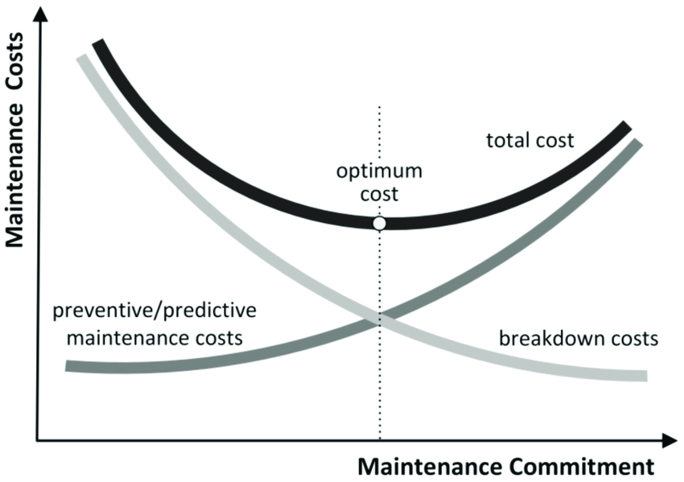
ESTIMATING MAINTENANCE COST (Cont’d..)
To carry out maintenance activities some direct cost are evolved.
The investment in direct cost results from the sound operation of plant and machinery that minimizes failure cost.
It is always recognized that the direct cost involved in regular maintenance is very less compared to the resulting failure cost due to a breakdown of the machine if maintenance is not carried out in time.
Source: [9]

Slide 31
ESTIMATING MAINTENANCE COST (Cont’d..)
Costing the intended maintenance program is an easy operation because the amount of work to be done has been determined and the basic unit prices are known.
It may be important to present a detailed justification for some of the intended works emphasizing the consequences (financial and social) if they are not carried out.
It is also advisable to earmark some funds for unexpected repairs. About up to 5 percent of the total budget for this purpose is generally accepted. [4]

Slide 32
MANAGEMENT OF MAINTENANCE AND FINANCING
Management of maintenance/Maintenance management is the overall process of getting works done related with maintenance of plants, machineries or systems.
Management of maintenance/Maintenance management generally consists of:
  Setting objectives
  Identifying and providing the means of attaining the set objectives
  Decision making

Slide 33
MANAGEMENT OF MAINTENANCE AND FINANCING (Cont’d….)
An effective maintenance management system covers/includes the following factors/elements:
  Maintenance policy
  People
  Control of materials
  Preventive maintenance
  Condition monitoring
  Work order
  Job planning
  Technology
  Finance
  Priority and backlog control
  Periodic review
  Data recording system
  Performance measurement measures or indices
  Learning

Slide 34
MANAGEMENT OF MAINTENANCE AND FINANCING (Cont’d….)
Finance is the field within economics that deals with the allocation of assets and liabilities over time under conditions of certainty and uncertainty. It is the science of money management.
A key point in finance is the time value of money, which states that one unit of currency today is worth more than one unit of currency tomorrow.
Finance aims to price assets based on their risk level and their expected rate of return.

Slide 35
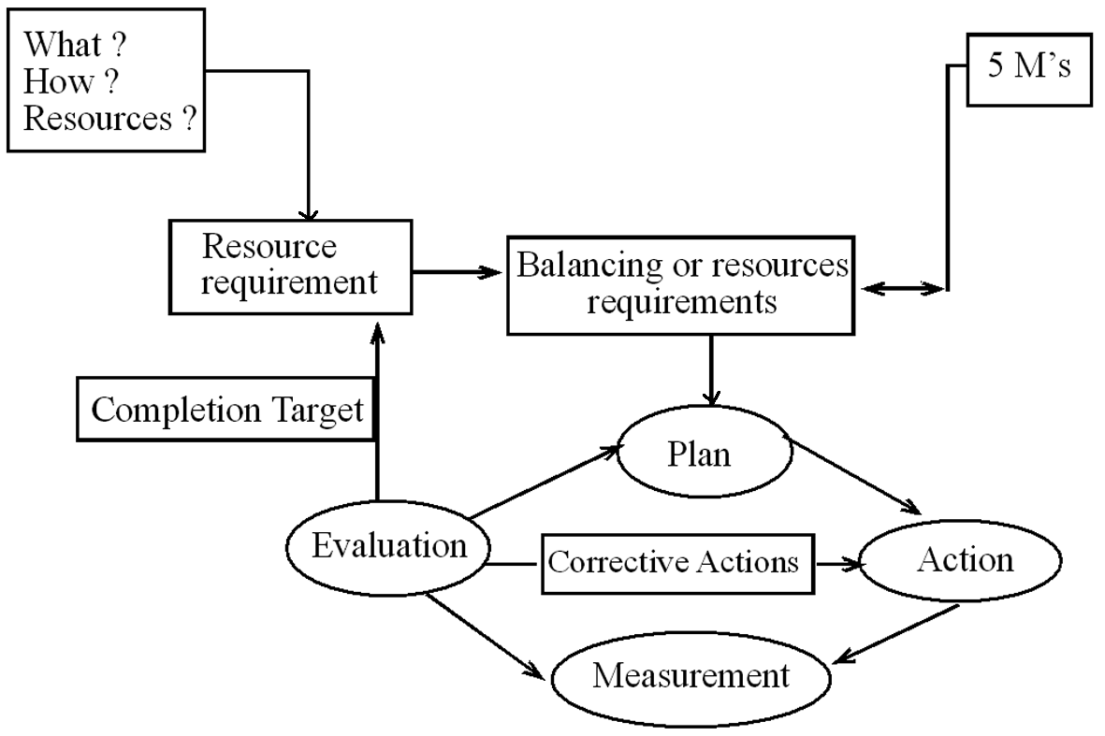
Maintenance Management Cycle

Slide 36
Maintenance Management Process

Slide 37
REFERENCES:
[1] www.linkedin.com/pulse/introduction-maintenance-management
[2] Production and Operations Management: Prajeet K. Timalsina, Samjhana Publication Pvt. Ltd. Kathmandu, Nepal.
[3] www.lawinsider.com/dictionary/project-maintenance
[4] Text Book of Construction Management: S.K. Shrestha, Ram Kumar Shrestha and Subash Kumar Bhattarai, First Edition, Heritage Publisher and Dristibutors Pvt, Ltd, Kathmandu Nepal, 2014.
[5] www.slideshare.net/kulbhushansharma908/maintenance

Slide 38
REFERENCES (Cont’d….)
[6] www.upkeep.com/learning/breakdown-maintenance
[7] www. slideplayer.com/slide/1478195
[8] www.reliableplant.com/Read/30261/maintenance-planning-scheduling
[9] www.google.com/search?q=cost+of+maintenance&source

