Slide 1

English in Business communication skills:
Lesson 1
Shipping and billing
Assets, Liabilities
Lecturer: N.A.Mukhitdinova

Slide 2
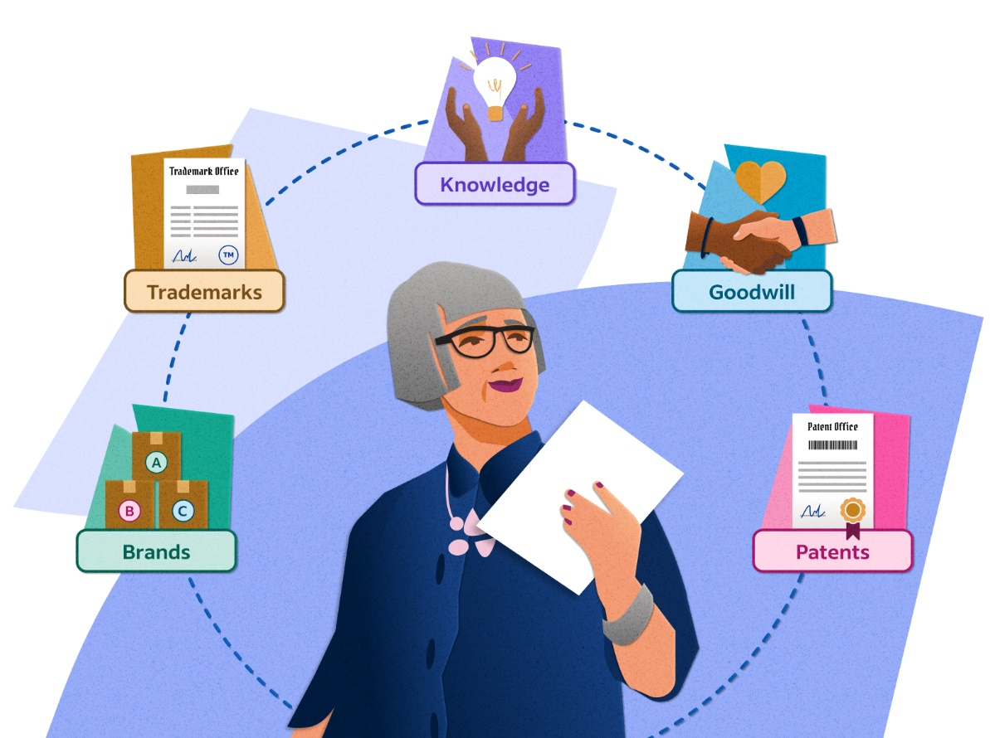
Content:
1. Shipping and billing;
2. Trade credit;
3. Accounts;
4. Types of Assets;
5. Depreciation;
6. Liabilities.

Slide 3
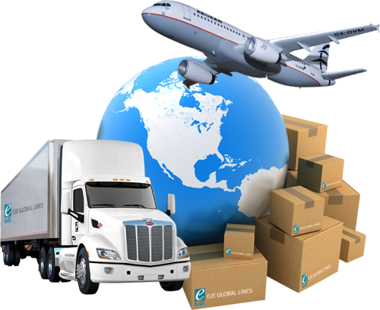
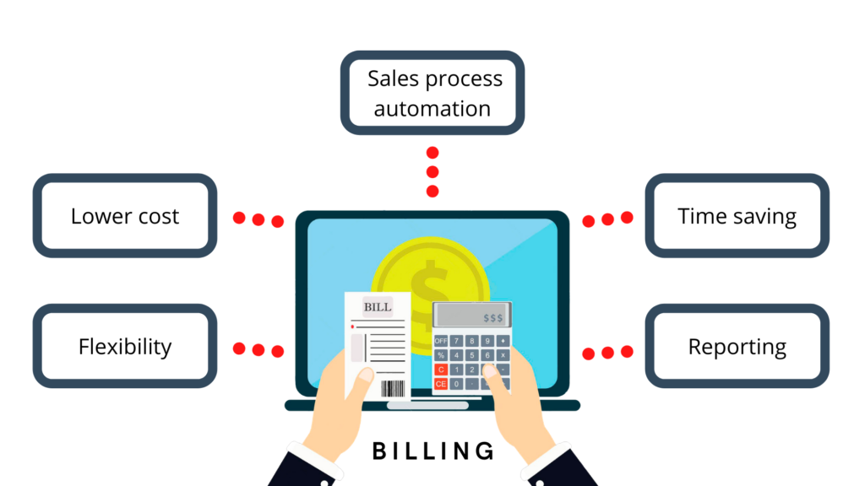
Shipping and billing
When you ask to buy something, you order it or place an order for it. When the goods are ready, they are dispatched or shipped to you.
An invoice is a document asking for payment for something and showing the amount to pay. The activity of producing invoices and sending them to customers is invoicing or billing. If a supplier chases an invoice, they ask for payment because it has not been paid on time. If you settle an invoice, you pay it.

Slide 4
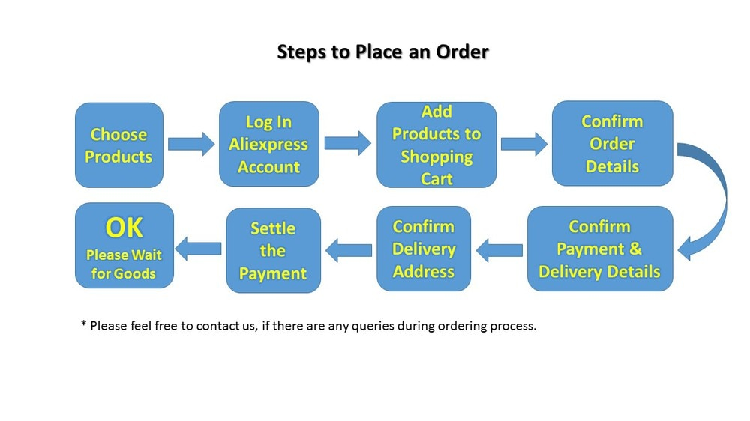
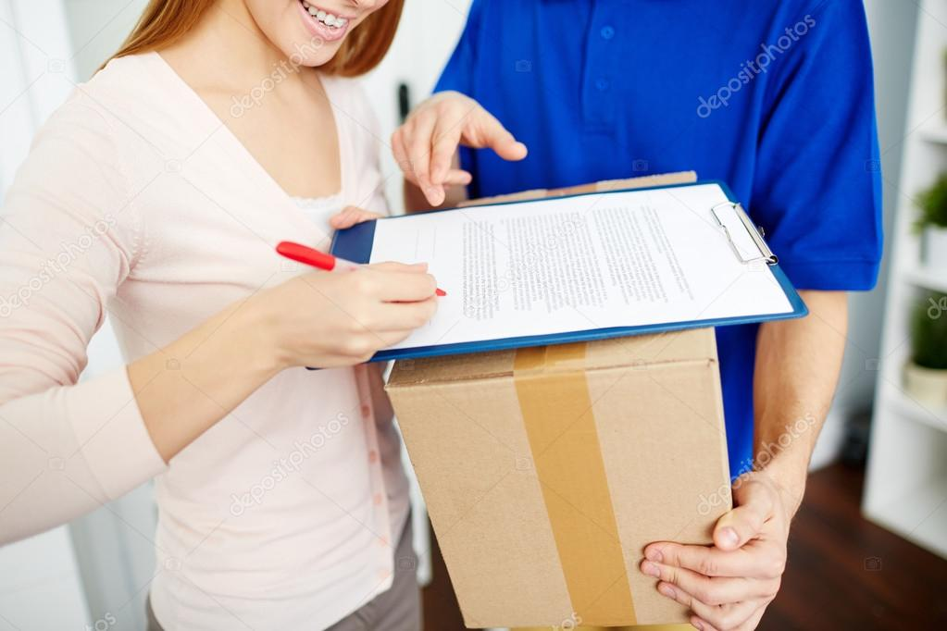
order – an official instruction telling someone what they can or cannot do; to issue a command;
place an order – order something; to submit an order for a product;
dispatch – to send something, especially goods or a message, somewhere for a particular purpose;
ship - to send something, usually a large object or a large quantity of objects, to a place far a way.

Slide 5
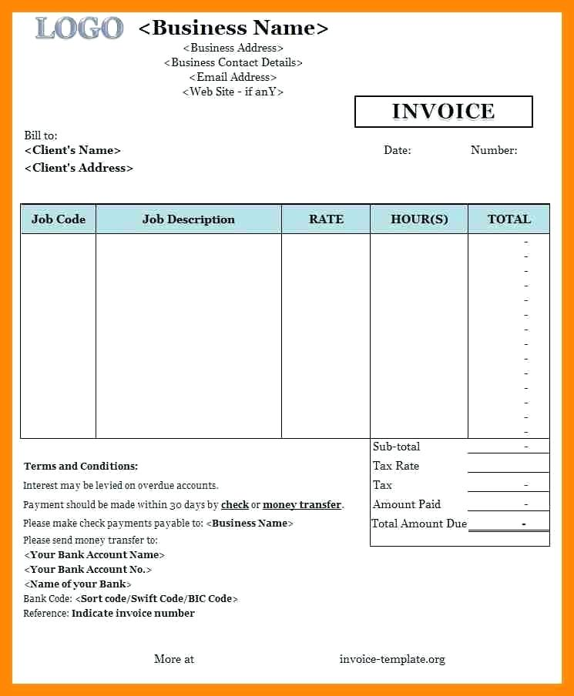
an invoice – a list of things provided or work done together with their costs, for payment at a later time;
invoicing – the process of creating and sending out invoices for work that you have completed;
billing – the process of sending people bills asking them to pay money owed;
settle an invoice - to pay the money you owe.

Slide 6
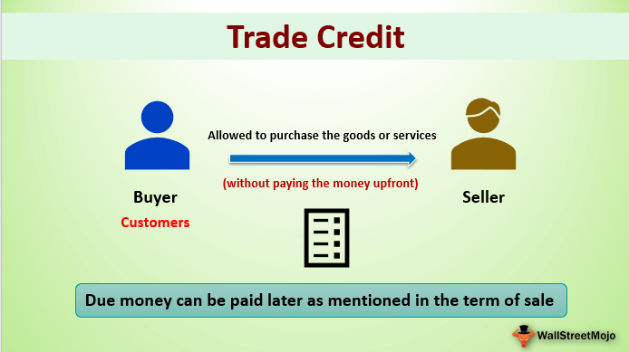
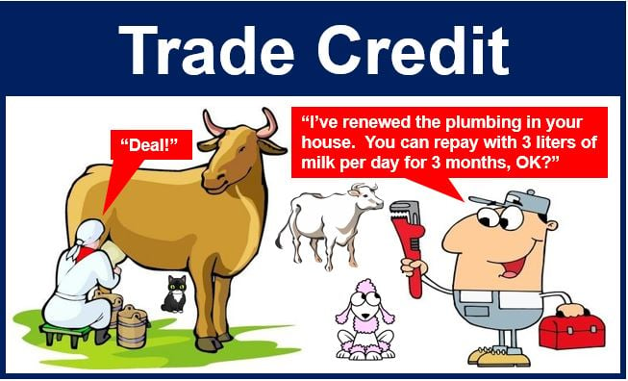
What Is a Trade Credit?
A trade credit is a business-to-business (B2B) agreement in which a customer can purchase goods on account without paying cash up front, paying the supplier at a later scheduled date. Usually businesses that operate with trade credits will give buyers 30, 60, or 90 days to pay, with the transaction recorded through an invoice.

Slide 7
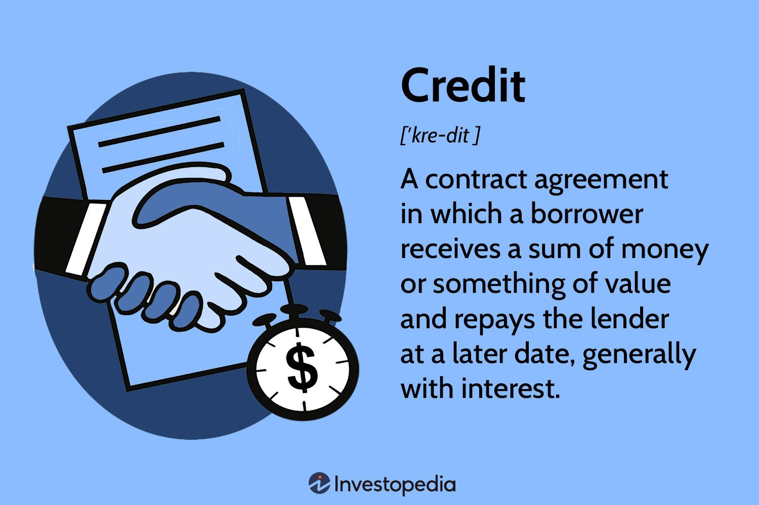
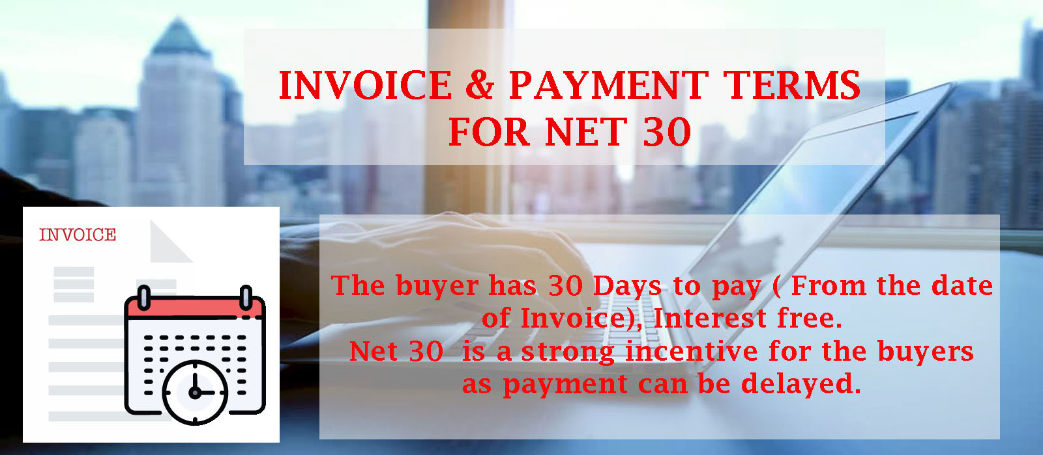
discount – a reduction in the usual price for something;
upfront – paid or obtained in advance;
credit policy – a set of principles that a financial organization or business uses in deciding who it will loan money to or give credit;
payment terms – the statement by a business about when and how it should be paid for goods or services that it has supplied;
cash flow – the amount of money moving into and out of a business

Slide 8
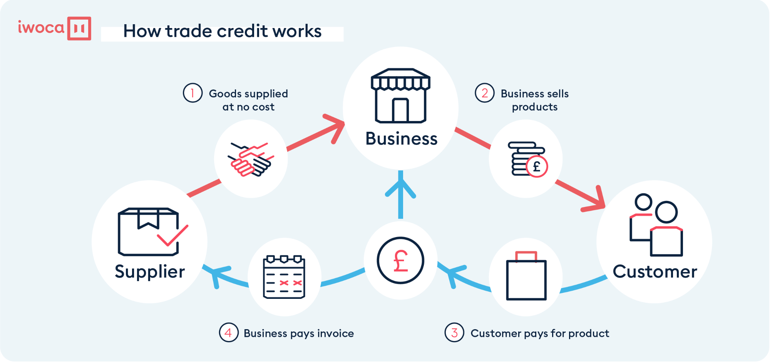
Trade credit
Vaclav talks about his furniture business.
‘Of course, we don’t expect our business customers to pay immediately: they are given trade credit –
a period of time, usually 30 or 60 days, before they have to pay. If a customer orders a large quantity or pays within a particular time, we give them a discount – a reduction in the amount they have to pay.
‘But we ask some customers, especially ones we haven’t dealt with before, to pay upfront – before they receive the goods. Like all businesses, we have a credit policy, with payment terms – rules on when and how customers should pay. This is part of controlling cashflow – the timing of payments coming into and going out of the business.’

Slide 9
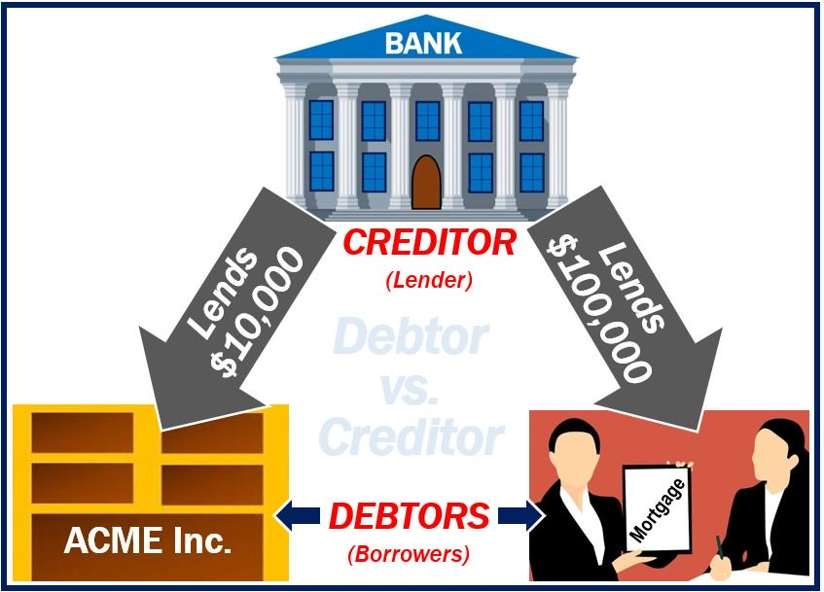
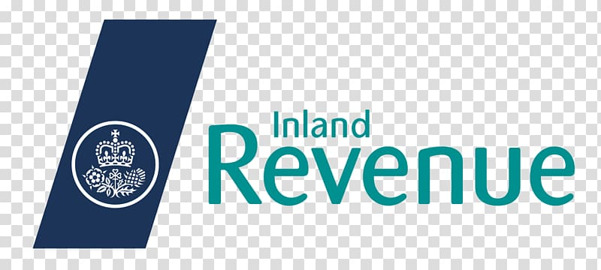
account – a customer who does business with a company;
key accounts – the most important customers;
debtor – someone who owes money
owe – to have the responsibility to pay or give back something you have received from someone;
creditors – someone who money is owed to;
The Inland Revenue – the former name for the government office in the U.K. that collects the main taxes; Inland Revenue Service (AmE)

Slide 10
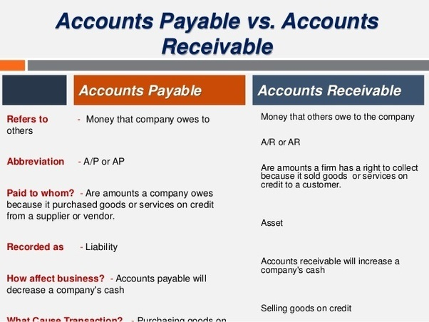
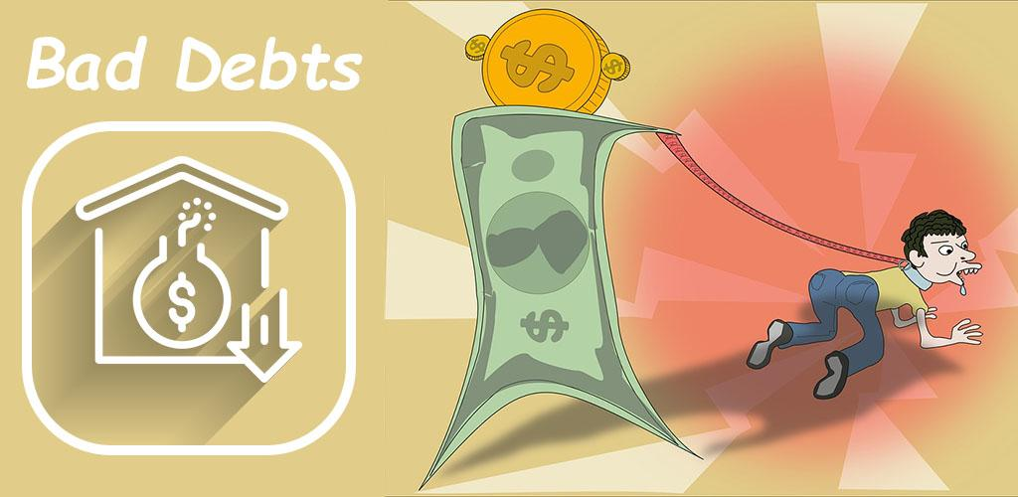
accounts receivable – the amounts in a company’s accounts that show money that is owed to the company by its customers;
accounts payable – the amounts in a company’s accounts that show money that it owes, for example to suppliers;
bad debts – a debt that is not likely to be paid;
write off – an amount of money that has been lost, for example, from a bad investment or a debt that will never be paid, shown as a loss in a company’s accounts

Slide 12
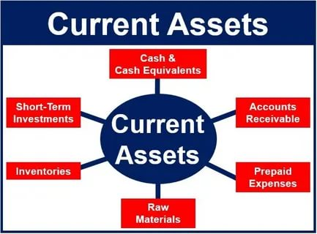
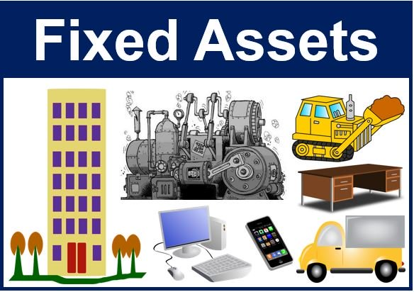
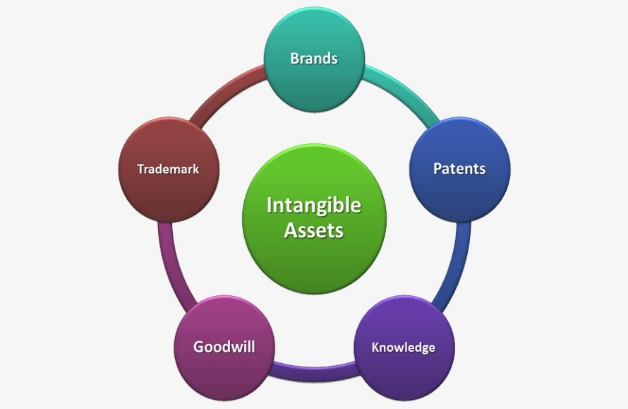
ASSETS
Something that has value or the power to earn money for a business is an asset. These include:
current assets – money in the bank, investments that can easily be turned into money, money that customers owe, stocks of goods that are going to be sold;
fixed assets – equipment, machinery, buildings, land;
intangible assets: goodwill – the value that a company has through its reputation with existing customers – and brands, because an established brand allows its owner to earn money from it, rather than having to build up a brand from nothing;
If a company is sold as a going concern, it is sold as a functioning operation.

Slide 13
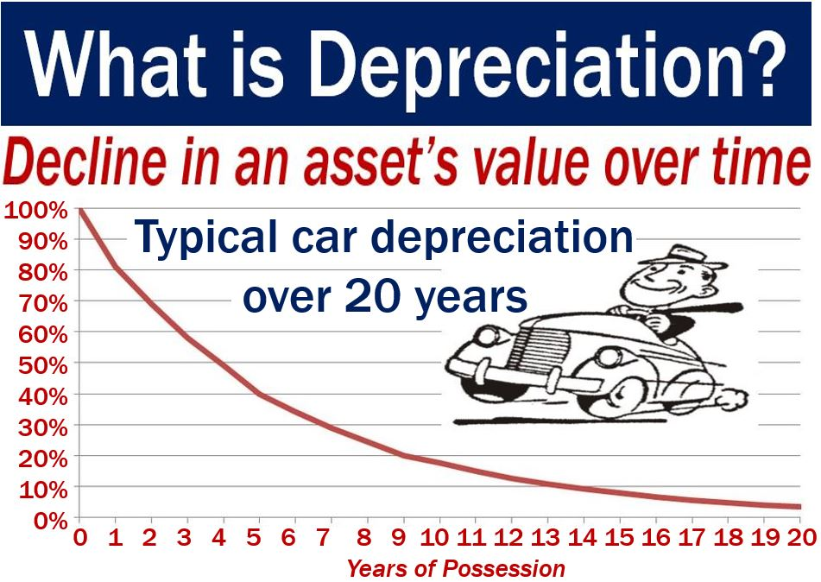
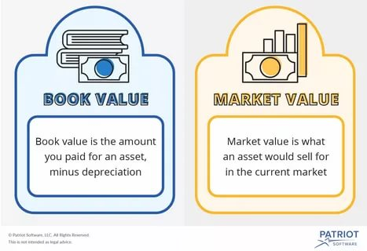
depreciation – the process of loosing value;
amortization – the process of reducing a cost or total in regular small amounts;
charge – to ask an amount of money for something, especially a service or activity;
book value – the value a company gives to something it owns in its accounts, which could be more or less than its real value if sold

Slide 14
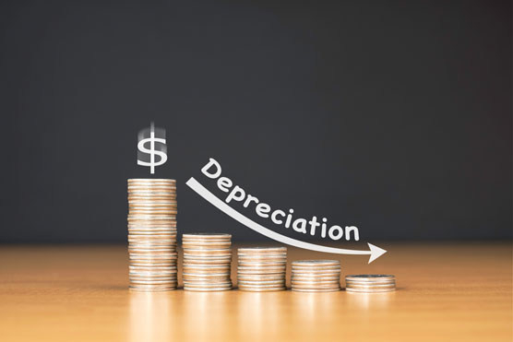
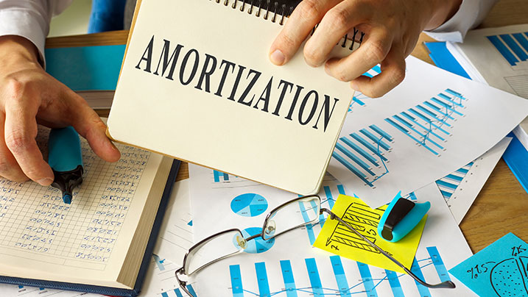
Depreciation
Joanna Cassidy is an accountant in a publishing company:
‘Assets, such as machinery and equipment, lose their value over time because they wear out, or are
no longer up to date. Amounts relating to this are depreciation or amortization (AmE mainly). For
example, when we buy new computers, we depreciate them or amortize (AmE mainly) them over a very short period, usually three years. A charge for this is shown in the financial records: the value of the equipment is reduced or written down each year over that period. It is then written off
completely – shown as having no value at all – at the end. This is a write-off.
‘The value of an asset at a particular time as shown in a company’s accounts is its book value. This
may or may not be the amount that it could be sold for. For example, land may be worth more than
shown, because it has increased in value. But our computers could probably only be sold for less
than book value.’

Slide 15
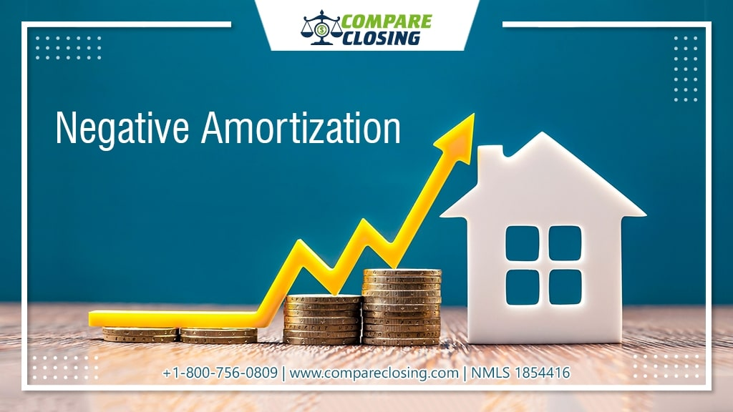
Negative amortization
In a regular amortization loan, the borrower makes the monthly mortgage payment including principal and interest.
With every payment made the principal balance goes down and eventually the mortgage is paid off over the tenure of the loan.
However, in a negative amortization loan, the principal amount or the original borrowed amount goes up.
For many borrowers, this type of mortgage could be the only option left before they could figure out a way to get around and be current on the loan.
However, you need to check all your options before getting into a negative amortization mortgage as it could prove very costly in the long run.

Slide 16
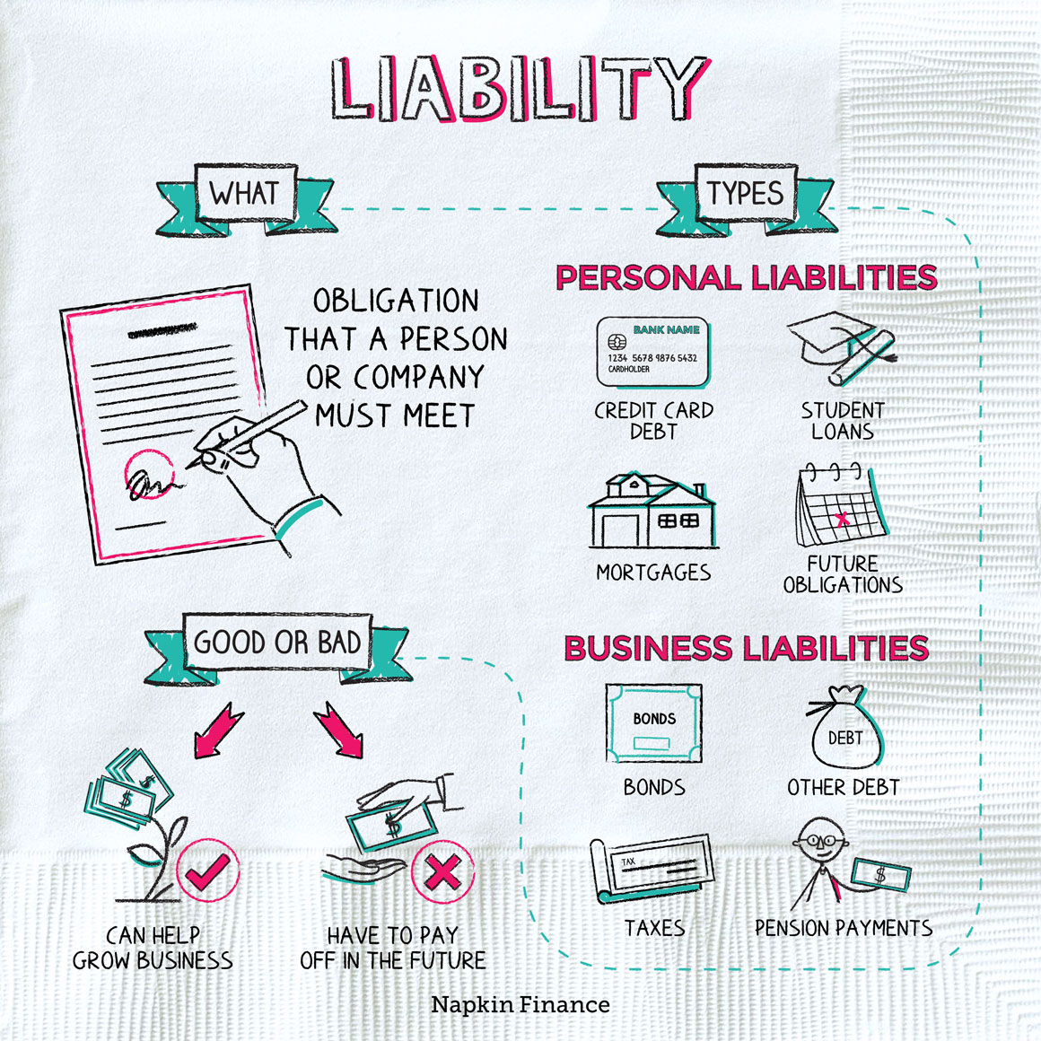
Liabilities
A company’s liabilities are its debts to suppliers, lenders, the tax authorities, etc.
In general, a liability is an obligation between one party and another not yet completed or paid for. In the world of accounting, a financial liability is also an obligation but is more defined by previous business transactions, events, sales, exchange of assets or services, or anything that would provide economic benefit at a later date. Current liabilities are usually considered short-term (expected to be concluded in 12 months or less) and non-current liabilities are long-term (12 months or greater).

Slide 17
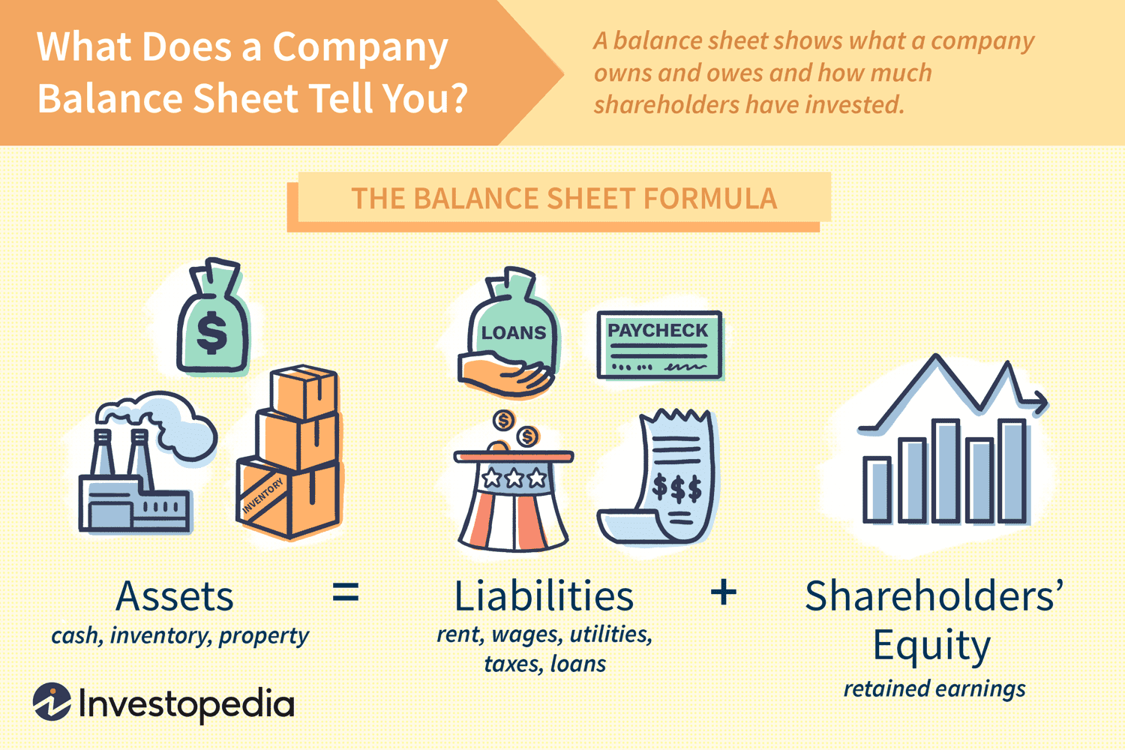
The term balance sheet refers to a financial statement that reports a company's assets, liabilities, and shareholder equity at a specific point in time. Balance sheets provide the basis for computing rates of return for investors and evaluating a company's capital structure.
In short, the balance sheet is a financial statement that provides a snapshot of what a company owns and owes, as well as the amount invested by shareholders. Balance sheets can be used with other important financial statements to conduct fundamental analysis or calculate financial ratios.
What Is a Balance Sheet?

Slide 18
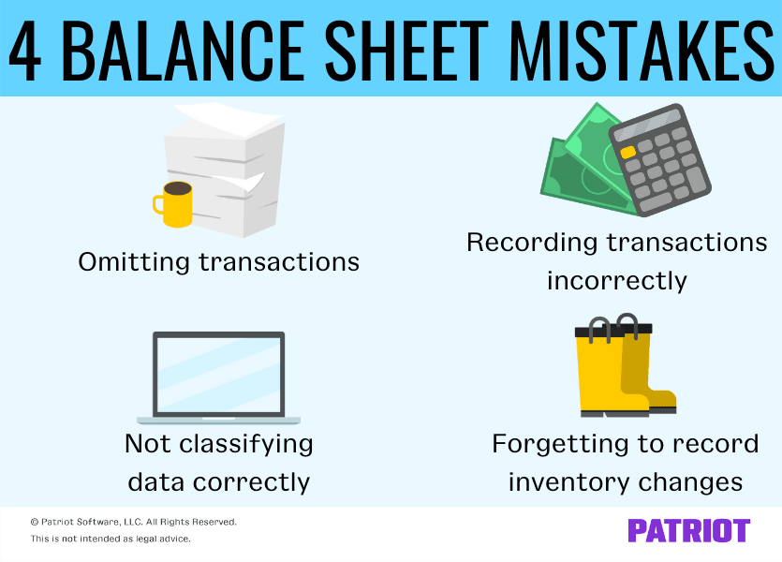

Slide 19
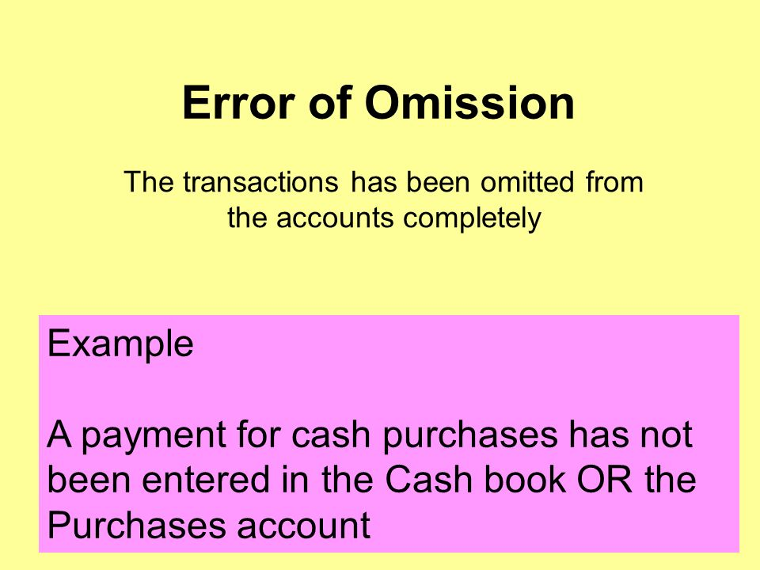
What is omitted transaction?
Again, depending on how many transactions your business does daily, weekly, and monthly, a large volume of transactions can be entered onto a balance sheet. Accountants can overlook transactions or forget to enter transactions into the business balance sheet. Even one missing transaction can throw the entire balance sheet off and can cause major issues. Considering your transactions, including expenses, supplies, cash flow, and inventory, are all put into the balance sheet as transactions happen. It can be easy to figure out what is omitted.
While mistakes happen, it can be costly and time-consuming to correct the error. The best way to handle it is to make sure you or your accountant enters every transaction as soon as it occurs and doesn’t accumulate them throughout the day and enter them all at once.

Slide 20
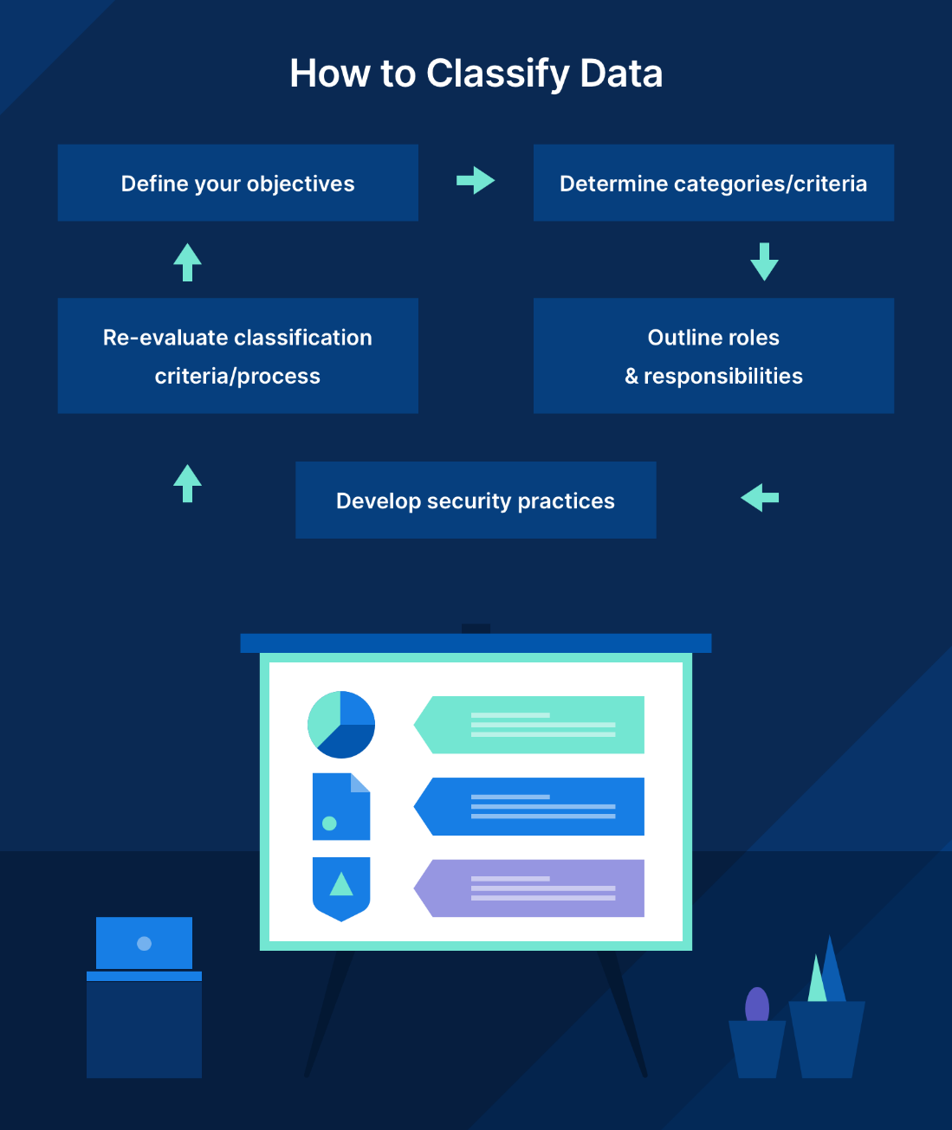
Incorrect data classification
The most common balance sheet mistake happens during the recording of transactions. The accountant will write transactions on the balance sheet as a liability or an asset but can make an error while classifying it. Incorrect data classification on the business balance sheet means it is invalid due to the errors.

Slide 21

Forgetting to record inventory changes
One of the more common errors on the balance sheet is when it comes to recording your inventory transactions. Having an accurate inventory entered on your balance sheet will give an overview of what does well and what doesn’t. It will also give you an idea of the success of certain products for development purposes. This is why you must have a regular accounting of your inventory.

Slide 22

Recording transactions incorrectly
Another fairly common mistake is to transpose numbers when entering in amounts to the balance sheet. While seemingly small in reality, this mistake can be big because the balance sheet will not be accurate. This is another mistake that can go undetected and make the balance sheet an inaccurate accounting of the company’s progress.
The key to having an accurate and useful balance sheet is to enter in information as you go and to check and double-check everything you enter. If even one of these mistakes occur and go undetected, you present an inaccurate report of your company’s progress.

Slide 23
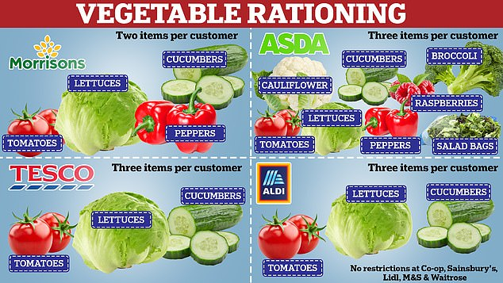
British supermarkets ration fruit
and vegetables (6th March 2023)
Shoppers in the United Kingdom (U.K.)
are having to hunt around to find supplies
of fruit and vegetables. Britain's major
supermarkets are rationing produce like
cucumbers, peppers and tomatoes amid
shortages from suppliers. The big chains
have cited various reasons for the shortfall
in supply that has left shelves bare in
green-grocery aisles. Britain's biggest
supermarket chain, Tesco, has limited purchases of certain vegetables to
three per customer. Tesco attributed its shortages to adverse weather overseas. In particular, it said a drought in Morocco had led to poor yields. Tesco assured customers it was working day and night to "get things back to normal".

Slide 24
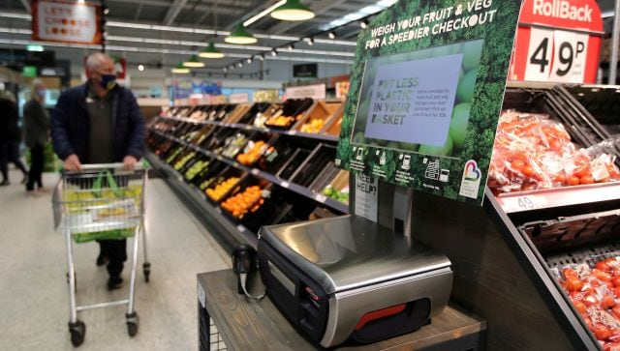
Other factors are being blamed for the
rationing. Britain's farmers' union said higher
energy costs meant it was no longer financially
viable for many growers to operate. It also said
a tomato disease has wiped out a lot of crops
across northern Europe. Industry analyst James
Walton said Brexit has played a part in
distribution problems. He said: "The EU
accounts for much of the UK's import volume.
If there are shortfalls in production in the EU,
then it makes sense for EU producers to serve their local demand first. This leaves less available for export to the U.K." Many shoppers are perplexed at seeing photos on social media of supermarket shelves across Europe, and in war-torn Ukraine, laden with fresh produce.

Slide 25
Reference
1. Business vocabulary in use, bill Mascull, Cambridge university press, 2017.
2. Business English, course handbook, Giedre Rimkiene, SMK university of applied social sciences, 2014.
3. https://www.investopedia.com
4. https://www.accountingtools.com
5. https://www.business-standard.com
6. https://breakingnewsenglish.com/2303/230306-uk-vegetable-rationing.html

Slide 26
Thank you for attention!

