Slide 1
COURSE NAME: INDUSTRIAL PIPING SYSTEM
LECTURE I-WEEK I: INTRODUCTION TO PIPING SYSTEM
LECTURER: HABANABAKIZE THEOPHILE
INSTITUTION: RWANDA POLYTECHNIC/IPRC TUMBA

Slide 2
OBJECTIVES
By the end of this session the learner/student will be able to:
Define different key terms used in piping system
Differentiate a pipe from a tube
Differentiate piping system main categories.

Slide 3
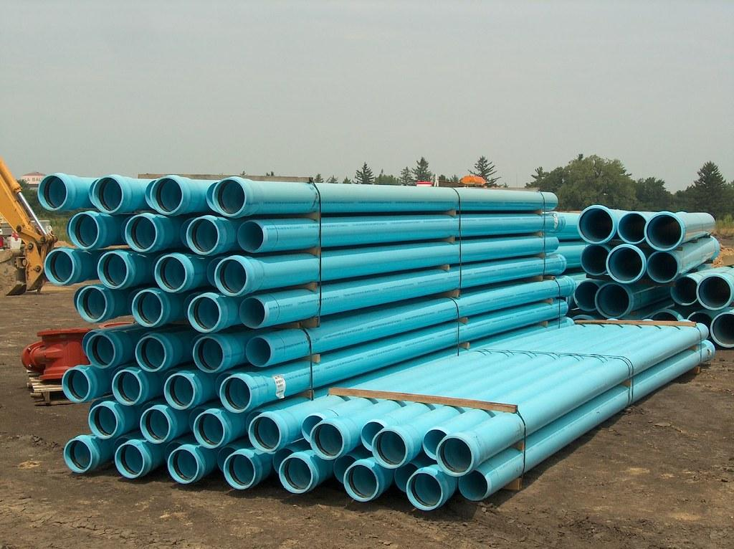
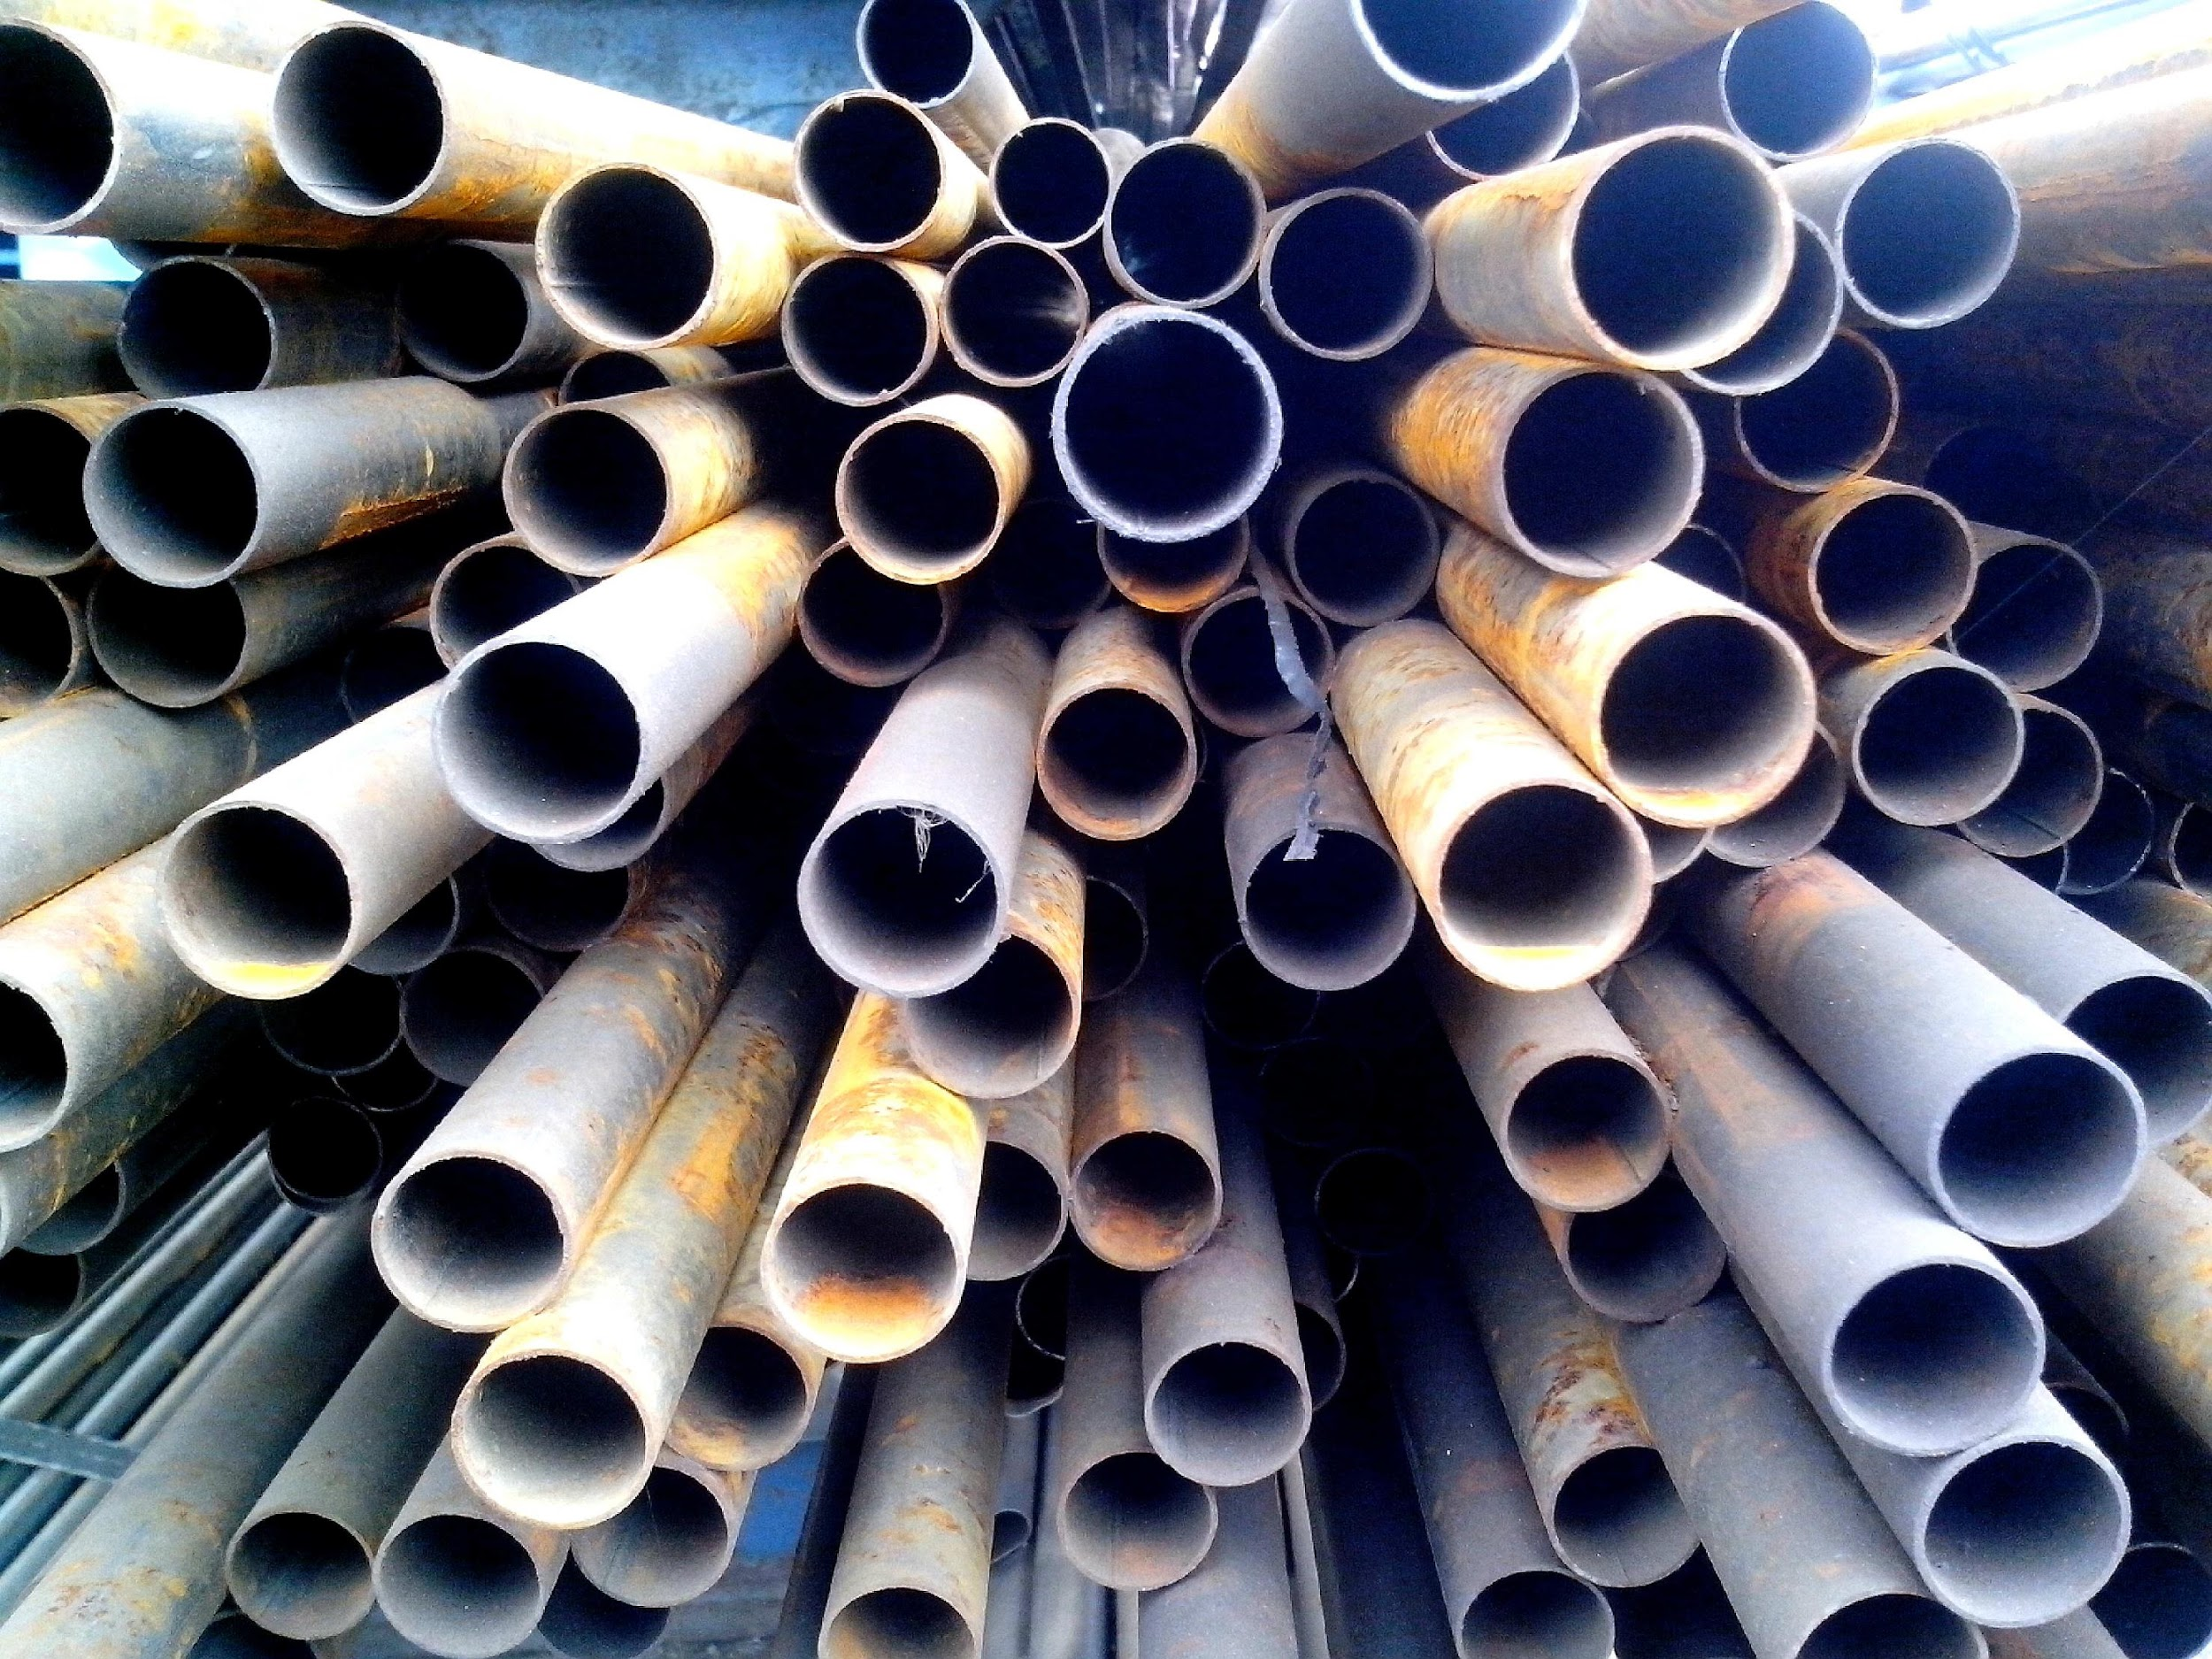
I.1. What is a Pipe
A pipe is a Tubular component which can be made from metal, plastic, wood, glass, etc meant for conveying fluid (liquid, gas, powder or any other thing that can flow). And It is a very important component for any industrial plant.
https://id.images.search.yahoo.com

Slide 4
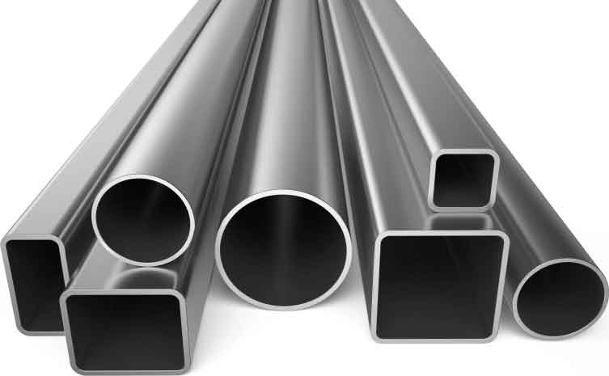
I.2. What is a Tube
In engineering, the name tube refers to round, square, rectangular and oval hollow sections that are used for pressure equipment, for mechanical applications, and for instrumentation systems.
https://www.wermac.org/pipes/pipes_img/steel_tubes1.jpg

Slide 5
I.3. Difference between a pipe and a tube
The most important dimensions for a pipe is the outer diameter (OD) together with the wall thickness (WT). OD minus 2 times WT determine the inside diameter (ID) of a pipe, which determines the liquid capacity of the pipe.
Tubes are indicated with outer diameter and wall thickness, in inches or in millimeters.

Slide 6
Difference between a pipe and a tube Cont’d
Parameters | Pipe characteristics | Tube characteristics
Size | A pipe is Specified by Nominal Pipe Size (NPS) or Nominal Bore (NB). | The size of the Tubes is specified in millimeters or in inches by outside diameter.
Type of shape | Round only | Round, rectangular, square, oval
Diameter | The outside diameter of pipe up to size 12” is numerically larger than the corresponding pipe size | The outside diameter of tubes is numerically equal to the corresponding size.
Application | Pipes are extensively used in all Process, Power & Utility lines to carry fluids. | Tubes are used in tracing lines, tubes for heat exchangers & fired heaters & instrument connections. They are more prevalent in the medical area, construction, structural, or load bearing.

Slide 7
Difference between a pipe and a tube Cont’d
Parameters | Pipe | Tube
Materials | A wide range of materials is available | Tubing is available in carbon steel, low alloy, stainless steel, and nickel-alloys; steel tubes for mechanical applications are mostly of carbon steel
Manufacturing | Pipe manufacturing is easier as compared to tubes | Tubes need more cumbersome tests, inspection, and quality control than pipes.
Production Quantity | Pipes are produced in mass quantity and for long-distance applications. | Tubes are produced in small quantities depending on requirements.

Slide 8
I.4. Piping system
A piping system is generally considered to include the complete interconnection of pipes, including in-line components such as pipes and pipe fittings, pumps, heat exchanges, valves and tanks are also considered part of piping system. Piping systems are the arteries of our industrial processes and the contribution of piping systems are essential in an industrialized society.

Slide 9
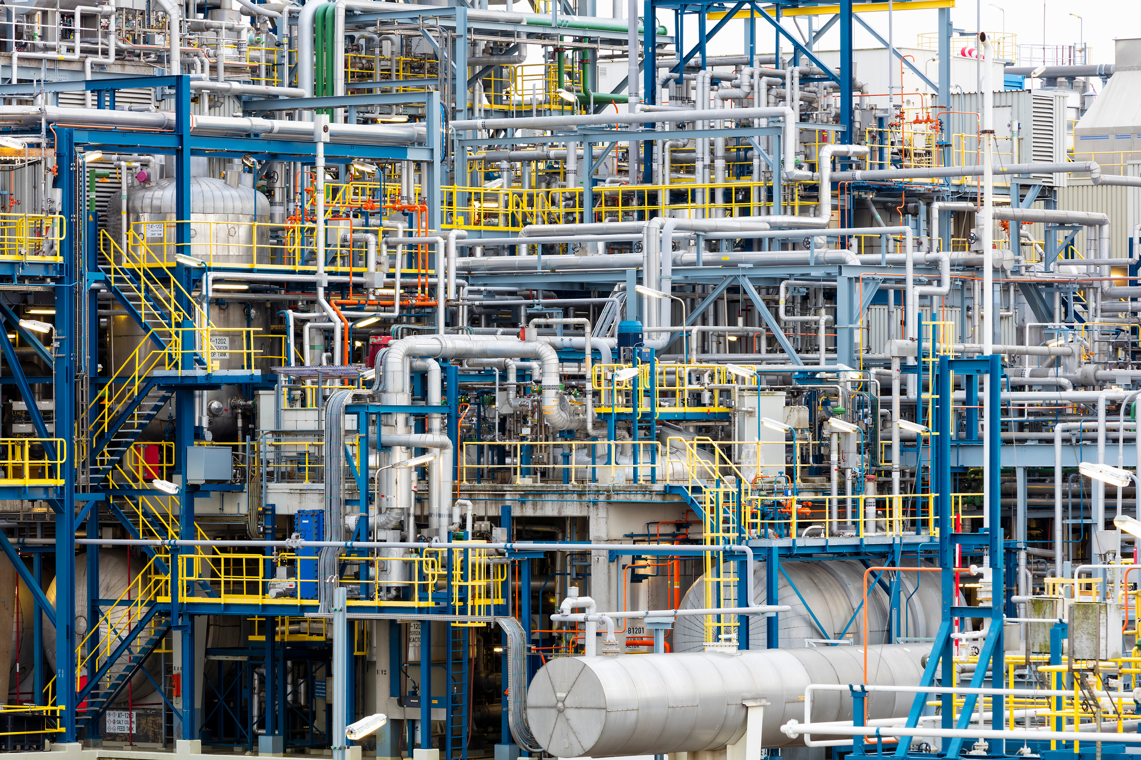
Piping systems accounts for a significant portion of the total plant cost, at times as much as one-third of the total investment. Piping systems arranged within a very confined area can be a added challenge to piping and support engineers.
The illustration of piping system
https://www.theprocesspiping.com/wp-content/uploads/2017/08/Pipe-network.jpg

Slide 10
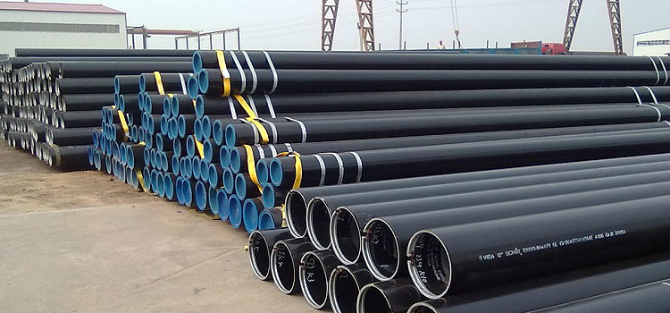
I.5. Classification and main characteristics of pipelines
Pipes are a structural element that is used in the installation of pipelines of various kinds. To date, there are many varieties of these products. There are outdated, but still popular parts and modern options, from which reliable and durable communications are mounted.
https://pipes.bigbadmole.com/en/vodoprovodnye/vidy-trub.html

Slide 11
Classification and main characteristics of pipelines Cont’d
All pipes for pipelines are classified according to several important parameters. Consider the main ones:
Classification of pipes by Diameter:
Considering diameter pipes can be classified as:
Small;
Medium;
Big ones.
A small part has a cross-sectional index from 5 to 102 mm, medium - from 102 to 426 mm, and products that are considered to be large - above 426 mm.

Slide 12
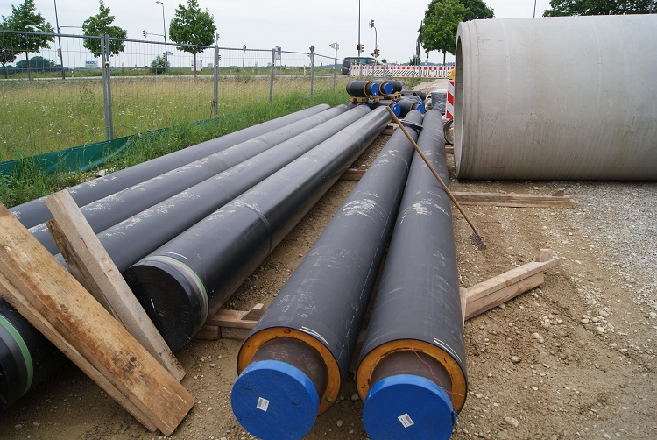
Classification and main characteristics of pipelines Cont’d
In addition, they are classified by such indicators:
According to the material of manufacture;
Along the cross-sectional profile;
By size;
By the method of connection;
By the type of insulation.
Some types of pipes are equipped with insulation, such products are used in the construction of heating networks and hot water.
https://pipes.bigbadmole.com/en/vodoprovodnye/vidy-trub.html

Slide 13
Classification and main characteristics of pipelines Cont’d
Classification by the specifics of production
Considering specifics of production pipes can be classified as:
Galvanized;
Welded;
Hot rolled;
Cold rolled;
Profile;
Cold drawn.

Slide 14
Classification and main characteristics of pipelines Cont’d
Classification by the type of section
Considering the type of section, pipes can be classified as:
Round;
Square;
Rectangular;
Polygonal.

Slide 15
I.6 Pipeline classification
Today, there are many types of pipelines. All of them are divided into groups according to the following indicators:
On a portable substance;
Material
Performance characteristics;
Environmental aggressiveness indicator;
The substances transported are: oil and gas pipelines, steam pipelines, water pipelines, etc.

Slide 16
According to the production materials there are:
Steel;
Copper;
Cast iron;
Metal-plastic;
Plastic;
In addition, there are concrete pipelines, as well as structures made of heat-resistant glass.

Slide 17
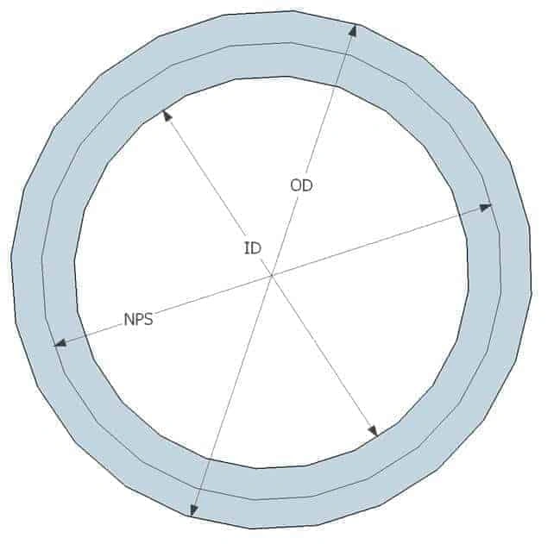
I.7 Pipe parameters
a. Pipe dimensions
Pipe dimensions are given in size and schedule numbers. Three different terms are commonly used to define the size of the pipes.
NPS – Nominal Pipe Size
NB – Nominal Bore
DN – Diameter Nominal
https://hardhatengineer.com/pipe-class-piping-specifications-pipeend

Slide 18
Pipe dimensions Cont’d
Nominal Pipe Size (NPS) is the number that defines the size of the pipe.
For example:
When you say 6” pipe, the 6” is the nominal size of that pipe. However, for the pipe sizes, NPS 14 and above Outside Diameter is the same as NPS.

Slide 19
Pipe dimensions Cont’d
Manufacturing of NPS ⅛ (DN 6) to NPS 12 (DN 300) pipe is based on fixed outside diameter (OD). So, with any increase in wall thickness, the pipe’s inside diameter (ID) decreases. So the NPS will be somewhere in-between OD & ID of the pipe.
Manufacturing of NPS 14 (DN350) and above pipe OD is corresponding to the Nominal Size of a pipe.

Slide 20
b. Comparision between OD, ID and NPS
OD in Inch | OD in mm | Thickness in Inch | Thickness in mm | ID in Inch | ID in mm
For NPS 2 Schedule 40 pipe
2.375 | 60.3 | 0.154 | 3.91 | 2.067 | 52.5
For NPS 14 Schedule 40 pipe
14 | 350 | 0.438 | 11.13 | 13.124 | 333.3
From the above table, you can see that for NPS 2, Pipe ID is near to pipe NPS, and for NPS 14, pipe OD is the same as NPS.

Slide 21
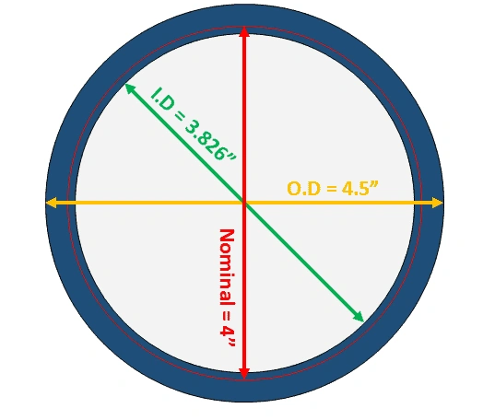
c. Converting inch dimension to mm
You can easily convert inch dimension to mm by multiplying it by 25.4 and rounding as follow;
Outside diameter above 16 inches rounded to nearest 1 mm
Outside diameter 16 inches and below rounded to nearest 0.1 mm
Pipe wall thickness is rounded to the nearest 0.01 mm.
A 4″ schedule 80 pipe size & thickness
https://hardhatengineer.com/pipe/pipe-schedule-chart-nominal-pipe-sizes/

Slide 22
d. Pipe Schedule
The pipe schedule is the way pipe wall thickness is mentioned. To simplify the ordering of the pipe ASME committee has developed Schedule Number, which is based on modified Barlow’s wall thickness formula.
You can see the pipe schedule calculation formula below;
Schedule number = P/S
P is the service pressure in (psi)
S is the allowable stress in (psi)

Slide 23
Pipe Schedule Cont’d
Schedule 80 is nothing but a pipe thickness designator. In simple words, you can say that for a given material, schedule 80 pipes can withstand a certain amount of pressure.

Slide 24
e. Pipe NB (Nominal Bore)
NPS is frequently referred as an NB (Nominal Bore). As such, there is no difference between NB and NPS. NB is also an American way to refer to pipe dimensions. When pipe’s dimensions are shown in mm (DN) people refer to pipe sizes in NB. So when someone says 25 NB pipe or 50 NB pipe, basically they are talking about DN.

Slide 25
f. Small Bore Pipe and Large Bore Pipe
In the project, you may come across the terms such as small Bore & big bore or large bore pipe.
Small Bore Pipe
Pipe Size up to 2” are considered small bore pipe. However, some companies consider up to 2.5″ pipe as small bore.
Large Bore Pipe or Big Bore Pipe
Pipe Size above 2″ are considered large bore or big bore pipe.

Slide 26
g. Pipe Length
The length of the pipe is mentioned in either meter or feet. During production, pipes are not manufactured in the same lengths, and during the construction of the process plants, you require varying lengths of pipes. To address this issue standard has defined pipe lengths in single random and double random categories.

Slide 27
Pipe Length Cont’d
Single random pipes
Single random pipes come in 4.8m to 6.7m in lengths, with 5% of lengths in between 3.7 to 4.8 m
Double random pipes
Double random pipes have a minimum average length of 10.7 m and a minimum length of 4.8 m, with 5 % of lengths between 4.8 m to 10.7 m

Slide 28
I.8 Pipe End Types
The pipes are produced in the following end types;
Plain ends
Bevelled ends
Threaded ends
Socket & spigot ends
Flanged ends, and

Slide 29
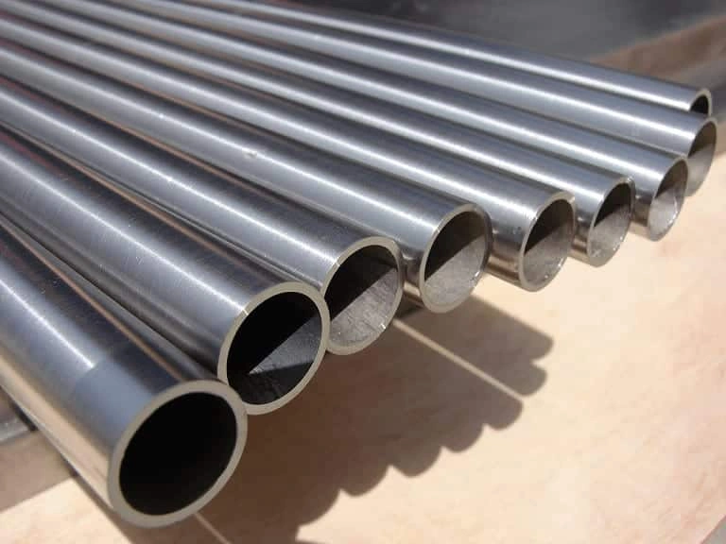
a. Plain Ends
Plain end pipes are used when socket-type weld fittings are used.
Advantages
Easier Alignment
No weld metal intrusion into a bore
Disadvantages
The 1/16″(1.5 mm) recess pockets liquid
Use not permitted by code if Severe Erosion or corrosion is anticipated.

Slide 30
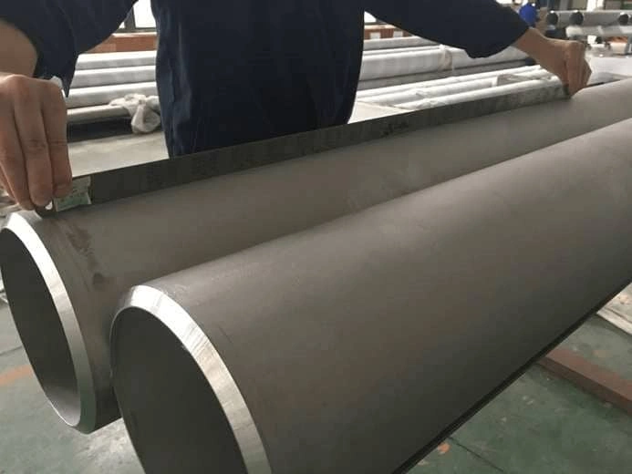
b. Bevelled Ends
Bevelled end pipes are used when butt-type weld fittings are used.
Advantages
The most practical way of joining big-bore piping
Reliable leak-proof joint
Joint can be radiographed
Disadvantages
Weld intrusion will affect the flow
End preparation is necessary
https://hardhatengineer.com/wp-content/uploads/2017/11/bevelled-end-pipe.jpg

Slide 31
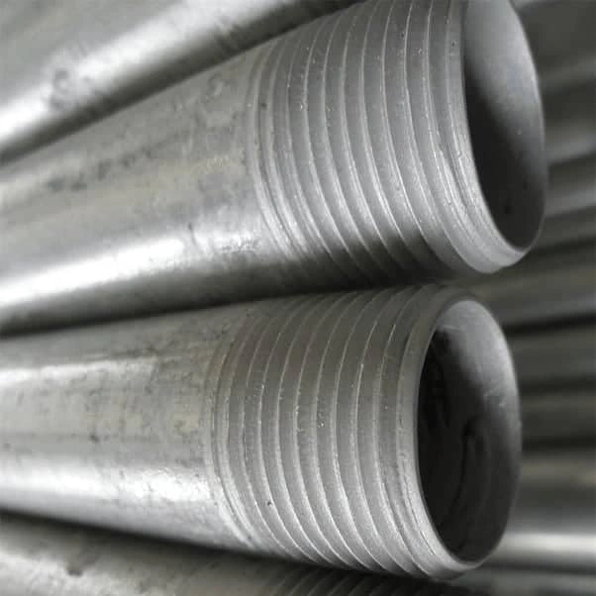
c.Threaded Ends
Threaded end pipes are used with threaded connections in a piping system.
Advantages
Easily made at the site
It can be used where welding is not permitted due to fire hazard
Disadvantages
Joint may leak when not properly sealed
Use is not permitted by code if severe erosion, crevice corrosion, shock, or vibration are anticipated.
The strength of the pipe is reduced as threads reduce the wall thickness
Seal welding may be required
The code specifies that seal welding shall not be considered to contribute to the strength of joints.
https://hardhatengineer.com/wp-content/uploads/2017/11/bevelled-end-pipe.jpg

Slide 32
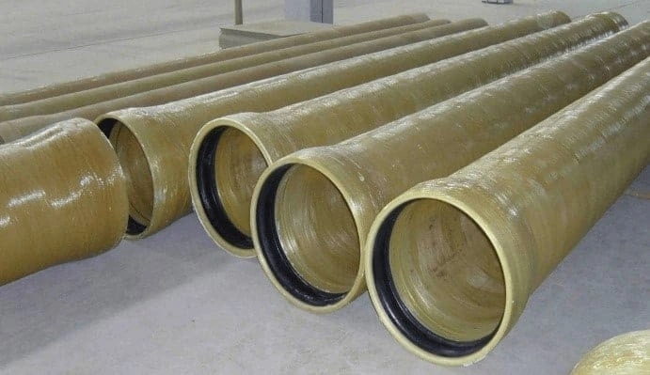
d. Socket & Spigot Ends
Socket & Spigot End pipes are generally used in the Ductile iron pipeline and non-metallic piping pipelines such as PVC, and GRE/GRP.
Advantages
It can be easily made at the site.
Can accept misalignment up to 10° at pipe joints.
Disadvantages
Suitable for low-pressure applications.
Special configuration at the pipe ends is required.
https://hardhatengineer.com/wp-content/uploads/2017/11/Spigot-and-Socket-ends-gre-pipe.jpg

Slide 33
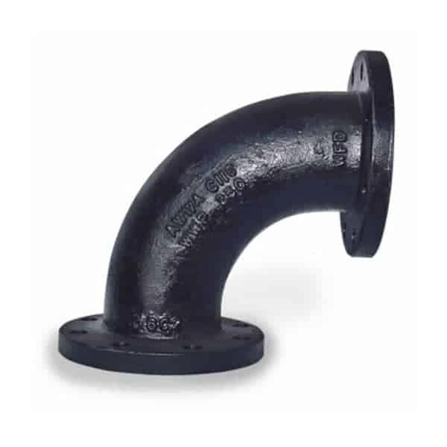
e. Flanged End
Flanged end pipes are used where the bolted connection is required
Advantages
Can be easily made at the site
It can be used where welding is not permitted due to material properties or fire hazards.
Dismantling is very easy
Disadvantages
It is a point of potential leakage
It cannot be used when piping is subjected to high bending moment.
https://hardhatengineer.com/wp-content/uploads/2017/11/Flanged-ends-Elbow.jpg

Slide 34
THANK YOU!!!!!!!!!!
QUESTIONS AND ANSWERS

Slide 35
References
ASPE, (2010). Plumbing Engineering Design Handbook: A Plumbing Engineer’s Guide to System Design and Specifications (Vol 2). River Road. Retrieved www.pdfdrive.com.
Rutger, B.& Peter, S.(2008) Process Piping Design Handbook: Advanced Piping Design (Vol 2). Gulf Publishing Company.
https://hardhatengineer.com/wp-content/uploads/2017/11/Flanged-ends-Elbow.jpg
https://hardhatengineer.com/wp-content/uploads/2017/11/Spigot-and-Socket-ends-gre-pipe.jpg

