Slide 1
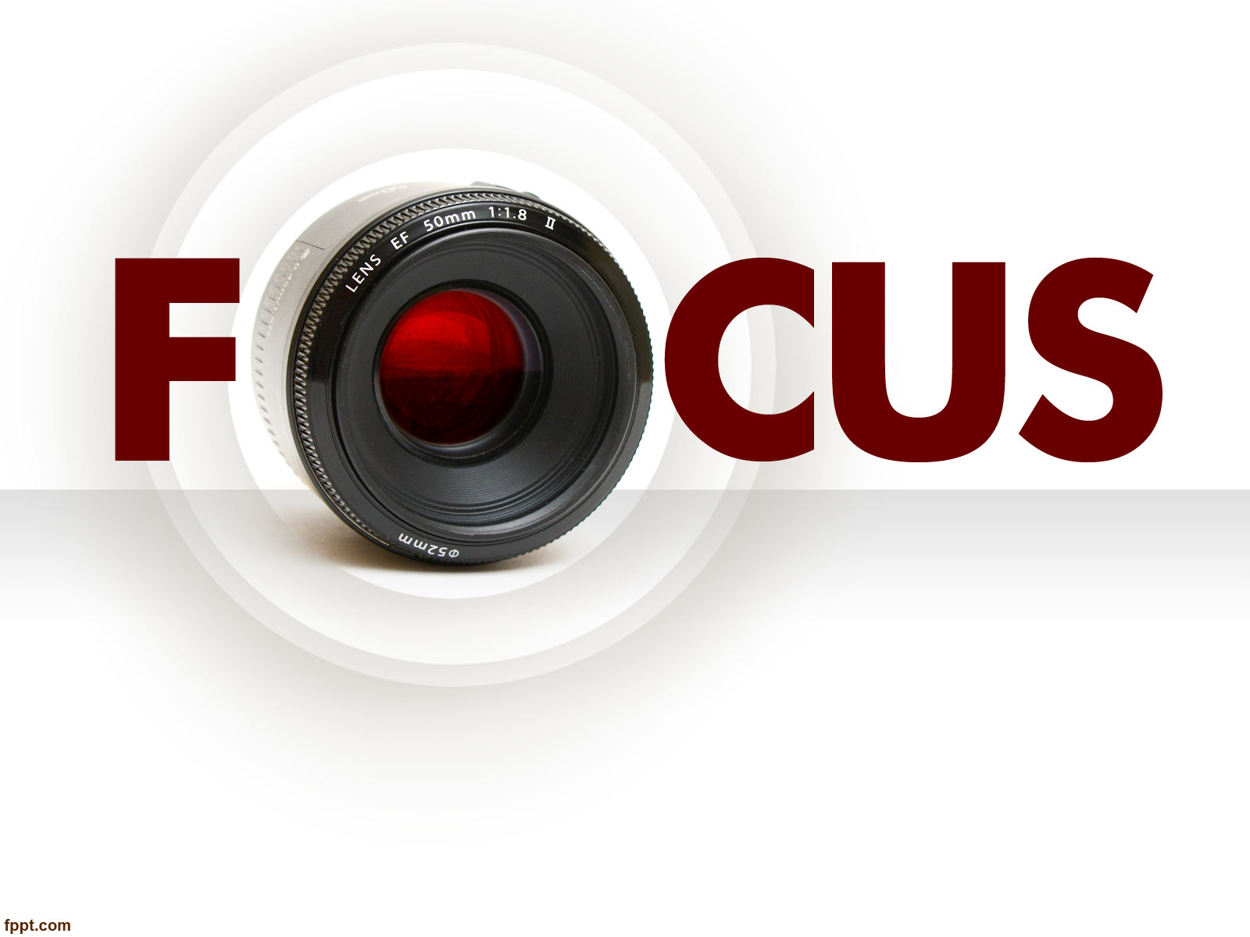
Photojournalism
WEEK 1 THEORETICAL ASPECTS OF PHOTOJOURNALISM
By Dr. Raphael Ogutu

Slide 2
Objectives
At the end of this Lecture, you should be able to:
Understand briefly all the lessons covered in the syllabus or lectures overview.
Understand the difference between Photography and photojournalism
Analyze the meaning of photojournalism and its historical development
Critique the qualities of a good photojournalist.
Watch a Youtube video compilation

Slide 3

Course Description
Introduces students to basic photography and photojournalism skills, which are the collecting, editing, and presenting of news material for publication or broadcast.
Images are objectively created through photography in order to tell a news story.
A powerful way to document events and convey information in a way that words alone cannot.
A photojournalist will use their camera to capture the visual representation of a story.
Face lots challenges in their line of duty, and have educated millions of people on various social injustices that happen around the world.
This course is more practical than theoretical.

Slide 4
Overall Course Goals and Objectives
Upon successful completion of this course, students will be able to:
Identify Photojournalism tools such as the camera, lighting equipment, camera accessories and their functions.
Explain the how media are used in the creation of visual imaging; the process of capturing and producing images in line with photojournalistic principles. Focus is on practical lessons using photo editing software.
Critique photojournalistic images in print and electronic media. The challenges and merits of photojournalism and today’s media.
Create ethical journalistic photographs and legal issues related to photojournalism.

Slide 5
Week 1 Theoretical aspects of photojournalism
Photojournalism- a form of journalism, which involves the collecting, editing, and presenting of news
Journalism-production and distribution of objective reports on the interaction of events, facts, ideas, and people that are the "news of the day"
Photography- the process of recording an image on light sensitive film or sensor
Story-powerful images that engage the viewer with the news story.
News-should capture images that have meaning or relevance to the timely story being told.
History- The evolution or developmental stages of Photojournalism

Slide 6
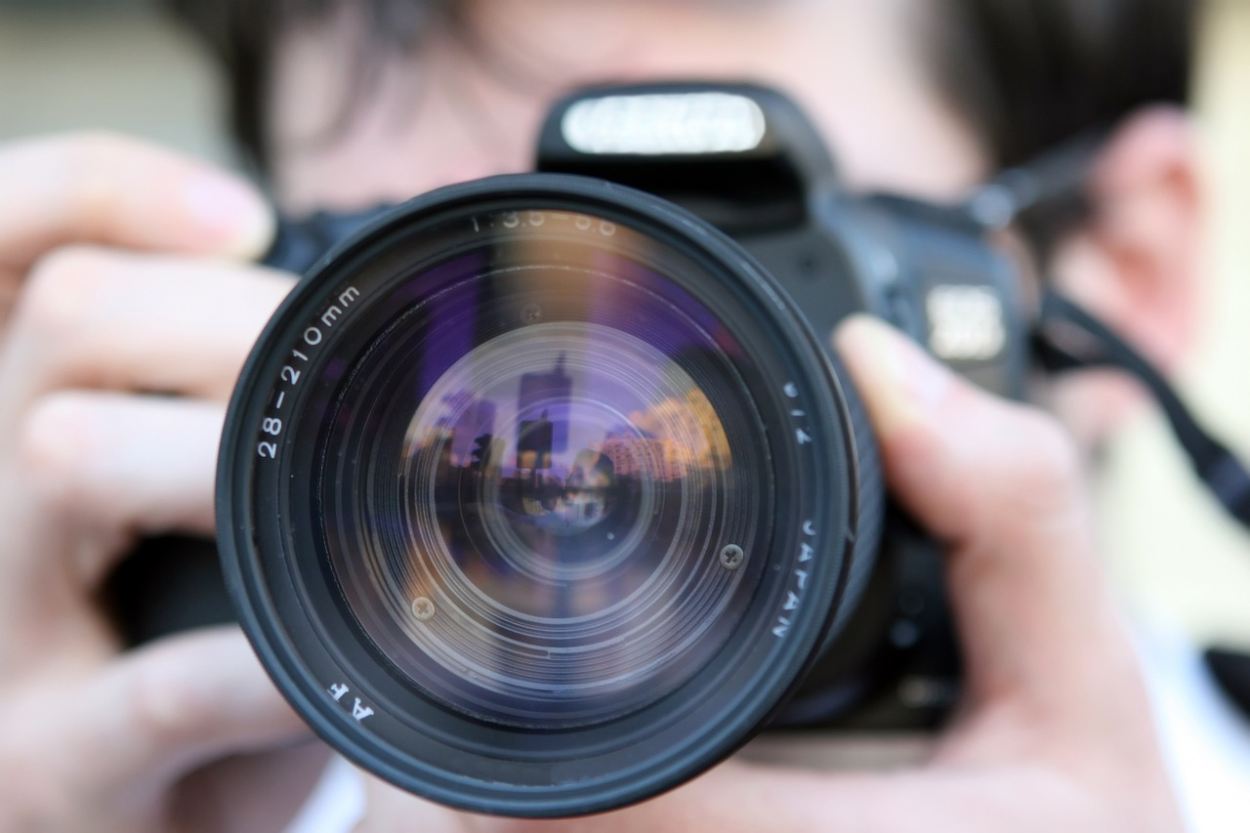
Source: https://pixabay.com/photos/camera-aperture-digital-camera-dslr-1239384/

Slide 7
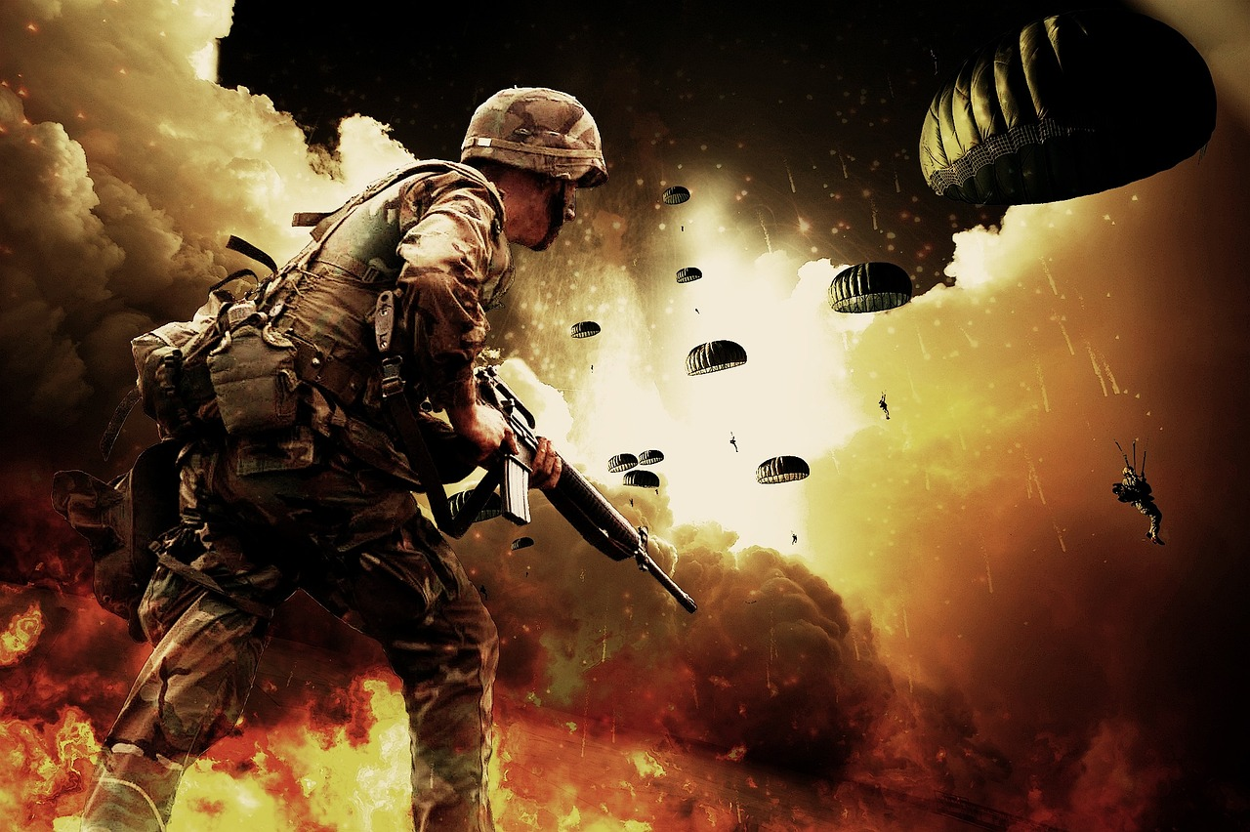
Source: https://pixabay.com/photos/war-soldiers-parachutes-469503/

Slide 8
Week 2 Photojournalism tools
Types of cameras-DSLR, SLR, Mirrorless and Compact
Lenses- Prime/ fixed and Zoom/ adjustable (Macro, Telephoto, Wide Angle, Standard, Specialty)
Filters- manipulate colors, saturation, light exposure or simulate a change in focus.
Tripods- a three-legged stand designed to support a camera e.g. All-in-One, Travel, Studio, Monopods etc.
Computer- For digital darkroom techniques or photo editing
Software- Photo editing software like Adobe Lightroom , DxO PhotoLab, Photoshop, Corel PaintShop Pro etc.
Camera Bags and other camera accessories like flashes

Slide 9
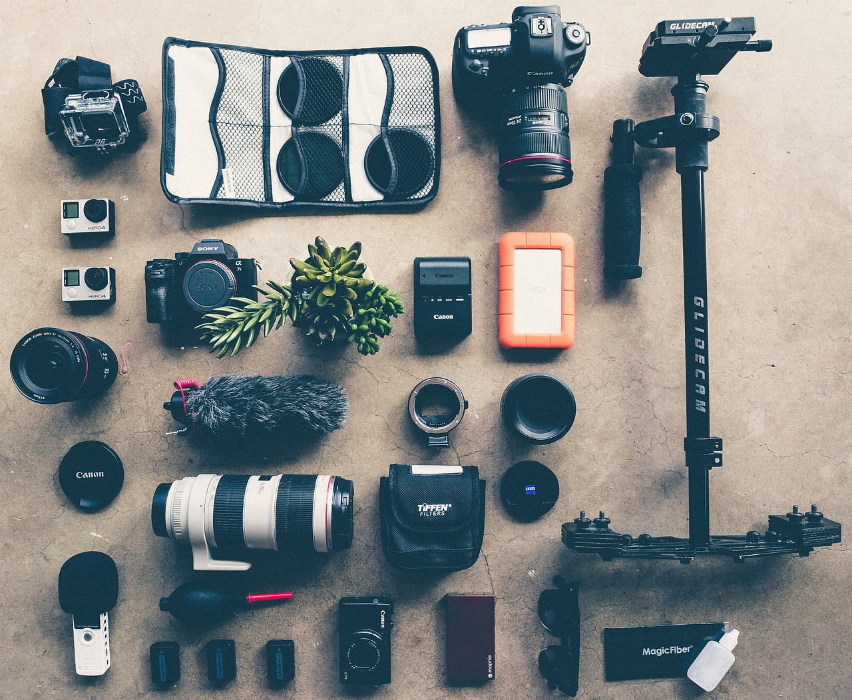
Source: https://pixabay.com/photos/accessories-cameras-canon-lens-1842573/

Slide 10
Week 3 Digital photography exposure
Viewing systems- the process of capturing light rays through the camera.
Lenses- Focusing and aperture settings,
Filters- Light correctional ability
Darkroom techniques- analogue and digital darkroom
Lighting – Natural and artificial lighting
DSLR versus a Mirriorless camera
Aperture, ISO and Shutter speed settings
White Balance-setting that establishes the true color of white.

Slide 11
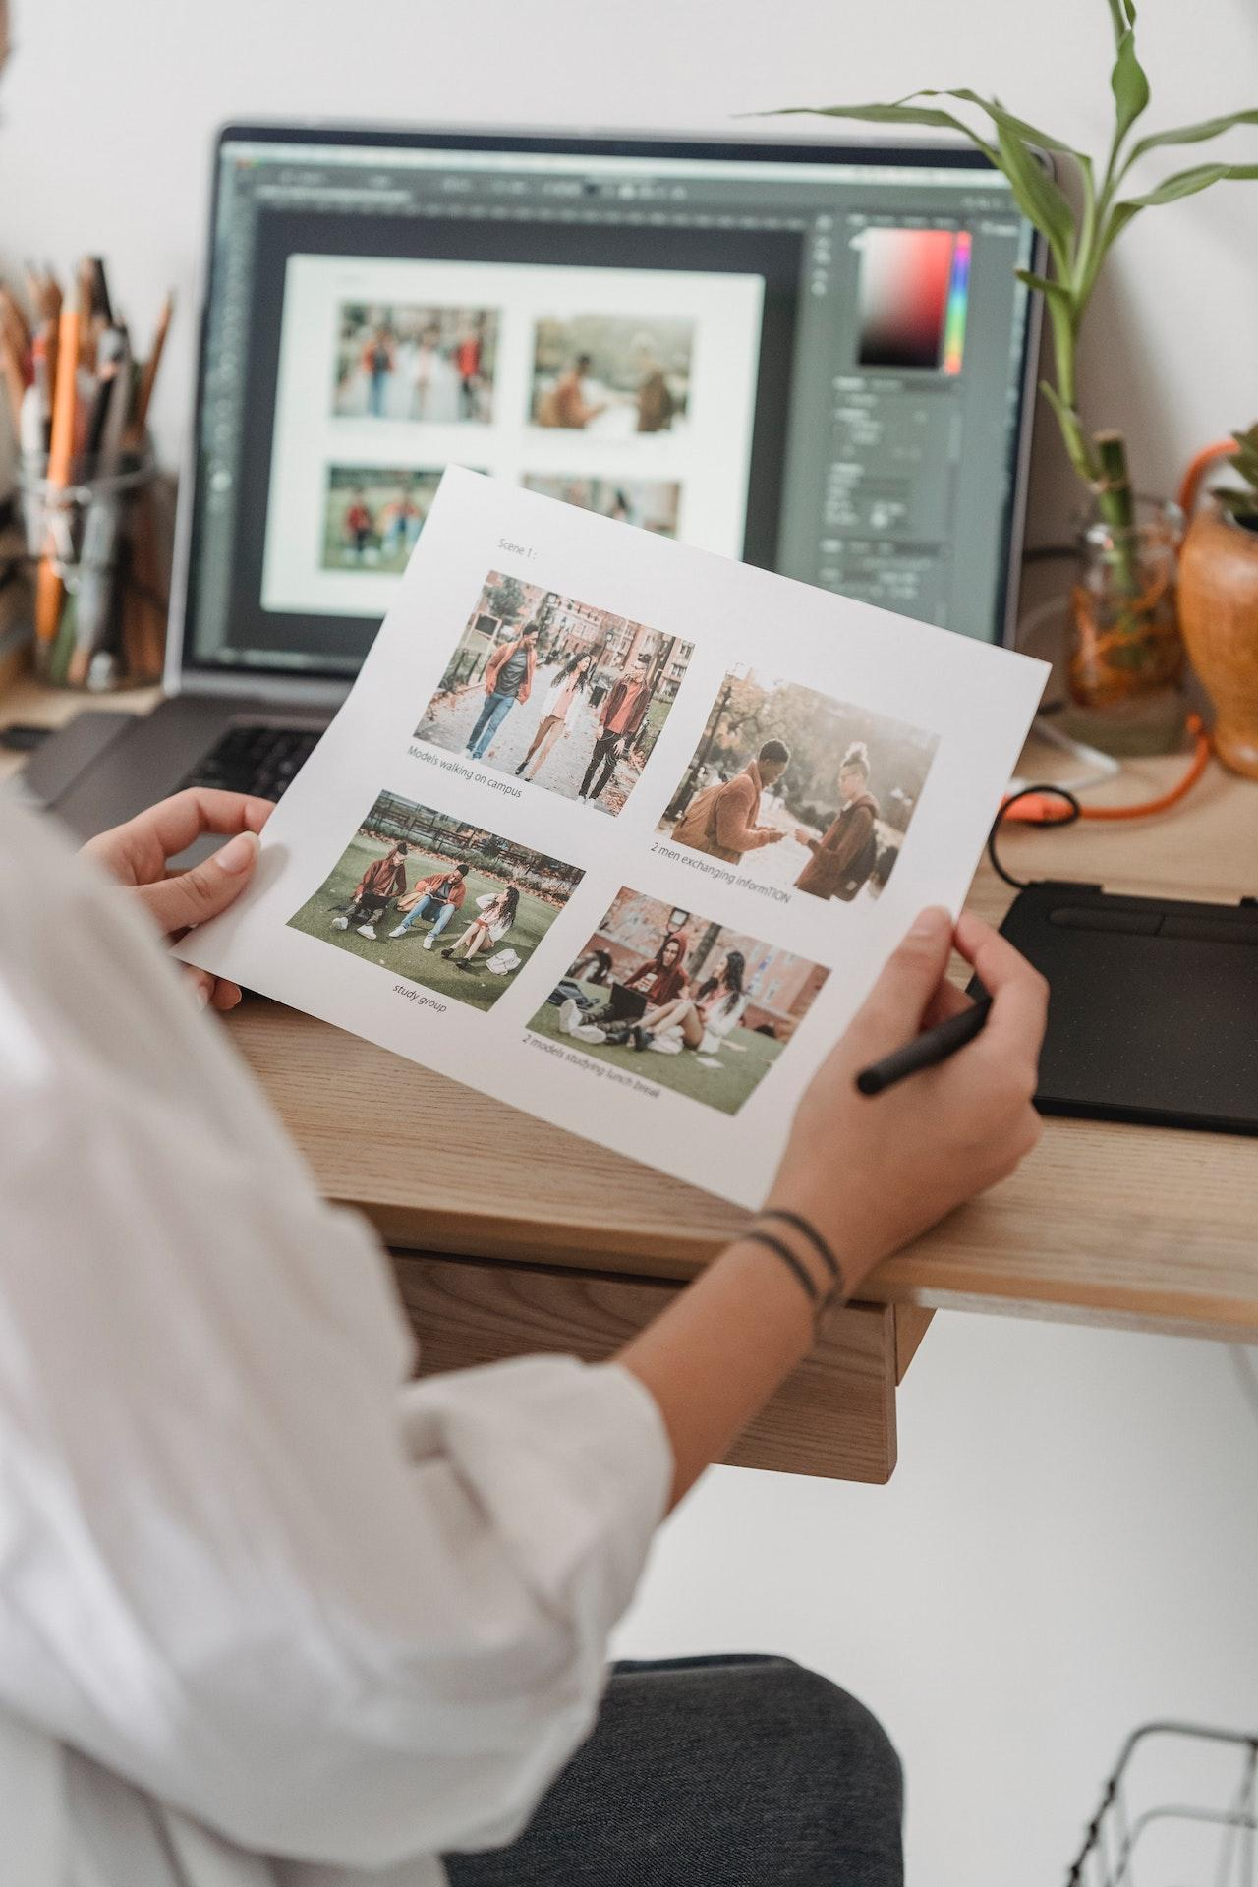
Source: https://www.pexels.com/photo/woman-with-printed-pictures-sitting-at-table-with-laptop-7014402/

Slide 12
Week 4 Arranging the image to communicate
photographers utilize a variety of artistic compositional elements:
Patterns, textures, lines, shapes, forms, color, tone, contrast, depth, frames, symmetry, asymmetry, depth of field, viewpoint, negative space, positive space, and visual tension
A well-composed shot will stand out from the rest and aid in distinguishing a great photographer from a good photographer.

Slide 13
Week 4 Arranging the image to communicate
Principles of composition to follow for the best shots:
i. Subject Positioning 1/3 Rule or Principle of thirds or rule of thirds
ii. The Golden Ratio or the Golden mean
iii. Leading lines
iv. Diagonals
v. Frame within a frame
vi. Figure to ground
vii. Fill the frame
viii. Center dominant eye
ix. Patterns and repetition
X. Simplicity and others

Slide 14
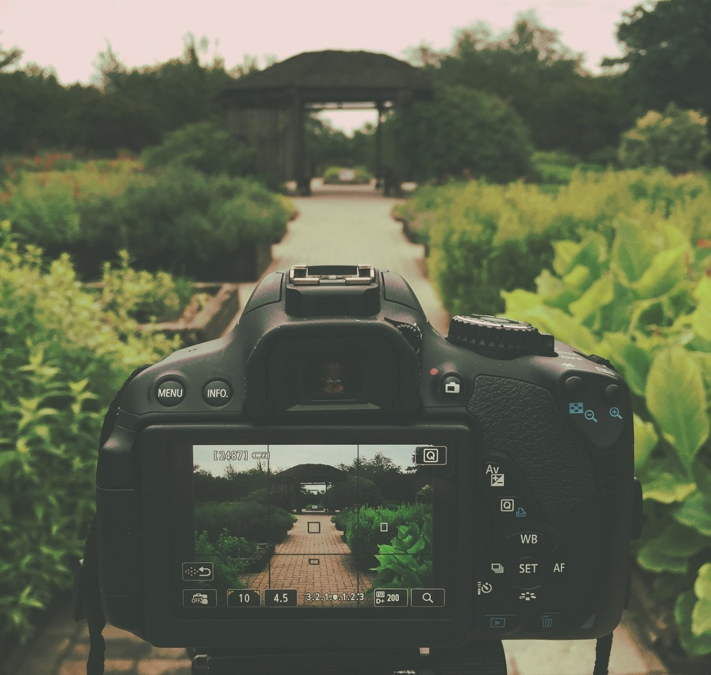
Source: https://pixabay.com/photos/canon-rebel-t4i-dslr-garden-path-780103/

Slide 15
Week 5 News and features
In journalism, what is the difference between news and feature writing?
How do those same differences apply to photography?
news writing:
Move through 5 W’s quickly
Focus on telling a news immediately
Tell about specific and timely events
feature writing:
Storytelling is primary goal
Focus on capturing reader interest
Talk about topics, emotions, issues, slices of life

Slide 16
Week 6 Sports features photojournalism
A type of photography that covers every sport and sporting event, capturing the action of a game and behind the scenes of the players.
The genre relies heavily on action photos, but not all sports photos have to be action shots.
Sports photography also includes story-telling images of the game or event as well as candid portraits, detail shots, and athlete portraits.

Slide 17
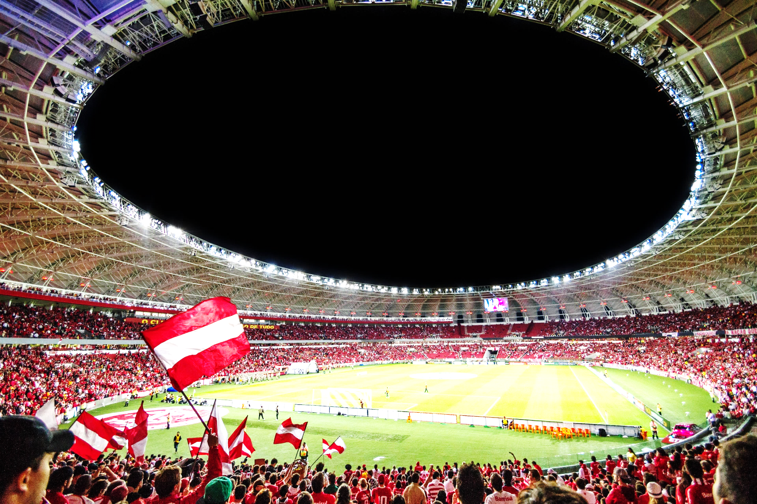
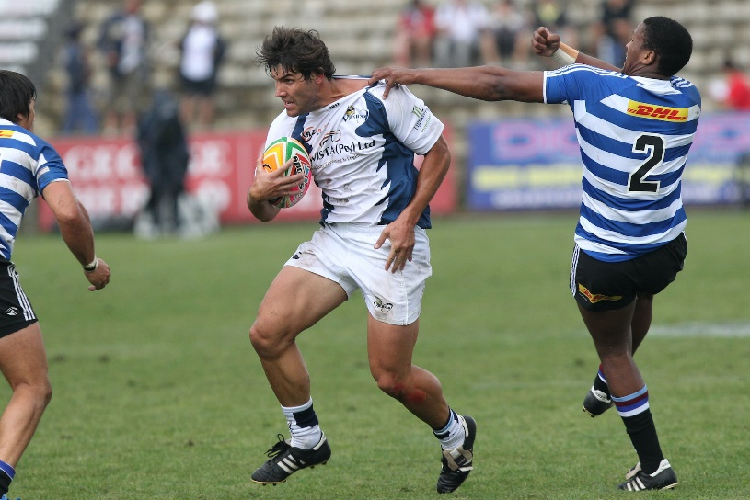
Source: https://www.pexels.com/photo/photo-of-a-men-holding-a-rugby-ball-3781312/
Source: https://www.pexels.com/photo/green-and-white-soccer-field-at-night-time-41257/

Slide 18
Week 8 The roles and responsibilities of photojournalist and editor
Capture images of events, incidents or people to create a press story.
editing and preparing pictures taken in real life situations to obtain visual materials used to support news stories.
visit several locations to obtain photographs of people, events or scenery for journalistic purposes.
They usually work for news agencies, magazines or documentary companies. Covering of important occasions such as the Olympics, national election, mass protest and other relevant events.
Operate a range of cameras and image-enhancing equipment such as artificial lighting, lenses, and filters. In order to capture clear images, which depict a situation and tell a convincing story.
Write a brief narration to describe or caption an image.
conduct research to gather useful information about a subject prior to photo shoot.
They process images by developing negatives and using specialized computer software such as Photoshop or Print Shop Pro to edit and enhance image, and so on

Slide 19
Week 9 Shooting the story, writing captions and editing the pictures
Captions must be accurate and answer the five basic questions of good journalism (who, what, where, when, why).
Avoid making assumptions. Do not assume anything that you can see in the photo.
Avoid the obvious. Do not use phrases such as ‘is shown, is pictured, looks on, above, etc.’ because the reader can already tell who is pictured. Also, tell the reader what they cannot see or might not know about the photo.
Start your captions as general and get more specific. Give your reader a broad idea of what the story is about and then provide them more information to get them interested in reading the story.
If you have to label multiple people in a photo, identify people from left to right and start your caption with the phrase ‘from left.’

Slide 20
Week 10 Designing the page and selecting photos for publication
Publication- to publish in broadcast and print media
Design- the creative artistic process
Page layout- Print media
Orientation- Layout in portrait or Landscape
Grid references- Layout’s rows and columns
Graphics- visual elements often used to point readers and viewers to particular information.
Communication- process involves understanding, sharing, and meaning

Slide 21
Week 11 Lighting techniques in digital photojournalism
There are two main kinds of light: natural and artificial.
Natural light is anything that occurs without human intervention, so it can be the direct light of the sun on a bright day, the diffused light created by a cloudy or foggy day, or even the light of the moon at night.
On the other side of things, artificial light can often be moved around and adjusted to fit your situation.
It is easier to position artificial light in relation to your subject than with natural lighting, where you would have to move the subject and camera according to the lighting technique that you want to use.

Slide 22
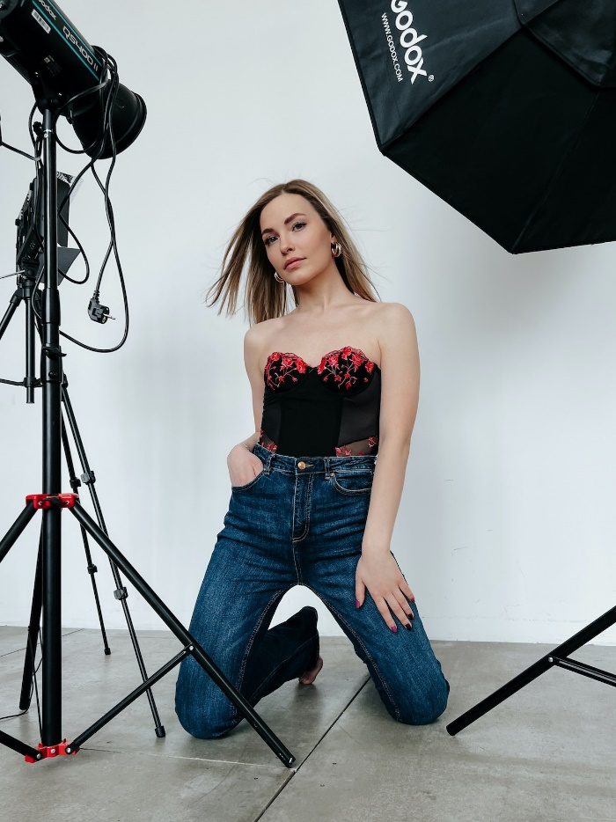
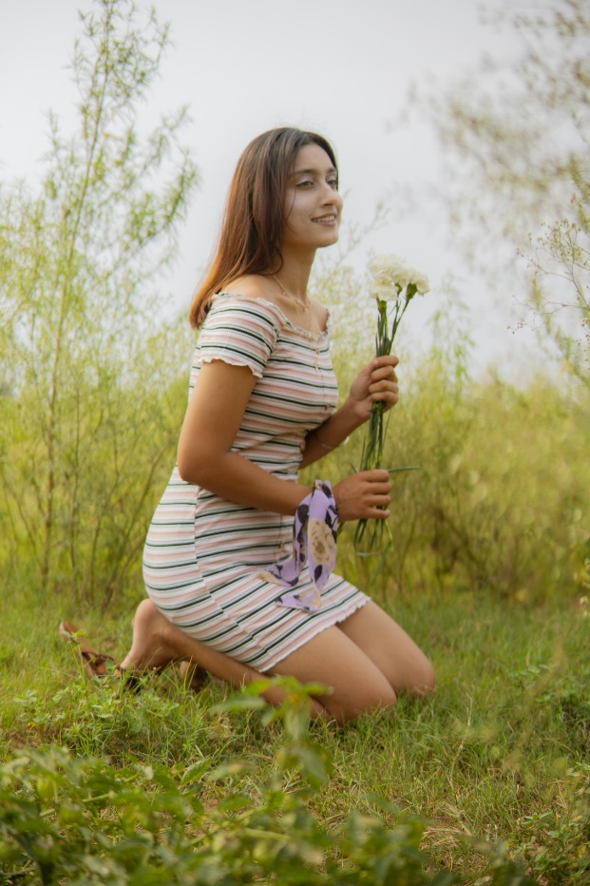
Indoor with artificial lighting, and outdoor with natural lighting
Source: https://www.pexels.com/photo/model-posing-in-a-studio-11697738/
Source: https://www.pexels.com/photo/woman-in-off-shoulder-striped-dress-kneeling-on-the-grass-13626279/

Slide 23
Week 12 Ethics and legal issues of photojournalism.
A set of principles of right conduct. Among many other interpretations of ethics is the one that views it as a study of good and bad, wrong and right
posing and accuracy
staging and truthfulness
recreation, alteration and objectivity
faking reality and professional honesty
hidden camera, privacy and public interest
tragedy, grief and gruesome photos: professional Vs humanity role
indecent photos, stereotyping and the role for human dignity

Slide 24
Week 13 The future of photojournalism.
A high degree of risk is experienced among professional photographers with a very strong correlation to the country in which they are based.
While the image is a central and vital component in modern communications, the place of the professional photographer has never been as potentially under threat as it is in the digital era.
The challenge to professional news photography, however, goes far beyond job security, and is both multi-faceted and complex.
The digital revolution has witnessed the transformation of the audience into producers and with technology growing in power and shrinking in cost, a new generation of amateur and citizen image-makers has emerged.
Every contemporary disaster, natural or self-inflicted, has been captured by people on the scene with cameras or mobile phones.

Slide 25
Differences between Photography and photojournalism
photography serves as a way to capture and preserve memories.
for technical purposes, such as illustrating technical information.
Studio and portrait photographers offer polished views reflecting professional standards to capture our memories.
Artists use photography to communicate their vision.
Advertisers use photography to sell things.

Slide 26
Differences between Photography and photojournalism
Photojournalists use photography for another purpose: to tell a news story.
The approach is similar to that of journalists.
A reporter tells a story using words based on accepted news values.
A photojournalist does the same thing, based on images.
To tell a story, a sentence needs a subject, a verb and a direct object.
A photographer takes pictures of nouns (people, places and things). Photojournalists shoot action verbs ("kicks," "explodes," "cries," etc.).
Photojournalists do shoot some nouns. These nouns can be standard photos of people (portraits), places (proposed zoning areas or construction sites) and things (name it). However, the nouns we seek still must tell a story.

Slide 27
Historical development of Photojournalism
But until the 20th century, news photos could not be printed directly.
Artists had to meticulously hand-copy them as engravings. Engravings were good, but not actual photos.
By the beginning of the 20th century it was possible to print photos directly using the halftone method. World War I in particular was heavily photographed.
But “photojournalism” as a story-telling concept didn’t exist. Photos were displayed in the style of a photo album, all the same size.
One reasons was that cameras were still cumbersome; candid photography was difficult.

Slide 28
Historical development of Photojournalism
The first technological change to make photojournalism possible was the invention of a small, fast-working camera.
Instead of the large-format film of the day, the Leica used left over movie film in smaller, 35mm format.
The Leica allowed news photographers to work unobtrusively, without bulky tripods or big cameras.
They could finally shoot natural, unmanipulated photos showing how people really lived.

Slide 29
Historical development of Photojournalism
The idea of combining the story-telling techniques of journalism with photography actually originated in Germany.
German publishers as early as the 1920s experimented with the photo magazine idea.
One dominant, theme-setting photo would be published larger, to help define the story.
Copy would be kept to a minimum.
This was a combination of photography and journalism. The term “photojournalism” actually was coined by a historian, Frank Luther Mott, in the 1940s.
After Hitler’s rise to power in 1933 most of these pioneering German photo editors were persecuted, their publications suppressed.
Many fled the country, often to the United States. The photojournalism idea moved by the 1930s to America.

Slide 30
The qualities of a good photojournalist
Uses the camera and other equipment to his or her best advantage.
A thinking creative person who mixes technique and judgments to capture images
Gives the viewer an image that is truthful and without manipulation.
Prepared to act fast and have his camera always at hand.
Events with prior notifications requires one to be there well before the action begins.
to act quickly while at the same time ensuring his or her own safety in dangerous areas like war, terror etc.
Should give their best as not all pictures taken by photojournalists get published.

Slide 31
SUMMARY
Photojournalism is going to meetings week after week, snapping pictures of a community’s new construction project, photographing farmers markets and checking out a protest with a camera in hand. It’s a rewarding and challenging field.
New photojournalists need to be aware of new ideas, new business models and new technology.
1. Photojournalism is relevant.
2. Photojournalism is timely.
3. Photojournalism is objective.
4. Photojournalism is narrative.
5. Aesthetically Interesting

Slide 32
SUMMARY
Before the first photographs as the early form of photojournalism arose, there were illustrations that depicted certain historical events.
Photojournalism isn’t the first form of journalism with the focus on pictures, but with the technological advancement of cameras, it was only logical to replace complex illustrations with photographs.
Watch this YouTube link: https://www.youtube.com/watch?v=PYu-Nc7m_ok&ab_channel=RaphTech.

Slide 33
THANK YOU

