Slide 1
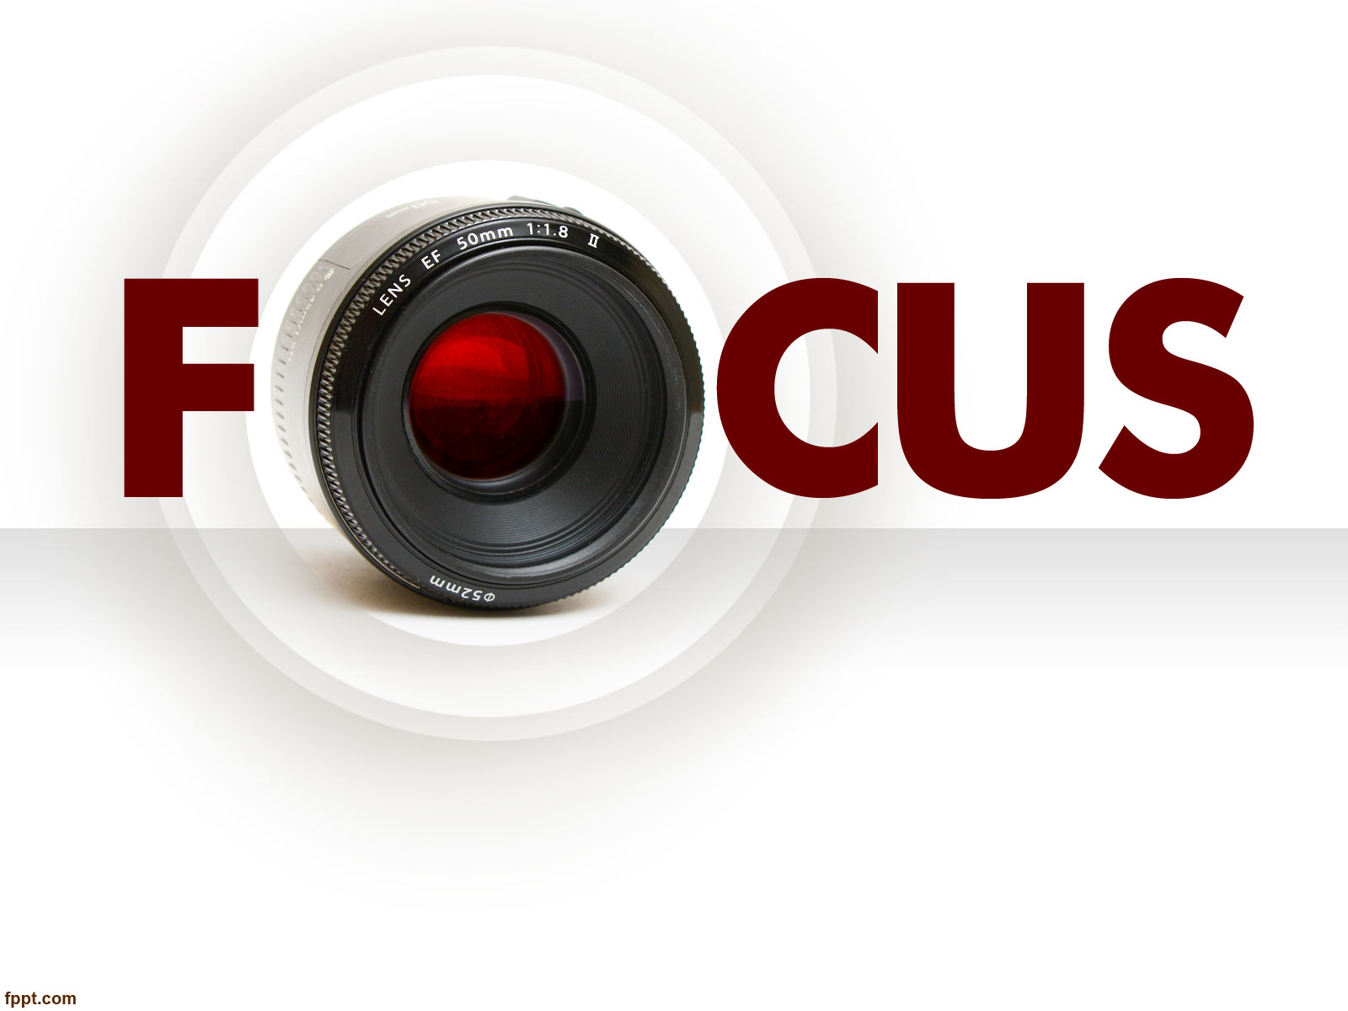
Photojournalism
WEEK 2 Photojournalism tools
By Dr. Raphael Ogutu

Slide 2
Objectives
At the end of this week, you should be able to:
1. Learn the different types of photojournalistic equipment
2. Understand the different types of cameras
3. Analyze how different tools of photojournalism work together
4. Discuss the role of technology in computer and software application in photojournalism

Slide 3

Introduction
This lecture introduces you to photojournalism tools, the type of photojournalism equipment you need depending largely on the assignment at hand.
working on a human interest story, might need prime lenses like a 50mm or 85mm to capture compelling portraits,
while one capturing a local protest, may need a camera with fast autofocusing and a high shutter speed, professional camera, and lens.
an on-camera microphone for recording interviews, a tripod for capturing more scene-setting landscapes, a spare battery, filters, carrying bag, external flash, and an extra SD card or two.

Slide 4
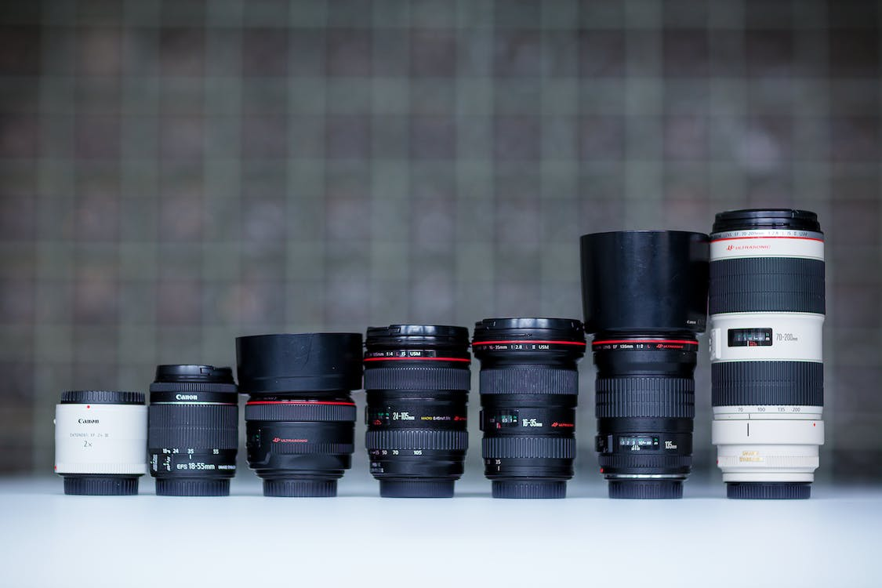
The different types of photojournalistic equipment
Invest in good glass
Get the best lenses you can afford.
Ideally, a wide-angle to normal zoom lens with a constant f/2.8 wide aperture, and a tele zoom are virtual requirements.
If you can’t afford these, at least get a couple of fast prime lenses, and a 180 or 200mm telephoto, plus a 50mm f/1.8 or f/1.4 (Adorama, 2022)
Photo Source: https://www.pexels.com/photo/close-up-shot-of-camera-lens-on-white-surface-12940934/ by Antony Trivet

Slide 5
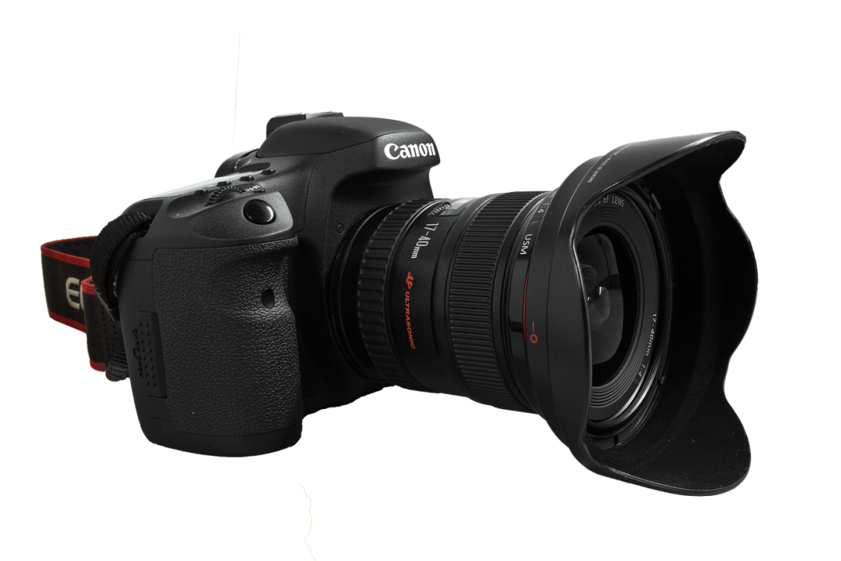
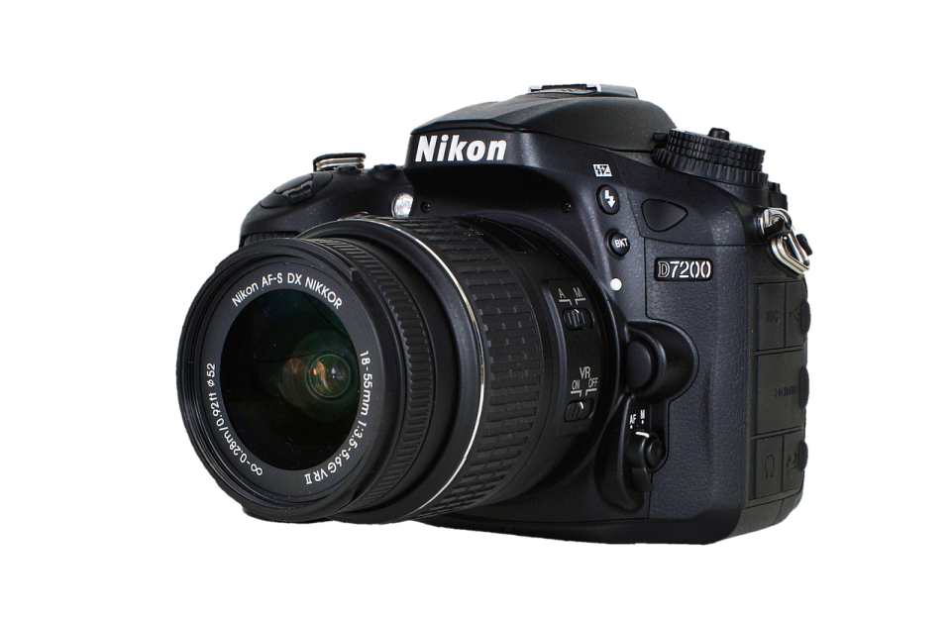
The different types of photojournalistic equipment
Camera Bodies
There are many excellent camera systems available, but the most commonly used in the photojournalism industry are either Nikon or Canon.
Some older used DSLR cameras may get you started, but it is strongly advised to have a current model with HD video and external sound connection capability.
In the end, this will save you time, money and frustration. (Adorama, 2022)
Source: https://pixabay.com/photos/camera-canon-photography-lens-542784/ PIXABAY.
Source: https://pixabay.com/photos/camera-nikon-nikon-7200-old-camera-2748859/ PIXABAY.

Slide 6
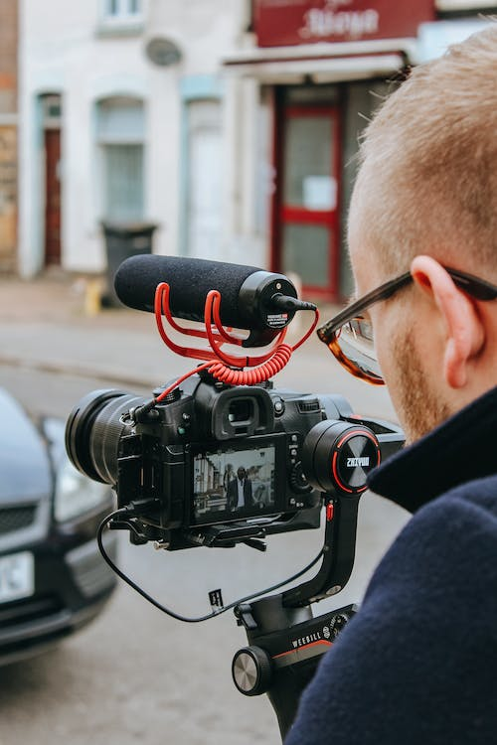
The different types of photojournalistic equipment
Buy a good omnidirectional microphone (if you’re going to shoot videos)
You need a good microphone to capture sound on your camera.
Get a good, rugged handheld microphone, with a wind sock, for interviews or to capture ambient sound. (Adorama, 2022).
Photo Source: https://www.pexels.com/photo/crop-anonymous-professional-videographer-recording-video-on-camera-on-street-5674663/
by Ethan Wilkinson

Slide 7
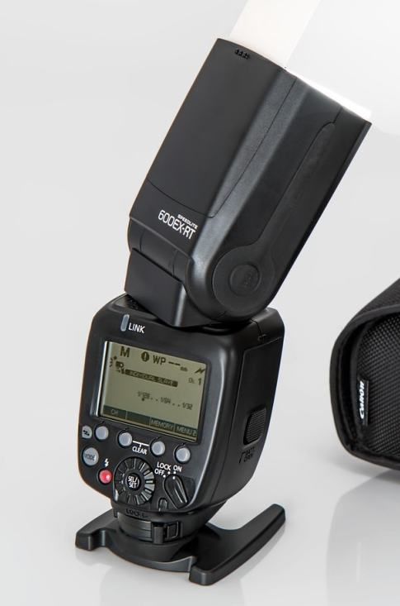
The different types of photojournalistic equipment
Bring a TTL strobe, either from the camera maker or an independent flash company
Get the most powerful unit you can afford. Even better: Make it a wireless set-up, or at least a TTL (Through The Lens metering)-friendly off-camera cord, so you can move the flash off the camera.
Use a flash modifier
At the very least, get a reflector so you can bounce the flash or a diffuser to widen the flash source for more flattering lighting. This will allow you to get more natural lighting. (Adorama, 2022).
Source: https://pixabay.com/photos/flash-unit-external-flash-642669/. PIXABAY

Slide 8
The different types of photojournalistic equipment
Fully-charged batteries
Bring at least two back-up batteries for each camera and flash.
Memory cards
Buy the fastest memory card you can afford, to take advantage of your camera’s burst rate and data transfer capabilities. This very well might make the difference between getting the moment and missing it.
data plan
Connect wirelessly via your provider’s data plan (hint: invest in a data plan!), and don’t have to rely on the availability of Wi-Fi. The ability to file pictures from the field on a tight deadline is an absolute necessity. (Adorama, 2022)

Slide 9
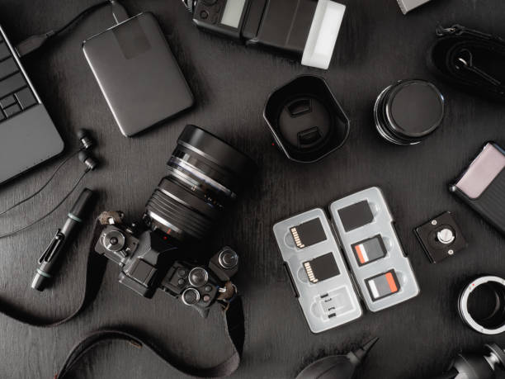
Source: https://www.istockphoto.com/photo/top-view-of-work-space-photographer-with-digital-camera-flash-cleaning-kit-memory-gm1140936741-305473220?utm_source=pixabay&utm_medium=affiliate&utm_campaign=SRP_photo_sponsored&utm_content=https%3A%2F%2Fpixabay.com%2Fphotos%2Fsearch%2Fcamera%2520accessories%2F&utm_term=camera+accessories

Slide 10
Sensor cleaners, microfiber cloth, etc
Be prepared to clean the lenses and sensor often.
Smartphone…
Note that your phone might be pressed into service as a way to wirelessly transmit images from your camera to your editor on tight deadline. Make sure your data plan can handle it.
A roll of gaffer tape
It’s good to have gaffer tape around because eventually, you will. If room in your bag is at a premium, micro Gaffer tape is a very handy option.
A good bag with room to grow
Make sure the camera bag has adjustable dividers so your gear will sit snugly. Investing in appropriate equipment will put you on the right track. (Adorama, 2022)

Slide 11
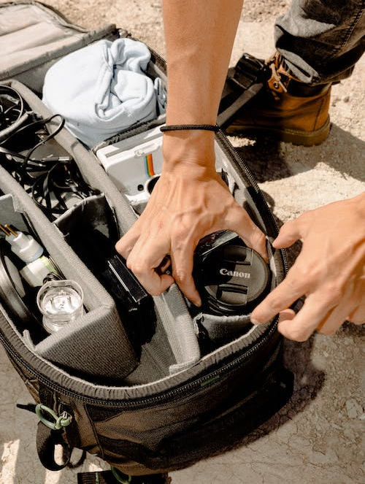

Source: https://www.pexels.com/photo/person-holding-camera-lens-in-camera-bag-2994110/ by Wendy Wei
https://www.pexels.com/photo/anonymous-woman-drawing-on-graphic-tablet-while-editing-photos-7014931/ by George Milton

Slide 12
External Hard Drive: You will need an external hard drive with big storage capacity. Minimum 1Terabyte or TB
Tripod and a monopod: A good solid tripod and monopod is needed occasionally for video and certain low-light situations.
Personal Computers: A laptop is certainly a great asset. The photojournalism industry is primarily based upon the Macintosh with Creative Cloud Suite, but some students use PCs. Most of the work performed will be done using Adobe Photoshop software and other related software. (Loyalist College, 2017).

Slide 13
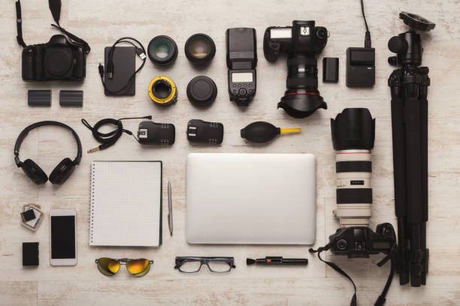
Source: https://www.istockphoto.com/photo/diverse-personal-equipment-for-photographer-gm953480840-260301277?utm_campaign=adp_photos_10&utm_content=https%3A%2F%2Fwww.pexels.com%2Fsearch%2Fcomputer%2520tripod%2520monopod%2520external%2520hard%2520drive%2F&utm_medium=affiliate&utm_source=pexels&utm_term=media

Slide 14
The different types of cameras
Compact Digital/Point and Shoot Cameras:
literally allow anyone to capture beautiful images by simply pointing the camera at the subject and clicking the shutter.
Also known as a point-and-shoot camera, it is the most user-friendly of all camera types.
It is smaller and lighter, and doesn’t require film or extra lenses. It also does all the hard work of automatically adjusting its settings to deliver well-exposed photos every time.
Cons of Compact Digital Cameras: Usually can’t customize shutter speed and aperture, Limited aperture and zoom range, Noisier photos due to small sensor, Lower resolution, and Slower focus.

Slide 15
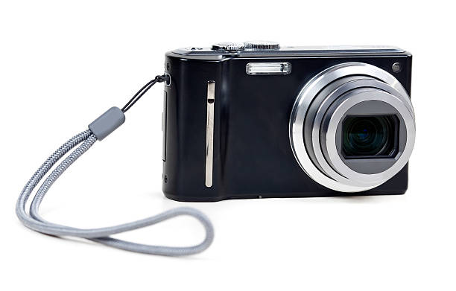
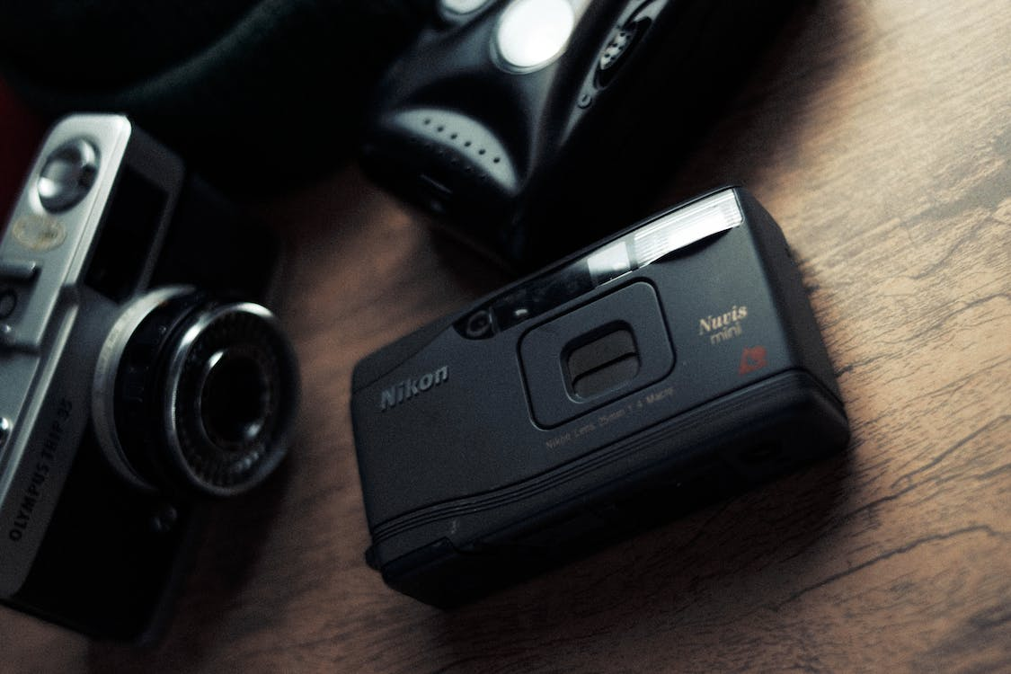
The different types of cameras
Source: https://www.istockphoto.com/photo/black-camera-with-sliding-lens-gm137064253-18865546
Source: https://www.pexels.com/photo/set-of-retro-photo-cameras-7123333/ by Wallace Chuck

Slide 16
The different types of cameras
Bridge Cameras
is “somewhere between” a point and shoot and an interchangeable lens camera.
has a large zoom range, a viewfinder, and allows for some manual control of settings.
Ideal for someone who has “graduated” from a point and shoot but isn’t ready yet to invest in an interchangeable lens camera (ILC) system or doesn’t want the inconvenience of carrying around and changing multiple lenses.
Single lens may not be ideal for specialized needs such as ultra-wide angle or extreme shallow depth of field portrait photography

Slide 17
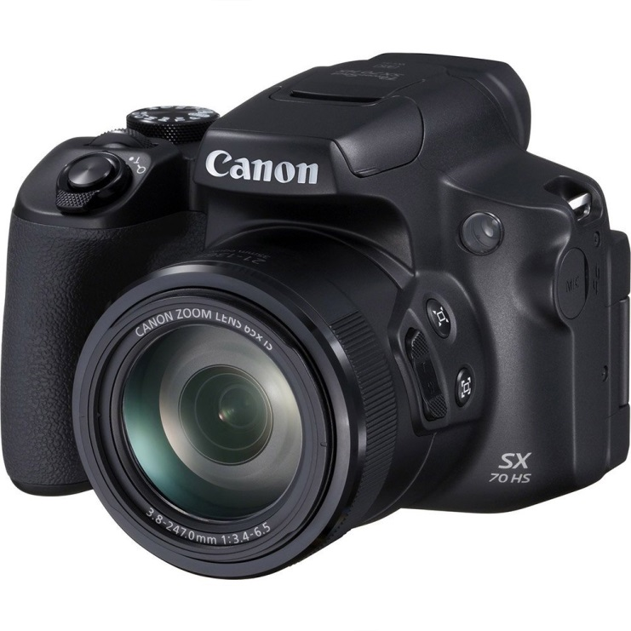
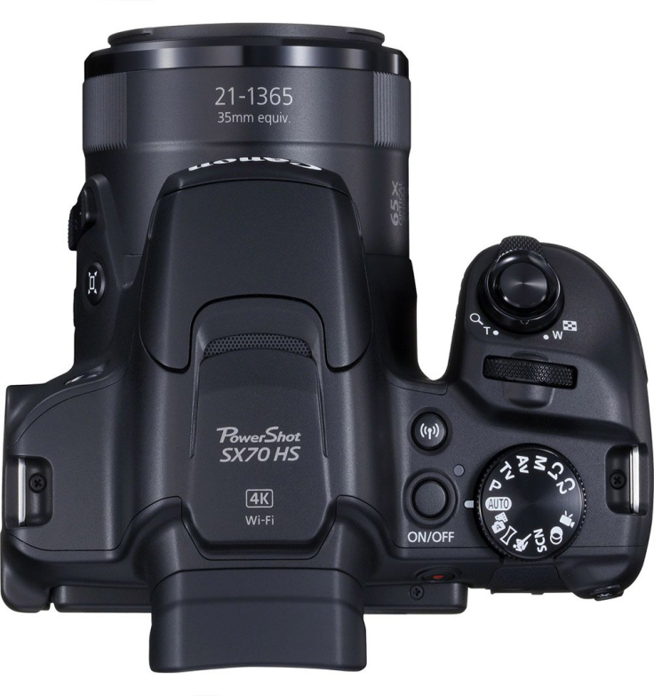
The different types of cameras
Canon PowerShot SX70 HS Bridge Camera
Source: https://www.tradeinn.com/techinn/en/canon-powershot-sx70-hs-bridge-camera/137344182/p by techinn. TRADEINN RETAIL SERVICES, S.L. CIF/VAT ES-B-17527524, C/ Pirineus, 9, 17460 Celrà (Girona), Spain.

Slide 18
The different types of cameras
Digital SLR Cameras (or digital single lens reflex)
Today, professional photographers and videographers from around the world mostly use DSLRs (now alternatively known as hybrid single reflex lens cameras or HDSLR) for commercial purposes.
Many of Canon’s and Nikon’s DSLR cameras are being used for capturing hi-res images for magazines and billboards, and even full HD 1080p videos at up to 60fps for television shows and movies.
Pentax DSLRs are also well-known for being the perfect camera buddy for shooting under the most difficult weather situations. Cons of DSLRs: Bigger and bulkier, Higher cost, and Requires ample know-how

Slide 19
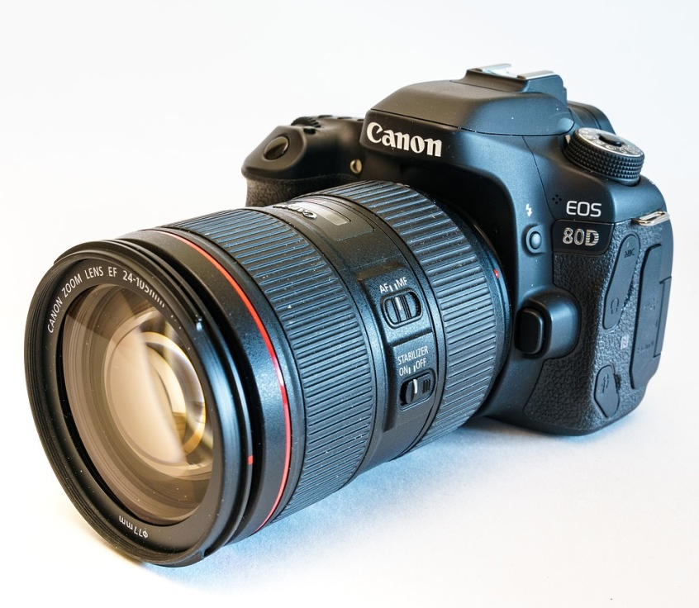
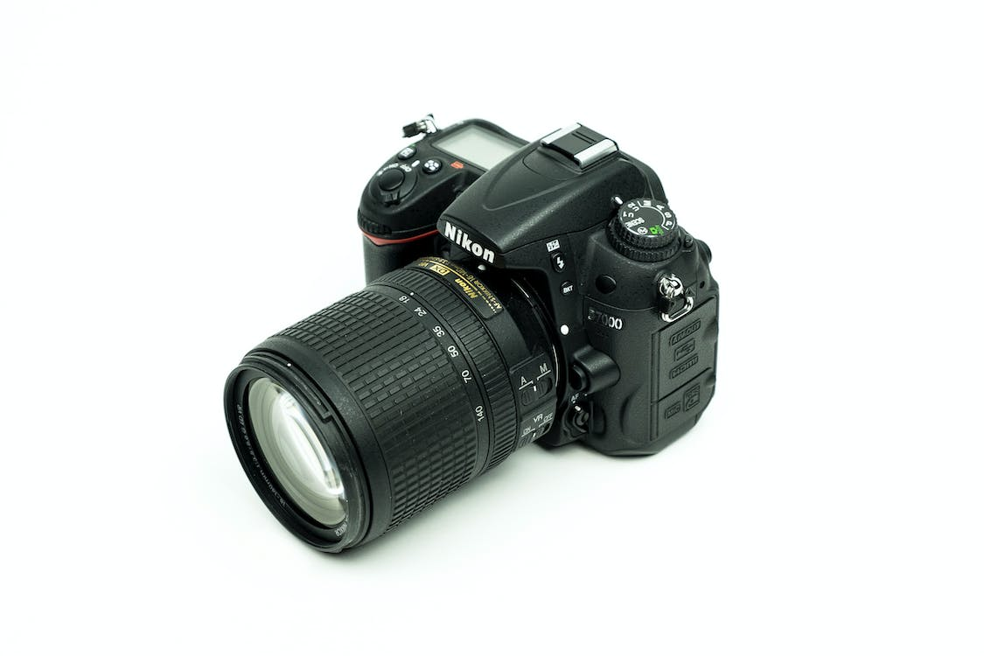
The different types of cameras
Source: https://pixabay.com/photos/camera-digital-camera-lens-canon-4838724/
Source: https://www.pexels.com/photo/close-up-shot-of-a-camera-249597/

Slide 20
The different types of cameras
Mirrorless Cameras: the latest in professional cameras.
They are basically more compact DSLRs without the internal mirror that reflects light onto the sensor.
Capable of capturing incredible, high-resolution images with even faster shutter speeds and record ultra HD videos that only the most expensive, higher-end DSLRs can produce.
It is a combination of two popular types of digital cameras—a point-and-shoot for its compact size and somewhat simpler controls, and a DSLR for its interchangeable lenses and impressive output.

Slide 21
The different types of cameras
Medium Format Cameras: in general, have sensor sizes that are smaller than film medium format. However, medium format sensor size is larger than a full frame sensor, which generally translates to higher quality images.
Medium format cameras also produce shallower depth of field, produce smaller equivalent focal length, and have more dynamic range when compared to a full frame camera.
Action Cameras: Common action cameras like the GoPro can fit in the palm of your hand, but they’re some of the most durable and versatile types of digital cameras that offer very high-resolution output.
A wide range of accessories like waterproof housing and mounts allow the user to attach action cameras to helmets, bicycles, and even drones, which enable hands-free shooting in different types of situations.

Slide 22
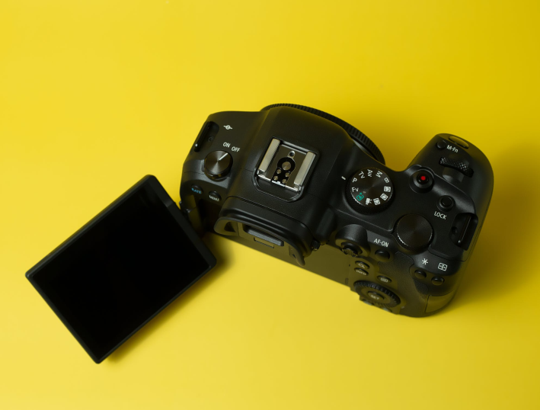
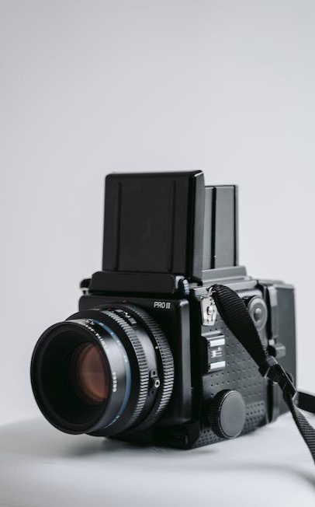
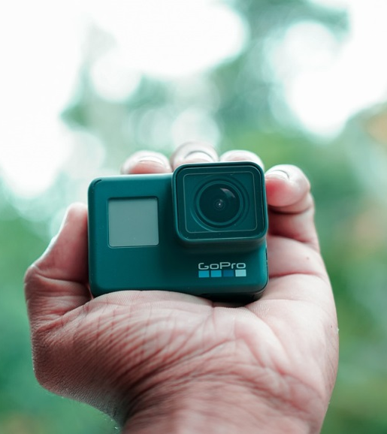
The different types of cameras
Soure: https://www.pexels.com/photo/a-close-up-shot-of-a-mirrorless-camera-7789067/ MIRRORLESS CAMERA by Ivan Babydov
Source: https://www.pexels.com/photo/a-vintage-medium-format-camera-on-a-white-stool-7206216/ by Tima Miroshnichenko
Source:https://pixabay.com/photos/gopro-camera-device-gopro-hero-6-6325014/ Action camera, PIXABAY.

Slide 23
The different types of cameras
Instant Cameras: instant film has made a strong resurgence. There are a variety of reasons why you should consider purchasing an instant camera. The biggest benefit of an instant cameras is it allows you to give a physical copy (print) of the image to anyone right after taking the picture.
Smartphone Cameras: the most significant advances in digital photography in recent years have been in smartphone cameras.
According to many online sources, images taken with smartphone cameras vastly outnumbers those taken by any other format.
Rugged Cameras: Most people will likely mention a camera that is waterproof or freeze-proof or one that can survive a drop from a certain height. So, it all depends on your definition of “rugged”.

Slide 24
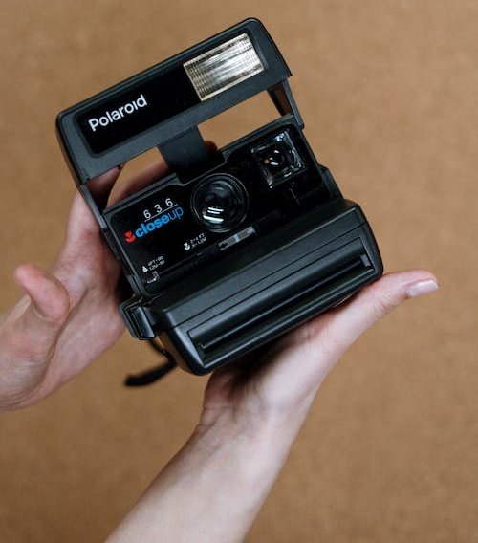

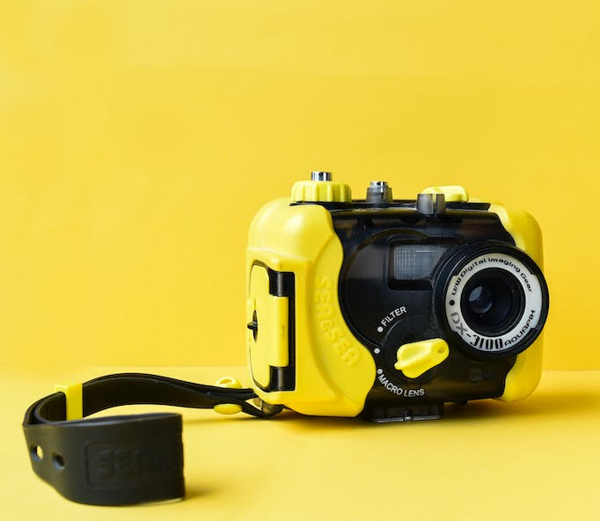
The different types of cameras
Source: Pexels https://www.pexels.com/photo/black-polaroid-instant-camera-on-persons-hand-3945339/ by cottonbro studio
Source: Pixabay, Selfie, Girl, Young image. https://pixabay.com/photos/selfie-girl-young-female-friends-4255884/
Source: Pexels https://www.pexels.com/photo/waterproof-camera-on-yellow-background-4523103/ by elif tekkaya

Slide 25
The different types of cameras
Digital Cinema Cameras: specialized cameras designed specifically for professional filmmaking and video production.
Are built with larger sensors, higher resolutions, and more advanced features to capture cinematic footage with exceptional quality.
Ability to capture video in high resolutions such as 4K or even 8K, which allows for greater detail and clarity in the final image.
Support the RAW format, which provides the highest quality image and the most flexibility in post-production.
Drones: offer a unique perspective that is impossible to achieve with traditional camera equipment, giving professionals access to stunning aerial views that would otherwise be difficult or impossible to capture.
cover a large area in a short amount of time, making them an ideal tool for capturing images of large events or landscapes.

Slide 26
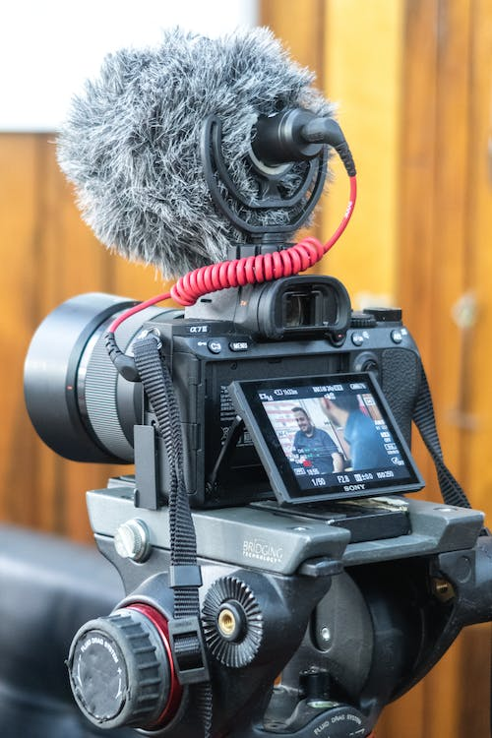
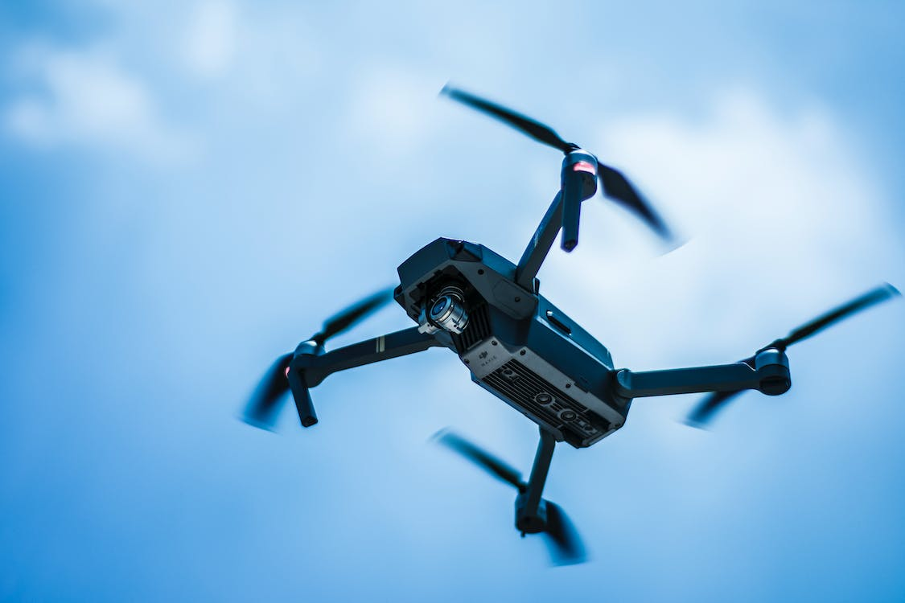
The different types of cameras
Source: DRONE CAMERA
https://www.pexels.com/photo/photo-of-gray-quadcopter-on-the-sky-739410/ by Eric Santoyo
Source: Pexels, https://www.pexels.com/photo/black-dslr-camera-on-black-tripod-stand-3738406/ ByLeticia Ribeiro

Slide 27
Types of camera lens
The two types of camera lenses are the zoom lenses and prime lenses.
What is a zoom lens?
Zoom lenses have variable focal lengths, so with a 70-200mm lens for example, allows you to photograph both close up and in the distance. Zoom lenses are a versatile choice of lens.
The downsides of a Zoom Lens are that they are usually heavier than Prime Lenses, not quite as sharp as proportionally priced Prime Lenses, and the aperture setting doesn’t usually go as low, meaning low-light shots aren’t as easy to get.
What is a prime lens?
Prime lenses have a fixed focal range, which means that you can't zoom in or out. The main advantage of prime lenses is that they specialize in just one focal length.
Are finely tuned to deliver on one specific type of photography, unlike a zoom lens which can be used in a multitude of cases.

Slide 28
Types of camera lens
Focal Length | Type of Lens | What is it used for?
4mm - 14mm | Fisheye | Abstract, creative
14mm - 35mm | Wide angle | Landscape, architecture
35mm - 85mm | Standard | Street, travel, portrait
85mm - 135mm | Short telephoto | Street photography and portraits
135mm+ | Medium telephoto | Sports, wildlife, action
300mm+ | Super telephoto | Sports from a distance, nature and astronomy
35mm - 200mm | Macro | Close-up shots
Source: PhotoGuard ( 2023) Focal length size guide https://www.photoguard.co.uk/camera-lens-guide

Slide 29
Types of Lens Filters
Common filters used by photographers include:
Clear filters: Used as lens protectors
Ultraviolet (UV) haze filters: Reduce haze, and they're commonly left on the lens permanently as a lens protector
Skylight filters: Slightly pink filters used to reduce blues, correct haze, and act as a lens protector
Polarizing filters: Reduce glare, cut unwanted reflections from water, and saturate colors, making skies appear bluer and clouds whiter
Neutral density filters (ND): Dark filters that reduce the amount of light the sensor receives so larger apertures and slower shutter speeds can be used to reduce the depth of field or to create motion blur
Graduated ND filters: Similar to ND filters except part of the filter is darker, so it's possible to expose bright backgrounds and dark foregrounds correctly
Diffusion and soft focus filters: Used to soften image details in portraits
Star filters: Create starburst effects over bright lights

Slide 30
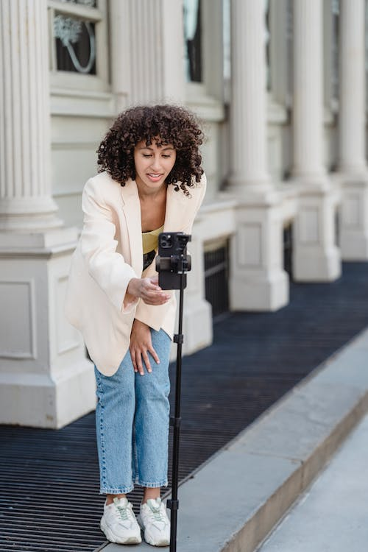
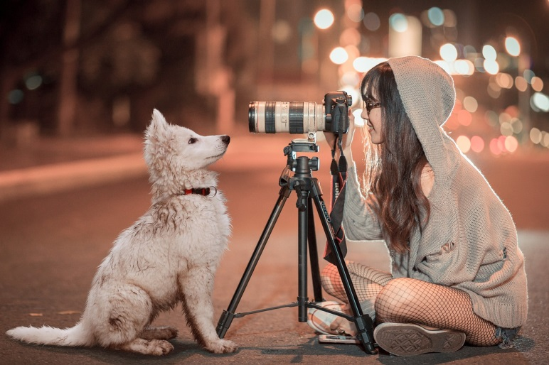
Tripods and monopods
A tripod steadies the camera to create a versatile and stable base from which to frame your composition. It doesn't matter if you're a beginner or a serious photographer—tripods are guaranteed to improve your imaging.
allow for easier manual adjustment of tricky lighting situations, such as a night sky or landscape.
Monopods or unipod, this is a one-legged support or a collapsible pole.
This photography accessory steadies a mounted camera by eliminating vertical motion.
Source: PIXABAY https://pixabay.com/photos/puppy-dog-pet-night-sch%C3%A4fer-dog-3688871/
Source: https://www.pexels.com/photo/ethnic-blogger-with-smartphone-on-urban-pavement-7243116/ byBlue Bird

Slide 31
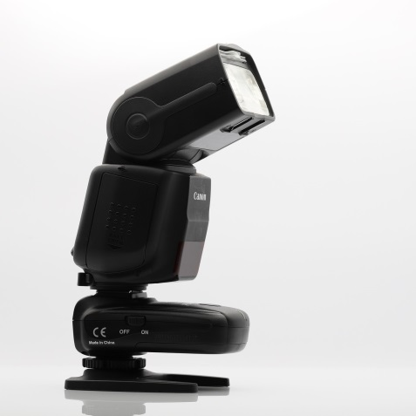
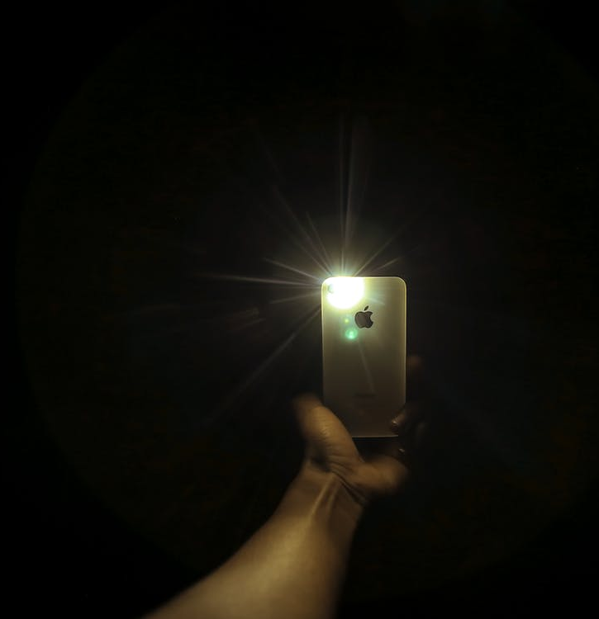
Detachable Camera Flashes
A flash is a piece of equipment that produces a beam of light for a very short period of time when you release the camera shutter.
You can use it to lighten shadows and to brighten your subject without having to decrease the shutter speed or increase the ISO settings.
External camera flash accessories outperform internal camera flashes because they're more powerful and thus can be used at greater distances.
Source: Pixabay https://pixabay.com/photos/detachable-camera-flash-camera-flash-7005118/
Source: https://www.pexels.com/photo/crop-person-using-smartphone-in-dark-room-3348724/ by Gift Habeshaw

Slide 32
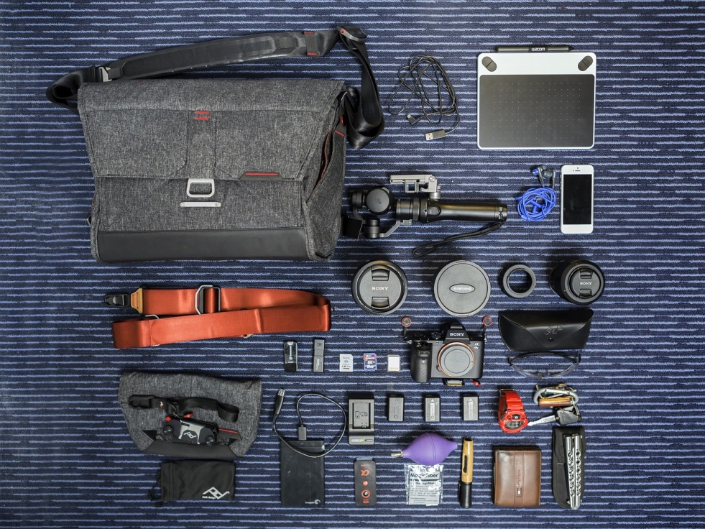
Photography bags and cases
A pouch is a small bag designed to take up little room. Those designed for a camera generally only have space for your camera and a few small accessories, such as batteries or memory cards.
Holsters and Belts: Wear a holster or belt around your waist or over your shoulders to allow for hands-free carrying of your camera when you're on the go.
Messenger Bags and Backpacks: Larger in size, messenger bags and backpacks offer lots of room for your photography equipment, and are easy to carry around from one location to another.
Trunks and Hard Cases: Trunks and other hard cases offer the most protection for your equipment, generally coming complete with cushioning and dividers so you can stay organized. These types of cases can range from the size of a large shoe box to the size of luggage or larger.
Source: Pixabay
https://pixabay.com/photos/bag-belt-box-cable-charger-camera-1867711/

Slide 33

Computer and software application
Desktops Edge over Laptops Disappear
There were times when desktop computers were the only option for serious craftspeople.
Today, however, new laptop models boast speed and storage that rival high-end desktops, suited for editing work
Built-in high-resolution screens up to Ultra HD 4K provide stunning color, contrast and, detail that discerning photo editors require.
In short, modern laptops have all the advantages of heavy-duty desktop photo editing in a lightweight package weighing only 3-4 pounds
Source : Pexels https://www.pexels.com/photo/a-woman-using-a-computer-7971616/ By Darlene Alderson

Slide 34
SUMMARY
There are different types of camera lens for almost any situation you could find yourself in as a photographer.
Knowing which lens is best for what scenario will set you on your way to becoming a much-improved photographer.
Photojournalists use digital cameras to capture images.
They also use other equipment in their roles, and these include:
Different lenses, such as zoom and fixed lenses
Lighting equipment, such as a flash stand and umbrella
Batteries, chargers and memory cards
Tripod
Computer photo editing software

Slide 35
THANK YOU

