Slide 1
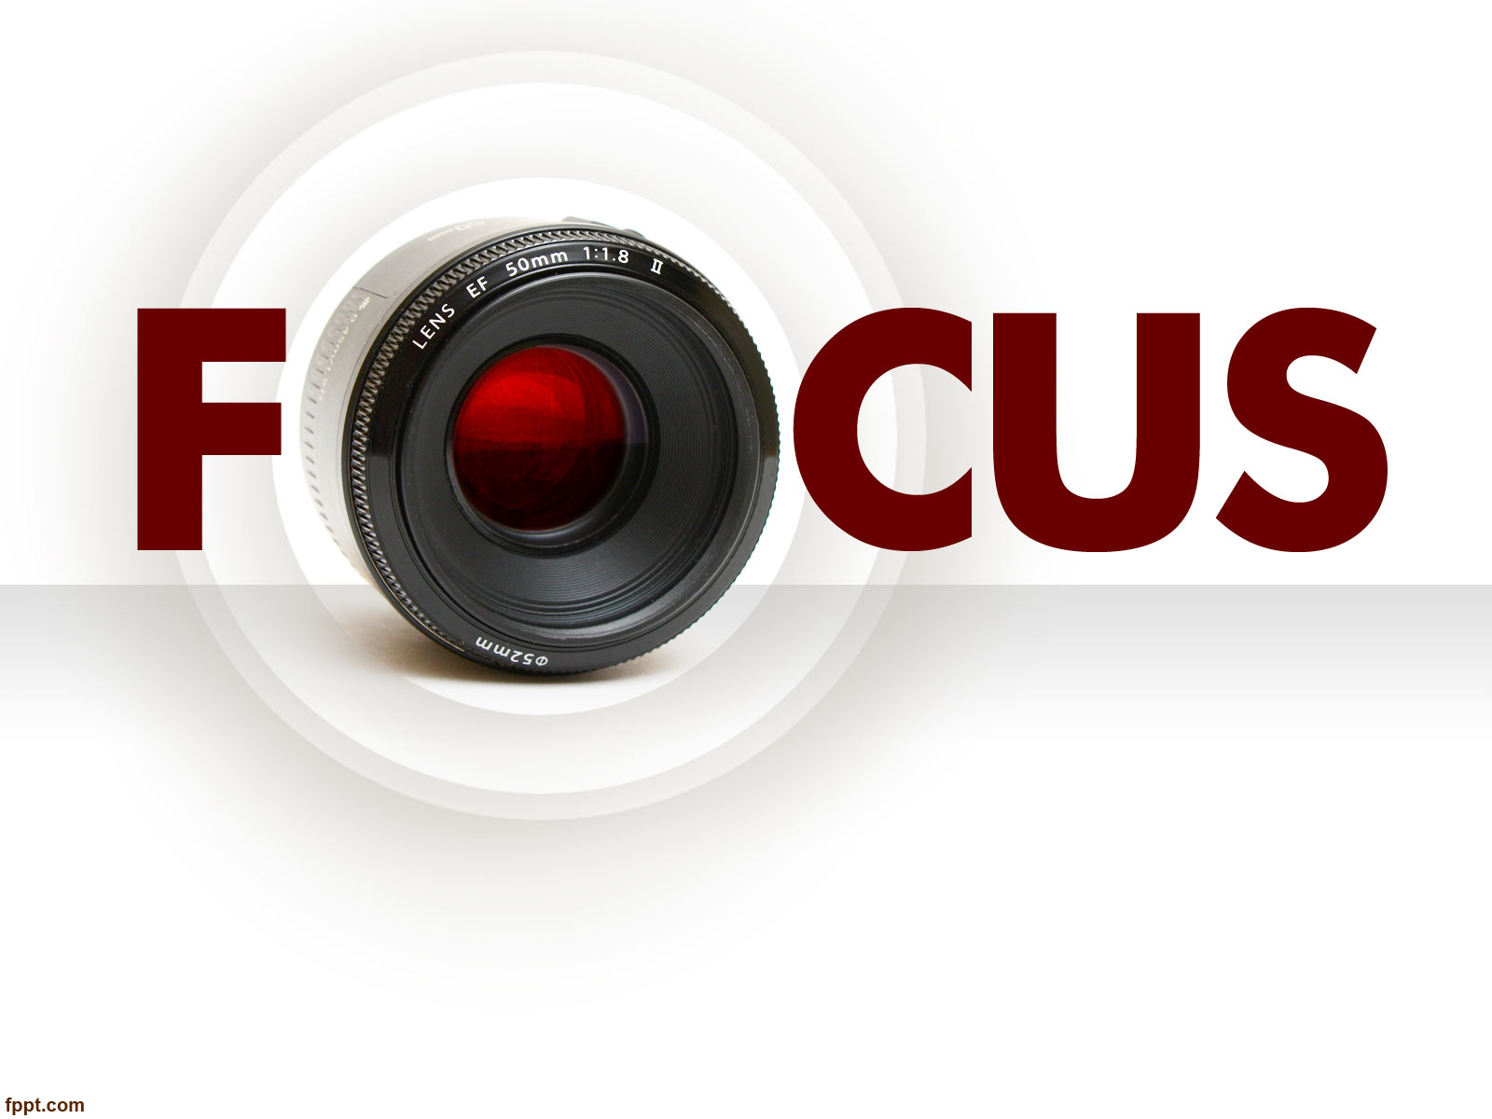
Photojournalism
WEEK 3 DIGITAL PHOTOGRAPHY EXPOSURE
By Dr. Raphael Ogutu

Slide 2
Objectives
At the end of this week, you should be able to:
Learn the operational parts of DSLR and Mirrorless cameras
Explore the lens focal systems and exposure in photography.
Analyze how exposure works in photography

Slide 3
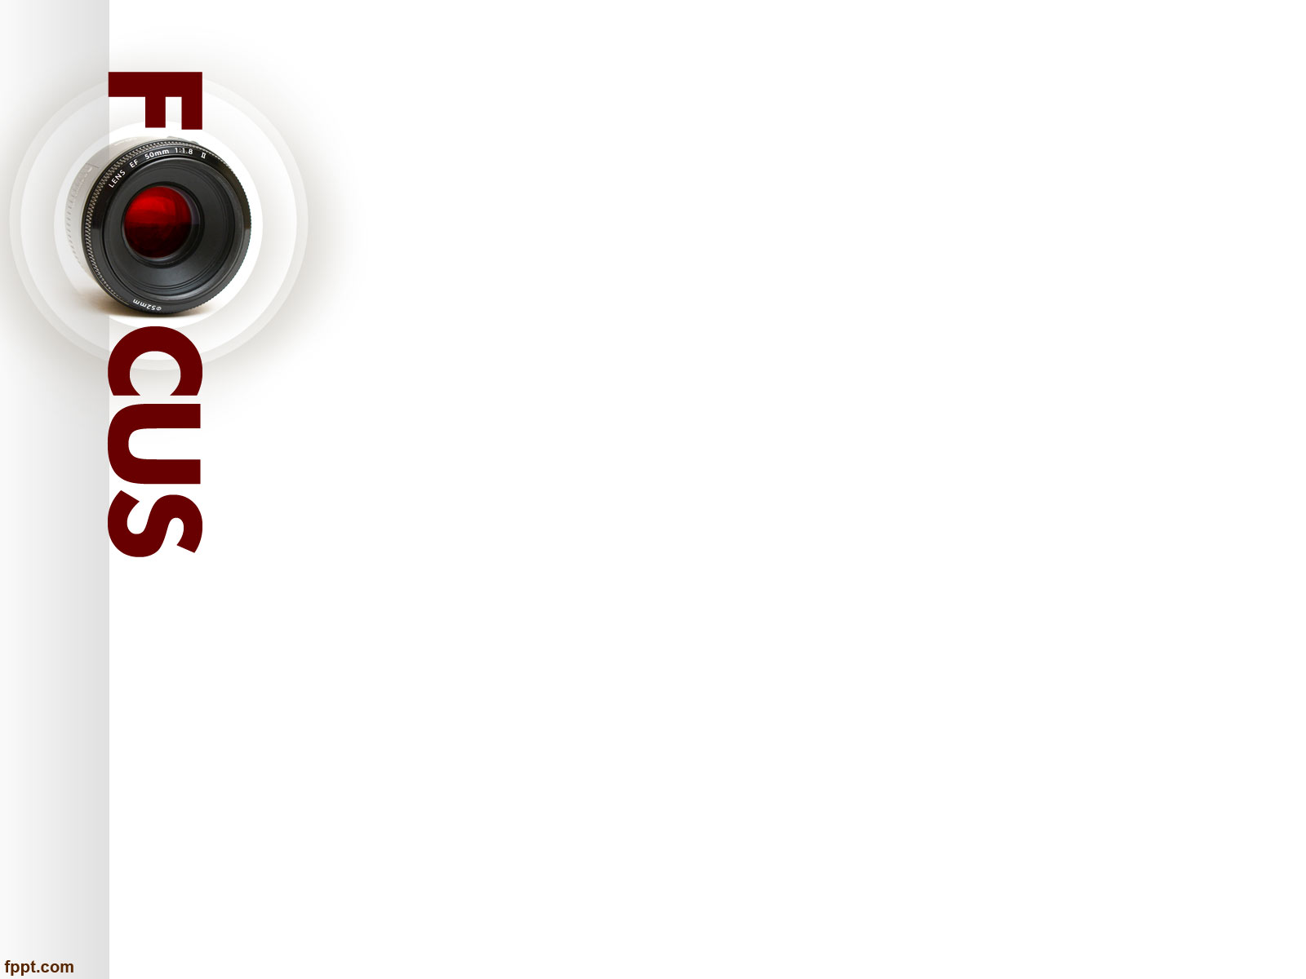
Introduction
This lecture introduces you to exposure, which is the total density of light allowed to fall on the photographic medium (photographic film or image sensor) during the process of taking a photograph.
Exposure setting in a camera’s parts such as the ISO, the aperture and the shutter speed aims to produce an appropriate looking picture.
Operational parts of a mirrorless and digital Single-lens reflex (DSLR) camera will be explored as well.
This topic will also focus on the lens as a part of exposure process in photography.

Slide 4
Parts of the Camera
There are many parts of the camera, all of them have a use, and different types of cameras with different items, however there are common parts, though this topic will focus more on digital cameras and not film or analogue camera.
According to Ranjan (2017), whether you have a Digital SLRs or point and shoot, these camera parts will inevitably be found on most cameras.
He further states that proper understanding of the names and functions is the primary step towards improving your photography skills.

Slide 5
Parts of the Camera
Camera Lens
A lens is a tool used to bring light to a fixed focal point.
Camera lenses are made up of a series of glass plates that are convex (curved outward) or concave (curved inward).
Focal length is the measurement of distance (in millimeters) between the point of convergence of your lens and the sensor recording the image. The focal length range of a lens is expressed by a number, and that number tells you how much of the scene your camera will be able to capture. Smaller numbers have a wider angle of view and show more of the scene; larger numbers have a narrower angle of view and show less.
Aperture is how big the opening is that lets light in, expressed in f-stops. F-stops are counterintuitive, because the larger the number, the smaller the opening. For example, f/2.8 allows twice as much light into the camera as f4, and 16 times as much light as f11. Aperture affects the depth of field: larger openings create a shallower depth of field, while smaller openings make more of the image in focus.

Slide 6
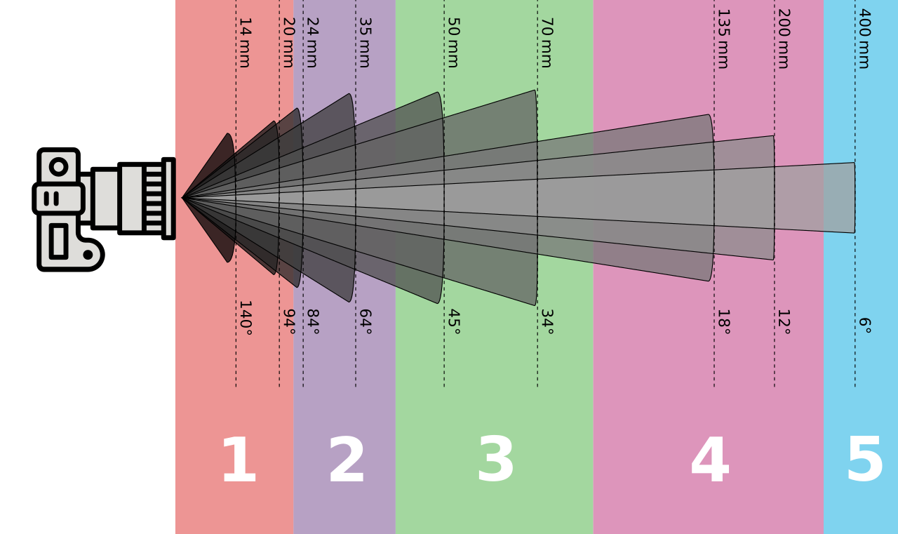
Parts of the Camera
Photo lenses with a focal length and angle. 1: ultra wide 2: wide angle 3: normal 4: short telephoto (70-85mm) / medium telephoto (100-200mm) 5: super telephoto (300-400mm) / ultra telephoto (500-1200mm)
Source: https://en.wikipedia.org/wiki/Coverage_%28lens%29#/media/File:Photo_lenses_with_a_focal_length_and_angle.svg

Slide 7
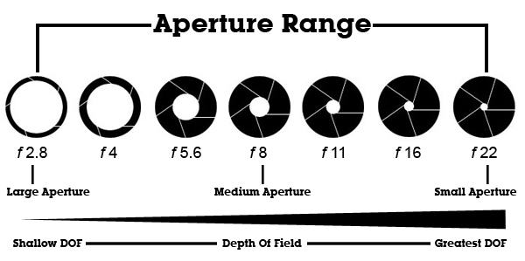
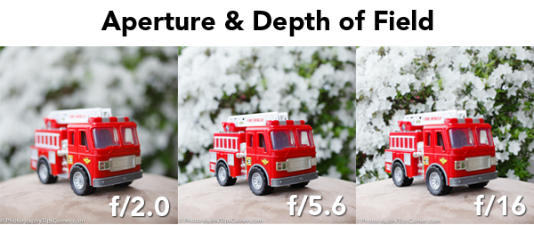
Parts of the Camera
• Maximum Aperture. Lenses will list a maximum aperture on the barrel, indicating the maximum width a lens aperture can open. Typically, lenses with a wider maximum aperture cost a bit more like f 1.4. A lens with a wide maximum aperture is great for low light situations.
• Depth of Field. Controlling the amount of the photo that is in focus is one of the photographer’s best tools to help draw the viewer’s eye where you want it. For example, landscapes are typically shot so that everything is in focus, so photographers will shoot at small apertures (e.g. f11 or f16).
Source: subratachak, Blog at WordPress.com. https://subratachak.wordpress.com/tag/camera/

Slide 8
Parts of the Camera
Viewfinder
The viewfinder is the area on the camera that you look through in order to compose your shot. For some cameras, an LCD screen is used as a viewfinder, or your camera may have the option to use either one.
The mode dial allows you to select different options, such as automatic mode, program mode, sport mode or macro mode. Older cameras may not have a mode dial, because all of the settings are manual.
The camera body is the main portion of the camera, and bodies can be a number of different shapes and sizes. DSLRs tend to be larger bodied and a bit heavier, while there are other consumer cameras that are a conveniently smaller size and even able to fit into a pocket
Shutter release button. This is simply the button on the camera that is used to snap the picture. It opens and closes the shutter, allowing the necessary light and information to enter the camera. The amount of time the shutter stays open depends on what you have your shutter speed set to.

Slide 9
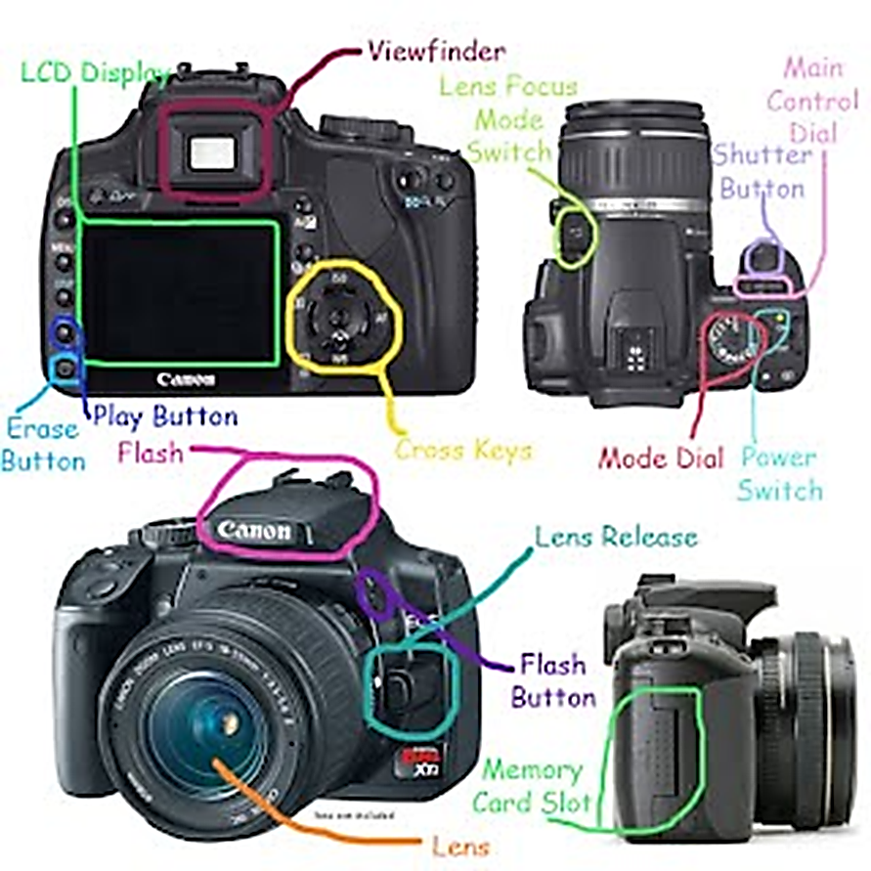
Parts of the Camera
Source: Google Sites, Parts of the Camera https://sites.google.com/a/psdschools.org/lcbeginning-photography/parts-of-the-camera

Slide 10
Parts of the Camera
The image sensor converts the optical image to an electronic signal, which is then sent to your memory card. There are two main types of image sensors that are used in most digital cameras: CMOS and CCD.
Both forms of the sensor accomplish the same task, but each has a different method of performance
The LCD screen is found on the back of the body and can vary in size. On digital compact cameras, the LCD has typically begun to replace the viewfinder completely.
On DSLRs, the LCD is mainly for viewing photos after shooting, but some cameras do have a “live mode” as well
The on-board flash will be available on all cameras except some professional grade DSLRs. It can sometimes be useful to provide a bit of extra light during dim, low light situations.
A focus ring. This is a ring typically found on the lens that allows manual control of the camera’s focus. You can decide if you want the whole image in focus, or just a part of it. Many cameras have an auto-focus feature in addition to the focus ring.

Slide 11
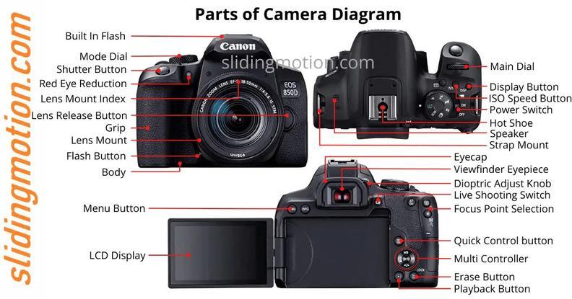
Parts of the Camera
Source: Swap, Complete Guide of 30 Parts of Camera: Names, Functions & Diagram https://slidingmotion.com/parts-of-camera-names-functions-diagram/

Slide 12
Parts of the Camera
Flash button
In any of the “advanced” exposure modes (P, S, A, or M), this button will trigger the pop-up flash. Its location may vary from camera to camera, but the “lightning bolt” symbol is universal. The icon next to it is the flash symbol, plus the exposure compensation symbol
Lens Retract Button
Retractable lenses are becoming increasingly popular as they are more compact than non-retractable models. You must press this button to initially “zoom” the lens into its operational position, and again to retract it when you’re done shooting.
Lens Release Button
Press this button to unlock the lens mount and detach the lens by rotating it. You don’t need to press it when mounting a lens.
Autofocus-Auto exposure Lock (AE/AF LOCK)
When using autofocus and auto exposure, holding this button down will lock those settings, even if you move the camera.
It is beneficial for more advanced shooters who can use it to take several shots with different framings while ensuring all remain focused on the same point and exposed identically.

Slide 13
Parts of the Camera
Pentaprism (single-lens reflex or SLR cameras)
The pentaprism is a mirror placed at a 45-degree angle behind the camera lens. The mirror projects the light captured from the lens to the prism then to viewfinder. Before pentaprisms, photographers always had to look downwards when taking photos. This is not ideal for some subjects and would only allow you to take photos at hip-level.
Memory Card Slot
The memory card slot is where the camera’s memory card is inserted. The memory card stores all the photographs taken by the camera.
Tripod Mount
The tripod mount is a 1/4-inch threaded hole at the bottom of the camera that allows it to be attached to a tripod, tripod head, or monopod.
Zoom Elements
Zoom lenses allow you to shift between focal lengths, from wide to telephoto, depending on your lens’ focal range, by turning the lens rings.
Batteries
Most of its components will not work if not powered by one. Having a long-lasting battery lets you shoot more photos and shoot for extended periods, allowing you to find the perfect shot.

Slide 14
Parts of the Camera
Grip
The grip is the right side of a camera, which has a special curved design to allow you to comfortably handhold the camera. It usually provides space to place your fingers and securely hold the camera.
Display
The camera display shows the user helpful information about the photos and the camera. Here you will see the different camera settings you can tweak to alter your exposure, ISO, shutter speed, and more. You can also access other menus using this display to change the settings on your camera. Most camera displays nowadays let you see how your image will appear before you press the shutter release button.
Electronics
Your camera’s electronic components are divided into three separate categories: photo capture components, camera controller, and user interface components. The controller elements control all the electronic components of the camera. Its photo capture elements are responsible for the recording of images. Meanwhile, the user interface elements are responsible for letting the user interact with and control the camera.

Slide 15
Parts of the Camera
Function Buttons
Function buttons, often labeled as “Fn” on cameras, are customizable buttons that can be programmed to perform specific tasks for quicker access. This can include adjusting ISO, white balance, autofocus mode, and more. The number and placement of these buttons vary among camera models and manufacturers.
ISO
ISO refers to the camera sensor’s sensitivity to light. Higher ISO values increase sensitivity, improving low-light performance and increasing image noise. Conversely, lower ISO values provide cleaner images but require more light.
Red-eye Reduction
Red-eye reduction is a feature found in many cameras that helps minimize the appearance of red eyes in portraits caused by the camera flash reflecting off the subject’s retinas.
Main Dial
located on the top or back of the camera. It allows you to quickly adjust settings like aperture, shutter speed, and ISO without needing to dive into menus, aiding in shooting efficiency and speed. Here, you will also find automatic preset modes such as “Portrait,” “Landscape,” and “Night.”

Slide 16
Parts of the Camera
Communication Ports
Communication ports are the various inputs and outputs found on the camera. These may include a Micro USB port for transferring photos to a computer, a micro or full-size HDMI port for external monitors, and a mini microphone jack for recording higher-quality audio using an external mic.
Hot Shoe
The hot shoe, a U-shaped metal bracket situated on top of the camera, is among the basic parts of a camera. It is a mechanical fitting that allows you to connect an external flash unit and other accessories such as radio triggers, external microphones, and light meters.
Contacts
The contacts are small metal pins on the back of the lens, aligning with the camera body once the lens is mounted. They facilitate communication between the lens and the camera, conveying automatic information such as aperture, focal length, and focus adjustments.
Processing Engine
The processing engine, also known as an image processor, turns the raw data captured by the camera’s sensor into a viewable image. This includes tasks like noise reduction and color correction.
Buffer
The buffer in a camera is temporary storage used when taking multiple photos quickly, such as in burst mode. Images are stored in the buffer before being written to the memory card. The size and speed of the buffer can affect the number of images that can be captured in quick succession.

Slide 17
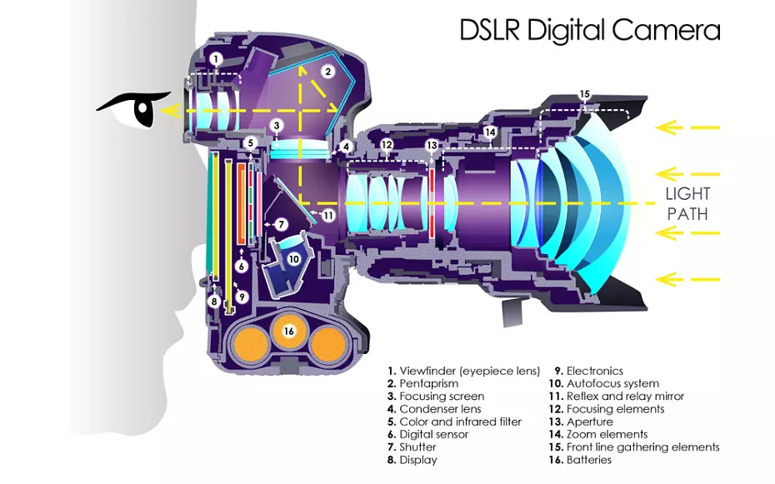
Parts of the Camera
Source: ePHOTOzine (2017). This Cutaway Diagram Shows The Inside Of A DSLR https://www.ephotozine.com/article/this-cutaway-diagram-shows-the-inside-of-a-dslr-30546

Slide 18
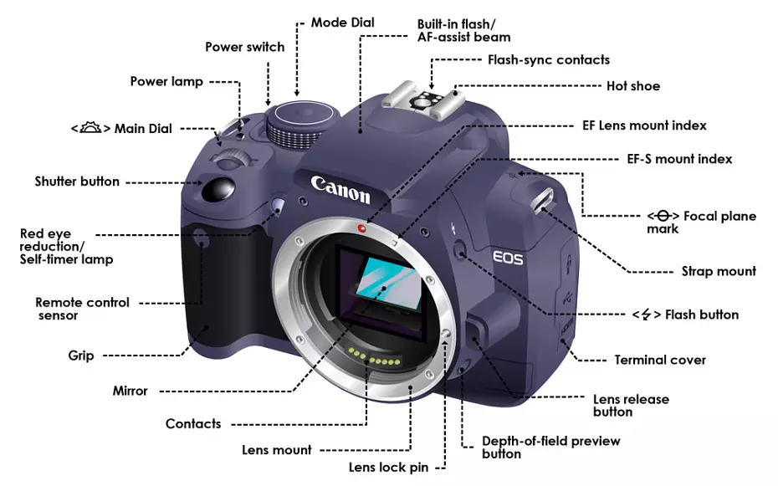
Parts of the Camera
Source: ePHOTOzine (2017). This Cutaway Diagram Shows The Inside Of A DSLR https://www.ephotozine.com/article/this-cutaway-diagram-shows-the-inside-of-a-dslr-30546

Slide 19
Mirrorless Cameras
A mirrorless camera, as the name suggests, lacks this mirror mechanism.
Instead, the light goes directly onto the image sensor, and the image is previewed digitally on the screen or electronic viewfinder.
Mirrorless cameras are often more compact, while DSLRs may offer a more traditional handling experience and optical viewfinder
The components of a mirrorless camera include:
The lens
The shutter
The image sensor
The digital display

Slide 20
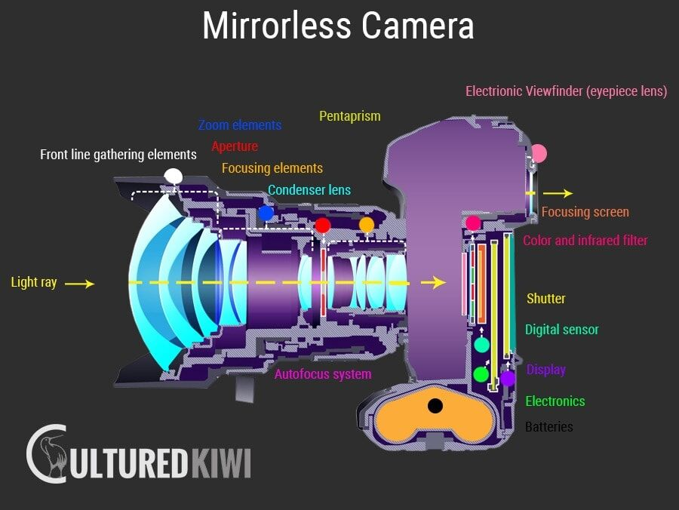
Source: Cultured Kiwi The 10 Best Mirrorless Cameras for Travel in 2023 – Buyers Guide https://www.culturedkiwi.com/best-mirrorless-camera-for-travel/

Slide 21
Similarities Between Mirrorless and DSLR Cameras
Mirrorless and DSLR cameras offer image quality and customization options that are superior to smaller point-and-shoot cameras.
Both mirrorless and DSLR cameras are interchangeable-lens cameras, which means that their lenses can be removed and changed to suit a photographer’s needs.
Mirrorless and DSLR lenses come in a variety of focal lengths that allow a photographer flexibility in capturing shots both near and far

Slide 22
The Differences Between Mirrorless vs. DSLR Cameras
Mirrorless vs. DSLR Cameras: Cost
DSLR camera technology is well established, with wide support by third-party vendors, resulting in more choices and lower prices. DSLR costs range from as low as $150 for the cheapest models, to well into the thousands for the most expensive.
By contrast, mirrorless cameras are a newer and less common technology, with fewer choices of lenses and accessories. Mirrorless cameras start as low as $300. Mirrorless vs. DSLR Cameras: Size
Due to their mirror system, DSLRs are quite large and heavy, ranging from about 1 ½ to 2 ½ pounds. Mirrorless cameras, on the other hand, are lighter and more compact cameras, with many weighing under one pound.

Slide 23
The Differences Between Mirrorless vs. DSLR Cameras
Mirrorless vs. DSLR Cameras: Image quality
DSLR image quality depends on sensor size, with larger sensors offering higher resolution and image quality. The more common formats for DSLR sensor size include:
Full-frame: This is the standard 35mm film format. Canon EOS and Nikon D-series are full-frame cameras.
APS-C: A sensor that renders at about 40% of the full frame. Sony, Pentax, and Samsung all offer APS-C sensor cameras.
Four-thirds system: Created by Olympus and Eastman Kodak, this is a smaller DSLR sensor that displays 26% of the full frame. (Even smaller? Micro four thirds.)
Both full-frame and compact sensors are also available in mirrorless cameras, but full frame mirrorless cameras typically cost more.

Slide 24
The Differences Between Mirrorless vs. DSLR Cameras
Mirrorless vs. DSLR Cameras: Autofocus
DSLR cameras use a technology called phase detection, which measures the convergence of two light beams, to drive their autofocus systems. Phase detection enables blazing fast autofocus functionality, which is essential for capturing sporting events and other fast-moving subjects.
Mirrorless cameras, meanwhile, tend to rely on slower contrast detection autofocus technology—but they’re beginning to catch up.
Mirrorless vs. DSLR Cameras: Shooting speed
While both DSLRs and mirrorless cameras can take photos at very fast shutter speeds, a mirrorless camera’s simpler internal mechanics enable it to take shoot faster than most DSLRs, particularly when it comes to a series or burst of images.

Slide 25
The Differences Between Mirrorless vs. DSLR Cameras
Mirrorless vs. DSLR Cameras: Viewfinder
DSLRs have an optical viewfinder, which enables the photographer to literally see through the camera lens in real time. However, this also means that a DSLR camera user must take a photo and then examine it to make sure their exposure is correct.
A mirrorless camera’s electronic viewfinder, or EVF, adds the convenience of seeing what your photo will look like on an LCD screen before you press the shutter button. However, EVF preview quality tends to decrease in low-light situations.

Slide 26
The Differences Between Mirrorless vs. DSLR Cameras
Mirrorless vs. DSLR Cameras: Video
Video clarity once made DSLRs a top choice for videography. However, the lack of an LCD screen and real-time display feedback for many DSLRs have led this option to fall out of favor in recent years.
By contrast, a responsive LCD screen with 4K technology, paired with the light camera body, make mirrorless cameras a great option for videographers.
Mirrorless vs. DSLR Cameras: Battery Life
Due to their electronic viewfinders and lighter camera body, mirrorless cameras tend to have shorter battery life than DSLR cameras, which can shoot without an electronic screen or viewfinder.

Slide 27
Exposure In Photography
understanding exposure and mastering its usage can help you improve your photography skills in many different settings.
Over time, no lighting situation will be too bright or too dark for you to manipulate to your own ends using the right angle, additional lighting equipment or the features on your camera.
An overexposed photo tends to look too bright, which can make the colours look faded or distorted.
An underexposed photo is the opposite, the colours look too dark.
Note that sometimes people use too much or too little exposure on purpose to create artistic effects, but you must learn the rules before you can break them.

Slide 28
The Exposure Triangle
The exposure triangle is a fundamental concept in photography that describes the relationship between three critical factors that determine the exposure, or the amount of light that reaches the camera's image sensor or film.
Aperture:
Definition: Aperture refers to the size of the opening in the lens through which light enters the camera. It is represented by an f-number or f-stop, such as f/2.8, f/4, f/8, etc. Smaller f-numbers indicate larger apertures, while larger f-numbers represent smaller apertures.
Effect on Exposure: Aperture controls the amount of light that passes through the lens to the sensor. A wider (larger) aperture (e.g., f/2.8) allows more light to enter, resulting in a brighter exposure. Conversely, a narrower (smaller) aperture (e.g., f/16) restricts the amount of light, leading to a darker exposure.
Depth of Field: Aperture also affects the depth of field (DOF) in an image. A wide aperture (e.g., f/2.8) creates a shallow DOF, where only a small portion of the image is in focus, while the background is blurred. A narrow aperture (e.g., f/16) produces a deep DOF, with most of the scene in focus.

Slide 29
The Exposure Triangle
  Effect on Exposure: Shutter speed controls the amount of time the sensor is exposed to light. A faster shutter speed (e.g., 1/1000s) lets in less light, resulting in a darker exposure. Slower shutter speeds (e.g., 1/30s) allow more light, resulting in a brighter exposure.
  Motion Control: Shutter speed also determines how motion is captured in a photograph. Fast shutter speeds freeze fast-moving subjects (e.g., sports), while slow shutter speeds can create motion blur, capturing the movement of subjects (e.g., flowing water or a moving car).
ISO:
  Effect on Exposure: Increasing the ISO value makes the sensor more sensitive to light, resulting in a brighter exposure. Lowering the ISO reduces sensitivity, leading to a darker exposure.
  Noise: Higher ISO settings may introduce digital noise or graininess into the image. Modern cameras are capable of handling higher ISO settings with minimal noise, but photographers should strike a balance between sensitivity and image quality.

Slide 30
The Exposure Triangle
The exposure triangle represents the interplay between these three factors. To achieve a properly exposed photograph, you must balance these elements based on the lighting conditions and the creative effect you desire. Changing one factor necessitates adjustments to one or both of the others to maintain the desired exposure.
For example, if you want to achieve a brighter exposure (increase exposure), you can:
Open the aperture wider (smaller f-number).
Use a slower shutter speed.
Increase the ISO sensitivity.
Conversely, if you want a darker exposure (decrease exposure), you can:
Use a narrower aperture (larger f-number).
Use a faster shutter speed.
Decrease the ISO sensitivity.
Understanding the exposure triangle and how these factors interact is essential for photographers to have creative control over their images and adapt to various shooting conditions.

Slide 31
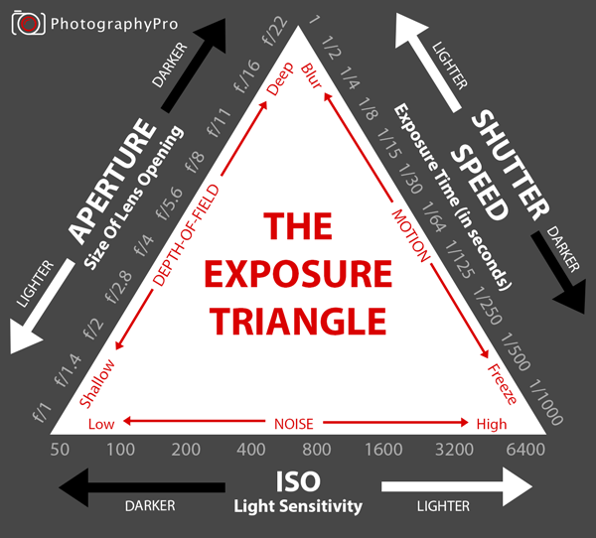
The Exposure Triangle
Source: subratachak, Blog at WordPress.com. https://subratachak.wordpress.com/tag/camera/

Slide 32
Exposure In Photography
What Is a Long Exposure in Photography?
Have you ever seen photos of waterfalls where the water appears unbelievably smooth and beautifully blurred? use a long exposure.
This creates what is known as a motion blur. It works even with people. If you took a long exposure photo and someone walked through it, you would see a ghostly blur in human form.
slow down the shutter speed. How much you need to slow your shutter speed is debatable. Use speeds below one second.
What Is Double and Multi Exposure In Photography?
Photographers can do this prior to the editing process and overlay two photos to create one artistic effect. When the final product involves more than two photos, then this is known as multi exposure and follows the same premise.
Using this method might allow you to create photos that are unique and carry symbolic meaning. (Kennedy, 2023).

Slide 33
SUMMARY
Information about the parts of a camera help to use every function to make your photography more impressive.
Mirrorless cameras are the new wave of digital photography.
They’re small, light, and offer conveniences over another common camera type: DSLR cameras.
Professional photographers have long opted for DSLRs, but entry-level mirrorless cameras are making it easier than ever for both the veteran and novice photographer to capture interesting shots. Aperture size the various sizes of an aperture are called f-stops or f- numbers.
On adjustable cameras, the f-stops generally include 2, 2.8, 4, 5.6, 8, 11, 16 and 22. The smaller the f-stop numbers the larger the size of the aperture.
The larger the f-stop numbers the smaller the size of the aperture. Like shutter speeds each f- stops let in either twice as much light as the preceding setting or half as much light as the next higher setting.

Slide 34
SUMMARY
Changes in the size of aperture affect the overall sharpness of the picture.
Shutter speed is the amount of time the shutter remains open to let light expose the film. A slow shutter speed lets in large amount of light and a fast shutter speed admits only a little.
Exposure is the total density of light allowed to fall on the photographic medium (photographic film or image sensor) during the process of taking a photograph.
Changes in the size of aperture affect the overall sharpness of the picture. As the aperture becomes smaller, the area of sharpness in front of and behind the subject becomes larger. This area of sharpness is called the depth of field.
It extends from the nearest part of the subject in focus to the furthest part in focus. A small aperture, such as f/11 or f/16, creates great depth of field.
As one opens up the aperture, the area in focus becomes shallower. At f/2 or f/4, the subject will be in focus, but the objects in the foreground and background may be blurry.

Slide 35
THANK YOU

