Slide 1

Photojournalism
WEEK 4 ARRANGING THE IMAGE TO COMMUNICATE
By Dr. Raphael Ogutu

Slide 2
Objectives
At the end of this Lecture, you should be able to:
Explain photo composition
Explore the Rules of composition
Apply photo composition correctly

Slide 3

Introduction
This lecture introduces you to composition that is how the elements of a photo are arranged.
Can be made up of many different elements, or only a few.
How the artist puts those things within a frame that help a photograph become more or less interesting to the viewer.
The art of organizing various elements in a scene to convey a specific message or evoke certain emotions in the viewer.
An essential aspect of photography, as it can greatly impact how the audience perceives and interprets a photograph

Slide 4
The Importance of Photocomposition
basic points that will help you understand the importance of building an interesting composition:
Effective composition can make an image visually appealing, engaging, and memorable.
It helps draw the viewer's attention to the central object or focal point, creating a strong visual impression.
It is a powerful tool for storytelling in photography, allowing the photographer to convey a narrative or evoke specific emotions in the viewer.

Slide 5
The Importance of Photocomposition
A well-balanced composition creates a sense of order and cohesiveness that enhances the overall impact of the image.
Through composition, photographers can emphasize the main subject or point of interest in the image.
It allows photographers to add their personal style and interpretation to photos, making them more distinctive and appealing.

Slide 6
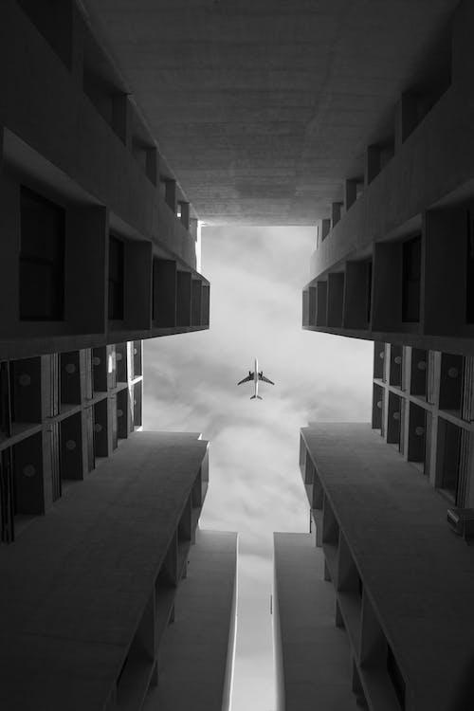
The Rules of composition
Source: Pexels, https://www.pexels.com/search/composition/

Slide 7

The Rules of composition
Source: Pixabay, Lens, Camera, Composition image. https://pixabay.com/photos/lens-camera-composition-photo-4192777/

Slide 8
The Rules of composition
The elements of photo composition are the fundamental building blocks that photographers use to create visually appealing and effective images.
These elements work together to form a cohesive and engaging photograph.
Elements of composition are:
patterns, texture, symmetry, asymmetry, depth of field, lines, curves, frames, contrast, color, viewpoint, depth, negative space, filled space, foreground, background, visual tension, shapes
principles are not strict rules but rather guidelines to help photographers create more compelling and engaging images using the elements. The best compositions often result from a blend of creativity, intuition, and a good understanding of these principles.

Slide 9
The Rules of composition
Subject: The subject is the main focal point of the photograph, the primary element that draws the viewer's attention.
It's what the photo is primarily about.
Foreground: The foreground is the part of the image that appears closest to the viewer, often located at the bottom of the frame.
It can be used to provide context, depth, and a sense of scale to the photograph the foreground is the part of the image that is closest to the camera.
The background is the part of the image that is further away from the camera.
So by default, the middle ground is that what is in the middle of the foreground and the background.

Slide 10

The Rules of composition
The foreground is the part of the image that appears closest to the viewer are the flowers, often located at the bottom of the frame, the subject is in the middle ground, and with a blurred background.
Source: Pexels, https://www.pexels.com/photo/a-girl-giving-a-flying-kiss-8507046/ by Nguyễn Văn Minh Vương,

Slide 11
The Rules of composition
Background: The background is the area behind the main subject. A well-chosen background can complement the subject, create contrast, or add to the overall story of the photo.
It is the part of a scene or picture that is farthest from the viewer.
Objects in the foreground are drawn larger than those in the background.
a photograph of a house with mountains in the background
The mountains provided a perfect background [=backdrop] for the wedding photos.
Lines: Lines within a photograph can be actual (like roads or fences) or implied (like the gaze of a person or a row of trees). Lines can be used to guide the viewer's eye, create a sense of movement, or lead to the main subject.

Slide 12

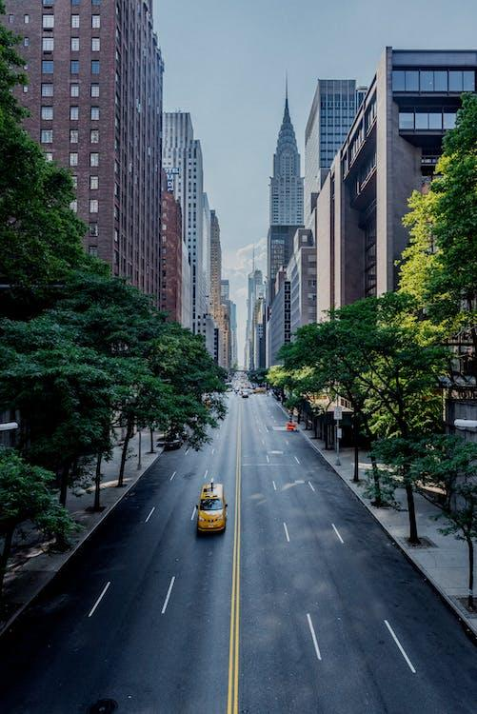
The Rules of composition
Source: Pexel, https://www.pexels.com/photo/light-city-traffic-night-14988729/ by selcuk sarikoz
Source: https://www.pexels.com/photo/another-day-in-the-city-13880578/ By wired_optics.

Slide 13
The Rules of composition
Shapes are created by the arrangement of objects within the frame. Recognizable shapes, such as circles, triangles, and rectangles, can add structure and visual interest to a photograph.
There are two basic types of shapes: geometric (or regular) and organic.
Colour has three properties: hue, value, and saturation. Hue is simply the description of the color (e.g., blue, red, yellow, etc.). Value is the relative brightness or darkness of a colour. Saturation is the intensity or purity of a colour.

Slide 14
The Rules of composition
Texture refers to the surface quality of objects within the frame. Highlighting textures, whether they are smooth, rough, soft, or gritty, can add depth and tactile appeal to a photo.
The physical print has its own texture—glossy versus matte, or even canvas-textured printing papers, for example—which may or may not be aligned with the texture of the objects in the photograph.
Contrast refers to the difference in brightness and color between elements in a photograph. It can be used to draw attention to the subject and create visual interest. Lighting is a critical element in photography. The way light falls on the subject and creates shadows can dramatically affect the composition, mood, and storytelling in a photograph.
Pattern and Repetition elements in a photo can create rhythm and harmony. Photographers often use patterns to add visual interest and structure to their compositions.

Slide 15

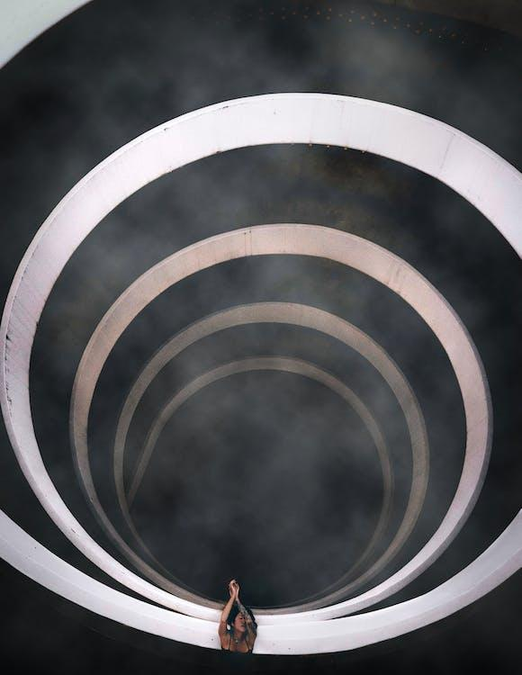
The Rules of composition
Source: Pixabay, https://pixabay.com/photos/lago-di-limides-dolomites-alps-3025780/
Source: https://www.pexels.com/photo/creative-3d-painting-3441746/ By Lukas Rodriguez

Slide 16
The Rules of composition
Symmetry and Balance: Symmetry involves creating a sense of equilibrium by arranging elements in a photograph to be mirror images of each other.
Balance refers to distributing visual weight evenly within the frame to achieve stability or tension, depending on the desired effect.
Asymmetrical compositions, on the other hand, use different elements with varying visual weight to create balance
Depth: Creating a sense of depth in a photograph can be achieved by including elements in the foreground, middle ground, and background. This can be done by adding depth to a photo through lighting and perspective.

Slide 17
The Rules of composition
Point of View (POV): The angle and perspective from which the photo is taken can drastically affect the composition.
Different points of view can convey different emotions and messages.
Negative Space: Negative space is the empty or unoccupied areas in a photograph. It can be used to highlight the subject, create a sense of isolation, or add simplicity to the composition.
Frame within a Frame: This technique involves using elements within the scene, such as arches, windows, or natural frames, to enclose or highlight the subject. A frame within a frame is the use of visual elements in a scene to border a subject, further drawing the focus to them.

Slide 18
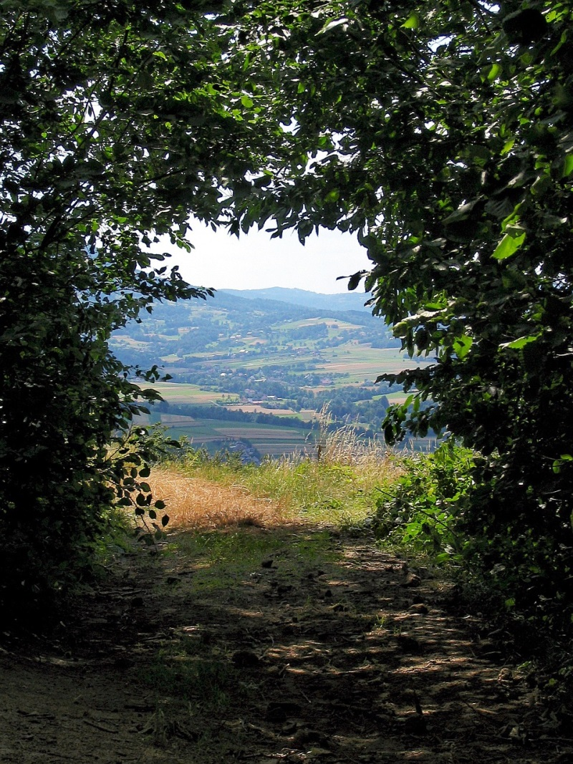

The Rules of composition
Source: https://pixabay.com/photos/view-forest-mountains-window-1302515/ by JerzyGorecki
Source: https://www.pexels.com/photo/portrait-of-man-on-city-street-307847/ By Kaique Rocha

Slide 19
Application of photocomposition Techniques
Rule of Thirds: One of the most well-known and widely used composition techniques. The image is divided into nine equal parts by two equally spaced horizontal and two equally spaced vertical lines. Important elements of the photo are then placed along these lines or at their intersections.
Repetition: Incorporating patterns or repetitive elements in the photo can add visual interest and create a sense of unity. Repetition in photography refers to the technique of integrating recurring elements, patterns, or themes in a composition to produce a sense of rhythm and balance in an image.
Simplicity: Striving for simplicity in the composition can often lead to more powerful and impactful images.

Slide 20
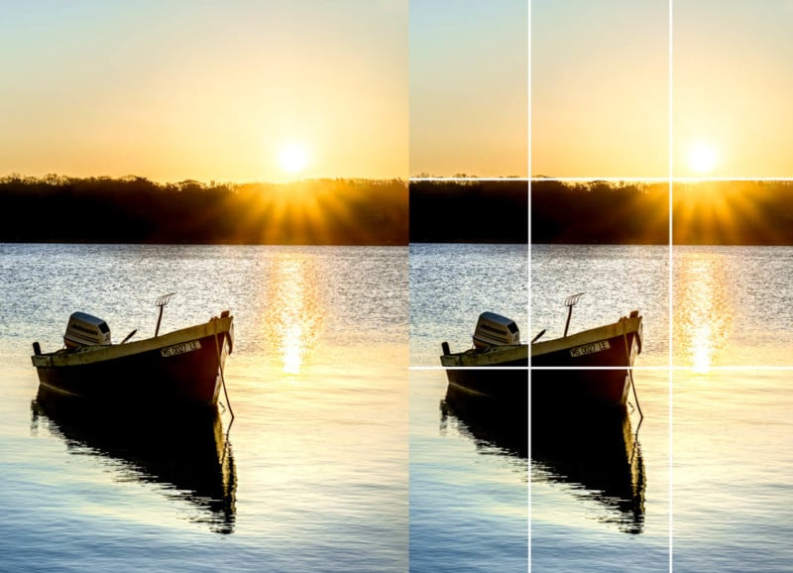
Application of photocomposition Techniques
Source: The rule of thirds works with both horizontal and vertical compositions. Photo by John Tunney. https://petapixel.com/rule-of-thirds/ PetaPixel.

Slide 21

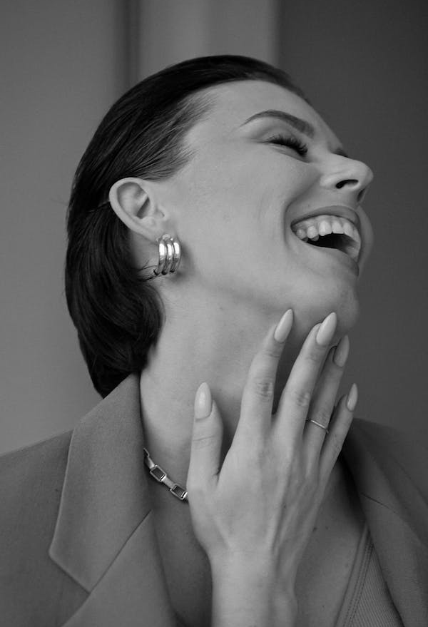
Application of photocomposition Techniques
Source: https://www.pexels.com/photo/low-angle-photo-of-staircase-3425882/ by David Underland
Source: https://www.pexels.com/photo/portrait-of-woman-laughing-and-throwing-her-head-back-11744655/ by Anastasiia Chaikovska

Slide 22
Application of photocomposition Techniques
The Golden Ratio: The Golden Ratio differentiates from the rule of thirds by the balance of the photograph. Here, the focus of the photograph is more towards the center (with more details).
The roots of this rule go back centuries and can be found in notable works of art. In essence, it is the perfect balance with a ratio of 1 to 1.618, and you can search for this to understand the proportions in photography, architecture, and art.
Instead of nine equal rectangles, the frame is divided into a sequence of squares that form a Golden Spiral, also known as the Fibonacci Spiral, which resembles a shell.
The spiral guides the viewer’s eye around the frame and shows how the scene should develop.

Slide 23
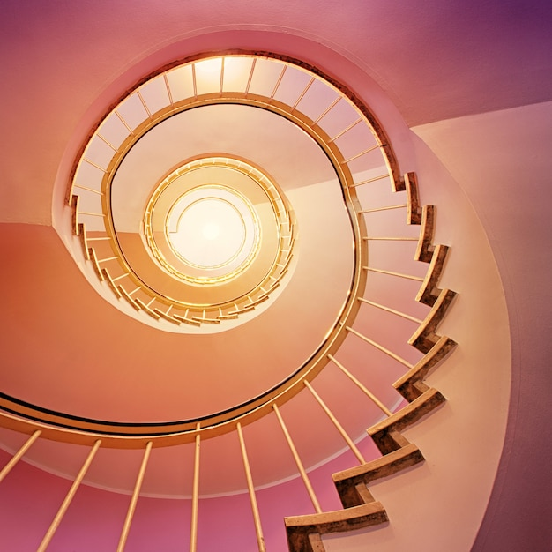
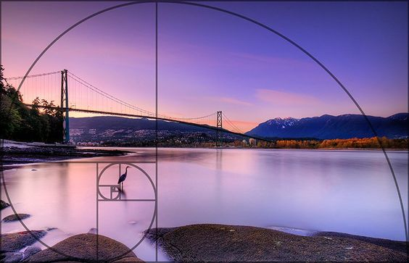
Source: https://www.freepik.com/free-photo/cafe-glockenspiel-into-light_12685757.htm#query=Golden%20ratio&position=46&from_view=search&track=ais By @ jplenio1
Source: Bloglovin Use the Golden Ratio to enhance your composition https://www.bloglovin.com/blogs/digital-photography-school-567509/6-advanced-composition-techniques-to-improve-4725881020

Slide 24
Application of photocomposition Techniques
Diagonals:
One thing about diagonal lines that differentiates it from other composition techniques is that the lines help create movement in the photograph, even when your subjects are still.
This is a great tip for photographers that want to step outside of perfect compositions, yet still create appealing photography compositions with the help of diagonal lines composition in photography is simply the arrangement of visual elements within a frame.

Slide 25
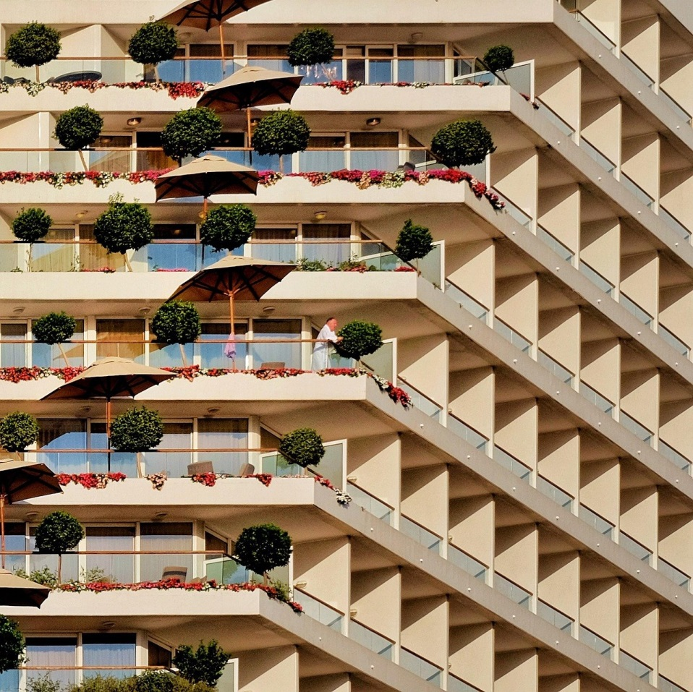
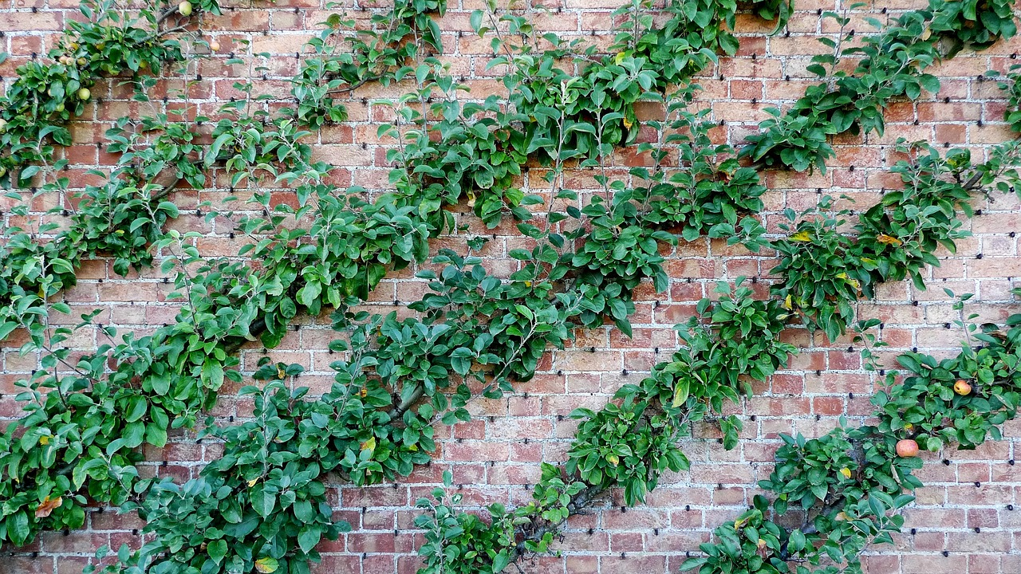
Application of photocomposition Techniques
Source: Pixabay. https://pixabay.com/photos/travel-hotel-eilat-architecture-7562041/ by TranThangNhat
Source: Pixabay https://pixabay.com/photos/apple-tree-cordon-oblique-fruit-1708511/ by aitoff

Slide 26
Application of photocomposition Techniques
Figure to ground
Focus on your subjects and make them stand out by narrowing in on the contrast between the subject and the background.
The more contrast, the more dramatic your shots, and the more prominent your subject.
A winning photo composition is one in which your main subject is isolated due to the contrast solution.
The pictures on the next slide area perfect example of the figure to ground photographic composition.
This effect can also be achieved with a contrast light difference, where more light falls on the subject than on the backdrop.
Alternatively, you can find a subject that is lighter than your background and place it in the same light.
.

Slide 27
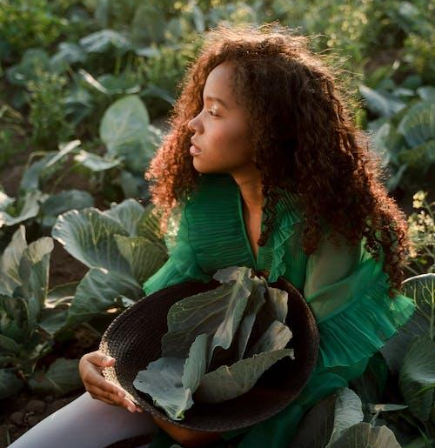

Application of photocomposition Techniques
Source: https://www.pexels.com/photo/attractive-woman-with-long-curly-hair-sitting-thoughtful-on-ground-among-cabbages-10553855/ by Ron Lach
Source: https://www.pexels.com/photo/woman-holding-pendant-10661630/ by Ron Lach

Slide 28
Application of photocomposition Techniques
Center dominant eye
When photographing people, place their dominant eye in the center of the photograph.
This makes the picture more luring as it appears that the subject’s eyes are following the viewer.
You’ll notice that the subject’s eyes are always following your movement
A compositional technique where the main subject or point of interest in an image is placed near the center of the frame but slightly shifted toward the dominant eye of the subject or viewer.
This technique is used to create a stronger connection between the subject and the viewer, making the composition more engaging and visually appealing.

Slide 29
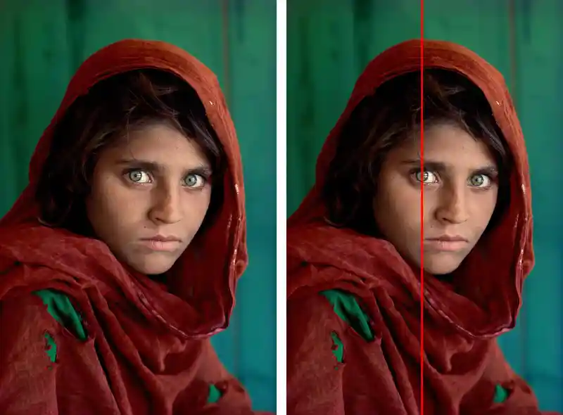
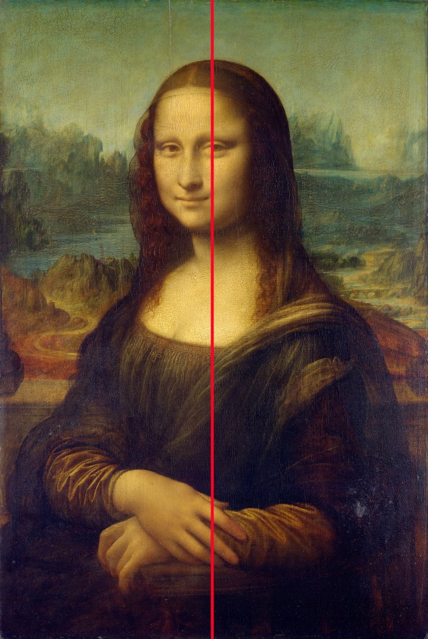
Application of photocomposition Techniques
Source: ERIC KIM A technique we can apply in our photography, with centering one eye in composition for photography / Sharbat Gula, Afghan Girl, at Nasir Bagh Refugee Camp near Peshwar, Pakistan. © Steve McCurry https://erickimphotography.com/blog/2017/03/06/how-to-make-a-better-portrait-center-your-subjects-eye/the famous
Source: ERIC KIM, the famous Mona Lisa has a centered eye composition
https://erickimphotography.com/blog/2017/03/06/how-to-make-a-better-portrait-center-your-subjects-eye/

Slide 30
Application of photocomposition Techniques
Fill the frame, your subject should occupy a significant portion of your image, leaving no or little space around it.
This way, the photographer removes all distractions, allowing the viewer to focus on the main subject and explore every detail.
Get up close and personal with your subjects.
Have them fill in the frame so that they are the focus and the dominant feature of the photograph. Note how in this photo composition example on the next slide, fill in the frame.

Slide 31


Application of photocomposition Techniques
Source: Daisy Laparra https://www.pexels.com/photo/baby-sleeping-while-covered-white-coat-826734/
Source: John-Mark Smith https://www.pexels.com/photo/close-up-portrait-of-cat-250575/

Slide 32
SUMMARY
Composition in photography is simply the arrangement of visual elements within a frame.
When you look at other photos, try to find these elements and principles of composition within them.
See how other photographers utilize them. Successful compositions often contain many of the strategies listed above, used in a harmonious and aesthetically pleasing way.
Photography is all about creativity, inspiration, and sharing your unique artistic vision.
Photography composition rules should always be kept in mind because they are fundamental in excelling as a photographer.

Slide 33
SUMMARY
Your basic knowledge of photography composition rules will give you the tools to experiment as you work on improving and establishing your style.
Remember, while these guidelines can be incredibly helpful, they’re not hard and fast rules.
Experiment, be creative, and don’t be afraid to break the rules once you’ve learned them.
After all, photography is an art form, and you are the artist.
Harness the power of principles and elements of photocomposition and let your unique vision shine through your work.

Slide 34
THANK YOU

