Slide 1

Photojournalism
WEEK 5 News and features
By Dr. Raphael Ogutu

Slide 2
Objectives
At the end of this Lecture, you should be able to:
Explain news and features in journalism
Explore news and features in Photojournalism
Discuss types of Photojournalism
Apply news and features in Photojournalism

Slide 3

Introduction
This lecture introduces you to news and features in Photojournalism.
In photojournalism, "news" refers to the practice of capturing and presenting visual images that report on current events, developments, or issues of public interest.
In photojournalism, "features" refer to a specific type of photographic storytelling that goes beyond the immediate news cycle.
Unlike breaking news or hard news, which focus on timely events and developments, features delve into the broader human experience, providing in-depth narratives, insights, and perspectives on various subjectsThis course is more practical than theoretical.

Slide 4
News and features in journalism
In journalism, news and features are two distinct types of content, each serving a different purpose and style of reporting. Below is an explanation of both:
News:
  Timeliness: News articles focus on recent events and developments. They aim to provide the most up-to-date information to the public.
  This often means reporting on events as they happen or shortly after they occur.
  Objectivity: News reporting strives for objectivity and impartiality.
  Journalists aim to present facts and information in a balanced and neutral manner, allowing readers to form their own opinions.

Slide 5
News and features in journalism
  Inverted Pyramid: is where the most important information is presented at the beginning (the lead) and less crucial details follow in descending order of importance.
  This structure allows readers to get the main points quickly. Essential information generally refers to the oft-cited “Five Ws” of journalism: Who, What, When, Where, and Why. A successful lead paragraph communicates, on a basic level, the essential facts of who did what, when, where, and why.
  Sources: News stories rely heavily on sources such as official statements, interviews with key individuals, eyewitness accounts, and data.
  Verification and accuracy are paramount in news reporting.
  According to Riordan (2014) the reality is that all journalists and media organizations have more complex editorial responsibilities in the hybrid social age.

Slide 6
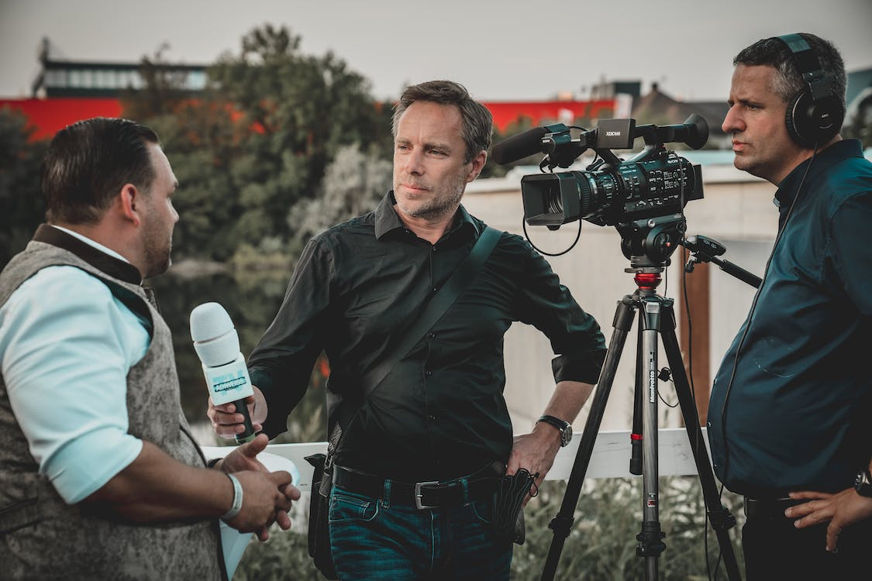
Source: https://www.pexels.com/photo/man-holding-microphone-while-talking-to-another-man-2872418/ by Redrec ©

Slide 7
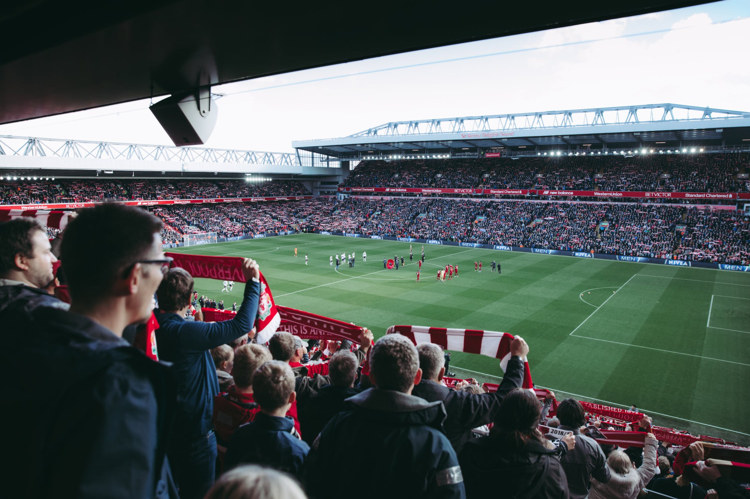
Source: https://www.pexels.com/photo/people-watching-soccer-game-1884574/ by Tembela Bohle

Slide 8
News and features in journalism
Headlines: News articles often have concise, informative headlines that summarize the main point of the story. Headlines are the marquees of news stories.
These short statements located at the beginning of an article frame the information that is to follow.
They encapsulate a portion of the story, presenting a snapshot of reality.
Examples: Breaking news reports, political updates, crime stories, and coverage of major events like elections or disasters are all examples of news journalism.
hard news, journalistic style and genre that focuses on events or incidents that are considered to be timely and consequential to people locally, regionally, nationally, or internationally.
The term soft news originally referred to feature articles, but it has since been applied to a wider range of news, usually including human-interest stories.

Slide 9
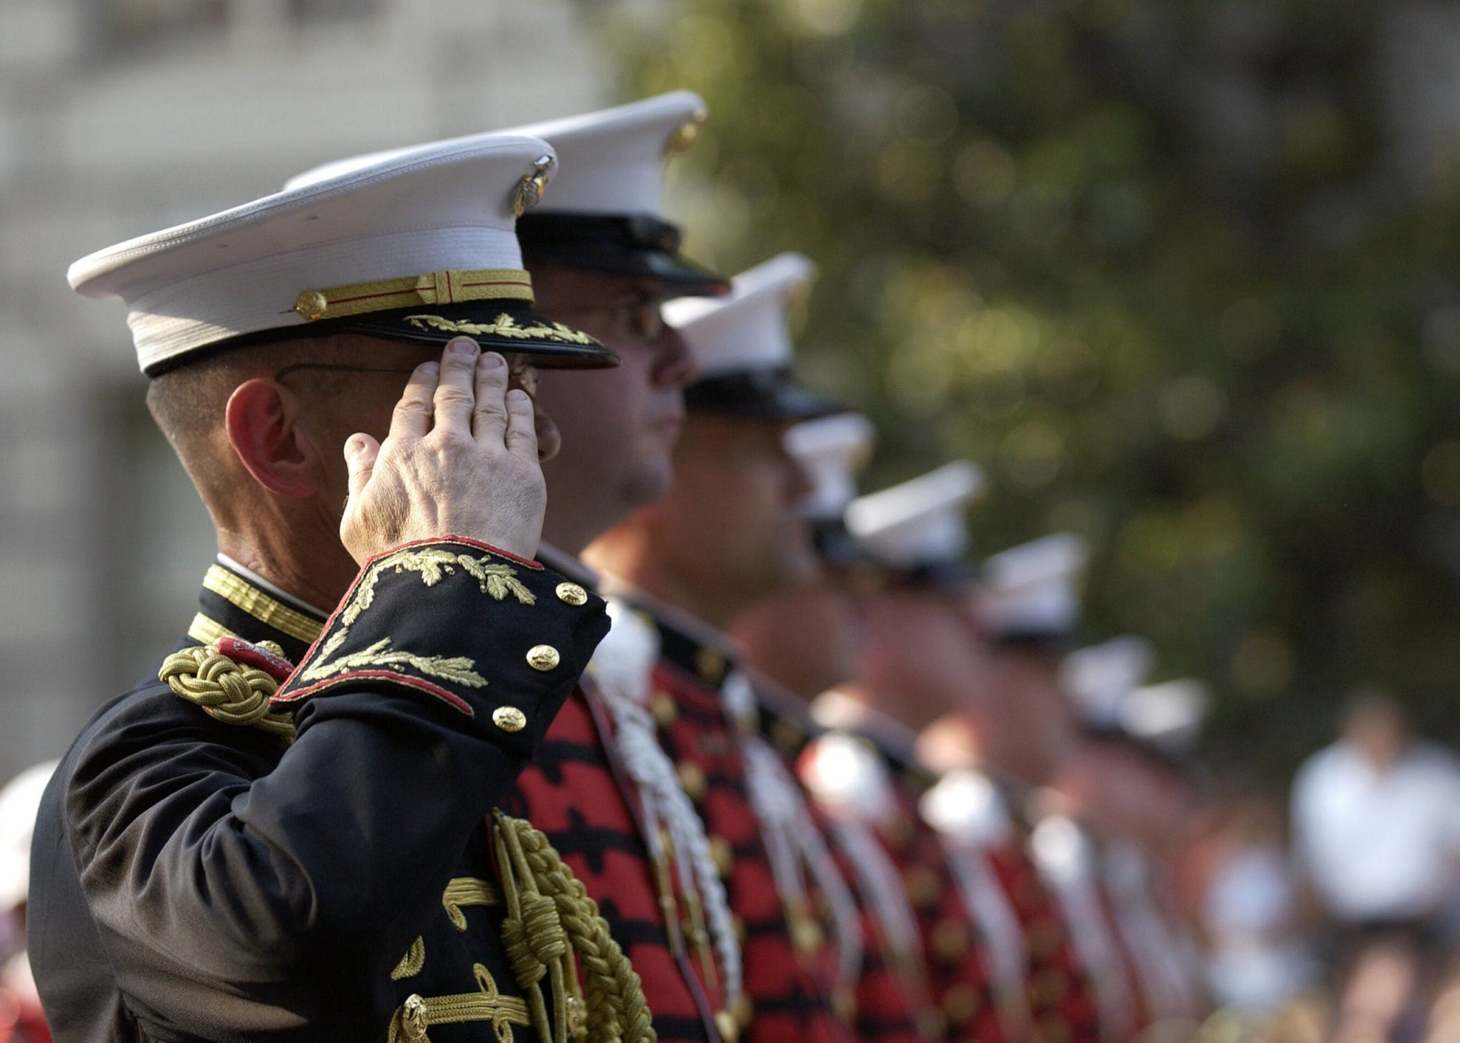
Source: https://www.pexels.com/photo/people-usa-military-patriotism-40546/

Slide 10
News and features in journalism
Features:
  Depth and Analysis: Feature articles provide in-depth analysis, context, and background information on a particular topic or issue.
  They go beyond the "who, what, where, when" of news to explore the "why" and "how." Rather than simply summarizing the subject, a feature article highlights one aspect or significance of the story.
  Its less formal style may take an odd twist or heartwarming angle.
  Human Interest: Features often focus on the human aspect of a story.
  They may include personal narratives, profiles of individuals, or stories that evoke emotions and empathy.
  Emotional storytelling is characterized by the frequent use of dramatic and personalized narratives.

Slide 11
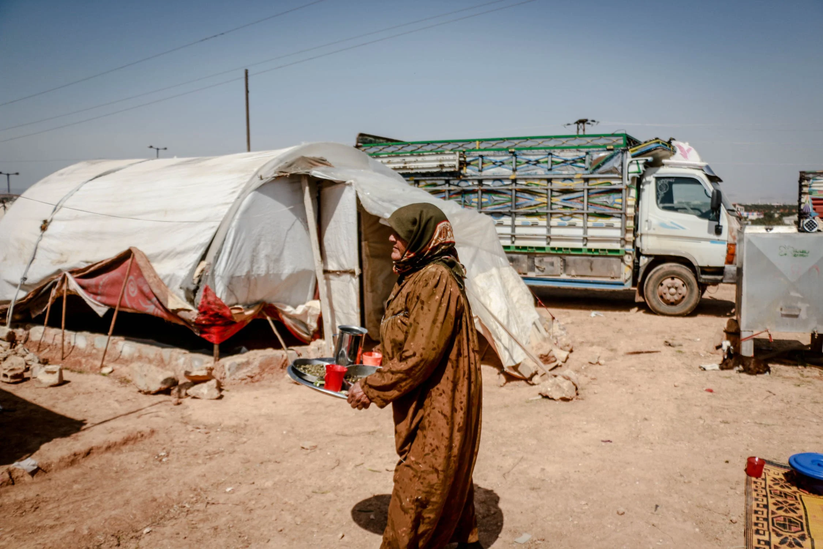
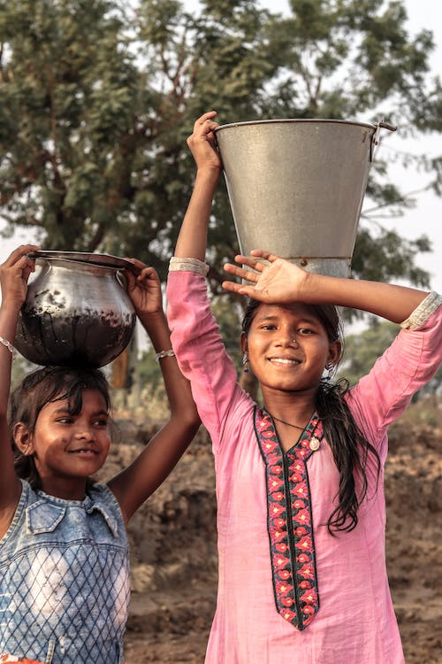
Source: https://www.pexels.com/photo/a-woman-refugee-carrying-a-tray-7385966/ by Ahmed akacha
Source: https://www.pexels.com/photo/two-asian-girls-carrying-a-bucket-3464432/ by Himesh Mehta

Slide 12
News and features in journalism
Narrative Structure: Unlike the inverted pyramid of news, feature stories often use a more narrative structure, with a lead that may draw readers in with a compelling anecdote or description.
Introduction or Lead: The lead must attract immediate attention and pull the reader into the story.
Transition: No matter how good the lead is, you need a solid transition into the body of the feature.
Body: Sound knowledge of the subject, coupled with good writing skills, will let you take the reader through a variety of experiences. You should use the standard writing devices of crisp dialogue, documental but vivid fact and detail, careful observation, suspense and if appropriate, plot.
Conclusion: should give the reader a sense of satisfaction. You need to tie the conclusion to the lead so that the story has unity.

Slide 13
News and features in journalism
Creativity: Feature writers have more flexibility to use descriptive language, storytelling techniques, and creative writing to engage readers.
News is immediate and current whereas a feature can be evergreen, although many are also topical. The topics are not always lighthearted however—some features shine a light on societal issues or expose suffering.
more flexible, adopting various styles. The lead or opening paragraph for instance can be anecdotal and descriptive.
creative freedom and an opportunity to practice their narrative writing skills and employ storytelling techniques like the ample use of descriptions, plot, and character development.
can be entertaining—profiling an artist or singer, it can be informative—shining a light on an obscure problem, or it can raise awareness about a current issue.

Slide 14
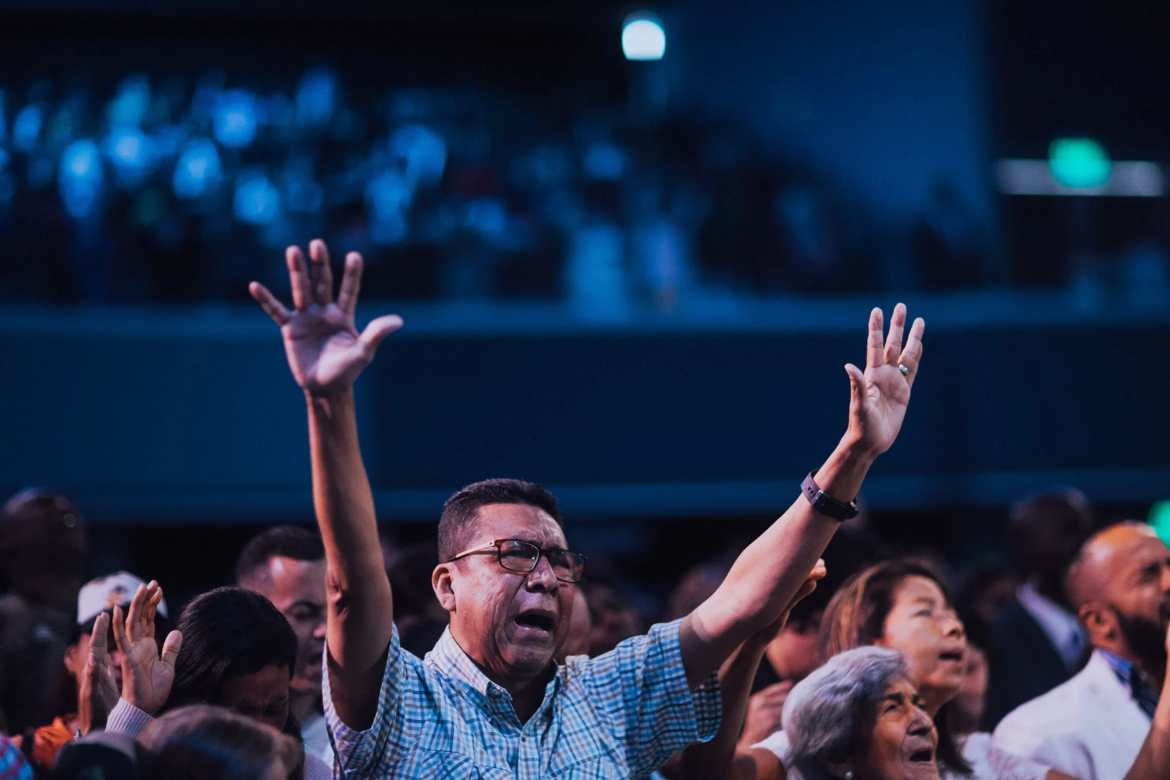

Source: https://www.pexels.com/photo/man-lifting-his-arms-2019331/ by Luis Quintero
Source: Luis Quintero
https://www.pexels.com/photo/fashion-people-woman-girl-18255287/

Slide 15
News and features in journalism
Longer Format: Features are typically longer and may cover multiple angles or perspectives on a topic.
They may also include interviews with experts, witnesses, or those directly involved.
A news story can end anywhere after you’ve described the most important facts, whereas a feature story ends with readers feeling satisfied that they gained some value from reading the story.
Examples: Magazine profiles, in-depth investigative reports, travel pieces, opinion pieces, and human interest stories are all examples of feature journalism.

Slide 16
News and Features in photojournalism
Timeliness: Like written news reporting, news in photojournalism is time-sensitive. Photographers aim to capture images that document events as they unfold or shortly after they occur like breaking news stories.
Visual Storytelling or narratives: Photojournalists tell stories through their images. They use the power of visual composition, lighting, and framing to convey the essence of an event or situation, sometimes in a single frame.
Objectivity or truthfulness: strive to present a fair and balanced representation of events, avoiding any manipulation or alteration of images that could mislead viewers.
Accuracy: Images must accurately represent the scene or subject being documented. Misleading or staged or manipulated photos can damage the credibility of both the photographer and the news organization.

Slide 17
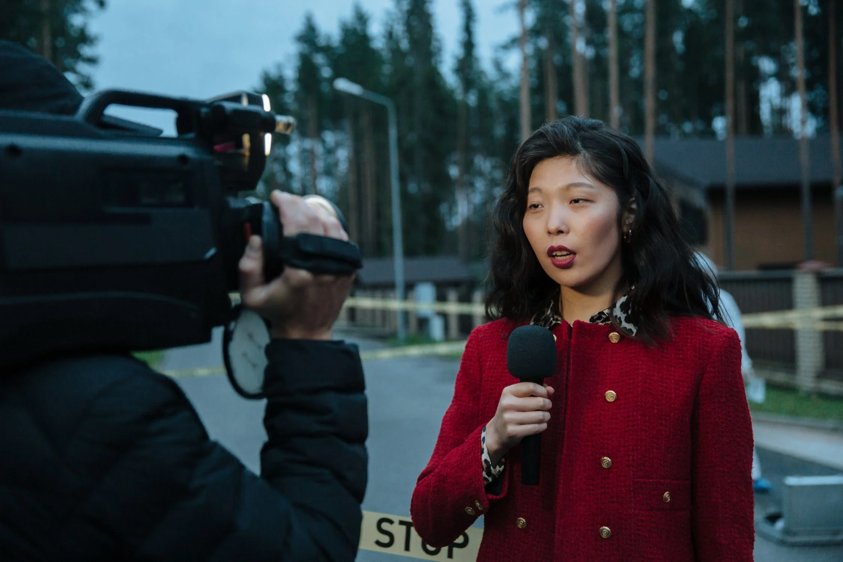
Source: https://www.pexels.com/photo/woman-in-red-and-black-sweater-holding-black-camera-10464476/ by cottonbro studio

Slide 18
News and Features in photojournalism
Ethical Considerations: Photojournalists adhere to ethical guidelines that govern their work. These guidelines include respecting the privacy and dignity of individuals photographed, obtaining appropriate permissions when necessary, and avoiding any interference in the events they are covering.
Candid Moments: News photographers often capture candid moments that provide an unfiltered and authentic view of events. These moments can convey raw emotions and the true nature of a situation. Though some are risky to capture for example a riot or in a war zone.
Composition: Composition in news photography is of essence. Photojournalists use techniques such as the rule of thirds, leading lines, fill the frame, perspective, framing and others to create visually compelling and informative images. The principles and elements of composition are well documented in our lecture four.

Slide 19
News and Features in photojournalism
Captioning: Each news photo is typically accompanied by a caption that provides essential information about the image, including the who, what, when, where, and why of the event.
Accurate and informative captions help viewers understand the context of the photo.
should be fact-checked and typo-checked.
They should be complete sentences that present the who, what, where, when and (sometimes) why without necessarily stating the obvious (i.e., he sits, she waves, they clap).
Captions give photos context, telling viewers what’s going on in a photo so they don’t have to guess or jump to conclusions.
You do not need to summarize the entire story in the caption; it should supplement or complement the story.
If the caption is as deep as the photo, it’s too long! Please keep captions to a couple lines.

Slide 20
News and Features in photojournalism
Deadline Pressure: News must be presented at the right time. They must capture, select, and transmit their images quickly to ensure they can be included in news stories published or broadcasted in a timely manner.
They also work under editors who most of the times are very strict.
Diverse Subjects: News photography covers a wide range of subjects, including politics, conflicts, disasters, sports, human interest stories, and more.
Photographers must adapt their skills to capture various types of events.
Impact: Powerful news photos can have a profound impact on public opinion and policy decisions. I
conic images can become symbols of historical moments or social issues.

Slide 21
Compare and contrast news and feature stories in photojournalism
Purpose:
News Stories in Photojournalism:
  Purpose: The primary purpose of news stories in photojournalism is to provide a visual representation of current events or developments. These events are typically of immediate public interest and often require quick and objective documentation.
  Timing: News photos are time-sensitive, capturing the most recent and breaking events.
  Objective: News photos aim to provide an objective and factual account of the event, allowing viewers to understand the "who," "what," "when," "where," and "why" quickly.
Feature Stories in Photojournalism:
  Purpose: Feature stories in photojournalism aim to provide a more in-depth and nuanced visual narrative. They go beyond the immediate news cycle to explore broader themes, emotions, and human experiences.
  Timing: Feature photos are often not tied to immediate events and can be published at any time. They have a more timeless quality.
  Objective: While they aim for objectivity, feature photos often allow for a more subjective and personal approach to storytelling. They may include the photographer's perspective and interpretation.

Slide 22
Compare and contrast news and feature stories in photojournalism
Content:
News Stories in Photojournalism:
  Content: News photos primarily focus on capturing key moments and essential details that convey the essence of the news event.
  Emphasis: The emphasis is on clarity and accuracy. News photos aim to provide a clear and factual representation of the event.
  Subjects: The subjects of news photos are often people involved in the immediate event, officials, protestors, or those directly impacted.
Feature Stories in Photojournalism:
  Content: Feature photos in photojournalism often focus on the human aspect of a story. They delve into individual experiences, emotions, and the broader context surrounding the subject.
  Emphasis: Feature photos aim to evoke emotions, empathy, and connection with viewers. They prioritize storytelling and often capture candid, unscripted moments.
  Subjects: The subjects of feature photos can be individuals, communities, or environments that are part of a larger narrative or theme.

Slide 23
Compare and contrast news and feature stories in photojournalism
Style:
News Stories in Photojournalism:
  Style: News photos are typically straightforward and focused on capturing the moment with accuracy.
  Composition: Composition is important, but the emphasis is on clarity and conveying the event's facts.
  Caption: Captions for news photos provide essential information about the event and its context.
Feature Stories in Photojournalism:
  Style: Feature photos often have a more creative and narrative style, allowing for experimentation with composition, lighting, and visual storytelling techniques.
  Composition: Creative composition, framing, and visual storytelling play a significant role in feature photos.
  Caption: Captions for feature photos may be longer and more descriptive, providing context and depth to the story.

Slide 24
Compare and contrast news and feature stories in photojournalism
Examples:
News Stories in Photojournalism: Images of protests, natural disasters, political rallies, and sporting events that capture the immediate action and impact.
Feature Stories in Photojournalism: Photo essays that explore the daily life of a community, personal narratives of individuals facing challenges, environmental photo stories, or in-depth explorations of cultural traditions.
In summary, news stories in photojournalism focus on capturing immediate events objectively and accurately, while feature stories aim to provide a deeper, more emotional, and narrative-driven perspective on broader themes and human experiences. Both forms of photojournalism are essential in conveying a comprehensive understanding of the world's events and stories.

Slide 25
Types of Photojournalism
Spot news photojournalism: It is the coverage of unplanned and often unpleasant occurrences like air crashes, road accidents, etc.
General news photojournalism: Just as the name suggests it deals with coverage of planned events like press conferences and other official events.
Feature photojournalism: It includes coverage of any non-news-related events or occurrences. It mainly focuses on pictures that are meant to entertain people.
Sports action photojournalism: It deals with covering important events occurring in the world of sports.
Portrait/personality photojournalism: Portrait or personality photojournalism deals with conveying the emotions of the person being photographed.
Pictorial photojournalism: It deals with producing outstanding images that are meant to showcase the artistic side of photojournalism.
Illustration photojournalism: It deals with manipulating two different images to create a new image which helps in conveying a message which may or may not is related to what is being photographed in the images.

Slide 26
Application of news and features in Photojournalism
Diversify Your Assignments:
Seek a variety of assignments that cover a wide range of topics and events. This will give you opportunities to practice both news and feature photography.
According to O’Neil, (2023), a photojournalism project begins with an idea, a theme, a topic.
Beginner photojournalists may have to find this on their own, by following their passion or relying on their network of contacts.
More experienced photojournalists can develop relationships with news outlets and work on assignment. Either way, photojournalists can work as freelancers or as staff photographers.
The only way to get started is to get out in the world and start shooting photos that tell true stories.

Slide 27
Application of news and features in Photojournalism
1. Understand the Assignment:
When you receive an assignment, clarify whether it's primarily a news story or a feature story.
Understanding the purpose and expectations will help you tailor your approach.
After choosing a suitable subject, or receiving an assignment, the photojournalist will often make a list of shots they’d like to incorporate in their story.
Even if sent spontaneously to cover a press conference or sporting event, a seasoned photojournalist will have a few necessary shots in mind, like some portraits, some wide-angle all-encompassing shots, and some storytelling feature shots (O’Neil, 2023).

Slide 28
Application of news and features in Photojournalism
2. News Photography:
For news assignments, focus on capturing key moments and essential details that convey the who, what, when, where, and why of the event.
Be ready to work quickly and under pressure to capture timely images.
Prioritize accuracy and objectivity. Avoid staging or altering scenes.
Pay attention to composition and framing to create clear and impactful images.
Capture reactions and emotions, as they can add depth to the news story.
3. Feature Photography:
For feature assignments, take a more storytelling approach. Look for unique angles, perspectives, and characters that can add depth and interest to your images.
Spend time getting to know your subjects and understanding their stories. Build rapport to capture intimate and candid moments.
Be patient and allow events to unfold naturally, capturing the emotions and interactions of people involved.
Experiment with creative composition, lighting, and framing to create visually striking images.
Use longer captions or accompany your images with written narratives to provide context and depth.

Slide 29
Application of news and features in Photojournalism
5. Develop a Narrative Eye:
Learn to recognize stories within events. Whether it's a news event or a feature story, every situation has its unique narratives waiting to be captured. Variety is important in visual storytelling.
6. Adapt to the Situation:
Be flexible and adaptable. Sometimes, news can evolve into feature stories, and vice versa. Be prepared to adjust your approach as the situation develops.
7. Ethical Considerations:
Always maintain high ethical standards, regardless of the type of assignment. Respect the privacy and dignity of the people you photograph.
Clearly communicate your intentions to your subjects, especially in sensitive situations.

Slide 30
Application of news and features in Photojournalism
8. Study and Learn:
Study the work of renowned photojournalists who excel in both news and feature photography. Analyze their techniques and storytelling approaches.
Continuously seek feedback from mentors, peers, and editors to improve your skills in both styles.
9. Build a Portfolio:
Create a portfolio that showcases your ability to excel in both news and feature photography. Having a diverse range of work will make you more marketable as a photojournalist.
10. Stay Informed:
Stay informed about current events and issues. Having a solid understanding of the news landscape will help you identify potential stories and opportunities for both news and feature coverage.

Slide 31
SUMMARY
News journalism focuses on delivering timely, objective, and concise information about current events, while feature journalism offers in-depth analysis, context, and often a more narrative and creative approach to storytelling.
Both forms of journalism play crucial roles in informing and engaging the public, but they serve different purposes and cater to different reader expectations.
In essence, news in photojournalism involves using photography to report on current events accurately, objectively, and ethically.
Photojournalists play a crucial role in conveying information, documenting history, and evoking emotions through their visual storytelling.
Their work helps the public better understand and connect with the world's most important stories.

Slide 32
SUMMARY
This century offers visual outlets like never before. Opportunities abound for rising photojournalists, thanks in large part to the internet.
A highly connected world also offers more subjects for photojournalists to cover.
Finding news and communicating with others takes far less effort today than it did in the 1930s, the “golden years” of photojournalism.
Camera equipment has also advanced enormously, allowing a budding photojournalist to acquire a kit without spending a fortune.
Well-executed photography, artistic and creative flair, ethically responsible practice, and a powerful story arc, all contribute to successful photojournalism.
Both news and feature photography require practice, experience, and a deep understanding of storytelling.
By mastering both approaches, you'll be better equipped to capture and convey the complexities of the world around you through your lens.

Slide 33
THANK YOU

