Slide 1

Photojournalism
WEEK 6 Sports features photojournalism
By Dr. Raphael Ogutu

Slide 2
Objectives
At the end of this Lecture, you should be able to:
1. Understand sport photography and sports feature photojournalism
2. Explore the tools for sports features photojournalism
3. Apply photojournalistic techniques in sports coverage

Slide 3

Introduction
This lecture introduces you to sports features photojournalism is a specialized form of photojournalism that goes beyond capturing the action on the field or court.
It focuses on telling the human, emotional, and narrative stories associated with sports, athletes, and sporting events.
Unlike traditional sports photography, which primarily emphasizes capturing key moments of the game, sports features photojournalism delves into the deeper aspects of the sports world, including the lives of athletes, their struggles, triumphs, and the impact of sports on society.

Slide 4
What is sport feature photojournalism?
It focuses on telling the human, emotional, and narrative stories associated with sports, athletes, and sporting events.
Unlike traditional sports photography, which primarily emphasizes capturing key moments of the game, sports features photojournalism delves into the deeper aspects of the sports world, including the lives of athletes, their struggles, triumphs, and the impact of sports on society.
According to Wagenknecht (2019), every game brings a different challenge. Whether it's trying new angles or photography techniques, there always is something new you can do to make your images stand out from the rest.

Slide 5
What is sport feature photojournalism?
The following are some key aspects of sport feature photojournalism:
Human Stories: Sports features photojournalism often revolves around the human stories within the world of sports.
It explores the lives, challenges, and personal journeys of athletes, coaches, fans, and other individuals connected to the sport.
Game coverage consists of a game story that recaps the key plays and moments of each contest; sidebars, which are shorter stories focusing on a specific play or player; and columns in which the writer voices his or her opinion and attempts to put the game into a larger context.

Slide 6
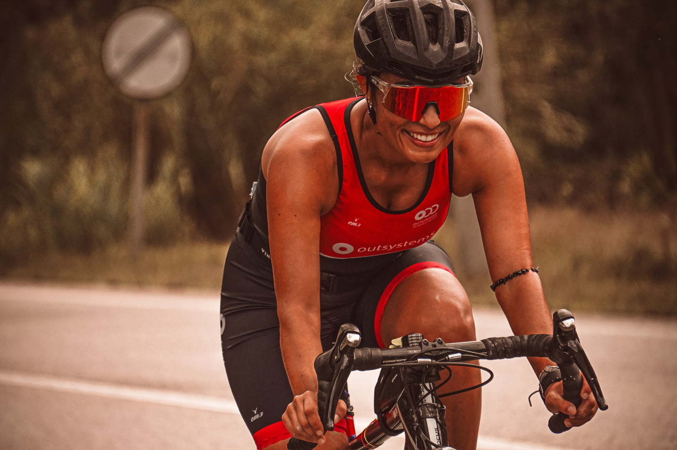
What is sport feature photojournalism?
Source: https://www.pexels.com/photo/woman-in-protective-helmet-and-sunglasses-riding-a-racing-bicycle-on-a-road-18424637/ By RUN 4 FFWPU

Slide 7
What is sport feature photojournalism?
Emotion and Character: It places a strong emphasis on capturing the emotions and character of the people involved in sports. This can include moments of joy, determination, heartbreak, and resilience.
Narrative-driven: Sports feature stories are narrative-driven, focusing on storytelling through images. A series of photographs is used to convey a complete story, often accompanied by written narratives.
Contextual Storytelling: It provides context to sports events, exploring the cultural, social, and historical aspects of sports. This can include documenting the impact of sports on local communities, traditions, and identity.
Behind-the-Scenes: Sports features often take viewers behind the scenes, showing the day-to-day lives of athletes, the training regimens, the preparation for competitions, and the challenges they face

Slide 8
What is sport feature photojournalism?
Cultural Exploration: Sports features can delve into the cultural significance of sports, highlighting the role of sports in shaping societies, fostering unity, or reflecting societal values.
in sports, as elsewhere in society, there is a tendency to explain differences in performance in terms of some alleged physical differences between races.
When Austrians do well at skiing and Swedes excel at tennis, cultural explanations have been sought through the analysis of social structures and environmental conditions.
On the other hand, when Kenyans prove exceptionally good at middle-distance running, there has been a tendency to look for a physiological explanation.
The tendency is misguided. As a result of the mapping of human DNA, the concept of "race" has become highly problematic. Guttmann, A., Rowe, . David Charles, Maguire,. Joseph Anthony and Luebering, . J.E. (2023),

Slide 9
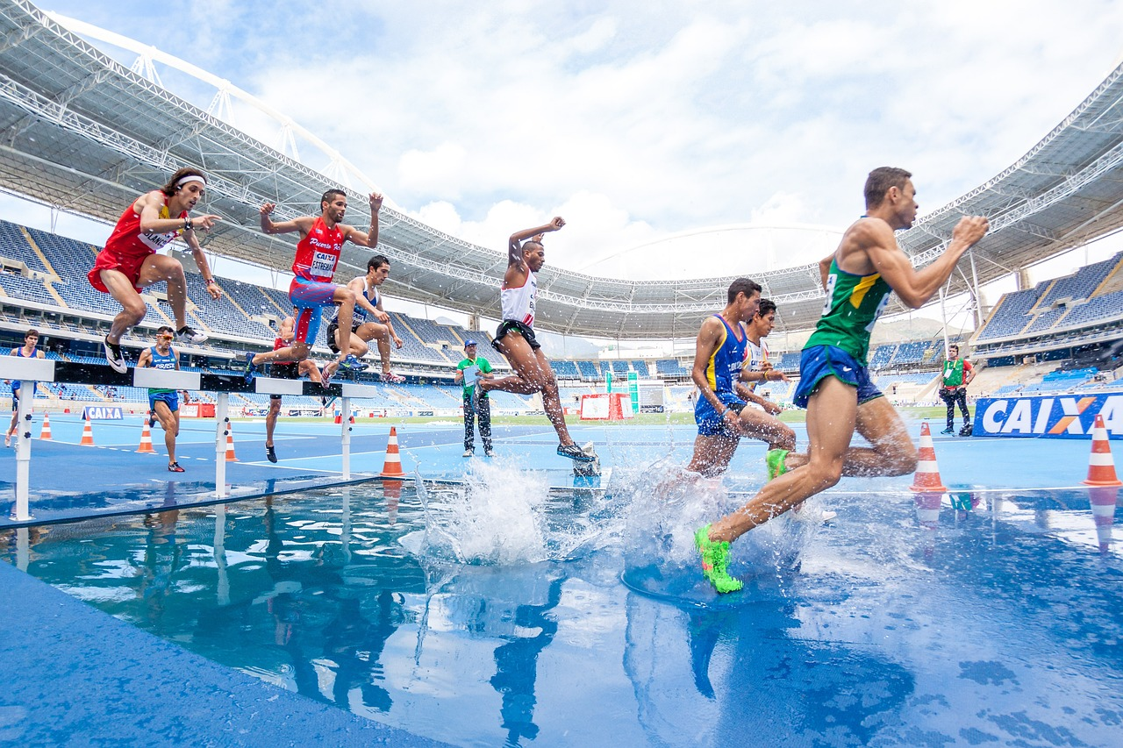
Source: https://pixabay.com/photos/action-athletes-competition-hurdles-1834465/ by Pexels

Slide 10
What is sport feature photojournalism?
In-depth Profiles: They involve in-depth profiles of athletes, coaches, and other sports figures. These profiles often reveal the personal and human aspects of these individuals, going beyond their public personas.
Visual Creativity: Sports features photojournalists have creative freedom to experiment with composition, lighting, and visual style. They aim to create images that are not only informative but also artistically engaging.
Long-form Storytelling: Sports features often require longer and more in-depth coverage compared to traditional sports reporting. They may include multiple photographs and extended written narratives.
Social Commentary: Some sports features serve as a form of social commentary, shedding light on societal issues, challenges, or triumphs related to sports. They may provoke thought and discussion on broader topics.

Slide 11

What is sport feature photojournalism?
Source: https://wallpapersafari.com/w/3qNcvy

Slide 12
What is sport feature photojournalism?
Publication: Sports features are often published in magazines, newspapers, online platforms, and documentaries.
They engage readers and viewers by providing a deeper understanding of the sports world.
Empathy and Connection: Sports features aim to evoke empathy and connection with viewers.
They use the power of storytelling to make audiences care about the people and stories within the sports world.
Empathetic differences have been generally observed between sexes (higher empathy in women), age (less cognitive empathy but lack of difference in emotional empathy with aging), cultures (more empathy with collective vs. individualistic societies) and interpersonal relationships (greater empathy for individuals within a group).
These factors could influence the choice of an individual to choose team or individual sports. (Behm and Carter, 2021).

Slide 13
Differences between sports photography and sports photojournalism?
There are differences between sports photography and sports photojournalism, although they share some common elements, just like photojournalism focuses more on verbs, while photography focuses more on nouns.
Sports photography includes all types of photography that cover every sport and sporting event.
This ranges from local and regional sports, high school athletics, all the way to the national and international sport, as well as a professional sport.
Sports features emphasize the environment, the ambience. They include warm-up pictures, victory/defeat pictures, fans and coaches.
Most sports photographers try to hang around a little while after the game, if possible, to capture these.

Slide 14
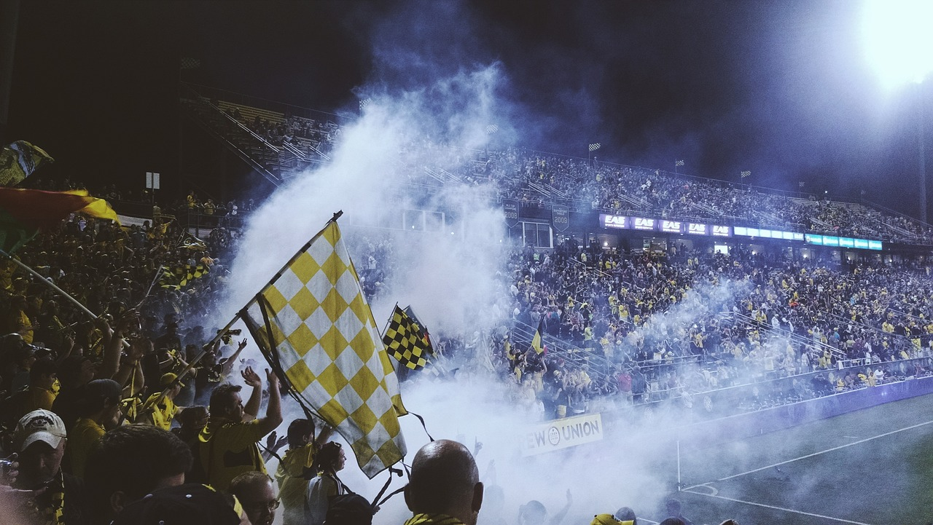
Source: https://pixabay.com/photos/stadium-sports-fans-arena-soccer-931975/

Slide 15
Sport photojournalism
Coverage of Sporting Events: Sport photojournalists cover a wide range of sporting events, from local competitions to international tournaments. These events can include team sports like football, basketball, and soccer, as well as individual sports like tennis, golf, and athletics.
Action Photography: A significant part of sport photojournalism involves capturing the action as it unfolds on the field or in the arena. This includes crucial moments such as goals, touchdowns, slam dunks, and record-breaking performances.
Emotion and Drama: Sport photographers aim to capture the emotions and drama of sports. This includes the elation of victory, the agony of defeat, the determination of athletes, and the reactions of fans.
Ethics: Ethical considerations are essential in sports photojournalism. Photographers must respect athletes' privacy and adhere to ethical guidelines while capturing images during events.

Slide 16
Sport photojournalism
Access: Sports photojournalists often have unique access to sporting events and athletes.
This access allows them to capture behind-the-scenes moments, locker room scenes, and candid interactions that add depth to their coverage.
Deadlines: Just like news journalists, sports photojournalists work under tight deadlines.
They must quickly process and deliver images to meet publication or broadcasting requirements, especially for live sports events.
Visual Storytelling: Sports photos are a form of visual storytelling. A single image should convey the essence of a game or a significant moment within it. A series of photos can tell a complete story.

Slide 17
Sport photojournalism
Technical Skill: Sports photography requires a high level of technical skill.
Photographers must be skilled in capturing fast-paced action, working in various lighting conditions, and using specialized equipment like telephoto lenses and high-speed cameras.
Creativity: To capture unique photographs, sports photographers are creative and try to find new angles or ways of portraying an athlete.
Problem-solving: Sports photographers may encounter technical problems during a photo shoot and need to be able to find ways to continue working.
Attention to detail: A sports photographer has an eye for details and can tell what colors, angles and other components may make their photograph look good.
Storytelling: Sports photographers need to be able to use their photographs to tell a story and compose them into a sequence for viewers to understand.
Lighting: When taking photographs, sports photographers using lighting tools and techniques to ensure they portray their subjects correctly

Slide 18
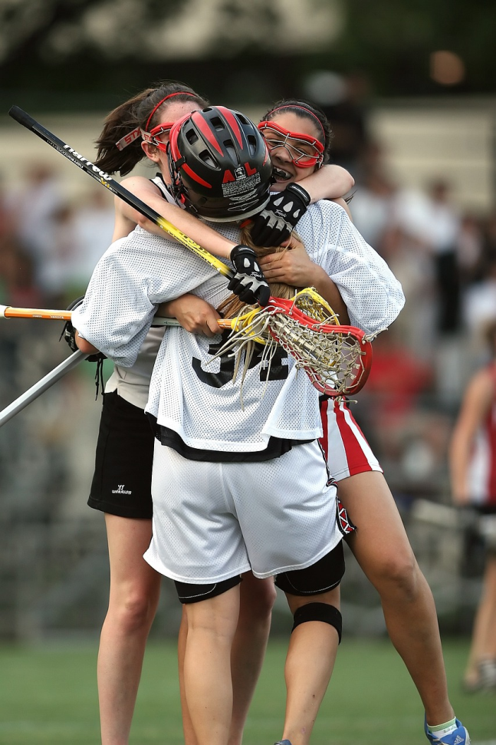
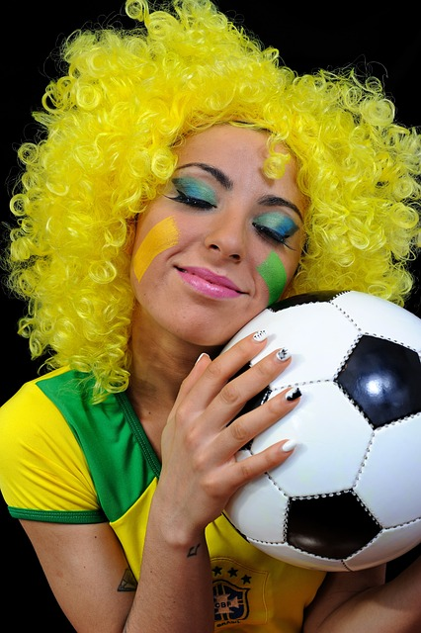
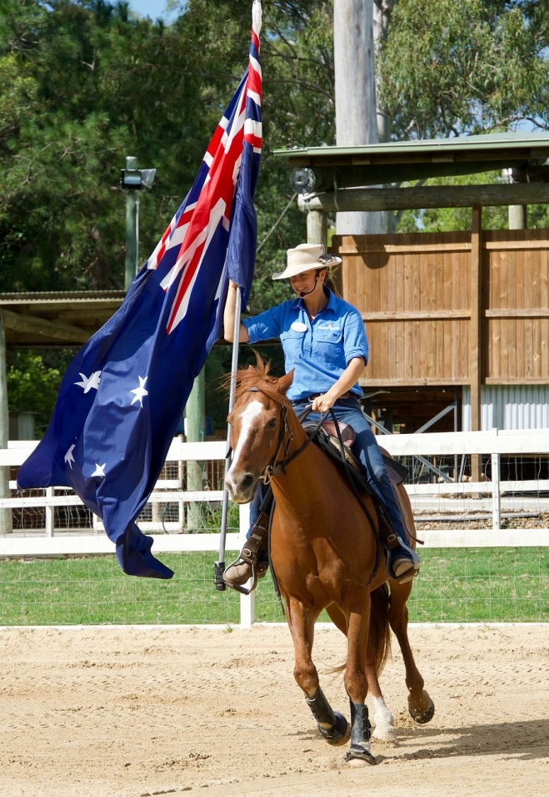
Sport photojournalism
Source: https://pixabay.com/photos/lacrosse-lax-sport-stick-equipment-1511208/ by
KeithJJ
Source: https://pixabay.com/photos/soccer-brazil-football-sport-fan-4137687/ by FOTOKALDE
Source: https://pixabay.com/photos/horse-flag-competition-sport-3286259/ by MemoryCatcher

Slide 19
Differences between sports photography and sports photojournalism
There are differences between sports photography and sports photojournalism, although they share some common elements, just like photojournalism focuses more on verbs, while photography focuses more on nouns.
Sports photography includes all types of photography that cover every sport and sporting event.
This ranges from local and regional sports, high school athletics, all the way to the national and international sport, as well as a professional sport.
Sports features emphasize the environment, the ambience. They include warm-up pictures, victory/defeat pictures, fans and coaches.
Most sports photographers try to hang around a little while after the game, if possible, to capture these.

Slide 20
Differences between sports photography and sports photojournalism
Sports Photography:
1. Primary Focus: Sports photography primarily focuses on capturing visually striking and compelling images of sports, athletes, and related activities. It emphasizes aesthetics, action, and the visual impact of the photographs.
2. Commercial Aspect: Sports photographers may work for sports magazines, advertising agencies, sports teams, or as freelancers selling their work to publications or for commercial purposes. The primary goal is often to create eye-catching images that appeal to a wide audience.
3. Staging and Posed Shots: In sports photography, staging and posed shots are more acceptable. Photographers may work with athletes and teams to create promotional or marketing images. These shots may not always represent the raw reality of the sports event.

Slide 21
Differences between sports photography and sports photojournalism
Sports Photography:
4. Creative Freedom: Sports photographers have creative freedom to experiment with composition, lighting, and visual style to produce visually stunning images. The goal is often to capture memorable and aesthetically pleasing moments.
5. Artistic Expression: Some sports photographers view their work as a form of artistic expression, and they may prioritize artistic elements over journalistic integrity or the reporting of facts.
6. Prints and Art Sales: Sports photographs are often sold as prints or displayed as art pieces, especially if they have artistic or aesthetic appeal. These prints may be purchased by sports enthusiasts or collectors.

Slide 22
Differences between sports photography and sports photojournalism
Sports Photojournalism:
1. Primary Focus: Sports photojournalism places a stronger emphasis on capturing and conveying the narrative and journalistic aspects of sports events.
It seeks to tell a story, document moments, and provide insight into the sports world.
2. News and Reporting: Sports photojournalists often work for news organizations, and their primary goal is to report on sports events in a factual and objective manner.
Their images are used to accompany news stories and provide visual evidence of the events.
3. Candid and Unscripted Moments: In sports photojournalism, the focus is on candid and unscripted moments that authentically represent the action and emotions of the event.
Staging or directing subjects is generally avoided.

Slide 23
Differences between sports photography and sports photojournalism
Sports Photojournalism:
4. Objective and Factual: Sports photojournalists adhere to ethical standards and strive for objectivity.
They aim to present a truthful representation of the sports event, even if the images are not always aesthetically perfect.
5. Editorial Use: The images captured by sports photojournalists are primarily used for editorial purposes, such as newspapers, news websites, and magazines.
They support the written news and provide context to the events.
6. Journalistic Integrity: Sports photojournalists prioritize journalistic integrity, including accurate captioning and context.
Their work is guided by the principles of news reporting, including fairness, accuracy, and impartiality.

Slide 24
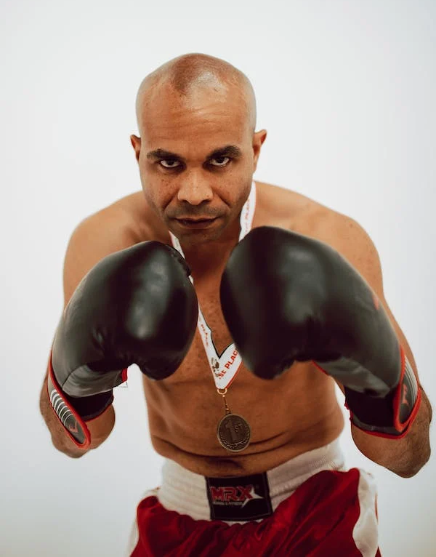
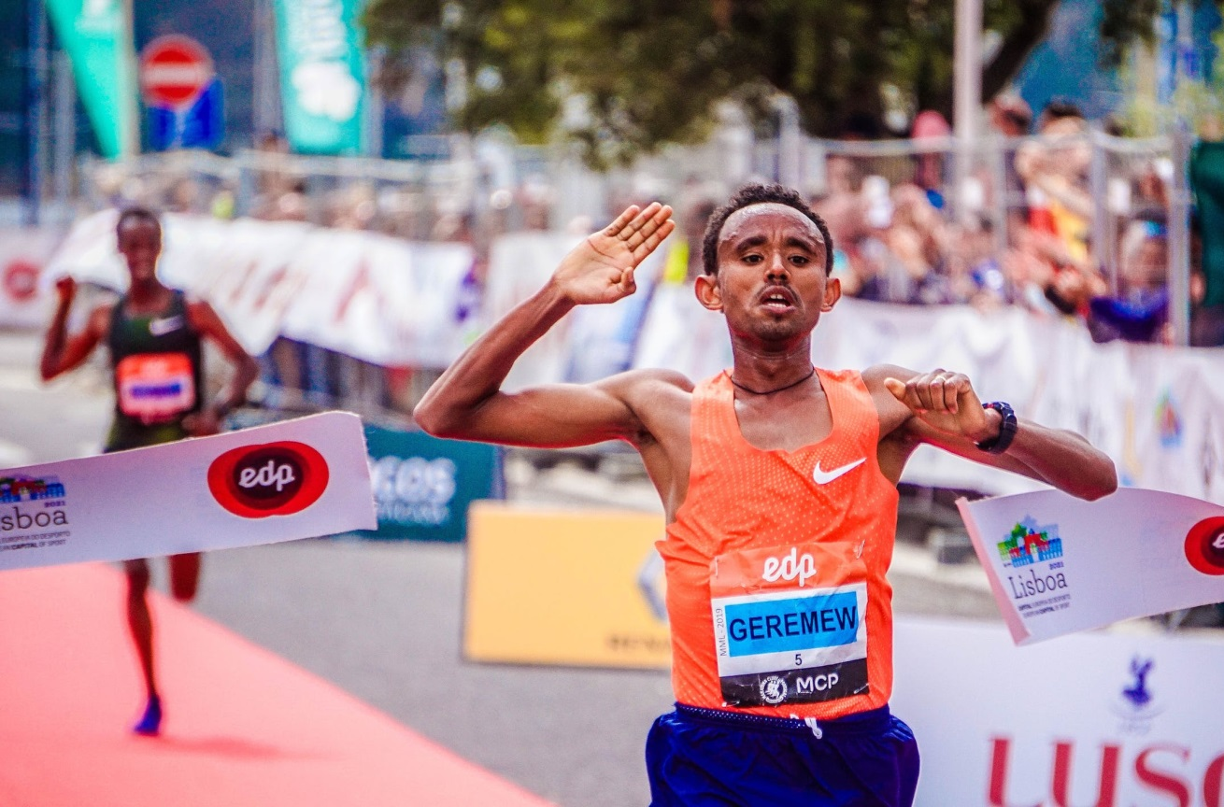
Differences between sports photography and sports photojournalism
Source: https://www.pexels.com/photo/man-in-black-and-red-boxing-gloves-7005111/
Source: https://www.pexels.com/photo/two-men-on-track-field-2567040/ By RUN 4 FFWPU

Slide 25
The tools for sports features photojournalism
1. Camera: A high-quality digital camera with manual settings is a must. Many professional sports photojournalists use DSLR or mirrorless cameras for their versatility, fast autofocus, and image quality. Ensure your camera can handle low light conditions, fast action, and high-resolution images.
2. Lenses:
  Telephoto Lens: A telephoto lens with a long focal length (e.g., 70-200mm or 100-400mm) is crucial for capturing action from a distance. It allows you to isolate subjects, get close-ups of athletes, and compress perspectives.
  Wide-Angle Lens: A wide-angle lens (e.g., 24-70mm) can be handy for capturing environmental and contextual shots, such as the stadium, crowd, or athletes in their surroundings.
  Prime Lenses: Prime lenses with wide apertures (e.g., f/1.4 or f/1.8) are excellent for low-light situations and creating a shallow depth of field for artistic shots.

Slide 26
The tools for sports features photojournalism
3. Tripod and Monopod: While you may not always use them, tripods and monopods can help stabilize your camera, especially for longer exposures or when shooting with heavy telephoto lenses. Monopods are particularly useful for mobility during sports events.
4. High-Speed Memory Cards: Sports photography generates large image files, especially if you shoot in burst mode. High-speed memory cards ensure that you can write data quickly and won't miss crucial shots due to buffer limitations.
5. External Flash: While natural light is often preferred, an external flash can be useful for filling in shadows in challenging lighting conditions, such as indoor arenas or nighttime events.
6. Remote Shutter Release: A remote shutter release or cable release can help you take photos without touching the camera, reducing the risk of camera shake, especially during long exposures.

Slide 27
The tools for sports features photojournalism
7. Camera Bag: Invest in a durable camera bag that can accommodate your camera body, multiple lenses, accessories, and possibly a laptop or tablet for immediate image transfer and editing on-site.
8. Extra Batteries: Sports events can be lengthy, and you'll likely shoot many images.
Carry extra camera batteries to ensure your camera doesn't run out of power during a critical moment.
9. Lens Cleaning Kit: Dust, rain, and debris are common at sports events.
A lens cleaning kit with lens cloths, cleaning fluid, and a blower can help keep your equipment clean and free of smudges.
10. Weather Protection: Sports photographers often work outdoors, so it's essential to have weather-resistant covers or protective gear for your camera and lenses to shield them from rain, dust, or extreme weather conditions.

Slide 28
The tools for sports features photojournalism
11. Laptop or Tablet: A laptop or tablet allows you to review, edit, and transmit images on-site, especially if you are working for a news organization with tight deadlines.
12. Lightroom or Photoshop: Photo editing software like Adobe Lightroom or Photoshop is crucial for post-processing your images, adjusting exposure, color, and sharpness, and preparing them for publication.
13. Press Credentials: For access to events and venues, you'll often need press credentials issued by your employer or a relevant organization. These credentials prove your status as a photojournalist and grant you access to restricted areas.
14. Mobile Connectivity: A smartphone or mobile hotspot can help you transmit images quickly to your newsroom or clients if you're working on a tight deadline.
15. Notebook and Pen: A small notebook and pen can be useful for jotting down notes, captions, or details about the event to accompany your images.

Slide 29
Apply photojournalistic techniques and skills in sports coverage
Shooting sports photography, entails capturing high speed movements of subjects or objects.
To make sure the action is completely frozen, you need a fast shutter speed. The faster the movements, the faster your shutter speed needs to be.
In general, a minimum shutter speed of 1/1000th of a second should freeze the action for a sharp image.
You need to choose a fast shutter speed, while balancing the widest aperture and lowest ISO possible for proper exposure.
A wide aperture will create a short depth of field that makes the player stand out against a blurred background and a low ISO will produce the best image quality.
When you’re able to balance those three settings—while prioritizing shutter speed—you will be able to capture a great action shot.

Slide 30
Apply photojournalistic techniques and skills in sports coverage
1. Know the Sport: Understand the rules, strategies, and nuances of the sport you're covering. Familiarize yourself with the key players, teams, and the significance of the event. This knowledge will help you anticipate important moments.
2. Research the Story: Before the event, research the context and storylines surrounding the game. Are there any personal narratives, rivalries, or records at stake? Understanding the broader narrative will guide your coverage.
3. Scout the Venue: Arrive early at the venue to scout the best vantage points and shooting positions. Identify locations that offer unique perspectives, interesting backgrounds, or opportunities for capturing fan reactions.

Slide 31
Apply photojournalistic techniques and skills in sports coverage
4. Capture the Action:
  Timing: Master the art of anticipation. Be ready to capture key moments, like goals, touchdowns, or winning shots, by tracking the action and using continuous shooting mode.
  Composition: Apply the principles of composition, such as the rule of thirds, leading lines, and framing, to create visually engaging images even during fast-paced action.
  Variety: Capture a variety of shots, including wide-angle shots to show the context, medium shots to focus on players, and tight close-ups to convey emotions. Use different lenses to achieve these perspectives.
  Panning: Use panning techniques to convey motion. Follow the movement of athletes while using a slow shutter speed to blur the background and emphasize the subject.
  Reaction Shots: Don't just focus on the athletes. Capture reactions from fans, coaches, and fellow players. Emotions in the crowd add depth to the story.

Slide 32
Apply photojournalistic techniques and skills in sports coverage
5. Tell the Human Story:
  Candid Moments: Look for candid, unscripted moments that reveal the human side of sports. These can include pre-game rituals, post-game celebrations, or players interacting with fans.
  Emotions: Photograph the range of emotions—joy, disappointment, determination—on the faces of athletes and fans. Emotions tell a powerful story.
  Interaction: Capture interactions between players, coaches, and fans. These moments can reveal the personal connections and dynamics within the sport.
6. Use Captions: Write informative and compelling captions for your photos. Captions should provide context, identify individuals, and add depth to the story. Accuracy and clarity are crucial.
7. Stay Neutral: Maintain objectivity and neutrality in your coverage. Avoid showing favoritism or bias toward any team or athlete, especially if you're working for a news organization.

Slide 33
Apply photojournalistic techniques and skills in sports coverage
8. Ethical Considerations:
  Respect the athletes' privacy and consent. Avoid capturing them in vulnerable or embarrassing moments without their permission.
  Ensure your photos accurately represent the events. Avoid altering images in a way that misrepresents the reality of the game.
9. Post-Processing: After the event, use post-processing software (e.g., Lightroom or Photoshop) to edit and enhance your photos. Adjust exposure, color, and sharpness to improve image quality without altering the integrity of the scene.
10. Transmit Quickly: If you're on a tight deadline, transmit your images to your newsroom or client as quickly as possible. High-speed internet connections or mobile hotspots can help expedite this process.
11. Stay Informed: Stay updated on developments in the sport, industry trends, and emerging athletes. This knowledge will help you capture relevant and timely stories.
12. Feedback and Critique: Seek feedback from peers, editors, or mentors to continuously improve your sports photojournalism skills. Constructive criticism can help you refine your techniques and storytelling abilities.

Slide 34
SUMMARY
In essence, sports features photojournalism is a form of storytelling that uses powerful images to capture the essence of sports and the people involved, transcending the scores and statistics to reveal the human side of the game.
It's a vital component of sports journalism, offering a more profound and holistic perspective on the world of sports.
Sport photojournalism combines photography, storytelling, and a deep understanding of sports to document and convey the excitement, emotion, and stories within the world of athletics.
It plays a crucial role in bringing the passion and drama of sports to audiences worldwide.
Sports photography is a dynamic and exciting genre that combines technical skill, creative composition, and the ability to capture the essence of sports and athleticism.
It plays a vital role in documenting and celebrating the world of sports for audiences around the globe.

Slide 35
SUMMARY
In summary, while both sports photography and sports photojournalism involve capturing
sports-related images, they differ in their primary focus, goals, and approach.
Sports photography leans toward aesthetics and commercial appeal, while sports photojournalism prioritizes journalistic integrity, factual reporting, and storytelling within the context of news and editorial coverage.
Remember that in sports feature photojournalism, the ability to tell a compelling story through your images is just as important as having the right equipment.
Understanding the sport, anticipating key moments, and being in the right place at the right time are also critical skills for success in this field.

Slide 36
THANK YOU

