Slide 1

Photojournalism
WEEK 8 The roles and responsibilities of photojournalist and editor
By Dr. Raphael Ogutu

Slide 2
Objectives
At the end of this Lecture, you should be able to:
Explain the roles of a Journalist and Photojournalist.
Explore job description or duties of a news editor and photo-editor
Compare and contrast the responsibilities of a photojournalist and photo-editor

Slide 3

Introduction
Journalists play a crucial role in society by gathering, analyzing, and presenting news and information to the public.
They keep people informed, holding individuals and institutions accountable, and fostering a well-informed citizenry.
Capture images of events, incidents, or people to create a press story.
Current debates and discussions include but are not limited to: responsible representation, manipulation, citizen contribution, and the evolution of digital technology.
The parameters of the professional photojournalist are in a continuing state of flux.
Their job description entails editing and preparing pictures taken in real-life situations to obtain visual materials used to support news stories.

Slide 4
The roles of a journalist and a photojournalist
The roles of a journalist can vary depending on their area of specialization, but the following are some common roles and responsibilities of journalists:
1. Information Gathering: Journalists are responsible for collecting information from various sources, including interviews, research, press releases, and eyewitness accounts.
They must verify the accuracy and credibility of the information they gather.
2. Reporting: Journalists write news articles, reports, or broadcast stories to convey information to the public.
They use clear and concise language to present facts, events, and developments in an understandable manner

Slide 5
The roles of a journalist and a photojournalist
Investigation: Investigative journalists delve deep into issues, often uncovering hidden truths or exposing wrongdoing.
They may spend extended periods researching and digging into complex stories.
Interviewing: Journalists conduct interviews with individuals relevant to the news story, including experts, witnesses, officials, and ordinary people.
Effective interviewing skills are essential to extract valuable insights and perspectives.
Fact-Checking: Journalists have a responsibility to verify the accuracy of the information they report.
Fact-checking ensures that stories are truthful and reliable.

Slide 6
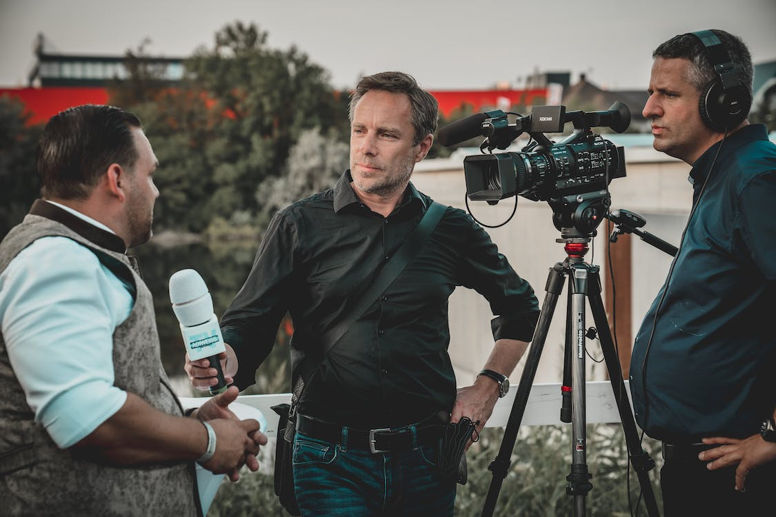
Source: https://www.pexels.com/photo/man-holding-microphone-while-talking-to-another-man-2872418/ By Redrec ©️
Source: https://pixabay.com/photos/camera-aperture-digital-camera-dslr-1239384/

Slide 7
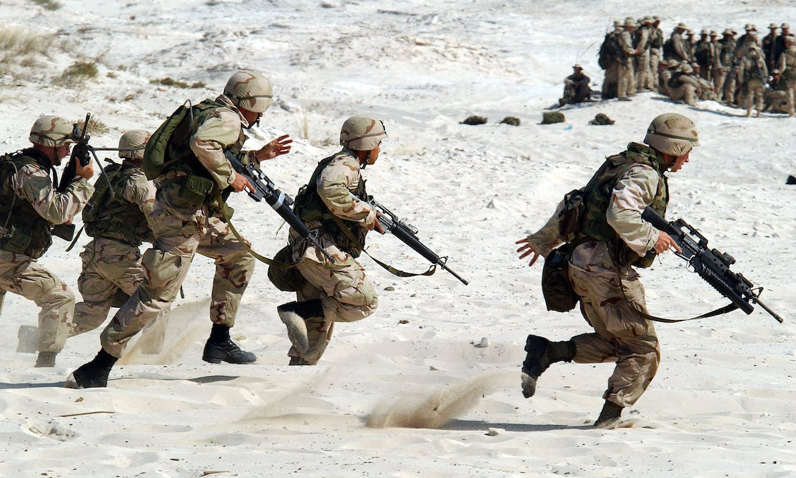
Source: https://www.pexels.com/photo/5-soldiers-holding-rifle-running-on-white-sand-during-daytime-87772/ PIXABAY

Slide 8
The roles of a journalist and a photojournalist
Editorial and Opinion Writing: Some journalists write opinion pieces, editorials, or columns to express their personal viewpoints on various topics.
These pieces are typically labeled as opinion to distinguish them from news reporting.
Photography and Visual Storytelling: Photojournalists and visual journalists use images and multimedia elements to complement news stories and provide a visual perspective on events.
Broadcasting: Broadcast journalists work in radio or television and may serve as news anchors, correspondents, or reporters.
They deliver news through live broadcasts or pre-recorded segments.
Social Media and Digital Journalism: With the rise of digital media, journalists often use social media platforms and online tools to disseminate news quickly and engage with audiences.
They also produce content for websites and digital publications.

Slide 9
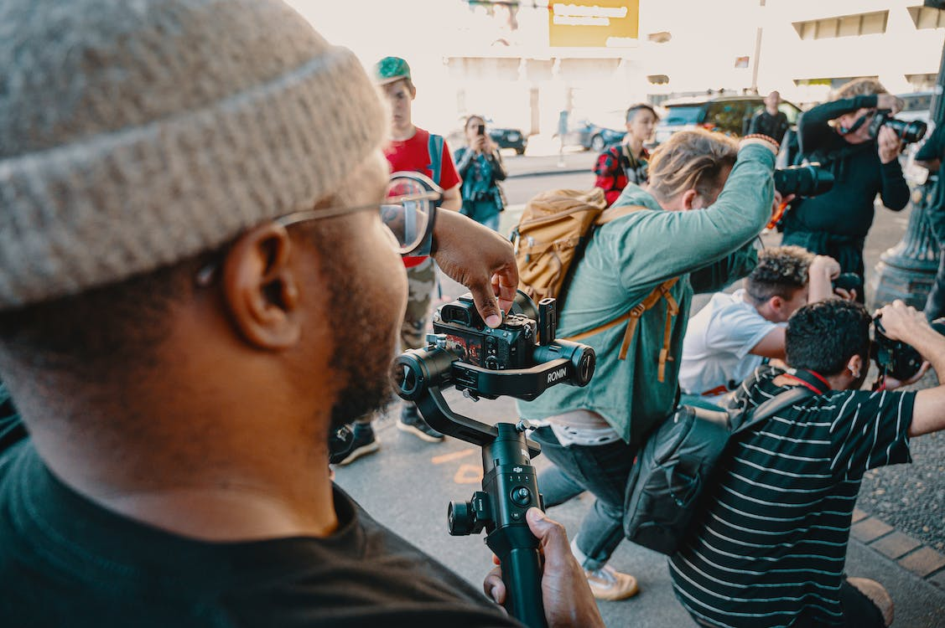
Source: https://www.pexels.com/photo/photo-of-people-taking-photos-2479958/

Slide 10
The roles of a journalist and a photojournalist
Ethical Responsibility: Journalists must adhere to ethical principles, including objectivity, fairness, impartiality, and respect for privacy.
They should avoid conflicts of interest and disclose any potential biases.
Accountability and Watchdog Function: Journalists hold individuals, organizations, and governments accountable for their actions and decisions by investigating and reporting on issues of public interest.
Educational and Informative Role: Journalists educate the public on various topics, including politics, economics, science, and culture.
They help people make informed decisions and understand complex issues.
Crisis Reporting: Journalists often cover crises such as natural disasters, conflicts, and emergencies.
Their role is to provide timely and accurate information to help the public stay safe and informed.

Slide 11

Source: https://www.pexels.com/photo/woman-using-smartphone-and-laptop-4549414/ By Plann

Slide 12
The roles of a journalist and a photojournalist
Community Engagement: Journalists may engage with the community they serve by attending public meetings, forums, and events to understand local concerns and gather news ideas.
Adaptation to New Technologies: Journalists must stay up-to-date with emerging technologies and digital tools to enhance their reporting capabilities and reach wider audiences.
A photojournalist plays a crucial role in journalism by using photography to tell stories, document events, and convey information to the public
A photojournalist is a professional photographer who specializes in capturing and telling stories through images.
Their primary role is to document events, people, and situations in a journalistic and visually compelling way.

Slide 13
The roles of a journalist and a photojournalist
Storytelling: Photojournalists use their skills to tell stories through images. They aim to capture the essence of an event, situation, or news story in a single frame or a series of photographs.
Storytelling: Photojournalists use their camera skills to tell stories through their photographs.
They aim to convey a narrative or capture the essence of an event, person, or situation using images.
The responsibilities and duties of the photojournalist vary from media house to media house.
The primary duty of the photojournalist is to take pictures.
They are responsible for providing clear, easy-to-read, high quality, truthful images, that communicate a meaningful message to the readers of the publication they work for.

Slide 14
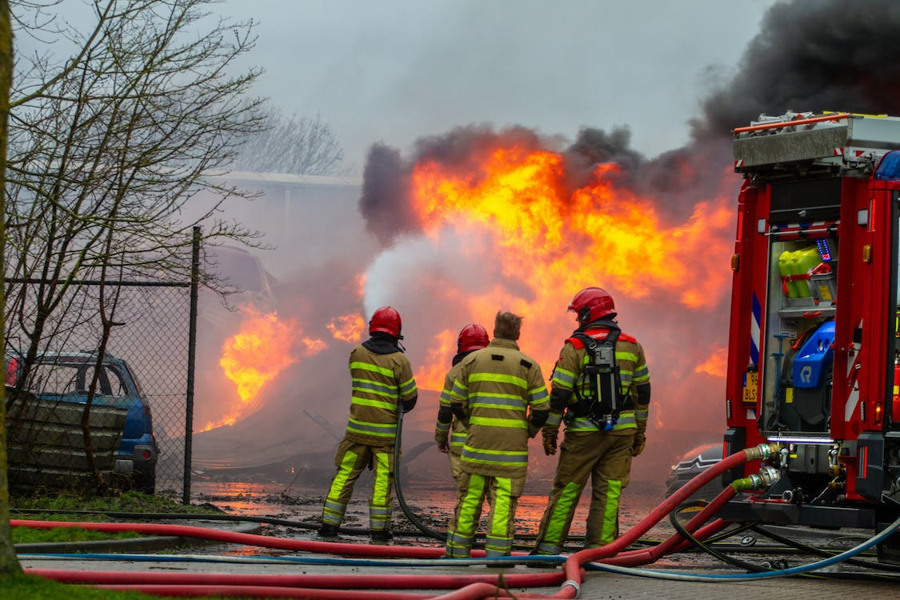
Source: https://www.pexels.com/photo/firefighters-putting-out-fire-4127694/ By damian Ruitenga

Slide 15
The roles of a photojournalist
Documentation: historical events, news stories, and everyday life.
Responsible for preserving visual records of significant moments in society, culture, politics, and more.
Documentary Photography: they create visual records of various subjects, including social issues, cultures, and everyday life.
These images can be used in documentaries, books, or exhibitions to raise awareness and provoke thought.
Objectivity: Like journalists, photojournalists strive for objectivity and accuracy in their work.
They aim to present events as they unfold without bias or manipulation, allowing viewers to form their own opinions.
Their photos should accurately represent the reality of the situation.
The photographer must also write caption information for each picture. The caption will explain the "WHO, WHAT, WHERE, WHY AND WHEN" of the photograph. Complete caption information is extremely important.

Slide 16
The roles of a photojournalist
News Gathering: work alongside reporters to cover news events. They capture images that complement the written or spoken content, enhancing the overall storytelling process.
News Coverage: are responsible for covering news events such as political rallies, protests, natural disasters, and other significant happenings.
Their photos are used to accompany news articles and provide visual context to the story.
At the beginning of their shift, they take a few minutes to get their mail, read messages left for them and take a peek at the story budget for the following day. They will go to the photo assignment desk and pick up their photo assignments for the day.
The photographer will read over their photo assignments to make sure there are proper directions, contact names and phone numbers, that they understand the angle of the story and if there will be opportunity to be able to take photographs that will tell that story.
If the photographer has any questions they will ask the photo editor, reporter or desk editor.
Most organizations also give the photographer other duties such as scanning their pictures into a computer, adjusting the tone and color of the pictures using Adobe Photoshop.

Slide 17
The roles of a photojournalist
Visual Impact: They use composition, lighting, and other photographic techniques to create visually compelling images that grab the audience's attention and convey the emotions and significance of the subject matter.
After the photographer looks over their photo, they will get the photo editor to edit the photo with them.
It is at this time the photo editor will not just work with the photographer and picks the best photo(s) for the story, but also critique how the photographer did on that assignment.
The photo editor will look at the film and discuss with the photographer their approach to the assignment.
Is there enough variety in their images? Were there any missed opportunities? Did the photographer use the best lens and/or try a variety of lenses? Is their photo over/under exposed? And if so, discuss why this happened.
Was the photographer too far away or too close to their subject? Does the photo tell the story? Is there emotion in the photograph?
The photo editor will point out the positive things about the work the photographer did as well as discuss how it could have been done better.

Slide 18
The roles of a photojournalist
Ethics and Responsibility: Photojournalists adhere to ethical guidelines and principles, including respecting the dignity and privacy of individuals in their photos.
They must also avoid staging or altering images to manipulate the truth, guidelines, and such as obtaining informed consent when photographing individuals.
Manipulating images to distort the truth is strictly prohibited in ethical photojournalism.
Adaptability: need to be adaptable and quick-thinking, as they often work in dynamic and unpredictable environments. They must make decisions on the spot to capture the best moments.
Adaptability: Photojournalists must be adaptable and resourceful, as they may encounter unexpected situations while covering events.
Safety Awareness: Some assignments may involve covering dangerous situations, so photojournalists must prioritize their safety and take precautions when necessary.
The photographer might have to call sources to set up the time and place of the photo session. Photojournalists generally carry police and fire scanners with them so in the event of breaking news, they can get to the scene quickly.

Slide 19
The roles of a photojournalist
Equipment and Technical Skills: Proficiency with photography equipment and editing software is essential.
Use a variety of cameras, lenses, and other gear to capture high-quality images in various conditions.
A strong understanding of photography techniques, including composition, lighting, and camera settings.
They often work in challenging conditions and need to be proficient in adapting to different situations quickly.
Equipment: Photojournalists typically use professional-grade cameras and lenses to ensure high-quality images. They also carry additional equipment such as tripods, flashes, and various accessories to handle different shooting conditions.
Deadline Pressure: They often work under tight deadlines, especially in the fast-paced world of breaking news. Meeting deadlines is crucial for delivering timely and relevant content to the public.
They must be able to deliver high-quality images promptly to meet publishing schedules.
They may also be required to read stories and work with reporters to come up with ideas of what to photograph to go with the story.

Slide 20
The roles of a photojournalist
Story Research: Before going into the field, photojournalists may research and prepare for their assignments to better understand the context and significance of the events they will be covering, which helps them capture the most relevant and impactful images.
Freelance vs. Staff: Photojournalists may work as freelance photographers, selling their work to media outlets, or they may be employed as staff photographers by newspapers, magazines, news agencies, or online publications.
Whether a freelance or staff, the photographer will discuss with the photo editor and/or the page designers how the photograph will run in the newspaper.
Questions: Will it run on the front page? Will it be the main photo on the page? Or will in run on an inside page big or small? Does the photo need to be cropped? Or are there any questions about the caption information that the photographer provided?

Slide 21
The roles of a photojournalist
Impact: Photojournalism has the power to inform, educate, and provoke emotional responses.
Powerful images can raise awareness, drive change, and provide a visual record of historical moments.
The photographer must download, crop and tone the photographs on the computer.
At other newspapers, there is a person on staff who does that for the photographers. This is good because it give the photographer more time to spend on shooting their assignments.
Toning a photograph means that the photographer makes adjustments to the image on the computer the same they would have done when photographic prints were developed in a darkroom.
These adjustments include; color balance, contrast and burning and dodging.

Slide 22
The roles or duties of a news editor and photo-editor
A news editor plays a crucial role in the process of gathering, evaluating, and presenting news stories to the audience.
News editors are typically found in newsrooms and media organizations, and their responsibilities can vary depending on the size and structure of the organization.
A photojournalist editor, also known as a photo editor, plays a similar crucial role like news editor in the field of journalism by overseeing the selection, processing, and presentation of photographs and visual content in news publications, websites, or other media platforms.
Their primary focus is on ensuring that visual storytelling effectively complements and enhances the overall news coverage.

Slide 23
The roles or duties of a news editor and photo-editor
1. Story Selection: News editors decide which stories are worth covering based on their relevance, significance, and potential impact on the audience. They prioritize stories and allocate resources accordingly.
They work closely with photographers and journalists to choose the best visuals that tell the story effectively.
2. Assignment: News editors assign reporters and journalists to cover specific stories or events. They may also set deadlines and provide guidance on how to approach a story.
Story Planning: Photo editors may participate in story planning meetings to discuss the visual aspects of upcoming news coverage and suggest ideas for photo assignments.
3. Story Review and Editing: News editors review and edit news stories submitted by reporters.
They ensure that stories are well-written, factually accurate, and adhere to the organization's editorial standards and style guidelines.
Editing and Enhancement: Photo editors may perform basic image editing tasks such as cropping, color correction, and retouching to optimize images for publication.
They ensure that images adhere to the publication's visual style and standards.

Slide 24
The roles or duties of a news editor and photo-editor
Fact-Checking: News editors verify the accuracy of information presented in news stories. They may cross-check facts, figures, and statements to ensure that the news is reliable and trustworthy.
Caption and Metadata: Photo editors often collaborate with photographers and journalists to write informative and accurate captions that provide context and information about the images. They may also handle metadata to organize and index photos.
Headline and Lead Writing: News editors craft attention-grabbing headlines and lead paragraphs (the opening sentences) that summarize the key points of a story and entice readers or viewers to continue reading or watching.
Story Organization: News editors structure news stories to ensure that they flow logically and are easy for the audience to follow. They may suggest revisions to improve the organization and clarity of a story.
Storytelling: Photo editors work to ensure that the selected images contribute to the narrative of a news story. They help convey the story's message and emotion through visuals.

Slide 25
The roles or duties of a news editor and photo-editor
Style and Grammar: News editors ensure that news stories adhere to the organization's style guide, including rules for grammar, punctuation, and spelling.
They maintain consistency in language and formatting.
Visual Consistency: Photo editors maintain a consistent visual style and quality throughout the publication, ensuring that photos adhere to established guidelines and standards.
Legal and Ethical Considerations: News editors are responsible for ensuring that news stories comply with legal and ethical standards.
They may review sensitive content, such as stories involving privacy, defamation, or conflicts of interest.
Ethical Considerations: Photo Editors are responsible for ensuring that photographs accurately represent events and situations.
They must avoid manipulation or staging that distorts the truth and adhere to ethical standards in photojournalism.
Verification of Sources: News editors ensure that reporters have properly cited and attributed their sources.
They may also verify the credibility of sources and the accuracy of quotes and information.
Legal and Copyright Compliance: Photo editors ensure that the publication has the necessary permissions and licenses for using images, respecting copyright and privacy laws.

Slide 26
The roles or duties of a news editor and photo-editor
Deadline Management: News editors work under tight deadlines to ensure that news stories are published or broadcast on time. They coordinate the workflow in the newsroom to meet deadlines efficiently.
Timeliness: In a fast-paced news environment, photo editors must select and process images quickly to meet publication or broadcasting deadlines, especially for breaking news coverage.
Collaboration: News editors collaborate with other newsroom staff, including reporters, photographers, graphic designers, and videographers, to create multimedia news content.
Photo editors collaborate closely with photographers, journalists, and other members of the newsroom to align visual content with the editorial direction and goals.
Breaking News: In the case of breaking news or emergencies, editors make quick decisions about coverage, prioritize updates, and manage the flow of information to keep the audience informed in real-time.

Slide 27
The roles or duties of a news editor and photo-editor
Quality Control: News editors maintain high editorial standards by upholding the quality and accuracy of news content.
They are responsible for the final approval of stories before publication or broadcast.
Photo editors review images for technical quality, composition, and visual impact. They ensure that selected photos meet high standards of clarity, resolution, and aesthetics.
Audience Engagement: News editors may consider audience feedback and analytics to understand what types of news stories resonate with the audience and adjust their editorial priorities accordingly.
Photo editors consider audience preferences and engagement when selecting images, taking into account what visuals will resonate with readers or viewers.
Editorial Leadership: Senior news editors may provide leadership and strategic direction for the newsroom, making decisions about long-term coverage priorities, editorial policies, and newsroom operations.
Photo Database Management: Photo editors often manage databases of images, organizing and archiving photos for future use, and ensuring that photos are easily retrievable.

Slide 28
Other key roles and responsibilities of a photojournalist editor
Feedback and Training: They provide constructive feedback to photographers to help them improve their skills and contribute to the overall quality of visual content.
Adaptation to New Technologies: Photo editors stay up-to-date with emerging technologies, photo editing software, and digital tools to enhance the visual storytelling capabilities of the newsroom.
Discussing the photographer’s photo assignment with them to make sure they clearly understand the angle of the story and types of opportunities that might be available to them on the assignment.
Editing and critiquing how the photographer approached the assignment.
Sifting through story budgets looking for stories that would lend themselves to great photos.

Slide 29
Other key roles and responsibilities of a photojournalist editor
Attending planning meetings, talking to editors and reporters about the stories and writing up or assisting reporters in writing up photo assignments.
Scheduling photographers’ shifts and juggling photo assignments with their schedules.
Talking to the design desk about the size, crop and the place a photo will appear in the newspaper.
Educating and training staff members.
Motivating staff and doing the annual performance reviews.
Handling complaints from editors, readers or anyone.
Making sure that camera, photo processing equipment and the computers and scanners stay in top working order.

Slide 30
Compare and contrast the duties of a photojournalist and photo-editor
Roles of a Photojournalist:
Capture Images
On-Field Work: They often work in the field.
Storytelling
Objectivity
Technical Skills
Ethical Considerations
Safety Awareness
Independence
Deadline-Oriented

Slide 31
Compare and contrast the duties of a photojournalist and photo-editor
Roles of a Photo Editor:
Selection and Curation: Photo editors are responsible for selecting and curating images for publication.
Quality Control: Editors review images for technical quality, composition, and visual impact.
Storytelling, planning and engagement: Photo editors work to ensure that the selected images contribute to the narrative of a news story. Photo editors may participate in story planning meetings to discuss the visual aspects of upcoming news coverage.
Editors consider audience preferences when selecting images to engage readers or viewers effectively.
Ethical Oversight: Editors are responsible for ensuring that photographs accurately represent events and situations.

Slide 32
Compare and contrast the duties of a photojournalist and photo-editor
Collaboration and desk work: Photo editors collaborate closely with photographers, journalists, and other members of the newsroom to align visual content with the editorial direction and goals. They primarily work in the newsroom, reviewing and processing images submitted by photojournalists.
Caption and Metadata: They may write informative and accurate captions that provide context and information about the images and handle metadata for organization and indexing.
Legal and Copyright Compliance: Editors ensure that the publication has the necessary permissions and licenses for using images, respecting copyright and privacy laws.
Visual Consistency: Photo editors maintain a consistent visual style and quality throughout the publication, ensuring that photos adhere to established guidelines and standards.
Feedback and Training: They provide constructive feedback to photographers to help them improve their skills and contribute to the overall quality of visual content.

Slide 33
SUMMARY
Journalists play a multifaceted role in society, acting as watchdogs, informants, and storytellers.
They are responsible for providing accurate and timely information, facilitating public discourse, and upholding the principles of responsible journalism.
Their work is vital for maintaining a healthy democracy and an informed citizenry.
The role of a photojournalist is to use their photography skills and storytelling abilities to document and convey news, events, and stories to the public, often working in collaboration with journalists and reporters to provide a comprehensive and engaging visual perspective on the world.
They play a vital role in journalism and storytelling by conveying information and emotions through their photographs.
The news editors are essential gatekeepers in the news production process.
They ensure that news stories are accurate, well-structured, and adhere to ethical and editorial standards before they reach the audience.
They play a vital role in shaping the content and quality of news in the media landscape.
A photojournalist editor plays a critical role in shaping the visual narrative of news stories.
They are responsible for selecting, processing, and presenting images that complement news coverage and engage the audience effectively while upholding the ethical standards of photojournalism.
Photojournalists and photo editors contribute to the visual aspects of journalism, they have different roles within the process. Photojournalists are primarily focused on capturing images in the field, while photo editors work in the newsroom to select, process, and present these images effectively.
Both roles require a commitment to accuracy, ethical considerations, and a deep understanding of visual storytelling, but they involve distinct sets of tasks and responsibilities. They collaborate closely but have distinct roles within the journalism workflow.
Both professionals are essential in delivering compelling visual content to the audience while upholding journalistic ethics and standards.

Slide 34
THANK YOU

