Slide 1

Photojournalism
WEEK 9 Shooting the story, writing captions and editing the pictures
By Dr. Raphael Ogutu

Slide 2
Objectives
At the end of this Lecture, you should be able to:
Learn shooting the story in journalism
Explore the various ways of writing photojournalism news captions
Apply photo editing that is the act of image enhancement and manipulation.

Slide 3

Introduction
Introduces students to uses photographic images as the key component in a news story or article, and the written word playing a supporting role in the storytelling process.
Powerful and evocative imagery is therefore the essential ingredient to help capture and retain the audience's attention.
In a world awash with digital images, less can be more. "Shooting the story" in journalism refers to the process of capturing visual elements, such as photographs or videos, to accompany a news story.
It is a term commonly associated with photojournalism and broadcast journalism.

Slide 4
Shooting the story in journalism
Photojournalism: In the context of photojournalism, "shooting the story" means a photojournalist's task of taking photographs that visually document and tell the story.
This involves capturing compelling and informative images that complement the written or verbal aspects of a news story.
Photojournalists often attend events, conduct interviews, and use their photography skills to capture moments, emotions, and the essence of the story.

Slide 5
Shooting the story in journalism
Broadcast Journalism: For broadcast journalism, "shooting the story" typically refers to the work of videographers or camera operators who capture video footage to create news packages or video reports.
This may include filming interviews, events, or scenes related to the news story.
The footage is then edited and integrated with audio elements to produce a video news segment.

Slide 6
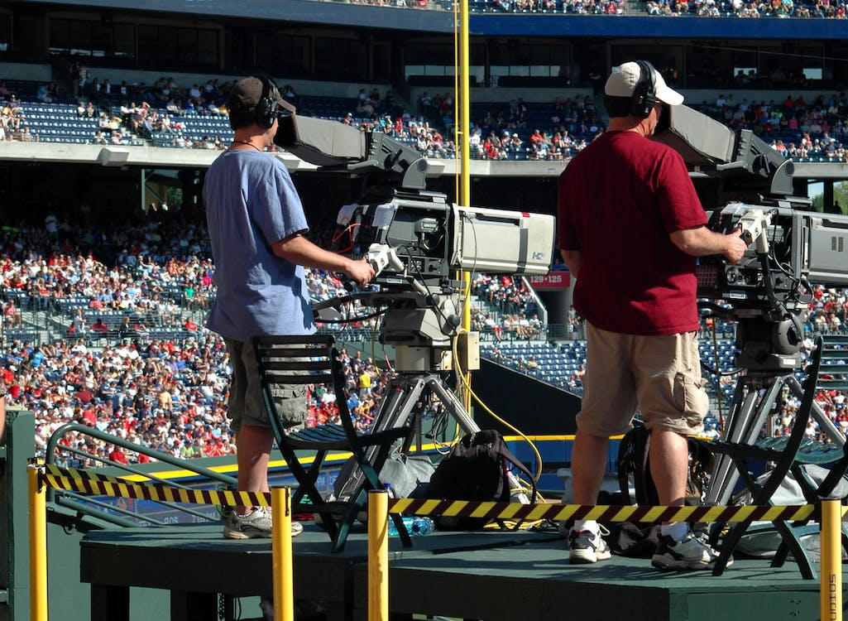
Source: https://www.pexels.com/photo/2-camera-man-standing-in-a-green-metal-stage-during-daytime-159400/ By Pixabay

Slide 7
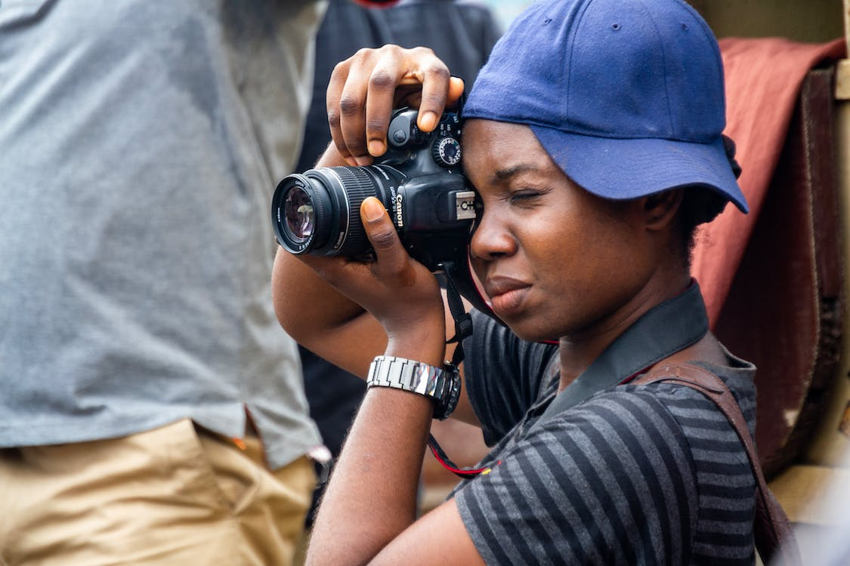
Source: https://www.pexels.com/photo/teenager-taking-a-picture-with-a-camera-11564301/

Slide 8
Shooting the story in journalism
In photojournalism and broadcast, the goal of "shooting the story" is to visually represent and enhance the news coverage, providing the audience with a more immersive and comprehensive understanding of the story.
The visual elements, whether photographs or video clips, help viewers or readers connect with the news, as images can convey emotions, context, and details that might not be as effectively communicated through text alone.
Visual storytelling is an essential component of journalism and plays a significant role in engaging the audience.
"Shooting the story" in journalism refers to the process of capturing images or video footage that visually tell the narrative or story being covered in a news article, television report, or other forms of journalism.
This term is commonly associated with visual journalism, including photojournalism and broadcast journalism.

Slide 9
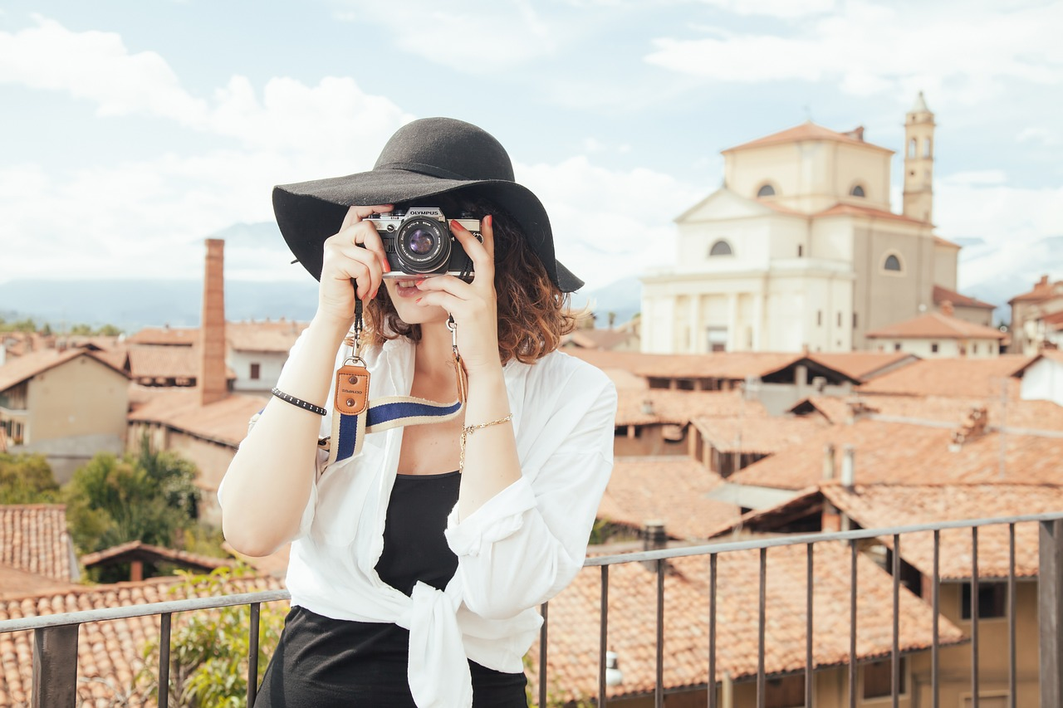
Source: https://pixabay.com/photos/photographer-tourist-snapshot-407068/

Slide 10
Shooting the story in journalism
Gathering Visual Content: Journalists, such as photojournalists and videographers, go to the location of an event, story, or subject to capture relevant images or video footage.
Documenting Events: They use cameras, video cameras, or other recording equipment to document what is happening.
This could involve taking still photos or recording video of people, places, actions, and scenes related to the story.
Storytelling through Visuals: The process of "shooting the story" is about visually narrating the story.
Journalists aim to capture moments and scenes that help convey the central message or emotion of the story.

Slide 11
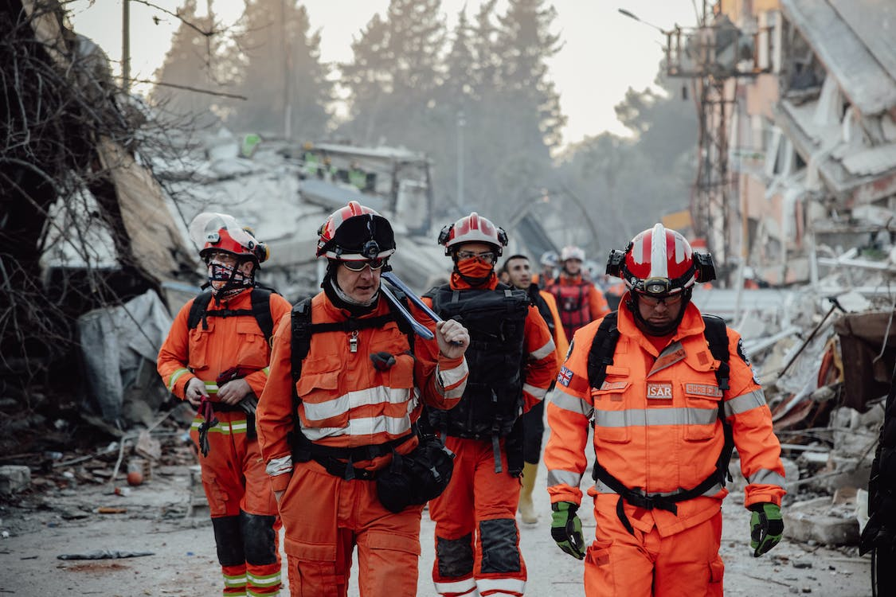
Source: https://www.pexels.com/photo/group-of-paramedics-walking-through-a-demolished-city-16105713/ By Faruk Tokluoğlu

Slide 12
Shooting the story in journalism
Emphasizing Key Details: Visual journalists focus on capturing key details that provide context and help the audience understand the story.
This can include close-ups, wide shots, and establishing shots that show the setting and atmosphere.
Photographic and Cinematic Techniques: They apply photographic and cinematic techniques to make the visuals more engaging and effective.
This includes considerations like composition, lighting, framing, and camera angles.
Capture of Quotes and Interviews: In broadcast journalism, "shooting the story" can also involve recording interviews with subjects or sources, capturing sound bites and quotes that will be used in the report.

Slide 13
Shooting the story in journalism
Ethical Considerations: Journalists must adhere to ethical standards, ensuring that their visual content accurately represents the events and situations they are documenting.
They should avoid the manipulation or staging of scenes.
Editing and Processing: After "shooting the story," journalists often process and edit their visual content.
This may include selecting the best images or video clips, enhancing the quality, and preparing them for publication or broadcast.
Deadline Adherence: Journalists must work under tight deadlines, especially in the world of news, to ensure that their visual content is ready for use when the story is published or aired.

Slide 14
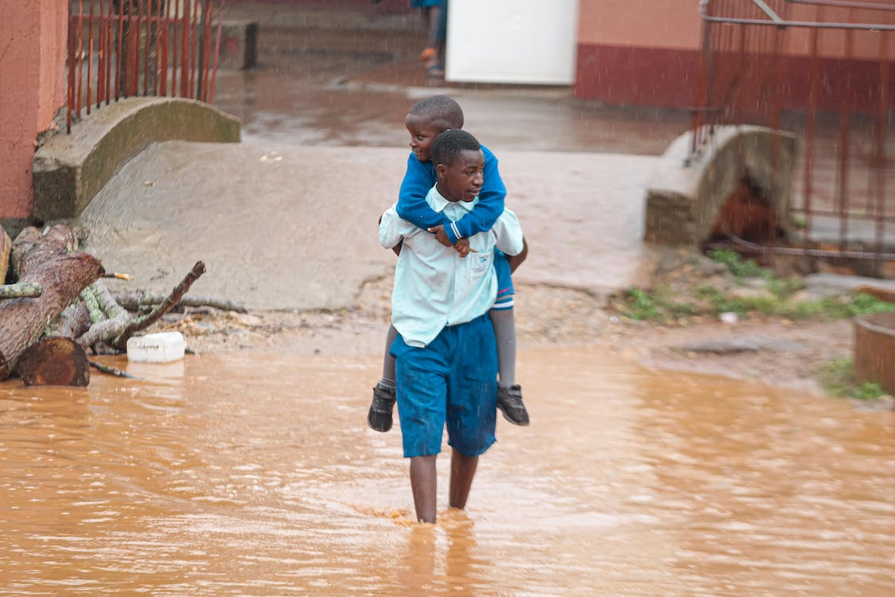
Source: https://www.pexels.com/photo/young-man-carrying-a-child-through-a-flooded-street-13633962/ By DIALO Photography

Slide 15
Writing news captions
Writing effective news captions is essential in journalism, as they provide context and information to accompany photographs, illustrations, or other visual elements.
A good caption should be concise, informative, and accurately describe the content of the image.
Note that a good caption adds value to the image, helps the audience understand the story better, and complements the overall news coverage.
Writing photojournalism news captions is a critical aspect of journalism, as captions provide context and information to accompany visual content, such as photographs.

Slide 16
Writing news captions
A well-crafted caption can help readers or viewers better understand the significance of the image and its relationship to the news story.
According to Smock (2015), in most photo captions, the first sentence identifies the people and place in the photograph, and the date and location where it was taken.
The second (and perhaps third) sentence should provide contextual information to help readers understand what they are looking at.
They should be fact-checked and typo-checked. They should be complete sentences that present the: who, what, where, when and (sometimes) why without necessarily stating the obvious (i.e., he sits, she waves, they clap).
Captions give photos context, telling viewers what’s going on in a photo so they don’t have to guess or jump to conclusions.

Slide 17
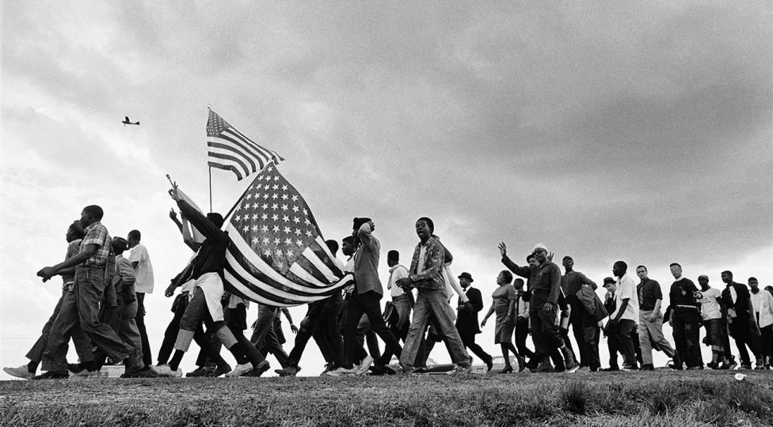
Like the civil rights revolution itself, the marches owed their success to the participation of thousands of ordinary people. Here, marchers line the horizon en route from Selma to Montgomery, Alabama. Selma—Montgomery, Alabama ©1965 Matt Herron, Courtesy CDEA
Source: https://loeildelaphotographie.com/en/skirball-cultural-center-this-light-of-ours-activist-photographers-of-the-civil-rights-movement/

Slide 18
Writing news captions
The following are some tips or step-by-step process for writing effective photojournalism news captions:
Identify the Main Elements: Start by identifying the main elements in the image. Who or what is in the picture, and what is happening? Carefully examine the photograph and identify the key elements, subjects, and details within the image. Ask yourself what the image conveys and why it is relevant to the story.
Be clear and concise: Captions should be clear and to the point. Avoid unnecessary words or jargon. Keep the caption concise, typically around 20-30 words.
Provide Context: Explain what is happening in the image. Include details about the scene, location, and the significance of the moment. Gather all the necessary information that should be included in the caption. This may include names of individuals in the photo, locations, dates, and the main action or subject matter of the image.
Use the Present Tense: Write captions in the present tense to make the description feel immediate and current. Begin the caption with a clear, active verb in the present tense to describe the primary action or the main focus of the image. This engages the reader and adds immediacy to the description.

Slide 19
Writing news captions
Name Individuals: If there are people in the photo, name them from left to right, using their full names if possible.
Include their titles or roles if relevant.
Name the individuals in the photograph, using their full names if possible.
If they have specific titles or roles relevant to the story, include that information as well.
Include Relevant Dates and Locations: Mention the date the photo was taken and the location if it's pertinent to the story.
Describe what is happening in the image.
Offer details that help the audience understand the scene, event, or action.
Include relevant information that complements the image.
Use Captions to Tell a Story: Captions can add depth to a story or highlight important details that might not be immediately obvious from the image.
Avoid Speculation: Stick to the facts and avoid speculating on details not visible in the image.
Ensure the caption remains neutral and does not contain subjective language, opinions, or biases.

Slide 20
Writing news captions
Double-Check Names and Spellings: Ensure that names and other details in the caption are spelled correctly and accurately.
Keep it Neutral: Maintain objectivity in your caption. Avoid inserting personal opinions or subjective language.
Match the Tone of the Story: The tone of the caption should be consistent or align with the tone of the overall news story or publication.
Whether the story is serious, lighthearted, or informative, the caption should reflect that tone.
Consider the Audience: Tailor the level of detail in your caption to the preferences and expectations of your audience.
A scientific publication might require more technical details than a general news outlet.
Technical publications may require more detailed information than general news outlets.

Slide 21
Writing news captions
Cite the Source: If the image comes from a specific source, such as a press release or a photographer's name, attribute the source in the caption.
Edit and Proofread: Always proofread your caption to ensure accuracy, grammar, and clarity.
Carefully edit and proofread the caption to eliminate errors in grammar, spelling, and clarity. Ensure that the details are accurate.
Use Active Voice: Write in active voice to make the caption more engaging and direct.
For example, "The president signs the bill" is better than "The bill is signed by the president."
These are some examples of well-written news captions:
"President Jane Smith signs the historic trade agreement with Prime Minister John Doe at the United Nations headquarters on September 15, 2023."
"Rescue workers evacuate residents from flooded neighborhoods after a severe storm in Houston on May 2, 2023."

Slide 22
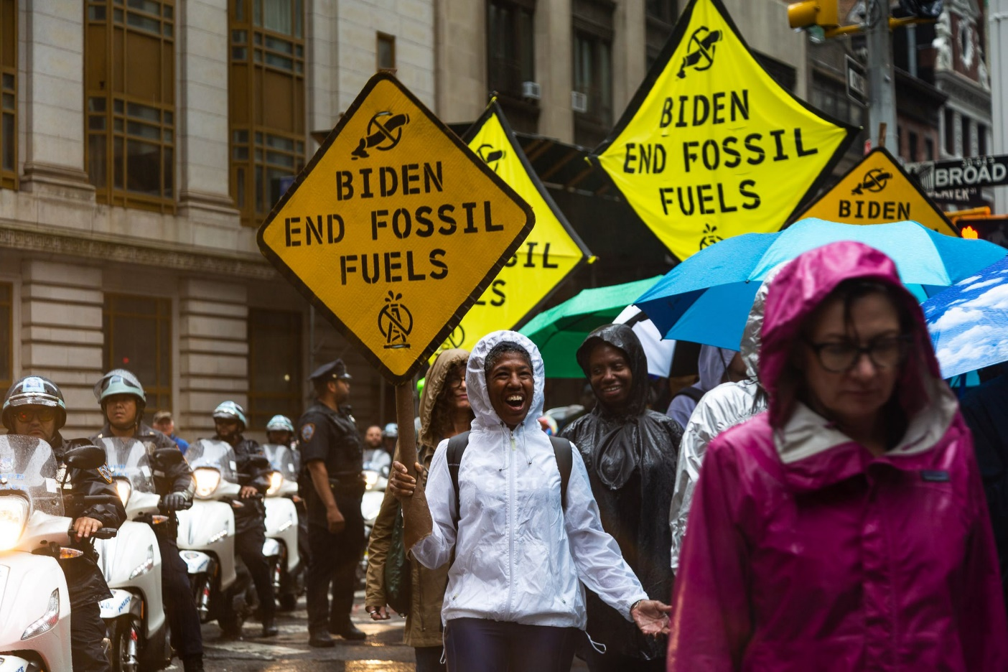
Climate activists marched through Manhattan’s financial district on September 18th, 2023. Photo by Justine Calma / The Verge.
Image Source: https://www.theverge.com/2023/9/18/23875180/protest-march-climate-change-end-fossil-fuels-new-york-city-joe-biden.
This caption provides a clear and concise description of the image, including the subject (protesters and the activist), the location (Manhattan’s financial district), the action (demanding climate action), and the date (September 18, 2023). Remember that a photojournalism caption should complement the image, providing readers or viewers with the necessary context to understand the significance of the photograph in the broader news story.

Slide 23
Editing the pictures in photojournalism
According to Sheehan (2023), photo editing is the act of image enhancement and manipulation.
This process is usually done with a digital photo editing software.
Photo editing can involve basic tweaks like when you crop and resize images or adjust saturation.
It also includes advanced techniques like swapping faces or photo retouching to get rid of distracting elements or unwanted objects.
Some image editing techniques are done manually, while others are conducted through automated photo editing tools and software.
Most edits to digital photography involve some one or a few photo editing programs.
Some edits are even done offline on actual photographs, posters, or other printed collateral without any image editing software

Slide 24
Editing the pictures in photojournalism
The following is an analysis of the key aspects of editing pictures in photojournalism:
Image Selection: The editing process begins with the selection of the most relevant and compelling images to accompany a news story.
Editors choose photos that effectively capture the essence of the story and its significance.
Accuracy: Is paramount in photojournalism. Editors must verify that the images selected accurately represent events, situations, and individuals.
This involves confirming the authenticity of the content and ensuring that there is no manipulation or staging.
Ethical Considerations: Ethical standards are fundamental to photo editing in journalism.
Editors must adhere to guidelines that prohibit the manipulation of images to alter their meaning or context.
This includes refraining from adding or removing elements from a photograph.

Slide 25
Editing the pictures in photojournalism
Cropping and Composition: Editors may crop images to improve composition or remove distracting elements.
However, this should be done judiciously to maintain the integrity of the image and story.
Color Correction and Enhancement: Photo editors may perform color correction and minor enhancements to improve the visual quality of images.
These adjustments should be subtle and not misrepresent the scene.
Caption and Metadata: Editors work with reporters and photographers to write informative captions that provide context and details about the images.
Metadata, including the date, location, and relevant details, should be accurately recorded and maintained.
Tone and Objectivity: The tone of edited images should align with the tone of the overall news story.
Editors must maintain objectivity and avoid inserting personal opinions, biases, or subjective language into the visuals.

Slide 26
Editing the pictures in photojournalism
Consistency: Photo editors ensure visual consistency throughout a publication or news outlet.
Images should adhere to established guidelines and maintain a consistent style to create a coherent visual narrative.
Speed and Efficiency: In a fast-paced news environment, photo editors must work quickly to meet tight deadlines for publishing or broadcasting.
They must balance speed with quality.
Collaboration: Photo editors collaborate closely with photographers and other members of the newsroom to align visual content with the editorial direction and goals.
This collaboration is vital for ensuring that the visuals enhance the storytelling process.
Audience Engagement: Editors consider the preferences and engagement of the target audience when selecting and presenting images.
They aim to choose visuals that resonate with the readers or viewers.

Slide 27
The importance of photo editing application
According to Sheehan (2023), editing helps you fine tune and get the best image possible, as close to what you imagined when you took the photo (or better perhaps).
Niche photographers can hone and emphasize their personal style.
And for businesses, editing helps cement branding and optimize for business goals.
Photo editing is particularly important for ecommerce companies.
Image quality directly affects people’s opinion of the product and sales numbers.
Studies have confirmed that high-quality images outperform stock photos and poorer quality imagery—and increasing the number of high-quality images helps build trust with consumers and increases conversion rates

Slide 28
The importance of photo editing application
Frequently Asked Questions
Can I edit a photo for free?
Yes, you can edit a photo for free. You can use free photo editing tools and do it yourself. You can also use free AI photo editing tools, but these edits require careful quality checks.
How can I edit a picture image?
Open your photo editing tool of choice
Upload or open the photo you want to edit
Make your desired edits
Save your work

Slide 29
The importance of photo editing application
What is the best app to use for photo editing?
Adobe Photoshop
Adobe Lightroom
GIMP
Pixlr
Snapseed
VSCO
How do I edit my photos like a pro?
Edit photos like a pro by learning basic and advanced Photoshop techniques, outsourcing the tedious edits, and optimizing for the right use and context (Sheehan, 2023).

Slide 30
The importance of photo editing application
What is the meaning of photo editing?
The meaning of photo editing is the process of manipulating and enhancing a photo.
Photo editing can involve basic tweaks like cropping, resizing, and applying artistic filters.
It also includes advanced manipulations like retouching and removing unwanted elements and distractions.
What are the 5 basics of photo editing?
Cropping
Resizing
Applying simple clipping paths
Changing colors
Adjusting exposure.
What is the purpose of a photo editor?
A photo editor can save you time and stress because they have the skills necessary to accomplish tedious, time-consuming, or complicated editing tasks for you (Sheehan, 2023).

Slide 31
SUMMARY
In summary, the goal of "shooting the story" is to provide the audience with a visual understanding of the news or event.
It complements the written or spoken aspects of journalism and can evoke powerful emotions and convey information that words alone may not capture effectively.
Visual storytelling is a vital component of journalism and plays a crucial role in conveying the news to the public.
Photo captions are often the first elements of a publication to be read.
Writing photo captions is an essential part of the news photographer’s job.
A photo caption should provide the reader basic information needed to understand a photograph and its relevance to the news.
It should be written in a consistent, concise format that allows news organizations to move the photo to publication without delay.

Slide 32
SUMMARY
Professional standards of clarity, accuracy and completeness in caption writing should be as high or higher than any other writing that appears in a publication.
A poorly written caption that is uninformative or worse, misleading, can diminish the impact of a good photo and undermine its credibility as journalism.
Photojournalism caption should complement the image, providing readers or viewers with the necessary context to understand the significance of the photograph in the broader news story.
Editing pictures in photojournalism is a multifaceted process that involves careful selection, ethical considerations, accuracy, and collaboration.
Photo editors play a critical role in maintaining the integrity of the news and enhancing its storytelling impact through visual elements.
Their work ensures that the audience receives accurate and compelling visual information that complements the written or spoken news story.

Slide 33
THANK YOU

