Slide 1

Photojournalism
WEEK 10 Designing the page and selecting photos for publication
By Dr. Raphael Ogutu

Slide 2
Objectives
At the end of this week, you should be able to:
1. Learn the principles and elements of news publication layout.
2. Select photographs for news publication
3. Apply publication layout designs

Slide 3
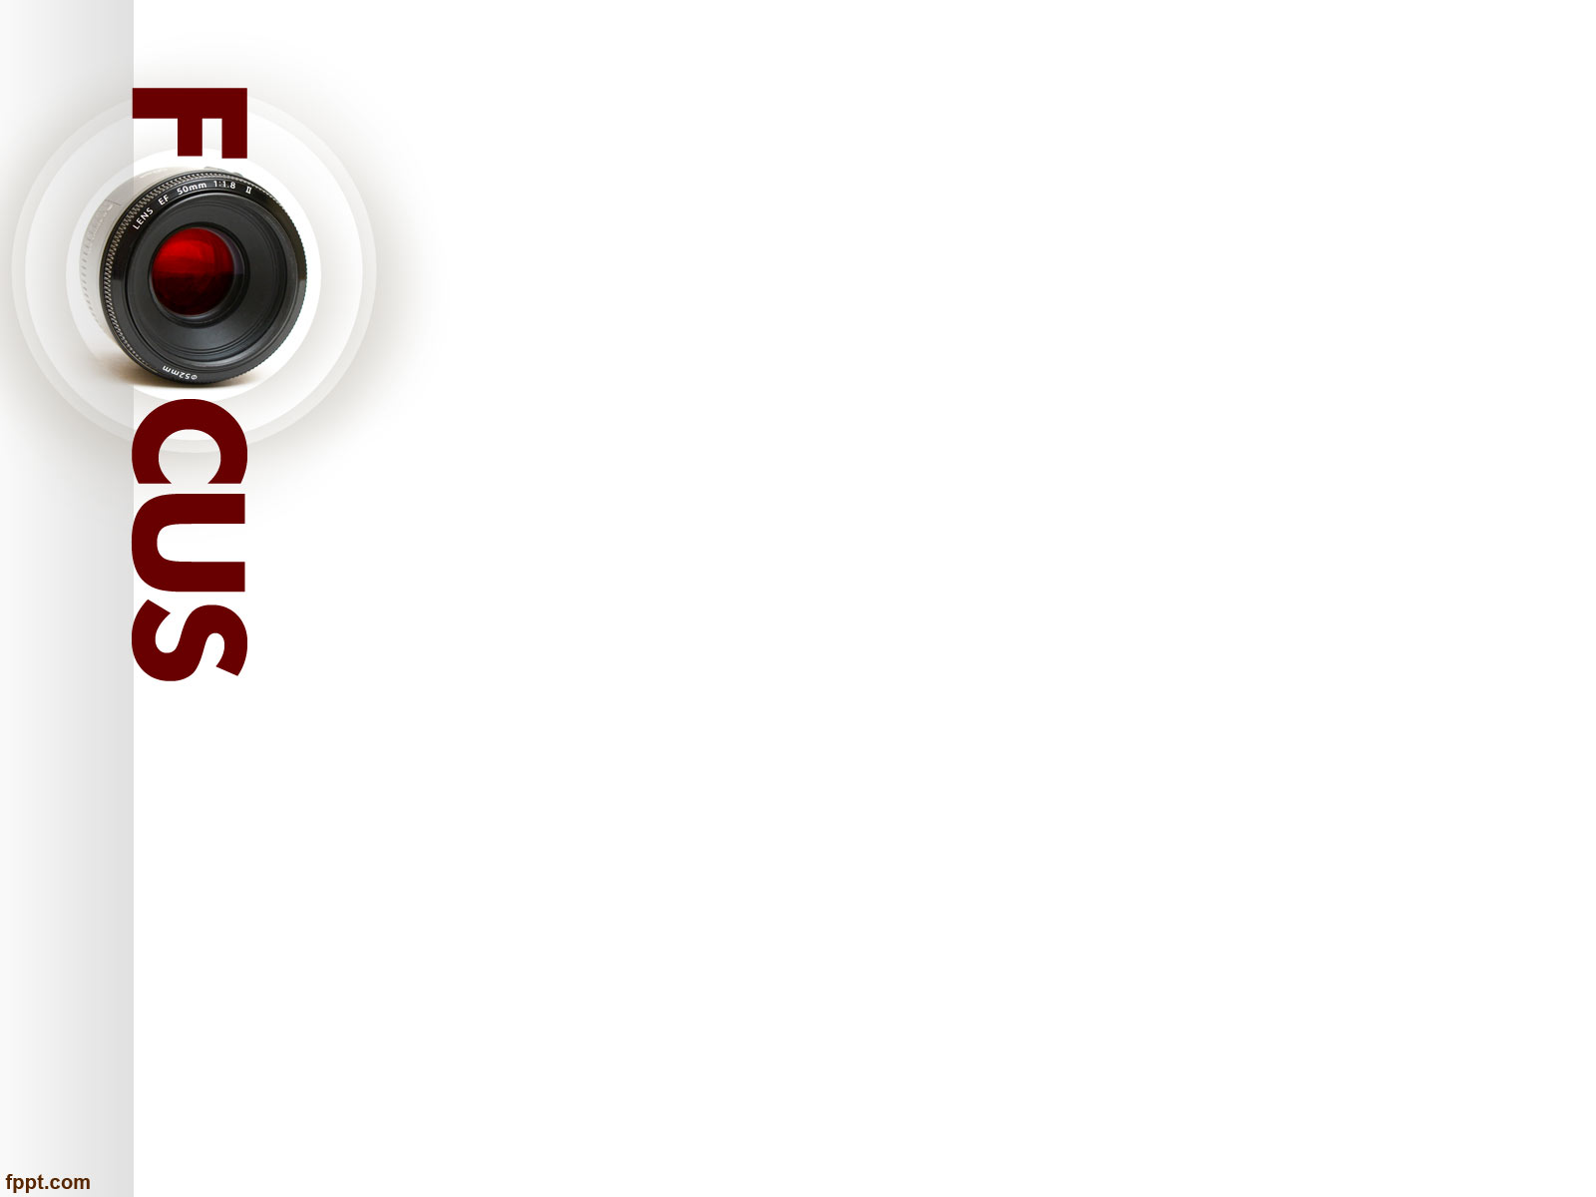
Introduction
Introduces students to designing the page and selecting photos for publication.
According to Lehti (1994-2023), one should approach page layout the same way that you do writing: determine your audience, define your purpose, and communicate your message.
When you're writing, you present information in a logical order, so do the same when you lay out the page. Photographs, pull-quotes, decks, and headlines help you tell the story.
Other elements such as subheads, boxes, rules, and white space help you organize the story.
A good layout improves readability by arranging text and graphics in a logical order.
Every time you place a textual or graphic element on the page, you are making a rhetorical decision, and where you place that element depends on its relationship to the other pieces.

Slide 4
Introduction
When you're writing, you organize sentences and paragraphs in a logical sequence so that readers will understand your message.
You should approach layout the same way. Just remember that page design is a flexible process.
There are no hard and fast rules, just guidelines. Keep good communication with readers as your top priority, and you will make the right design choices (Lehti, 1994-2023), designing a page for a news publication involves a combination of visual and editorial elements that help engage readers and deliver information effectively.
The following are some of the steps and key considerations for designing a news publication page:

Slide 5
The principles and elements of news publication layout
Determine the Layout:
Choose a layout format that suits your publication, such as a broadsheet, tabloid, or digital format.
Decide on the number of columns and the overall structure of the page.
Digital formats are becoming more popular as more people consume content online.
When choosing a digital format, it's important to consider the device on which the publication will be viewed, such as a desktop computer, tablet, or smartphone.
The number of columns and overall structure of the page should also be considered.
A grid system can help create a consistent and organized layout.
It's important to balance text and visual elements and create a hierarchy of information to guide the reader's eye.
Overall, the layout should be visually appealing and easy to navigate for the target audience.

Slide 6
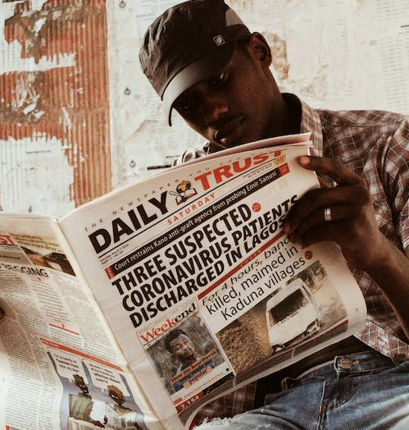
Source: https://www.pexels.com/search/news%20publication%20layout/ By Muhammad-taha Ibrahim

Slide 7
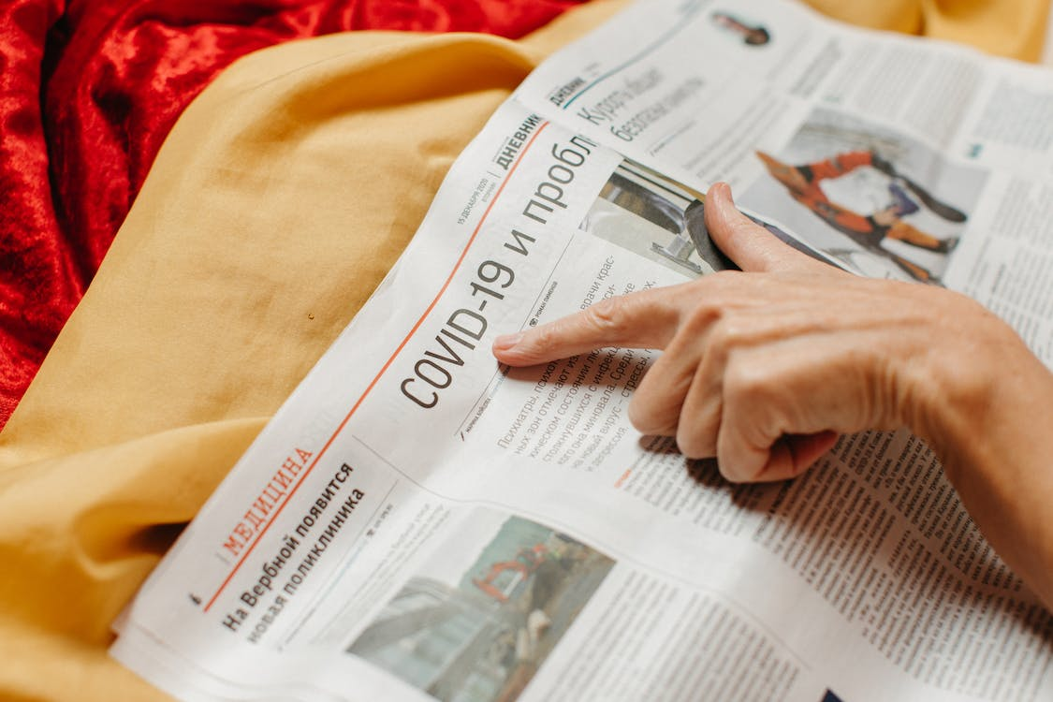
Source: https://www.pexels.com/photo/woman-pointing-on-a-newspaper-page-6236039/ By Anastasia Shuraeva

Slide 8
The principles and elements of news publication layout
Content Hierarchy:
Determine which stories or articles are the most important and should be given prominent placement on the page.
Use varying font sizes, colors, and styles to distinguish headlines, subheadings, and body text.
According to Dodd (2021), content hierarchy is the strategic arrangement of information on a web page (or another content asset) where the most important information is emphasized more than less important content.
Often, this means that the important content is at the top of the page and less important information is toward the bottom.
There are other strategies that you can use to create content hierarchy beyond just where the content is located.
You can also use font size, spacing, bold, italics, and color to emphasize important information on the page.

Slide 9
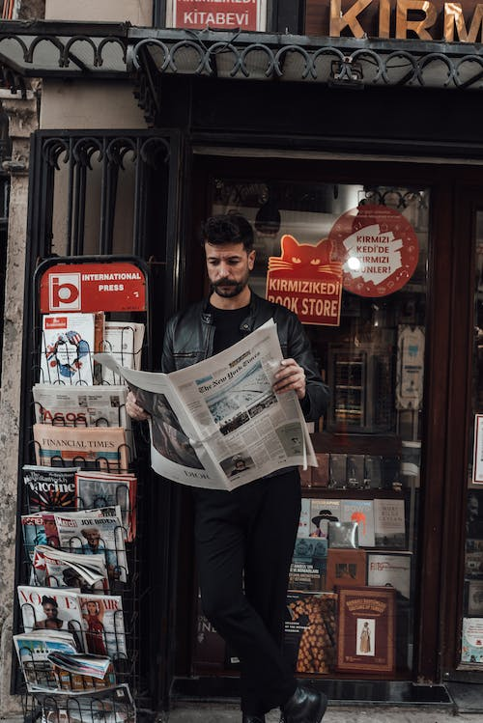
Source: https://www.pexels.com/photo/pensive-man-in-stylish-clothes-reading-newspaper-on-street-6207007/ By furkanfdemir

Slide 10
The principles and elements of news publication layout
Masthead and Branding:
Place your publication's masthead, logo, and branding elements at the top of the page. This helps readers quickly identify the source and establish brand recognition.
The masthead typically includes the publication's name, logo, and sometimes additional information like the date or edition.
It is essentially the official nameplate of the publication, providing readers with a quick and recognizable way to identify the source.
The masthead often includes the publication’s name, logo, publisher’s name, and sometimes the editorial team’s names or contact information.

Slide 11
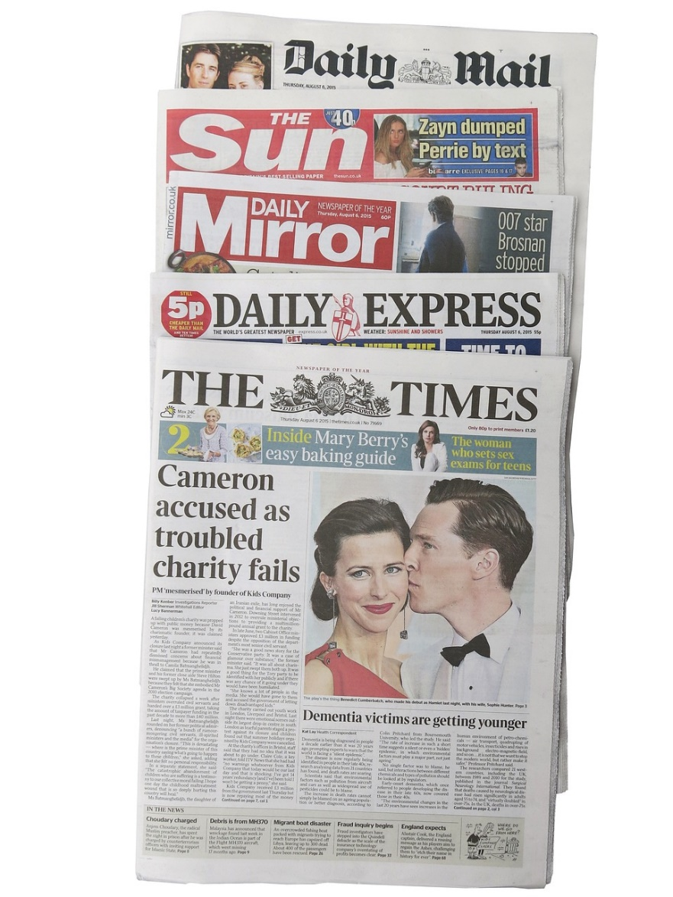
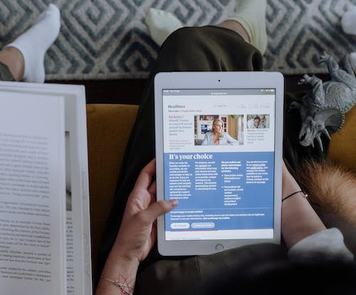
Source: https://pixabay.com/photos/british-newspapers-the-times-881358/ BY Naomi Booth
Source: https://www.pexels.com/photo/a-person-sitting-while-holding-a-tablet-5998822/ By cottonbro studio

Slide 12
The principles and elements of news publication layout
Headlines and Titles:
Create compelling and informative headlines for your articles.
These should be eye-catching and make readers want to delve into the stories.
No matter how good your content is, a bad headline will bury it under a pile of competitor’s mediocre content on the same topic.
That’s a lot of pressure. If you feel like you never have enough time to focus on brainstorming headlines, his guide is for you. Refer to your notes: Kostelac, M. (2023), 25 Headline Examples for Every Type of Content You’ll Write. https://coschedule.com/blog/headline-examples CoSchedule Blog.

Slide 13
The principles and elements of news publication layout
Bylines and Credits:
Include bylines to credit the authors or contributors to each article.
Mention photographers or artists where applicable, giving credit where credit is due is always the respectful way to say thanks, and is sometimes a requirement to use an image.
Depending on the license terms set by the creator, they may give you special permission to use their image as long as you follow the terms.
This is most common in a Creative Commons (CC) type license, where the creator grants permission at no cost, but requires something in return, e.g., attribution, no modifications, or non-commercial use.

Slide 14
The principles and elements of news publication layout
Body Text and Columns:
Choose a legible and consistent typeface for the body text.
Organize the text into columns to improve readability.
Ensure line spacing, font size, and paragraph spacing are suitable for the medium (print or digital). Paying attention to spacing is a fundamental aspect of typography that can significantly impact the readability and aesthetics of your text.
Organize your content into columns, and set appropriate margins.
This can make your page more structured and visually appealing.
Images and Captions:
Incorporate images, photographs, and illustrations to visually enhance your stories.
Add informative captions that provide context for the visuals.
An image description is a written caption that describes the essential information in an image.
Image descriptions can define photos, graphics, gifs, and video — basically anything containing visual information

Slide 15
The principles and elements of news publication layout
Layout and Grid Design:
Choose a clean and organized layout with a clear grid structure. The layout should guide the reader's eye from one story to another seamlessly.
Consistency in the layout throughout the publication is important.
According to Tidwell (2023), page layout is the art of manipulating the user's attention on a page to convey meaning, sequence, and points of interaction. If the word "manipulating" sounds unseemly to you, think about it this way.
Film and television directors make their living by manipulating your attention on the movie or TV screen, and you are presumably a willing participant.
Likewise for editors who arrange articles, headlines, and ads on a newspaper. Grid reference in a layout is its row and columns.

Slide 16
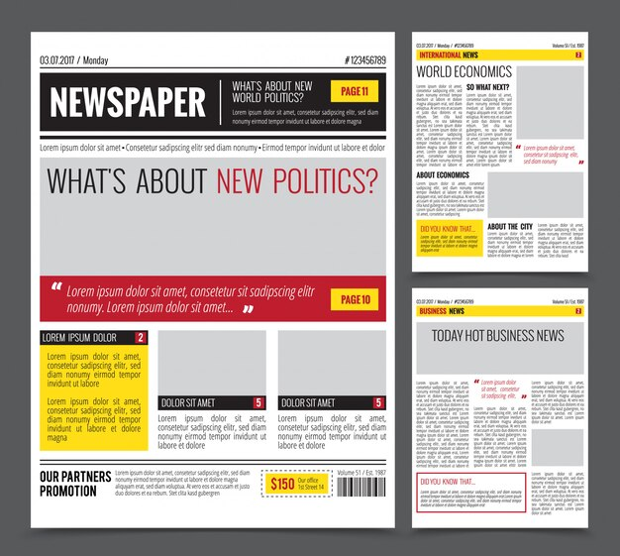
Source: https://www.freepik.com/free-photos-vectors/newspaper-design

Slide 17
The principles and elements of news publication layout
Other elements and principles related to layout design
Pull Quotes and Highlight Boxes: Use pull quotes or highlight boxes to emphasize key points or quotes from the articles.
This adds visual interest and helps break up the text.
White Space: Allow for adequate white space to prevent overcrowding and make the page appear more visually appealing.
White space also helps guide the reader's eye. Use ample whitespace (empty space) around content to give the page a clean and uncluttered appearance.
Whitespace helps improve readability and allows the content to breathe.
Color Scheme: Choose a color scheme that aligns with your publication's branding and complements the overall design. Be mindful of color contrast for text and readability.
Be consistent with your use of colors to maintain a professional and cohesive look

Slide 18
The principles and elements of news publication layout
Other elements and principles related to layout design
Ad Placement: If your publication includes advertisements, carefully plan their placement to ensure they do not disrupt the flow of the content or interfere with the reading experience.
Navigation Elements (for Digital): For digital publications, include clear navigation elements such as menus, links, and buttons to help readers move between different sections or articles.
Interactive Features (for Digital): Incorporate interactive elements, such as multimedia, videos, infographics, or interactive charts, to engage readers in a more dynamic way.
Mobile Responsiveness (for Digital): Ensure that your digital publication is responsive to different devices and screen sizes to accommodate readers using smartphones and tablets.

Slide 19
The principles and elements of news publication layout
Other elements and principles related to layout design
Testing and Feedback: Before finalizing the design, gather feedback from readers or colleagues, and conduct usability testing to identify any design issues or areas for improvement.
Consistency: Maintain a consistent design style and format throughout your publication to create a cohesive look and feel.
A consistent design style and template throughout your publication, ensures that each page looks and feels like a part of the same publication.
Accessibility: Pay attention to accessibility standards to ensure that your publication is inclusive and can be accessed by people with disabilities.

Slide 20
The principles and elements of news publication layout
Other elements and principles related to layout design
Print and Digital Considerations: Keep in mind that designing for print and digital formats may require different approaches, such as optimizing images for web use or planning for print-specific design elements.
Adaptability: Design with adaptability in mind to accommodate evolving trends, changing content needs, and emerging technologies.
Understand Your Audience: Before you start designing, it's essential to have a clear understanding of your target audience.
Consider their demographics, interests, and preferences. Tailor your design to meet their expectations.

Slide 21
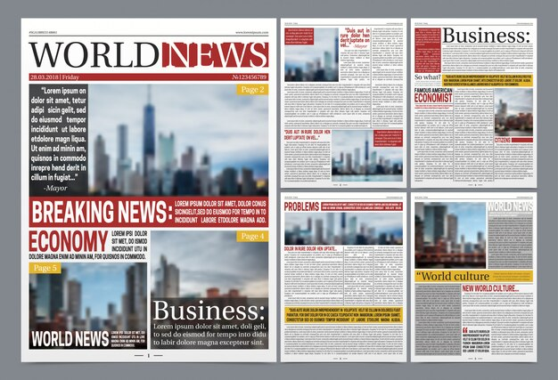
Source:https://www.freepik.com/free-vector/newspaper-template-realistic-poster_5921625.htm#query=newspaper%20design&position=10&from_view=keyword&track=ais

Slide 22
Selecting photographs for news publication
Many graphic artists rely on professional photojournalists, either on staff or freelance, to provide quality images that fit needs of specific publications.
Alternatives include stock photography and free images ("clip art"), mostly from the net.
Free images are tempting but you need to be careful: many are poorly composed or exposed, and have a "generic free image" unprofessional look to them.
Other than those which clearly state they can be used without permission, photos from the net are presumed to be copyrighted.
That means you need permission to use them. For non-journalistic use (advertising and public relations), you need signed model releases from anyone easily identifiable in the photo.

Slide 23
Selecting photographs for news publication
According to Maloy, Trust, Butler, and Xu, (2021), Photographs in print newspapers and online news sites convey powerful messages to readers and viewers, but they are not to be viewed uncritically.
Selecting photographs for a news publication is a critical process that involves choosing images that complement the news stories, enhance the visual appeal of the publication, and effectively convey the intended message.
The following is a step-by-step guide on how to select photographs for a news publication:
Understand the Story: Start by thoroughly understanding the news story or stories that the photographs will accompany. This includes the context, significance or emotions, and key elements of the story.

Slide 24
Selecting photographs for news publication
Identify the Main Subject: Determine the primary subject or subjects of the news story.
Consider the tone and nature of the story. Select images that match the emotional and thematic tone of the news story, whether it's serious, celebratory, or informative.
Consider Visual Impact: Look for photographs that are engaging, emotionally resonant, or capture a critical moment.
Determine the visual elements that are essential to conveying the story.
This could be the main subjects, events, or scenes related to the story.
Relevance and Accuracy: Ensure that the selected photographs are directly relevant to the news story and accurately represent the events or situations.
Avoid adding unrelated or tangential visuals that may confuse readers.

Slide 25
Selecting photographs for news publication
Timeliness: In news, freshness matters, so select photographs that are recent and reflect the current state of affairs.
Diversity: Represent different perspectives, backgrounds, and demographics where relevant to the story.
Include a variety of images to provide a well-rounded representation of the story.
This may include portraits, action shots, environmental shots, and close-ups, where applicable.
Action and Emotion: Look for images that capture action or evoke emotions.
A powerful visual that conveys a sense of urgency, joy, or sorrow can draw readers into the story.
Composition and Clarity: Ensure that the photographs have good composition, clarity, and focus.
Avoid images that are overly cluttered or out of focus.

Slide 26
Selecting photographs for news publication
Visual Balance: Maintain a visual balance in your publication.
When possible, select images that represent diversity in race, gender, age, and other demographic factors to reflect the inclusivity of your publication.
Captions: Review the captions associated with the photographs. Ensure that each selected image can be accurately and informatively captioned.
The caption should provide context and additional details about the photograph.
Source Verification: Verify the source of the images to ensure their authenticity. Check for any potential copyright or usage restrictions if you are not using in-house photography.
Avoid images that have been manipulated or staged.
Editorial Guidelines: Adhere to your publication's editorial guidelines and standards when selecting photographs.
Ensure that the images align with the publication's style and tone.

Slide 27
Selecting photographs for news publication
Balance of Content: Consider the overall balance of content in the publication.
Ensure that the mix of text and visuals creates an engaging and informative reading experience.
Collaboration: Collaborate with photographers, reporters, and editors to make informed decisions about which images to use.
If possible, consult with the photographers who captured the images.
They can provide insights and context that can inform your selection process.
Seek feedback and collaborate with colleagues, editors, and fellow journalists to gather diverse perspectives on image selection.

Slide 28
Selecting photographs for news publication
Audience Consideration: Keep your target audience in mind. Consider what visuals will resonate with your readers or viewers and enhance their understanding of the story.
Be mindful of privacy and sensitivity concerns, particularly when selecting images involving individuals in distress or tragic events.
Always adhere to ethical standards and guidelines in photojournalism.
Usability: Consider how the selected photographs will fit within the publication's layout.
Ensure that they work well within the design and don't disrupt the reading experience.
Conduct a final review to ensure that the selected images collectively create a cohesive and engaging visual narrative for the news story.
Proofread: Finally, double-check your selection to ensure that the photographs match the stories and captions accurately.
Verify that you have the necessary permissions and rights to use the selected images, and provide proper attribution as required.

Slide 29
Application of publication layouts designs
WRITE INTERESTING TITLES
Your titles need to be interesting and even intriguing. Make sure they stand out and capture the attention of your readers.
There are several types of titles you can write:
Titles that meet a need. These are often "How-To" type articles, but they meet a need someone has.
This could be something like, "How to Avoid Divorce" or "Winning the Heart of Your Rebellious Teenager."
Titles that spark curiosity. These titles grab the attention with a mental, "That's interesting..." These titles may sound like this, "Mysterious Blob Discovered in Man's Grill" or "Dog Learns to Fly the Hard Way."
Titles that provoke. This does not mean you are trying to offend the reader, but the title is meant to provoke an emotional response to the reader's sensibilities so that they'll read it.
Copyright © 2023 MakeMyNewspaper.com Inc.

Slide 30
Application of publication layouts designs
USE WHITE SPACE
White space is essential part of design for two reasons. First, to separate elements. Don't crowd things so close together that the eye has a hard time distinguishing individual elements.
Use horizontal and vertical white space between columns, pictures, and titles. Second, use white space to draw attention to specific elements.
DESIGN FOR READABILITY
You want people to read your newspaper, so designing in such a way that a reader instinctively reads things is important.
Done right, the reader will not even notice what you did because the design will feel natural to the reader. Here are some things to keep in mind:
Use a comfortable and readable font.
Keep fonts and font sizes consistent.
Make navigation easy.
Use white space. Copyright © 2023 MakeMyNewspaper.com Inc.

Slide 31
Application of publication layouts designs
PICTURES TELL A STORY
Your pictures need to tell part of the story and, if possible, evoke emotion in the reader. Don't stretch a picture out of normal proportion to get it to fit in a particular space.
Don't make people fat or skinny just to get it to fit. Instead, crop pictures to fit and make the image part of the story itself.
KEEP IT SIMPLE
Don't try to get fancy. Let your words and images evoke the interest and emotion you want.
Don't go for flash. Go for simple. Let your titles and images do the work.
DESIGN AROUND ARTICLES
When designing your newspaper, put your articles in place first. Instead of trying to make your articles fit to your images, titles, and other elements, make the other elements fit your articles.
The articles is the essence of a newspaper, so start with the articles and add the content around it appropriately.
Copyright © 2023 MakeMyNewspaper.com Inc.

Slide 32
SUMMARY
The goal of news publication design is to provide a visually engaging and reader-friendly experience that effectively communicates news and information.
Design should enhance the content, making it easier for readers to access and engage with the stories.
The process of selecting photographs for a news publication is a balance of editorial judgment, visual storytelling, and the need to inform and engage the audience effectively.
The ultimate goal is to use images that enhance the news story, provide valuable context, and resonate with your audience.
When designing your newspaper, put your articles in place first.
Instead of trying to make your articles fit to your images, titles, and other elements, make the other elements fit your articles.

Slide 33
THANK YOU

