Slide 1
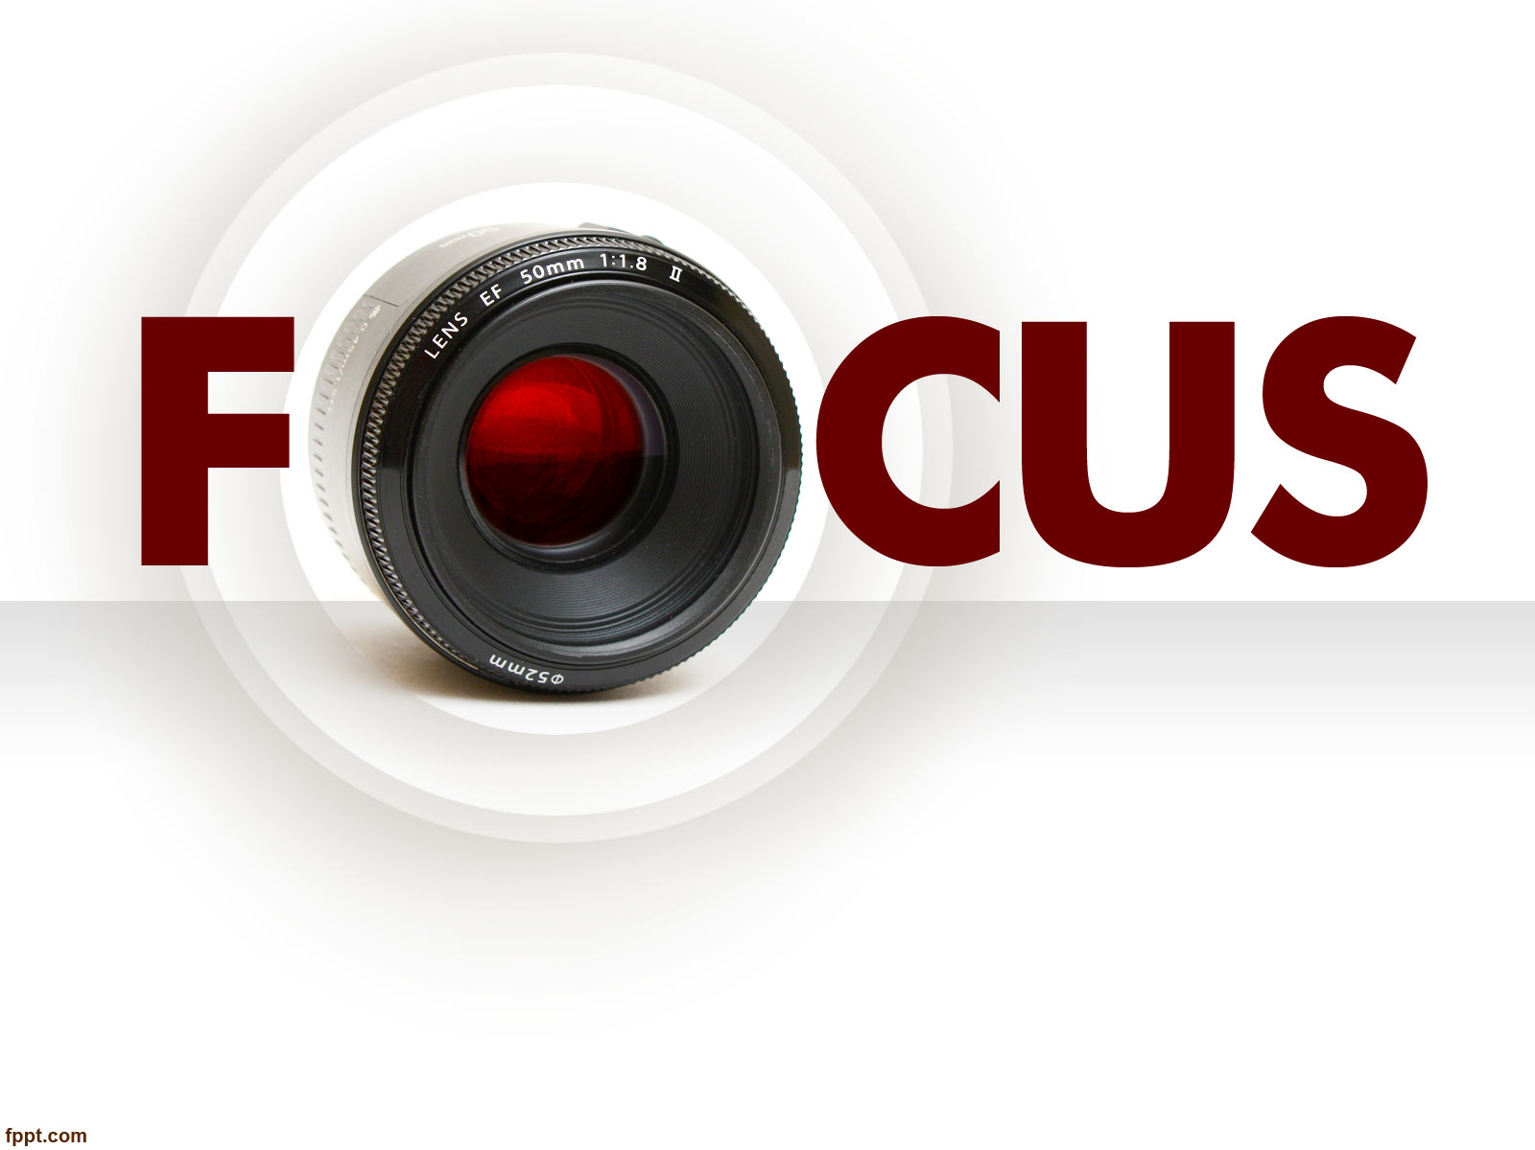
Photojournalism
WEEK 11 Lighting techniques in digital photojournalism
By Dr. Raphael Ogutu

Slide 2
Objectives
At the end of this Lecture, you should be able to:
Understand photographic lighting
Explore the photographic lighting techniques and principles
Apply lighting techniques in photojournalism.

Slide 3

Introduction
Lighting can come from the sun or moon, which are natural lighting, and your camera's flash, a lamp, or ceiling lights, which are artificial lighting (stage lighting for example in scene design and stage lighting).
The direction, brightness, and color of the lighting can have a dramatic effect on the appearance of your photos.
Lighting should not be manipulated to create false impressions.
Photographic lighting refers to the use of artificial or natural light sources to illuminate a subject or scene for the purpose of capturing photographs.
It is a fundamental aspect of photography that plays a crucial role in creating well-exposed and visually appealing images.
The use of different lighting techniques can significantly influence the mood, composition, and visual impact of a photograph.

Slide 4
Photographic Lighting Techniques and Principles
Photographic lighting is the deliberate use of artificial or natural light to illuminate a subject or scene in photography.
It is a critical aspect of photography that significantly impacts the quality, mood, and aesthetics of an image.
Different lighting techniques and setups can be used to achieve various effects and meet the specific needs of a photographic project.

Slide 5
Photographic Lighting Techniques and Principles
Natural Light: Natural light refers to the illumination provided by the sun, moon, or other natural sources.
Photographers often use the quality and direction of natural light to create various effects in their images.
For example, soft, diffused sunlight at sunrise or sunset can produce warm and flattering portraits, while direct midday sunlight can create harsh shadows.
Twilight occurs during the transition between the day and night is happening.
It is before the sun rises and after it sets. This time of day has a cool color with diffused lighting.
If it is almost night, you will have to rely on some artificial light as well.

Slide 6
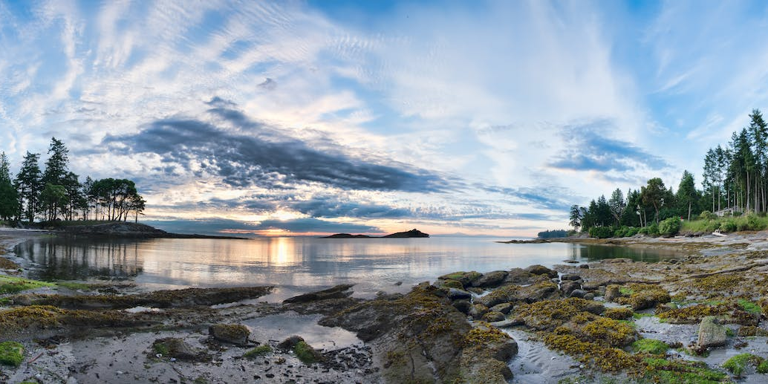
Natural Lighting
Source: https://www.pexels.com/photo/body-of-water-1487031/ By James Wheeler

Slide 7
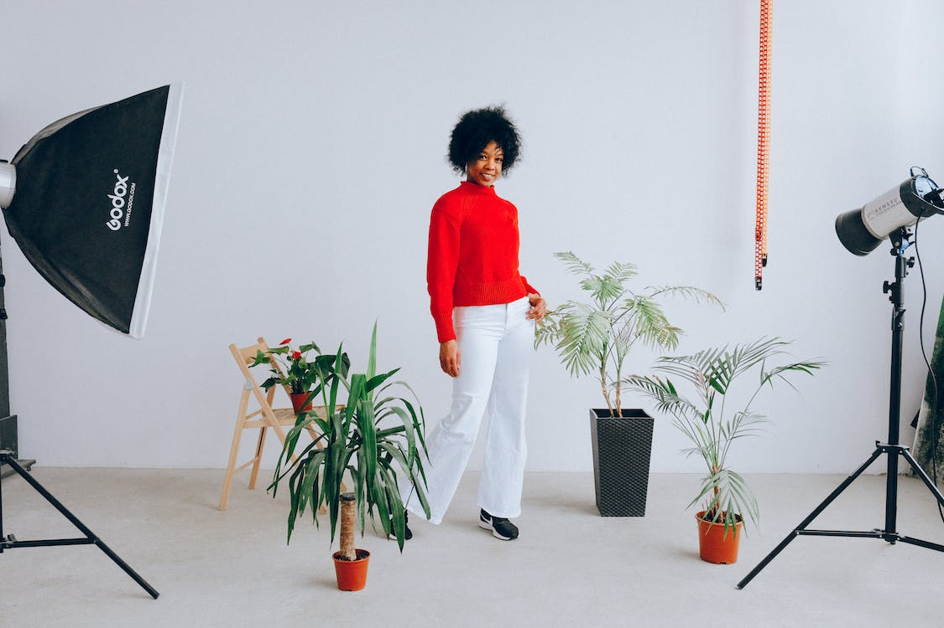
Artificial Lighting
Source: https://www.pexels.com/photo/smiling-ethnic-woman-having-photo-session-with-plants-3746149/ By Anna Shvets

Slide 8
Photographic Lighting Techniques and Principles
Artificial Light Sources: Photographers use various artificial light sources to control and manipulate lighting conditions.
Continuous Lighting: These are lights that stay on continuously, such as tungsten or fluorescent lights. They are commonly used in studio photography and video production.
photographers have used photoflood, tungsten, quartz, and all kinds of continuous light sources that fall under the general heading of “hot lights.”
Flash or Strobe Lighting: Integral, built-in, or pop-up flashes are common on many point-and-shoot cameras, as well as entry-level and prosumer DSLR and mirrorless interchangeable-lens cameras.
Monolights are commonly used in studios to provide powerful flashes of light.
Like the speedlight, the monolight is self-contained with a capacitor and strobe light in a single unit.

Slide 9
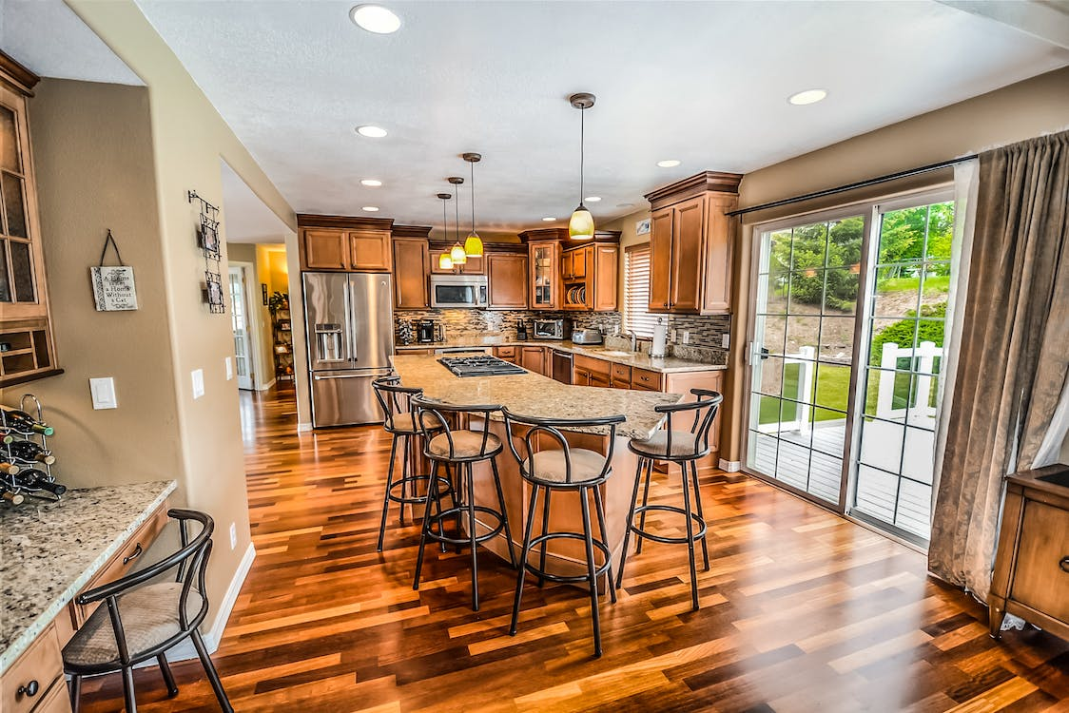
Source: https://www.pexels.com/photo/kitchen-island-and-barstools-534151/ By Pixabay

Slide 10
Photographic Lighting Techniques and Principles
Light Quality: Light quality refers to the characteristics of the light, which can be soft or hard, depending on how it interacts with the subject.
Soft light creates gentle, gradual transitions between highlights and shadows and is often preferred for portrait photography.
Hard light creates distinct, sharp-edged shadows and is used for more dramatic effects.
Sunlight and moonlight produce hard “pinpoint” lighting, characterized by quick transitions between bright highlights and dark shadows.
Soft light, on the other hand, is often produced by diffusion or reflection. On an overcast day, clouds act as a massive natural soft box, scattering the sun’s rays.

Slide 11
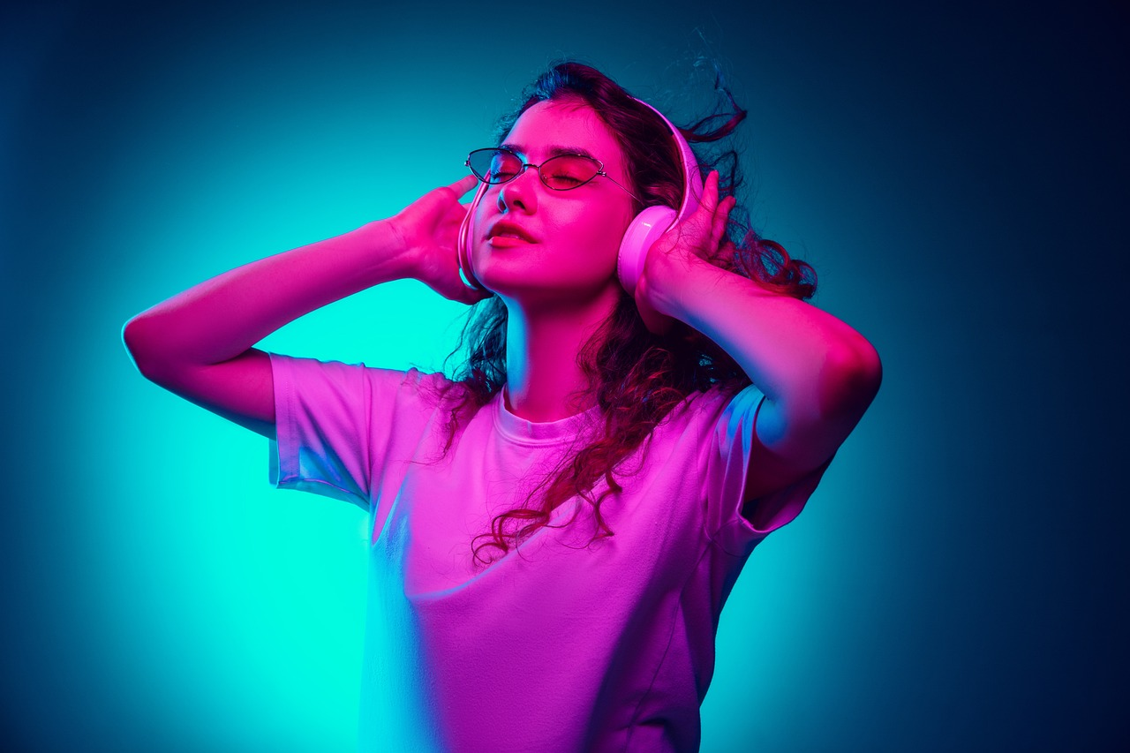
Source: https://pixabay.com/photos/woman-model-young-person-business-6805813/
Source: https://www.pexels.com/photo/woman-with-printed-pictures-sitting-at-table-with-laptop-7014402/

Slide 12
Photographic Lighting Techniques and Principles
Direction of Light: According to Dempsey (2022), there are just five essential lighting directions you need to know. Common lighting directions include:
Front Lighting: Light comes from in front of the subject, reducing shadows and providing even illumination. Front light will give you a well-lit subject, so it can be a good go-to when in a pinch.
Side Lighting: Light strikes the subject from the side, creating more pronounced shadows. Unlike front light, offers a lot of three-dimensionality.

Slide 13
Photographic Lighting Techniques and Principles
Direction of Light
Backlighting: Light comes from behind the subject, often creating silhouettes and rim lighting effects.
While backlit images tend to be the most noticeable when they’re taken in nature, thanks to the powerful sun, there are plenty of indoor photographers that shoot with backlight of some sort.
You can create images with softly-lit subjects and bright backgrounds or images with stunning background bokeh or images with dramatic silhouettes.
Top Lighting: Light shines from above the subject like sunlight, casting shadows downward. as a rule, photographers rarely shoot with overhead light. When the light comes from overhead, it creates unpleasant shadows that fall over your subject in unflattering ways.
Upward Lighting: Upward lighting is the rarest, form of directional lighting in photography. As the name suggests, upward lighting comes from underneath your subject, and will upward-moving shadows. It is rare to find upward lighting in nature, because the sun doesn’t come from below subjects.

Slide 14
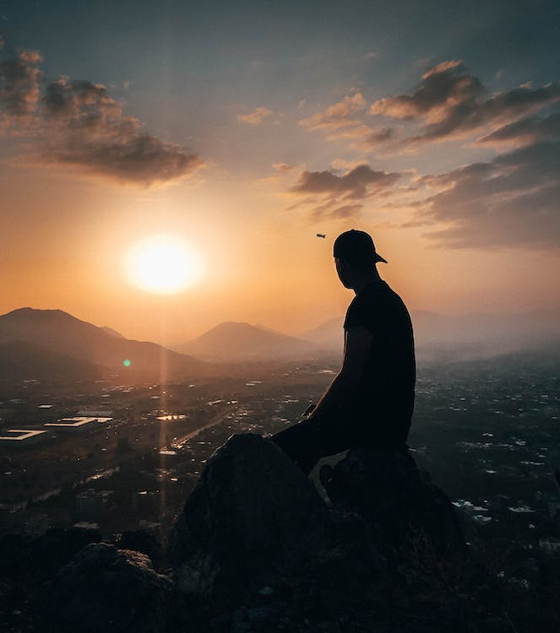
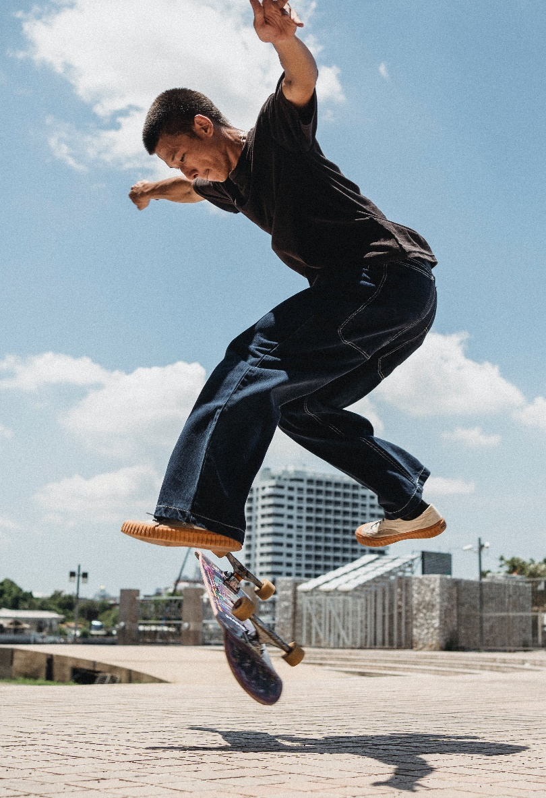
Source: https://www.pexels.com/photo/man-sitting-on-rock-during-golden-hour-3107467/ By Suliman Sallehi
Source: https://www.pexels.com/photo/young-skater-jumping-on-skateboard-in-park-5370393/ By Allan Mas

Slide 15
Photographic Lighting Techniques and Principles
Modifiers and Accessories: Photographers use various modifiers and accessories to shape and control the light. These include:
  Softboxes: These are large, fabric-covered boxes that soften and diffuse the light, creating a more flattering and even illumination.
  Umbrellas: They are used to bounce or shoot light through, providing a softer and more diffused lighting effect.
  Reflectors: These are surfaces, often in silver or white, used to bounce light back onto the subject, filling in shadows and providing additional illumination.

Slide 16
Photographic Lighting Techniques and Principles
Modifiers and Accessories
  Snoots: These are attachments that narrow and concentrate the light, creating a spotlight effect.
  Grids: Grids are used to control the spread of light, narrowing the beam and preventing it from spilling onto unwanted areas.
  Gels: These are colored filters placed over the light source to add creative or corrective color effects.
  Scrim: It is a material placed in between your light source and subject matter. A scrim helps to reduce or diffuse light. Scrims are available in a range of sizes and shapes.

Slide 17
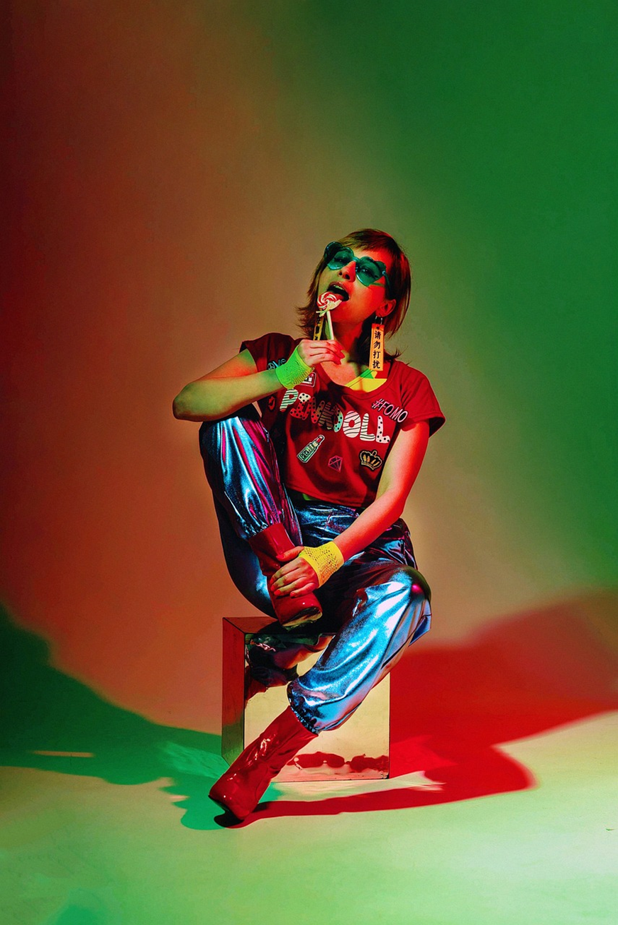
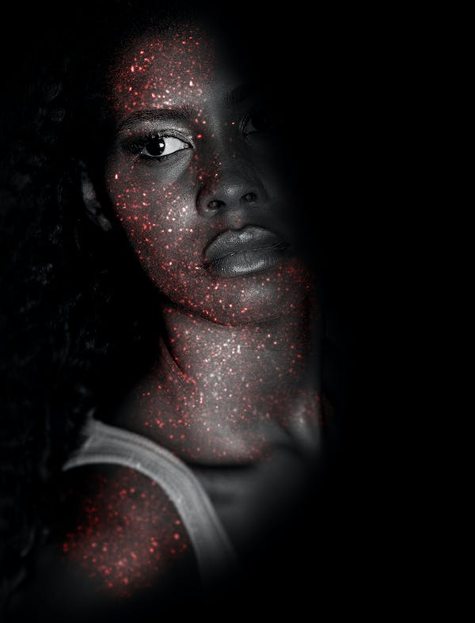
Source: https://pixabay.com/photos/woman-fashion-street-style-beauty-5987564/
https://www.pexels.com/photo/fashion-photography-of-glitter-face-paint-1081939/ By 3Motional Studio

Slide 18
Photographic Lighting Techniques and Principles
Modifiers and Accessories
  Beauty dishes: These modifiers create a soft, yet slightly more contrast light, often used in portrait photography.
  Parabolic lighting: These gives off a sparkling light that helps to beautify an object.
  Parabolic lighting comes with a range of options. You can attach a front diffuser which more or less turns them into a softbox.
  The shape of a parabolic light is not suitable for all products and genres, its versatility means that you have many modifiers in one light source.

Slide 19
Photographic Lighting Techniques and Principles
Color Temperature: The color of light is measured in kelvin (K). Different light sources have different color temperatures, ranging from warm (e.g., candlelight or incandescent bulbs) to cool (e.g., daylight or fluorescent bulbs).
Every light, from the sun to your computer screen, has a unique color.
The human eye is good at adjusting to different types of light. We often do not even notice that it has a color.
Our cameras record the exact color. They ‘see’ the yellow of candles or the blue of a flash. If you have taken a photo that looks orange or blue, the temperature needs adjusting.
In photography, we often interchange the terms color temperature and white balance.
Our goal is to adjust the colors so that the whites are not tinted.
To do this, we adjust the colors around a neutral shade of grey
(Mishra, 2023).

Slide 20
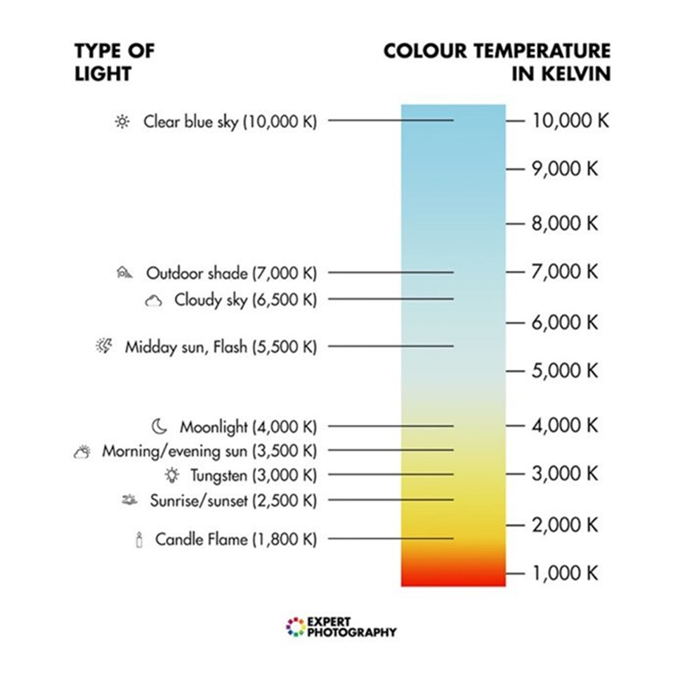
Photographic Lighting Techniques and Principles
On a color temperature scale, the lowest numbers are the warmest. The higher numbers are cooler. Daylight is around 5,500 – 6,500K.
Some photographers favour cooler or warmer tones as part of their editing style. Most cameras, including some smartphone apps, have color temperature presets.
The most common are Tungsten, Fluorescent, Daylight, Cloudy, Shade, and Flash.
Professional models also allow you to set a specific temperature.
Color temperature scale showing the Kelvin temperatures of many light sources.
Source: https://expertphotography.com/color-temperature/#:~:text=Color%20temperature%20is%20a%20measurement,camera%20or%20during%20post%2Dprocessing .

Slide 21
Photographic Lighting Techniques and Principles
Light Sources:
  Photographers can use various light sources, including natural light (sunlight), studio lighting equipment (such as strobes and continuous lights), flash units, LED panels, and even reflectors.
  According to Walton (2021), ambient lighting doesn’t just mean sunlight – though that’s the most abundant and cheapest form of ambient lighting for photographers.
  If you’re indoors, ambient lighting simply refers to light that already exists in that room – a lamp, ceiling light, light from a TV and so on.
  Ambient light is basically a light that you don’t add to your photo; it’s the light that already exists before you took the shot.

Slide 22
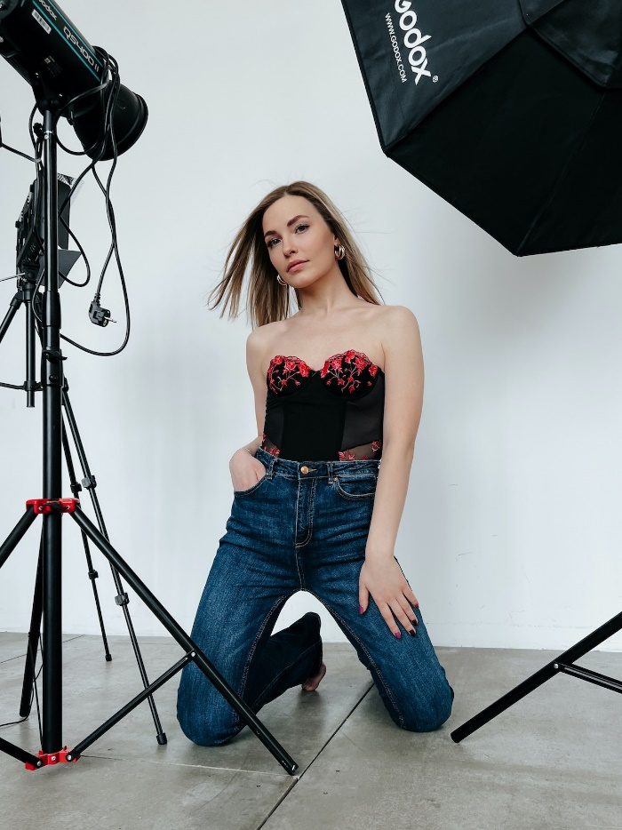
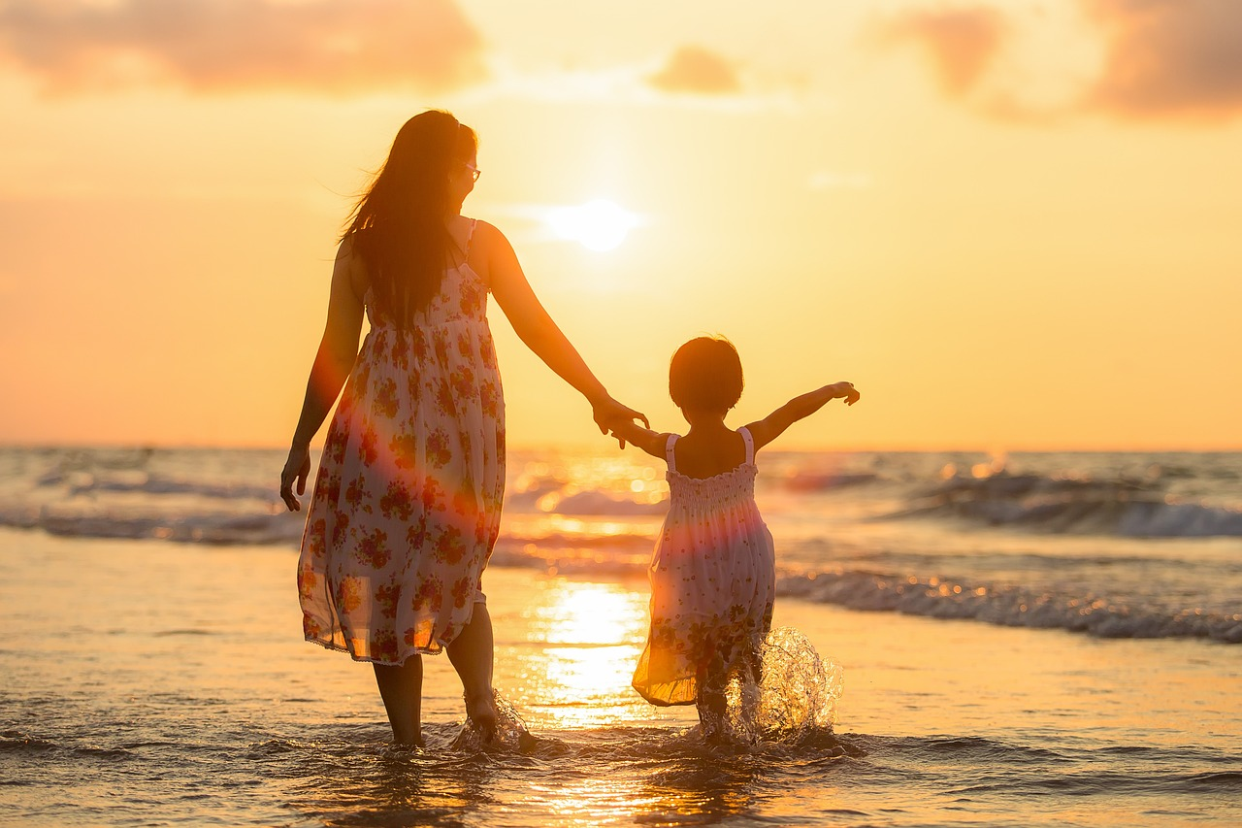
Indoor with artificial lighting, and outdoor with natural lighting
Source: https://www.pexels.com/photo/model-posing-in-a-studio-11697738/
Source: https://pixabay.com/photos/adult-mother-daughter-beach-kids-1807500/ By sasint

Slide 23
Photographic Lighting Techniques and Principles
Three-Point Lighting:
  This is a classic lighting setup used in studio and portrait photography. It consists of a key light (the main light source), a fill light (to reduce shadows), and a backlight (to separate the subject from the background).
  This is aimed at photographers who are looking for a more rounded image where the subject is illuminated evenly to show shape, depth and texture.
  And positioning these lights at the right angles is also important to consider
  High Key and Low Key Lighting:
  High Key and Low Key photography make use of lighting and contrast (or lack thereof) to create a specific mood.
  Originally high key photography emerged as a solution for screens that could not correctly display high contrast ratios.
  Today it is a stylistic choice in photography. High key lighting involves using bright, even lighting to create a soft, shadowless look.
  Low key lighting employs strong contrast between light and shadow for a dramatic effect.

Slide 24
Photographic Lighting Techniques and Principles
Lighting Ratios:
  In photography, lighting ratios refer to the relative intensity of light falling on a subject from different light sources or directions.
  It helps photographers control the contrast and mood of an image by manipulating the ratio between the key light (main light source) and fill light (secondary light source).
  A lighting ratio is typically expressed as a numerical value, such as 1:1, 2:1, 4:1, etc.
  These values indicate the difference in intensity between the key light and the fill light. For example, a 2:1 ratio means the key light is twice as bright as the fill light.

Slide 25
Photographic Lighting Techniques and Principles
Creative Lighting Effects:
  Lighting is what makes or breaks a photograph, and in portrait photography, knowing how to use the light to flatter your subject or create the mood you want is key to capturing stunning images.
  Photographers often experiment with creative lighting effects, such as silhouettes, lens flares, and light painting, to produce unique and artistic images.
Rembrandt Lighting:
  Named after the Dutch painter Rembrandt, this technique creates a triangle of light on the subject's cheek and opposite eye.
  It adds depth and dimension to the subject's face, often used in portrait photography.
  the light source is usually set up at that 45 degree angle from the subject.
  You move the light further to the side of the subject until the opposite side of the face (the side in the shadows) has a small triangle of light on the cheek just below the eye.
  You should also set the height of the light a foot or two above eye level.
  If you’re using a single light source, you can use a reflector to create this lighting setup.

Slide 26
Application lighting techniques in photojournalism
Applying lighting is a crucial aspect of capturing impactful and compelling images that effectively tell a news story.
The following are some suggestion on how to apply lighting techniques in photojournalism:
Understand the Story:
  Begin by thoroughly understanding the news story you're covering. Determine the key elements, emotions, and context of the story to guide your lighting decisions.
  Knowing the context and significance of the story will guide your choice of lighting techniques.
Use Available Light:
  In many photojournalistic situations, you'll rely on available light, such as natural light or existing ambient light.
  Make the most of the light sources at the scene to capture authentic and candid moments.
  Use modifiers like reflectors or diffusers to modify available light.
  Reflectors can bounce light onto the subject, reducing shadows, while diffusers soften harsh light.
  Invest in fast lenses (those with wide apertures like f/1.4 or f/2.8) to allow more light into the camera.
  These lenses are especially useful in low-light situations.

Slide 27
Application lighting techniques in photojournalism
Light Direction and Quality:
  Pay attention to the direction and quality of the available light. Natural light can vary from hard, direct sunlight to soft, diffused light.
  Position yourself and your subjects to make the most of the available light.
  When ambient light is insufficient, use flash to supplement it. Consider off-camera flash or a flash modifier to soften and control the flash output.
Reflectors:
  Reflectors can be invaluable tools for photojournalists.
  They bounce available light onto the subject, filling in shadows and providing additional illumination.
  A white or silver reflector can help create soft, flattering light.
Diffusers:
  Diffusers can soften harsh sunlight or artificial light sources.
  In situations with strong, direct sunlight, using a diffuser can create more even and pleasing illumination on your subjects.

Slide 28
Application lighting techniques in photojournalism
Flash Photography:
  Use your flash when necessary to balance exposures or to fill in shadows.
  Photojournalists often use flash to illuminate subjects in dimly lit environments or to capture details in situations with mixed lighting.
  Photographers actually use their flash on sunny days to reduce unwanted shadows.
  This is known as fill flash because it "fills in" the shadows with additional light. You should only use fill flash when you notice problematic shadows; in other situations, flash may make the photo look worse.
External Flash Modifiers:
  If you have an external flash unit, consider using modifiers like diffusers, softboxes, or bounce cards to soften and control the flash's output.
  This helps avoid harsh shadows and overexposed highlights.
  When photographing individuals, especially in controlled settings, consider using controlled flash setups like three-point lighting or softboxes to achieve studio-like results in the field.

Slide 29
Application lighting techniques in photojournalism
Environmental Lighting:
  Embrace the existing lighting within the environment, such as streetlights, signs, or indoor lighting.
  In low-light situations, consider using long exposures to capture movement and drama in events like protests, marches, or performances.
Balancing Ambient and Artificial Light:
  In situations where you're capturing both the subject and their surroundings, consider using your flash to balance ambient light with the main subject, ensuring that both are correctly exposed.
  Composition and Light Direction:
  Pay attention to the composition of your shots.
  Place the light source and your subjects in ways that create visually interesting and well-lit images.
  Be mindful of white balance settings to ensure that colors are accurate, especially when using mixed lighting sources.
  In post-processing, make subtle adjustments to enhance the image without altering the reality of the scene for ethical reasons.

Slide 30
Application lighting techniques in photojournalism
Silhouettes and Backlighting:
  Use backlighting to create silhouettes when the situation calls for it. Position your subjects in front of a bright light source, making sure their shapes are well-defined.
  Backlighting can be used to emphasize the shape and outline of a subject.
  This technique can be particularly effective when capturing protests, rallies, or events.
Environmental Portraits:
  When photographing people in their natural environments, use a combination of available light and fill flash to highlight your subjects and their surroundings effectively.
  Creative gels can add unique color effects to your images and conveys mood or atmosphere, especially in feature stories.
Respect Ethical Guidelines:
  Ensure that your lighting techniques adhere to ethical standards in photojournalism.
  Avoid overly manipulating images or staging scenes in a way that misrepresents the reality of the situation.

Slide 31
Application lighting techniques in photojournalism
Capture Authentic Moments:
  Photojournalism is about capturing real, unscripted moments. Use lighting techniques to enhance the mood and emotion of the scene, but never compromise the authenticity of the story.
  Use available light to create authentic, documentary-style images that convey the story's real emotions
Adapt to Changing Conditions:
  Photojournalists often work in dynamic and unpredictable environments. Be ready to adapt your lighting techniques to changing lighting conditions or unexpected developments in the story.
  In sensitive or conflict situations, being unobtrusive is essential. Use available light or minimal flash to avoid drawing attention to yourself.
The golden hour:
  The majority of photographers find that their photos look best when taken just before the sun sets, or just after it rises. This is commonly known as the "golden hour".
  Since the sun is lower in the sky, it creates longer, softer shadows. These shadows can add contrast to your photos while still giving them a soft, pleasant appearance.
  In addition, the sunlight has a more golden color, which adds warmth to your photos.

Slide 32
SUMMARY
Photographic lighting techniques encompass a variety of methods used by photographers to achieve specific lighting effects, moods, and styles in their images.
Different lighting techniques are employed depending on the subject, purpose, and desired outcome of the photograph.
In any photo, the light will fall on the subject in a certain way, creating highlights (bright areas) and shadows (dark areas).
The highlights and shadows create contrast, which can help to make the photo more interesting but can also create problems in some situations.
There are three very popular types of light: backlight, front light, and sidelight (where the light comes from behind the subject, from in front of the subject, and off to the side of the subject, respectively).
But you can also shoot with upward light, where the light comes from underneath your subject, or with overhead light, where the light comes from above your subject.
In photojournalism, the primary goal is to capture authentic moments and tell a story through images. Being proficient in various lighting techniques allows photojournalists to apply these skills in different environments and lighting conditions while delivering powerful visual narratives.

Slide 33
THANK YOU

