Slide 1

Photojournalism
WEEK 12 Ethics and legal issues of photojournalism.
By Dr. Raphael Ogutu

Slide 2
Objectives
At the end of this Lecture, you should be able to:
Define ethics
Explore the importance of ethics in photojournalism
Apply ethics in photojournalism

Slide 3

Introduction
Ethics refers to a system of moral principles, values, and rules or standards that guide or govern human behavior, decision-making, and interactions.
It provides a framework for distinguishing right from wrong, good from bad, and acceptable from unacceptable conduct.
Ethical principles help individuals, organizations, and societies make decisions and judgments about what is morally appropriate and responsible.
Ethics provides a framework for individuals, groups, and societies to evaluate and determine the morality of their actions and choices.
Photojournalism works within the same ethical approaches to objectivity that are applied by other journalists.
What to shoot, how to frame, and how to edit are constant considerations.
Photographing news for an assignment is one of the most ethical problems photographers face.
Photojournalists have a moral responsibility to decide what pictures to take, what picture to stage, and what pictures to show the public.

Slide 4
What is ethics?
Ethics are the set of moral principles that guide a person's behavior.
These morals are shaped by social norms, cultural practices, and religious influences.
Ethics reflect beliefs about what is right, what is wrong, what is just, what is unjust, what is good, and what is bad in terms of human behavior.
They serve as a compass to direct how people should behave toward each other, understand and fulfill their obligations to society, and live their lives.
Ethics plays a fundamental role in shaping human behavior, relationships, and society as a whole. It helps maintain trust and cooperation in communities, organizations, and governments by establishing a moral foundation for decision-making and actions.
Has an overall look of ethical considerations that are particularly important in fields such as philosophy, law, medicine, business, journalism, and many others where moral decisions and responsibilities are central to the practice.

Slide 5
What is ethics?
The key aspects of ethics include:
Moral Values: Ethics is rooted in moral values, which are deeply held beliefs about what is inherently good or bad.
These values can vary from person to person, culture to culture, and society to society.
Ethics involves a system of moral principles or values that influence human behavior.
These principles help individuals distinguish between right and wrong and guide their actions.
Moral Framework: Ethics provides a framework for evaluating actions and making decisions based on principles like fairness, honesty, integrity, respect, and empathy.
Ethics often concerns itself with issues of justice and fairness.
It seeks to address questions of how to treat others with equity and impartiality.

Slide 6
What is ethics?
Norms and Rules: Ethical principles give rise to norms and rules that guide behavior.
These norms can be formalized into laws or codes of conduct, or they may exist informally in social and cultural contexts.
Ethical Dilemmas: Ethical dilemmas occur when individuals or organizations face situations in which moral principles conflict, making it challenging to determine the right course of action.
Resolving these dilemmas often requires careful consideration and moral reasoning.
Consequences: Ethical decision-making often involves considering the potential consequences of actions and their impact on others, including the well-being and rights of individuals and the overall societal good.

Slide 7
What is ethics?
Social Responsibility: Ethics extends to the concept of social responsibility, which involves taking actions that benefit society as a whole, such as philanthropy, environmental stewardship, and ethical business practices.
These frameworks emphasize the importance of taking responsibility for one's actions and considering the consequences of those actions on others and society as a whole.
Professional Ethics: Many professions have their own codes of ethics that set standards for conduct within that field, ensuring that practitioners adhere to ethical norms.
These codes establish expectations for ethical behavior within specific contexts.
Ethical Theories: Ethical theories provide frameworks for understanding and justifying ethical decisions.
Common ethical theories include utilitarianism, deontology, virtue ethics, and ethical relativism.

Slide 8
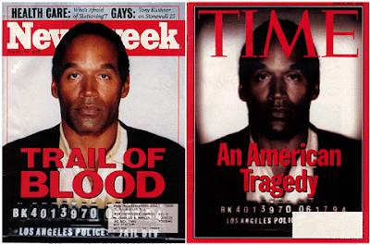
Source: https://tuhsphotojournalism.blogspot.com/2011/04/ethics-1.html

Slide 9
What is ethics?
Cultural and Contextual Variation:
Ethical norms can vary across different cultures and contexts, leading to cultural relativism, the idea that what is ethical is determined by the culture in which it occurs.
Therefore, what is considered ethical behavior in one culture or situation may differ from another.
Personal and Professional Ethics: Individuals often have personal ethical beliefs, and they may also be subject to professional or organizational ethical standards that guide their behavior in specific roles or settings.

Slide 10
What is ethics?
Accountability: Ethical frameworks hold individuals and organizations accountable for their actions.
This accountability can involve legal, social, or professional consequences.
Honesty and Integrity: Honesty and integrity are fundamental ethical principles.
Ethical behavior involves being truthful, transparent, and consistent in one's actions and words.
Beneficence and Non-Maleficence: Ethical principles often address the concepts of doing well (beneficence) and avoiding harm (non-maleficence).
This means acting in ways that promote the well-being of individuals and society while minimizing harm.

Slide 11
The importance of ethics in photojournalism
Photojournalists have a unique responsibility to accurately capture and convey events and stories through their photographs.
Ethics in photojournalism is of paramount importance because it governs the behavior and actions of photojournalists as they capture and present images that inform, educate, and shape public opinion (Lavoie, 2010).
The ethical principles and guidelines in photojournalism help maintain the integrity, credibility, and responsibility of the profession.
Ethics play a critical role in photojournalism, a field dedicated to capturing and presenting accurate, informative, and truthful visual narratives of news events.
The importance of ethics in photojournalism cannot be overstated, as it directly influences the credibility, integrity, and impact of the profession

Slide 12
The importance of ethics in photojournalism
The key reasons why ethics are vital in photojournalism are:
Preservation of Truth and Accuracy:
  Photojournalism's primary responsibility is to report the truth. Ethical photojournalists aim to capture and present images that accurately represent the events they document.
  Manipulating or staging images can undermine the trust of the audience and distort the truth.
  Photojournalists are entrusted with the responsibility of providing a visual record of events.
  Ethical photojournalism ensures that images are accurate and truthful representations of those events.
  Photojournalists must not manipulate images to deceive the audience.
  Ethical reporting ensures that photographs convey the real, unaltered story.

Slide 13
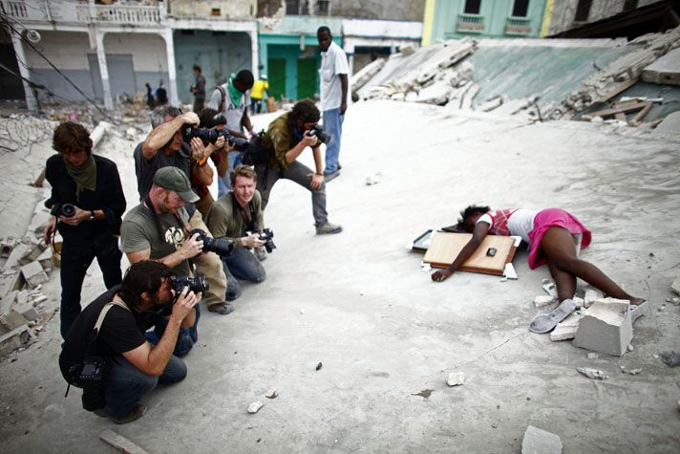
A GROUP OF JOURNALISTS PHOTOGRAPH THE TRAGIC SHOOTING OF FABIENE CHERISMA, 15 WHO WAS SHOT IN THE HEAD WHILE LOOTING FOR ANYTHING THAT COULD BE USED FOR SURVIVAL AFTER THE EARTHQUAKE THAT STRUCK THE CAPTIAL CITY OF PORT AU PRINCE IN JANUARY 2010
.Source: https://journalismunlocked.wordpress.com/2016/05/17/imagery-and-ethics-in-photojournalism/

Slide 14
The importance of ethics in photojournalism
Public Trust and Credibility:
  Photojournalism relies on the trust of the public. When the public believes that photojournalists adhere to ethical standards, they are more likely to trust the news sources that publish these photographs.
  A loss of trust can have detrimental consequences for the profession and society.
  Photojournalism serves the public interest by informing and educating society.
  Ethical photojournalism upholds the principle that the news should be presented in a way that benefits the public good and contributes to a well-informed citizenry.
  Maintaining ethical standards builds trust with the audience. Viewers and readers expect that the images they see are a reliable representation of reality.
  A breach of this trust can have severe consequences for the credibility of both the photojournalist and the publication.

Slide 15
The importance of ethics in photojournalism
Safeguarding Privacy and Dignity:
  Ethical photojournalism respects the privacy and dignity of individuals captured in images.
  In sensitive situations, such as accidents, tragedies, or protests, photographers must balance their duty to inform with the need to treat subjects with respect and empathy.
  Photojournalists must balance the need to inform the public with the privacy rights of individuals.
  They should avoid intrusive or invasive methods when documenting people in private moments.
Avoiding Sensationalism:
  Sensationalism can distort the truth and exploit sensitive situations for dramatic effect.
  Ethical photojournalism aims to avoid sensationalistic practices and present images that provide a balanced, honest portrayal of events.

Slide 16
The importance of ethics in photojournalism
Objectivity and Fairness:
  Ethical photojournalists strive to maintain objectivity.
  This ensures that the images presented are fair and balanced, allowing viewers to form their own opinions.
  Ethical photojournalism demands objectivity and impartiality.
  Photographers should not inject their personal biases, opinions, or agenda into their work.
  Their photos should tell the story as it is, allowing viewers to form their own opinions.
  Photojournalism should strive for fairness and objectivity.
  This means representing diverse perspectives and avoiding bias or favoritism.
  Ethical journalists do not manipulate images or narratives to push a particular agenda.

Slide 17
The importance of ethics in photojournalism
Preventing Harm and Exploitation:
  Photojournalists must consider the potential harm or exploitation that may result from their images.
  They should exercise restraint and discretion, especially in situations involving vulnerable individuals or sensitive content.
  Ethical considerations dictate that photojournalists should not engage in actions that could harm individuals or communities, whether physically, emotionally, or socially.
  Careful judgment is crucial when choosing what to photograph and publish.
  Ethical photojournalism takes care to avoid causing harm, both physical and emotional, to subjects.
  Photographers should not interfere in emergencies or take photos that may exacerbate distressing situations.

Slide 18
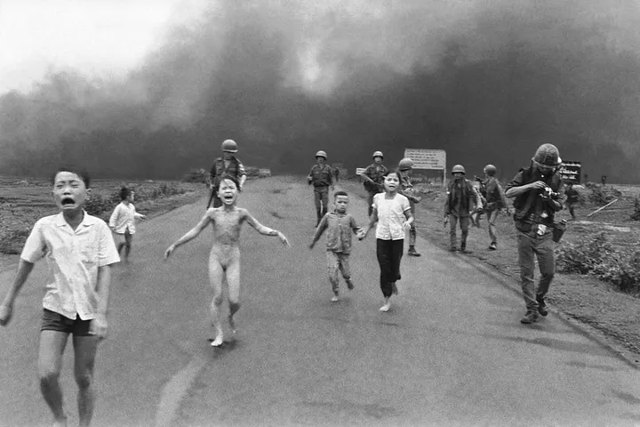
the photo manipulated the privacy and person-hood of the girl Kim Phuc in which she was shown as a child in misery, naked and burned.
Source: https://medium.com/@yarayatim/photojournalism-ethical-crisis-11f12c42336e By Yara Yatim

Slide 19
The importance of ethics in photojournalism
Respecting Cultural Sensitivities:
  Photojournalists working in diverse cultural settings must be aware of and respect cultural sensitivities, beliefs, value, and norms of the subjects being photographed.
  Ethical conduct involves understanding and adapting to the cultural context.
  Photographers should avoid causing offense or misrepresenting cultural contexts.
  Photojournalists serve as visual reporters, providing information to the public.
  Ethical photojournalism ensures that the public receives an accurate and comprehensive understanding of events, which is essential for informed decision-making in a democratic society.

Slide 20
The importance of ethics in photojournalism
Responsible Editing:
  Ethical photojournalism extends to the editing and post-processing of images.
  Editors and photographers must ensure that their edits do not misrepresent the reality of the scene.
Transparency and Accountability:
  Ethical photojournalists are transparent about their methods and the context of their images.
  They are willing to be held accountable for their work, including explaining their decisions and practices.
  It is important to provide context and accurate captions to help the audience understand the image.
  When photojournalists use photo editing or manipulation, they should disclose these alterations and provide context to maintain transparency and trust with the audience.

Slide 21
The importance of ethics in photojournalism
Transparency and Accountability:
  Ethical breaches in photojournalism should have consequences.
  Photojournalists and media organizations should be held accountable for unethical practices.
  This accountability helps maintain the standards of the profession.
  Photojournalists and their employers are accountable for the accuracy and ethics of their work.
  Ethical standards provide a framework for evaluating and addressing errors, misrepresentations, or ethical violations.
Professional Standards:
  Most professional organizations for photojournalists have established codes of ethics that members are expected to adhere to.
  These standards help maintain professionalism and ethical conduct within the industry.
  Professional organizations such as the National Press Photographers Association (NPPA) have established codes of ethics for photojournalists.
  Adhering to these codes helps maintain professional standards, ensures that photographers are held accountable for their actions, helps photographers avoid legal issues and maintain their professional standing.

Slide 22
The importance of ethics in photojournalism
Long-Term Impact:
  Ethical photojournalism contributes to the long-term impact of the profession.
  Maintaining ethical standards ensures that photojournalism continues to be a respected and valued source of news and information.
  It distinguishes photojournalism from other forms of photography and reinforces its role as a trustworthy source of information.
  An ethical photojournalist builds a reputation for honesty, accuracy, and integrity.
  This reputation can lead to more opportunities and assignments, as well as the respect of peers and colleagues.
Respect for Subjects:
  Photojournalists must treat the subjects of their photographs with dignity and respect.
  Ethical guidelines prevent the exploitation of vulnerable or distressed individuals, especially during sensitive events.
  They seek consent when necessary, especially in sensitive situations, and avoid exploiting or sensationalizing individuals who are vulnerable or in distress.
  Ethics includes respecting the dignity, rights, and autonomy of others.
  It promotes treating people with respect, regardless of their background or characteristics.

Slide 23
Application of ethics in photojournalism
The following are some practical guidelines on how to apply ethics in photojournalism:
Understand and Uphold Ethical Codes:
  Familiarize yourself with the codes of ethics set forth by professional photojournalism organizations, such as the National Press Photographers Association (NPPA) or the World Press Photo Code of Ethics.
  These guidelines provide valuable principles and standards for ethical conduct.
  Adhere to the ethical standards and guidelines established by professional organizations and publications.
  Familiarize yourself with the code of ethics for photojournalists in your field.

Slide 24
Application of ethics in photojournalism
Accuracy and Truthfulness:
  Present events accurately and truthfully. Avoid altering, staging, or manipulating images in a way that distorts reality.
  Caption your images accurately to provide context.
  According to NPR (2023), increasingly, photos and video are being posted online by individuals.
  In considering whether to use those materials, do your best to verify their accuracy and when in doubt, do not publish them.
  When reporting on news events, the photographs we take and use depict them truthfully, honestly and without bias.
  They are only enhanced for technical clarity — to correct color or improve contrast, for example.
  Always strive to capture and present the truth. Avoid staging or manipulating images to enhance drama or impact.
  Be honest in your representation of events and situations.
  NOTE: Your primary responsibility is to capture and present accurate and truthful images. Avoid staging or manipulating scenes or subjects to create a false narrative.

Slide 25
Application of ethics in photojournalism
Informed Consent:
  When possible, seek the informed consent of individuals you photograph, especially in sensitive or private situations.
  Obtain their permission and explain how the images will be used.
  Respect people's right to refuse being photographed. Consent is rooted in respect for the human right to autonomy, the right to make decisions about oneself.
  Applied to photography, it means that people have the right to decide whether or not they want to be photographed.
  A good way to ensure that we are respecting a person’s right to autonomy is by asking for consent.
  When photographing minors, seek permission from their legal guardians.
  Be cautious when taking or publishing images of children in potentially compromising or dangerous situations.

Slide 26
Application of ethics in photojournalism
Respect Privacy and Dignity:
  Exercise sensitivity and respect for the privacy and dignity of individuals you photograph.
  Avoid intruding on personal grief or sensitive moments without permission.
  Photojournalists must seek informed consent when photographing individuals in potentially compromising situations.
  Ethical photojournalism respects the rights and dignity of subjects.
  Respect the privacy of individuals and their personal spaces.
  Do not intrude into private homes or spaces without permission.
  Be cautious when photographing children and victims of trauma.
  Use discretion and empathy when photographing people in distress or vulnerable situations.

Slide 27
Application of ethics in photojournalism
Avoid Harm and Exploitation:
  Do not create or exacerbate harm through your actions.
  Avoid taking photographs that exploit individuals or contribute to their suffering.
  Consider the potential harm or distress that your images may cause. Exercise discretion in documenting and sharing distressing or graphic scenes.
  Balance your duty to inform with the need to minimize harm.
  Avoid exploiting individuals, especially in vulnerable or distressing situations.
Cultural Sensitivity:
  Avoid actions that could be seen as disrespectful or offensive.
  When working in diverse or international settings from different cultural contexts, respect local norms and customs.
  Be aware of and adapt to cultural sensitivities.
  Understand the context of the events you are covering, including the cultural and social aspects.
  This ensures that you present a comprehensive and respectful portrayal.

Slide 28
Application of ethics in photojournalism
Balance Sensationalism:
  Avoid sensationalistic practices that distort the reality of an event.
  Choose images that provide a balanced and honest representation of the situation.
  Consider the broader context of the story you are covering and its potential consequences.
  Be responsible in your storytelling to minimize harm.
  Refrain from creating or selecting images solely for their dramatic or sensational value.
  Focus on providing a balanced, honest representation of events.
Maintain Objectivity:
  Strive for objectivity and impartiality in your work.
  Do not insert your personal opinions, biases, staged elements that could distort the truth or political views into your images.
  Present events fairly and allow viewers to form their own opinions.
  Maintain objectivity and avoid imposing your personal biases on the images.
  Present a fair and balanced representation of the events and subjects you document.

Slide 29
Application of ethics in photojournalism
Responsible Editing:
  When editing and processing images, ensure that your edits do not misrepresent the scene.
  Maintain the integrity of the photograph and provide an accurate representation.
  Be transparent and honest in your post-processing and editing.
  Ensure that your edits do not alter the reality of the scene or misrepresent the facts.
Transparency and Accountability:
  Be transparent about your working methods and the context of your images.
  If questions arise about your work, be prepared to explain your decisions and practices.
  Be willing to be held accountable for your work.
  Address any concerns or criticisms regarding your photographs in a transparent and responsible manner.
  Explain your methods and practices when questioned and acknowledge and correct any errors or misrepresentations.
  In most cases, identify yourself as a photojournalist to subjects and authorities when taking photographs.
  Transparency and professionalism build trust.

Slide 30
Application of ethics in photojournalism
Long-Term Impact:
  Consider the potential long-term impact of your images.
  How will they be remembered and used in the future?
  Ensure that your work contributes positively to the historical record.
Avoid Plagiarism and Misrepresentation:
  Give proper attribution to the work of others, and do not present others' images or content as your own. Respect copyright and intellectual property rights.
  Write captions that accurately describe the images and provide context.
  Misleading or inaccurate captions can distort the meaning of a photograph.
  If an image has been significantly altered in post-processing, disclose this information to maintain transparency.
Resist Peer Pressure, exploitation, and interference:
  In high-pressure situations, resist the temptation to compromise your ethics due to external pressures or demands.
  Stay committed to your principles.
  Do not interfere with the events you are documenting. Avoid causing harm or changing the course of events to get a better shot.
  Be sensitive to the potential exploitation of your subjects or their suffering.
  Refrain from taking images that unduly exploit the pain or vulnerability of individuals.

Slide 31
Application of ethics in photojournalism
Continuing Education:
  Stay informed about evolving ethical standards in photojournalism. Attend workshops, seminars, and discussions to keep up to date with the latest developments in the field.
  Stay informed about evolving ethical issues and standards in the field of photojournalism. Engage in continuous learning and adapt your practices accordingly. The industry and its ethical considerations may change over time.
Peer Review and Mentorship:
  Seek feedback and mentorship from experienced photojournalists and editors. They can provide guidance and help you navigate ethical challenges.
  When in doubt about ethical decisions, consult with your editors, colleagues, or mentors for guidance. Ethical dilemmas may arise, and collaboration can help find the most ethical solution.
Reflect and Learn:
  Regularly reflect on your work and ethical choices. Learn from your experiences and use them to inform your future decisions.
  Ensure your safety and the safety of your subjects. Do not put yourself or others at risk to obtain a photograph.
  Uphold your personal integrity by consistently applying ethical principles to your work. Your reputation as a photojournalist relies on your ethical conduct.

Slide 32
SUMMARY
Ethical considerations play a significant role in various aspects of human life, including personal relationships, business practices, healthcare decisions, legal systems, and public policy.
Ethical behavior is central to building trust, maintaining social order, and ensuring that individuals and institutions act in ways that benefit society as a whole.
Ethical discussions often revolve around complex questions related to morality, values, and the greater good.
Photojournalism works within the same ethical approaches to objectivity that are applied by other journalists.
What to shoot, how to frame, and how to edit are constant considerations. Photographing news for an assignment is one of the most ethical problems photographers face.
Photojournalists have a moral responsibility to decide what pictures to take, what picture to stage, and what pictures to show the public.
For example, photographs of violence and tragedy are prevalent in American journalism because as an understated rule of thumb, that "if it bleeds, it leads".
The public is attracted to gruesome photographs and dramatic stories. A lot of controversy arises when deciding which photographs are too violent to show the public.
By consistently applying these ethical principles, you can maintain the integrity of your work as a photojournalist and contribute to the responsible and truthful representation of events and stories.

Slide 33
THANK YOU

