Slide 1
INTERMEDIATE MICROECONOMICS
WEEK 2-CONSUMER THEORY

Slide 2
contents
1.0 Objectives
2.0 Introduction
3.0 Consumer Theory-Overview
  Definition
  Basic assumptions
  Advantages
  Limitations
  Examples

Slide 3
4.0 Budget Constraint
5.0 Consumer Preferences.
6.0 Indifference curves
7.0 Summary
8.0 References

Slide 4
1.0 OBJECTIVES
At the end of the topic, the student should be able to:
Explain the concept of Budget Constraint
Explain the concept of consumer Preferences.
Outline assumptions about preferences
Define Indifference curves.
Explain and illustrate the shapes of Indifferent Curves
Explain the concept of Marginal Rate of Substitution

Slide 5
2.0 INTRODUCTION
This topic evaluates the standard methods that economists use to model the behavior of consumers.
A consumer is a person who has the opportunity to buy various different commodities at fixed market prices.

Slide 6
3.0 CONSUMER THEORY- AN OVERVIEW
Definition
What Is Consumer Theory?
It is the study of how people decide to spend their money based on their individual preferences and budget constraints.
It shows how individuals make choices subject to how much income they have available to spend and the prices of goods and services.
Understanding how consumers operate makes it easier for vendors to predict which of their products will sell more.

Slide 7
Consumer Theory-Basic Assumptions
What are the 3 basic assumption in consumer theory?
Utility maximization—Individuals are said to make calculated decisions when shopping, purchasing products that bring them the greatest benefit, otherwise known in economic terms as a maximum utility.
Non-satiation—People are seldom satisfied with one trip to the shops and always want to consume more.
Decreasing marginal utility—Consumers lose satisfaction with a product the more they consume it.

Slide 8
Consumer Theory-necessary inputs
What are the necessary inputs?
1. A full set of consumption options
2. How much utility a consumer derives from each bundle in the set of options
3. A set of prices assigned to each bundle
4. Any initial bundle that the consumer currently holds

Slide 9
Advantages of Consumer Theory
It provides a better understanding of individuals’ tastes and incomes.
Evaluates the demand curve.
Explains the overall economy-consumer spending drives a significantly large chunk of gross domestic product in most economies.

Slide 10
Typical example of Consumer Theory
Kyle is a consumer with a budget of $200 who must choose how to allocate his funds between shoes and books (the bundle of goods).
If a pair of shoes costs $10 and a book costs $50, Kyle could buy 20 pairs of shoes, or four books, or five pairs of shoes and three books.
Alternatively, he could keep all $200 in his pocket.
How can an outsider predict how Kyle is most likely to spend his money?
-Consumer theory can help give an answer to this question.

Slide 11
Limitations of Consumer Theory
Rational expectations-Challenges to developing a practical formula for this situation are numerous.
Lack of information- not easily available.
Emotional Component not captured in the economic function.
Too many assumptions.

Slide 12
4.O BUDGET CONSTRAINT
Suppose that there is some set of goods from which the consumer can choose.
Let the consumer’s consumption bundle be ( X1 X2)
where X 1,represents the number of units the consumer chooses of good I and
X2 is the number of units of good to be chosen by the consumer.
Let P1 and P2 represent the unit prices for the two goods respectively; and
M to represent the amount of money the consumer has to spend.

Slide 13
Budget Constraint
The budget constraint of the consumer can be written as:
P1X1+P2X2≤M
Where P1X1 is the expenditure on good 1 and P2X2 is the expenditure on good 2.
The consumer’s affordable consumption bundles are those that do not costs any more than M.
The set of affordable consumption bundles at prices P1P2 income M is called the budget set of the consumer.

Slide 14
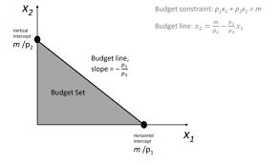
Budget Line
The set of bundles that cost exactly M is called the budget line.
P1X1+P2X2≤M
These are the bundles of goods that are affordable at the given prices and income.

Slide 15
Equations-Budget line
Rearranging equations-
X2=M/P2 – P1/P2 X2
This is an equation for a straight line with a vertical intercept of M/P2
and a slope of -P1/P2.
The example tells how many units of good 2 the consumer needs to consume to just satisfy the budget constraint, if she is consuming X1 units of good 1.

Slide 16
The slope of the budget line
The slope of the budget line measures the rate at which the market is willing to substitute good 1 for good 2
∂X2 / ∂X1 = -P1/P2
The slope of the budget line is also said to be an opportunity cost of consuming good 1.

Slide 17
5.0 CONSUMER PREFERENCES
The Optimization Problem
Assumptions
that a consumer has a well-defined set of desires, or ‘preferences’, which can be represented by a numerical utility function.
that the consumer chooses optimally, in the sense that they choose the option with the highest utility of those available to them.
This means that a consumer is solving an optimization problem.

Slide 18
The Optimization Problem-Components
1. The objects of choice. What is it that is being chosen?
2. The objective function What is it that the chooser is trying to maximize?
3. Constraints. What constraints are there on the choices that can be made?
Optimization problems can always be written in the following form:
Choose <some object> in order to maximize <some objective function> subject to <some constraint>

Slide 19
Optimization problems-examples
Example 1 -A Brown student is trying to decide what courses they are going to take. They want to get the highest possible grade point average, but they also want to do the economics concentration.
Choose courses offered by Brown in order to maximize grade point average subject to satisfying the requirements of the economics concentration.
Example 2- The British government is signed up to reduce emissions by 25%. However, they want to do so in a way that minimizes the damage to the economy.
Choose fiscal policy (taxes and subsidies) in order to maximize economic output subject to reducing greenhouse emissions by 25%

Slide 20
Preferences
Suppose there are two consumption bundles (X1 X2 ) and (Y1 Y2).The consumer can rank them as to their desirability.
Assumption about preferences
Completeness: It is assumed that any two bundles can be compared.
Given any X bundle and Y bundle, then (X1 X2) > (Y1Y2) or (Y1 Y2) > (X1 X2) or both, in which case the consumer is indifferent between two bundles.

Slide 21
Preferences cont…
2. Reflexive: We assume that any bundle is at least as good as itself.
(X1 X2) > (X1 X2)
Transitive: If (X1 X2) > ( Y1Y2) and ( Y1 Y2) > ( Z1 Z2) then we assume that consumer thinks that X is at least as good as Y and that Y is at least as good as Z, then the consumer thinks that X is at least as Z.

Slide 22
6.0 INDIFFERENCE CURVES(Ic’s)
Definition
An indifference curve is a chart showing various combinations of two goods or commodities that consumers can choose.
At any point on the curve, the combination of the two will leave the consumer equally well off or equally satisfied—hence indifferent.

Slide 23
Features of Indifference curves
1.An indifference curve has a negative slope, i.e. it slopes downward from left to right.
2. IC is strictly Convex to origin i.e., MRS xy (marginal rate of substitution of goods X and good Y) is always diminishing.
3. Higher indifference curve represents larger bundles of goods i.e. bundles which contain more of both or more of at least one.

Slide 24
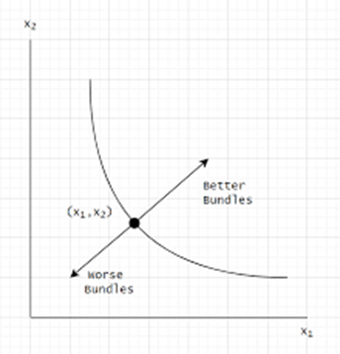
ICs
Consider a consumer’s consumption of goods 1 and 2
Worse bundles-are weakly preferred to Better bundles.
The bundles on the IC represent all combinations of goods that the consumer is indifferent to.

Slide 25
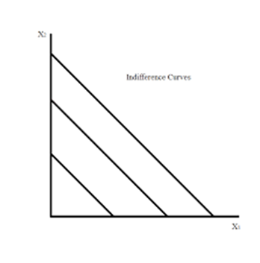
Shapes of ICs
1. Perfect Substitutes
Two goods are perfect substitutes if the consumer is willing to substitute one good for the other at a constant rate.
ICs for such a consumer are all parallel straight lines.

Slide 26
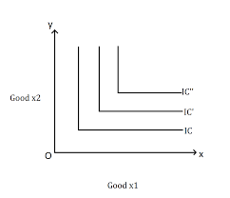
Shapes of ICs
2. Perfect Complements
Perfect complements are goods that are always consumed together in fixed proportions.
The ICs L shaped.

Slide 27
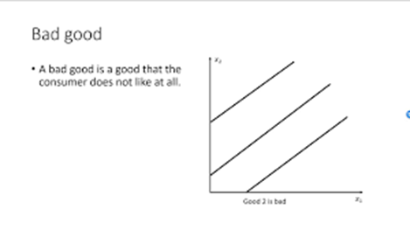
Shapes of ICs
3. Bad goods
A bad good is a commodity that a consumer does not like at all.

Slide 28
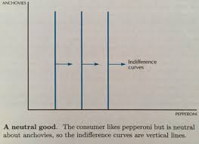
Shapes of ICs
4. Neutral goods
A good is a neutral good if the consumer doesn’t care about it one way or the other.

Slide 29
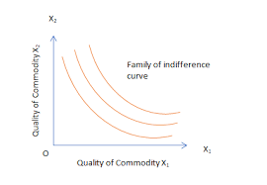
Shapes of ICs
5. Imperfect Substitutes
If the rate at which one good is substituted for another is not constant, but diminishing, then the two goods are imperfect substitutes.

Slide 30
7.0 MARGINAL RATE OF SUBSTITUTION (mrs)
The slope of the IC is known as the MRS.
It measures the rate at which the consumer is just willing to substitute one good for another.
Suppose that we take a little of good 1; ∆X1 away from the consumer. Then we give him ∆ X2 an amount i.e. just sufficient to put him back on his/her IC,.
The ration ∆X2 is thought as being the rate at which the consumer is willing to ∆X1 substitute good 1 for good 1 and is called the MRS.

Slide 31
Mrs cont…
Suppose that the consumer has well behaved preferences.
and currently consuming some bundle (X1 X2). The consumer is now offered a trade: to exchange good I for 2 or good 2 for I in any amount at a “rate of exchange” of E. i.e. If the consumer gives up ∆X1 units of good1, he can get E∆X1 units of good 2 in exchange or conversely, if he gives up ∆ X2, units of good 2, he can get ∆X2 units of good 1.
MRS = ∆X2 / ∆ X1 =E
∆ X2 = E ∆ X1
∆ X1= - ∆ X2/E

Slide 32
Behavior of the marginal Rate of substitution
Perfect substitute’s indifference curves are characterized by the fact that the MRS is constant at – 1 .
The neutral case is characterized by the fact that the MRS is everywhere infinite .
The preference for perfect complements are characterized by the fact that the MRS is either ) or infinite and nothing is between.
The assumption of monotonicity implies that ICs must have a negative slope.
For Convex ICs, the MRS decreases as more of X1 is consumer.

Slide 33
8.0 SUMMARY
Consumer theory is to demand as producer theory is to supply.
Consumer theory is based on the premise that we can infer what people like from the choices they make.
Utility refers not to usefulness but to the flow of pleasure or happiness that a person enjoys—some measure of the satisfaction a person experiences.
There are no natural units for utility; any increasing transformation is acceptable.

Slide 34
Summary
The budget set or feasible set is the set of goods that the consumer can afford to purchase.
The budget line is the pair of goods that exactly spend the budget. The budget line shifts out when income rises and pivots when the price of one good changes.
Increasing prices and income by the same multiplicative factor leaves the feasible set unchanged.
Isoquants, meaning “equal quantity,” are also known as indifference curves and represent sets of points holding utility constant.
Preferences are said to be convex if any point on the line segment connecting a pair of points with equal utility is preferred to the endpoints.

Slide 35
REFERENCES
Border, K. C., Fixed Point Theorems with Applications to Economics and Game Theory, Cambridge: Cambridge University Press, 1985.
Luenberger, D., Microeconomic Theory, McGraw-Hill, 1995, Appendixes A-D.
Takayama, A. Mathematical Economics, the second edition, Cambridge: Cambridge University Press, 1985, Chapters 1-3.
Tian, G., The Basic Analytical Framework and Methodologies in Modern Economics, 2004
Tian, G., \Fixed Points Theorems for Mappings with Non-Compact and Non-Convex Domains," Journal of Mathematical Analysis and Applications

Slide 36
  THE END,THANK YOU

