Slide 1
INTERMEDIATE MICROECONOMICS
Week 3- Utility

Slide 2
CONTENTS
1.0 Objectives
2.0 Introduction
Definition of key terms
3.0 Utility Theories
Cardinal Utility and Ordinal Utility
4.0 Total Utility and Marginal Utility

Slide 3
CONTENTS
5.0 The Law of diminishing Marginal Utility
6.0 Utility Maximization
7.0 The Utility functions
8.0 Marginal Utility and Marginal Rate of Substitution(MRS)
9.0 Consumer Equilibrium
10.0 Summary
11.0 References

Slide 4
1.0 OBJECTIVES
Define what economists mean by utility.
Distinguish between the concepts of total utility and marginal utility.
State the law of diminishing marginal utility and illustrate it graphically.
Discuss Cardinal and Ordinal Utility
State, explain, and illustrate algebraically the utility-maximizing condition.
Describe consumer’s equilibrium condition

Slide 5
2.O INTRODUCTION
Definition of key terms Why do you buy the goods and services you do?
It must be because they provide you with satisfaction—you feel better off because you have purchased them. Economists call this satisfaction utility.
Each consumer acts as if he or she can measure utility and arranges consumption so that the utility gained is as high as possible.
Utility Maximization:- Consumers aim to maximize their total utility subject to their budget constraints.
A consumer's budget constraint is determined by the prices of goods and services and their income.

Slide 6
Introduction cont…
Consumer Surplus:- Consumer surplus is the difference between the total amount that consumers are willing to pay for a good or service and the amount that they actually pay.
Consumer surplus represents the extra value that consumers derive from consuming a good or service.
Utility is a concept in economics that refers to the satisfaction or happiness that individuals derive from consuming goods and services.
Total utility and marginal utility are measures of the satisfaction that consumers derive from consuming goods and services.-

Slide 7
Introduction cont…
Expected utility is the utility that an economic agent is expected to reach in the future given several probable outcomes.
Expected utility value is a probability concept used when several future outcomes are possible.
It is calculated by multiplying each possible utility outcome by the probability of its occurrence and then adding them up.
Expected utility theory deals with decision-making under uncertainty.

Slide 8
Introduction cont…
Subjective utility is utility based on an individual's perceived level of satisfaction from consuming a good or service.
Subjective utility is not based on market judgment.
It is based on how attractive an individual perceives the benefit of using a good or service.

Slide 9
3.0 Utility theories
The theory of consumer behavior has been formulated with an objective of utility maximization .
Utility refers to the ability of in a good to satisfy the consumer.
The approaches/theories to the study of utility include-
1. The cardinal utility theory
It attaches significance to the magnitude utility.
In this theory, the size of the utility difference between the bundles of goods is important.

Slide 10
The cardinal utility theory
The Cardinalist school of thought postulates that utility is measurable.
Some economist have suggested that utility can be measured in monetary terms, by the amount of money the consumer is willing to sacrifice for an additional unit of the commodity.
Others have suggested the measurement of utility using subjective units called utils.

Slide 11
Assumptions of the cardinal utility theory
a) Rationality
The consumer is assumed to be rational. i.e.. he aims to maximize his utility subject to the budget constraint.
b) Cardinality
That the utility of each commodity is measurable. Utility is a cardinal concept; the most convenient way of measurement is monetary terms.
c) Constant Marginal Utility of Money

Slide 12
d) Diminishing Marginal Utility of Commodity
The utility gained from successive units of a commodity diminishes.
Total utility of a basket of goods depends on the quantities of the individual commodities.
If there are n commodities in the bundle with quantities x1, x2, x3,……….,xn .
The total utility is
U = f (X1,X2,X3……Xn

Slide 13
2. Ordinal utility theory
The theory formulates the consumer behavior entirely in terms of consumer preferences.
Utility is seen only to describe preferences by ranking bundles according to utility derived from each bundle.
Emphasizes on ranking of consumer bundles and not on the amount of utility difference between the bundles,
Postulated that utility is not measurable, but is an ordinal magnitude.
The main ordinal approach theories are the indifference curve and revealed preference theories.

Slide 14
4.0 Total utility and marginal utility
There are two different types of utility:
Marginal utility (MU)
Marginal utility is the satisfaction that a person receives from consuming an additional unit of the same good or service.

Slide 15
Example of mu
If John is drinking his first glass of water and gets 10 units of satisfaction, the marginal utility he derives from the first glass is 10 units.
He then has a second glass of water and gets 8 units of satisfaction.
The marginal utility he derives from the second glass is 8 units.
With the third glass, he gets only 7 units of satisfaction.
Thus, the marginal utility he derives from the third glass is 7 units.

Slide 16
Total utility (TU)
Total utility is the aggregate satisfaction a person receives from the consumption of all the units of the same good or service.
Total utility is derived from adding every marginal utility from each additional unit.
TU=MU-1+MU-2 +MU-3 +….MU-N
Where MU-N is the marginal utility from consuming the N-th unit of a good.

Slide 17
Relationship between marginal utility and total utility
of glasses of water | Marginal utility | Total utility
1 | 10 | 10
2 | 8 | 18
3 | 7 | 25
4 | 4 | 29
5 | 0 | 29
6 | -2 | 27
The marginal utility decreases with the addition of further units.
The total utility increases until a certain point.
At that point, which is 5 glasses of water, the total utility reaches its maximum and starts declining.

Slide 18
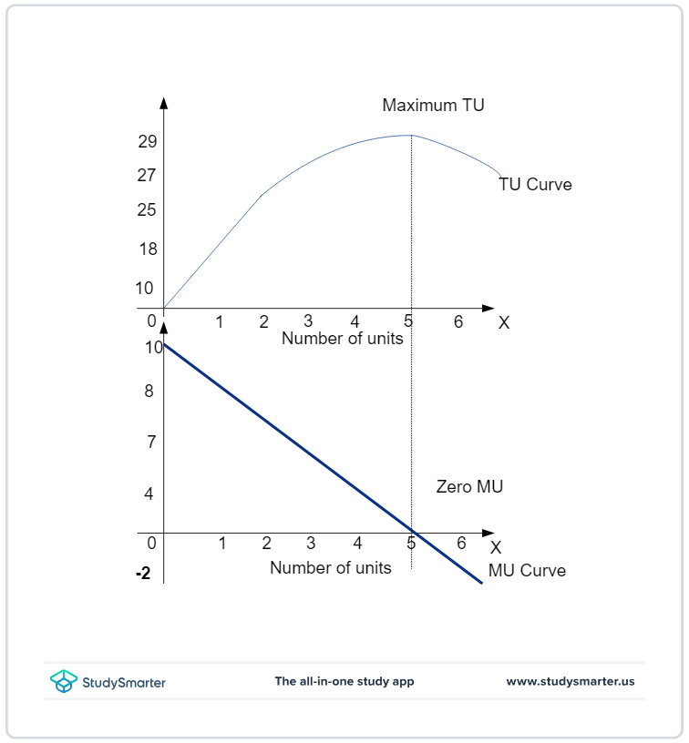
Relationship between marginal utility and total utility:
As the number of units increases, MU decreases, and TU increases.
When TU reaches its maximum level, MU is 0. At that unit, the marginal utility is 0.
MU starts to get negative and TU starts decreasing.

Slide 19
5.0 THE LAW OF DIMINISHING MARGINAL UTILITY
The Law of diminishing marginal utility states that the level of satisfaction for an individual diminishes as the use of the same product increases.
The consumption of the first unit gives the consumer maximum utility. Then, the level of satisfaction starts reducing as the units increase.
The consumer starts getting negative utility after a particular unit of consumption, which may vary from consumer to consumer.

Slide 20
7.0 Utility maximization
Utility maximization means that a consumer will try to get the highest level of satisfaction for consuming something they paid for.
The utility may be different for every individual and cannot be stated as a single total unit.
Consumers seek to derive maximum utility from their consumption, however they will be limited by the following-
1.Limited income
Consumers will be limited by the amount of income they have despite the bundles ability to give maximum utility.

Slide 21
Utility Maximization cont…
2. A given set of prices
Consumers will opt for a substitute or a similar product due to the set of prices.
3. Budget constraints
Consumers’ choices are subject to their budget constraints.
Budget constraints can also be understood as limited income.
4. Limited time
Consumer choices will also be constrained by time.

Slide 22
Utility Maximization cont…
Economists say that most choices are made at the margin.
The margin is the current state at which an individual is making choices.
Margin helps the consumers decide how much they will gain or lose with the extra unit of a good or service. Hence, the consumer’s buying decision is on the margin.
Margin is important for these reasons:
Decision on the quantity to consume.
Determination of utility.
Understanding consumers’ total marginal utility

Slide 23
7.0 UTILITY FUNCTION
A utility function is a mathematical function that ranks bundles of consumption goods by assigning a number to each, where larger numbers indicate preferred bundles.
A utility function is a way of to label indifference curves.
Every bundle of an IC must have the same utility
A utility function is a way to assign number to the different indifference curves in a way that higher ICs get assigned larger numbers.
This labeling will represent the different preferences.

Slide 24
Utility functions cont…
Not all kinds of preferences can be represented by a utility function for example, suppose a consumer had intransitive preferences so that A > B > C > A.
Then a utility function for these preferences would have to consist of numbers U(A), U(B) and U(C) such that U(A) >U(B) > U (C) U(A), which is impossible.

Slide 25
Examples of utility functions
1. Perfect Substitutes goods
Preferences for perfect substitutes are represented by linear utility functions of the form. U(X 1X2) = α X1 = βX2
Where∞ α, β>0, numbers that measure the value of goods 1 and 2 to the consumer.
By plotting all the points (X1X2) such that U(X1X2) equals a constant, yields a linear indifference curve with a slope -α/β.
For every different value of a constant, there is a different IC, but having a similar slope of -α/β .
Each represents utility functions which are monotonic transformations to each other.

Slide 26
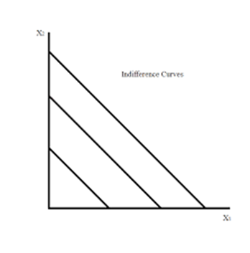
Perfect substitutes
The slope of the IC is α/β.
Interchangeable goods
Utility for both goods is the same.
Consumer does not mind having either.
Consumer would not trade less quantity of one good for more quantity of another.

Slide 27
Examples of utility functions cont…
Complimentary goods
These goods used together.
The preferences for complementary goods take utility functions of the form.
U (X1 X2) = min ( X1 X2) = Min (α X1, βX2 )
Where a and β are positive numbers that indicate the proportion in which the goods are consumed e.g. αx 1 < β X 2, then U ( X1X2 = αX1) if α X1 > β X2 then U (X1X2) = bX2
Any monotonic transformation of this utility function will describe the same preferences which are presented by L – shaped ICs.

Slide 28
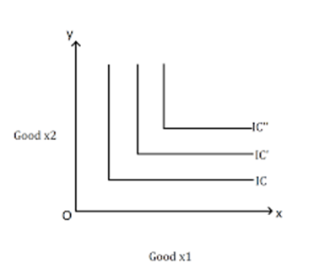
Complimentary goods
Demand for complementary goods is directly related.
Buying one good increases the probability that you will buy the other good.
E.g. right shoe and left shoe.

Slide 29
Imperfect substitutes
They have an additive utility function which implies that a consumer will yield some level of utility even by consuming only one of the goods.
In many cases are such that some level of utility is only possible when a combination of the goods is consumes.
Imperfect substitutes and their preferences take multiplicative form of utility functions. α/β ( X 1 X 2 )= X_{a} ¹ X₂ ^{b}

Slide 30
imperfect substitutes cont…
This kind of a function is refereed to as a Cobb – Douglas utility function.
It yields a convex monotonic indifference curve and are said to be well behaved.
It is the most useful preference in presenting algebraic examples of the economic ideas.
A monotonic transformation of the Cobb – Douglas utility function above will represent exactly the same preferences as.

Slide 31
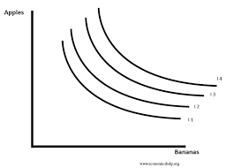
Imperfect substitutes-convex ICs
What is the primary reason why ICs are convex to the origin-
Most goods for consumers are imperfect substitutes.
ICs frequently intersect each other.
Bundles further from origin are preferred to those that are closer.
Consumers have a diminishing MRS.
An IC passes through any possible bundle.

Slide 32
8.0 Marginal utility(MU) and Marginal Rate of Substitution(MRS)
Consider a consumer consuming bundle ( X1X2 ).
The amount by which the total utility changes U ( X1X2) when an extra unit of a good is consumed is the marginal u utility with respect to the good.
Suppose an extra unit of good is consumed such that total utility changes from U( X1X2) to U ( X1 + ∆X1 ,X2) the MU of good 1 is written as:
Mu=∆X1/∆X2=u(X1+∆X1,X2-U(X1,X2)/ ∆X1
It measures the rate of change in utility (∆U) associated with a small change in the amount of good 1 ( ∆X1 )

Slide 33
MU and mrs cont…
Therefore to calculate the change in utility associated with a small change in consumption of good 1, we can multiply the change in consumption by the MU of the good.
∆U = ∆MU1 ∆X1
Similarly, ∆MUx = ∆U/∆X2 = U(X1 + ∆X1 X2)-U(X1,X2 )/ ∆X1
MRS measures the slope of the IC at a given bundle of goods.
Consider now a change in the consumption of each good ( ∆ X1 ∆X2) that keeps utility constant,
i.e. a change in consumption that moves us along IC, then MU1 ∆X1 + MU ∆X2 = ∆ U =

Slide 34
MU and mrs cont…
Solving for the slope of the IC we have,
MRTs=∆X2/∆X1= -MU1/MU2
But ∂U= 0 since utility does not change along the indifference curve.
MUX1 ∆X1 = - MUX2 ∆X2
-∆X2/∆X1= MUX1/ MUX2

Slide 35
MU and mrs cont…
The slope is negative since to get more of one good, lesser units of the other good must be consumed in order to keep the same level of utility.
For example
∆X2/∆X1 = -MU1/MU2 = - 2
Give up 2 units of good 2 to consume extra unit of good 1.

Slide 36
9.0 Consumer Equilibrium
Puts together the budget line and the theory of preference in order to examine the optimal choice of consumers.
Let us assume that a consumer is consuming only two goods X1 and X2
The utility which she receives from consuming X1 and X2 is given by the utility function
U=f (X1, X2)
This satisfies the property of eventual diminishing marginal utility.

Slide 37
Consumer equilibrium cont…
The consumer is required to spend her entire income on X1 and X2, the budget equation is given as,
M = P1X1 + P2X2
Where M is her nominal income. Since the consumer is a utility maximiser, her consumption problem can be formulated as follows:
Maximize
U = f (X1, X2)
Subject to the budget constraint
M = P1X1 + P2X2

Slide 38
Consumer equilibrium cont…
By using the Marshallian Equi-Marginal Principle (which is based on the Lagrange Multiplier Technique), we get the equilibrium condition,
  MU1/ P1 = MU2/ P2 = λ
This is the first order condition (necessary) for achieving equilibrium.
The second order condition will be automatically fulfilled so long as the marginal utility schedules for each good MU1 and MU2 are both downward sloping.

Slide 39
A consumer attains equilibrium when she maximizes total utility from consuming X1 and X2. The equilibrium condition can also be stated in an alternative form:
  MUI / MU2 =P1/ P2 ...(1)
The ratio of marginal utilities of goods X1 and X2 must equal the price ratio of the same two goods.
Condition (1) above is the famous Marshallian law of the equi-marginal utility.

Slide 40
Consumer equilibrium -example
Question
The table gives an individual’s marginal utility schedules for goods X1 and X2.
If the prices of X1 and X2 are USD 2.00 each.
The individual has USD 20.00 of Income, which she spends on X1 and X2.
What is the individual’s equilibrium purchase of X1 and X2?
Q | 1 | 2 | 3 | 4 | 5 | 6 | 7 | 8 | 9 | 10 | 11
MU1 | 16 | 14 | 11 | 10 | 9 | 8 | 7 | 6 | 5 | 3 | 1
1MU2 | 15 | 13 | 12 | 8 | 6 | 5 | 4 | 3 | 2 | 1 | 0

Slide 41
The solution:
The individual’s equilibrium purchase is given by the conditions
MU 1/P1 = MU2/P2
and the budget constraint must be fully satisfied.

Slide 42
The solution:
Q | 1 | 2 | 3 | 4 | 5 | 6 | 7 | 8 | 9 | 10 | 11
MU1/P1 | 8 | 7 | 5.5 | 5 | 4.5 | 4 | 3.5 | 3 | 2.5 | 1.5 | 0.5
MU2/P2 | 7.5 | 6.5 | 6 | 4 | 3 | 2.5 | 2 | 1.5 | 1 | 0.5 | 0
At X1 = 6
MU1 / P1 is 4
At X2 = 4 units
MU2/ P2 is 4
Hence MU 1/ P1 = MU2/ P2 = 4

Slide 43
The solution:
The amount spent is P1X1 + P2X2 which is USD 20.00 (2*6+2*4 = 12 + 8).
Money income is also USD 20.00. Hence, the budget constraint is satisfied.
The equilibrium purchase is X1 = 6 units and X2=4 units.
Since MU 1 falls from 16 to 1 as X1 increases from 1 to 11 and MU2 declines from 15 to zero as X2 increases from 1 to 11, the second order condition is also fulfilled.

Slide 44
Consumer equilibrium cont…
Note
When the consumer consumes n goods, the law of equi- marginal utility would then read as:
  MU1/P1 = MU2/P2 = MU3/P3=..... =..MUn/Pn = λ (the marginal utility of money)
with the second-order conditions (the law of eventual diminishing marginal utility must hold for each of the n goods).

Slide 45
10.0 SUMMARY
Utility is the level of satisfaction a person derives from consuming a good or service.
Utility theory explains individuals’ choices and measures their level of satisfaction from consuming a good or service. The level of satisfaction is measured in units called ‘utils.’
Marginal utility is the satisfaction that a person receives from consuming an additional unit of the same good or service.
Total utility is the aggregate satisfaction a person receives from consuming all the units of the same good or service.
As the number of units increases, marginal utility decreases, and total utility increases.

Slide 46
Summary cont…
When the total utility reaches its maximum level, the marginal utility is zero. After that point, marginal utility starts to get negative and total utility starts decreasing.
The Law of diminishing marginal utility states that an individual’s level of satisfaction diminishes as the use of the same product increases.
Utility maximization is the highest level of satisfaction a consumer is able to derive from the decision they made in return for the cost they paid.
Individual choices when trying to maximize utility may be limited by income, prices, time, and budget constraints.

Slide 47
References
Border, K. C., Fixed Point Theorems with Applications to Economics and Game Theory, Cambridge: Cambridge University Press, 1985
Luenberger, D., Microeconomic Theory, McGraw-Hill, 1995, Appendixes A-D.
Takayama, A. Mathematical Economics, the second edition, Cambridge: Cambridge University Press, 1985, Chapters 1-3.
Tian, G., The Basic Analytical Framework and Methodologies in Modern Economics,2004
Tian, G., \Fixed Points Theorems for Mappings with Non-Compact and Non-Convex Domains," Journal of Mathematical Analysis and Applications

Slide 48
        THE END, THANK YOU.

