Slide 1
INTERMEDIATE MICROECONOMICS
WEEK 5-THEORY OF PRODUCTION

Slide 2
CONTENTS
1.O OBJECTIVES
2.0 INTRODUCTION
  Definition of Production Concepts
3.0 Production function
4.0 Similarity and difference between Consumer Behavior and Production Theory
5.0 Types of Production curves
  Total Product
  Marginal Product
  Average Product

Slide 3
contents
6.0 Relationships between
  Total Product and Marginal Product
  MPPL and APPL
7.0 Stages of Production
8.0 Isoquant Analysis
  Shapes of Isoquants
  Characteristics of isoquants

Slide 4
CONTENTS
9.0 Returns to Scale
10. The equilibrium of the Firm
11. Returns To Scale and Homogeneity of the Production Function
12. SUMMARY
13. REFERENCES

Slide 5
1.0 OBJECTIVES
1. Understand the production theory.
2 .Identify the three stages of production.
3. Understand the isoquant analysis.
4. Be able to use the concept of the returns to scale.
5. Determine the equilibrium of the firm

Slide 6
2.0 introduction
THE PRODUCTION THEORY
Definition of production concepts
(i) Production:- this is the creation of goods and services through the transformation of inputs into outputs.
(ii) Inputs:- these are the ingredients used by a firm to produce a good or service. Sometimes they are called factors of production or resources. These include land, capital, labor, entrepreneurs etc.
iii) Output:- this is the end-product of transforming input into goods or services. Output is thus a function of the various input expressed in the production function.

Slide 7
2.0 A production function
Iv)A production function is a schedule (or table, or mathematical equation) showing the maximum amount of output that can be produced from any specified combination of inputs, given the existing technology.
In short the production function is like a “recipe book” showing what output are associated with which combination of inputs.
It may be represented as follows-
Q = f (K, L, r)
Where : Q is output
L is labour ,K is capital, r are other input resources

Slide 8
Definition of production concepts
(V)Short run period:- refers to the period of time during which it is impractical to change the employment levels of some inputs so as to immediately increase output.
(vi) Long run period:- is defined as that period of time in which inputs are variable in the long run it may be economical to install additional productive facilities.
(vii) Isoquant:- is a curve that shows all the combinations of inputs that will produce a certain level of output, given same level of technology.
In the analysis of theory of production two approaches will be used.
Analysis of production in the short run.
Isoquant analysis, which is long-run approach.

Slide 9
4.0 Similarity and differences between consumer behavior & production theory
Objectives:- the consumer aims at maximizing utility while producer aims at maximizing cost.
Constraint:- the consumer is constrained by the income level and prices of commodities while the producer is constrained by technology level and the cost of inputs.
Tools of analysis:- the analysis of consumer behavior employs indifference curves, while that of the production theory employs isoquant.

Slide 10
5.0 TYPES OF PRODUCTION CURVES
1) Total product curve
2) Marginal product curve
3) Average product curve
Total Product (TP)
In the short run, production function gives the total (maximum) output obtainable from different amounts of the variable inputs, given a specified amount of the fixed input.
In the short-run, production function is written as Q = f (K,L)
where capital is fixed and labour is variable.

Slide 11
2) average product (ap) or average physical product (app)
The average product of an input is that product divided by the amount of the input used to produce this output.
APL=Q/L=f(K,L)/L
This can be read as average product of the variable input labour.

Slide 12
3) Marginal Physical Product (MPP or MP)
Is the change in total product that results from one unit change in the amount of variable inputs (e.g. labour), the fixed input remaining unchanged.
The marginal product of labour is the derivative of output with respect to labour.
MPL=δ Q/ δL = δf (K,L)/ δ L

Slide 13
Table-TPL,APL,MPL
No of capital | No of labor | TP_{L} | AP_{L}=(TP/L) | MP_{L=} δTP/ δ L | Stages
1 unit | 0 | 0 | 0 | 0 | I
1 unit | 1 | 5 | 5 | 5
1 unit | 2 | 16 | 8 | 11
1 unit | 3 | 36 | 12 | 20
1 unit | 4 | 68 | 17 | 32
1 unit | 5 | 95 | 19 | 27 | II
1 unit | 6 | 114 | 19 | 19
1 unit | 7 | 119 | 17 | 5
1 unit | 8 | 120 | 15 | 1
1 unit | 9 | 117 | 13 | -3 | III
1 unit | 10 | 100 | 10 | -17

Slide 14
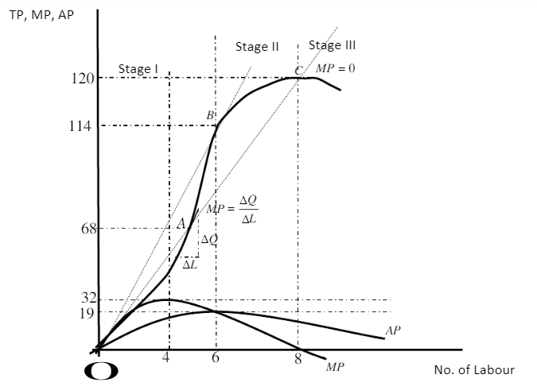
GRAPH-TPL,APL,MPL
This is a short run case whereby not all inputs are variable. Labour (L) is variable, while capital is fixed at 1 unit.

Slide 15
6.0 RELATIONSHIPs
i) BETWEEN TP & MP
As long as LMP is increasing, TP will continue to raise at an increasing rate.
When MPL reaches zero, TP reaches its maximum. At this point TP=120 while L=8.
When MPL becomes negative, TP will start declining so any employment beyond L=8 yield negative MP.

Slide 16
law of diminishing returns
The law of diminishing returns which states that:-
If more and more units of a variable input (in our case labour) are applied to a given quantity of fixed input,
  -the total output may initially increase at an increasing rate,
  -but beyond a certain level of output, the rate of increase in the total output diminishes.
Conditions;
1) Some input(s) must remain fixed as the amount of the input in question, say labour is varied.
2) Technology must remain unchanged, since a change in technical know-how would cause the entire TP curve to shift.

Slide 17
II) BETWEEN APPL & MPPL
1) MPPL>APPL, when APPL is rising (MPL is above APL)
2) MPPL = APPL when APPL is at maximum.
3) MPPL < APPL when APPL is declining (MPL is below APL)
Proof Q=f(K,L)
APL =Q/L = f(K,L)/L

Slide 18
7.0 THE THREE STAGES OF PRODUCTION
Stage I:
Marginal product continues to increase making total product increase at an increasing rate. Marginal product reaches maximum at L=4
It is a stage of increasing returns because output increases as you increases the use of the variable factor (Labour).
Here fixed factors (capital) is under utilized.

Slide 19
Stage II
Is a stage of diminishing returns MP starts declining until it reaches zero.
Total product increases but at a diminishing rate and reaches maximum when MP=0.
Once optimum capital-labour ratio is reduced additional workers have less and less tools to work with.
Firms should operate in this stage because optimal utilization of factors is realized.

Slide 20
Stage III
It is the Stage of declining returns.
TP is declining and MP is negative.
It will be very illogical for a firm to operate in this stage because employment of additional labour adds nothing to total product.
In stage III, capital is over utilized/overburdened by large units of labour.

Slide 21
8.0 ISOQUANT ANALYSIS
In the short-run, we assume that one factor of production remain fixed as the other one varies that is Q = F(K,L)
However, in the long-run, all factors of production become variable so that Q =F(K,L) .
In isoquant analysis, all factors are assumed to be variable.
What is an isoquant?
It is a curve joining various combinations of Inputs that yield a given amount of output

Slide 22
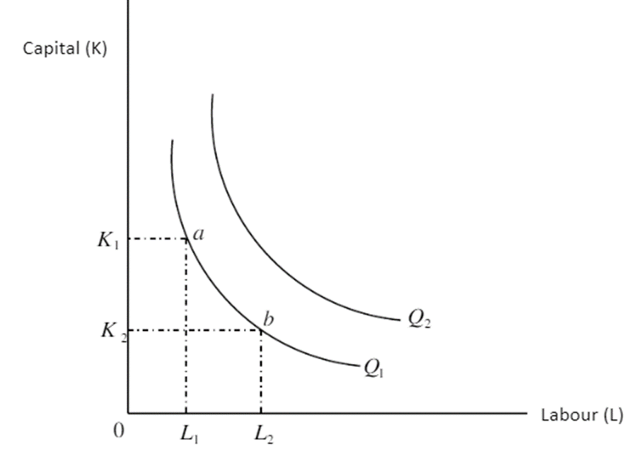
ISOQUANTS
Combination of inputs (a) and (b) yield same level of output.
A higher isoquant to the right represents superior output Q₂>Q₁
The slope of the isoquant δK/δL defines the degree of substitutability of the factors of production.

Slide 23
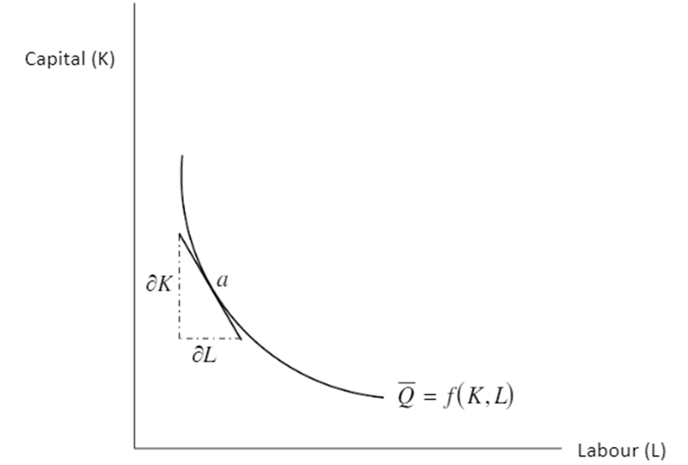
Marginal rate of technical substitution (MRTS) of labour and capital.
Is the slope of isoquant.
The slope of the isoquant at point (a) is given by the slope of the tangent at point
Therefore slope =δK/δL
-δK/δL= MRTSK,L = MPL/MPK

Slide 24
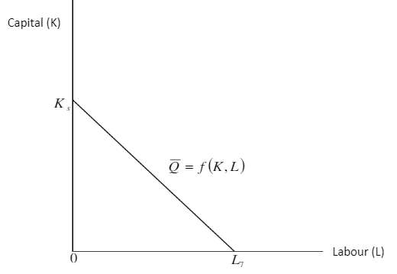
SHAPES OF ISOQUANTS
1) Linear isoquant
It reflects perfect substitution between factors of production.
It represents infinite methods of production, which in economic analysis is unrealistic assumption.

Slide 25
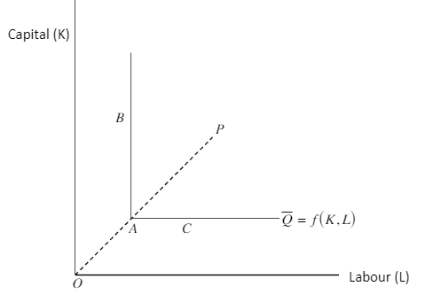
2) Input- output isoquant (Leontief isoquant)
Isoquants input cannot be substituted for one another.
There exists only one single production process (P).
All efficient production must take place at the corner of the isoquant (point A).

Slide 26
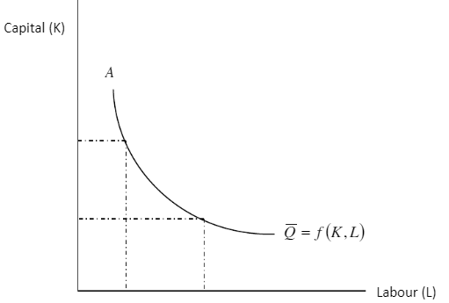
3)Smooth convex isoquant
• Assume continuous substitutability between K and L over a certain range AB, beyond which factors cannot substitute each other.
Mostly adopted in economic theory because it is mathematically simpler to handle by the rules of calculus.
• E.g. to get its slope we differentiate the equation δL/δK.

Slide 27
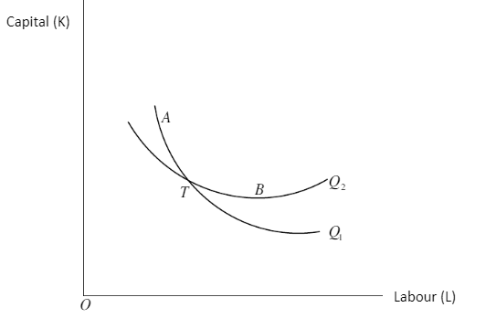
CHARACTERISTICS OF ISOQUANTS
Are downwards sloping within the relevant range.
Isoquants do not intersect.
Superior isoquants are represented by those far away from the graph origin.
Isoquants are convex to the origin within the relevant range

Slide 28
9.0 THE LAW OF RETURNS TO SCALE
It is a long-term analysis of production.
It shows by how much total output will change as a result of a change in all factor inputs by same proportion.
Suppose we start from an initial level of input and output.
      X₀=f (K, L)
And we increase all the factors by the same proportion k.
We will clearly obtain a new level of output X*, higher than the original level X_{O}
    X*= f(K,L)

Slide 29
Returns to scale
X*increases by the same proportion k as the input, we say that there are constant returns to scale.
If X* increases less than proportionally with the increase in the factors, we have decreasing returns to scale.
If X* increases more than proportionally with the increase in the factors, we have increasing returns to scale.

Slide 30
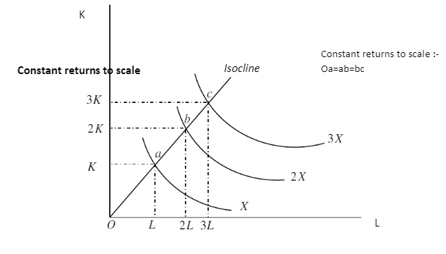
Constant returns to scale
A line joining points a, b, c from origin is called an isocline.
Doubling the factor inputs achieves double the level of initial output.
Tripling inputs achieves triple output and so on.

Slide 31
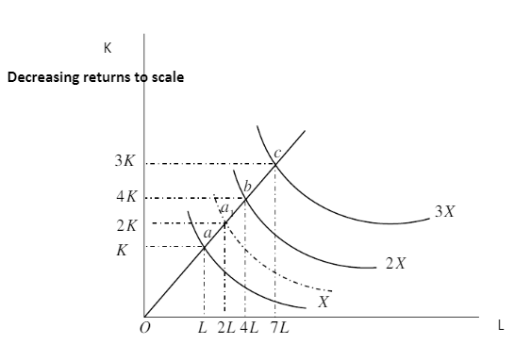
Decreasing returns to scale
By doubling the inputs, output increases by less than twice its original level.
The point a, defined by 2K and 2L lies on an isoquant below the one showing 2X

Slide 32
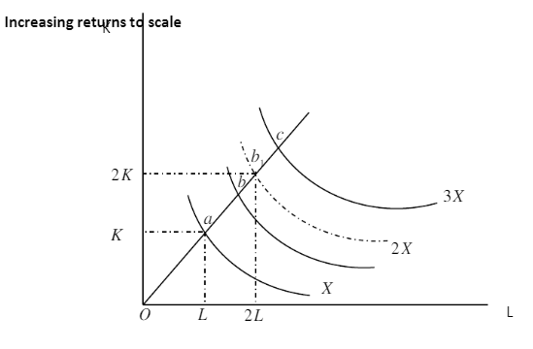
Increasing returns to scale
When inputs are doubled output increases by more than double.
Distance between consecutive multiple isoquant decreases. i.e 0a < ab < bc

Slide 33
11. Returns To Scale and Homogeneity of the Production Function
A homogeneous function is a function such that if each of the inputs is multiplied by a constant k can be completely factored out of the function.
e.g. take production function X0 =f (K, L)
increase both factors L and K by same proportion k
new level of input X* =f (kL, kK)
If k can be factored out so that –
X* Kv f( L,K)

Slide 34
Returns to scale.
A production function is said to be homogeneous of degree n, if when inputs are multiplied by some constant say k, the resulting output is a multiple of kn times the original output. e.g. X0 = b0 Lb1 Kb2
multiplying L and K by a constant k
X* = b0(kL)b1 (kK)b2
= bo kbl kb2(Lb1, Kb2 )
=K(b1+b2) (b0 Lb1, Kb2)
=K(b1+b2) , X0

Slide 35
Returns to scale.
Here returns to scale is measured by the power of k which is (b1+b2).
Notice b1and b2 are powers of factor inputs too.
If (b1+b2) = 1 constant returns to scale.
This production function is sometimes called linear homogeneity.
If (b1+b2)< 1 decreasing returns to scale
If ( b1 + b2) > 1 increasing returns to scale.

Slide 36
10.0 the EQUILIBRIUM OF THE FIRM
The goal of any firm is to maximize profit.
π = R-C
Where;
R is revenue
C is cost.
The firm strives to choose an optimal combination of factors of production that would maximize profits.
The problem facing the firm would be that of constrained profit maximization.
Constrained profit maximization may take one of the following forms.

Slide 37
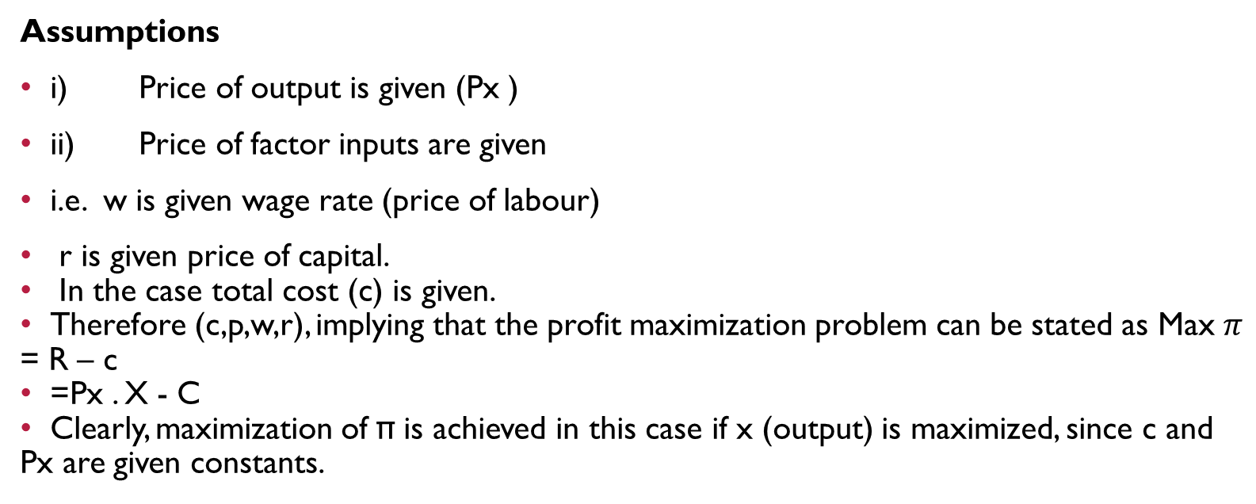
Case 1: maximize output subject to a cost constraint
Assumptions
i) Price of output is given (Px )
ii) Price of factor inputs are given
i.e. w is given wage rate (price of labour)
r is given price of capital.
In the case total cost (c) is given.
Therefore (c,p,w,r), implying that the profit maximization problem can be stated as Max $π$ = R – c
=Px . X - C
Clearly, maximization of π is achieved in this case if x (output) is maximized, since c and Px are given constants.

Slide 38
Case 2: maximizing profit π if output and price are given.
For example, a contractor want to build a ridge (x is given) with the maximum profit.
In this case;
Max π = Px X-C
Maximization of profit can only be achieved by minimizing cost.
Cost function is
  C=w.L =r.K

Slide 39
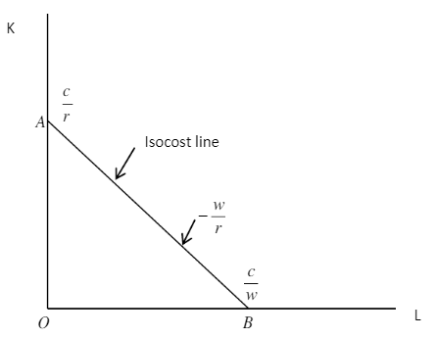
Isocost line
is a locus of all combinations of factors the firm can purchase with a given monetary cost outlay

Slide 40
ISOCOST LINE
When : K = 0
L = C/w
When: L = 0
K= C/r
Slope = OA/OB= -C/r = w/r
  C/w
  Slope of the isocost line is equal to the ratio of the prices of the factor of production.

Slide 41
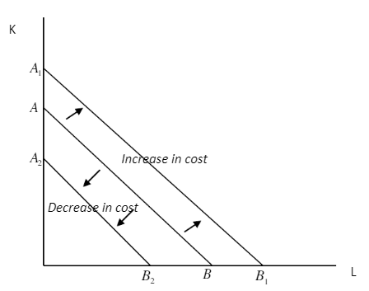
Shifts of isocost lines
i) Due to change in expenditure or cost

Slide 42
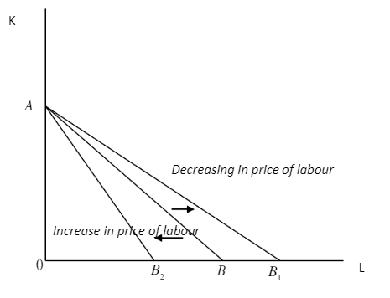
Shifts of isocost lines
ii) due to change in price of labour, price of capital and cost being held constant.

Slide 43
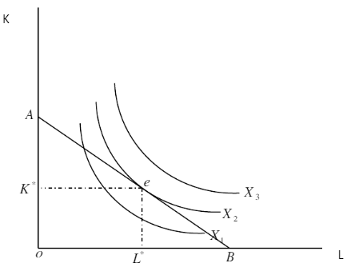
EQUILIBRIUM OF THE FIRM
• Firm is maximizing output subject to cost constraint.
• Equilibrium is attained at the point of tangency between isocost line and the isoquant at point e.
•The optimal combination of inputs that maximize output is (K*,L*).

Slide 44
11.0 SUMMARY
The law of increasing returns is also called the law of diminishing costs,.
The law of increasing return states that when more and more units of a variable factor is employed, while other factor remain fixed, there is an increase of production at a higher rate.
The tendency of the marginal return to rise per unit of variable factors employed in fixed amounts of other factors by a firm is called the law of increasing return.

Slide 45
Summary cont…
An increase of variable factor, holding constant the quantity of other factors, leads generally to improved organization.
The output increases at a rate higher than the rate of increase in the employment of variable factor. Isocost line is a locus of all combinations of factors the firm can purchase with a given monetary cost outlay.

Slide 46
12.0 REFERENCES
Nicholson, W. (1992): Microeconomic Theory: Basic principles and extensions, 5th edition, San Diego, Dryden Press
Koutsoyiannis, A. (1979): Modern Microeconomics, 2nd edition, Macmillan
Mansfield, E, (1991): Microeconomic theory/applications, 7th edition, New York, Norton

Slide 47
            THE END,THANK YOU.

