Slide 1
INTERMEDIATE MICROECONOMICS
WEEK 6- COMPETITIVE MARKETS

Slide 2
CONTENTS
1.0 0bjectives
2.0 Introduction
3.0 Characteristics of Competitive markets
4.0 Advantages and disadvantages of Perfectly Competitive Markets
5.0 Demand in a Perfectly Competitive Markets

Slide 3
CONTENTS
6.0 Profit Maximization
7.0 Short-run Supply Curve
8.0 Long-run Supply Curve
9.0 Summary
10.0 References

Slide 4
1.0 OBJECTIVES
At the end of this topic, you should be able to-
1. Discuss the characteristics of competitive markets
2. Differentiate competitive markets form other markets
3. Evaluate the Profit-Maximizing Output Level
4. State the equilibrium conditions
5. Explain supply in a competitive market.

Slide 5
2.0 INTRODUCTION
What Is Perfect Competition?
It is market structure where all producers and consumers have full and symmetric information and no transaction costs.
There are a large number of producers and consumers competing with one another in this kind of environment.
Perfect competition is theoretically the opposite of a monopolistic market.
The opposite of perfect competition is imperfect competition, which exists when a market violates the abstract tenets of neoclassical pure or perfect competition.

Slide 6
Types of Markets
A competitive firm is a firm that has many other firms producing identical goods and has no control over its price.
Competitive firms are rather unusual and is on one end of the spectrum.
The other extreme is a market with only one firm – a monopoly.
Monopolies have a good bit of influence, but not total influence over the price.
Markets can differ is the existence of barriers to entry.
Oligopolies which are markets with only a few competitors.
An oligopoly, firms have more influence over prices than firms in markets with many competitors.

Slide 7
How does Perfect Competition Work?
It is a benchmark or ideal type to which real-life market structures can be compared.
In a perfect competition model, there are no monopolies.
All firms sell an identical product (the product is a commodity or homogeneous).
All firms are price takers (they cannot influence the market price of their products).
Market share has no influence on prices.
This can be contrasted with the more realistic imperfect competition.
-This market exists whenever a market, hypothetical or real, violates the abstract tenets of neoclassical pure or perfect competition.

Slide 8
3.0 CHARACTERISTICS OF PERFECT COMPETITION
1.A Large and Homogeneous Market
There are a large number of buyers and sellers in a perfectly competitive market.
The sellers are small firms, instead of large corporations capable of controlling prices through supply adjustments.
2. Perfect Information Availability
Information about an industry's ecosystem and competition constitutes a significant advantage.
For example, knowledge about component sourcing and supplier pricing can make or break the market for certain companies.

Slide 9
Characteristics of perfect competition cont…
3. Absence of Controls
Governments play a vital role in market formation for products by imposing regulations and price controls.
They can control the entry and exit of firms into a market by setting up rules to function in the market.
The entry and exit of firms in such a market are unregulated.
This frees firms to spend on labor and capital assets without restrictions.

Slide 10
Characteristics of perfect competition cont…
4. Cheap and Efficient Transportation
companies do not incur significant costs to transport goods. This helps reduce the product’s price and cuts back on delays in transporting goods.
5. Negligible Transaction Costs
Buyers and sellers don’t have to spend much time or money to interact with each other.
If this were not the case, buyers might absorb a higher price charged by firms who have a lower transaction cost.

Slide 11
Note
1. Theory vs. Reality of Perfect Competition
Real-world competition differs from this ideal primarily because of differentiation in production, marketing, and selling
2. Barriers to Entry Prohibit Perfect Competition.
Significant obstacles exist that prevent perfect competition from developing in the economy.
3. Conditions for Perfect Competition
4. Price‐taking behavior.

Slide 12
4.0 ADVANTAGES AND DISADVANTAGES OF PERFECT COMPETITION
Advantages of Perfect Competition
1.Productive Efficiency
A firm is productively efficient when it produces on its long-run average cost curve, from firm’s perspective.
2. Allocative Efficiency
A firm is allocatively efficient when it cannot change the allocation of resources in the economy in a way that will increase the welfare of society.

Slide 13
Advantages of Perfect Competition
3. Lower Price
Perfectly competitive firms have no market power.
The price charged by perfectly competitive firms is lower than the price that would be charged by a monopoly operating in the same market.
4. Income Equity
The distribution of income in perfectly competitive markets will be more equitable than one that abounds with monopolistic markets and oligopolistic markets.

Slide 14
Advantages of Perfect Competition
6. No Price Discrimination
Perfectly competitive firms are price-takers and hence they are unable to exploit consumers through price discrimination.

Slide 15
Disadvantages of Perfect Competition
1.Higher Price
A perfectly competitive firm reaps less economies of scale than a monopoly and hence charges higher prices.
2.Dynamic Inefficiency
Perfectly competitive firms do not engage in research and development due to lack of ability and incentive and hence are dynamically inefficient.
3. No Variety of Choices
Perfectly competitive firms sell homogeneous products and hence offer consumers no variety of choices.

Slide 16
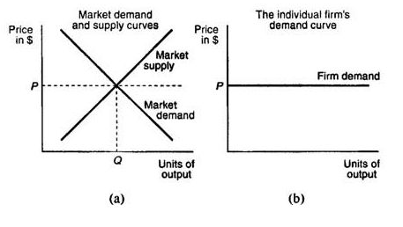
5.0 DEMAND IN A PERFECTLY COMPETITIVE MARKET
The demand and supply curves for a perfectly competitive market are illustrated in Figure (a)
The demand curve for the output of an individual firm operating in this perfectly competitive market is illustrated in Figure (b).

Slide 17
Demand in a perfectly competitive market
The demand curve for the market is downward sloping.
The demand curve for the individual firm is flat or perfectly elastic, reflecting the fact that the individual takes the market price, P, as given.
The difference in the slopes of the market demand curve and the individual firm's demand curve is due to the assumption that each firm is small in size.
The individual firm's equilibrium quantity of output will be completely determined by the amount of output the individual firm chooses to supply.

Slide 18
Demand in a perfectly competitive market
As long as the additional revenue earned from selling a unit is greater than the marginal cost of producing the unit, the firm should produce it.
In perfect competition, the additional revenue earned from selling another unit of output is simply equal to the market price.
Total revenue is the total amount received as firms sell their products.
Marginal revenue is the change in total revenue as a firm sells on more unit of a good or service.
Average revenue is the average amount received per unit.

Slide 19
6.0 PROFIT MAXIMIZATION
Choosing the Profit-Maximizing Output Level
If the goal of a firm is to maximize profit, this can be done by choosing the output level where marginal revenue = marginal cost.
If a firm is producing at an output where marginal cost equals marginal revenue, and yet the price is below average cost, the firm is earning a loss.
If the marginal revenue is greater than the average variable cost, the firm is better off producing than not producing.
If the marginal revenue is greater than average cost, the firm can reduce losses by producing more.

Slide 20
7.0 SHORT-RUN SUPPLY
The firm's profits are the difference between its total revenues and total costs.
Total revenue and marginal revenue. A firm's total revenue is P * Q
In a perfectly competitive market, the firm's marginal revenue is just equal to the market price, P.
Short‐run profit maximization
Choosing to supply the level of output where its marginal revenue equals its marginal cost.
When marginal revenue exceeds marginal cost, the firm can earn greater profits by increasing its output.
When marginal revenue is below marginal cost, the firm is losing money, and consequently, it must reduce its output.

Slide 21
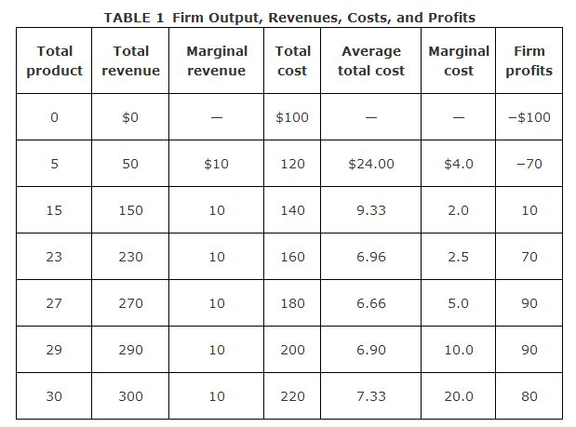
Table 1-firms outputs, revenues, costs and profits
The firm maximizes its profits by choosing to produce exactly 29 units of output.
In choosing to produce 29 units of output, the firm earns $90 ($290 − 200) in profits.

Slide 22
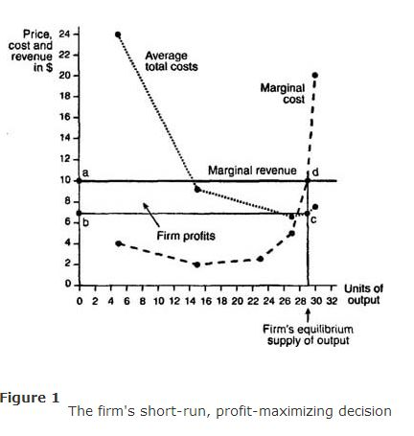
Graphical illustration of short‐run profit maximization.
The firm's equilibrium supply of 29 units of output is determined by the intersection of the marginal cost and marginal revenue curves (point d in Figure ).
When the firm produces 29 units of output, its average total cost is found to be $6.90 (point c) on the average total cost curve in Figure ).

Slide 23
Short‐run losses and the shut‐down decision.
When the firm's average total cost curve lies above its marginal revenue curve at the profit maximizing level of output, the firm is experiencing losses.
The firm will take into account its average variable costs rather than its average total costs.
The difference between the firm's average total costs and its average variable costs is its average fixed costs.
The firm must pay its fixed costs regardless of whether it produces any output.
Hence, the firm's fixed costs are considered sunk costs and will not have any bearing on whether the firm decides to shut down.
Thus, the firm will focus on its average variable costs in determining whether to shut down.

Slide 24
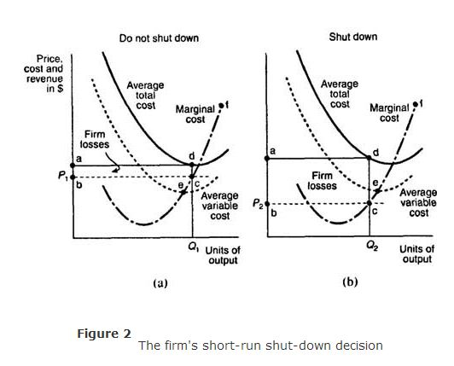
The firms short-run shut down decision
As a general rule, a firm will shut down production whenever its average variable costs exceed its marginal revenue at the profit maximizing level of output.

Slide 25
The firm's short‐run supply curve
Short‐run supply curve.
The firm's short‐run supply curve is the portion of its marginal cost curve that lies above its average variable cost curve.
As the market price rises, the firm will supply more of its product, in accordance with the law of supply.
If, however, the market price, which is the firm's marginal revenue curve, falls below the firm's average variable cost, the firm will shut down and supply zero output.

Slide 26
short-run equilibrium
At short-run equilibrium, the firm has two conditions:
If price is less than the average variable cost, the firm should shut down.
If price is greater than the average variable cost, the firm should produce. ▪The firm always produces at the output level where marginal revenue equals marginal cost.
Both conditions apply to firms in all different types of markets.

Slide 27
8.0 LONG-RUN SUPPLY
In the long‐run, firms can vary all of their input factors.
New firms will be tempted to enter the market if some of the existing firms in the market are earning positive economic profits.
Zero economic profits. The entry and exit of firms, which is possible in the long‐run, will eventually cause each firm's economic profits to fall to zero.
Hence, in the long‐run each firm earns normal profits.
A perfectly competitive market achieves long‐run equilibrium when all firms are earning zero economic profits and when the number of firms in the market is not changing.

Slide 28
Minimization of long‐run average total cost.
In the long‐run, a perfectly competitive firm can adjust the amount it uses of all factor inputs, including those that are fixed in the short‐run.
If, in the short‐run, the firm is operating below its minimum efficient scale and experiencing economies of scale,
in the long‐run it can adjust its use of factor inputs so as to increase its output to the minimum efficient scale level.
Alternatively, if the firm is experiencing diseconomies of scale because its short‐run level of output exceeds its minimum efficient scale,-
in the long‐run the firm can adjust its use of factor inputs so as to reduce its output to the minimum efficient scale level.

Slide 29
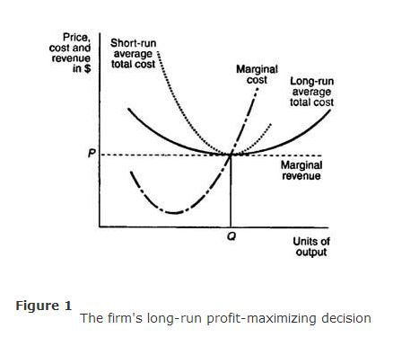
Graphical illustration of long‐run profit maximization
The profit maximizing level of output, where marginal cost equals marginal revenue, results in an equilibrium quantity of Q units of output.

Slide 30
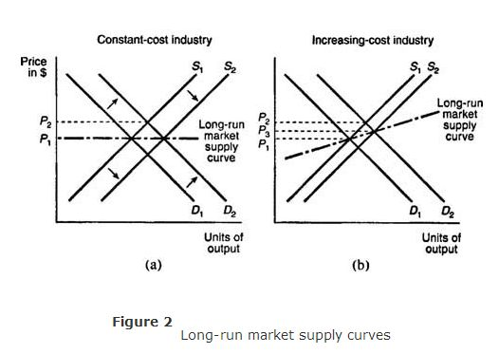
Long‐run market supply curve.
The short‐run market supply curve is just the horizontal summation of all the individual firm's supply curves.
The long‐run market supply curve is found by examining the responsiveness of short‐run market supply to a change in market demand.

Slide 31
supply in a competitive market
In perfect competition, the firm’s short-run supply curve is just the marginal cost function above the shutdown price.
The market supply curve is the horizontal sum of all the individual firm’s supply curves.
Profits: Economics and Accounting Profits
Accounting profit is the difference between revenue and explicit costs.
Economic profit accounts for costs of the factors of production.
Accounting profit that could be earned elsewhere is the normal profit.
This is the opportunity cost of capital and other inputs supplied by the owners of a business.
Zero economic profit means that this firm is earning the same accounting profit in the current business that they could earn elsewhere.

Slide 32
9.0 SUMMARY
If firms in an industry are earning positive economic profit, other firms will enter the industry.
If there are positive economic profit new firms will enter, increasing the market supply.
In the long-run, entry and exit of firms will cause the price to adjust back to the long-run equilibrium where economic profits are zero
An increasing cost industry is one where the price of inputs increase as the industry expands.
A decreasing cost industry is one where the price of inputs decreases as the industry expands.
In the short run, demand increases, creating a shortage.

Slide 33
SUMMARY
Business also increase prices due to higher costs as they expand. As prices rise, some consumers reduce the amounts they are willing to purchase.
This process continues until quantity demanded equals quantity supplied and firms are producing at levels of output that are maximizing profits in the short run.
At this point, prices are still above average costs, so firms will be earning economic profit.
This prompts additional firms to enter the market, which ultimately cycles to cause all firms to earn zero economic profit in the long run.
Economic Efficiency-In the long run, a perfectly competitive market will create a technically efficient and allocatively efficient outcome.

Slide 34
10.0 REFERENCES
Nicholson, W. (1992): Microeconomic Theory: Basic principles and extensions, 5th edition, San Diego, Dryden Press
Koutsoyiannis, A. (1979): Modern Microeconomics, 2nd edition, Macmillan
Mansfield, E, (1991): Microeconomic theory/applications, 7th edition, New York, Norton

Slide 35
    THE END,THANK YOU

