Slide 1
INTERMEDIATE MICROECONOMICS
WEEK 7-MONOPOLY

Slide 2
CONTENTS
1.0 OBJECTIVES
2.0 INTRODUCTION
Definition
Characteristics
Barriers to entry limiting competition
3.0 TYPES OF MONOPOLY
Simple Monopoly and Discriminating Monopoly
Pure Monopoly and Imperfect Monopoly
Natural Monopoly
Legal Monopoly

Slide 3
CONTENTS
4.0 Monopoly Pricing and Short run equilibrium
5.0 The Long-run in Monopoly
6.0 Impacts of Monopoly on inefficiency.
7.0 Government responses to Monopoly
8.0 SUMMARY
9. 0 REFERENCES

Slide 4
1.0 OBJECTIVES
At the end of this unit, you should be able to:
Describe the monopoly market
State the features of monopoly
Enumerate sources of monopoly power
Explain total revenue, marginal revenue and demand curve monopoly market
Explain profit maximization and loss minimization under monopoly market.

Slide 5
2.0 INTRODUCTION
2.1 Definition
It refers to a market situation where one firm or a group of firms which are combined to have a control over the supply of the product.
Three essential conditions to constitute as monopoly-
Single producer or seller.
Absence of close substitutes.
Barriers to the entry of new firms.

Slide 6
2.2 Characteristics of Monopoly
1. There is a single seller, so the firm and industry are synonymous.
2. There are no close substitutes for the firm’s product.
3. The firm is a “price maker,” that is, the firm has considerable control over the price.
4. Entry into the industry by other firms is blocked.
5. A monopolist may or may not engage in nonprice competition.

Slide 7
2.3 Barriers to entry limiting competition
Sources of Monopoly Power
Monopolies derive their market power from barriers to entry.
The major types of barriers to entry;
Economies of scale
Legal barriers to entry into a monopolistic industry also exist in the form of patents and licenses.
Ownership or control of essential resources.

Slide 8
Barriers to entry limiting competition cont…
4. Monopolists may use pricing or other strategic barriers such as selective price-cutting and advertising.
5. Technological superiority: A monopoly may be better able to acquire, integrate and use the best possible technology in producing its goods.
Entrants do not have the size or finances to use the best available technology.
6. No substitute goods: A monopoly sells a good for which there is no close substitute.
The absence of substitutes makes the demand for the good relatively inelastic enabling monopolies to extract positive profits.

Slide 9
Barriers to entry limiting competition cont…
7. Ownership/control of a key resource: A prime source of monopoly power is the control of resources that are critical to the production of final goods.
8. Network effects: The use of a product by a person can affect the value of that product to other people. This is the network effect.
There is a direct relationship between the proportion of people using a product and the demand for that product.
Special right given by government: Legal rights can provide opportunity to monopolize the market of a good.
Intellectual property rights, including patents and copyrights, give a monopolist special control of the production and selling of certain goods.

Slide 10
Barriers to entry limiting competition cont…
9. Elimination strategies/ actions:
A company wanting to monopolize a market may engage in various types of deliberate action to exclude competitors or eliminate competition.
10. Difficulty to exit may be a source of market power:
Barriers to exit include market conditions that make it difficult or expensive for a company to end its involvement with a market.

Slide 11
3.0 TYPES OF MONOPOLY
1.Simple Monopoly and Discriminating Monopoly:
A simple monopoly firm charges a uniform price for its output sold to all the buyers.
While a discriminating monopoly firm charges different prices for the same product to different buyers.
2. Pure Monopoly and Imperfect Monopoly:
Pure monopoly is that type of monopoly in which a single firm which controls the supply of a commodity which has no substitutes not even a remote one.
Imperfect monopoly refers to a single firm which produces a commodity having no close substitutes.

Slide 12
Types of monopoly cont…
3. Natural Monopoly:
Is a monopoly established due to natural causes.
4. Legal Monopoly:
When anybody receives or acquires Monopoly due to legal provisions in the country.

Slide 13
4.0 Monopoly Pricing and Short run equilibrium
1.What is firm demand/market demand in a monopoly market?
In monopoly, however, firm and market demand are the same because only one firm exists in the market.
A monopoly can charge any price it wants, and the consumer must pay that price. True or false? False.
Monopolies do have less competition, but consumers do not have to buy their product.
As the monopoly charges a higher price, we expect that quantity demanded will fall.

Slide 14
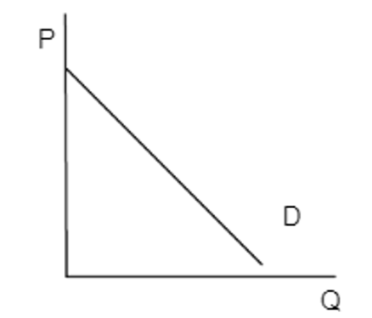
Demand curve of a monopolist market.
Demand is determined by consumers not by the monopoly firm.
Note –market power
Price is a factor of market power, the ability to increase price without decreasing sales
Monopoly has more market power than Perfect Competition but does not have absolute market power.

Slide 15
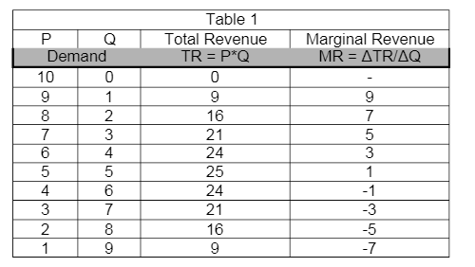
Short-run profit maximization
Table 1 shows a downward sloping demand curve for a monopolist.
As price falls quantity demanded rises.
Why is MR = 7 when Q = 2 when price equals 8?
(Hint: What happens to the price of the first unit sold?)

Slide 16
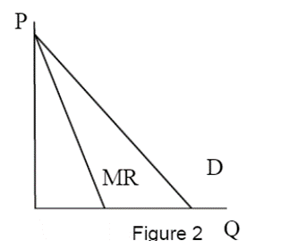
MR and price(demand) for a monopoly
Notice that MR < P (which is given by the demand curve) as shown in Figure 2 to the right.

Slide 17
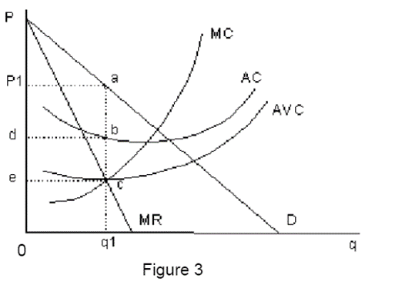
MR,P and cost curves
In the short-run the ATC, AVC, and MC are all u-shaped (law of diminishing returns.)
Profit maximizing firms produce at the quantity where MR = MC and where q is q1.
The appropriate price that is the maximum price it can just sell all of q1.
MR = MC at point c => both equal the distance from 0 to e.

Slide 18
Graphical analysis – questions to be answered using figure 3.
1. At what q is π maximized?
all profit maximizing firms produce at the quantity where MR = MC. In Figure 3 this occurs at q1.
2. What P does a firm charge?
The appropriate price that is the maximum price it can just sell all of q1.
This is given by the demand curve at q1 – which occurs at point a.
The appropriate profit maximizing price is P1.

Slide 19
Graphical analysis
3. What does π equal?
These are calculated at the profit maximizing output, q1.
Q = q1 = distance 0 to q1.
The price is given by the demand at point a = P1.
MR = MC at point c => both equal the distance from 0 to e.

Slide 20
The average costs
o ATC = distance 0 to d.
o AVC = distance 0 to e.
o AFC = ATC – AVC = distance e to d.

Slide 21
Total revenue and total costs
o TR = p*q = distance 0-q1 * distance 0 – P1 = area of the rectangle 0 – P1 – a – q1.
o TC = ATC*q = area of the rectangle 0 – d – b – q1.
o TVC = AVC*q = area of the rectangle 0 – e – c – q1.
o TFC = AFC*q = area of the rectangle e- d – b –c.
• Profit. Recall that there are two methods of calculating profits.

Slide 22
Total revenue and total costs
o π = TR – TC = the area of the rectangle 0 – P1 – a – q1. minus the area of rectangle 0 – d – b – q1 = the area of rectangle d – P1 – a – b.
o π = TR – TC = p*q – ATC*q = (p – ATC)*q. Again, this is the most
useful equation but gives the same answer. Notice that profit is positive here because P > ATC.

Slide 23
Loss minimization for monopolist firms
Recall the three possibilities that can occur in the short-run for all firms:
π > 0, which occurs whenever P > ATC-the firm continues to produce.
π = 0, which occurs whenever P = ATC-the firm will continue to produce (zero economic profit implies that all costs, including opportunity costs are covered.)
π < 0, which occurs whenever P < ATC. Should the firm shutdown in this situation?
Answer-
Firms should only shut down if they cannot cover their variable (not fixed) costs.
Thus, if price falls below AVC then the firm will shutdown.

Slide 24
what is the industry/market short-run supply curve?
Examine Figure 3 again. Recall that the firm produces where MR=MC at q1.
Hence, the MC curve does show quantity supplied.
If the MC curve were the firm’s supply curve, then the price would be given by MC at that output level or a price of 0 – e.
The interaction of MC and MR determine quantity supplied but the demand curve determines price.
This means that no single curve determines quantity supplied and price.
In monopoly no supply curve exists.

Slide 25
5.0 The Long-run in Monopoly
The long-run equilibrium in monopoly markets:
1• if π > 0, the positive profits attract firms to the market in the long-run.
However, monopolies have entry barriers which keep potential competitors from entering the market.
Hence, π remains positive.
2. If π < 0, the negative profits cause the firm to go out of business / leave industry in the long-run (there are no fixed costs, recall).
if the firm exits in the long-run, then it has no revenue but also avoids all costs so that π = 0.
3. • Thus in the long-run π is ≥ 0.

Slide 26
6.0 IMPACTS OF MONOPOLY ON EFFICIENCY
What are the reasons for Efficiency Loss?
A monopoly generates less surplus and is less efficient than a competitive market, and therefore results in deadweight loss.
What is the economic inefficiency created by monopolies?
In a monopoly, the firm will set a specific price for a good that is available to all consumers.
The quantity of the good will be less and the price will be higher (this is what makes the good a commodity).
The monopoly pricing creates a deadweight loss because the firm forgoes transactions with the consumers.

Slide 27
Impact of monopoly on inefficiency
The deadweight loss is the potential gains that did not go to the producer or the consumer.
Deadweight loss results in the combined surplus (wealth) of the monopoly and the consumers being less than that obtained by consumers in a competitive market.
A monopoly is less efficient in total gains from trade than a competitive market.
Monopolies can become inefficient and less innovative over time because they do not have to compete with other producers in a marketplace.

Slide 28
Market Failure
When a market fails to allocate its resources efficiently, market failure occurs.
Market failure occurs when the price mechanism fails to consider all the costs and/or benefits of providing and consuming a good.
Market failure in a monopoly can occur because not enough of the good is made available and/or the price of the good is too high.
Without the presence of market competitors, it can be challenging for a monopoly to self-regulate and remain competitive over time.

Slide 29
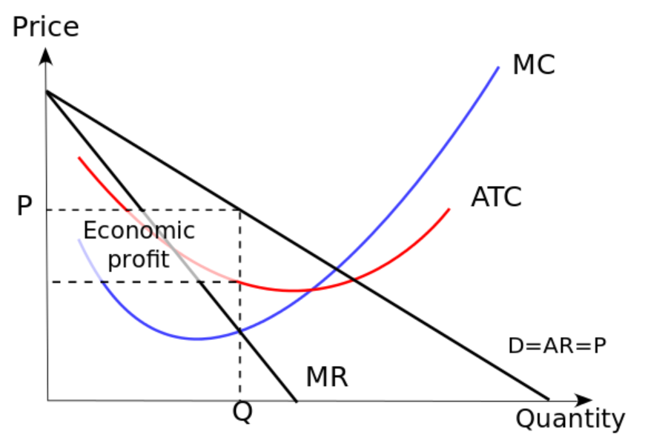
Abnormal profits in a monopoly
Imperfect competition: This graph shows the short run equilibrium for a monopoly.
The gray box illustrates the abnormal profit, although the firm could easily be losing money.
A monopoly is an imperfect market that restricts the output to maximize its profits.

Slide 30
Understanding and Finding the Deadweight Loss
Explain how to determine the deadweight loss in each market.
Deadweight loss is a loss of economic efficiency that occurs when equilibrium for a good or service is not Pareto optimal.
When deadweight loss occurs, there is a loss in economic surplus within the market.
Deadweight loss implies that the market is unable to naturally clear.
It is an indication, therefore, of market inefficiency.
The supply and demand of a good or service are not at equilibrium

Slide 31
Causes of Deadweight Loss
Causes of deadweight loss include:
Imperfect markets
Externalities
Taxes or subsides
Price ceilings
Price floors

Slide 32
Determining Deadweight Loss
To determine the deadweight loss in a market, the equation P=MC is used.
The deadweight loss equals the change in price multiplied by the change in quantity demanded.
This equation is used to determine the cause of inefficiency within a market.

Slide 33
Case example-dead weight loss
For example, in a market for nails where the cost of each nail is $0.10.
The demand will decrease from a high demand for less expensive nails to zero demand for nails at $1.10.
In a perfectly competitive market, producers would charge $0.10 per nail .
A consumer whose marginal benefit exceeds the $0.10 would have a nail.
If one producer has a monopoly on nails, they will charge whatever price will bring the largest profit.
If they charge $0.60 per nail, every party who has less than $0.60 of marginal benefit will be excluded.
When equilibrium is not achieved, parties who would have willingly entered the market are excluded due to the non-market price.

Slide 34
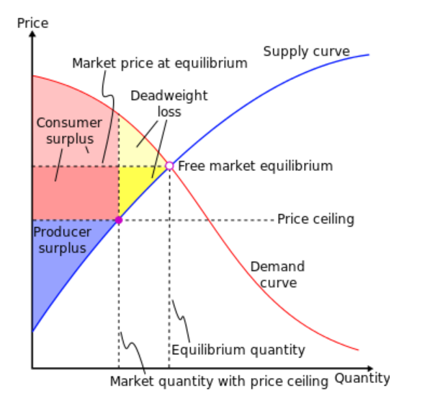
Deadweight loss-
The deadweight loss that is the result of a binding price ceiling.
Policy makers will place a binding price ceiling when they believe that
the benefit from the transfer of surplus outweighs the adverse impact of the deadweight loss.

Slide 35
7.0 GOVERNMENT RESPONSE TO MONOPOLY
A key role of government is to correct problems of market failure associated with public goods, external costs and benefits, and imperfect competition.
Government intervention to correct market failure always has the potential to move markets closer to efficient solutions, and thus reduce deadweight losses.
Governments may seek to alter the provision of certain goods and services based on a normative judgment that consumers will consume too much or too little of the goods.
Governments redistribute income through transfer payments.

Slide 36
8.0 SUMMARY
The true monopoly exists where there is only one seller of a product for which no close substitute is available.
Monopoly firm faces the industry demand curve; it can pick the most profitable point on the demand curve.
Monopolist is a price maker rather than price taker.
Legal barriers to entry include patent right, licensing and the control of natural resources, and large entry cost, give monopolist power control the market.

Slide 37
Summary
In this unit, you learnt about-
The concept and features of monopoly market, and its characteristics.
The sources of monopoly power and the nature of its demand curve, marginal cost, marginal revenue, average total cost and average revenue.
How monopolist maximizes profit and minimizes losses in case it fails to manage its fortune and market power it has.

Slide 38
9.0 REFERENCES
Fashola, M.A. (2004). Microeconomic Theory: Highlights and Policy Extensions for Less-Developed Economies. Lagos: Concept Publications.
Karl, E.C. & Ray, C. F. (2007). Principles of Microeconomics. New Jersey, USA: Pearson Education International.
Umo, J.U. (1986). Economics: African Perspective. Lagos: John West Publications Limited.

Slide 39
        THE END,THANK YOU!

