Slide 1
INTERMEDIATE MICROECONOMICS
WEEK 9-GENERAL EQUILLIBRIUM

Slide 2
CONTENTS
1.0 OBJECTIVES
2.0 INTRODUCTION
  Definition
  Assumptions
3.0 WORKING OF THE GENERAL EQILLIBRIUM SYSTEM
3.1 Product Market
3.2 Factor Market
4.0 LIMITATIONS

Slide 3
CONTENTS
5.0 USES OF THE GENERAL EQUILLIBRIUM IN THE ECONOMY
6.0 COMPARISON OF THE MARSHALLIAN EQULLIBRIUM AND GENERAL EQULLIBRIUM
6.1 Walras General Equilibrium analysis
6.1.1 Edge Worth Box Model
7.0 SUMMARY
8.0 REFERENCES

Slide 4
1.0 OBJECTIVES
By the end of this topic, the learner should be able to:
1.Explain the concept of general equilibrium
2.Evaluate general equilibrium in the factor and product markets
3.List the assumptions of general equilibrium
4.Discuss the uses of general equilibrium in the economy.
5.Illustrate the concept of Edgeworth Box Diagram and its application

Slide 5
2.0 INTRODUCTION
Definition-What Is General Equilibrium Theory?
General equilibrium analyzes the economy, rather than single markets with partial equilibrium analysis.
General equilibrium shows how supply and demand interact and tend toward a balance in an economy of multiple markets working at once.
The balance of competing levels of supply and demand in different markets creates a price equilibrium.

Slide 6
Definition
French economist Leon Walras introduced and developed the theory in the late 19th century.
General equilibrium analysis is-
an extensive study of several economic variables, their interrelations and interdependences for understanding the working of the economic system.

Slide 7
Definition cont..
General equilibrium brings together the cause-and-effect sequences of changes in prices and quantities of commodities and services in relation to the entire economy.
An economy can be in general equilibrium only if-
all consumers, all firms, all industries and all factor-services are in equilibrium simultaneously and they are interlinked through commodity and factor prices.

Slide 8
Assumptions
(1) There is perfect competition both in the commodity and factor markets.
(2) Tastes and habits of consumers are given and constant.
(3) Incomes of consumers are given and constant.
(4) Factors of production are perfectly mobile between different occupations and places.
5) There are constant returns to scale.

Slide 9
Assumptions
(6) All firms operate under identical cost conditions.
(7) All units of a productive service are homogeneous.
(8) There are no changes in the techniques of production.
(9) There is full employment of labour and other resources.

Slide 10
3.0 WORKING OF THE GENERAL EQUILIBRIUM SYSTEM
The economy is in a state of general equilibrium when the demand for every commodity and service is equal to the supply for it.
The decisions of consumers for the purchase of each commodity must be in perfect accord with the decisions of producers for the production and sale of each commod­ity.
The decisions of owners for selling each factor service must be in perfect harmony with the decisions of their employers.
It is only when the decisions of buyers of goods and services fit in perfectly with the decisions of sellers that the market is in general equilibrium.

Slide 11
3.1 Product Market
Each consumer maximizes his satisfaction relative to the prices ruling the market. For him, the marginal utility of each commodity equals its price.
The demand of consumers for the various commodities depends upon their prices and the prices of services
The costs of production, in turn, depend on the quantities of the various productive services employed and the prices paid for them.

Slide 12
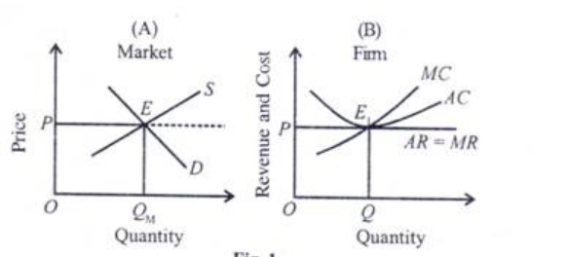
The equilibrium of the commodity market
The market is in equilibrium at point E where the market demand and supply curves D and S intersect.
It determines OP price at which OQM quantity of the product is bought and sold in the market.
It is in equilibrium when MC=MR and AC=AR at point E1producing OQ units of the commodity, as shown in Panel B.

Slide 13
3.2 Factor Market
The equality of demand and supply of factor services is also essential for the general equilibrium system.
The demand for productive services comes from the producers and supply from the consumers.
Since there is full employment in the economy, the markets for factors are in equilibrium when the total quantities of factors offered, and the total quantities employed are equal.

Slide 14
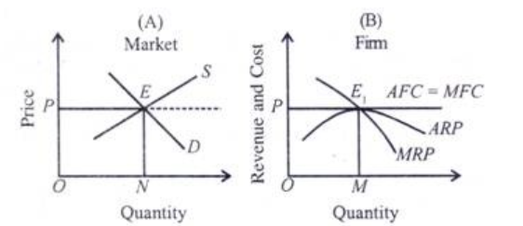
The equilibrium of the factor market
In Panel (A), the price of a factor OP and its quantity ON are determined in the market by the interaction of its demand and supply curves D and 5 respectively at point E.
Panel (B) shows that the supply curve of this factor to an individual firm is perfectly elastic and is the same as the marginal cost of that factor, MFC.

Slide 15
General Equilibrium:
The economy is in general equilibrium when-
Commodity prices make each demand equal to its supply and
Factor prices make the demand for each factor equal to its supply so that
All product markets and factor markets are simultaneously in equilibrium.
A general equilibrium is characterized by two conditions-
1) All consumers maximize their satisfaction, and all producers maximize their profits; and
(2) All markets are cleared which means that the total amount demanded equals the total amount supplied at a positive price in both the product and factor markets.

Slide 16
3.3 General equilibrium-Case Example
Assume a simple hypothetical economy where there are only two sectors, the household and the business.
The economic activity takes the form of flow of goods and services between these two sectors and monetary flow between them.
These two flows which are called real and monetary.
In the product market, consumers purchase goods and services from producers.
In the factor market, consumers receive income from the former for providing services.

Slide 17
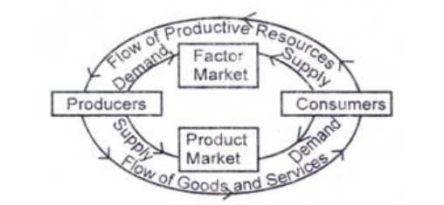
Real and monetary flows-product and factor markets
Consumers purchase all goods and services provided by producers and make payments to the latter in lieu of these.
Goods flow from the business sector to the household sector in the product market.
Services flow from the household sector to the business sector in the factor market, as shown in dies inner portion of the figure.

Slide 18
Real and monetary flows-product and factor markets
These two flows are linked by product prices and factor prices.
The economy is in general equilibrium when a set of prices is allowed at which the magnitude of income flow from producers to consumers is equal to the magnitude of the money expenditure from consumers to pro­ducers.

Slide 19
4.0 Limitations
1. It is based on several unrealistic assumptions which are contrary to the actual conditions prevailing in the world.
It is a static analysis. All consumers and producers in this analysis consume and produce the same products day in and day out without any time-lag.
Prof. Stigler regards general equilibrium as a misnomer. No economic analysis has ever been general in the sense that it considered equilibrium studies as more inclusive than partial equilibrium studies, never that they are complete.

Slide 20
5.0 Uses of General Equilibrium Analysis
A Picture of Economy Equilibrium:
To Understand the Working of Economic System:
To Understand the Complex Problems of the Market:
To Understand the Working of the Pricing Process:
To Understand the Input-Output Analysis:

Slide 21
6.0 Marshall’s Partial Equilibrium Analysis and Walras General Equilibrium Analysis
Marshall’s Partial Equilibrium Analysis
Partial equilibrium approach to the pricing, seeks to explain the price determination of commodity.
It keeps the prices of other commodities constant and assuming that the various commodities are not interdependent.

Slide 22
6.1 Walras General Equilibrium Analysis
General equilibrium analysis-
Deals with inter-relationship and inter-dependence between equilibrium adjustments with each other.
It exists when at the going prices, the quantities demanded of each product and each factor are equal to their respective quantities supplied.
The quantity demanded of each good is described by an equation in which its quantity demanded is a function of prices of all goods.
The quantity supplied of each good is the function of price of all factors of production.

Slide 23
6.1.1 Edgeworth box model
Edgeworth box , named after F.Y. Edgeworth, is a powerful tool of economic analysis used for representing various distributions of resources.
This tool is used in general equilibrium analysis and is an indicator of Pareto optimal distribution of resources, showing the level of social welfare.
Consider a simple case of exchange of given quantities of the two commodities, X and Y between two individuals, A and B.

Slide 24
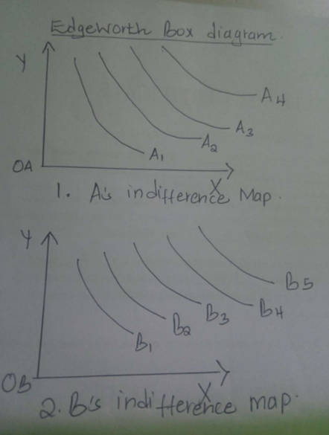
Indifference maps of two individuals
Preferences, with slope of indifference curves showing MRSy,x
A Pareto optimum exists when it is not possible to improve an individual’s welfare without reducing the welfare of the other individual.

Slide 25
Edgeworth box model cont…
Edgeworth box can be utilized to show that exchange between two individuals.
This may lead to an increase in the welfare of an individual without causing a reduction in the welfare of the other.
This can lead to an increase in the overall social welfare from a given bundle of resources. This is a Pareto improvement.
To understand the optimum distribution of the given quantities of x and y between A and B, we superimpose indifference map of B over that of A to get a box like structure.

Slide 26
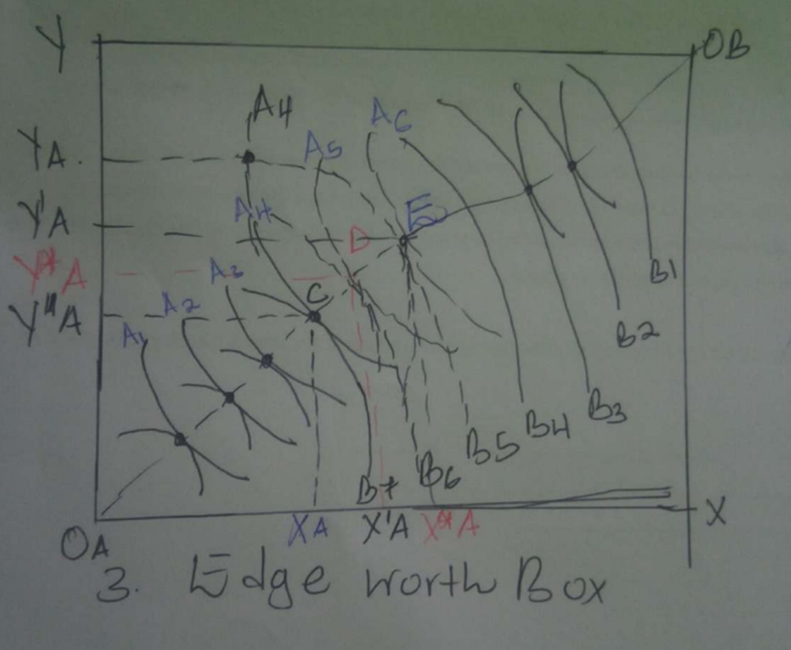
Edgeworth box diagram
OA-origin point of A and OB –origin point of B.
The horizontal axis shows given quantity- OAx of commodity x and vertical axis shows given quantity OBY
indifference curves are labeled as A1, A2 ….and Bs as B1, B2 …

Slide 27
Edgeworth box model cont…
Any point of the Edgeworth box shows a certain distribution of the two commodities between the two individuals.
The indifference curves of A and B are of opposite curvature and thus are tangential to each other.
The locus of these points of tangency is Edgeworth contract curve, shown as OA OB in the figure above.
Any point on the contract curve shows the equality of marginal rate of substitution between the two commodities for the two individuals

Slide 28
Edgeworth box model cont…
At the points of tangency of the two indifference curves of A and B respectively, the following condition will hold:
Only the distribution on the contract curve represents an optimal distribution of resources, as any distribution off this curve represents lesser welfare for at least one individual.
At this point consumer A is having OA XA of x and OA YA of y leaving XA X of x and YAY of y for individual B.
The level of welfare of A is given by IC A4 and for B by IC B5.
This is a suboptimal distribution because any exchange which causes them to move at a point on the contract curve will result in the increase in welfare of either one of them or of the both.

Slide 29
Edgeworth box model cont…
If the individuals move to point E on the contract curve-with A having additional XA X’A of x and giving up YA Y’A of y, his level of utility increases as he moves from IC A4 to A6.
B remains on the same level of welfare as points E and F lie on the same IC B5.
The exchange which involves movement from a point off the contract curve –
to a point on the contract curve has improved the welfare of one individual without worsening the condition of the other.
This is a case of Pareto improvement, resulting in an increase in social welfare- if we assume society to be made up of two individuals only.

Slide 30
Edgeworth box model cont…
Similarly, a movement from F to C on the contract curve improves the welfare of B,
This can be seen by his movement from IC B5 to B7 because of this exchange in which he is having YA and Y”A additional units of y in Exchange of giving up X”A.
If they move to point D, then both are gainers as A moves from A4 to A5 and B moves from B5 to B6.
Any distribution of resources in which the two individuals move on the segment denoted by segment CE on the contract curve leads to improvement in social welfare.

Slide 31
Edgeworth box model cont…
Ultimately which individual will be a greater beneficiary in this exchange process depends on the noneconomic factors, such as bargaining power of the two.
It is clear from this analysis that the distribution denoted by a point on contract curve represents
an optimal distribution of resources as either one of them or both are beneficiaries by moving from a point off the contract curve to a point on it.
Edgeworth box is also a tool which can be used in the analysis of general equilibrium.
In general equilibrium of production, the vertical and horizontal axes represent the two factor inputs and instead of ICs we have isoquants for products x and y.

Slide 32
7.0 SUMMARY
General Equilibrium Theory shows how supply and demand in a multi-market economy interact and create an equilibrium of prices.
French economist Léon Walras is credited with developing and expanding the theory in the late 19th century.
Walras applied the theory to calculate price ratios and helped economics evolve into a study that includes mathematical analysis.

Slide 33
Summary
The Edgeworth box-
Considers a two-person, two-good “exchange economy.”
It is a graphical representation of the exchange problem facing these people and permits a straightforward solution to their exchange problem.
A point in the Edgeworth box is the consumption of one individual, with the balance of the endowment going to the other.
Pareto efficiency is an allocation in which making one person better off requires making someone else worse off—there are no gains from trade or reallocation.

Slide 34
8.0 REFERENCES
Border, K. C., Fixed Point Theorems with Applications to Economics and Game The-ory, Cambridge: Cambridge University Press, 1985.
Luenberger, D., Microeconomic Theory, McGraw-Hill, 1995, Appendixes A-D.
Takayama, A. Mathematical Economics, the second edition, Cambridge: Cambridge University Press, 1985, Chapters 1-3.
Tian, G., The Basic Analytical Framework and Methodologies in Modern Economics, 2004
Tian, G., \Fixed Points Theorems for Mappings with Non-Compact and Non-Convex Domains," Journal of Mathematical Analysis and Applications. 117

Slide 35

              THE END,THANK YOU.

