Slide 1
INTERMEDIATE MICROECONOMICS
WEEK 10-EXTERNALITIES

Slide 2
CONTENTS
1.0 OBJECTIVES
2.0 INTRODUCTION
3.0 TYPES OF EXTERNALITIES
4.0 SOLUTIONS TO EXTERNALITIES
  4.1 PRIVATE SOLUTION TO EXTERNALITIES-
  Coase Theorem
  Failures of Private Remedies for Externalities

Slide 3
CONTENTS
  4.2 PUBLIC SECTOR SOLUTIONS TO EXTERNALITIES –
  Market-based solutions
5.0 REGULATION
6.0 IMPLICATIONS OF EXTERNALITY
7.0 TOPIC QUESTIONS AND ANSWERS
8.0 SUMMARY
9.0 REFERENCES

Slide 4
1.0 OBJECTIVES
At the end of the Lecture, the student should be able to:
Explain the concept of externalities in economics and give examples.
Explain the various types of externalities
Discuss the private and public remedies for externalities
Explain the implications and solutions of externality

Slide 5
2.0 INTRODUCTION
Definitions
What are externalities?
This refers to the favorable and unfavorable effects which are associated with the production or consumption of goods.
The economic effects are also referred to as spill-over effect, neighborhood effects or third-party effects.
These externalities may either be economic gain or economic loss to other parties.
This economic gain or loss cannot be priced in the market and apportioned to parties.

Slide 6
Definitions
Market price is fixed in terms of the internal cost of goods and services whereas social cost of some goods and services must be borne by the society in the form of physical inconvenience and disease.
Externality ≡ cost or benefit accruing to party not involved in economic transaction
  Positive externality ≡ benefit accruing to party not involved in economic transaction.
  Negative externality ≡ cost accruing to party not involved in economic transaction.
What is market failure?
A problem that violates one of the assumptions of the 1st welfare theorem and causes the market economy to deliver an outcome that does not maximize efficiency.

Slide 7
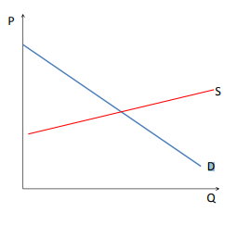
In a Market Without Externalities
If private demand = private marginal benefit = social marginal benefit
And Private supply =private marginal cost =social marginal cost
Then market equilibrium maximizes social welfare, which is total surplus
Provides goods to consumer at lowest possible cost

Slide 8
In a Market With Externalities
Assume a negative externality
=⇒ Social marginal cost 6= private marginal cost
=⇒ Social marginal cost = Private marginal cost + external marginal cost
Assume a positive externality
=⇒ Social marginal benefit 6= private marginal benefit
=⇒ Social marginal benefit = Private marginal benefit +external marginal benefit
What are the Socially Optimal P and Q?

Slide 9
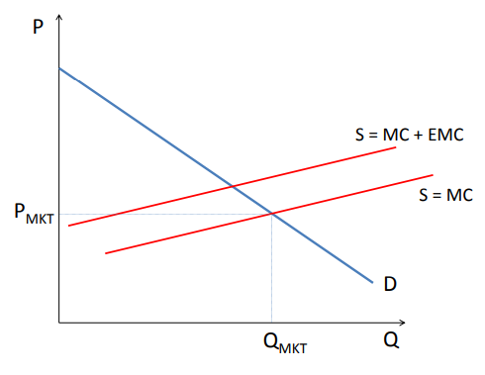
What Does a Negative Externality Do to Market Supply?
What are the Socially Optimal P and Q?

Slide 10
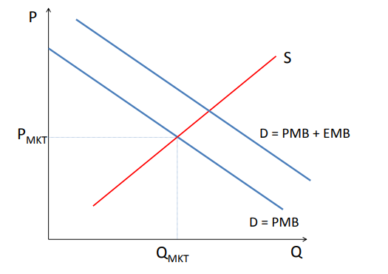
Positive Externalities
What are the Socially Optimal P and Q?

Slide 11
Examples of Externalities
Externalities may be negative or positive.
External cost (negative externality) - cost of producing a good/service not borne by consumers but by others.
Consumers can create externalities when they purchase and consume goods and services. Pollution from cars and motorbikes
Litter on streets and in public places
Vandalism of public property
Negative externalities arising from crime

Slide 12
Externalities
Externalities create market failure (allocative inefficiency).
Markets overproduce goods/services with external cost and overproduce goods/services with external benefits.

Slide 13
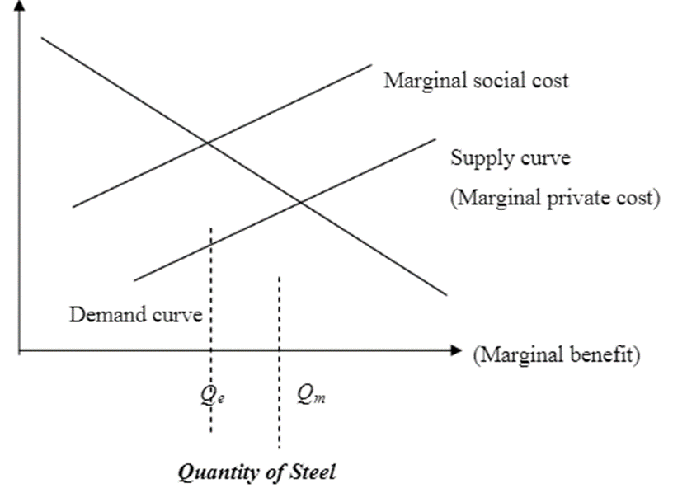
Figure 1 Excessive Production of Goods Yielding Negative Externalities

Slide 14
Excessive Production of Goods Yielding Negative Externalities cont…
. Figure 1 show a conventional demand and supply curves.
The absence of externalities will result the market equilibrium efficient.
The demand curve reflected the individual’s marginal benefits from the production of an extra unit of the commodity, and the supply curve reflected the marginal costs of producing an extra unit of commodity.
At the intersection of the two curves the marginal benefits just equal the marginal costs.
Now, with externalities, the industry’s supply curve will not reflect marginal social costs, only marginal private costs, those borne privately by the producers

Slide 15
Excessive Production of Goods Yielding Negative Externalities cont…
Figure 1 also shows the marginal social cost curve, giving the total extra costs (private and social) of producing an extra unit of steel.
This cost curve lies above the industry supply curve.
Efficiency requires that marginal social cost equal the marginal benefit of increasing output:
production should occur at Qe, the intersection of the marginal social cost and the demand curve.
The efficient level of production is lower than the market equilibrium level.

Slide 16
3.O TYPES OF EXTERNALITIES
1. EXTERNAL BENEFIT (POSITIVE EXTERNALITY)
These are the benefits from consuming a good/ service going not to consumers but to others.
In some cases, the actions of an individual or firm confer (uncompensated) benefits.
The issue of external benefits is related to that of public goods, which are goods where it is difficult if not impossible to exclude people from benefits.
The production of public goods has beneficial externalities for all or almost all, of the public.
As with external costs, there is a problem here of societal communication and coordination to balance benefits and costs.

Slide 17
Types of externalities
Example of positive externalities includes:
Knowledge spillover of inventions and information (most other forms of practical information).
Copyright and intellectual property law is mechanisms to allow the inventor or creator to benefit from a temporary, state-protected monopoly.

Slide 18
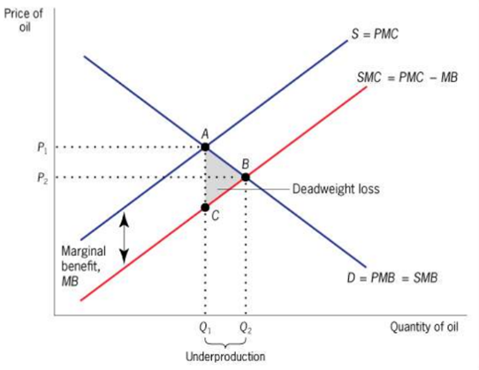
Externality theory-Positive production externality
When a firm’s production increases the well-being of others, the firm is not compensated by those others.
Expenditures on oil exploration by any company has a positive externality because they offer more profitable opportunities for other companies.
This led to a social marginal cost that is below the private marginal cost and a social optimum quantity that (Q2) that is greater than the competitive market equilibrium quantity (Q1).
There is overproduction of Q1-Q2 with an associated dead weight loss area of ABC.

Slide 19
Types of externalities
2. NEGATIVE EXTERNALITIES
A negative externality is an action of a product on consumers that imposes a negative side effect on a third party; it is "social cost".
Many negative externalities (also called "external costs" or "external diseconomies") are related to the environmental consequences of production and use.
The most extensive and integrated effort to quantify and monetize these impacts was in the European External project series.
Anthropogenic climate change is attributed to greenhouse gas emissions from burning oil, gas, and coal.

Slide 20
Types of externalities
Climate change presents a unique challenge for economics: it is the greatest example of market failure we have ever seen.
A condition of moral hazard can occur in the absence of well-designed banking regulation, or in the presence of badly designed regulation.
A business may purposely underfund one part of their business, such as their pension funds, to push the costs onto someone else, creating an externality.
Here, the "cost" is that of providing minimum social welfare or retirement income; economists more frequently attribute this problem to the category of moral hazards.
Pecuniary externalities appear to be externalities but occur within the market mechanism and are not a source of market failure or inefficiency.

Slide 21
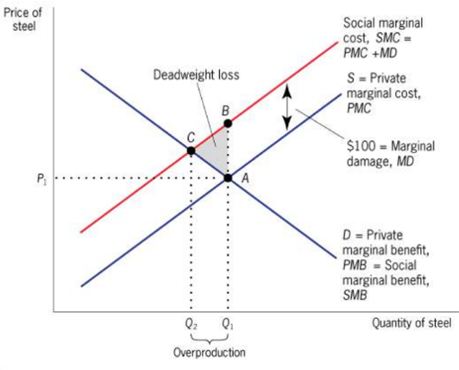
Externality Theory -
1. Economics of Negative Production Externalities
Externalities in the steel market
A negative production externality of USD 100 per unit of steel produced (marginal damage, MD) leads to a social marginal cost that is above the private marginal cost and a social optimal quantity Q2 that is lower than competitive market equilibrium quantity(Q1).
There is over productivity of (Q1-Q2) with an associated dead weight loss of the area BCA.

Slide 22
Negative Production Externalities
A negative production externality: When a firm’s production reduces the well-being of others who are not compensated by the firm.
Private marginal cost (PMC): The direct cost to producers of producing an additional unit of a good.
Marginal Damage (MD): Any additional costs associated with the production of the good that are imposed on others but that producers do not pay.
Social marginal cost (SMC = PMC + MD): The private marginal cost to producers plus marginal damage.
Example: steel plant pollutes a river but plant does not face any pollution regulation (and hence ignores pollution when deciding how much to produce).

Slide 23
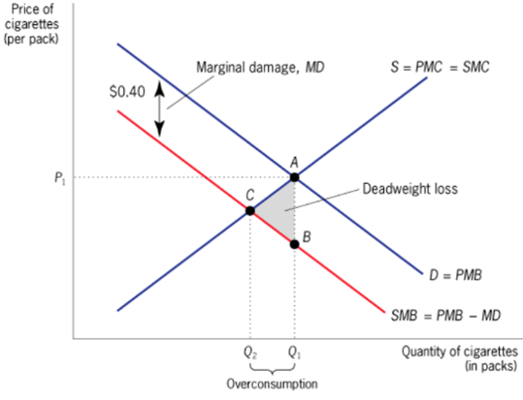
Externality Theory Negative Consumption Externalities
Market failure due to negative consumption externalities in the cigarette market.
A negative consumption externality of 40 C per pack of cigarettes consumed leads to a social marginal benefit that is below the private marginal benefit and a social optimum quantity(Q2) that is lower than the competitive equilibrium (Q1).
There is overconsumption (Q1-Q2) with an associated deadweight loss area ACB.

Slide 24
4.0 Solution to Externalities
4.1 PRIVATE SOLUTION TO EXTERNALITIES
Economic efficiency can be attained without resort to government intervention in some instances.
By establishing sufficiently large economic organizations, the externalities can be internalized.
By establishing clear property rights, private parties can bargain toward an efficient solution, as suggested by Coase.

Slide 25
Coase theorem-
Coase theorem suggests that we may be able to do even better. If property rights are fully assigned, then the regulatory body should not, in theory, have to be involved.
Instead, parties will negotiate among themselves on the lowest cost solution to correcting the externalities.
The use of the legal system, will force imposers of externalities to compensate victims.
The legal system can provide protections against externalities

Slide 26
Failures of Private Remedies for Externalities
Public Good (free rider) problems -Many externalities involve the provision of a public good, it may be very costly to exclude anyone from enjoying the benefits of these goods.
Compounded by imperfect information problems -the presence of imperfect information exacerbates efforts to arriving voluntarily at an efficient solution.
Transactions costs -are a major disadvantage of dealing with externalities through judicial processes.
For many externalities, the losses involved may simply be too small to justify undertaking litigation.

Slide 27
Failures of Private Remedies for Externalities cont…
Additional problems with litigation - If litigation costs are large, the uncertainty acts as a further deterrent to individuals contemplating using the court system to deal with externalities.
The high litigation costs and uncertain outcome of the litigation process imply that there is, in effect, differential access to legal remedies-
—poor people may not be able or willing to bear the risks of litigation—a situation which conflict with our usual notion of justice in democracy.

Slide 28
4.2 Public Sector Solutions to Externalities
MARKET-BASED SOLUTIONS
Fines and Taxes
Whenever there is an externality, there is a difference between
the social cost and the private cost, and
Social benefit and private benefit
A properly calculated fine or tax presents the individual or firm with the true social costs and benefits of its actions.
Fines designed to make marginal private costs equal marginal social costs, and marginal private benefits equal to marginal social benefits- are called corrective taxes, or sometimes Pigouvian taxes.

Slide 29
Market based solutions
2 Subsidizing pollution abatement-
The government could subsidize pollution abatement expenditures rather than taxing pollution.
The efficient level of pollution abatement expenditures can be attained by providing a
subsidy equal to the difference between the marginal social benefit of pollution abatement and firm’s marginal private benefits.
3. Marketable Permits
These limits the amount of pollution that any firm can emit.

Slide 30
Market based solutions
Firms will be willing to sell permits so long as the market price of the permit is greater than the marginal cost of reducing pollution, and
firms will be willing to buy permits so as long as the marginal cost of reducing pollution is greater than the market price of the permit.
Thus, in equilibrium, each firm will reduce pollution to a level such that the marginal cost of pollution reduction is equal to the market price of the permit.
Marketable permits have one advantage over fines. With fines, the government may not be sure about the level of emissions that the firms will choose to produce.

Slide 31
5.0 REGULATION
Most economists believe that market-based solutions provide the most promise for curbing environmental externalities, but government traditionally has replied upon direct regulation.
Government regulation has-
set emission standards for automobiles;
put forth detailed regulations relating to the disposal of toxic chemicals;
outlawed smoking on domestic airline flights;
imposed laws requiring oil companies with wells in the same oil pool to unitize their production;
imposed restrictions on fishing and hunting to reduce the inefficiencies associated with excessive utilization of these common resources.

Slide 32
6.0 Implications of Externalities
1. Welfare economics has shown that the existence of externalities results in outcomes that are not socially optimal.
Those who suffer from external costs do so involuntarily, while those who enjoy external benefits do so at no cost.
A voluntary exchange may reduce societal welfare if external costs exist.
The person who is affected by the negative externalities in the case of air pollution will see it as lowered utility:
either subjective displeasure or potentially explicit costs, such as higher medical expenses.

Slide 33
Implications of externalities cont…
Externalities may be viewed as-
An external cost may pose an ethical or political problem.
It might be seen as a case of poorly defined property rights.
2. Externalities will also lead to improvement of collective societal welfare ;
but the providers have no way of monetizing the benefit,
less of the good will be produced than would be optimal for society.

Slide 34
Implications of externalities cont…
Positive externalities are often associated with the free rider problem.
There are a number of potential means of improving overall social utility when externalities are involved.
The market-driven approach to correcting externalities is to "internalize" third party costs and benefits, for example, by requiring a polluter to repair any damage caused.
The monetary values of externalities are difficult to quantify, as they may reflect the ethical views and preferences of the entire population.

Slide 35
Implications of externalities cont…
It may not be clear whose preferences are most important, interests may conflict, the value of externalities may be difficult to determine, and
all parties involved may try to influence the policy responses to their own benefit.
It may not be feasible to monetize the costs and benefits, another method is needed to either impose solutions or aggregate the choices of society, when externalities are significant.
This may be through some form of representative democracy or other means.

Slide 36
7.0 Topic Questions and answers
We answer the following topic questions-
1. What is an externality? Define it
Answer- Externalities are spillover costs or benefits. They arise whenever a production or consumption decision affects a third party.
2. What are the four kinds of externalities-Give examples.
Answer-Positive externality in consumption, positive externality in production, negative externality in consumption, negative externality in production

Slide 37
Topic Questions and answers
3. "Social cost" and "private cost": what is the difference between these two kinds of costs?
Answer-Social cost- Private cost= external cost (example: pollution).
4. Social benefit" and "private benefit": what is the difference between these two kinds of benefits?
Answer- External benefits
5) Explain why the consumption of alcohol entails a social cost that is higher than private cost. Answer-The person drinking alcohol only consider the private cost and the private benefit of her/his decision. This person neglects the costs imposed to the society due to her/his choice (cost for a medical treatment, loss of productivity).

Slide 38
Topic Questions and answers
6) Explain why the consumption of education entails a social benefit that is higher than private benefit.
Answer When deciding to go to University you only consider your private cost and benefit. You consider the fees to pay to the University, the lack of income for the years that you spend studying, and the additional income you will receive one day when able to start your first job as a graduate. However, if you decide to go to University, it is not just you who benefit from this decision but also the society you are living in. More people with a degree will favour more investments in your community and more wealth will be generated.

Slide 39
8.0 SUMMARY
Externalities are the classic answer to the “when” question of public finance:
when one party’s actions affect another party, and the first party doesn’t fully compensate (or get compensated by) the other for this effect, then the market has failed, and government intervention is potentially justified.
This naturally leads to the “how” question of public finance.
There are two classes of tools in the government’s arsenal for dealing with externalities: price-based measures (taxes and subsidies) and quantity-based measures (regulation).

Slide 40
9.0 REFERENCES
Aronson, Richard J (1985) Public Finance, USA, New York: Mc Graw Hill Book Co.
Rosen, Harvey S (1999) Public Finance, 5th edition, USA, New York: Mc Graw Hill Book Co.
Stiglitz, Joseph E (2000), Economics of the Public Sector, 3rd edition, W.W. Norton & Co., New York.
Border, K. C. (1985) Fixed Point Theorems with Applications to Economics and Game Theory, Cambridge: Cambridge University Press.

Slide 41
REFERENCES
Luenberger, D (1995) Microeconomic Theory, McGraw-Hill, Appendixes A-D.
Takayama (1985) A. Mathematical Economics, the second edition, Cambridge: Cambridge University Press, Chapters 1-3.
Tian, G (2004) The Basic Analytical Framework and Methodologies in Modern Economics.

Slide 42
THE END,THANK YOU

