Slide 1
INTERMEDIATE MICROECONOMICS
WEEK 11-INTRODUCTION TO GAME THEORY

Slide 2
CONTENTS
1.0 OBJECTIVES
2.0 INTRODUCTION
  Definition
  Common elements of games
  Differentiating aspects of games
3.0 PRISONERS DELIMMA

Slide 3
CONTENTS
Noncooperative games
Cooperative games
4.0 STRATEGIES AND SOLUTIONS FOR GAMES
Dominant strategy
Nash equilibrium
Maximin strategy (safety first, or secure strategy)
Cooperative strategy (collusion).

Slide 4
CONTENTS
5.O APPLICATIONS OF GAME THEORY
6.0 OPEN PROBLEMS IN GAME THEORY
7.0 SUMMARY
8.0 REFERENCES

Slide 5
1.0 OBJECTIVES
At the end of this topic, you should be able to-
1.Define Game theory
2.Discuss the key aspects that make a game strategic
3.Evaluate the Prisoner’s dilemma
4.Explain the different strategies and solutions for games
5. Explain the equilibrium positions based on the different strategies adopted.

Slide 6
2.0 INTRODUCTION
Definition
What is a Game?
A game is a mathematical model of a strategic interaction
What are the common elements of games?
Players- people, model businesses, teams, political parties, countries, etc.
Choices.-Players have to make a choice or multiple choices between different actions.

Slide 7
Common elements of games
Outcomes.-When the players are done choosing, an outcome is realized and the game ends.
Preferences-Players have preferences over outcomes.
Q. What makes a game strategic?
The fact that outcomes are determined by everyone’s actions, rather than by the actions of just one player.
That players have different preferences. This creates tensions, which make games interesting.

Slide 8
Differentiating aspects of games
1.Timing
Do players choose once, or again and again over time
2. Observations
Can players observe each other’s choices?
3. Uncertainty
Is the outcome random, or is it a deterministic function of the players’ actions?
Do some players have information that the others do not?

Slide 9
Key concepts
Game theory generally refers to the study of mathematical models that describe the behavior of logical decision-makers.
Game Theory = A framework to study strategic interactions between players, firms, or nations.
Game theory is the study of strategic interactions between players.
A payoff is the outcome of a game that depends of the selected strategies of the players.

Slide 10
Key concepts cont…
Strategy = A rule or plan of action for playing a game.
An optimal strategy is one that provides the best payoff for a player in a game.
Cooperative Game = A game in which participants can negotiate binding contracts that allow them to plan joint strategies.
Noncooperative Game = A game in which negotiation and enforcement of binding contracts are not possible.

Slide 11
Key concepts cont…
Simultaneous Games- both players make their moves simultaneously or
if they do not, the later player is unaware of the earlier player’s action, making it effectively simultaneous
Sequential games are often represented in normal form,.
which, for a game with 2 players and N possible moves for each player, consists of an N x N matrix
where each entry is a 2-tuple containing the payoff for each respective player.

Slide 12
3.0 PRISONER’S DILEMMA
An Illustration-
This is a type of sequential game
Each prisoner has the option to either betray the other prisoner for a reduced punishment (Confess).
or cover up for the other prisoner and hope the other prisoner does the same (Lie).

Slide 13
Prisoner’s Dilemma cont…
In each cell of the matrix, the first element of the tuple represents the payoff for Prisoner 1, and
The second element represents the payoff for Prisoner 2.
One reads this payoff matrix by first identifying the choice (Confess or Lie) that each player will make, and
Then locating the matrix entry that corresponds to that row and column.

Slide 14
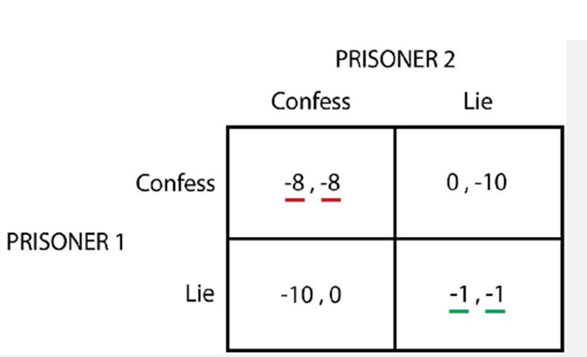
Prisoner’s Dilemma cont…
if Prisoner 1 chooses Confess and Prisoner 2 chooses Lie,
you would read the matrix entry in the 1st row and 2nd column,
giving Prisoner 1 a payoff of 0 and
Prisoner 2 a payoff of -10

Slide 15
Prisoner’s Dilemma cont…
In a simultaneous game, each player must make decisions based on what he assumes the other player will do.
One method of predicting the game’s outcome is by identifying dominant strategies for each player.
A dominant strategy is one that is the best for a given player regardless of the choice of the other player
In the Prisoner’s Dilemma game, we can observe that the dominant strategy for both players is to Confess.

Slide 16
Prisoner’s Dilemma cont…
The (Confess, Confess) option is therefore a Nash Equilibrium.
A Nash Equilibrium is a set of choices in which no player has anything to gain by changing only their own choice
Dilemma provide us with formalized methods to study conflict and cooperation

Slide 17
Noncooperative games,
Individual players take actions, and the outcome of the game is described by the action taken by each player, along with the payoff that each player achieves.
Examples of noncooperative games include checkers, the prisoner’s dilemma, and most business situations where there is competition for a payoff.

Slide 18
Cooperative games
Cooperative games are different.
The outcome of a cooperative game will be specified by which group of players become a cooperative group, and the joint action that the group takes.
An example of a cooperative game is a joint venture of several companies who band together to form a group (collusion).

Slide 19
4.0 strategies and solutions for games
1. Dominant strategy
2. Nash equilibrium
3. Maximin strategy (safety first, or secure strategy)
4. Cooperative strategy (collusion).

Slide 20
4.1 Dominant Strategies
Equilibrium in Dominant Strategies
Dominant Strategy = A strategy that results in the highest payoff to a player regardless of the opponent’s action.
Equilibrium in Dominant Strategies = An outcome of a game in which each firm is doing the best that it can regardless of what its competitor is doing

Slide 21
Prisoner’s Dilemma: Dominant Strategy
1) If B CONF, AB CONF, A should CONF (8<15)CONF (8<15)
(2) If B NOT, AB NOT, A should CONF (1<3)CONF (1<3)
…AA has the same strategy (CONF)(CONF) no matter what BB does.
(3) If A CONF, BA CONF, B should CONF (8<15)CONF (8<15)
(4) If A NOT, BA NOT, B should CONF (1<3)CONF (1<3)
…BB has the same strategy (CONF)(CONF) no matter what AA does.

Slide 22
4.2 Nash Equilibrium
Nash Equilibrium = A set of strategies in which each player has chosen its best strategy given the strategy of its rivals.
To solve for a Nash Equilibrium:
(1) Check each outcome of a game to see if any player wants to change strategies, given the strategy of its rival.
(a) If no player wants to change, the outcome is a Nash Equilibrium.
(b) If one or more player wants to change, the outcome is not a Nash Equilibrium. A game may have zero, one, or more than one Nash Equilibria.

Slide 23
Prisoner’s Dilemma - Nash Equilibrium
1) Outcome = (CONF, CONF)= (CONF, CONF)
(a) Is CONFCONF best for AA given B CONF B CONF? Yes.
(b) Is CONFCONF best for BB given A CONF A CONF? Yes.
…(CONF, CONF)(CONF, CONF) is a Nash Equilibrium.

Slide 24
Prisoner’s Dilemma - Nash Equilibrium cont…
2) Outcome = (CONF, NOT)= (CONF, NOT)
(a) Is CONFCONF best for AA given B NOTB NOT? Yes.
(b) Is NOTNOT best for BB given A CONFA CONF? No.
…(CONF, NOT)(CONF, NOT) is not a Nash Equilibrium.

Slide 25
Prisoner’s Dilemma - Nash Equilibrium cont…
(3) Outcome = (NOT, CONF)= (NOT, CONF)
(a) Is NOTNOT best for AA given B CONFB CONF? No.
(b) Is CONFCONF best for BB given A NOTA NOT? Yes.
…(NOT, CONF)(NOT, CONF) is not a Nash Equilibrium.

Slide 26
Prisoner’s Dilemma - Nash Equilibrium cont…
(4) Outcome = (NOT, NOT)= (NOT, NOT)
(a) Is NOTNOT best for AA given B NOTB NOT? No.
(b) Is NOTNOT best for BB given A NOTA NOT? No.
…(NOT, NOT)(NOT, NOT) is not a Nash Equilibrium.

Slide 27
Prisoner’s Dilemma - Nash Equilibrium cont…
In summary-
(CONF, CONF)(CONF, CONF) is a Nash Equilibrium, and the only one Nash Equilibrium in the Prisoner’s Dilemma game.
Note that in the Prisoner’s Dilemma game, the Equilibrium in Dominant Strategies is also a Nash Equilibrium.

Slide 28
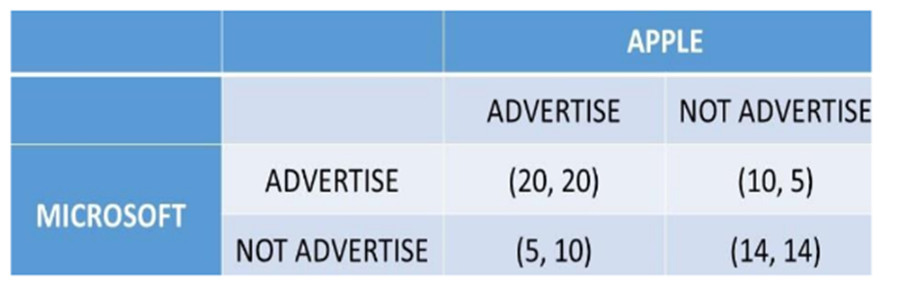
Advertising Game-(Microsoft and Apple)

Slide 29
Advertising: Dominant Strategy
Two computer software firms (Microsoft and Apple) decide whether to advertise or not.
The outcomes depend on their own selected strategy and the strategy of the rival firm.
Advertising: Dominant Strategy
(1) If APP AD, MICAPP AD, MIC should AD (20>5)AD (20>5)
(2) If APP NOT, MICAPP NOT, MIC should NOT (14>10)NOT (14>10)
…different strategies, so no dominant strategy for Microsoft.

Slide 30
Advertising: Dominant Strategy cont…
3) If MIC AD, APPMIC AD, APP should AD (20>5)AD (20>5)
(4) If MIC NOT, APPMIC NOT, APP should NOT (14>10)NOT (14>10)
…different strategies, so no dominant strategy for Apple.
Thus, there are no dominant strategies, and no equilibrium in dominant strategies for this game.

Slide 31
Advertising: Nash Equilibria
(1) Outcome = (AD, AD)= (AD, AD)
(a) Is ADAD best for MICMIC given APP ADAPP AD? Yes.
(b) Is ADAD best for \(\text{APP\) given MIC ADMIC AD? Yes.
…(AD, AD)(AD, AD) is a Nash Equilibrium.
(2) Outcome = (AD, NOT)= (AD, NOT)
(a) Is ADAD best for MICMIC given APP NOTAPP NOT? No.
(b) Is NOTNOT best for APPAPP given MIC ADMIC AD? No.
…(AD, NOT)(AD, NOT) is not a Nash Equilibrium.

Slide 32
Advertising: Nash Equilibria cont…
(3) Outcome = (NOT, AD)= (NOT, AD)
(a) Is NOTNOT best for MICMIC given APP ADAPP AD? No.
(b) Is ADAD best for APPAPP given MIC NOTMIC NOT? No.
…(NOT, AD)(NOT, AD) is not a Nash Equilibrium.
(4) Outcome = (NOT, NOT)= (NOT, NOT)
(a) Is NOTNOT best for MICMIC given APP NOTAPP NOT? Yes.
(b) Is NOTNOT best for APPAPP given MIC NOTMIC NOT? Yes.
…(NOT, NOT)(NOT, NOT) is a Nash Equilibrium.

Slide 33
Advertising: Nash Equilibria cont…
In Summary-
There are two Nash Equilibria in the Advertising game:
(AD, AD)(AD, AD) and
(NOT, NOT)(NOT, NOT).
In the Advertising game, there are two Nash Equilibria, and no Equilibrium in Dominant Strategies.

Slide 34
4.3 Maximin Strategy (Safety First; Secure Strategy)
A strategy that allows players to avoid the largest losses is the Maximin Strategy.
Maximin Strategy = A strategy that maximizes the minimum payoff for one player.
The maximin, or safety first, strategy can be found by identifying the worst possible outcome for each strategy.
Then, choose the strategy where the lowest payoff is the highest.

Slide 35
Prisoner’s Dilemma: Maximin Strategy (Safety First)
We use Figure 1 to find the Maximin Strategy for the Prisoner’s Dilemma.
(1) Player AA
(a) If CONFCONF, worst payoff =8=8 years.
(b) If NOTNOT, worst payoff =15=15 years.
…AA’s Maximin Strategy is CONF (8<15)CONF (8<15).

Slide 36
Prisoner’s Dilemma: Maximin Strategy (Safety First) cont…
2) Player BB
(a) If CONFCONF, worst payoff =8=8 years.
(b) If NOTNOT, worst payoff =15=15 years.
…BB’s Maximin Strategy is CONF (8<15)CONF (8<15).
Therefore, the Maximin Equilibrium for the Prisoner’s Dilemma is (CONF, CONF)(CONF, CONF).
This outcome is also an Equilibrium in Dominant Strategies, and a Nash Equilibrium

Slide 37
Advertising Game: Maximum Strategy (Safety First)
(1) MICROSOFTMICROSOFT
(a) If ADAD, worst payoff =10=10.
(b) If NOTNOT, worst payoff =5=5.
…MICROSOFT’s Maximin Strategy is AD (5<10)AD (5<10).

Slide 38
Advertising Game: Maximum Strategy (Safety First) cont…
The relationships between the game theory strategies can be summarized:
An Equilibrium in Dominant Strategies is always a Maximin Equilibrium.
A Maximin Equilibrium is NOT always an Equilibrium in Dominant Strategies.
An Equilibrium in Dominant Strategies is always a Nash Equilibrium.
A Nash Equilibrium is NOT always an Equilibrium in Dominant Strategies

Slide 39
Advertising Game: Maximum Strategy (Safety First) cont…
(2) APPLEAPPLE
(a) If ADAD, worst payoff =10=10.
(b) If NOTNOT, worst payoff =5=5.
…APPLEAPPLE’s Maximin Strategy is AD (5<10)AD (5<10).
Therefore, the Maximin Equilibrium in the Advertising game is (AD, AD)(AD, AD).

Slide 40
5.O APPLICATIONS OF GAME THEORY
1. Economics-providing insights into market behavior, pricing strategies, and competition dynamics.
2. Political Science-It models negotiation strategies, arms races, and alliances, shedding light on diplomatic interactions.
3. Biology and Evolution-offers a framework to analyze interactions in biological systems, such as predator-prey relationships, cooperation among species, and the evolution of behavior.

Slide 41
Applications of Game Theory cont…
4. Social Sciences-Game theory informs social dynamics, including the “Tragedy of the Commons” scenario where individual rationality leads to collective inefficiency.
5. Computer Science-It influences the development of efficient routing protocols, resource allocation, and automated negotiation systems.
6. Environmental Management-Game theory aids in analyzing environmental issues like pollution control and resource management etc.

Slide 42
6.0 OPEN PROBLEMS IN GAME THEORY
Computational Complexity
Dynamic Games
Incomplete and Imperfect Information
Evolutionary Game Theory
Fair Division and Allocation
Behavioral Game Theory

Slide 43
7.0 SUMMARY
Game theory, is
A branch of mathematics and economics, offers a comprehensive framework for analyzing interactions and decisions in strategic situations.
Developed to model decision-making within competitive and cooperative environments
Has transcended its origins and found applications in diverse fields.
Serves as a powerful tool for analyzing strategic interactions across diverse fields, providing insights into decision-making, cooperation, and conflict resolution. Its

Slide 44
8.0 references
Halpern, J. Y. (2001). Substantive rationality and backward induction. Games and Economic Behavior, 37:425–435.
Gonz´alez-D´ıaz, J., Garc´ıa-Jurado, I., and Fiestras-Janeiro, M. G. (2010). An Introductory Course on Mathematical Game Theory. American Mathematical Society, Providence, RI.
Gilboa, I. (2009). Theory of Decision under Uncertainty. Cambridge University Press, Cam-bridge.
Gilboa, I. (2010). Rational Choice. MIT Press, Cambridge.
Ewerhart, C. (2002). Backward induction and the game-theoretic analysis of chess. Games and Economic Behavior, 39:206–214.

Slide 45
THE END,THANK YOU

