Slide 1
INTERMEDIATE MICROECONOMICS
WEEK 13- AUCTIONS, OPTIMAL SELLING MECHANISMS AND PUBLIC GOODS

Slide 2
CONTENTS
1.O OBJECTIVES
2.0 AUCTIONS
  Definition
  Taxonomy/types
  Assumptions
  Auction choice
  Auction process

Slide 3
CONTENTS
3.0 PUBLIC GOODS
  Definition
  Pure and Impure
  Optimal provision
  Vertical Summation in the Public Goods Market
  Private Provision of a Public Good

Slide 4
CONTENTS
  Free rider problem
  Crowding out
4.0 SUMMARY
5.0 REFERENCES

Slide 5
1.0 OBJECTIVES
At the end of this topic, you should be able to
1.Explain Auctions in terms of characteristics, choice, process and assumptions.
2. Define public goods.
3. Discuss optimal provision of public goods.
5.Analyse the vertical summation in a public goods market.
6. Examine key terms- Free rider problem and crowding out.

Slide 6
2.0 AUCTIONS
Definition
What is an auction?
An auction is an economic mechanism whose purpose is the allocation of goods and the formation of prices for those goods via a process known as bidding.
Some auction structures may be either more efficient or more profitable to the seller than others.
Auction design is a careful balance of encouraging bidders to reveal valuations, discouraging cheating or collusion, and maximizing revenues.

Slide 7
Taxonomy of auctions
William Vickrey first established the taxonomy of auctions.
Taxonomy is based on the order in which the auctioneer quotes prices and the bidders tender their bids.
He established four major (one-sided) auction types:
(1) the ascending-bid (open, oral, or English) auction;
(2) the descending-bid (Dutch) auction;
(3) the first-price, sealed-bid auction; and
(4) the second-price, sealed-bid (Vickrey) auction.

Slide 8
The four basic auction types
1. The English auction
The auctioneer opens the bidding at a reserve price, the lowest price he is willing to accept for the item.
Once a bidder has announced interest at that price, the auctioneer solicits further bids, usually raising the price by a predetermined bid increment.
This continues until no one is willing to increase the bid any further.
At which point the auction is closed and the final bidder receives the item at his bid price.

Slide 9
2. The Dutch auction
This first-price auction, is descending.
The auctioneer begins at a high price.
Then decreases the price until a bidder finally calls out, , “Mine!”
The bidder then receives the item at the price at which he made the call.
One of the primary advantages of Dutch auctions is speed-there are never more bids than there are items being auctioned.

Slide 10
3. The first-price, sealed-bid auction
In this mechanism, each bidder submits a single bid in a sealed envelope.
Then, all the envelopes are opened, and the highest bidder is announced, and he receives the item at his bid price.
This type of auction is most often used for -
Refinancing credit and foreign exchange,
Bid bonds among other (primarily financial) venues.

Slide 11
4. The second-price, sealed-bid (Vickrey) auction
Like first-price, sealed-bid auction, bidders submit sealed envelopes in one round of bid submission.
The highest bidder wins the item, but at the price offered by the second-highest bidder or, in a multiple-item case, the highest unsuccessful bid.
This type of auction is rarely used aside from setting the foreign exchange rates in some African countries.

Slide 12
Assumptions on auction forms
Why So Many Auction Forms?
The revenue equivalence theorem (Vickrey) states that all four auction types will result in an identical level of revenue to the seller.
These assumptions regarding the nature of the item’s value and the risk attitudes of the bidders are very restrictive and rarely hold.
The assumptions
1. The asset being auctioned has an independent, private value to all bidders.

Slide 13
Assumptions on auction forms cont…
This assumption tends to hold when the item is for personal consumption, without thought toward resale.
2. The assumption of the revenue equivalence theorem is that all bidders are risk-neutral.
Risk neutrality is- given the choice between a guaranteed return r and a gamble with expected return also equal to r, the bidder is completely indifferent.
“risk-averse,” bidder-bidder who prefers the guaranteed return.
“risk-loving” bidder-the bidder who prefers the gamble.

Slide 14
Auction choice
The style of auction a seller chooses depends on his judgment about which of these assumptions holds.
If values are common rather than independent, the English auction yields higher seller revenue than the second-price, sealed-bid auction,
Sealed-bid auction in turn yields higher revenues than the Dutch and first-price, sealed-bid auctions (which are tied).

Slide 15
Auction choice
What about the role of risk aversion?
In first-price, sealed-bid and Dutch auctions, risk aversion causes bidders to bid slightly higher than they might otherwise.
Once a seller has decided on which of the four basic auction forms to use, he can use many variations within the auction to further manipulate the outcome to maximize revenue.
These mechanisms can have profound, and often counterintuitive, effects on bidding behavior.
The available mechanisms are reserve prices, entry fees, invited bidders only, closing rules, lot sizes, proxy bidding, bidding increment rules, and post win payment rules.

Slide 16
Auction process
1.Initial buyer and seller registration is an authentication of trading parties, exchange of cryptography keys, and profile creation.
2. Setting up a particular auction event is a step in the process of describing items sold or acquired and establishing auction rules.
3. Scheduling and advertising is done to attract potential buyers. Items of the same category should be auctioned together to attract potential buyers.

Slide 17
Auction process
4. Bidding step collects bids and implements bid control rules of the auction.
5. Evaluation of bids and closing the auction implements auction closing rules and notifying winners and losers.
6. Trade settlement handles payment to seller, transfer of goods, fees to agents.

Slide 18
3.0 PUBLIC GOODS
Pure public goods: Goods that are perfectly non-rival in consumption and are non-excludable
Non-rival in consumption: One individual’s consumption of a good does not affect another’s opportunity to consume the good.
Non-excludable: Individuals cannot deny each other the opportunity to consume a good.
Impure public goods: Goods that satisfy the two public good conditions (non-rival in consumption and non-excludable) to some extent, but not fully

Slide 19
Defining Pure and Impure Public Goods
 |  | Is the good rival in consumption?
 |  | YES | NO
Is the good excludable? | yes | Yes Private good (ice cream) | Impure public good (Cable TV)
 | no | Impure public good (crowded sidewalk) | Public good (defense)

Slide 20
Optimal provision of private goods
Two goods: ic (ice-cream) and c (cookies) with prices Pic , Pc
Pc = 1 is normalized to one (numéraire good):
Two individuals B and J demand different quantities of the good at the same market price.
MRSic,c = MUic/MUc = # cookies the consumer is willing to give up for 1 ice-cream
The optimality condition for the consumption of private goods is written as:
MRSBic,c = MRSJic,c = Pic/Pc = Pic
Equilibrium on the supply side requires: MCic = Pic
In equilibrium, therefore: MRSBic,c = MRSJic,c = MC

Slide 21
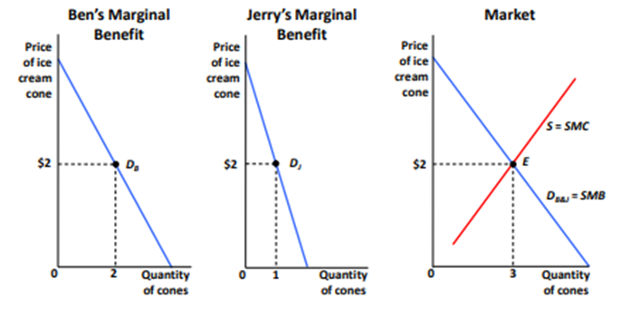
Horizontal Summation in the Private Goods Market
To find social demand curve, add quantity at each price—sum horizontally.

Slide 22
Optimal provision of public goods
Replace private good ice-cream ic by a public good missiles m
MRSBm,c = # cookies B is willing to give up for 1 missile
MRSJm,c = # cookies J is willing to give up for 1 missile
In net, society is willing to give up MRSBm,c + MRSJm,ccookies for 1 missile
Social-efficiency-maximizing condition for the public good is:
MRSBm,c + MRSJm,c = MC
Social efficiency is maximized when the marginal cost is set equal to the sum of the MRSs, rather than being set equal to each individual MRS.
This is called the Samuelson rule (Samuelson, 1954)

Slide 23
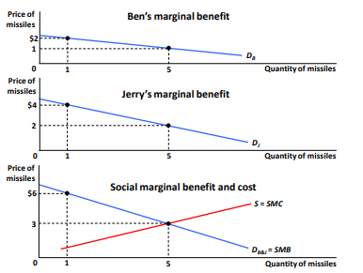
Vertical Summation in the Public Goods Market

Slide 24
Private-sector under provision
Private sector provision such that MRSmc = MCm for each individual so that ∑PMRSmc > MCm ⇒ Outcome is not efficient, could improve the welfare of everybody by having more missiles (and less cookies)
Free rider problem: When an investment has a personal cost but a common benefit, individuals will underinvest.
Because of the free rider problem, the private market undersupplies public goods
Another way to see it: private provision of a public good creates a positive externality (as everybody else benefits) ⇒ Goods with positive externalities are under-supplied by the market.

Slide 25
Private provision of public good
2 individuals with identical utility functions defined on X private good (cookies) and F public good (fireworks).
F = F1 + F2 where Fi is contribution of individual i
Utility of individual i is Ui = 2 log(Xi) + log(F1 + F2) with budget Xi + Fi = 100
Individual 1 chooses F1 to maximize 2 log(100 − F1) + log(F1 + F2) taking F2 as given
First order condition:
−2/(100 − F1) + 1/(F1 + F2) = 0 ⇒ F1 = (100 − 2F2)/3

Slide 26
Private provision of public good
Note that F1 goes down with F2 due to the free rider problem (called the reaction curve, show graph)
Symmetrically, we have F2 = (100 − 2F1)/3
Nash equilibrium definition: Each agent maximizes his objective taking as given the actions of the other agents.
At the Nash equilibrium, the two reaction curves intersect:
F1 = (100 − 2F2)/3 and F2 = (100 − 2F1)/3
⇒ F1 + F2 = (200 − 2(F1 + F2))/3 ⇒ F = F1 + F2 = 200/5 = 40 ⇒ F1 = F2 =20

Slide 27
Private provision of public good
What is the Social Optimum? ∑MRS = MC = 1
MRSiFX = MUiF/MUi
X = (1/(F1 + F2))/(2/Xi) = Xi/(2F )
⇒∑MRSi = (X1 + X2)/(2F ) = (200 − F )/(2F )
⇒∑MRSi = 1 ⇒ 200 − F = 2F ⇒ F = 200/3 = 66.6 > 40
Public good is under-provided by the market

Slide 28
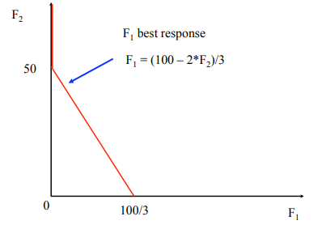
Private provision of public good

Slide 29
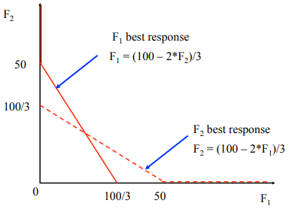
Private provision of public good

Slide 30
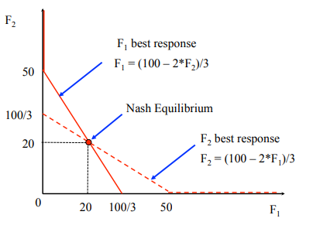
Private provision of public good

Slide 31
Can Private Provision Overcome Free Rider Problem?
The free rider problem does not lead to a complete absence of private provision of public goods. Private provision works better when:
1) Some Individuals Care More than Others:
Private provision is particularly likely to surmount the free rider problem when individuals are not identical, and
When some individuals have an especially high demand for the public good.

Slide 32
Can Private Provision Overcome Free Rider Problem?
2) Altruism:
When individuals value the benefits and costs to others in making their consumption choices.
3) Warm Glow:
Model of public goods provision in which individuals care about both the total amount of the public good and their particular contributions as well.

Slide 33
Experimental evidence on free riding
Laboratory experiments are a great device to test economic theories.
Subjects (often students) are brought to the lab where they sit through a computer team game and get paid based on the game outcomes.
Many public good lab experiments. Example (Marwell and Ames 1981):
10 repetitions for each game.
In each game, group of 5 people, each with 10 tokens to allocate between cash and public good.
If you take token in cash, get $1 in cash for you.

Slide 34
Experimental evidence on free riding
Nash equilibrium: get everything in cash.
Socially optimal equilibrium: contribute everything to public good.
In the lab, subjects contribute about 50% to public good, but public good contributions fall as game is repeated (Isaac, McCue, and Plot, 1985).
Explanations: people are willing to cooperate.

Slide 35
Crowding out of private contributions by government provision
Suppose government forces each individual to provide 5 so that now
F = F1 + F2 + 10 where Fi is voluntary contribution of individual i
Utility of individual i is Ui = 2 log(Xi) + log(F1 + F2 + 10) with budget
Xi + Fi = 95
You will find that the private optimum is such that F1 = F2 = 15 so that government forced contribution crowds out one-to-one private contributions

Slide 36
Crowding out of private contributions by government provision
Why? Rename F0i = Fi + 5. Choosing F0i is equivalent to choosing Fi:Ui = 2 log(Xi) + log(F01 + F02) with budget Xi + F0i = 100
⇒ Equivalent to our initial problem with no government provision hence the solution in F0i must be the same.
However, government forced contributions will have an effect as soon as private contributions fall to zero (as individuals cannot contribute negative amounts and undo government provision).

Slide 37
Empirical evidence on crowd-out
Two strands of empirical literature
1) Field evidence (observational studies)
2) Lab and field experiments
Lab experiments show imperfect crowd-out in public good games (where you compare situation with no forced public goods contributions and with forced public good contributions), see Andreoni (1993).
Lab experiment may not capture important motives for giving: warm glow, prestige, solicitations from fund raisers

Slide 38
Charitable giving
Charitable giving is one form of private provision of public good (big in the US, 2% of National Income given to charities).
Funds (1) religious activities, (2) education, (3) human services, (4) health,(5) arts, (6) various causes (environment, animal protection, etc.)
Encouraged by government: giving can be deducted from income for income tax purposes
People give out of (1) warm-glow (name on building), (2) reciprocity (alumni), (3) social pressure (churches), (4) altruism (poverty relief).
Those effects are not captured in basic economic model Charities have big fund-raising.

Slide 39
Empirical evidence on crowd-out: andreoni-payne ’03
Government spending crowds out private donations through two channels: willingness to donate + fundraising.
Use tax return data on arts and social service organizations
Panel study: follows the same organizations overtime
Results: $1000 increase in government grant leads to $250 reduction in private Fundraising.
Suggests that crowd out could be non-trivial if fundraising is a powerful source of generating private contributions
Subsequent study by Andreoni and Payne confirms this.
Find that $1 more of government grant to a charity leads to 56 cents less private contributions
70 percent ($0.40) due to the fundraising channel.

Slide 40
Randomized field experiment to test reciprocity
Falk (2007) conducted a field experiment to investigate the relevance of reciprocity in charitable giving
In collaboration with a charitable organization, sent 10,000 Christmas solicitation letters for funding schools for street children in Bangladesh to potential donors (in Switzerland) randomized into 3 groups
1) 1/3 of letters contained no gift (control group).
2) 1/3 contained a small gift: one post-card (children drawings)+one-envelope(treatment 1).
3) 1/3 contained a larger gift: 4 post-cards (children drawings)+4-envelopes(treatment 2).
Likelihood of giving: 12% in control, 14% in treatment 1, 21% in treatment 2“large gift” was very effective (even relative to cost).

Slide 41
Empirical Evidence on Social Pressure
Dellavigna-List-Malmendier ’12 design a door-to-door fundraiser randomized experiment:
Control: no advance warning of fund-raiser visit.
Treatment group 1: flyer at doorknob informs about the exact time of solicitation (hence can seek/avoid fund-raiser).
Treatment group 2: same as treatment 1 but flyer has a check box “Do not disturb”
Results (relative to control):
Treatment group 1: 9-25% less likely to open door for fund-raiser, same (unconditional) giving.
Treatment group 2: a number of people opt out and (unconditional) giving is 28-42% lower.
⇒ Social pressure is an important determinant of door-to-door giving and door-to-door fund-raising campaigns lower utility of potential donor.

Slide 42
Social prices as a policy instrument
Traditional focus in economics is on changing prices of economic goods.
Different set of policy instruments: “social prices”
Suppose people care about social norms and policy maker can manipulate social norms.
Should make status good one that generates positive externalities.
E.g. large SUVs are frowned upon as gas guzzlers contributing to global warming while electric cars are admired.
Creates another set of policy instruments to explore.

Slide 43
Welfare analysis of social pricing
Should social pricing be used on top of standard pricing through corrective taxes (or tradable permits)?
1) Making people feel bad about driving an SUV is inefficient relative to gas tax: destroys welfare without bringing tax revenue.
Could still be desirable if imposing a gas tax is impossible. Some negative actions (such as littering) are hard to enforce with fines so social norm on feeling bad about littering is desirable.
2) Making people feel good about driving an energy efficient car is efficient relative to gas tax: adds to welfare as driving an energy efficient car becomes more enjoyable.

Slide 44
4.0 SUMMARY
Auctions facilitate transactions by enforcing a specific set of rules regarding the resource allocations of a group of bidders.
Theorists consider auctions to be economic games that differ in two respects: format and information.
The format defines the rules for the announcement of prices, the placement of bids, the updating of prices, the auction close, and the way a winner is picked.
The way auctions differ with respect to information regards the asymmetries of information that exist between bidders.

Slide 45
summary
Public goods are commodities or services that benefit all members of society, and which are often provided for free through public taxation.
Public goods are the opposite of private goods, which are inherently scarce and are paid for separately by individuals.
Societies will disagree about which goods should be considered public goods; these differences are often reflected in nations’ government spending priorities.

Slide 46
5.0 REFERENCES
Jonathan Gruber, Public Finance and Public Policy, Fourth Edition, 2012 Worth
Publishers, Chapter 7
Andreoni, James. “An experimental test of the public-goods crowding-out hypothesis.” The American Economic Review (1993): 1317-1327.(web)
Andreoni, James, and A. Abigail Payne. “Do government grants to private charities crowd out giving or fund-raising?.” American Economic Review (2003):792-812.(web)
Dellavigna, Stefano, John A. List and Ulrike Malmendier, “Testing for Altruism and Social Pressure in Charitable Giving,” Quarterly Journal of Economics, 2012,127(1), 1-56. (web)
Falk, Armin. “Gift exchange in the field.” Econometrica 75.5 (2007):1501-1511.(web)

Slide 47
REFERENCES
Gerber, Alan S., Donald P. Green, and Christopher W. Larimer. “Social pressure and vote turnout: Evidence from a large-scale field experiment.” American Political Science Review 102.1 (2008): 33. (web).
Isaac, Mark R., Kenneth F. McCue, and Charles R. Plott. “Public goods provision in an experimental environment.” Journal of Public Economics 26.1 (1985): 51-74.(web).
Marwell, Gerald, and Ruth E. Ames. “Economists free ride, does anyone else?:Experiments on the provision of public goods.” Journal of Public Economics 15.3 (1981): 295-310. (web).

Slide 48
THE END,THANK YOU!

