Slide 1
COURSE TITLE
CONSTRUCTION ENGINEERING AND MANAGEMENT
CHAPTER 4 (Week 4)
CONSTRUCTION PROCUREMENT
Lecture - 4
  ABC classification of construction materials, Meaning of purchasing and procurement, Procurement management, Procurement cycle, Inventory management, Procurement of consulting services
Er. Ishwar Adhikari
Associate Professor
Kathmandu Engineering College, Nepal

Slide 2
Learning Objective
The main objective of this lecture is to understand about :
  ABC classification of construction materials.
  Meaning of purchasing and procurement.
  Procurement management.
  Procurement cycle.
  Inventory management.
  Procurement of consulting services

Slide 3
INTRODUCTION
Construction materials cover all types of materials used in construction.
It includes electrical and mechanical fittings, fixtures, devices and instruments that are incorporated during the construction of permanent works and temporary supporting works at site.
Efficient materials management is an integrated approach covering numerous functions, such as materials planning, purchasing, inventory control, store-keeping and warehousing, handling and transportation, codification and standardization and the disposal of surpluses. [1]

Slide 4
INTRODUCTION
Construction materials planning involves
Identifying the materials,
Estimating their quantities,
Defining the specifications,
Forecasting the requirements,
Locating the sources for procurement,
Getting the samples of materials approved,
Designing the materials inventory,

Slide 5
INTRODUCTION
The primary purpose of classifying materials is to control their quality, cost and timely supply.
There are many factors that need consideration while classifying materials.
Factors considering classification of materials are:
Storage space
Useful life
Supply reliability
Inventory cost
Ease in construction
Transportation factor
Prices
Procurement time and sources
Life of project

Slide 6
ABC CLASSIFICATION OF MATERIALS
In general, the construction materials can be grouped into any one or a combination of the following categories:
(a) Bulky, one-time purchases, repetitive use and minor materials.
(b) Vital, Essential and Desirable materials (VED).
(c) Indigenous and imported materials.
(d) High-priced, Medium-priced and Low-priced materials (HML).
(e) High usage value, medium usage value and low usage value materials (ABC).

Slide 7
ABC CLASSIFICATION OF MATERIALS (Cont’d..)
ABC Analysis
  ABC analysis is the method of classifying items involved in a decision situation on the basis of their relative importance.
  The most commonly used method for classifying construction materials is to group them into high usage value, medium usage value and low usage value materials.
  ABC analysis suggests that inventories of an organization are not of equal value.
  Thus, the inventory is grouped into three categories (A, B, and C) in order of their estimated importance.

Slide 8
ABC CLASSIFICATION OF MATERIALS (Cont’d..)
Group A Items: These are the high usage value items, which account for 70% of the inventory cost. The number of items is about 5% to 15% of all the items.
Group B Items: These are the medium usage value items, which account for 20% of the inventory costs. Their number is in the range of 15% to 25% of the total number of items.
Group C Items: These are the remaining (about 65% to 75%) items, which account for hardly 10% of the inventory costs.

Slide 9
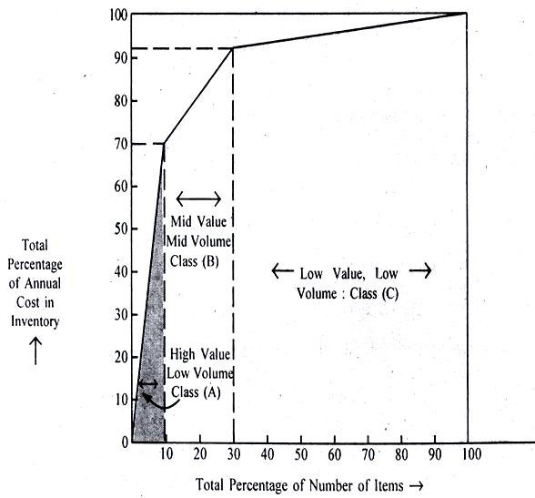
ABC CLASSIFICATION OF MATERIALS (Cont’d..)
ABC analysis enables management to reduce the investment to the minimum possible level because a reasonable quantity of ‘A’ items representing a significant portion of the material cost is purchased. [2]
Management time is saved by this analysis because this technique requires minimum attention to be paid to some items only.
ABC Grouping (in general)
Group class | Total items | Inventory costs
A | 10% | 70%
B | 20% | 20%
C | 70% | 10%
Source: [1]

Slide 10
MEANING OF PURCHASING AND PROCUREMENT
Purchasing means a set of functions that are associated with buying goods and services that the company or organization requires. [3]
In other words, the process of acquiring goods, works, services from external source to satisfy organizational/ personal needs.
Purchasing process includes activities like ordering, expediting (timely delivery), receiving, and fulfilling payment.
Procurement is the process of sourcing and purchasing the goods and services a company needs to fulfil its business objectives, usually from an external source, like a third-party vendor or supplier.

Slide 11
PROCUREMENT V/S PURCHASING
Procurement is umbrella term that includes purchasing.
Procurement is a broader process where few activities are performed prior to purchasing like and few activities after the purchasing.
Purchasing is more reactive whereas procurement is more Proactive
Purchasing has short term goals whereas procurement has long term goals which contributes to the organizational objectives.
Purchasing is typically more focused on the short-term and is more transactional where as procurement is more long term.

Slide 12
PROCUREMENT V/S PURCHASING (Cont’d..)
Procurement is used for high-value items— contracting for construction-type works, acquiring equipment, and obtaining large quantities of goods.
Purchasing is used for the ongoing supply of things such as office supplies.
Procurement on the other hand, especially public procurement, is almost always carried out in discrete packages in which bidders submit sealed bids and compete on price.

Slide 13
PROCUREMENT MANAGEMENT
Procurement management includes the processes required to acquire goods and services, to attain project scope, from outside the performing organization. [4]
Procurement includes purchasing of equipment, materials, supplies, labor, and services required for construction and implementation of a project. [5]
The term construction procurement emphasize the purchase of construction related services with the ultimate aim of :
- alteration, refurbishment, maintenance, extension or demolition of an existing building or structure .
- the creation of a new building or structure, including all associated site works.

Slide 14
PROCUREMENT MANAGEMENT (Cont’d..)
Procurement Management focuses on planning and executing well-defined contract agreements for specific scopes of work throughout the project life cycle.
Therefore, project procurement is obtaining all of the materials and services required for the project.
It includes the processes required to acquire design and engineering services and construction-related materials, equipment, machinery, and services.
Project procurement management includes three primary processes. These are:
Plan procurements
Conduct procurements
Administer (or control) procurements

Slide 15
PROCUREMENT MANAGEMENT (Cont’d..)
Plan procurements
This includes all specifications of the materials and services, such as minimum quality requirements.
What are the contract requirements for outside purchases?
Required delivery dates of product or services
Do you want a fixed price contract or cost-reimbursable?
Are there key milestones to be included?
What about legal terms and conditions that must be met?
How will you search for suppliers of the materials or services you need?
Will you release a request for proposal (RFP)?
Do you have a preferred supplier?

Slide 16
PROCUREMENT MANAGEMENT (Cont’d..)
Conduct procurements
This is the execution phase of project procurement management.
It’s when the RFPs are released, bids are gathered, and selections are made.
Any vendor negotiations will occur during this phase, and then the agreed-upon contracts are signed.
Conducting procurements also includes the actual receipt of and payment for goods and services.
Two key steps included in this process are:
Status or progress updates from vendors
Quality checks of products or services delivered

Slide 17
PROCUREMENT MANAGEMENT (Cont’d..)
Administer (or control) procurements
The project manager does not generally conduct the procurements.
However, you are still responsible for ensuring they are conducted appropriately.
This means you need to be aware of the status of procurements.
If something is late, you need to know how it impacts the rest of your project schedule and mitigate it appropriately.
If there is a conflict between department requirements, it will be up to you to resolve it.

Slide 18
PROCUREMENT MANAGEMENT (Cont’d..)
Public procurement
Public procurement refers to the purchase by governments and state-owned enterprises of goods, services and works.
As public procurement accounts for a substantial portion of the taxpayers’ money, governments are expected to carry it out efficiently and with high standards of conduct in order to ensure high quality of service delivery and safeguard the public interest. [6]
Sound public procurement policies and practices are among the essential elements of good governance.

Slide 19
PROCUREMENT MANAGEMENT (Cont’d..)
Good practices reduce costs and produce timely results; poor practices lead to waste and delays.
It also involves the management of large amounts of money and is the largest single cause for allegations of corruption and government inefficiency.
Importance of Public procurement.
• It influences economic growth
• Efficiency in public procurement releases funds for development
• It is a tool to meet social and economic objectives
• It affects quality of life of the citizens
• The public servant is accountable

Slide 20
PROCUREMENT MANAGEMENT (Cont’d..)
Public procurement is interwoven with key development issues—economic growth, poverty reduction, decentralization, and private sector development.
It is also closely linked to trade and foreign investment. Weakness in the procurement system adversely affects welfare and prospects for growth.
PRINCIPLES OF PUBLIC PROCUREMENT
Economy (Value for Money)
Efficiency (Time)
Fairness (No Biasness)
Transparency (Information)
Integrity (Reliability)
Competition
Accountablity

Slide 21
Components of an Effective Public Procurement System
Legal Framework | Based on a procurement law that defines responsibility of procuring agencies and suppliers
Policy | Consistent, national policies and standards to be followed by all procuring agencies, including arbitration procedures
Institutional Set-up | Defined structures for conducting procurement that minimize subjective decisions and politicization (including approval mechanisms, authorities, and composition of bid and evaluation committees)
Professional Civil Service | Procuring agencies staffed with procurement professionals, trained and recognized as such under civil service
Resources | Procuring agencies supported with adequate budget, standard documents, and operations manuals
Fraud Prevention | Clear laws applicable to procurement officials and suppliers that increase transparency and encourage inclusion of civil society

Slide 22
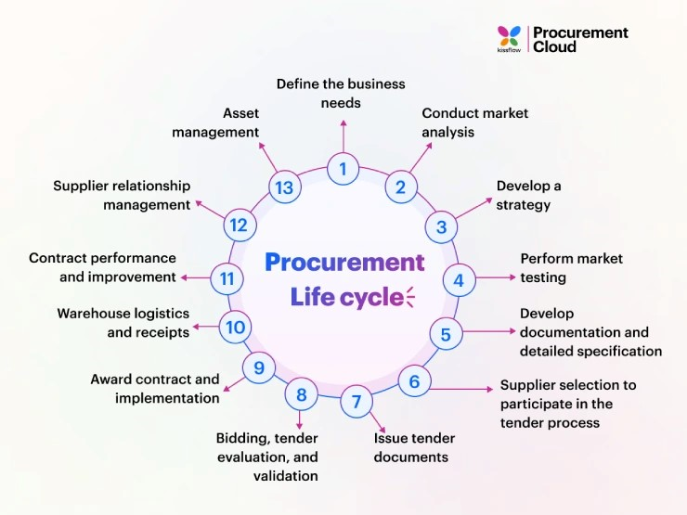
PROCUREMENT CYCLE
Steps [4]:
Identification of the need during design or estimating.
Determination of the design characteristics required to perform the desired function.
Quantification of the element needed, and preparation of procurement specification.
Issuance and processing of internal requisition.
Source: [7]

Slide 23
PROCUREMENT CYCLE (Cont’d..)
Solicitation of bids or price quotation,
Receipts and evaluation of proposals.
Issuance of purchase orders, subcontract or lease.
Vendor’s preparation and submission of shop drawings or samples.
Review and approval of shop drawing by contractors and owner’s architect or engineers.
Fabrication by vendor or subcontractor
Tracking and expediting.
Delivery and inspection
Storage and handling on site prior to use.
on-site fabrication operations.
Installation and testing in constructed facility.
Owner acceptance /rejection, warranties, corrections and other follow –up.

Slide 24
PROCESS OF PROCUREMENT OF WORKS
Preparation of
Pre qualification (PQ) documents
PQ notice of minimum 30 days
PQ evaluation
Approval of Evaluation
Preparation of Standard Bidding Documents and Tender Notice and approval
Tender Notice of minimum 30 days for NCB and minimum 45 days for ICB
Preparation and Approval of Design and Estimate
Tender Opening and Evaluation
Approval of Tender Evaluation
Letter of Intent (7 days notice)
Letter of Acceptance (15 days)
Contract Document
Source: [1]

Slide 25
Principle Documents of Procurement
Prime Contract
It is one let by the owner to a contractor who is in turn responsible for performing the work according to contract specifications.
With multiple contract and professional construction management approaches, the owner may award a number of prime contracts.
Purchase order
It is a short form of contract normally issued for procurement of materials, permanent equipment and supplies.

Slide 26
Principle Documents of Procurement
Subcontract
It is a form of lower-tier contract for procurement of work and services to be performed by other than a prime contractor.
Agreement and Leases
Agreement and leases are forms of contracts used in procurement of technical services or lease of automobiles, construction or office equipment or other temporary items that do not become part of the finished work.

Slide 27
INVENTORY MANAGEMENT
Inventory implies the cost of materials in stock at a given time. Stock of material is held to act as cushion between supply and demand.
Project starts with zero material stock. Ideally construction activity should end up with zero stock when the activity is completed.
Inventory management includes aspects such as controlling and overseeing purchases — from suppliers as well as customers — maintaining the storage of stock, controlling the amount of product for sale, and order fulfilment.

Slide 28
INVENTORY MANAGEMENT (Cont’d…)
Effective Inventory Management is
A system to keep track of inventory.
A reliable forecast of demand.
Knowledge of lead times.
Reasonable estimates of
Holding costs
Ordering Costs
Shortage costs
A classification System.

Slide 29
INVENTORY MANAGEMENT (Cont’d…)
INVENTORY DECISION CONTROL
Even though there are millions of different types of product manufactured in our society, there are only two fundamentals decisions that we have to make when controlling inventory.
How much to order ?
When to order ?
As the inventory level goes up, the cost of storing and holding inventory also increases.
Thus we must reach the fine balance in establishing the inventory levels.
A major objective in inventory control is to minimize total inventory costs.

Slide 30
INVENTORY MANAGEMENT (Cont’d…)
Terminologies
Inventory Cost
It is the cost of maintaining inventory. It comprises carrying cost and ordering cost.
Inventory Ordering Cost
It is the cost of placing and receiving an order. It is charged as per order. Communication cost, custom and duty charge, labor cost for loading and unloading, transportation cost etc.
Total Ordering Cost (TOC) = Number of order (N) * Ordering cost per order (O)
Number of Order = Total requirement(A) / Ordering quantity (N)

Slide 31
INVENTORY MANAGEMENT (Cont’d…)
Carrying Cost/Holding Cost
Cost incurred in storing or holding an item till it is required.
The holding cost is the cost associated with the storing of the inventory items which includes insurance, cost of handling equipment, depreciation, rent of storage space. Etc. [8]
It is charged in per unit of item
Total Carrying Cost (TCC) = Average quantity *Carrying Cost per unit
TCC = Q/2 * C
Total Inventory Cost (TIC) = Ordering cost + Carrying cost
(TIC) = TOC + TCC

Slide 32
INVENTORY MANAGEMENT (Cont’d…)
4. Shortage Cost: Costs when demand exceed supply.
5. Annual Requirements is the total numbers of materials required for the given project.
6. Lead Time is the time period elapsed between placing an order and its arrival in inventory stock. The lead time is crucial in case of machinery and equipment purchased from abroad, which may take even full year or so.

Slide 33
ECONOMIC ORDER QUANTITY
Economic Order Quantity (EOQ) also known as Wilson EOQ model or simply EOQ model is the model that defines the optimal quantity to order that minimizes the total variable costs required to order and hold the inventory.
Economic order quantity refers to that number (quantity) ordered in a single purchase so that the accumulated costs of ordering and carrying costs are at the minimum level.
In other words, the quantity that is ordered at one time should be so, which will minimize the total of. Cost of placing orders and receiving the goods, and Cost of storing the goods as well as interest on the capital invested.

Slide 34
ECONOMIC ORDER QUANTITY (Cont’d….)
Underlying Assumptions [2]
The annual demand for the item is known, deterministic and constant.
The lead time is zero i.e. delivery is immediate. (The time between placement of order and the receipt of the order)
The receipt of the order occurs in a single instant and immediately after ordering it.
Demand is even throughout the year.
There is no any quantity discount. In other words it does not make any differences how much we order, the price of the product will still be the same.

Slide 35
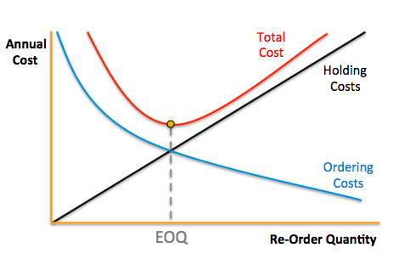
ECONOMIC ORDER QUANTITY (Cont’d….)
EOQ is that level where the ordering cost and holding cost lines intercepts each other.
Source: [9]

Slide 36
ECONOMIC ORDER QUANTITY (Cont’d….)
The graph shows the cost on the vertical or Y axis and the order quantity on the horizontal or X axis.
The straight light which commence from the origin is the carrying cost/holding cost curve, the total costs of carrying units of inventory.
As expected, as we order more on the X axis, the carrying cost line increases in the proportionate manner.
The downward ward sloping curve which commence on the Y axis and decreases as it approaches to the X axis and moves to the right is the ordering cost curve.
This curve represents the total ordering cost depending on the size of the order quantity.

Slide 37
ECONOMIC ORDER QUANTITY (Cont’d….)
Obliviously, the ordering cost will decrease as the order quantity is increased thereby causing there to fewer orders which need to be made in any particular period of time.
The point at which these two curves intersect is the same point which is the minimum of the curve which represents the total cost for the inventory system or EOQ
Thus the sum of carrying cost curve and ordering cost curve is represented by the total cost curve and the minimum point of the total cost curve corresponds to the same point where the carrying cost curve and the ordering cost curve intersect.

Slide 38
ECONOMIC ORDER QUANTITY (Cont’d….)
Economic order quantity is that quantity at which the total inventory cost is minimum as far as possible.
For this the total carrying cost must be equal to the total ordering cost.
Total carrying cost = Total ordering cost
Q/2 * Carrying Cost per unit = Number of order (N) * Ordering cost per order (O)
Q/2 * C = Total requirement(A) / Ordering quantity (N) * O
Using Calculus,
Economic Order Quantity (Q _{opt}) = [2AO/C]^{1/2}

Slide 39
ECONOMIC ORDER QUANTITY (Cont’d….)
Reorder Point (ROP)/ Reorder Level (ROL)
We have decided how much to order, now the second inventory question is when to order ?
It is assumed that we have instantaneous inventory receipt i.e. firms waits until inventory level is zero, places an order, and receives the item in stock immediately.
However, the time between the placing and receipt of an order (called Lead Time) is often few days or weeks.
Thus when to reorder decision is usually expressed in terms of reorder point (ROP), the inventory level at which the order should be placed.

Slide 40
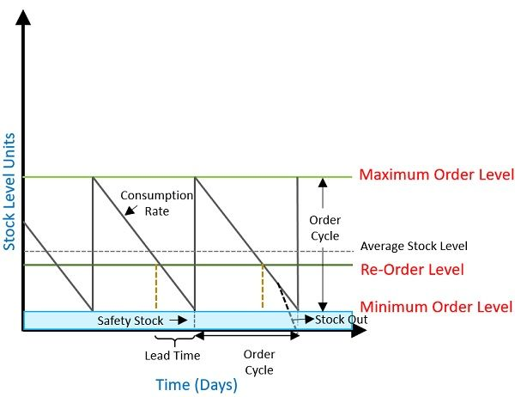
ECONOMIC ORDER QUANTITY (Cont’d….)
EOQ answers “how much” question.
Re-Order Point tells “when” to Order.
Re Order Point (ROP) = {Demand per day} * {lead time for new orders in days}
= d*L
Where, d = Total annual requirement/ Number of working days in a year.
Source: [10]

Slide 41
PROCUREMENT OF CONSULTING SERVICES
Least Cost selection (LCS)
Consultant’s Qualification Selection (CQS)
Fixed Budget selection (FBS)
Single Source selection (SSS)
Quality selection (QBS)
CONSULTANT SELECTION
Individual Consultant Selection (ICS)
Quality & cost based selection (QCBS)

Slide 42
PROCUREMENT OF CONSULTING SERVICES (Cont’d…)
Quality & Cost Based Selection (QCBS)
This is a competitive process among shortlisted firms that take into account the quality of the proposals and the cost of the services in the selection of the successful firm.
Quality Based Selection (QBS)
QBS is a method based on evaluating only the quality of the technical proposals and the subsequent negotiation of the financial proposal and the contract with the Consultant who submitted the highest ranked technical proposal. [2
QBS is appropriate when assignments are complex or highly specialized making it difficult to define precise TOR.

Slide 43
PROCUREMENT OF CONSULTING SERVICES (Cont’d…)
Fixed Budget Selection (FBS)
FBS is a method where the RFP will indicate the available budget and request the Consultancy Organizations to provide their best technical and financial proposals in separate envelopes, within the budget.
Consultant’s Qualification Selection (CQS)
CQS is a method where detailed technical and financial proposals are invited from only a selected Consultancy/Organization to negotiate a contract.
EOI shall be invited using an amplified format and a shortlist of three to five organizations shall be prepared.

Slide 44
PROCUREMENT OF CONSULTING SERVICES (Cont’d…)
Least Cost Selection(LCS)
LCS is a method a “minimum” qualifying mark for the “quality” is established. Proposals, to be submitted in two envelopes, are invited from a short list.
Technical envelopes are opened first and evaluated.
Those securing less than the minimum marks specified shall be rejected, and
The financial envelopes of the rest are opened in public.
The Consultancy/Organization with the lowest price shall then be selected.

Slide 45
PROCUREMENT OF CONSULTING SERVICES (Cont’d…)
Single Source Selection (SSS)
Single-source selection of consultants does not provide the benefits of competition in regard to quality and cost,
Lacks transparency in selection, and Could encourage unacceptable practices.
Therefore, single-source selection shall be used only in exceptional cases.

Slide 46
REFERENCES
[1] Text Book of Construction Management: S.K. Shrestha, Ram Kumar Shrestha and Subash Kumar Bhattarai, First Edition, Heritage Publisher and Distributors Pvt, Ltd, Kathmandu Nepal, 2014.
[2]Production and Operations Management: Prajeet K. Timalsina, Samjhana Publication Pvt. Ltd. Kathmandu, Nepal.
[3] Procurement Vs. Purchasing – 5 Crucial Differences You Should Know, accessed on September 19, 2023. www.procurementtactics.com/procurement-purchasing

Slide 47
REFERENCES (Cont’d…)
[4] A Guide to the Project Management Body of Knowledge (PMBOK): 2000 Edition, Project Management institute, Newton Square, Pennsylvania, USA.
[5] Professional Construction management: Donald S. Barrie and Boyd C. Paulson Jr., Third Edition, McGraw Hill, Inc., 1992.
[6] OECD, Better policies for better life, Public Procurement, accessed on September 18, 2023, www.oecd.org/gov/public-procurement
[7]13 stages of the procurement life cycle explained, what is procurement cycle, Procurement cloud, accessed on 18th September, 2023, https://kissflow.com/procurement/procurement-lifecycle-guide

Slide 48
REFERENCES (Cont’d…)
[8] Fundamentals of PERT/CPM and Project Management: S. K. Bhattacharjee, Second Edition, Khanna Publishers, New Delhi, India, 2002.
[9] How to Find the Right Economic Order Quantity, Originally published at www.eazystock.com on December 1, 2014. accessed on 19th September 2023, www.eazystock.medium.com/how-to-find-the-right-economic-order-quantity-39a5abdd3e78
[10] Difference Between Re-Order Level and Re-Order Quantity, Last updated on August 23, 2021 by Surbhi S, accessed on 19th September. https://keydifferences.com/difference-between-re-order-level-and-re-order-quantity.html

