Slide 1
COURSE TITLE
CONSTRUCTION ENGINEERING AND MANAGEMENT
CHAPTER 5 (Week 5)
CONSTRUCTION EQUIPMENT
Lecture - 5
  Concept of Construction Equipment, Selection of Equipment, Construction Equipment for various construction work.
Er. Ishwar Adhikari
Associate Professor
Kathmandu Engineering College, Nepal

Slide 2
Learning Objective
The main objective of this lecture is to understand about :
Concept of Construction Equipment.
  Selection of Construction Equipment.
  Equipment for Excavation.
  Equipment for Transportation.
  Earth Compacting Equipment.
  Concrete Construction Equipment.
  Equipment for Tunnel Construction.

Slide 3
CONCEPT OF CONSTRUCTION EQUIPMENT
Construction is the transformation of a design by construction into a useful structure which is accomplished by men and equipment/machine.
Construction equipment and accessories are a vital part of any structural engineering works or infrastructural projects.
Massive equipment and construction vehicles are involved in excavation and digging of huge quantities of earth, compacting and levelling, transfer of materials and heavy loads, placement of construction materials, and construction[1]
It has been estimated that about 20-30% of the total project cost has been accounted towards machinery and equipment. [2]

Slide 4
CONCEPT OF CONSTRUCTION EQUIPMENT (Cont’d..)
In order to have a proper quality construction projects, the use of mechanical equipment has become an important and essential feature. [2]
Proper use of the appropriate equipment contributes to economy, quality, safety, speed and timely completion of a project.
Therefore equipment acts as a backbone in the case of large construction project.
It is important for site managers and construction planners to be familiar with the characteristics of the major types of equipment and commonly used in construction.

Slide 5
CONCEPT OF CONSTRUCTION EQUIPMENT (Cont’d..)
Equipment intensive projects present great financial risks for contractors.
Some projects require an equipment commitment that is greater than the amount that a contractor will be paid for completing the job. [3]
Equipment cost is often one of a contractor’s largest expense categories.
To be successful equipment owners must carefully analyse the two important questions about machine:
How much does it cost to operate the machine?
What is the optimum economic life and the optimum manner to secure a machine?

Slide 6
CONCEPT OF CONSTRUCTION EQUIPMENT (Cont’d..)
Advantages of Construction Equipment
Large and complicated works can be carried out easily.
Increase the rate of output with the best effective and efficient methods.
Reduce the overall construction costs especially for large contracts.
Carryout activities which can not be done manually.
Maintain the high quality standards often required by present day design and specification (technical standards).
Eliminates various hazards and health issues.

Slide 7
CONCEPT OF CONSTRUCTION EQUIPMENT (Cont’d..)
Advantages of Construction Equipment
It is free from social and emotional factors.
It helps maintaining construction site safer and cleaner.
Faster rate of progress
High quality of work
Equipment can work in adverse weather, climate and topography

Slide 8
CONCEPT OF CONSTRUCTION EQUIPMENT (Cont’d..)
Disadvantages of Construction Equipment
Large investment is required.
Low availability of spare parts.
Trained and skilled operator will be required.
Cause unemployment as it replace large no of labors.
Reselling or disposing off the construction equipment will be a problem.
Uses of fuel causes environmental problem

Slide 9
TYPES OF CONSTRUCTION EQUIPMENT
Equipment for excavation
Equipment for transportation/hauling
Earth compacting equipment
Concrete construction equipment
Equipment for tunnel construction
Hoisting equipment
Pile driving equipment

Slide 10
SELECTION OF CONSTRUCTION EQUIPMENT
Good project management in construction must vigorously pursue the efficient utilization of labor, material and equipment.
The use of new equipment and innovative methods has made possible wholesale changes in construction technologies in recent decades.
During construction, selection of justified equipment has always been a key factor in the success of any construction work.
The selection of the appropriate type and size of construction equipment often affects the required amount of time and effort and thus the job-site productivity of a project. [4]

Slide 11
SELECTION OF CONSTRUCTION EQUIPMENT (Cont’d…)
It is therefore important for site managers and construction planners to be familiar with the characteristics of the major types of equipment most commonly used in construction.
Hence, equipment Selection is a decision planning process whereby an organization decides to purchase equipment for business purpose.
This may be done in the pre tender stage by the contractors by studying the contract documents, plans and the local conditions.

Slide 12
SELECTION OF CONSTRUCTION EQUIPMENT (Cont’d…)
Main Basis for Selection
Identification of task
Quantity of materials.
Unit weight and size.
Changeable characteristics
Haul distance
Traffic ability
Manoeuvrability
Criteria for selection
Geological conditions.
Weather conditions.
Site Conditions.
Transport facilities.
Availability of fuel and labor.
Availability of services (electricity and water)
Pollution Standards.

Slide 13
SELECTION OF CONSTRUCTION EQUIPMENT (Cont’d…)
Factors considered for selection are:
Economic Consideration.
The economic consideration such as owning costs and operating fuel costs of equipment, resale value, replacement cost of existing equipment, salvage value are most important in selection of equipment. [4]
Site Specific
Site conditions –both ground condition as well as climatic conditions.
3. Cost of repair and maintenance

Slide 14
SELECTION OF CONSTRUCTION EQUIPMENT (Cont’d…)
Economic life of construction equipment
Cost and availability of spare parts
Labor consideration-availability or non availability of trained manpower
Quality and speed

Slide 15
EQUIPMENT FOR EXCAVATION
Earth work in excavation is basic task in any civil engineering projects.
Excavation may be in the surface of ground or below the surface of ground.
Excavation is done for foundation or for collection and production of construction materials.
Mass excavation involves moving a substantial volume of material and the excavation work is a primary part of the project.
Structural excavation is performed to support the construction of other structural elements.

Slide 16
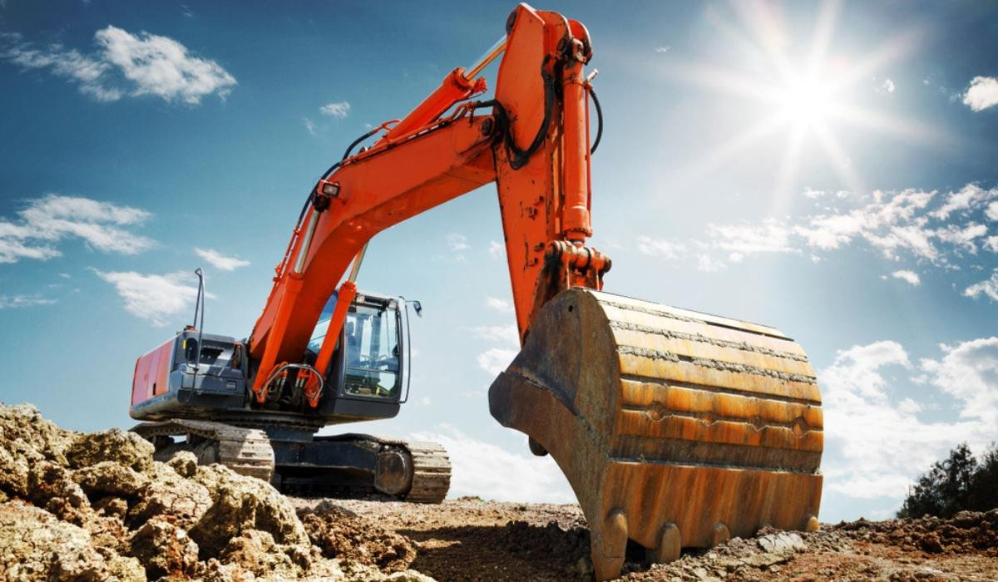
EQUIPMENT FOR EXCAVATION (Cont’d…)
Excavator
Excavators can be used for digging foundations, trenches, and excavation sites, as well as for removing materials and debris from construction sites
Are heavy construction equipment consisting of a boom, stick bucket and cab on a rotating platform.
Excavation is done by teeth attached to a bucket, which is capable of loading the excavated material directly to the transporting vehicle. [5]
Source: [5]

Slide 17
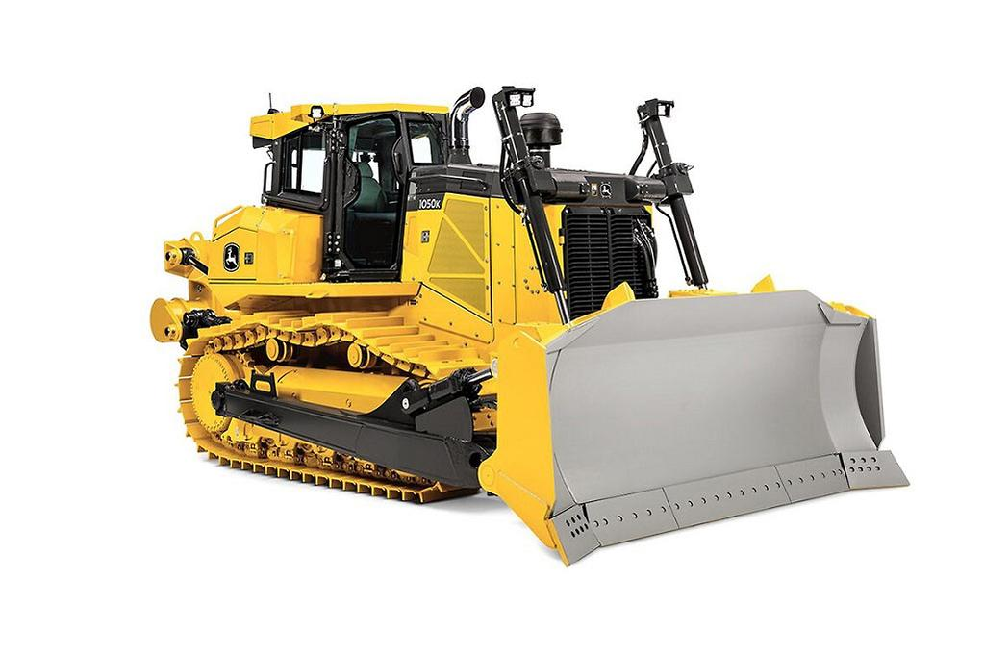
EQUIPMENT FOR EXCAVATION (Cont’d…)
Dozers/ Bull Dozers
Bulldozers are, specifically, tractors equipped with a heavy, front-mounted blade on tracks or wheels.
It is a versatile mechanical instrument for scraping and the excavating in both firm and hard soil.
It can work in worst condition of site like water logged as well as loose soil where other equipment cannot run.
It is used for site clearance, cutting mountainous and rocky terrain, Earthen road maintenance, moving earth haulages up to 100m etc.
Source: [6]

Slide 18
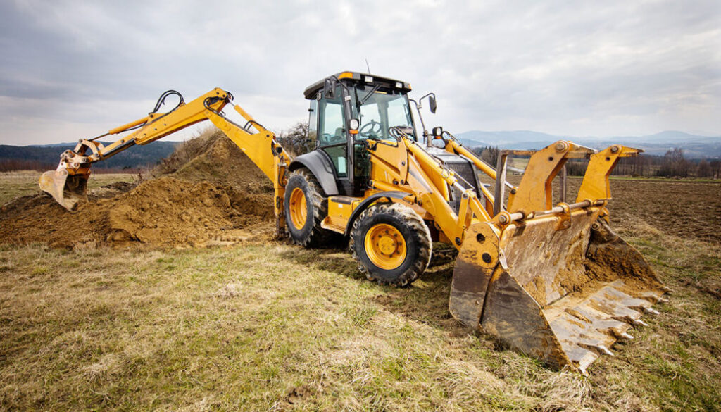
EQUIPMENT FOR EXCAVATION (Cont’d…)
Back Hoe Loaders
It is an excavating machine of the power shovel group which provides flexibility to accomplish a variety of work tasks.
It is used to excavate below the natural surface on which it rests and can work on unstable ground conditions because of its four wheel drive tractor capability.
Back hoes are used to excavate trenches, pits for basement and generally grading work which requires precise control of depths. [2]
Source: [7]

Slide 19
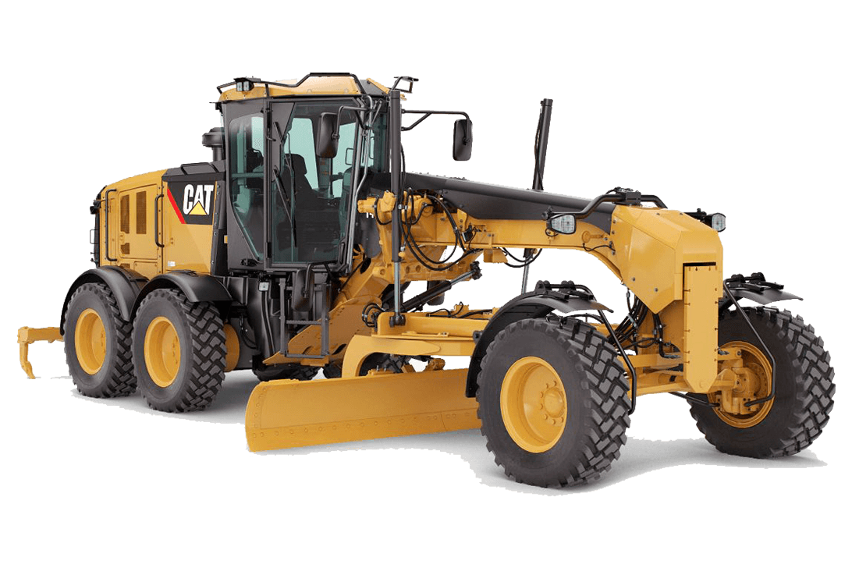
EQUIPMENT FOR EXCAVATION (Cont’d…)
Graders
Graders are most commonly used in civil construction, road works and on mining sites for creating smooth and flat surfaces.
With the help of teeth attached to them, they can scarify earth surface to loosen the materials which can eventually be shifted forward or to the sides by grading blades. [8]
The self propelled grader are also known as motor grader and the blade on a motor grader can be used on construction sites, road works and farm.
Source: [9]

Slide 20
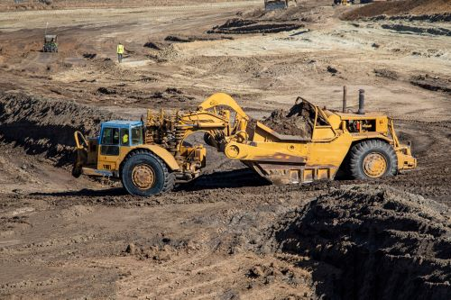
EQUIPMENT FOR EXCAVATION (Cont’d…)
Scrapers
It is the machine capable of cutting thin layer of earth and taking some excavated material in its bowl to be discharged in depression uniformly.
Scraper can be self propelled or tractor pulled type.
Self propelled can be crawler mounted type or rubber tyre mounted .
These are not suitable in such location where the cutting blade cannot work like wet and muddy or rocky strata.
Source: [10]

Slide 21
EQUIPMENT FOR TRANSPORTATION
In construction site, the earth moving work is especially carried out by transportation equipment.
In transporting excavated materials, processed aggregate, and construction materials, and for moving other pieces of construction equipment, transportation equipment serves as a hauling unit.
Large scale cutting and embankment is necessary in construction.
The types of equipment for transportation can be trucks, rail wagon, mini dumpers, loaders, belt conveyor, bucket conveyor, ropeways etc.

Slide 22
EQUIPMENT FOR TRANSPORTATION (Cont’d…)
Trucks
Trucks are the hauling units that provide transportation facility for excavated materials, equipment, aggregates etc.
Trucks can be an ordinary type and dump type.
Ordinary truck (Flat bed truck) are not capable of self emptying the materials.
Dump truck are capable of dumping the load automatically by lifting the body with the help of hydraulic attachment.

Slide 23
EQUIPMENT FOR TRANSPORTATION (Cont’d…)
Rail wagons
Mostly rail wagons are used in tunnel excavation.
They are used when large quantity of material has to be transported to large hauling distance.
Mini Dumpers
Mini dumpers are small front end dump truck with small capacity bowl in front.
They are used when materials to be transported is of very small quantity to a relatively short distance.
Belt Conveyor
Belt conveyor are generally of fixed type. Belt conveyor are loaded with the help of loaders. Used in gravel and sand quarries.

Slide 24
EQUIPMENT FOR TRANSPORTATION (Cont’d…)
5. Loaders
They are used to excavate soft soil and transport it while excavating to a short distance.
Loaders are used to load rocks and stones for crushing aggregates in jaw crusher at site.
6. Bucket Conveyors
These are efficient means of transporting loose materials in vertical direction.
Loading is done manually or mechanically and emptying is done automatically.

Slide 25
EARTH COMPACTING EQUIPMENT
After the ground is brought to shape by cutting or filling , it needs to be compacted to specified density for supporting load over it.
By applying weight to the material, the size of the spaces between individual particles will be decreased.
A compacting machine is a device that applies downward pressure on dirt, soil or gravel to compress the ground and fill in air pockets.
The type of the compacting equipment that the contractor uses depend on the material being compacted.
Equipment may be rollers and compactors.

Slide 26
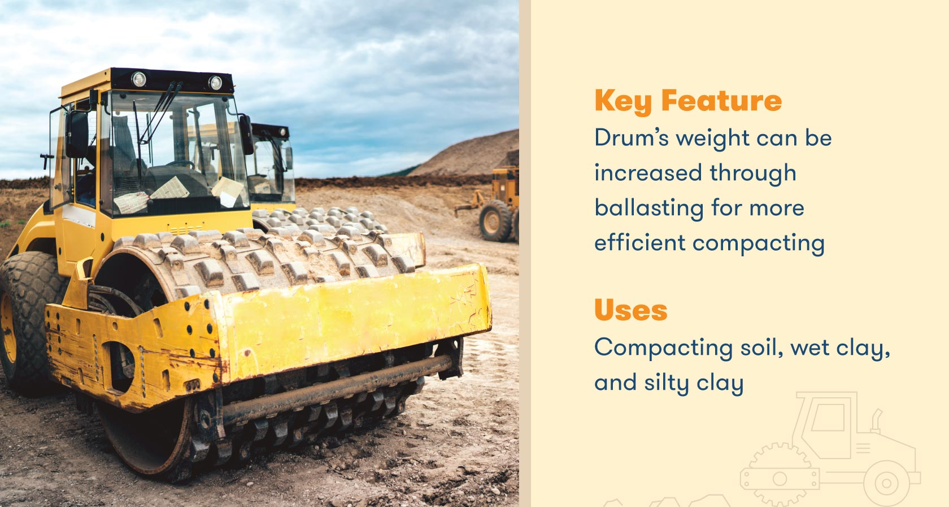
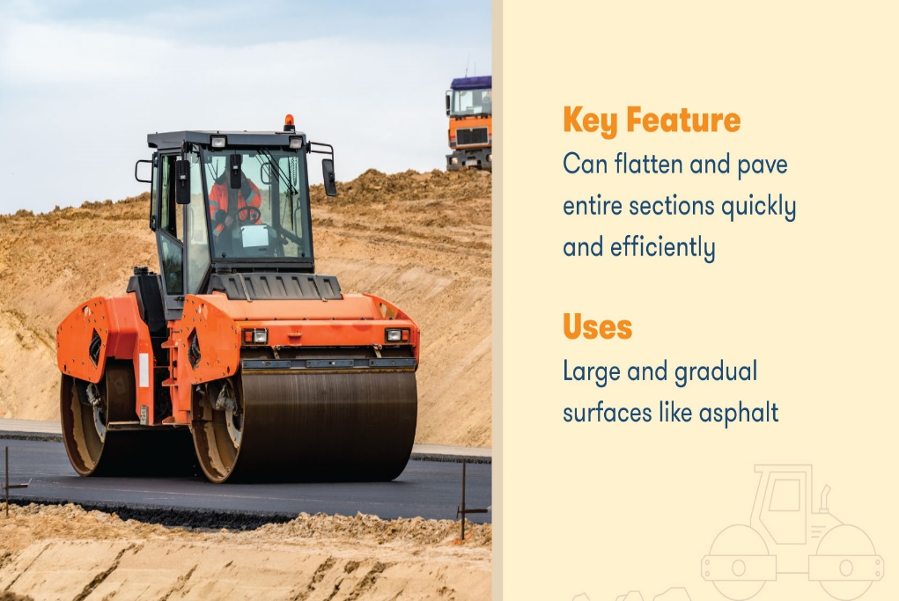
EARTH COMPACTING EQUIPMENT (Cont’d..)
Rollers
Steel Wheel Roller
It is also called smooth wheel rollers used for the compaction of sand, gravel and mixtures of sand and gravel.
Sheep Footed Roller
It consist of hollow steel drum and suitable for clayey soil. Pads of the shape of sheep’s foot are attached on an outer surface of a hollow drum.
Source: [11]
Source: [11]

Slide 27
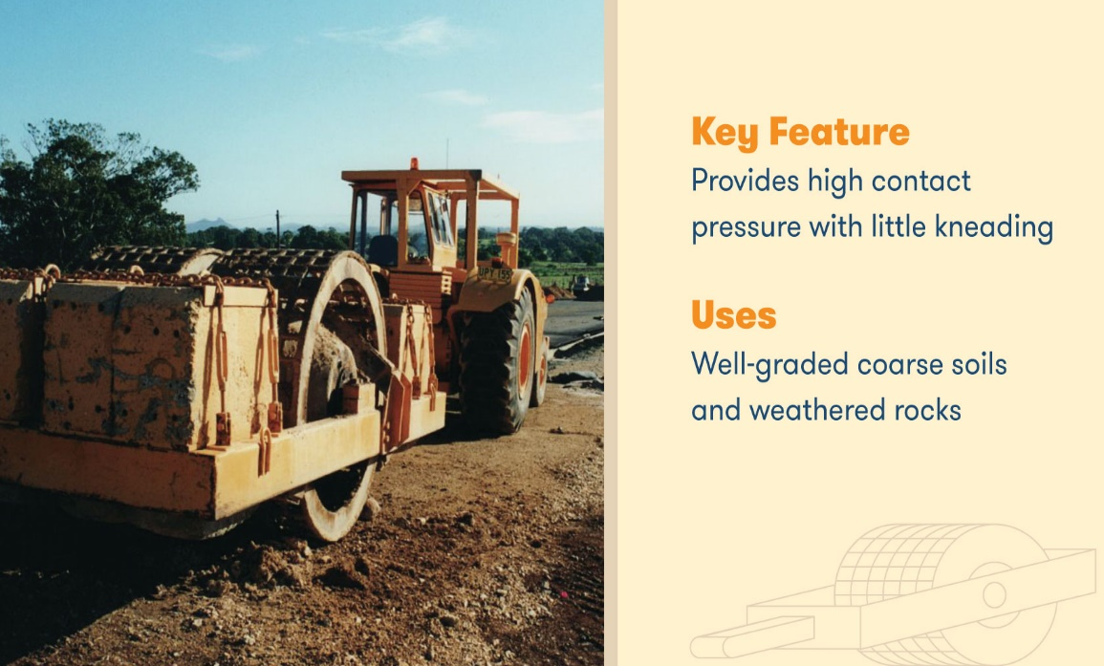
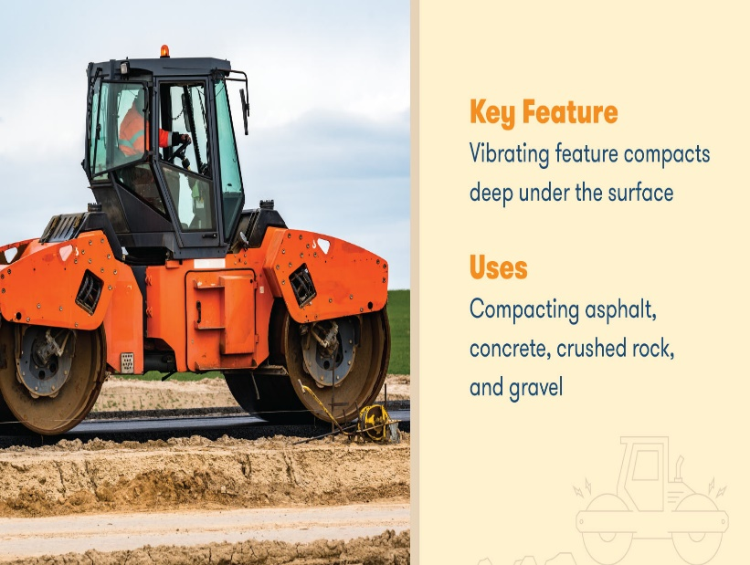
EARTH COMPACTING EQUIPMENT (Cont’d..)
Grid Roller
The drum of this roller is covered by steel chain grids which gives more pressure on the surface to be compacted. These compactors are used on granular materials when size of the grain is relatively larger.
Vibratory Roller
Vibratory rollers are almost identical to smooth wheel rollers (including the single and double drum) except for one major difference: they come with a specialized vibrating component. As the roller compacts and flattens the surface, it will vibrate.
Source: [11]
Source: [11]

Slide 28
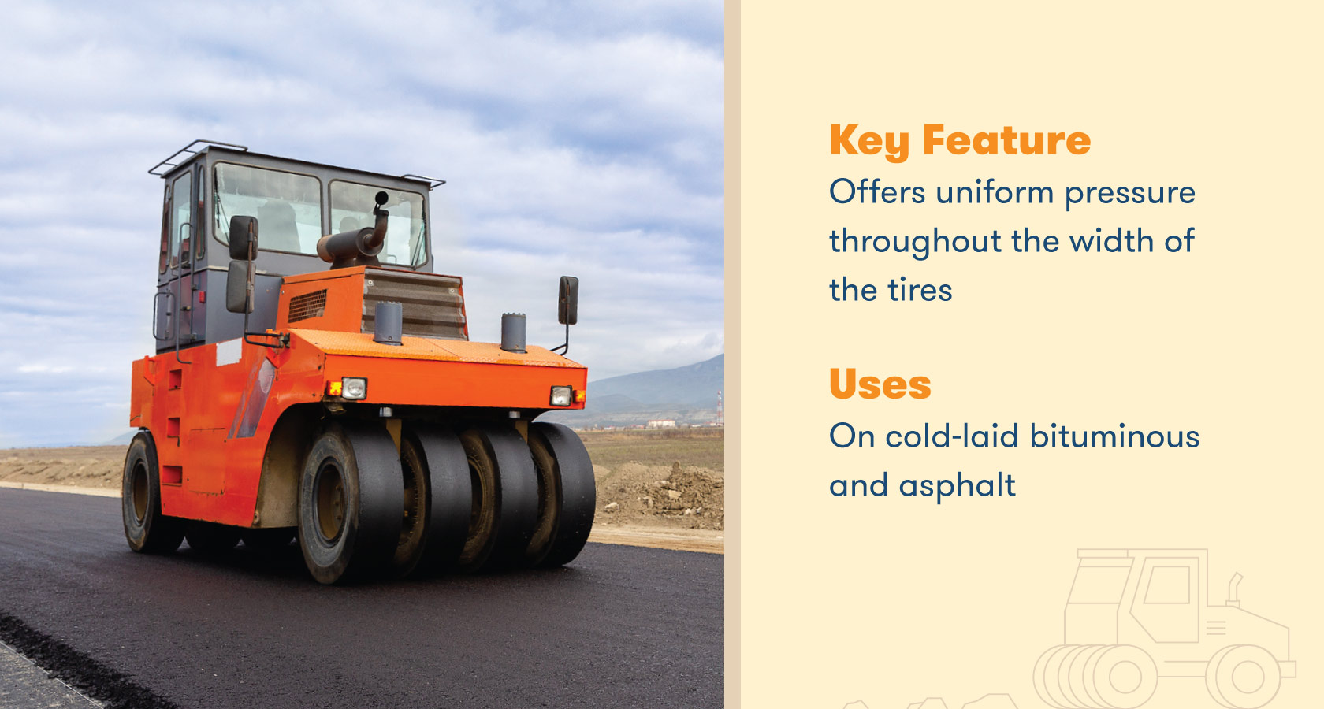
EARTH COMPACTING EQUIPMENT (Cont’d..)
Pneumatic Roller
These are surface rollers and work on the principle of kneading action to produce compaction in the soil below.[8]
These type of roller has rubber tyres, generally it consists of 3 in front and 4 in the rear.
They are non vibrating types and suitable for the compaction of the bituminous pavement and asphalt concrete paving work for finished surface. .
Source: [11]

Slide 29
EARTH COMPACTING EQUIPMENT (Cont’d..)
Manually Operated Compactors
They are used in areas where it is not possible to use a full size compactors.
This includes compacting the fill over trench, compacting soil around footing, or working in areas where large equipment might cause damage to adjacent structures. [2]
These compactors have different styles depending on application like small steel wheel roller, vibratory plate compactors, and rammers.

Slide 30
CONCRETE CONSTRUCTION EQUIPMENT
Concrete is the construction material used in concrete construction and are the most popular forms of construction all over the world.
Concrete is the mixture of appropriate proportion of cement, sand, coarse aggregate, and water.
Its versatility, adaptability, availability and economy shows its usefulness and its low maintenance have made it an excellent building materials.
Advantages of concrete is ability to cast, economical, durable, fire resistant, energy efficient and on-site fabrication.
Operations like batching, mixing, handling and transporting, placing, finishing and curing are involved.

Slide 31
CONCRETE CONSTRUCTION EQUIPMENT (Cont’d…)
Batching
After proportioning the materials from mix design, batching is done to achieve the correct measurement of the ingredients of the concrete.
Batching is measuring different ingredients of concrete to correct quantity.
Batching is performed by weight rather than by volume, because of inaccuracies in measuring aggregates, especially damp aggregates.
For large construction, automatic batching plant is used and for small work simple weighing scale are used.

Slide 32
CONCRETE CONSTRUCTION EQUIPMENT (Cont’d…)
Mixing
The objective of mixing of concrete is to coat the surface of all aggregates particles with cement paste.
Mixing allows the blend of all ingredients of the concrete into a uniform mass.
The small quantity of concrete at a micro-level is mixed by hand which is termed as hand mixing.
For good quality of works at macro level mixing are done through mixing plant.
Batch mixers and continuous mixers are two types of readily available mixers for concrete mixing.

Slide 33
CONCRETE CONSTRUCTION EQUIPMENT (Cont’d…)
Batch mixers can be further classified as:
Tilting type mixers
The mixer consists of a conical or bowl-shaped drum with inside vanes. These vanes revolve on an inclined axis. It discharges mix by tilting its drum without segregation. This mixer is preferable for mixes of low workability and having large size aggregates.
Non-tilting type mixers
In this type of mixer, the drum is cylindrical and always rotate about a horizontal axis. The discharge of mixed is obtained either by inserting chute into the drum or reversing the direction of rotation of the drum. Concrete is liable to segregate in these types of mixer due to the slower rate of discharge.

Slide 34
CONCRETE CONSTRUCTION EQUIPMENT (Cont’d…)
Transportation of Concrete
After mixing of concrete, it should be transported and placed at the site as quickly as possible.
Segregation and drying should be avoided while transporting the concrete after mix.
For most of the small jobs, concrete mix is transported manually with the help of wheelbarrows or even in a pan carried manually.
For any medium to large projects, mechanical equipment is used to transport concrete from mixer to the formwork where it has to be laid in the final shape.
Depending upon the type of work and equipment available various methods of transporting concrete can be employed.

Slide 35
CONCRETE CONSTRUCTION EQUIPMENT (Cont’d…)
Pan method
This method of concrete transportation can be employed for small jobs, where the quantity of concrete required is small and labor are available at a cheaper rate.
Bucket conveyors
Bucket conveyors are used to transporting concrete in the vertical direction from bottom to top.
Dumpers and trucks
These are a special type of trucks. These dumpers are suitable to transport concrete for relatively longer distance without segregation and setting. Tipping lorries are also used to transport concrete
Chutes
They are used to transfer concrete from ground level to lower level. The chute section should be lined with a metal sheet with the uniform slope for the full length.

Slide 36
CONCRETE CONSTRUCTION EQUIPMENT (Cont’d…)
Belt Conveyors
Belt conveyors are very convenient in the movement of concrete easily to different parts at site. It can transport concrete continuously and is suitable for a hot climate. When other methods of transportation are not feasible, belt conveyors are best for the alternate solution.
Cranes
Cranes are commonly used to transfer concrete from the mixer or a place of delivery to the form of work where it has to be laid. It is a very suitable transferring system as it can take concrete to the right location where it is required.
Concrete Pumps
Concrete is transported through pumps in tunnel construction. The guniting and shotcreting are specially done through pumps in high pressure. [8]

Slide 37
CONCRETE CONSTRUCTION EQUIPMENT (Cont’d…)
Concrete Compaction Equipment
Internal Vibrators
Internal vibrators are also called needle vibrator. It consists of three parts. The power unit, flexible tube, and vibratory head. They are introduced into the fresh concrete to vibrate and give a compacting effect to the concrete. [8] Power is given to vibrator either by petrol engine or electricity input.
Form Vibrator
These vibrators are external vibrators and are attached to the outside of the concrete formwork. They vibrate formwork and in turn formwork vibrates the concrete. These are used in compaction of precast concrete.
Plate Vibrators
They are used to compact concrete with lesser thickness. This vibrator falls under the category of a surface vibrator. It is extensively used in slab construction.

Slide 38
EQUIPMENT FOR TUNNEL CONSTRUCTION
Tunnels are civil engineering structures that create an underground passage that may pass through a hill, under buildings or roads, under water or even under entire cities.
Modern tunnels constructions are done with the tunnel boring machines.
A tunnel boring machine is a machine that can excavate tunnels in a single operation, called full-face drilling.
It has a rotating head with cutting parts and runs on hydraulic or electric motors, though its power supply is 100% electric.

Slide 39
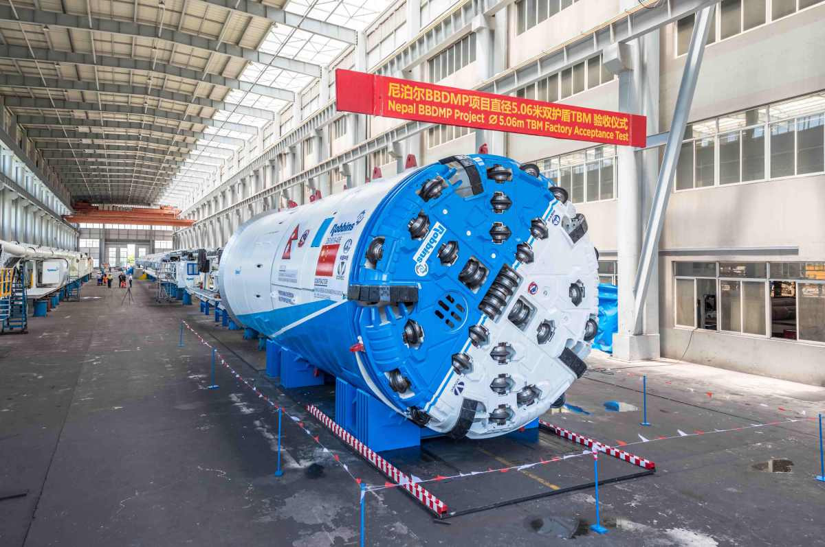
EQUIPMENT FOR TUNNEL CONSTRUCTION (Cont’d..)
TBM’s are available of different capacity and size. Once programmed before operating, these machines can progress in the fixed co-ordinates in all the X, Y, and Z direction.
These are the machines which have programmed boring head or moles which drill mountain to bore tunnel through them.
The muck is taken out through a pipe attached to the boring machine. This method of tunneling is very fast and efficient and are very costly.
Source: [12]

Slide 40
REFERENCES
[1]Failures of construction equipment and accessories: metallurgical root-cause analysis: Goutam Mukhopadhyay, in Handbook of Materials Failure Analysis, 2018, accessed on September 20th , 2023, www.sciencedirect.com/topics/engineering/construction-equipment
[2]Construction Management and Equipment: Saurabh Kumar Soni, First Edition, S.K. Kataria &Sons, Publisher of Engineering and Computer Books, New Delhi, India, April 2014.

Slide 41
REFERENCES (Cont’d…)
[3] Construction Planning, Equipment and Methods: Robert L. Peurifoy, P.E., Clifford J. Schexnayder, P.E, Ph.D and Aviad Shapira, D.Sc, Seventh Edition, McGraw Hill Education (India) Private Limited, New Delhi, India, 2006, Eighth reprint 2013.
[4] SELECTION CRITERIA OF EQUIPMENT IN CONSTRUCTION PROJECT: Abdullah Azmi, Dr. Syed Khursheed Ahmad, Mohd Danish, International Research Journal of Engineering and Technology (IRJET), Volume: 04 Issue: 07 | July -2017.

Slide 42
REFERENCES (Cont’d…)
[5] Excavator machines: Know different types, advantages and disadvantages, By HOUSING NEWS DESK MARCH 29, 2023, accessed on 20th September 2023, https://housing.com/news/excavator-machines-know-different-types-advantages-and-disadvantages/
[6] Dozer types and uses, Construction Sales, by Dave Bullard -
19 Apr 2022, accessed on 20th September, 2023, www.constructionsales.com.au/editorial/details/what-can-you-do-with-a-bulldozer-121384/
[7] THE TOP 7 BEST BACKHOE BRANDS, BROOKELYN TILLERY Backhoe, Construction, Top Mark Funding LLC, April 25, 2022, accessed on 20th September 2023, www.topmarkfunding.com/best-backhoe-brand/

Slide 43
REFERENCES (Cont’d…)
[8] Text Book of Construction Management: S.K. Shrestha, Ram Kumar Shrestha and Subash Kumar Bhattarai, First Edition, Heritage Publisher and Distributors Pvt, Ltd, Kathmandu Nepal, 2014.
[9] What is a Grader and where is it used? Written by Neil McLeod, Civil Trans Training, accessed on 20th September 2023, https://civiltranstraining.com.au/Blog/What-is-a-Grader-and-where-is-it-used
[10] WHAT IS A SCRAPER USED FOR IN CONSTRUCTION? Blog, Courses , WEST COAST TRAINING, accessed on 21st September 2023, https://heavyequipmenttraining.com/what-is-a-scraper-used-for-in-construction/

Slide 44
REFERENCES (Cont’d…)
[11] Compaction Equipment: 6 Types of Rollers Commonly Used in Construction Projects, By: Dustin Eusebio on December 27, 2019, accessed on 21st September 2023, www.bigrentz.com/blog/types-of-rollers
[12] Nepal’s first TBM bores Tunnel for Irrigation & Hydroelectric Project, accessed on 21st September 2023, https://www.tunnel-online.info/en/artikel/tunnel_Nepal_s_first_TBM_bores_Tunnel_for_Irrigation_Hydroelectric_Project-3133964.html

