Slide 1
COURSE TITLE
CONSTRUCTION ENGINEERING AND MANAGEMENT
CHAPTER 7 (Week 7)
CONSTRUCTION PROCESS AND SITE MANAGEMENT
Lecture - 7
  Site Surveying and Preparation, Arrangement of Job Layout, Roles and Responsibilities of Site Engineers, Record Keeping and Documentation, Site Order Book, Procedures to Prepare Bills, Measurement book and Muster roll
Er. Ishwar Adhikari
Associate Professor
Kathmandu Engineering College, Nepal

Slide 2
Learning Objective
The main objective of this lecture is to understand about :
Site surveying and preparation.
  Arrangement of facilities/job layout.
  Roles and responsibilities of site engineers.
  Record keeping and documentation.
  Site order book.
  Procedure to prepare bills.
  Measurement book and muster roll.

Slide 3
SITE SURVEYING AND PREPARATION
Site is a place or area where the construction activities are being carried out which includes surveying, grading, levelling, clearing land, earthmoving and demolition etc.
Construction work is different from each other because of construction site even its design and drawing are the same.
Site preparation is the preparation work done before construction work can begin, which includes evaluating the site, soil testing, locating boundary lines, clearing etc. [1]
Site preparation is the process of preparing the site for future construction work.

Slide 4
SITE SURVEYING AND PREPARATION (Cont’d…)
It is a critical step in the construction process as it lays the groundwork for a successful and safe construction project.
Without proper site preparation, the construction work will be of poor quality and will not meet the required standards.
Temporary services are necessary to execute the construction work. It includes temporary offices, electricity, telecommunication, roadways (access road), drinking water, sanitation system, etc.
Also, spaces should be allocated for heavy and costly equipment in and around the site for their safety.

Slide 5
SITE SURVEYING AND PREPARATION (Cont’d…)
Site Surveying is an inspection of an area where work is proposed, to gather information for initiating construction work, to stake out reference points and marks that will guide the construction of structures.
It can determine a precise location, access, best orientation for the site and the location of obstacles.
Land surveys and surveys of existing conditions are generally performed according to the coordinates system.
Surveying equipment such as Levels, Total Station, Theodolites, and electronic distance measurement (EDM), GPS with computerization are used for accurate measurement of angular deviation, horizontal, vertical and slope distances.

Slide 6
SITE SURVEYING AND PREPARATION (Cont’d…)
Elements of the construction survey
Survey existing conditions of the future work site, including topography, existing buildings and infrastructure, and underground infrastructure whenever possible.
Stakeout reference points and markers that will guide the construction of new structures.
Verify the location of structures during construction.
Conduct an As-Built survey: a survey conducted at the end of the construction project to verify that the work authorized was completed to the specifications set on plans.

Slide 7
SITE SURVEYING AND PREPARATION (Cont’d…)
Factors to be considered for the construction site preparation
Remove all the scrubs or jungle if there exists any on the site for building construction.
The whole area will be roughly leveled.
As a part of site preparation, the trees will be cut off and their roots are totally uprooted as directed.
Before starting the work, permanent benchmarks established at a suitable point in the construction site.

Slide 8
SITE SURVEYING AND PREPARATION (Cont’d…)
The orientation and trench lines of the building should be correctly laid out in the construction site and the location for the storage and stacking of the materials should be definitely set on the ground in the site.
Fixing position of the site office, go-downs, the guard and the labor shed, the access and existing roads for trucks and carts, etc.

Slide 9
  ARRANGEMENT OF FACILITIES/JOB LAYOUT.
Facility layout refers to the arrangement of machines, departments, workstations, storage areas, and common areas within an existing or proposed facility.
Before starting construction, a job layout plan is prepared which indicates the site arrangements to facilitate the work to proceed in a smooth and ordinary manner.
A job layout is prepared to promise that work proceeds smoothly without any obstruction.
Job layout can be defined as a site drawing of the proposed construction showing the location of entry, exit, temporary services, material stores and stocks, plant or equipment and site offices. [2]

Slide 10
  ARRANGEMENT OF FACILITIES/JOB LAYOUT (Cont’d…)
Facility Layout is simply the way a facility is arranged in order to maximize processes that are not only efficient but effective towards the overall organizational goal.
The basic requirements of construction job mainly man, material, the machine must be controlled and placed at a site in such a manner that
Machines are placed in the most advantageous position.
Materials are placed/stored near the place of their utilization
General site circulation to manpower is orderly and their site accommodation is available

Slide 11
  ARRANGEMENT OF FACILITIES/JOB LAYOUT (Cont’d…)
Good site layout planning leads to
Provide a uniform flow of material about the site, free from bottlenecks.
Provide adequate control on equipment theft.
Facilitate movement of equipment on the jobsite.
Promote a safe working environment.
Provide safe, non-destructive access to the jobsite for visitors.

Slide 12
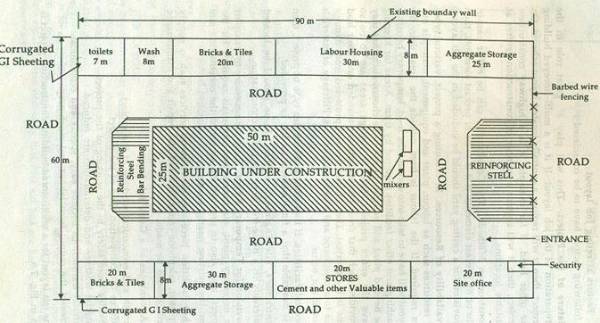
  ARRANGEMENT OF FACILITIES/JOB LAYOUT (Cont’d…)
Source: [3]

Slide 13
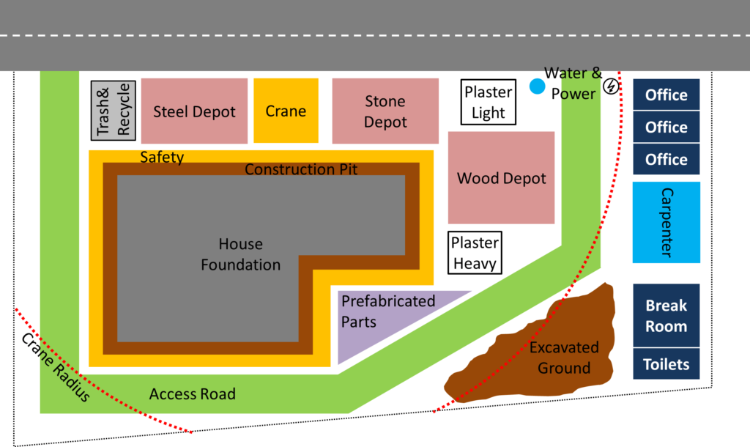
  ARRANGEMENT OF FACILITIES/JOB LAYOUT (Cont’d…)
Source: [4]

Slide 14
  ARRANGEMENT OF FACILITIES/JOB LAYOUT (Cont’d…)
Factors to be considered in construction site planning/job layout
Access to site
There should be a separate entrance and exit to the site. Besides, there should be a track on the site for easy and efficient movement of all site traffic.
Storage of material
Cement bags should be stacked on a raised platform covering with waterproofing material.
Bricks, tiles and concrete blocks are stacked at ground level/ height of stack should not exceed 2 m.

Slide 15
  ARRANGEMENT OF FACILITIES/JOB LAYOUT (Cont’d…)
  Inflammable materials must be stacked separately from other materials and should be protected from fire hazards.
  Re-bars should be kept away from moisture to prevent rusting.
  Timbers must be stacked in well ventilated shady areas.
  The material of common use must be stacked near the place of their use to minimize handling.
  Heavy items must be stacked away from trenches, soft ground or unsure support.
  Cement should be kept constantly moving by using the earliest arrival first.
  Materials must be stored/stacked in a secured place.

Slide 16
  ARRANGEMENT OF FACILITIES/JOB LAYOUT (Cont’d…)
Location of machinery and equipment
  Equipment should be kept near the material it utilizes and as well as near the place of its use.
  For costly equipment, the temporary shed should be provided for weather protection.
  Provision should be made for essential fuel and lubrication.
  Adequate space should be left for scaffolding as well as erection, removal, and shifting.
  Adequate parking facility should be provided.
  Location of security checkpoints should be in such a place so that materials/equipment could not pass in or out without proper authorization.

Slide 17
ROLES AND RESPONSIBILITIES OF SITE ENGINEER
Site engineers perform a technical, organizational and supervisory role on construction projects at site.
An engineer can be liable for failure to exercise their duty of care to all persons lawfully on the premises they have designed or constructed.
The engineer should function in their duties, diligently with technical soundness, contractual fairness, promptly coordinating with employer and contractor.

Slide 18
ROLES AND RESPONSIBILITIES OF SITE ENGINEER (Cont’d…)
A site engineer works as part of the site management team liaising with and working alongside architects, engineers, construction managers, supervisors, planners, surveyors, and subcontractors.
They share responsibility for site security, health and safety, and the organization and supervision of material and human resources.

Slide 19
ROLES AND RESPONSIBILITIES OF SITE ENGINEER (Cont’d…)
Technical Function
Studying the work plan submitted by the contractor and suggests any modifications.
To watch and inspect the construction work and assure that it is done in full accordance with the drawings, technical specifications, and bills of quantities.
Supervising the works on-site in accordance with the contract documents and using the template and procedure established by the consultant.

Slide 20
ROLES AND RESPONSIBILITIES OF SITE ENGINEER (Cont’d…)
Inspecting and testing materials prior to their use at the site as per sample approved by the consultant and ensuring removal of rejected material out from the site.
Ensuring the correct implementation of the works according to technical specifications, to designs and quality of materials
Checking of layout and setting out of buildings w.r.t. existing structures and site levels.
Preparing a list of tests that may be required and following these tests to be carried out at the site and keeping a log of all test conducted at the site.

Slide 21
ROLES AND RESPONSIBILITIES OF SITE ENGINEER (Cont’d…)
Checking and testing of completed works before they are covered by the contractor, taking photos on a regular basis and also on account of defective work.
Checking and ensuring that the site is arranged as per the site management plan and that all measures are taken for site safety and the safety of the third parties in the vicinity of the site
Ensuring that health and safety measures are adopted and followed to the full extent and prepare the weekly report and suggest and instruct additional safety measures if needed.

Slide 22
ROLES AND RESPONSIBILITIES OF SITE ENGINEER (Cont’d…)
Preparation of the list of critical items and its close monitoring.
Maintain a filing system for all site memos and instructions, measured quantities of work and materials on-site, reports and other documents and correspondence pertaining to the construction activities.
Maintain a site order book to be made available for the consultants and senior officers to write comments or defects in construction noticed during site visits and carrying out compliance at the site.

Slide 23
ROLES AND RESPONSIBILITIES OF SITE ENGINEER (Cont’d…)
Administrative Functions
He/she will be required from time to time to assist the Administrative head/consultants.
Interacting with local authorities/ departments for statutory approval/certificates as and when instructed.
Performing other relevant duties as assigned by Administrative head/consultants.

Slide 24
ROLES AND RESPONSIBILITIES OF SITE ENGINEER (Cont’d…)
Deliverables
Weekly progress reports per each project/contract assigned.
Compliance of comments on defective or rejected work in the site order book.
Update of the work plan of the contracts – monthly.
Duly maintain an electronic library of photos of the progress of the works.
Required Qualities of site engineer
Knowledge of technology
2. Social understanding
3. Economical realities
4. Legal awareness
5. Environmental skills
6. Management
7. Leadership and innovation

Slide 25
RECORD KEEPING AND DOCUMENTATION
Every activity relating to the work execution and procurement should be recorded and documented separately.
Record is a document required to prove any construction activity has taken place at site during billing or any other claims. These records have all the data of various construction activities carried out at site. [5]
These documents helps to defend any claims such as liquidated damages or false claims or violations of any guidelines by authorities or clients.
A separate file index is necessary for every action regarding the execution of the works.

Slide 26
RECORD KEEPING AND DOCUMENTATION (Cont’d..)
Records at Construction Site
The following are the various records that need to be maintained at construction site: [5]
Drawings (Architectural, structural, electrical, plumbing etc.)
Contract Agreement ( approval of municipality or development authorities, drawings and its amendment)
Time and Progress Charts or CPM Charts (approved from concerned authorities)
Work Orders Book (orders given by client to contractor including date and signature)

Slide 27
RECORD KEEPING AND DOCUMENTATION (Cont’d..)
Work Diary (weather condition, material arrival date and quantity, visit of VIPs, types of tools and plants used etc.)
Test Result Record (Cube test, sieve analysis, slump test, compressive strength, tensile strength etc.)
Cement Register (manufacturing date, daily consumption, initial final setting time, remaining balance etc.)
Labour Attendance Record and Daily Wages Sheet
Periodic Bills Record
Records of Changes, Deviation Orders and Amendments

Slide 28
RECORD KEEPING AND DOCUMENTATION (Cont’d..)
Documentation is a tool to reduce and resolve contract disputes. It also maintains proper communication.
Few Situations of Documentation: [6]
A. Bidding and Negotiation
delay in supplying bid documents (Correspondence, prebid meetings)
Findings of site inspection
Rate analysis of major items
Construction schedule with critical activities
Negotiation during finalization of award

Slide 29
RECORD KEEPING AND DOCUMENTATION (Cont’d..)
B. During Signing of Contract Agreement and Mobilization Period
Extension of validity of tender documents
Delay in payment of mobilization amount
Delay in the supply of necessary drawings and documents
Site position date should be recorded
Site order book, MB

Slide 30
RECORD KEEPING AND DOCUMENTATION (Cont’d..)
C. During Construction period for Delays and Extra Costs:
The contractor should be aware to maintain proper documents to establish facts that caused the delay.
Changes in contract work
Variation in quantities
Unusual site conditions
Force majeure
Unusual inflation

Slide 31
SITE ORDER BOOK
Every worksite should have a site order book in the prescribed format so as to record the comments of the higher official while inspecting the work.
It is a book of record of all the orders given by the client to contractor to perform the activities in a construction site.
A Site Order Book is a register duly certified by the Client regarding the number of pages it contains, each page is numbered, Name of work, name of the contractor, reference of a contract/work order, etc.
Site Order Books shall be maintained on the sites of works and should never be removed therefrom under any circumstances.

Slide 32
SITE ORDER BOOK (Cont’d…)
The Engineer-in-Charge or his authorized representative shall duly record his observations regarding any work which needs action on the part of the contractor like improvement in the quality of work failure to adhere to the scheduled program etc. as per contract agreement/work order. [6]
The contractor shall promptly sign the Site Order Book and note the orders given therein by the Engineer-in-Charge or his representative and comply with them.
The compliance shall be reported by the contractor to the Engineer in Charge or his authorized representative in time so that it can be checked and recorded.

Slide 33
PROCEDURE TO PREPARE BILLS
A bill or invoice is a typical payment document or a billed list of items that are submitted or sent by a contractor or a subcontractor to the client to receive payment as discussed before for the work which they have completed.
It is a written record of the purchase agreement between the client and the contractor that ensures cash flow for the contractor.
‍Usually, the payment to the contractor is made on the basis of the statement of work done, these are called running bills. It is also called an Interim Payment Certificate (IPC).

Slide 34
PROCEDURE TO PREPARE BILLS (Cont’d…)
The bills are prepared and submitted by the contractor to the client for the payment by following the below-listed steps:
Measurement of book
Entry in Measurement Book
Preparing a bill

Slide 35
PROCEDURE TO PREPARE BILLS (Cont’d…)
Name of Project: Description of Works………………….
Name of Budget Head: Date of measurement…………………
Name of Contractor /UC: Date of Running Bill…………………..
Date of Agreement :
1st / 2nd / 3rd Running Bill
S.No | Items | unit | Measurement |  |  | Total Quantity | Unit Rate | Amount | Remarks
 |  |  | L | B | H / D
Amount In words:
Bill Prepared By: Checked By Approved By:

Slide 36
PROCEDURE TO PREPARE BILLS (Cont’d…)
The most common construction billing methods: [7]
1. Advanced billing in construction
Advanced billing in construction is a method where payments are finalized before a project begins — usually in the form of a lump sum payment.
This invoicing practice can be risky for the stakeholders in charge of the project.
Advanced payments mean they are putting a lot of trust into the parties responsible for working on the project.
This method can also be risky for the contractor involved in the build, as projects often run over budget.

Slide 37
PROCEDURE TO PREPARE BILLS (Cont’d…)
2. Arrears billing in construction
Arrears billing in construction is the process of billing at the end of a project.
Payment is sent out as a lump sum once all stakeholders have signed off and approved the final product.
This billing method can be especially risky for the contractor as the construction business is essentially floating the costs of the job.
Contractors will have to pay out of pocket for materials and labor and count on their clients to pay fully and on time.
However, it’s common for payments in the construction industry to take weeks or months to be sent out.

Slide 38
PROCEDURE TO PREPARE BILLS (Cont’d…)
3. Progress billing in construction
Progress billing in construction is the invoicing practice of billing incrementally throughout a project.
More complicated than billing before the project begins or after a project ends, progress billing invoices are created based on the percentage of completion of work to-date.
Payments are made at agreed points in the project completion.
The progress billing method is ideal for major construction projects that are lengthy and typically have big budgets.

Slide 39
MEASUREMENT BOOK AND MUSTER ROLL
Measurement Book is a book showing an original record of work done or supply of materials received duly weighed, measured or counted.
It includes finance, so the record should be lucid, clear such that if necessary it can be checked with the entries made.
It is evidence of work done and measurement, so act as valid documents.
It serves as a detailed record of the measurements taken during various stages of construction, including excavation, foundation, structural work, finishes, and other related activities.

Slide 40
MEASUREMENT BOOK AND MUSTER ROLL (Cont’d…)
A Sample of MB
Location …………. |  | Item number………… |  |  |  | Description of Works ….
Date of start….. |  | Date of Completion……. |  |  |  | Date of measurement…
Drawing number… |  |  |  |  |  | Reference data.
S.N. | Items | unit | Measurement |  |  |  | Total Quantity | Remarks
 |  |  | L |  | B | H / D
Measurement Taken By:………………………………. |  |  |  |  |  | Contractor's Representative:…………
Checked By:…………………. |  |  |  |  |  | Approved By:………….
Source: [6]

Slide 41
MEASUREMENT BOOK AND MUSTER ROLL (Cont’d…)
Muster Rolls actually the register of employee data which is usually kept in the factory or establishment.
Muster Roll is commonly used in the department to make payment to the labor engaged in daily wages.
It should be clearly maintained as payment to the labor is done on the basis of this roll.
It usually consists of the following:
Name of employee
Age
Sex
Date of joining
Roll/Employee number
Type of employment: Regular/Contract/Casual
Category(Designation): Management/Supervisor/Skilled/Semi-Skilled/Unskilled
Rate of payment
Shift (if applicable)
Attendance

Slide 42
MEASUREMENT BOOK AND MUSTER ROLL (Cont’d…)
Muster roll has three parts [6]
Part I: Detailed information about labor engaged, attendance, rate, the total amount to be paid, signature columns, etc.
Part II: Record of unpaid Wages
Part III: Record of completed works for which payment is to be made.

Slide 43
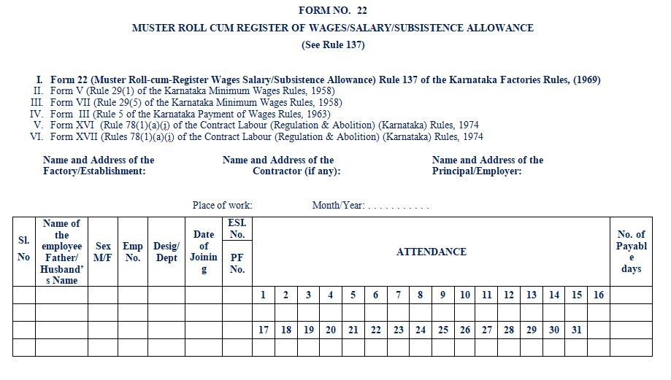
MEASUREMENT BOOK AND MUSTER ROLL (Cont’d…)
Source: [8]

Slide 44
REFERENCES:
[1]What Is Construction Site Preparation? by Tom Belmont on November 30, 2022, accessed on October 13, 2023, https://www.bigrentz.com/blog/site-preparation
[2] “Study of Job Layout for Construction Project”, Soygaonkar Amit R. , P. P. Bhangale, International Journal of Engineering and Research Technology, Volume 03, Issue 11 (November 2104), accessed on 14th October 2023, https://www.ijert.org/study-of-job-layout-for-construction-project
[3] Guidelines for site layout or job layout at construction site, Arka Roy, accessed on 14th October 2023, https://www.linkedin.com/pulse/guidelines-site-layout-job-construction-arka-roy/

Slide 45
REFERENCES (Cont’d…)
[4] Construction Site Layout, by Christoph Roser, accessed on 14th October, 2023, https://www.allaboutlean.com/lean-construction/construction-site-plan/
[5] Records to be Maintained at Construction Site, Building Technology Guide, Building Byelaws, The Constructor, accessed on 14th October 2023, https://theconstructor.org/construction/records-maintained-construction-site/9607/
[6] Text Book of Construction Management: S.K. Shrestha, Ram Kumar Shrestha and Subash Kumar Bhattarai, First Edition, Heritage Publisher and Distributors Pvt, Ltd, Kathmandu Nepal, 2014.

Slide 46
REFERENCES (Cont’d…)
[7] Construction billing methods & best practices, by Ben Morse March 3, 2021, accessed on 15th October 2023, https://tread.io/blog/construction-billing-methods-best-practices
[8] Muster Roll – Attendance Register in Payroll, accessed on 15th October 2023, https://officeanywhere.io/payroll/muster-roll

