Slide 1
COURSE TITLE
CONSTRUCTION ENGINEERING AND MANAGEMENT
CHAPTER 8 (Week 8)
CONTROLLING OF CONSTRUCTION WORK
Lecture - 8
  Project Scope Control, Project Quality Control, Labor Productivity Control, Equipment Productivity Control, Work Schedule Control, Performance Control using EVA
Er. Ishwar Adhikari
Associate Professor
Kathmandu Engineering College, Nepal

Slide 2
Learning Objective
The main objective of this lecture is to understand about :
Project Scope Control.
  Project Quality Control.
  Labor Productivity Control.
  Equipment and Materials Productivity Control.
  Work Schedule Control.
  Performance Control Using EVA

Slide 3
INTRODUCTION
During the implementation phase the paper works are translated into reality or physical form.
The major role of the construction manager is to observe the performance of the project is in accordance with the planned standard or not.
The process of comparing the actual field performance with the planned data and taking some actions is called the project monitoring and controlling.
Monitoring and Evaluation are essential tools, which helps to improve the efficiency of on-going projects and the selection and design of future projects.

Slide 4
INTRODUCTION (Cont’d…)
Project management monitoring and controlling means actively reviewing the status of the project as it proceeds, evaluating potential obstacles, and implementing necessary changes. [1]
It also helps the project team to make a rational and improved decision about the project performance. It is must for achieving the objective of the project.

Slide 5
PROJECT SCOPE CONTROL
Project scope management includes the processes required to ensure that the project includes all the work required, and only the work required to complete the work successfully. [2]
The construction project scope defines the works that must be undertaken in order to deliver a facility, a product or a service with the specified attributes and features.
Project work scope management aims at ensuring that planned works are done to ensure the achievement of the stated purpose of the project. It focuses on the project scope of work and its components.

Slide 6
PROJECT SCOPE CONTROL (Cont’d…)
A typical project scope definition covers the project purpose, project objectives, brief statement of work, Work Breakdown Structure (WBS), outline execution methodology, milestone time plan, cash flow pattern, outline project organization, and potential risks and problem areas
Project scope control is primarily concerned with defining and controlling what is or is not included in the project. [2]
Scope control implies controlling the performance of all the scope related processes in the project life cycle.
These processes include control of the work designs, work quality, construction contracts and the site performance of resources productivity, scheduled time and budgeted cost.

Slide 7
PROJECT SCOPE CONTROL (Cont’d…)
In a construction project, the typical scope related parameters that are controlled are design, contracts, quality, time and cost. Controlling of project scope of work follows the system approach.
Project Formulation and Appraisal
Product Scope Design and Specification
Extrinsic
(Hygiene / maintenance)
Fig. Project Work Scope and Integration Planning Flow Diagram [3]
Intrinsic
(Motivators / Satisfiers)
Work Scope Quantities Baseline
Project Time Schedule
Scope Change Requirement
Project Resource Schedule
Project Cost Plan and Budget
Scope Management Integrated Plan
Risk Response Plan

Slide 8
PROJECT QUALITY CONTROL
Quality may be defined as “The totality of features and characteristics of a product or services which bear on its ability to satisfy stated or implied need”.
Quality Concept moves through different stages such as inspection, quality assurance, quality control, and total quality to reach the quality concept called Total Quality Management (TQM).
Planning and controlling standards for quality are fundamental in both the design and construction phases of a project.

Slide 9
PROJECT QUALITY CONTROL (Cont’d…)
The aim of quality control is to ensure the production of items for their intended use with defects and variations from their prescribed standards within limits prescribed. [4]
It also aims to avoid wastage of time, materials and money by highlighting the point at which a production process is becoming defective.
The cornerstone of quality control is specification.
Objectives
To maintain quality standards.
To ensure customer satisfaction.
To reduce costs associated with defective goods.

Slide 10
PROJECT QUALITY CONTROL (Cont’d…)
Quality Control Process includes: [5]
Setting specific standards for construction performance, usually through the plans and specifications.
Measuring variances from the standard
Taking action to correct or minimize adverse variance and
Planning for improvements in the standards themselves and in conformance with the standards.

Slide 11
PROJECT QUALITY CONTROL (Cont’d…)
Quality Related Process
Process | Description | References
Quality Planning | Involves identifying the quality standards that are relevant to the project and determining how to ensure conformance to these standards. | ISO 8402:3.5
Quality Assurance | All the planned and systematic activities implemented within the quality system and demonstrated as needed, to provide adequate confidence that an entity will fulfil requirement for quality, | ISO 8402:3.5
Quality Control | The operational techniques and activities which together sustain the product, service or quality to specific requirements. | ISO 8402:3.5
Quality Inspection | It determines the acceptability of a product or a service or stages of construction. Includes measuring, examining and testing of product. | ISO 8402:2.15
Quality Audit | A systematic and independent examination to determine whether quality activities and related results comply with planned arrangements. | ISO 8402:4.9
Quality Improvement | Actions taken throughout the organization to increase the effectiveness and efficiency of activities. | ISO 9004-1:5.6
Source: [3]

Slide 12
PROJECT QUALITY CONTROL (Cont’d…)
Six Sigma Model
Six Sigma is a quality management methodology used to help businesses improve current processes, products, or services by discovering and eliminating defects.[6]
The goal is to streamline quality control in manufacturing or business processes so there is little to no variance throughout.
The six sigma methodology helps greatly to reduce errors and defects in products, processes, and services.
The six sigma methodology is a proactive management philosophy aim at problem-solving and performance improvement.
Six sigma methodology involves the application of both statistical and non-statistical methods to reduce the number of variations which implies greater efficiency and lower costs.

Slide 13
PROJECT QUALITY CONTROL (Cont’d…)
The six sigma model can be adapted to a project environment. The six processes involved in the six sigma model is as follows:
Define: determination of the quality characteristics of the output from the project that are critical to the customers satisfaction
Measure: determine what to measure, sources of information and data and data collection plan
Analyze: use of appropriate quality planning or quality control tools and techniques to analyze the collected data
Improve: based on performance and comparing with standards, modify or redesign existing methods and implement the change
Control: monitoring the change to assure the required performance level is satisfied or not

Slide 14
LABOR PRODUCTIVITY CONTROL
Human resources (skilled or unskilled) are one of the important resources to execute the construction activities in the site.
The productivity means ability to produce and implies the ratio of output to input.
The input and output can be measured in terms of physical quantities, monetary terms or a combination of both.
Labor productivity achieved at the site for a given work provides a measure of the labor's efficiency.
It shows the total time for which the labor was employed at work, the time he was productive on work and the time he remained unproductive.

Slide 15
LABOR PRODUCTIVITY CONTROL (Cont’d…)
The control process involves accounting of actual productivity, comparing the actual with the standard, analyzing the causes for variations between actual and standard, and finally taking remedial measures to improve productivity.
Labor productivity is a measure of the overall effectiveness of an operating system in utilizing labor, equipment and capital to convert labor efforts into useful output.
Resources Productivity
Workers’ productivity = quantity of work done per man-hours
Material productivity = quantity of work done per unit mix of material(s) consumption
Equipment productivity = quantity of work done per equipment–hour

Slide 16
LABOR PRODUCTIVITY CONTROL (Cont’d…)
Factors affecting Labor productivity
Skills (education, experience, leadership, discipline, communication, legacy data from previous projects)
Health (overwork, mental health, fatigue, stress, recovery, vacation)
Job satisfaction (motivation, salary, perks, contract changes, conflicts, recognition, promotion)
HR (on boarding, training, planning, instructions, supervision)
Working conditions (noise, shift duration, security check, weather, hazardous work area)

Slide 17
LABOR PRODUCTIVITY CONTROL (Cont’d…)
Typical Causes of Low Labor Productivity
(a) Un-productive time: It can be due to
Rework of defective work done.
Waiting for material, equipment and/or instructions.
Absence from work by workers.
Other reasons.
Frequent changes in the scope of work and work methodology.
Conflicts between supervisors and workers.

Slide 18
LABOR PRODUCTIVITY CONTROL (Cont’d…)
(b) Worker's low morale: This can result from :
Non-fulfillment of employment terms and conditions by the management.
The insecurity of employment.
Sub-standard working conditions.
Frequent transfers.
Frequent changes in the scope of work and work methodology.
Conflicts between supervisors and workers.

Slide 19
LABOR PRODUCTIVITY CONTROL (Cont’d…)
(c)Poor pre-work preparation by supervisors: The lack of preparation for the execution of the assigned work prior to commencement can result in inefficient handling of resources due to
Excess workers employed for the task.
Insufficient instructions for the execution of work.
Incorrect sequencing of work activities.
(d) Directional failures of the project management: These include
Failure to set performance targets.
Failure to make provision for timely resource support.
Failure to provide feedback.
Failure to motivate workers.

Slide 20
LABOR PRODUCTIVITY CONTROL (Cont’d…)
Labor Productivity Improvement Measures
Reduce unproductive time by constantly reviewing and minimizing the causes that are contributing to unproductive time.
Replace Labor by appropriate equipment, where economically feasible.
Substitute inefficient working tools by appropriate efficient tools.
Improve the method of executing work, remembering that there is always a better way of doing a task.
Improve working conditions.
Employ competent supervisors.
Cover commuting time from home to work site.

Slide 21
LABOR PRODUCTIVITY CONTROL (Cont’d…)
Other ways of improving labor productivity are:
Provide Training and Career Options
Mitigate Weather-Related Risks
Set Up Communication Between Field and Office
Set Realistic Goals and Offer Recognition
Limit Overtime
Properly Manage Seasonal Hiring

Slide 22
EQUIPMENT PRODUCTIVITY CONTROL
In construction, some tasks are labor-intensive, some pre-dominantly employ equipment and some use a combination of both, i.e., Labor and equipment.
Equipment productivity refers to the time during which the machine is in operation performing productive work.
The equipment productivity control is undertaken to determine its employment time, the output achieved and its productivity at the site.
The main purpose of equipment productivity control is to minimize the wastage in utilization.

Slide 23
EQUIPMENT PRODUCTIVITY CONTROL (Cont’d….)
Equipment Productivity Analysis
In order to make the construction site cost-conscious and to assess the unit rate for various items of work, the equipment utilized by the sites can be charged by the equipment cost center at a standard hourly rate. [3]
The usage cost accounting takes into consideration the owning and operating costs of each equipment.
These costs can be determined by maintaining the following records for each equipment, in the form of a logbook: [3]

Slide 24
EQUIPMENT PRODUCTIVITY CONTROL (Cont’d….)
The equipment ownership data, including the identification numbers, make and model, purchase particulars, such as date and purchase cost and replacement costs of major components.
A history sheet of the equipment's major repairs.
The equipment periodical maintenance record.
The equipment employment history since its purchase, monthly operating hours and fuel consumption record.
The operator's record.
The do's and don'ts of the equipment operation.

Slide 25
EQUIPMENT PRODUCTIVITY CONTROL (Cont’d….)
Causes and Remedies for Low Productivity of the Equipment
Insufficient preparation.
Lack of continuity of task.
Inadequate operator skill.
Lack of effective supervision.
Non-availability of maintenance, repair facilities, and spares.
Poor equipment management, especially lack preventive maintenance measures.
Accidents.

Slide 26
EQUIPMENT PRODUCTIVITY CONTROL (Cont’d….)
Remedies
Equipment productivity can be improved by:
Suitably matching machines with the job.
Employing experienced operators and competent maintenance staff
Adopting correct methods for work execution
Employing service-worthy machines
Enforcing proper maintenance measures and having an effective plant manager.

Slide 27
WORK SCHEDULE CONTROL
Project scheduling refers to the process of laying out all the actual activities of the project in the time order in which they are to be performed. [7]
The tools like Bar chart, Critical path method, Program evaluation and review techniques and Line of balance are used for scheduling a project.
The construction schedule – including monthly progress status reports, schedule updates, and revisions – is integral to the project’s successful completion.
Controlling the schedule includes monitoring and controlling any and all of the project schedules.

Slide 28
WORK SCHEDULE CONTROL (Cont’d..)
In a construction project, the controlling of time and cost objectives involves the control of the following interacting, parameters: [3]
Time Progress Control
Analyzing the project time status.
Evaluating the implications of the deviation on the project time objectives.
Formulating remedial measures, including time crashing, to achieve the time objectives.

Slide 29
WORK SCHEDULE CONTROL (Cont’d..)
Resources Productivity Control
Evaluating the variances from resources productivity standards.
Analyzing the causes of variations.
Directing resources productivity improvement measures.
Revising the resources standards (if necessary) for modifying the resources mobilization plan, so as to ensure timely execution of the project.
Resources Mobilization Control
Updating the resources status and forecasting requirements.
Analyzing the implications of the variations from the original mobilization plan.
Directing the resources mobilization for timely completion.

Slide 30
WORK SCHEDULE CONTROL (Cont’d..)
Direct Cost Control
Updating the project cost status.
Evaluating the variances from the standard direct costs.
Analyzing the causes of variances.
Directing the cost economizing measures.
Developing the unit rates of items of work for future tendering.
Budgeted Cost Control
Evaluating the project cost status and its variations from the budget.
Analyzing the causes of variations.
Forecasting the production cost behavior.
Initiating cost reduction measures.

Slide 31
PERFORMANCE CONTROL USING EVA
Earned Value Analysis (EVA) is a method that allows the project manager to measure the amount of work actually performed on a project beyond the basic review of cost and schedule reports. [8]
“EVA is a standard method of measuring a project’s progress (performance) at any given point in time, forecasting its completion date and final cost and analyzing variances in the schedule and budget as the project proceeds”.
It compares the planned amount of work with what has actually been completed, to determine if the cost, schedule and work accomplished are progressing in accordance with the plan.

Slide 32
PERFORMANCE CONTROL USING EVA (Cont’d…)
EVA compares three pieces of Information
Budgeted Cost of Work Scheduled (BCWS) / Planned Value
  It is the budgeted amount of cost of the work scheduled to be accomplished in a given time period (including support and allocated overhead)
Actual cost of work performed (ACWP) /Actual Value
  It is the amount actually expended in completing the particular work accomplished within a given time period.
  3. Budgeted cost of work performed (BCWP)/Earned value
  The value, in terms of your baseline budget, of the work accomplished by now (in dollars or hours), called the Earned Value.

Slide 33
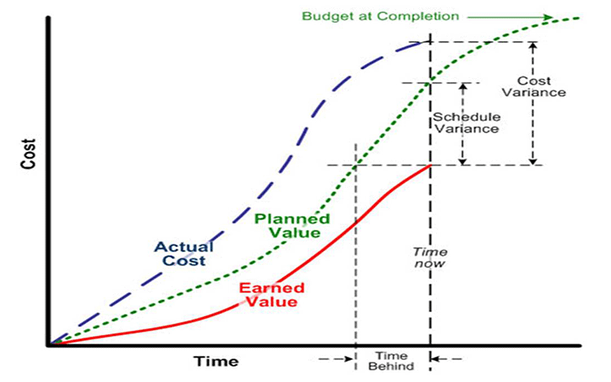
PERFORMANCE CONTROL USING EVA (Cont’d…)
Source: [9]

Slide 34
PERFORMANCE CONTROL USING EVA (Cont’d…)
Some Derived Metrics in EVA (parameters in EVA)
1. Variances | Formula | Interpretation
Cost Variance | CV = BCWP - ACWP | If CV is +ve, cost under run (actual budget expense is less than planned) If CV is -ve, cost overrun (actual budget expense is greater than planned) If CV is 0 No cost variance (actual expense is equal to planned)
Schedule Variance | SV = BCWP - BCWS | If SV is +ve, Schedule under run (actual schedule is ahead of planned) If SV is -ve, Schedule overrun (actual schedule is behind of planned) If SV is 0 No Schedule variance (actual Schedule is equal to planned)

Slide 35
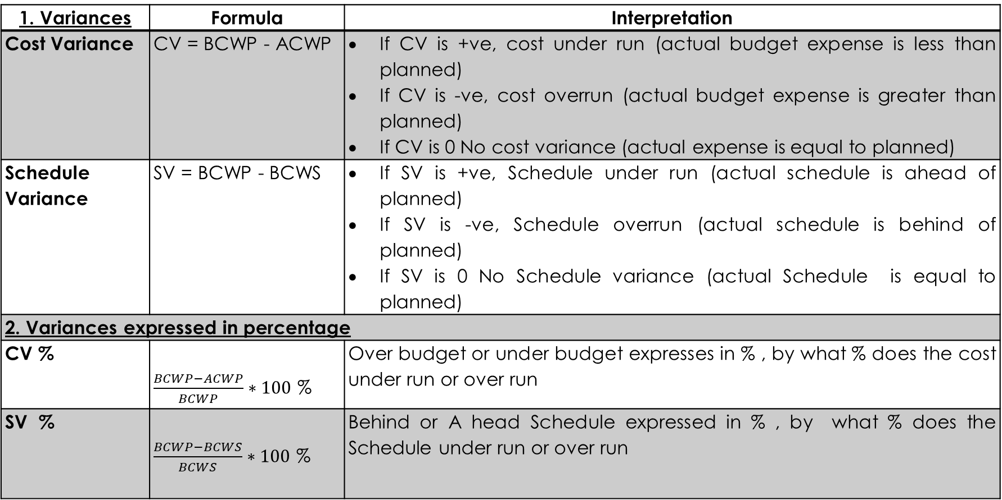
PERFORMANCE CONTROL USING EVA (Cont’d…)
2. Variances expressed in percentage
CV % |  | Over budget or under budget expresses in % , by what % does the cost under run or over run
SV % |  | Behind or Ahead Schedule expressed in % , by what % does the Schedule under run or over run
3. Indices
Cost performance index | CPI = BCWP / ACWP | If CPI ≥ 1, Better Performance for Cost, less budget If CPI < 1, Poor Performance for Cost, more budget
Schedule Performance Index | SPI = BCWP / BCWS | If SPI ≥ 1, Better Performance in Schedule, ahead of schedule If SPI < 1, Poor Performance in Schedule, behind of schedule

Slide 36
PERFORMANCE CONTROL USING EVA (Cont’d…)
4. Trends & Fore Cast
Estimate at Completion |  | EAC = Total project Cost / CPI
Schedule at Completion |  | SAC = Original project duration / SPI

Slide 37
PERFORMANCE CONTROL USING EVA (Cont’d…)
Suppose that an activity had 5-day duration and was expected to cost $10, 000. Set into the project, and prior to finishing an activity, the following data were obtained about the progress done to that activity:
    Have so far worked for 3.5 days on activity.
    60% of an activity has been accomplished
    $ 8000 already spent on activity.
Perform the earned value analysis (EVA).

Slide 38
PERFORMANCE CONTROL USING EVA (Cont’d…)
The following quantities can be easily computed:
ACWP = 8000
BCWP = 60%*10000 = 6000
BCWS = 3.5*10000/5 = 7000
Cost variance = BCWP – ACWP
= 6000-8000 = - 2000(over budget)
Schedule variance = BCWP – BCWS
= 6000 - 7000 = -1000 (behind the schedule)
Similarly,
CPI = BCWP/ACWP = 6000/8000 = 0.75(<1)
SPI = BCWP/BCWS = 6000/ 7000 = 0.86 (<1)

Slide 39
PERFORMANCE CONTROL USING EVA (Cont’d…)
% overrun/under run = (8000-6000) / 6000
= 33.33% (+ve) (cost overrun)
From above, a new activity duration estimate can be computed using the following method:
New activity duration = original time estimate/ SPI
= 5/0.86
= 5.8 (i.e. 6 days)
New cost estimate = original cost estimate/CPI
= 10000/0.75
= $ 13333.33

Slide 40
REFERENCES:
[1] Project Monitoring and Controlling Phase, Adobe Communication Team, 03-18-2022, accessed on October 15, 2023, https://business.adobe.com/blog/basics/monitoring-controlling
[2] A Guide to the Project Management Body of Knowledge (PMBOK): 2000 Edition, Project Management institute, Newton Square, Pennsylvania, USA.
[3] Text Book of Construction Management: S.K. Shrestha, Ram Kumar Shrestha and Subash Kumar Bhattarai, First Edition, Heritage Publisher and Distributors Pvt, Ltd, Kathmandu Nepal, 2014.

Slide 41
REFERENCES (Cont’d…)
[4] Construction Management And Accounts: B.L.Gupta and Amit Gupta, Third Edition, Standard Publishers Distributors, New Delhi, India, 2000.
[5] Professional Construction management: Donald S. Barrie and Boyd C. Paulson Jr., Third Edition, McGraw Hill, Inc., 1992.
[6] What is Six Sigma? Streamlining quality management, by Sarah K. White, 13 Feb 2023, accessed on 15th October 2023, https://www.cio.com/article/227977/six-sigma-quality-management-methodology.html
[7] Project Management: K. Nagarajan, New Age International (P) Ltd. Publishers, New Delhi, India, 2001.

Slide 42
REFERENCES (Cont’d…)
[8] Earned value management systems (EVMS), CONFERENCE PAPER Technical Skills, Earned Value Management 2006, Reichel, Chance W. accessed on 16th October 2023, https://www.pmi.org/learning/library/earned-value-management-systems-analysis-8026
[9] Earned Value Analysis, Updated Febreuary 23, 2020, accessed on 16th October 2023, https://dreamcivil.com/earned-value-analysis/

