Slide 1
COURSE TITLE
CONSTRUCTION ENGINEERING AND MANAGEMENT
CHAPTER 9 (Week 9)
CONSTRUCTION SAFETY MANAGEMENT
Lecture - 9
  Construction Accidents, Important Safety Rules, Site Safety Management, Safety in Construction Operations, Safety Legislation, Safety Cost
Er. Ishwar Adhikari
Associate Professor
Kathmandu Engineering College, Nepal

Slide 2
Learning Objective
The main objective of this lecture is to understand about :
Construction Accident.
  Important Safety Rules.
  Site Safety Management.
  Safety in Construction Operations.
  Safety Legislation.
  Construction Safety Cost.

Slide 3
INTRODUCTION
The construction industry has registered an enormous growth world-wide during the last few decades.
Construction work involves the dangerous activities like works above the ground level, works in open excavation, underground works and underwater works and many more.
Industrialized countries, with their technological advancements, have invested more on civil work projects associated with nuclear energy, space research, etc.
The developing countries have been engaged in infrastructure development necessary for their economic growth and social betterment.

Slide 4
INTRODUCTION (Cont’d..)
Initially, the size of the world construction market was around 1.5 trillion U.S. dollars and the global construction industry is projected to grow from US$7.4 trillion in 2010 to US$8.5 trillion in 2015 and to US$10.3 trillion in 2020. [1]
Over 100 million workers are engaged in the construction trades around the globe.
Construction workers constitute 6 to 7 percent of the world labor force; the figures climb to as high as 20 percent in some countries. [2]

Slide 5
INTRODUCTION (Cont’d..)
Construction is also a high accident prone industry.
It is estimated that more than 10 million workers receive injuries in the course of one year throughout the world.
Compared with the manufacturing sector which averages 60-80 accidents per 1000 workers, construction averages 160-250 accidents per 1000 workers. [3]
Constructing safe structures and providing safe work environment to the personnel is a vital factor in successful construction business.
This makes safety an important function in the management of construction projects.

Slide 6
INTRODUCTION (Cont’d..)
The concern for safety starts from the design stage and continues till the facility is delivered to the owner.
The designer, consultant, client and contractor share equal responsibility for safety which should be built into their work system.
The term “Construction” refers to the buildings and civil engineering activities like repair, maintenance, construction, and demolition of building.
Safety would mean the absence of danger at work which is made possible by eliminating hazards that create the danger.
Safety is adjudged in terms of an inverse relationship with high accident rate. High rate means low safety and vice versa.

Slide 7
INTRODUCTION (Cont’d..)
Construction safety is the process of seeking to improve or maintain a safe work environment while people are building infrastructures like a road, bridge or other structure.
Safety management is way of controlling the safety policies, its procedure and practices in construction.
Construction safety management deals with actions which create organizational setting under which all workers will be trained and motivated to perform safe construction work.
Safety culture and safety climates are important aspect of construction safety management.

Slide 8
INTRODUCTION (Cont’d..)
Objectives of Construction Safety Management
To help increase speed in construction.
To increase the standard of living.
To reduce cost of construction.
To conserve the available labour force by minimizing idle time.
To reduce human suffering.

Slide 9
CONSTRUCTION ACCIDENTS
An accident or mishap is an unforeseen and unplanned event or circumstance, often with lack of intention or necessity.
The accidents occur due to lack of supervision, training, knowledge about the specific task, reckless and carefree attitudes of management and workers.
Further, lack of controlled working environment and work culture of organization also lead to accidents in working sites.
Accident cause several damage in terms of material loss, injury and damage to men and machinery.

Slide 10
CONSTRUCTION ACCIDENTS (Cont’d…)
Cause of Accidents [4]
Lack of effective communication among different workers/contractors.
Non-use of protective gear in different contexts.
Lack of monitoring and security at site of works.
Uncleared debris or equipment.
Alcoholism of workers on duty.
Lack of training in safety matters.
Failure of construction equipment
Improper and unsafe operation of machines.
Electrical shocks, struck by falling object.

Slide 11
CONSTRUCTION ACCIDENTS (Cont’d…)
Causes of Accident
Physical
Physiological
Psychological
Relating to machines
Poor eye sight
Mental tension and worries
Relating to materials
Poor health
Emotional attitude
Relating to environment
Over work
Impulsiveness
Relating to tools
Old age
Nervousness
Over confidence
Relating to uniform
Intoxication
Carelessness
Relating to unsuitable time table etc.
Physical handicapped
Fear

Slide 12
CONSTRUCTION ACCIDENTS (Cont’d…)
Prevention of accidents
A willing positive attitude towards safety will help make a safer work environment. The strategies are:
Daily safety meeting
Reduce the amount of night work.
Use of proper safety gear.
Reflective or highly visible uniform.
Regular and frequent breaks
Clear signage to warn of danger.
Education and training.
Enforcement of law.

Slide 13
IMPORTANT SAFETY RULES
Every employee should be provided an initial training to safety by the contractor.
No employee should be given a new assignment without proper explanation of the hazards involved both to himself and his fellow employees.
Smoking should not be permitted around fire-prone areas and adequate fire fighting equipment should be provided at crucial locations.
Employees under influence of any intoxicating beverage should not be permitted to remain at work.
The staircases and passageways should be adequately lighted.

Slide 14
IMPORTANT SAFETY RULES (Cont’d..)
Accident Reporting
If someone has been injured in the workplace it is a legal requirement to report it.
Any employer, self-employer or person in control of a workplace must report work-related accidents.
The information gathered by accident reports assist the HSE(Health Safety Executive) in identifying where and how risks take place so that they can implement future health and safety procedures that will help prevent re-occurrence.
A construction employee must report an accident to a site manager or safety representative.

Slide 15
IMPORTANT SAFETY RULES (Cont’d..)
The accident should be recorded in the accident book along with any treatment given to the sufferer.
On the event of any accident, a report should be made to the safety engineer with a copy to the engineer –in –charge within 12 hours of the occurrence of the accident. [3]
In case of fatal accidents or those which are so serious that they are likely to result in the death of any workman, a report should be made immediately to the engineer-in-charge of the work.

Slide 16
IMPORTANT SAFETY RULES (Cont’d..)
Storage of Materials
The improper handling and storing of materials can cause costly injuries.
Workers can be injured by falling objects, improperly stacked materials, or by various types of equipment.
Strains and sprains from improperly lifting loads, or from carrying loads that are either too large or too heavy.
Fractures and bruises caused by being struck by materials, or by being caught in pinch points.
Cuts and bruises caused by falling materials that have been improperly stored, or by incorrectly cutting ties or other securing devices.

Slide 17
IMPORTANT SAFETY RULES (Cont’d..)
3. Atmosphere in Confined space
A confined space is an enclosed or partially enclosed space that:
- is not primarily designed or intended for human occupancy
- has a restricted entrance or exit by way of location, size or means.
- can represent a risk for the for the health and safety of anyone who enters, due to:
its design, construction, location or atmosphere
the materials or substances in it
work activities being carried out in it, or the
mechanical, process and safety hazards present

Slide 18
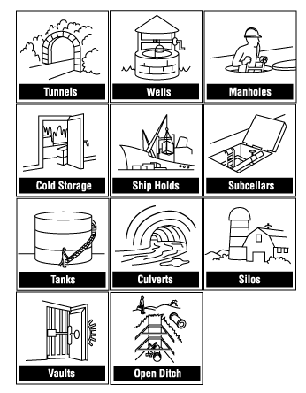
IMPORTANT SAFETY RULES (Cont’d..)
Fig: Examples of Confined Spaces [5]

Slide 19
IMPORTANT SAFETY RULES (Cont’d..)
Hazards in a confined space
Poor air quality (insufficient oxygen, contains poisonous substances)
Chemical exposures (due to skin contact or ingestion as well as inhalation of 'bad' air)
Process-related hazards (such as residual chemicals, release of contents of a supply line).
Safety hazards (such as moving parts of equipment, structural hazards, entanglement, slips, falls).
Shifting or collapse of bulk material
Fire Hazard
Uncontrolled energy including electrical shock

Slide 20
SITE SAFETY MANAGEMENT
Site is the place where the construction activities are carried out.
Construction site safety is a form of occupational safety that relates directly to job conditions and procedures put in place at a construction site.
The purpose of these safety regulations and initiatives is to provide a measure of protection to the general public who may be in the general vicinity of the construction while also protecting those who are involved in the actual building effort.
Three areas are considered during site safety management i.e. workplace, equipment and structures and working platforms.

Slide 21
SITE SAFETY MANAGEMENT (Cont’d…)
Workplace
Adequate and safe means of entry and egress (exit) should be provided in all work places.
Adequate, suitable, and artificial lighting should be provided where natural light is not adequate to prevent danger.
Suitable provision of circulation of fresh air including forced ventilation should be provided in enclosed places.
All projected nails should be removed or bent to prevent injury.
Suitable and efficient fire extinguishing equipment and adequate water supply at ample pressure should be provided.
Places of fire risks should be regularly inspected like electrical installations and conductors and inflammable materials.
No materials from the heights should be thrown up or down.

Slide 22
SITE SAFETY MANAGEMENT (Cont’d…)
Structures and Equipment
The structures for construction i.e. scaffolding, towers and lifting appliances and other machines should be of sound material and quality, be free from potent defect and be properly constructed.
These structures and equipment should be strong enough to withstand the loads and stresses which they have to bear.
The individual members of the structures should not be weakened by cracks, rust corrosions and should be given a protective coating.
These structures and equipment should be inspected at regular intervals by authorized workers before they are put to use.

Slide 23
SITE SAFETY MANAGEMENT (Cont’d…)
3. Working Platforms
All scaffolds on which workers are employed should be provided with sufficient number of working platforms.
No working platform should be used until necessary safe-guards are properly fixed and checked.
Provision of factor of safety should be maintained.
All vertical and horizontal parts of scaffolds should be securely fastened.
In case of tall building or structures, safety belts should be provided.
Places of heights from where workers cannot be protected from falling should be protected by catch nets.

Slide 24
SITE SAFETY MANAGEMENT (Cont’d…)
Ways to improve construction site safety [6]
Make safety a priority
Create a comprehensive site safety plan
Conduct regular jobsite safety training
Service and update equipment regularly
Keep open lines of communication
Document & track safety incidents
Work with your insurance provider

Slide 25
SAFETY IN CONSTRUCTION OPERATION
Excavation
An excavation is any man-made cut, cavity, trench, or depression in the earth’s surface formed by earth removal. It is the first step in construction project.
Excavated materials should be dumped sufficiently away from the edge of the excavated trench to avoid slipping of the excavated earth causing injury to the workers.
Deep excavation beyond 3m depth should be properly fenced to prevent workers from falling in.
Warning signals, red danger light should be displayed prominently at conspicuous places near excavation.
Potential hazards include falls, falling loads, hazardous atmospheres, and incidents involving mobile equipment.

Slide 26
SAFETY IN CONSTRUCTION OPERATION (Cont’d…)
Common causes of excavation collapse [3]
Simple mechanical failure of the soil because it cannot support its own weight.
Breakdown of the strength of the soil by moisture usually caused by heavy rain
Failure caused by the vibration from the movement of vehicles nearby.
Failure due to the weight of loads placed near the edge of excavation.
Failure due to excavation on or near the side of the previous excavation

Slide 27
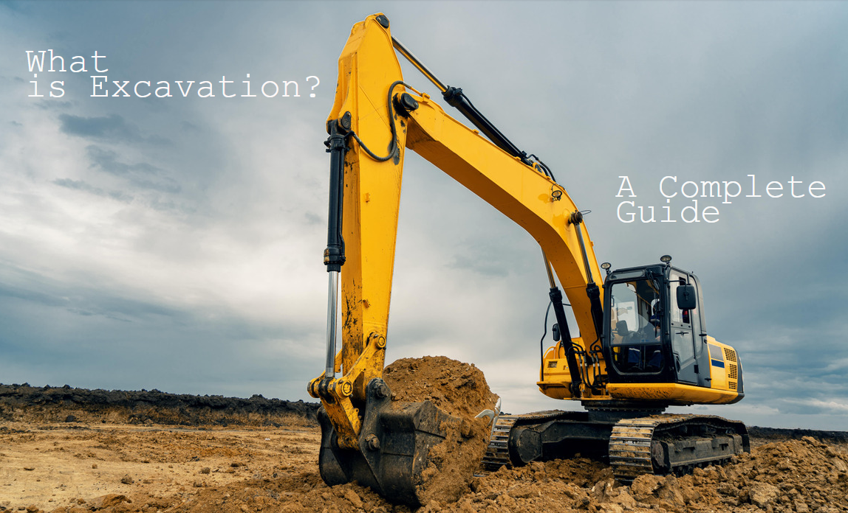
SAFETY IN CONSTRUCTION OPERATION (Cont’d…)
Prevention for Excavation
Requires safe access and egress to all excavations, including ladders, steps, ramps, or other safe means of exit for employees working in trench excavations 4 feet (1.22 meters) or deeper.
Keep heavy equipment away from trench edges.
Keep surcharge loads at least 2 feet (0.6 meters) from trench edges.
Know where underground utilities are located.
Test for low oxygen, hazardous fumes and toxic gases.
Inspect trenches at the start of each shift.
Inspect trenches following a rainstorm.
Do not work under raised loads.
Source: [7]

Slide 28
SAFETY IN CONSTRUCTION OPERATION (Cont’d…)
Blasting
Blasting is the controlled use of explosives and other methods such as gas pressure blasting pyrotechnics, to break rock for excavation.
It is practiced most often in mining, quarrying and civil engineering such as dam, tunnel or road construction
Blasting will be limited primarily to rocky terrain where traditional excavation and earth moving equipment are not adequate to meet project specifications.
The "blast site" is the area where explosive material is handled during loading, including an area extending at least 50 feet in all directions.

Slide 29
SAFETY IN CONSTRUCTION OPERATION (Cont’d…)
Safety Measures in Blasting
Storage Requirements
Personal Safety, Protection of Property, and Notification (warning signals)
Fire Safety
Transportation of Explosives
Environmental Protection Measure

Slide 30
SAFETY IN CONSTRUCTION OPERATION (Cont’d…)
3. Tunnelling
A tunnel is an underground passageway, dug through the surrounding soil/earth/rock and enclosed except for entrance and exit, commonly at each end.
Tunneling work includes constructing a tunnel and supporting systems and associated temporary work.
Generally used for construction of mines, roads, hydropower, subways etc.
Working under reduced light conditions, difficult or limited access and egress, with the potential for exposure to air contaminants and the hazards of fire and explosion, underground construction workers face many dangers.

Slide 31
SAFETY IN CONSTRUCTION OPERATION (Cont’d…)
Safety Measures in tunnelling
Control of entry and exit
The employer (contractor) must ensure safe access to and egress from all workstations at the construction site to protect employees from potential hazards, such as being struck by excavators, haulage machines, or other moving equipment.

Slide 32
SAFETY IN CONSTRUCTION OPERATION (Cont’d…)
2. Scaling and mucking
After every blast inside a tunnel, scaling of loose rock should be performed thoroughly by experienced staff, because falling of small rocks from this portion can cause serious problems.
When a tram track is laid, it should be maintained to proper line and level. This would not only improve efficiency of mucking operations, but would also avoid injuries to workers.
If a tram line is laid too steep a gradient, the tip wagon could go out of control.

Slide 33
SAFETY IN CONSTRUCTION OPERATION (Cont’d…)
3. Ground Support
Most tunnels need permanent ground support.
The permanent lining can be installed as the excavation progresses or temporary support installed followed by a permanent lining.
Lining is done:
When it is desired to permanently protect the material surrounding the tunnel, when the cohesion between masses of particles surrounding the tunnel is not sufficient.
When the tunnel is subjected to internal or external pressure or heavy ground pressure.
To increase the strength of tunnel cross-section.

Slide 34
SAFETY IN CONSTRUCTION OPERATION (Cont’d…)
4. Ventilation requirements
Temporary ventilation: When ventilation is to be provided at the time of construction only.
Permanent ventilation: When ventilation is to be provided after construction work is over, such ventilation system must be permanent
Tunnels of up to 600m of length, generally no difficulty is felt, as the fumes after the blast clears out in about 30 minutes if the tunnel is not through. [3]
Nobody should be permitted to go in during this period.

Slide 35
SAFETY IN CONSTRUCTION OPERATION (Cont’d…)
5. Lighting
To allow traffic to enter, pass through and exit the enclosed section safely.
Good tunnel lighting allows users to enter, pass through and exit the enclosed section safely and comfortably.
The tunnel must be well-lit. with better lighting, efficiency of all operation would go up, thus making up for the extra cost in lighting.
Several accidents could be avoided by better lighting. A 100 watt lamp every 20 to 25 meters or so would be adequate. [3]

Slide 36
SAFETY LEGISLATION
Legislation, all over the world, has been evolved as a consequences of historical necessity.
Legislation purpose is to “secure the health, safety, welfare and convenience of persons in or about buildings and of others who may be affected by buildings or matters connected with buildings. [3]
Laws are enacted to meet changing social conditions and pressures and labor legislation in particular, is a fairly recent aspect of legislation as a whole.
Legislation consists of the law that regulates wages, welfare, health, safety and working condition of labors at construction sites.

Slide 37
SAFETY LEGISLATION (Cont’d…)
Safety in construction industry is being taken care of to some extent, by the bye-laws framed by the municipalities, Public Works Departments, and the Government.
The provisions are very inadequate and there is no enforcing machinery to check whether the safety provisions are being followed
At the national level, occupational health legislation is influenced, mainly by the social and economic situation of the country and the political tendencies of the government.
At the international level, the ILO and OSHA contribute actively to the task of ensuring progress in the protection of the workers health, particularly in developing countries.

Slide 38
SAFETY LEGISLATION (Cont’d…)
OCCUPATIONAL HEALTH AND SAFETY ADMINISTRATION (OSHA)
Occupational Safety and Health Administration (OSHA) is an agency of the United States Department of Labor.
OSHA is intended to assure, insofar as it is possible, that every employee in the united states has safe working condition. [8]
OSHA's mission is to "assure safe and healthful working conditions for working men and women by setting and enforcing standards and by providing training, outreach, education and assistance". [9]

Slide 39
SAFETY LEGISLATION (Cont’d…)
INTERNATIONAL LABOR ORGANIZATION (ILO)
ILO was established in the year 1919, to set the standards to protect basic worker rights, enhance workers’ job security, and improve their terms of employment on a global scale.
The main aims of the ILO is to promote rights at work, encourage decent employment opportunities, enhance social protection and strengthen dialogue on work-related issues. [10]
The intent of such standards is to establish a worldwide minimum level of protection from inhumane labor practices through the adoption and implementation of said measures.

Slide 40
CONSTRUCTION SAFETY COST
Construction business involves huge sum of money where every cents counts fro contractor and owner.
The economics of safe construction should be viewed from long term point of view.
Any evaluation of costs should take into account the cost of damage to personnel and property due to accidents.
Also consequential delays and escalated costs during the extended period of construction should be considered.
Every accident costs the employer a considerable amount and inconvenience directly and indirectly due to following:

Slide 41
CONSTRUCTION SAFETY COST (Cont’d….)
Unearned wages paid to the injured worker.
Unearned wages of others who stop work out of sympathy.
Expenses incurred for medical care, transportation of injured worker to hospital.
Interruption to planned sequence of work.
Cost of repairs/ replacement of damaged equipment and materials.
Cost of equipment idle time due to interruption.
Loss of momentum of work due to interruption.
Cost of arranging replacement personnel.
Impact on insurance cost.

Slide 42
CONSTRUCTION SAFETY COST (Cont’d….)
Direct Cost Of Accidents
It is also called the insured cost and relates to stoppage of works.
Direct cost in injury prevention work meant payments under worker’s compensation laws and medical expenses of the type usually covered by the insurance.
Indirect Cost Of Accidents
These include the cost of insurance, legal fees, and the cost of equipment or machinery.
Variable costs are those that can vary by accident.
These expenses include the expense of medical treatment, lost productivity, and reputation loss.

Slide 43
CONSTRUCTION SAFETY COST (Cont’d….)
Cost of Safety Programs
Management is always pre occupied with economical and speedy construction and to the achievement of higher profitability and successful completion of works.
The expenditure on safety in construction is neither included as an individual item of cost nor is it taken into account at the estimation stage.
While making the bids, contractors do not generally take into account the expenses involved in ensuring safety of workers.
The cost of safety is not reflected in the estimates of cost of projects prepared by the construction department and agencies.

Slide 44
CONSTRUCTION SAFETY COST (Cont’d….)
There is no separate unit in the organization which has the sole responsibility to oversee safety in construction in a coordinated manner.
Non inclusion of safety expenditure on safety in construction may result high cost to the contractor or to the construction department in the event of unforeseen mishaps.
There are direct losses in terms of temporary stoppage of works, and payment of compensation etc.
Indirect losses in terms of disputes and delays in the execution of project.
It is therefore always in the interest of all to ensure safety in construction.

Slide 45
REFERENCES
[1] Global Perspective on International Construction Contracting, Moavenzadeh F., Journal of Construction Management, Vol. II, No. III, October 1987.
[2] Occupational Safety and Health Branch, I.L.O, Kliesch G, Chief, Asian Regional Seminar on Occupational Safety, Health and Welfare in Construction Industry, Bangkok, 1986, PP 21.
[3] Construction Safety Management, K.N. Vaid, Editor, Published by National Institute of Construction Management and Research (NICMAR), Bombay, India, 1988.
[4] Construction Management and Equipment: Saurabh Kumar Soni, First Edition, S.K. Kataria &Sons, Publisher of Engineering and Computer Books, New Delhi, India, April 2014.

Slide 46
REFERENCES (Cont’d..)
[5] Confined Space Regulatory Resources, accessed on October 17th 2023, https://www.jsabuilder.com/resources/confined-space-resources.php
[6] 7 Ways to Improve Construction Site Safety, By Thomas Tracy, Last Updated Aug 23, 2023,accessed on 17th October, 2023, https://www.procore.com/library/improve-construction-site-safety
[7] What is Excavation? busybusy Time Tracking | September 19, 2023, accessed on 17th October 2023, https://busybusy.com/blog/what-is-excavation/
[8] Safety Management, John V. Grimaldi and Rollins H. Simonds, Fifth edition, Richard D. Irwin, Inc, Homewood, Illinois 60430, 1991.

Slide 47
REFERENCES (Cont’d..)
[9] Occupational Safety and Health Administration, U.S. department of labor, OSHA’s mission, accessed on 17th October, 2023, https://www.osha.gov/aboutosha#:~:text=OSHA's%20Mission,%2C%20outreach%2C%20education%20and%20assistance.
[10] About the ILO, International Labor Organization, accessed on 17th October, 2023, https://www.ilo.org/global/about-the-ilo/lang--en/index.htm

