Slide 1
COURSE TITLE
CONSTRUCTION ENGINEERING AND MANAGEMENT
CHAPTER 12 (Week 12)
PERSONNEL MANAGEMENT
Lecture - 12
  Management and Organization, Motivation, Leadership, Communication, Recruitment and Selection, Training
Er. Ishwar Adhikari
Associate Professor
Kathmandu Engineering College, Nepal

Slide 2
Learning Objective
The main objective of this lecture is to understand about :
Management and Organization.
  Motivation.
  Leadership.
  Communication.
  Recruitment and Selection.
  Training.

Slide 3
MANAGEMENT AND ORGANIZATION
Management is the process of coordinating people and other resources to achieve the goals of the organization.
Management is the “art of getting things done with and through people.”
The task of planning, coordinating, motivating, and controlling efforts of others towards a specific objective is called management.
Management is a process of planning, decision making, organizing, leading, motivation and controlling the human resources, financial, physical, and information resources of an organization to reach its goals efficiently and effectively.

Slide 4
MANAGEMENT AND ORGANIZATION (Cont’d..)
It involves the coordination of human and material resources towards objective accomplishment.
Four basic elements can be identified in the context of management. They are: towards objective; through people via technique; and in an organization.
Management is considered as both science and art.
It is a science because of universally accepted principle of cause and effect relationship and art because it requires perfection through practice, practical knowledge and creativity etc.

Slide 5
MANAGEMENT AND ORGANIZATION (Cont’d..)
Management Includes 5 Core Components
Planning, organizing, directing and controlling the activities of human and other resources.
Making the most efficient and effective use of resources.
Coordinating various activities.
Coping with the changing environment.
Achieving organizational goal.

Slide 6
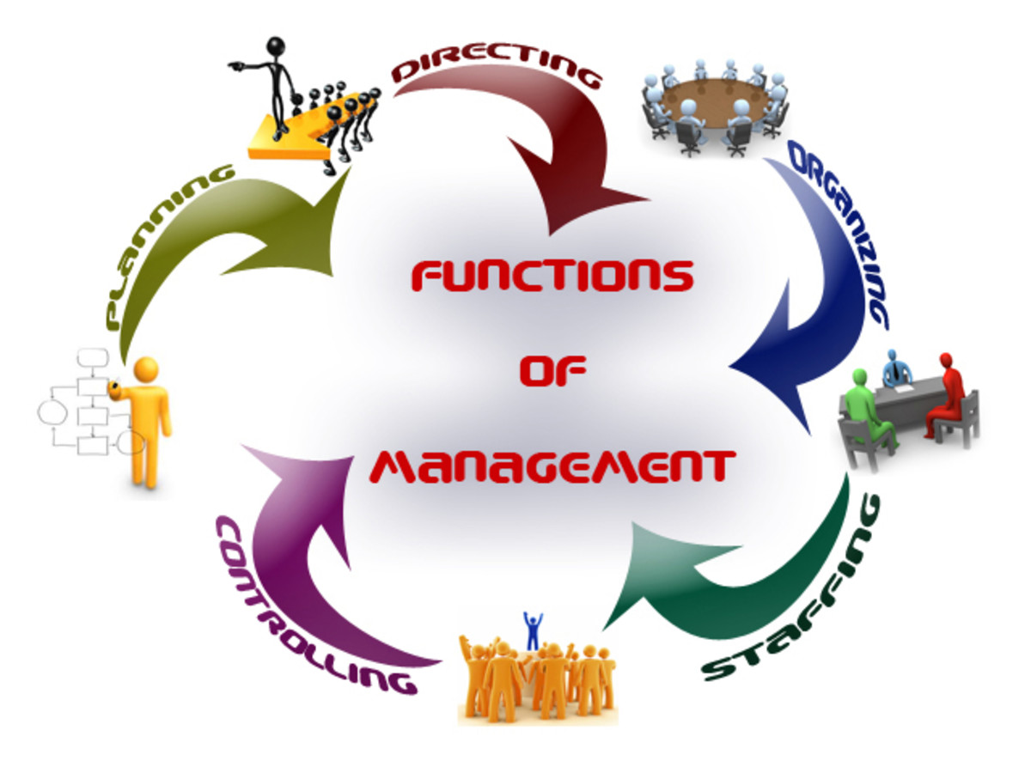
MANAGEMENT AND ORGANIZATION (Cont’d..)
Features of Management
Continuous and Never Ending Process.
Is result Oriented.
Multidisciplinary in Nature.
Group and Not an Individual Activity.
Follows Established Principles or Rules.
Aided but not replaced by Computers.
Intangible but its Impact is Felt.
Dynamic in Nature
Art of Getting Work Done from People.
Source [2]

Slide 7
MANAGEMENT AND ORGANIZATION (Cont’d..)
Importance of Management
Optimum utilization of resources.
Achievement of desired goals.
Minimises costs.
Creates healthy working environment.
Helps in growth and expansion.
Improves company goodwill.
Motivates employees.

Slide 8
MANAGEMENT AND ORGANIZATION (Cont’d..)
An organization is formally defined as a collection of people working together in a division of labor to achieve a common purpose. [3]
A set-up where individuals from diverse backgrounds, different educational qualifications and varied interests come together to work towards a common goal is called an organization.
Two or more people working together in a coordinated manner to achieve group goals.
The core purpose of an organization may be stated as the creation of goods or services for customers.

Slide 9
MANAGEMENT AND ORGANIZATION (Cont’d..)
PURPOSE OF ORGANIZING
Divides work into specific jobs and departments.
Assign tasks and responsibilities associated with individual jobs.
Coordinates diverse organizational tasks.
Clusters jobs into units.
Establishes relationships among individuals, groups and units.
Establishes formal lines of authority.
Allocates and deploys organizational resources.

Slide 10
MOTIVATION
Motivation is as the willingness to exert high levels of efforts towards organizational goals, conditioned by the effort’s ability to satisfy some individual needs. [4]
The "will" to do is known as motivation. The force that lead to performance is motivation.
Motivation refers to the process that account for an individual’s
  Intensity : How hard a person tries (physically and mentally)
  Direction: Towards beneficial goal
  Persistence: How long a person tries
Motivation is an internal feeling (Motivation is inside the person but goal is outside the person)

Slide 11
MOTIVATION (Cont’d…)
Unsatisfied need/motives
Tensions-physical, psychological sociological
Drives for satisfying need/motives
Fig: Motivation Process
Search behavior to satisfy needs / motives
Reduction of Tensions
Satisfies needs
Understanding a person's ability and his motivation helps a manager to predict his level of performance.
Performance of a person is the product of ability and motivation.
Performance = ability x motivation

Slide 12
MOTIVATION (Cont’d…)
TYPES OF MOTIVE
PRIMARY MOTIVE
Which are predominantly physiological (biological) in nature and unlearned such as air, water, shelter, food, etc;
SECONDARY MOTIVE
Which are social and psychological in nature and comprise needs for affiliation, belongingness, power, prestige, knowledge, competence, recognition, achievement, etc.
INTERNAL MOTIVES: Which start from the ego needs (freedom, prestige, recognition, status, etc.) of the person.
EXTERNAL MOTIVES: Which arise because of the social and family influences

Slide 13
MOTIVATION (Cont’d…)
Importance
Helps in satisfying the need of the employees.
Change the negative attitude to positive attitude.
Reduce labor turnover and absenteeism.
Helps in introducing change.
Improves level of efficiency of employees.
Creating friendly and supportive relationships.

Slide 14
MOTIVATION (Cont’d…)
Indication of Motivation
One wants to come to work willingly.
When at work, he or she gives his or her best.
He or she has a definite sense of belonging and pride in the organization.
Indication of Demotivation
Increasing Absenteeism
Low Output and Productivity
An Increasing Rate of Accident
An Increasing Rate of Wastage of Raw Material .
Rank Indiscipline
Frustration and Unrest in the Work Place
Violent Behavior of Employees: Strikes, Demonstration etc.

Slide 15
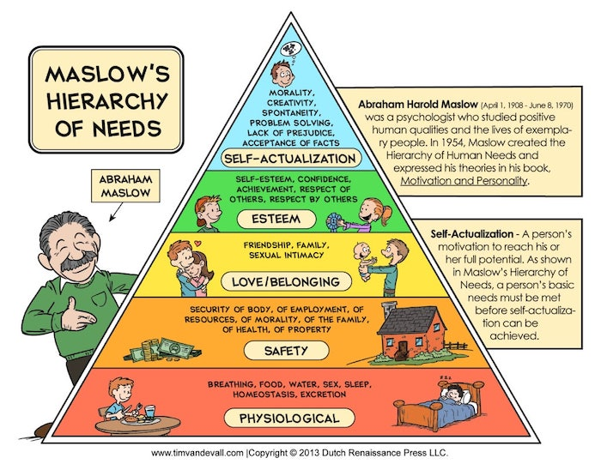
MOTIVATION (Cont’d…)
MASLOW HIERARCHY OF NEEDS THEORY
Maslow's "need hierarchy theory" is probably the most popular theory of motivation.
Suggested that people have a complex set of strong needs which determines the behavior of individuals.
In 1943, He formulated his theory of hierarchical needs by asking the same question: "what is it that makes people behave the way they do?"
Source [5]

Slide 16
MOTIVATION (Cont’d…)
ERG THEORY OF MOTIVATION
CLAYTON PAUL ALDERFER , an American Psychologist extended and simplified Maslow’s Hierarchy into a shorter set of three needs.
Instead of the five needs that are hierarchically organized, Alderfer proposed that basic human needs may be grouped under three categories, namely, existence, relatedness, and growth.
Existence corresponds to Maslow’s physiological and safety needs, relatedness corresponds to social needs, and growth refers to Maslow’s esteem and self-actualization.

Slide 17
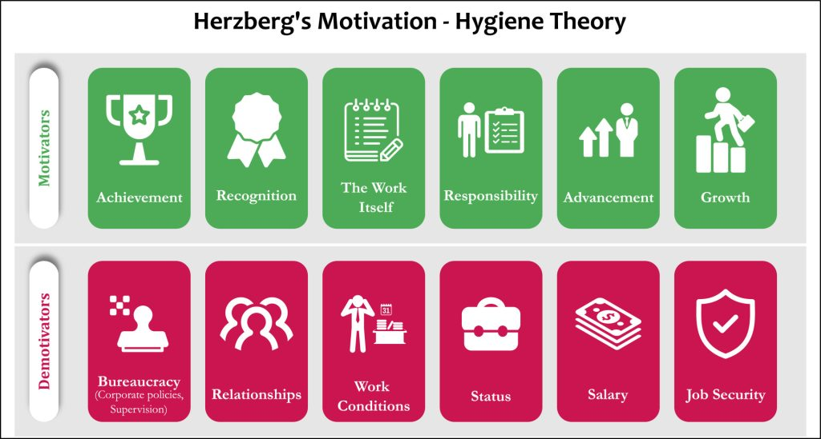
MOTIVATION (Cont’d…)
TWO FACTOR THEORY
This theory argues that there are separate sets of mutually exclusive factors in the workplace that either cause job satisfaction or dissatisfaction. [6]
Presence of these factors does not cause motivation but their absence causes dissatisfaction.
They are, therefore, dis-satisfiers and not motivators. They simply prevent dissatisfaction.
Source [6]

Slide 18
LEADERSHIP
A leader is a person who has a vision, a drive and a commitment to achieve that vision, and the skills to make it happen.
Leadership is guiding and influencing people to achieve goals willingly and enthusiastically in a given situation.
The act of motivating or causing people to perform certain tasks intended to achieve specified objectives.
It is the function by which a manager unleashes the available resources in order to get the organization to carry out plans to accomplish objectives.

Slide 19
LEADERSHIP (Cont’d….)
"Leadership is the lifting of a man’s vision to higher sights, the raising of a man’s performance to a higher standard, the building of a man’s personality beyond its normal limitations.” Peter Drucker. [7]
Functions of Leadership
Goal Determination
Environmental adaptation
Task orientation
Representation

Slide 20
LEADERSHIP (Cont’d….)
Characteristics of Leadership
It is an interpersonal process in which a manager is into influencing and guiding workers towards the attainment of goals.
It denotes a few qualities to be present in a person who includes intelligence, maturity, and personality.
It is a group process. It involves two or more people interacting with each other.
A leader is involved in shaping and molding the behavior of the group towards the accomplishment of organizational goals.
Leadership is a situation bound. There is no best style of leadership. It all depends upon tackling the situations.

Slide 21
LEADERSHIP (Cont’d….)
Importance of Leadership
Initiates action
Motivation
Providing guidance
Creating confidence
Building morale
Builds work environment
Co-ordination

Slide 22
LEADERSHIP (Cont’d….)
Leader | Manager
Innovative and risk taking, Develop organization, Originate, Long range view and missionary, Focus people, Inspire Trust, Informal power, Ask what and why | Implement, get job done, Maintain organization, Imitate, Short-range & goal oriented, Focus system and structure, Rely on control, Formal power, Ask how and when

Slide 23
LEADERSHIP (Cont’d….)
LEADERSHIP STYLE
AUTOCRATIC STYLE
In this style, power and decision making are centralized on the leader. Its features are –
Leaders make all decisions. Subordinates are not consulted.
Leaders have position based authority. They demand total obedience.
Leaders give reward and punishment as they like,
Permits quick decision making. Information is controlled by leader.
This type of leadership is effective in emergency and it result high productivity.

Slide 24
LEADERSHIP (Cont’d….)
DEMOCRATIC STYLE
In this style of leadership, power and decision making are decentralized.
Discussion, consultation and participation of the subordinates are encouraged.
Leaders consult the subordinates about decisions. Also, the subordinates willingly cooperate with the leader.
Authority and responsibility are delegated.
Information is shared between leaders and followers.

Slide 25
LEADERSHIP (Cont’d….)
FREE REIN (Laissez-faire) STYLE
In this style, power and decision making are entrusted on to the subordinates. Its features are
Leaders use very little power and control. They serve as an information center.
Subordinates set own goals. Their potential is effectively utilized.
Subordinates have decentralized authority and responsibility.
They are high degree of independence in decision making.
Influence flow in all directions.

Slide 26
COMMUNICATION
It is the exchange of information between two people.
Involves transfer of meaning, if no information or ideas have not been conveyed, communication hasn’t taken place.
It is taken as the fundamental management function and lifeblood of any organization.
Without proper and effective communication, information will not flow in proper direction
Communication is a way that one organization member shares meaning and understanding with another.

Slide 27
COMMUNICATION (Cont’d…)
ADVANTAGES
Increases productivity
Reduces stresses.
Better understanding what other are saying.
Better understanding how to get your message across.
Enhance relationships.
Save time and money.
CHARACTERISTICS
Continuous process.
Complete system.
Interactive, timely and ever changing.
Mostly irreversible.
Intentional or unintentional.
Multi directional. .

Slide 28
COMMUNICATION (Cont’d…)
Structure of Communication
Formal Structure
(a) Vertical Structure
Downward Communication
Any communication that flows from a manager down the authority or along the chain of commands.
It is used to inform, direct coordinate and evaluate subordinates.
Upward Communication
Managers rely on individuals below them for information.
Reports are sent upwards in the authority hierarchy to inform higher management of progress towards goals and current problems.
Hence upward communication is flow from subordinates to higher level managers

Slide 29
COMMUNICATION (Cont’d…)
Both way Communication
When the communication is flown from both sides top level managers and the subordinates then it is taken as both way communication.
Basically found in those organization which follows participative management.
Horizontal Structure
Communication that takes place among any horizontally equivalent employees is known as horizontal communication.
It is necessary to save time and facilitate coordination.

Slide 30
COMMUNICATION (Cont’d…)
Diagonal Structure
It cuts across functions and levels in the organization.
When supervisors in credit department communicates directly with the marketing manager, who is not only different department but higher class, then they are engaged in diagonal communication.
Horizontal
Diagonal

Slide 31
COMMUNICATION (Cont’d…)
Informal Structure
It is that communication structure that is not approved by management and not defined by the structural hierarchy.
Grapevine is most common kind of information structure almost present in any organization.
When the formal channels fail or do not work properly and some over-smart people spread rumors, false and irresponsible statement or half-truths in all the directions.
It is called the communication on the grapevine channel.

Slide 32
COMMUNICATION (Cont’d…)
Process of Communication
The communicator develops or conceptualizes an idea to be sent.
Encoding means converting or translation the idea into a perceivable form that can be communicated to others.
Medium is the channel or means of transmitting the message to the receiver. (speaking, writing etc)
The message can be received in the form of hearing, seeing, feeling and so on by the receiver.
Decoding is the receiver’s interpretation of the sender’s message.
Feedback means receiver’s response to sender’s message.
Noise is the disturbances that interfere with the transmission of a message.
Sender
Encoding
Noise
Transmission
Message Channel
Feedback
Receiver
Decoding
Source [8]

Slide 33
RECRUITMENT AND SELECTION
Recruitment is the process of searching for prospective employees and stimulating and encouraging them to apply for the jobs in organization. [9]
Recruitment purpose is to provide management with enough candidates from which they can select qualified employees.
Recruitment has been regarded as the most important function of HR management because unless the right type of people is hired, even the best plans, and control systems would not produce a good result.

Slide 34
RECRUITMENT AND SELECTION (Cont’d….)
Selection is essentially a process of choosing right applicants best suited for the organization’s requirement.
The most common approach to the selection objective is to choose individuals who possess the necessary skills, abilities, and personalities to successfully fill specific jobs in the organization.
The mutual process whereby the organization decides to make a job offer and the candidate decides whether or not to accept it.

Slide 35
RECRUITMENT AND SELECTION (Cont’d….)
Major activities involved in selection are:
  Establishing selection policies
  Identifying and choosing selection criteria
  Gathering information about potential employees
  Evaluating information and assessing applicants
  Making decision to select or reject
  Communicating decision – selected or rejected

Slide 36
Recruitment Versus Selection
Basis
Recruitment
Selection
Meaning
Process of searching candidates for vacant job positions and making them to apply.
Process of selection of right candidates and offering job to them.
Nature
Positive process of aggregation of potential candidates.
Negative process (process of eliminating of unsuitable candidates).
Objective
To attract more and more candidates.
To evaluate and then reject unsuitable candidates and select the most suitable candidates.
Procedure
Notification of vacancies to potential candidates through various means.
Candidates asked to go through a series of steps in the selection process.

Slide 37
TRAINING AND DEVELOPMENT
Training is the process designed to maintain or improve current employee performance.
Development is a process designed to develop skills and attitudes necessary for future work.
Training is the application of knowledge and gives people an awareness of the rules and procedures to guide their behaviour. [9]
Training and development attempts to improve the performance of employee in current job or prepare them for an intended job.
Training and developmental program improve three types of skill: Technical skill, Interpersonal skill and Problem solving skill.

Slide 38
TRAINING AND DEVELOPMENT (Cont’d…)
Importance of Training
Training makes employees to develop and rise within organization and increase their earning capacity.
Trained worker enable the enterprise to face competition from rival organization.
Training moulds the employees attitude and helps them to achieve better cooperation with the organization.
Trained workers need lesser supervision.
Training leads to job satisfaction and high morale of the employees.
Trained material make better economic use of materials and equipment resulting in reduction of wastage and spoilage.

Slide 39
TRAINING AND DEVELOPMENT (Cont’d…)
  ON THE JOB TRAINING
  This is also called learning by doing.
  This method is the most widely used method and it simply means putting the workers on the job under close supervision of trained instructor.
  This training continues until supervisor is satisfied that the employee can adequately perform the job without supervision.
  This method is appropriate for skill oriented jobs with small number of employees.
  This method is suitable for the employees in clerical positions, shop floor and workers in manual and repetitive jobs.

Slide 40
TRAINING AND DEVELOPMENT (Cont’d…)
OFF THE JOB TRAINING
Such training takes place outside the actual workplace but attempts to simulate actual working conditions.
Location of such training may be the organization’s class room, an outside place owned by the organization, an educational institution etc.
Various methods can be employed in this type of training like lecture, conference method, case study, role playing, audio visual techniques etc.

Slide 41
REFERENCES
[1] Management: Definition, Features, Concept, & Basics, by Dr. Neha Mathur, iEduNote, accessed on 22nd October, 2023, https://www.iedunote.com/management
[2] The Five Functions of Management, by DILIP CHANDRA, JUL 19, 2015, accessed on 22nd October, 2023, https://discover.hubpages.com/business/The-Five-Functions-of-Management
[3] Organizational Behavior, John R. Schermmerhorn Jr., James G. Hunt, Richard N. Osborn, 7th edition, John Wiley and Sons, Inc., 2002.
[4] Organizational Behavior, Stephen P. Robbins, Timothy A. Judge, 19th edition, Pearson Publication, 2022,

Slide 42
REFERENCES (Cont’d…)
[5] Theories Of Motivation, Explore the complex landscape of human motivation through key theories. Uncover how our needs, beliefs, and desires shape our behaviors, Paul Main, May 9, 2023, accessed on 24th October 2023, https://www.structural-learning.com/post/theories-of-motivation
[6] Herzberg’s Two-Factor Theory Of Motivation-Hygiene, by
Charlotte Nickerson, Updated on September 28, 2023, accessed on 25th October, https://www.simplypsychology.org/herzbergs-two-factor-theory.html

Slide 43
REFERENCES (Cont’d…)
[7] Drucker's Top Tips to Successful Leadership, by William Cohen, updated on June 25th 2019, accessed on 25th October 2023, https://www.corporatelearningnetwork.com/leadership/columns/druckers-top-tips-to-successful-leadership#:~:text=Peter%20Drucker%20defined%20leadership%20in,definition%20says%20anything%20about%20management.
[8] Text Book of Construction Management: S.K. Shrestha, Ram Kumar Shrestha and Subash Kumar Bhattarai, First Edition, Heritage Publisher and Distributors Pvt, Ltd, Kathmandu Nepal, 2014.
[9]Construction Management and Equipment: Saurabh Kumar Soni, First Edition, S.K. Kataria &Sons, Publisher of Engineering and Computer Books, New Delhi, India, April 2014.

