Slide 1
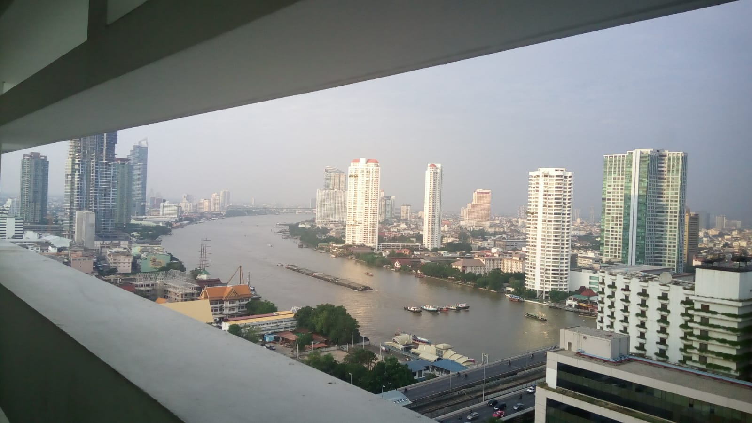
COURSE TITLE
BUILDING TECHNOLOGY
Chapter 1 - (Week 1)
FUNCTIONAL REQUIREMENT OF BUILDING
LECTURE – 1
Heat phenomena in building
Ar. Ranju Kamal
Lecturer
Advanced college of engineering and management, Nepal
Affiliated to Tribhuvan University
Thailand, Bangkok (photo credit:Abhinay Kushwaha)

Slide 2
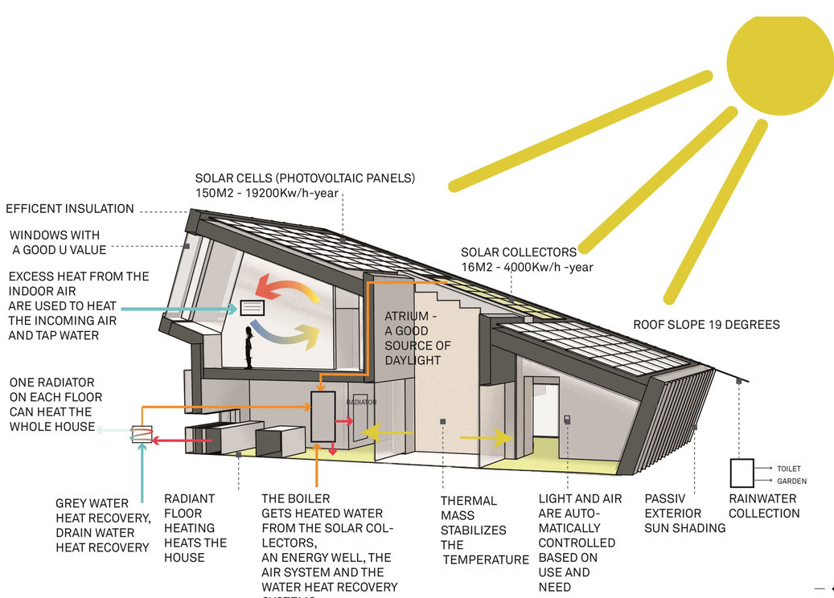
LEARNING OUTCOMES
1.Building and their types.
2.Thermal performance of building
3.Thermal comfort
4.Thermal Design
5.Planning of building
6.Orientation of building
At the end of the session students will get acquainted to:
Figure 1:Building Parameters(Source: Stouhi, 2019:Online), https://www.archdaily.com/908320/how-to-design-for-optimal-thermal-comfort-and-why-it-matters

Slide 3
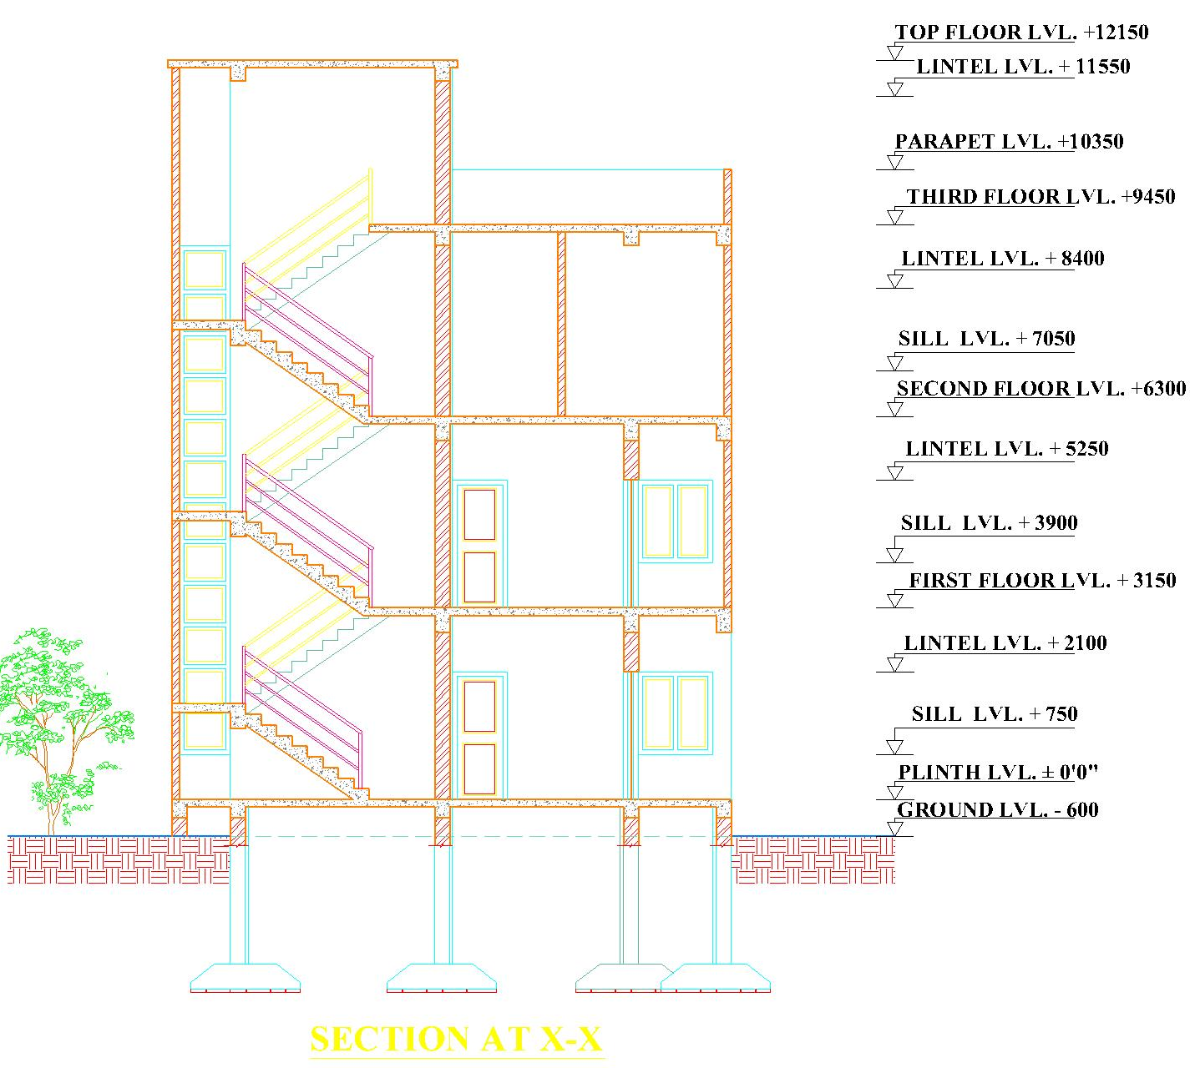
INTRODUCTION
Building:
Building is defined as the dwelling places for human beings which provides protection against weather conditions , safety , security and privacy etc. It is constructed on the basis of need and requirements, uses, designs, safety standards and several other features like comfort etc. The two major components of building are:
Super-structure
Sub-structure
SUPER STRUCTURE
Super Structure
The super-structure is the part of the building which lies above the ground.
Sub structure
The sub-structure is the part of the building which lies below the ground.
SUB STRUCTURE

Slide 4
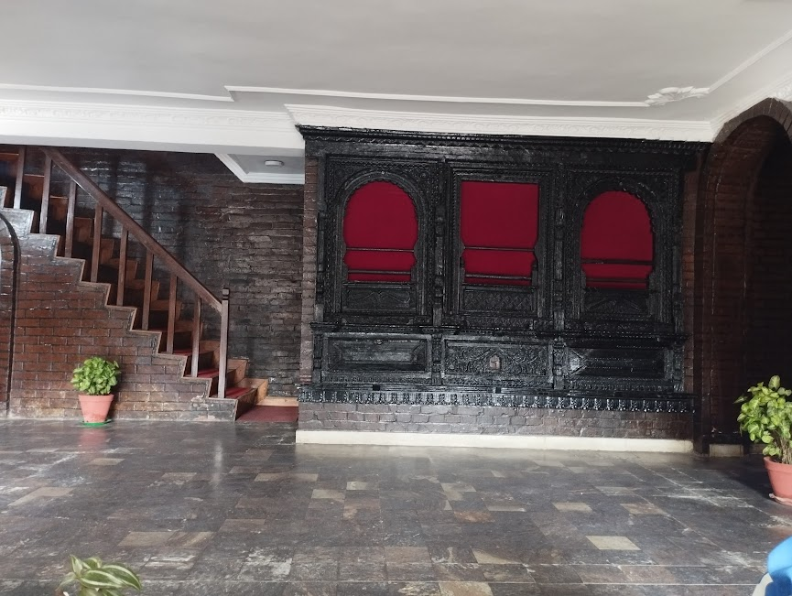
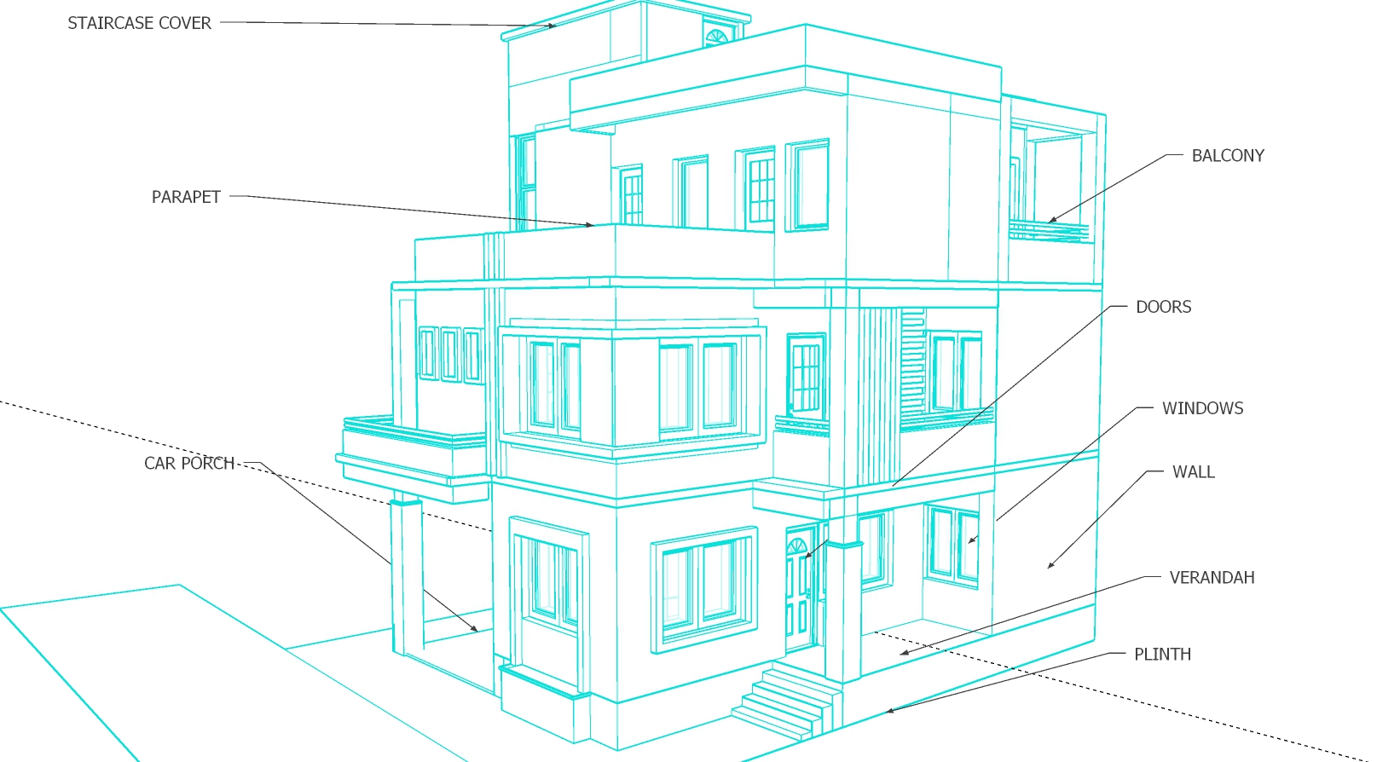
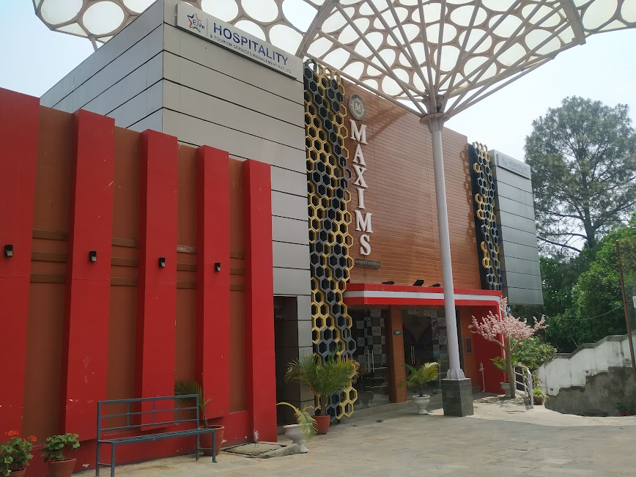


INTRODUCTION
National building code of India (SP:7-2005) defines the building as” any structure for whatsoever purpose and of whatsoever materials constructed and every part thereof whether used as human habitation or not and includes foundation , plinth , walls, floors, roofs, chimneys, plumbing and building services, fixed platforms, verandah , balcony , cornice, or projection, part of a building or anything affixed thereto or any wall enclosing or intended to enclose any land or space and signs and outdoor display structures”
Foundation
Plinth
Wall
Door , Windows other openings
Building finishes
Floor
Roof
Staircase , ramp, lift, Escalator
Thailand, Bangkok (photo credit:Abhinay Kushwaha)
Office

Slide 5
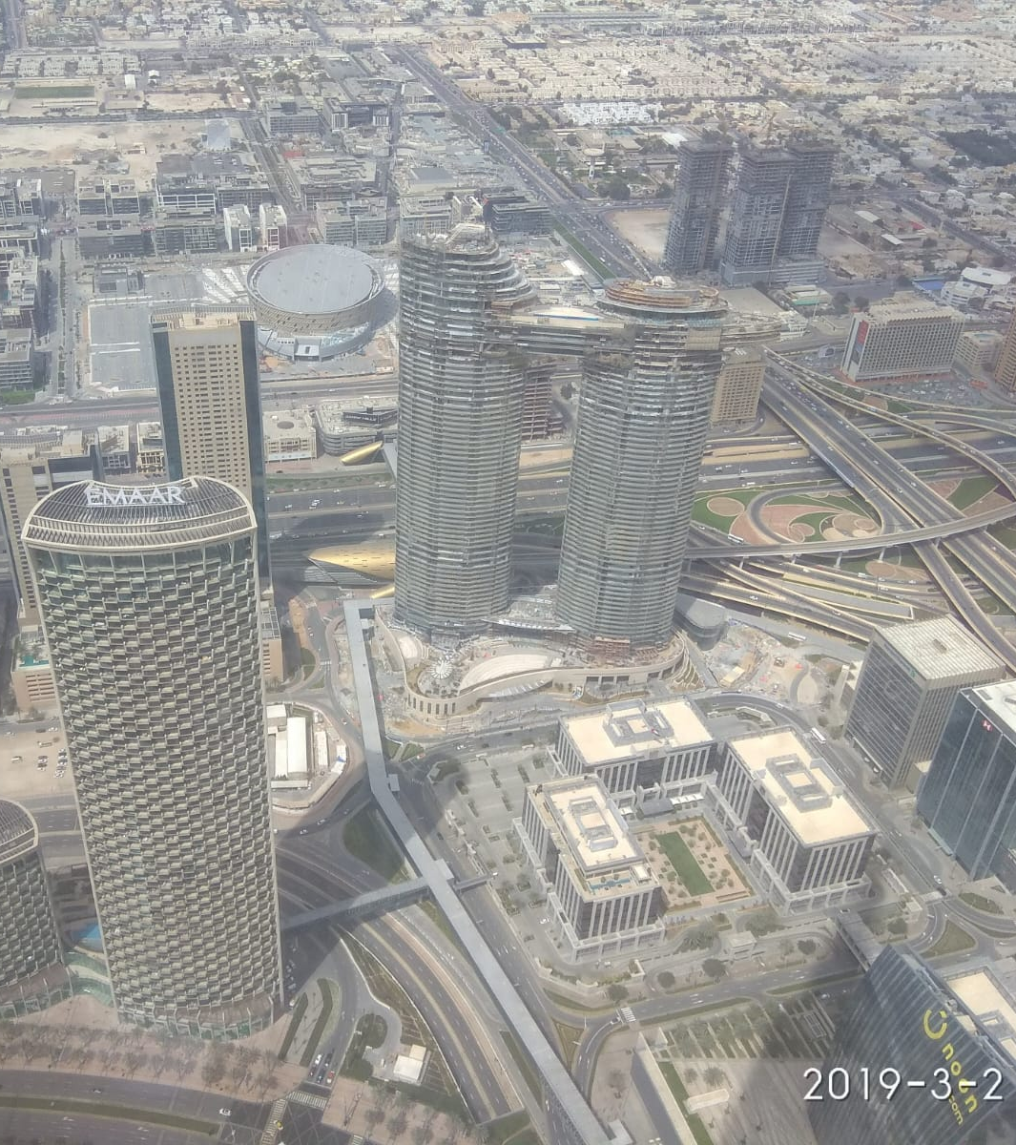
CLASSIFICATION OF BUILDING
National building code of India (SP:7-2005) classify building on the basis of storey and height as:
General Buildings
1 to 5 Stories or below 16m
Medium Rise
6 to 8 Stories or between 16m to below 25m
High Rise
9 to 39 Stories or 25m to below 100m
Skyscrapers
40 Stories and above or above 100m
Residential
Commercial
Educational
Assembly
Industrial
Storage
Hospital
Office
National building code of India (SP:7-2005) classify building on the basis of occupancy as:
Dubai, UAE (photo credit:Abhinay Kushwaha)

Slide 6
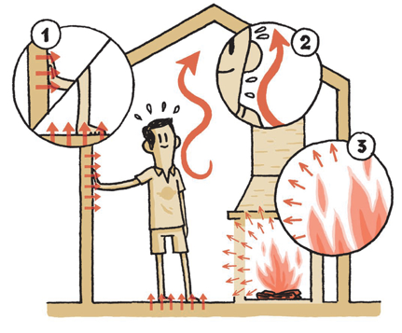

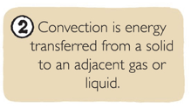

HEAT PHENOMENA IN BUILDING
The process of heating or cooling imply basically a transfer of thermal energy from one region to another. This transfer of heat from hotter to cooler parts of building due to existence of temperature difference can take place in three different ways:
Conduction:
Direct interaction with neighbouring particles(collisions)
Convection:
By mixing different parts of a fluid with different temperature.
Radiation:
By absorption or emission of electromagnetic radiation.[2]
Heat flows through various building elements such as walls, roof, ceiling, floor, etc. It also takes place from different surfaces by convection and radiation. solar radiation is transmitted through transparent windows and is absorbed by the internal surfaces of the building.
Figure 2:Heat exchange in Building
(Source: Stouhi, 2019:Online), https://www.archdaily.com/908320/how-to-design-for-optimal-thermal-comfort-and-why-it-matters

Slide 7
HEAT PHENOMENA IN BUILDING
Heat exchange in a building:
The internal environment within the building results from the response of the building fabric to the changing outdoor conditions of climatic parameters such as
air temperature,
solar radiation ,
humidity,
precipitation or evaporation ,
wind velocity , and
the direction and the clearness of the sky.
In order to determine the state of thermal comfort inside a building space detail thermal analysis of building should be done.[2]

Slide 8
THERMAL PERFORMANCE OF BUILDING
The thermal performance of a building refers to the process of modeling the energy transfer between a building and surroundings. Various heat exchange processes are possible between a building and the external environment. [3]
The thermal performance of a building depends on a number of factors. They are as follow :
design variables (geometrical dimensions of building elements such as walls, roof and windows, orientation, shading devices, etc.;
material properties (density, specific heat, thermal conductivity, transmissivity
weather data (solar radiation, ambient temperature, wind speed, humidity, etc.)
a building’s usage data (internal gains due to occupants, lighting and equipment, air exchanges, etc.[3]
Thermal Performance of the building plays a role Whether we feel comfortable or uncomfortable in the building.

Slide 9
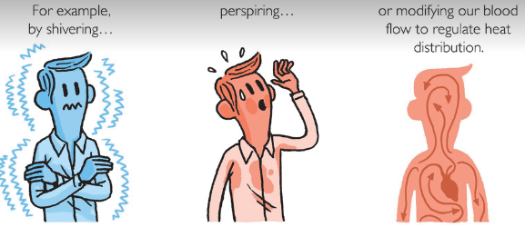
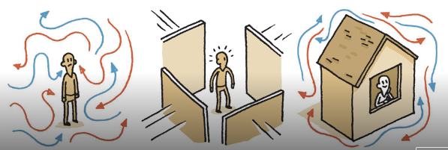
THERMAL COMFORT
Physiological aspect of thermal comfort:
‘thermal comfort’, it is the creation of building systems that are adapted to the local environment and functions of the space, cooperatively.
One of the first elements to consider while designing for thermal comfort is creating an efficient building exterior. A building’s envelope acts as a filter between the outdoor climate and indoor environment, stabilizing the atmosphere inside. Properly managing the envelope results in a well-balanced interior environment and reduces the use of mechanical systems, all of which contributes to a more sustainable structure
Figure 3:Thermal comfort(Source: Stouhi, 2019:Online), https://www.archdaily.com/908320/how-to-design-for-optimal-thermal-comfort-and-why-it-matters

Slide 10
THERMAL COMFORT
The physiological aspect of thermal comport.
Human bodies are thermal engines that generate and dissipate energy.
The objective of human metabolism is to regulate body temperature with minimal effort.
Body have different ways to balance constant heat exchange with the environment. like
Shivering
Perspiration
Modifying our blood flow to regulate heat distribution.[1]

Slide 11
Thermal comfort
Human body
State of activities
Fatigue
Recreation,
Rest , Sleep
Recovery
RESULTS STRESS ON THE BODY AND MIND
CAUSES DISCOMFORT,
LOSS OF EFFICIENCY AND EVENTUALLY LEAD TO A BREAKDOWN OF HEALTH
UNFAVOURABLE CLIMATIC CONDITIONS

Slide 12
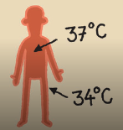
THERMAL COMFORT
Thermal balance of the human body:
Human response to the thermal environment depends to a great extent on the ease with which the body is able to regulate the heat balance in such a way that the internal body temperature is maintained constant at 37.4℃.[1]
Figure 4:Thermal comfort(Source: Stouhi, 2019:Online), https://www.archdaily.com/908320/how-to-design-for-optimal-thermal-comfort-and-why-it-matters

Slide 13
THERMAL COMFORT
Factors affecting comfort
Air temperature
Wind
Humidity
Solar radiation
Human activities
Clothing
Personal Variables
Environmental variables

Slide 14
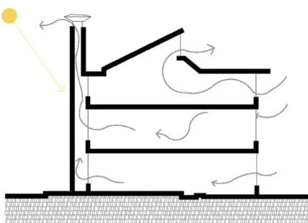
THERMAL DESIGN
The building envelope can greatly affect the interior thermal environment through the management of following parameters:
Insulation
Solar gain
Thermal inertia
Ventilation
Figure 5:Thermal Design ( Source: Arch-Monarch, n.d., Online), https://archi-monarch.com/introduction-of-passive-design/

Slide 15
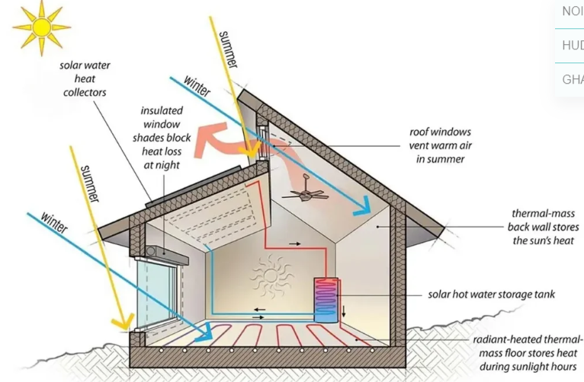
THERMAL DESIGN
Figure 5:Thermal Design ( Source: Arch-Monarch, n.d., Online), https://archi-monarch.com/introduction-of-passive-design/

Slide 16
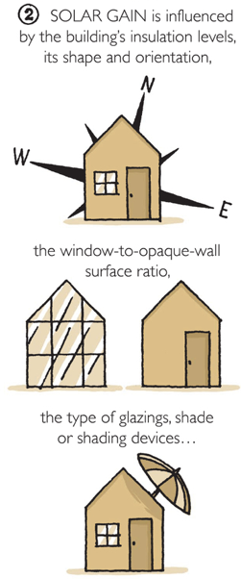
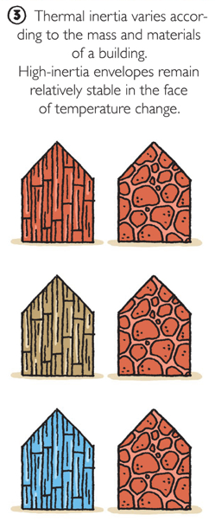
THERMAL DESIGN
Figure 6:Thermal comfort(Source: Stouhi, 2019:Online), https://www.archdaily.com/908320/how-to-design-for-optimal-thermal-comfort-and-why-it-matters

Slide 17
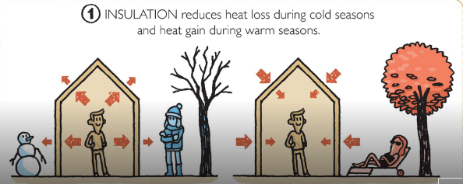
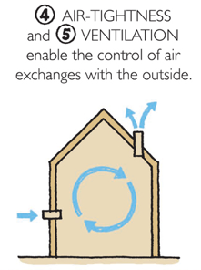
Thermal Design
Figure 6:Thermal comfort(Source: Stouhi, 2019:Online), https://www.archdaily.com/908320/how-to-design-for-optimal-thermal-comfort-and-why-it-matters

Slide 18
BUILDING DESIGN
Before any building is planned and constructed, its suitable site must be selected. Then Orientation should be Planned and Finally Building planning should be done.
A properly selected site of the building provides aesthetic value to the building.
Following points should be considered while selecting the site for any building design:[5]
The soil of the building site should be of good type. Building constriction over such soil normally undergo different settlement and sometime even collapse. Cracks in building in such condition are quite common.
The site should not be very much undulating.
The site should have its general shape, sloping away from the site. This will enable easy drainage of the rainwater from the side. This will also facilitate the drainage of the building itself.

Slide 19
BUILDING DESIGN
Following points should be considered while selecting the site for any building design:[5]
Civic services such water supply mains, electric lines, telephone lines, drainage, sewers, site so that obtain their services with no extra cost.
The site should be such that the ground water table is not very high.
Residential house sites should be located away from the busy commercial roads.
Topographical features of the site, natural and artificial surrounding affect site selection to a large extent.
Selection of the site also depends on the general scope or purpose of the building extent of privacy desired.

Slide 20
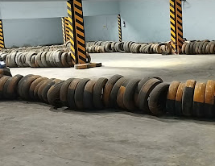
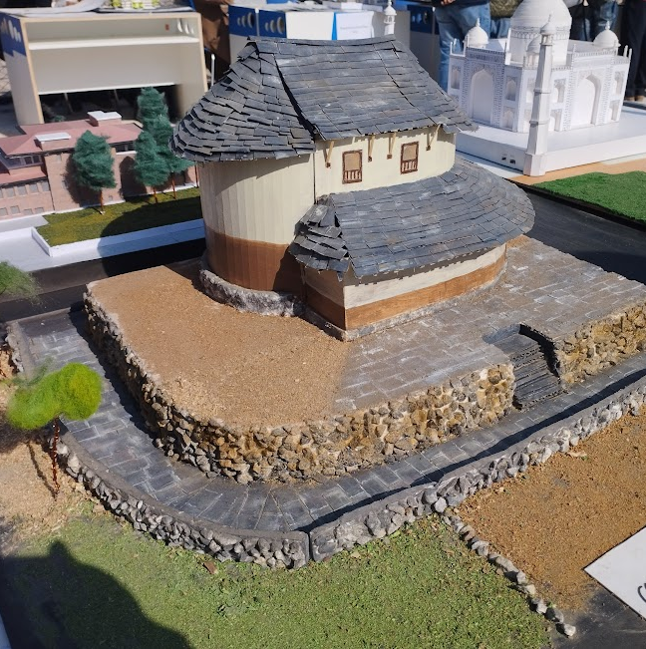
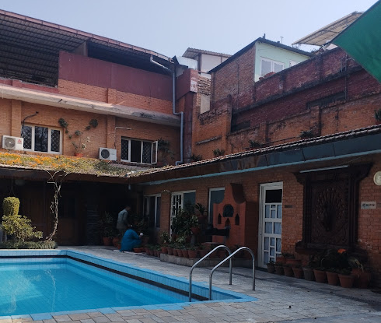
BUILDING PLANNING
Principles of planning of building
Aspect
Furniture requirements
Roominess
Prospect
Grouping
Circulation
Privacy
Sanitation
Flexibility
Practical considerations
Elegance

Slide 21
BUILDING PLANNING
Aspect:
Aspect is the peculiar arrangement of door and windows in the external wall of a building which allow the occupant to enjoy natural sunshine, breeze, scenery etc. [5]
Living room-south-east aspect
Bedroom- west or southwest aspect
Kitchen- north aspect
Storeroom- north aspect
Studios, reading room, classroom- north aspect.
Aspect is simply the positioning of the rooms in a building in such a way that all the functional requirement of the building is taken into Consideration.

Slide 22
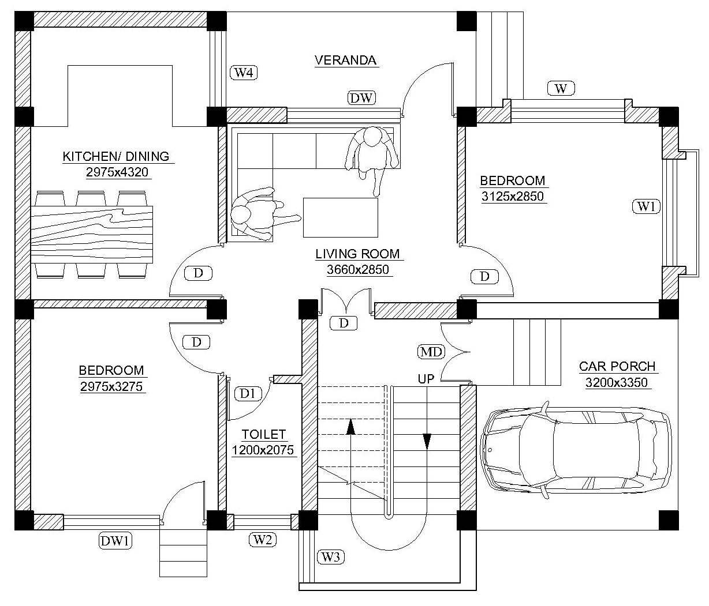
BUILDING PLANNING
ASPECT
LIVING ROOM:SOUTH EAST
BEDROOM:WEST OR SOUTHWEST
KITCHEN:EAST
STOREROOM:NORTH
STUDIOS,READING ROOM:NORTH
GROUND FLOOR PLAN

Slide 23
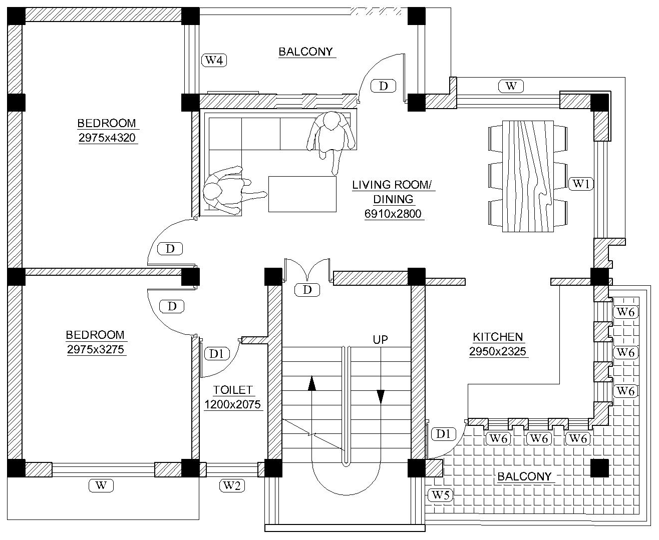
BUILDING PLANNING
STOREROOM:NORTH
STUDIOS,READING ROOM:NORTH
ASPECT
KITCHEN:EAST
BEDROOM:WEST OR SOUTHWEST
LIVING ROOM:SOUTH EAST
FIRST FLOOR PLAN

Slide 24
ORIENTATION OF BUILDING
Orientation of the building means setting the plan of the building so that its main front faces particular direction , which allows the future occupants of the building to enjoy the utmost gifts of the nature .[5]
Factors affecting orientation:
Wind direction
Humidity
Rain fall
Site conditions
Neighborhood conditions

Slide 25
ORIENTATION OF BUILDING
Orientation of the building is the first consideration prior to the planning of the building.
Because of the surrounding of the site, proximity of streets and other factors such as privacy and protection against the nuisance of noise and dust a building had to be orientation to face fixed direction.
In the cold climates, orientation west of north increase solar gains in the afternoon when they are most desirable for evening comfort, but east of north can warm the house more in the morning improving daytime comfort for those who are at home then.
In warmer climate, orientation east of north can allow better capture of cooling breezes.

Slide 26
Orientation of building
Analysis for best orientation.
Prioritize heating and cooling needs.
Climate analysis
Local climate
Temperature ranges both seasonal and diurnal (day-night)
Humidity range
Direction of cooling breezes, hot winds, cold winter, wet winds
Seasonal characteristics, including extremes.
Impact of local geographic features on climatic conditions.
Impact of adjacent building and existing landscape.
On the basis of analysis:
Passive heating
Passive cooling
Combination of both

Slide 27
Orientation of building
In all other climates a combination of passive solar heating and passive cooling is desirable.
North orientation
It is generally desirables in climate requirement winter heating the position of the sun in the sky allows you to easily shade northern facades and the ground near them in summertime with simple horizontal devices such as caves, while allowing full sum penetration winter.
North facing walls and windows receive more solar radiation in winter than in summer.

Slide 28
REFERENCES
[1] Stouhi, D. (2019, January 31). Archdaily. Retrieved from https://www.archdaily.com/908320/how-to-design-for-optimal-thermal-comfort-and-why-it-matters
[2]B. Pahari, "Passive Building: Concept & Design," no. ISBN: 99933-34-24-3, 2002. [3]Jha, D. B. (2020). Thermal Performance of Buildings. Amity School of architecture and planning
.

Slide 29
REFERENCES
[4]Arch-Monarch. (n.d.). Retrieved from https://archi-monarch.com/introduction-of-passive-design/ [5]Singh, G. (1998). Building Constructions and materials. Standard Book House, Delhi.
[6]S.C.Rangawala, ""Building Construction".
.

Slide 30
THANK YOU

