Slide 1
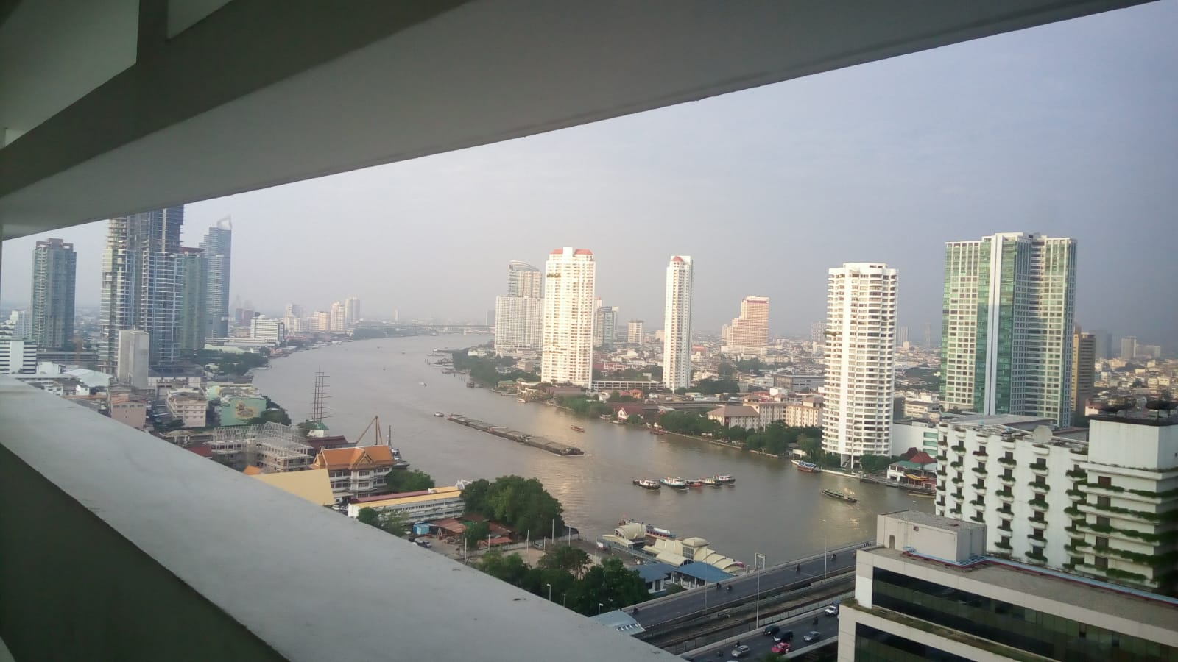
COURSE TITLE
BUILDING TECHNOLOGY
Chapter 1 - (Week 2)
FUNCTIONAL REQUIREMENT OF BUILDING
(PART 2)
LECTURE – 2
Ventilation , Sound, Light , Moisture movement
Ar. Ranju Kamal
Lecturer
Advanced college of engineering and management, Nepal
Affiliated to Tribhuvan University
Thailand, Bangkok (photo credit:Abhinay Kushwaha)

Slide 2
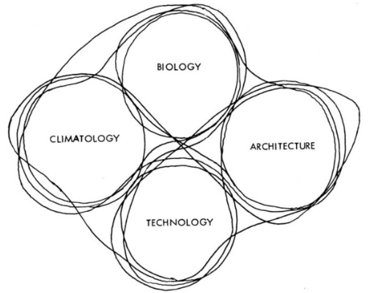
LEARNING OUTCOMES
1.Ventilation and air conditioning
2.Lighting
3.Sound and Acoustic
4.Moisture Movement
5.Dampproofing
At the end of the session students will get acquainted to:
Figure: Design influences(Source: Stouhi, 2021:Online),
https://www.archdaily.com/963706/back-to-basics-natural-ventilation-and-its-use-in-different-contexts?ad_source=search&ad_medium=search_result_articles

Slide 3
VENTILATION
Ventilation:
The process of supplying fresh air and removing contaminated air by natural or mechanical means to or from a room is termed as Ventilation.[1]
Air-Conditioning:
The simultaneous control of temperature, humidity, air motion, and air purity is known as air-conditioning. [1]
A series of ventilation systems can help in the projects:
Natural cross ventilation
Induced ventilation
Chimney effect
Evaporative cooling
Notes:
Proper ventilation and temperature in a building is very essential for health, efficiency, and hygienic condition. lack of ventilation causes unhygienic conditions and effect health and efficiency
A series of ventilation systems can help in the projects: natural cross ventilation, natural induced ventilation, chimney effect and evaporative cooling, which combined with the correct use of constructive elements allows improvement in thermal comfort and decrease in energy consumption.
Nothing is more rational than using the wind, a natural, free, renewable and healthy resource, to improve the thermal comfort of our projects. The awareness of the finiteness of the resources and the demand for the reduction in the energy consumption has removed air-conditioning systems as the protagonist of any project. Architects and engineers are turning to this more passive system to improve thermal comfort. It is evident that there are extreme climates in which there is no escape, or else the use of artificial systems, but in a large part of the terrestrial surface it is possible to provide a pleasant flow of air through the environments by means of passive systems, especially if the actions are considered during the project stage.

Slide 4
VENTILATION
For designing ventilation following parameters should be considered:
Meteorological data of the locality
Temperature , humidity, air direction
Types of use of room space
Suitable design of ventilation system
Ventilation requirement of different seasons, for different type of occupancies.
Notes:
A successful ventilation system must be aligned with the project's context, which includes the geographical location, the material it is built in, its architecture as a whole, and the habits of users occupying the space.
Save this picture!

Slide 5
NECESSITY OF VENTILATION
To create air movement
To prevent an undue accumulation of carbon dioxide and moisture.
To prevent depletion of oxygen content in air.
To prevent flammable concentration of Gas vapour or dust.
To prevent an undue concentration of body odours, fumes, dust , other industrial products and Bacteria carrying particles.
To prevent condensation in the building.
To remove body heat and heat liberated by other equipments.
To remove suffocating conditions in committee halls, cinema halls and other types of assembly
Notes:
What is ventilation, and why is it important?
Air movement is created by the rising of warm and the lowering of cool air. As the air above the land gets warmer, it rises and creates an area of low pressure. When air continues to rise, it cools and moves towards water surfaces, where it falls and creates an area of high pressure, and pushes cold air towards the land. This movement of areas is what creates the wind.

Slide 6
FUNCTIONAL REQUIREMENT
OF VENTILATION
Air changes or air movement
Air movement is necessary for proper ventilation.
If the rate of air change is less than one per hour ,there will be no ventilation. If the rate of air change is more than sixty per hour discomfort condition may occur due to high air velocity.[3]
Cross Ventilation is provided to increase the rate of air movement naturally.
Humidity
Relative Humidity within the range of 33 to 70 percent at the working of 21 $℃$ is considered to be desirable.[3]
Relative Humidity within the range of 33 to 70 percent at the working of 21 ℃ is considered to be desirable.[3]
For higher temperature low humidity and greater air movement are necessary from removing greater portion of heat from the body.
Notes:
Provision of Adequate ventilation should be provided at the design stage of buildings:

Slide 7
Quality of air
Air containing less than 0.5 mg of suspended impurity, per m³ and less than 0.5 part per million Sulphur dioxide is considered to be clean and does not require further treatment.[3]
Air within the room containing 0.06 percent CO2 may be considered vitiated but with 0.09 or 0.1 percent, it becomes stuffy and unbearable. Hence the air in habitable rooms should never contain more than 0.06% of CO2.[3]
Notes:
From the point of view of human comfort Ventilation system should meet the following requirements:

Slide 8
Temperature
It is desirable that the incoming ventilating air should be cool in summer and warm in winter before it enters the room. The general temperature difference between inside and outside is kept not more than 8°C. [3]
Effective temperature is an index which combines single value, the effect if air movement, humidity and temperature. [3]
The valve of effective temperature from human comfort point of view depends upon the type activity, graphical conditions, age of occupants amount of heat loss from the body etc. [3]
The common values of effective temperature in winter and summer are 20°c and 22°c respectively. [3]
Notes:
From the point of view of human comfort Ventilation system should meet the following requirements:

Slide 9
SYSTEM OF VENTILATION
VENTILATION
Natural Ventilation
Single-Sided Ventilation
Cross Ventilation
Artificial/Mechanical Ventilation
Stack Ventilation
Chimney Effect

Slide 10
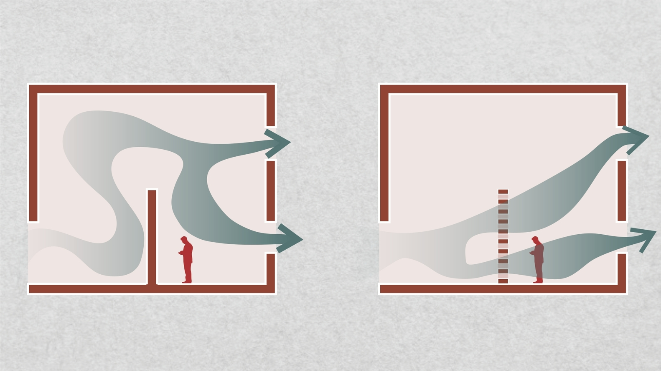
Natural Ventilation:
It is the supply of outside air ,into a building through windows or other openings due to wind outside and convection effects arising from temperature or vapour pressure differences (or both ) between inside or outside of the building. [2]
It is affected by doors, windows, Ventilators, skylights and other openings in the building. [3]
Natural cross ventilation : when openings in a certain environment or construction are arranged on opposite or adjacent walls, allowing air to enter and exit. [4]
Induced natural ventilation : thermal induction systems use to conduct air cooling.
In this system, openings are positioned close to the ground so the cold air enters the space by pushing the mass of warm air above, where air outlets are positioned in the ceiling such as sheds and clerestory. [4]
Figure: Design influences(Source: Stouhi, 2021:Online),
https://www.archdaily.com/963706/back-to-basics-natural-ventilation-and-its-use-in-different-contexts?ad_source=search&ad_medium=search_result_articles
Notes:
Natural ventilation is the use of environmentally-friendly systems that do not require any automated or mechanical solutions. In addition to being more ecological, natural ventilation is also more cost-efficient, and relies on natural external factors such as the wind and the temperature of the interior space and its surroundings.
The warm air is lighter than the cold air, in this case, in an external or internal environment the warm air goes up and the cold air goes down.

Slide 11
Types of Natural Ventilation
Single-Sided Ventilation
Single sided ventilation is the use of openings on one side of a building.
It is used to naturally ventilate the space of projects with limited area.
They are also used in projects where cross ventilation cannot be provided, due to structural or environmental constraints.
This ventilation generates the least air circulation when it comes to natural ventilation systems. [4]
Cross Ventilation
when the openings in a structure are arranged on opposite or adjacent walls, allowing air to enter from both sides, cross the space, and exit from the opposite direction. [4]
This system is usually used in buildings located in climatic zones with higher temperatures, as it creates constant air renewal within the building, reducing the internal temperature. [4]
Notes:
Indicated for buildings in climatic zones with higher temperatures, the system allows constant changes of the air inside the building, renewing it and still, considerably reducing the internal temperature.

Slide 12
Stack Ventilation
It introduces cooler air from the outside into the building at a low level, which gradually becomes warmer as it gets exposed to heat sources within the space. This causes the warm air to rise and leave the space through openings situated at a higher level. [4]
It is more effective in tall buildings with central atriums ,
It is used in buildings where cross ventilation is not able to penetrate sufficiently throughout the space.
for this ventilation system to work properly, the indoor temperature must be higher than the outside.

Slide 13
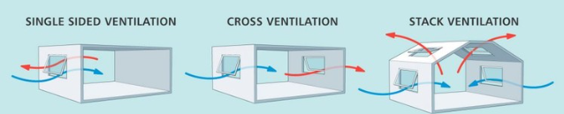
Figure: Ventilation(Source: : Stouhi, 2021:Online),
https://www.archdaily.com/963706/back-to-basics-natural-ventilation-and-its-use-in-different-contexts?ad_source=search&ad_medium=search_result_articles

Slide 14
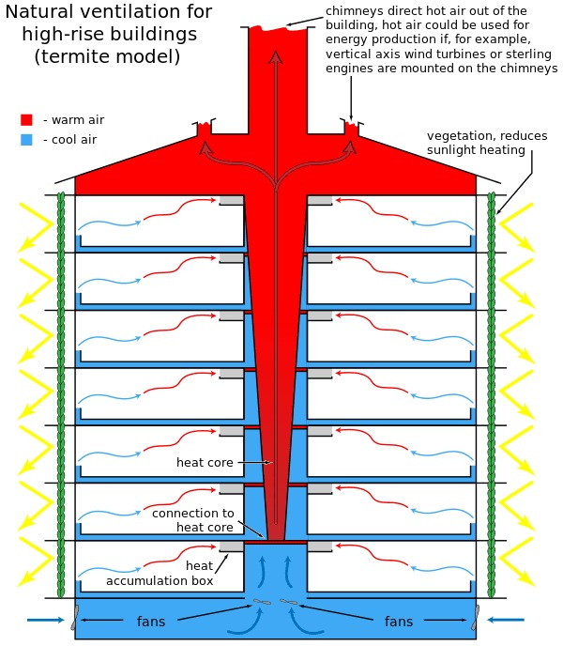
Chimney Effect
In vertical buildings, the chimney effect is constantly used. Cold air produces pressure under the warm air, forcing it to go upwards. however, opened areas in the project's center or towers allow that same air to circulate throughout the indoor environment, leaving through the roof, clerestory, zenithal openings, or wind exhausts. [4]
Figure: chimney effect(Source: Stouhi, 2021:Online),
https://www.archdaily.com/963706/back-to-basics-natural-ventilation-and-its-use-in-different-contexts?ad_source=search&ad_medium=search_result_articles

Slide 15
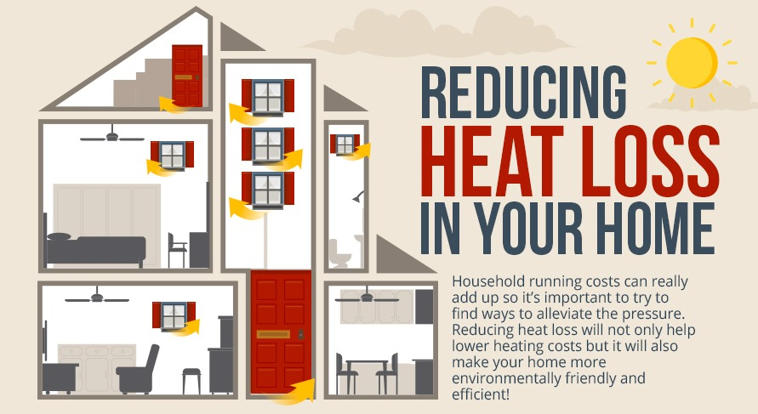
Artificial/Mechanical Ventilation
Supply of outside air, by positive ventilation, by infiltration , by reduction of pressure inside due to exhaust air or by combination of positive ventilation and exhaust of air. [2]
Figure: Ventilation(Source: : Stouhi, 2021:Online),
https://www.archdaily.com/963706/back-to-basics-natural-ventilation-and-its-use-in-different-contexts?ad_source=search&ad_medium=search_result_articles

Slide 16

DAYLIGHTING IN BUILDING

Slide 17
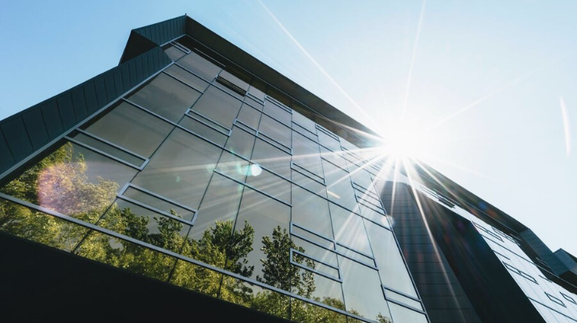
DAYLIGHTING
Daylighting is the controlled admission of natural light, direct sunlight, and diffused-skylight into a building to reduce electric lighting and saving energy.[5]
It helps to maximize the benefits of natural light, including reduced energy consumption, improved occupant well-being, and enhanced architectural aesthetics. [5]
By technology and scientific analysis, daylight modeling creates well-designed, sustainable, and human-centric spaces. [5]
Passive daylighting strategies promote the quantity and even distribution of daylight throughout a building by collecting natural light and reflecting it into darker areas of the building. [5]
Figure: Daylighting(Source: : Ltd, W. e., 2021:Online),
Retrieved from linkedin.com: https://www.linkedin.com/pulse/passive-design-strategy-daylighting-/
Notes:
Natural light is a powerful architectural tool. As the importance of sustainable design grows, passive strategies like daylighting have become critical in reducing the impact of the built environment.
Radiance and Illuminance are the two initial concepts to be considered. Radiance refers to the total energy that is reflected, transmitted, or received by a surface, per angle per area. It is a metric that evaluates specific light levels on a predetermined day and time, simulating localized sky conditions. Illuminance, on the other hand, measures the amount of light emitted by a source and received by a surface. It is quantified in lux (lumens per square meter) or footcandles (lumens per square foot).

Slide 18
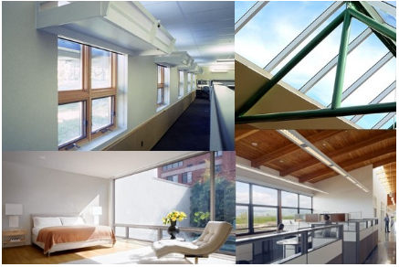
Architects use windows, skylights, clear doors, light tubes, mirrors, light shelves and other reflective surfaces to collect and direct light to key areas in the room. [5]
It involves carefully balancing heat gain and loss, glare control, and variations in daylight availability. [5]
Figure: Daylighting(Source: : Ltd, W. e., 2021:Online),
Retrieved from linkedin.com: https://www.linkedin.com/pulse/passive-design-strategy-daylighting-/
Notes:
Careful design of daylight within a building is one of the most fundamental ways to ensure a building maximizes its environmental performance. By designing a building envelope to allow adequate levels of daylight to the building interior, demand for artificial lighting and electricity consumption can be reduced. Careful product selection and orientation can also reduce the need for heating, cooling, and artificial ventilation.
Good daylighting solutions require an integrated approach to building design where the functional requirements for light, ventilation and thermal comfort of the building users are considered alongside the building form and design concepts throughout the design process. Fundamental to good lighting design is building orientation, design of the roof, facades, the selection of glazing solutions and daylight controls such as blinds or louvers.

Slide 19
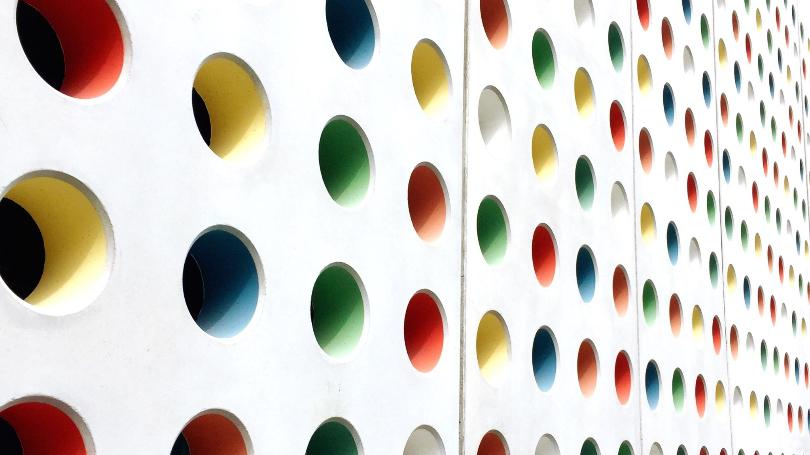
SOUND AND ACOUSTICS IN BUILDING

Slide 20
SOUND AND ACOUSTICS
"Acoustics" in architecture means improving sound in environments. [7]
There are two technical categories used in acoustics: [7]
  soundproofing
  acoustical treatment.
Soundproofing means "less noise" and treatment, "better sound". [7]
Soundproofing :
It is commonly used in music recording studios ,applied in locations near major avenues like schools, construction zones. [7]
Soundproofing an environment is like protecting it against bad weather: the structure should be as solid as possible and without holes or cracks. [7]
To reduce the noise coming into and going out of a room, one must increase the structural mass of the walls, floor and ceiling, and seal the air gaps surrounding doors and windows, as well as the openings for refrigeration and electrical outlets. [7]

Slide 21
sound treatments are used to improve sound quality within an environment
for diners to hear and understand conversations at their tables in a restaurant , for students to understand teachers , for the whole audience to enjoy the music in an auditorium. [7]
All building materials have acoustic properties as they can potentially absorb, reflect or transmit sounds that reach them. [7]
When sounds are reflected, they cause an increase in the overall echo and reverberation levels in a space. When treating rooms correctly, echo and reverberation is reduced to treat rooms, there are two methods available: [7]
  sound absorption
  diffusion.
The best treatment strategies combine these two techniques.

Slide 22
Noise.
Unwanted sound reaching the ears is called noise. Unwanted sound may be due to intensity of sound or frequency of sound or both.[1]
Effect of noise on human comfort. [1]
Noisy condition result in uncomfortable living condition, fatigue, inefficiency and mental strain.
Prolonged exposure to such conditions may cause temporary deafness or nervous breakdown.
Sound insulation by scientific planning of Buildings and colonies. [1]
Interposing buffer zones between source of noise and residential area.
Screening noise
Less noise vulnerable building is interposed between source of noise and more noise vulnerable building.

Slide 23
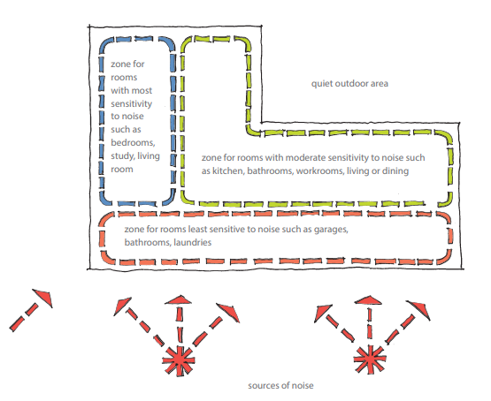
Controlling noise
Controlling noise through design and layout
The impact of noise can be reduced through building layout and other design elements.[8]
controlling noise at source;
increasing distance from the noise source;
closing potential sound paths (such as openings in walls facing sources of noise); and using mass,
insulation or buffering to block the noise.
install sound-absorbent surfaces in rooms that are potential sources of noise such as laundries, children’s playrooms, and rooms where loud music or games may be played.[8]
Figure:Insulation(Source:Level:The authority of sustainable buildings, n.d.:online), www.level.org.nz: https://www.level.org.nz/passive-design/controlling-noise/controlling-noise-through-design-and-layout/

Slide 24
Where noise cannot be controlled at source:
increase the distance between the noise and the location where it will be heard – for example, locate the building as far as possible from a noisy street frontage
use zones to control noise, by grouping noisy or quiet activity spaces together
don’t locate windows or doors towards sources of noise
avoid direct and flanking sound paths by off-setting doors and windows from noise sources
provide a buffer space or spaces between quiet and noisy spaces – for example, by locating a wardrobe between bedrooms
incorporate mass into external walls to block external noise, or use fencing or earth mounding
use sound-attenuating exterior walls or sound-insulated interior partitions to control noise

Slide 25
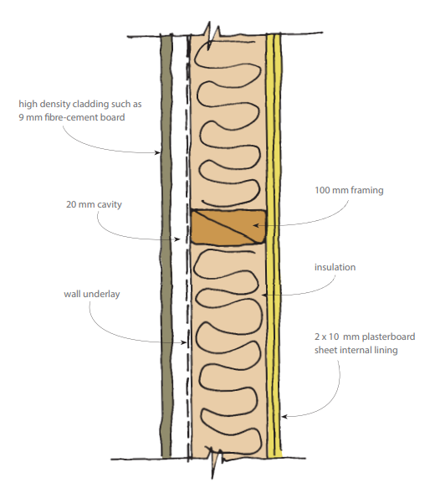
External sound envelope (bre-cement cladding) A high-density sheet cladding, with sealed joints, thermal insulation, and sound attenuating interior lining. This will provide sound reduction at moderate cost, using lightweight construction.[8]
Figure:Insulation(Source:Level:The authority of sustainable buildings, n.d.:online), www.level.org.nz: https://www.level.org.nz/passive-design/controlling-noise/controlling-noise-through-design-and-layout/
Notes:
Exterior building elements can be constructed to limit the effects of exterior noise.
On this page:
sound-attenuating external walls
sound-attenuating roofs
sound-attenuating external doors and windows
The two types of noise that the building envelope must be able to keep out are:
airborne sound passing through gaps and openings
structure-borne sound from impact or vibration.
Sound-attenuating walls, roofs, windows and doors can be used to block external sources of noise. They are frequently difficult and costly to retrofit into existing homes so they should be considered during the design stage of a new building.
Sound-attenuating external walls
Where external walls face a source of outdoor noise, they should be of heavy construction and without windows or doors if possible. If doors or windows are necessary, doors should be solid with seals around the opening, and windows should preferably be non-opening, using sound-attenuating laminated panes.
Acoustic performance of framed walls may also be improved by:
using staggered stud framed construction
incorporating proprietary sound absorbing materials into the ceiling construction
using a proprietary acoustic rated wall construction system.

Slide 26
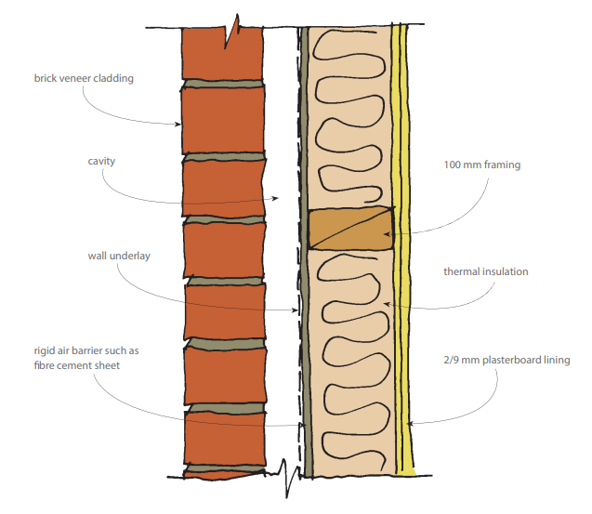
External sound envelope (brick veneer) A brick or concrete masonry veneer, a rigid air barrier, thermal insulation, and sound attenuating interior lining is an expensive option using heavier weight construction. It will provide eective sound reduction. [8]
Figure:Insulation(Source:Level:The authority of sustainable buildings, n.d.:online), www.level.org.nz: https://www.level.org.nz/passive-design/controlling-noise/controlling-noise-through-design-and-layout/

Slide 27
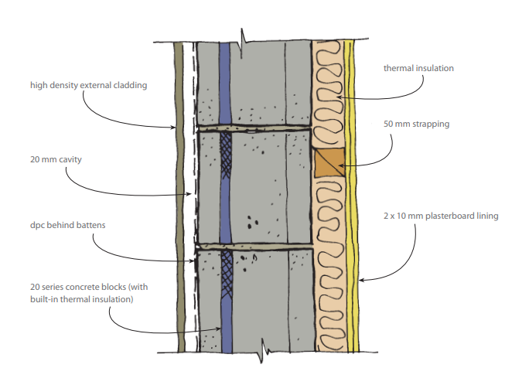
External sound envelope (concrete masonry) A high density sheet cladding installed over battens, interior strapping, thermal insulation and sound-attenuating interior lining will provide an effective sound barrier. [8]
Figure:Insulation(Source:Level:The authority of sustainable buildings, n.d.:online), www.level.org.nz: https://www.level.org.nz/passive-design/controlling-noise/controlling-noise-through-design-and-layout/

Slide 28
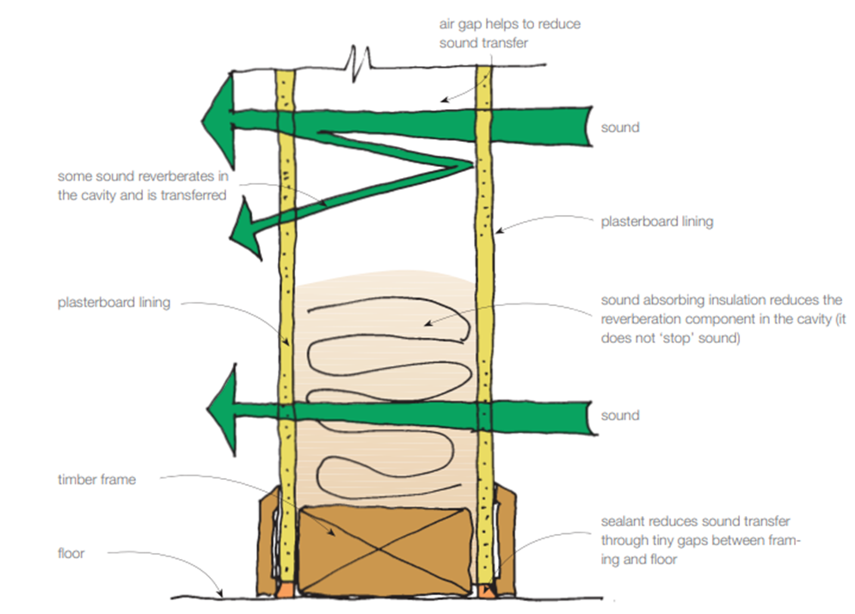
Interior noise can be controlled by sealing joints and incorporating sound-absorbing materials.
In general, internal sound-reducing construction should have mass and sound-absorbent material. All joints should be sealed (to minimise air gaps through which sound might pass), and – as much as possible – the structure between the linings should be discontinued. [8]
Figure:Insulation(Source:Level:The authority of sustainable buildings, n.d.:online), www.level.org.nz: https://www.level.org.nz/passive-design/controlling-noise/controlling-noise-through-design-and-layout/

Slide 29
Fences, walls and earth mounds as sound barriers
High-mass fences or walls, or earth mounds, can reduce external noise as long as the source is lower than or level with the barrier.
Barriers will not reduce noise that originates from above the barrier.
Design factors for a south sloping site with loud noise source on the north side Where there is noise on the north side, careful design is required to minimise the disturbance caused by the noise while still allowing sun .[8]
Notes:
The ideal house orientation may not be possible if there is a significant source of noise from the north side. Careful design can minimise the disturbance caused by the noise, while still allowing sun into the house:
Brick/concrete walls: A 2.0 m high brick or concrete masonry wall is an effective barrier against direct noise, but some noise will pass over the barrier.
Earth mounds: A similar effect may be achieved by building an earth mound to a similar height.
Timber fences: A 2.0 m high timber fence with solid palings (no gaps), sheet material or a combination of both will create an effective noise barrier. The palings or sheet material should have a minimum mass of 12 kilograms per square metre. The fence must have no gaps or cracks or no spaces under the fence at the ground level. Some noise may pass over the barrier. The effectiveness of the barrier can be improved by building the fence on top of a bank or rise. The maximum height of fencing is governed by requirements in the district plan, which can be obtained from the local council.
Trees and shrubs: These are not effective as an acoustic barrier but they provide a visual barrier and may have psychological benefits.

Slide 30
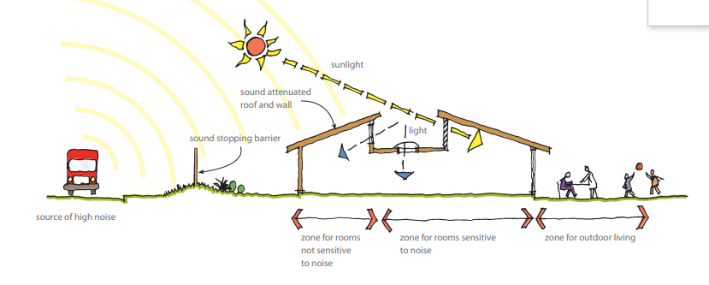
Figure:controlling noise(Source:Level:The authority of sustainable buildings, n.d.:online), www.level.org.nz: https://www.level.org.nz/passive-design/controlling-noise/controlling-noise-through-design-and-layout/

Slide 31

MOISTURE MOVEMENT IN BUILDING

Slide 32
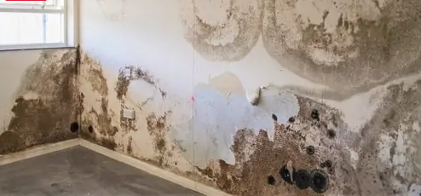
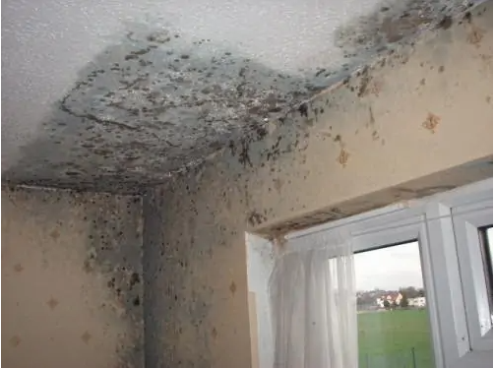
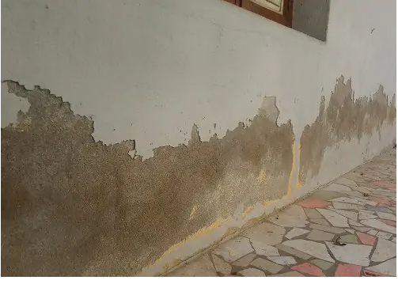
Dampness in a building is the presence of moisture in various parts of building like floor, wall, roof etc. The continuous dampness of building give rise to unhygenic condition.[6]
Dampness may be caused by:
  Ground water
  Rainwater and
  Leakages from pipes.
Figure: Dampness(source:Daily Civil, n.d.,online), https://dailycivil.com/dampness-in-buildings-causes-sources-prevention/

Slide 33
Dampness due to Ground Water:
Due to capillary action moisture from ground rises into foundation, floor and even in wall.
(b) Rainwater: May enter the building components due to various reasons.
(i) From wall top: If top of wall is not protected with impervious course like concrete, water can enter the wall and keep it damp for a long time.
(ii) From face of external walls: Splashing of outer wall by rain results into moisture entering the wall. Poor plaster coat is the main source of this type of dampness.
(iii) Improper fixing of down take pipes: If down take pipes from roof are not properly fixed, a thin layer of water stagnates near the mouth of down take pipes. This results into entry of rainwater into roof and wall. [6]
Notes:
All buildings are founded on soils. Soil holds water for a long time. Sometimes water level may rise and come in contact with foundation.

Slide 34
(iv) Improper slopes to roof:
If slope is not given properly, water ponds are formed on the flat roof, which results into entry of water into slab.
(v) Defective construction: Imperfect wall joints, improper slopes to chajja, construction joints in roof etc. cause dampness in buildings.
(c) Leakage from Pipes: From over head tanks, pipes are taken over roof and along the wall. From bathrooms, toilets and kitchen water is drained out with different types of pipes. The pipes are joined to get required length and turns. Many time water leaks through joints resulting into moisture in building components.[6]

Slide 35
EFFECTS OF DAMPNESS
Effects of dampness are as listed below:
Patches develop and destroy the appearance of the building.
Colour wash, whitewash and paintings are damaged.
Plaster crumbles.
Bricks and stones disintegrate endangering the building.
Steel in the slabs and beam start rusting. It reduces the life of structure.
Electric short circuits may take place.
Wooden components of buildings like door frames, cupboard warp.
Dry rotting of wood takes place.
Termite becomes active and attack wooden articles.
Mosquito breeding takes place.
Darkness along with warmth and darkness breed germs giving rise to many diseases.
Notes:
Design and building faults can also lead to damage in building structure or finishes – such as rot in framing; deterioration/disintegration of linings, flooring, and cabinetry; and peeling paint. Structural damage in wet areas is becoming more common. It is often not immediately obvious, but can be substantial.
With good design, detailing and installation of waterproof membranes and impervious finishes to manage the moisture generated, wet areas can be durable, healthy, safe and comfortable, and should not result in damage to the building structure, surface finishes and fixtures.

Slide 36
METHODS OF DAMP PROOFING
Providing D.P.C. course
Providing cavity walls
Surface treatment
Integral treatment
Guniting
Pressure grouting.
Notes:
The requirements of an ideal materials for damp proofing are:
It should be impervious.
It should be flexible.
It should be easy to carry out leak proofing joints.
It should be stable
It should be durable. It’s life should be as much as the life of building itself.
It should resist the load safely.
It should not contain sulphates, chloride and nitrates.
It should be cheap.
REQUIREMENTS OF AN IDEAL MATERIAL FOR DAMP PROOFING:

Slide 37
Providing damp proof course:
It consists of providing a damp proof course between the source of dampness and building component.
The DPC may be with any water repellant material like bitumen, mastic asphalt, cement concrete, metal or plastic sheets.
DPC should cover full width of wall. It should be laid on levelled surface of mortar. Joints should be minimum and should not be at critical points. [6]
When horizontal DPC on roof is continued on vertical face of parapet wall, the junction should be filled with about 75 mm fillet of cement concrete[6]
2. Providing cavity wall:
Cavity wall is constructed to protect foundation masonry and the wall .
The cavity prevents moisture travelling from outer to inner wall.
Notes:
. Figure 9.1 shows details of providing water proof course at plinth level. Whereas Figure 9.2 shows the details of water proofing course for wall and floor. Figure 9.3 shows details of water proofing course for basement.

Slide 38
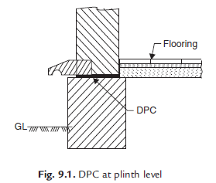
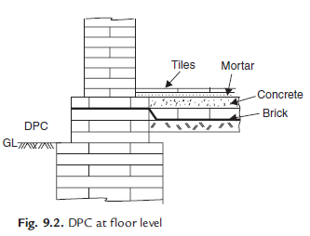
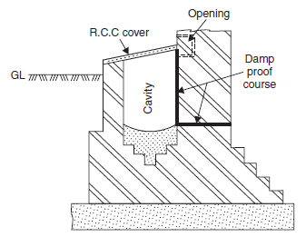
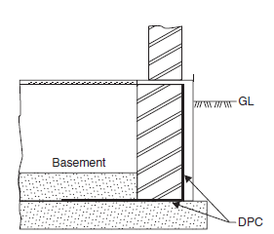
Figure: DPC at plinth level
Figure : DPC at floor level
Figure: DPC for basement
Figure: Providing Cavity wall
Source: Bhavikati, S. (2010). Basic Civil Engineering. new delhi: New Age International (P) Ltd., Publishers.

Slide 39
3. Surface treatment:
If moisture is only superficial and not under pressure this method is useful.
It consists of application of layer of water repellant compounds on the surface.
Some of the water proofing agents used for such treatment are silicates of sodium or potassium and sulphates of aluminium , zinc and magnesium.[6]
4. Integral treatment:
It consists in mixing commercially available compounds in water before concrete is wet mixed. These compounds are made from chalk, talc, flutter earth or chemical compounds like calcium chloride, aluminium sulphate, calcium chloride etc. Some compounds contain compounds like soap, petroleum oils, fatty acids etc. [6]
5. Guniting :
In this method a mixture of cement and water is forced by cement gun on the surface to be made water proof. Later 1 : 3 or 1 : 4 cement mortar is applied to the surface with pressure using compressed air. Thus an impervious layer of mortar is provided.
6. Pressure grouting: This is the method used to seal cracks in the concrete surfaces. In this method cement grout is forced under pressure. [6]

Slide 40
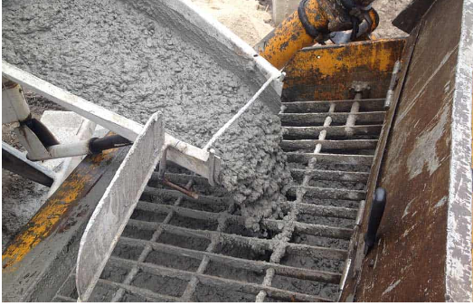
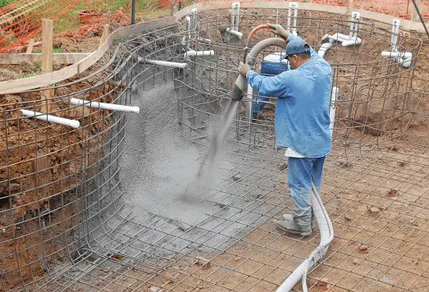
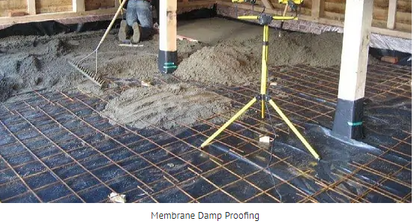
Figure: Waterproof Concrete
Figure: Guniting
Figure: Membrane Damp Proofing
(source:Daily Civil, n.d.,online), https://dailycivil.com/dampness-in-buildings-causes-sources-prevention/

Slide 41
REFERENCES
[1]Singh, G. (2005). Building Constructions and materials. Standard Book House, Delhi.
[2]B. Pahari, "Passive Building: Concept & Design," no. ISBN: 99933-34-24-3, 2002.
[3] Dr B.C. Punima, E. A. (2017). Building Construction. New Delhi: Laxmi Publications (P) Ltd.
[4]Stouhi, D. (2021, 6 23). Archdaily. Retrieved from Archdaily.com: https://www.archdaily.com/963706/back-to-basics-natural-ventilation-and-its-use-in-different-contexts?ad_source=search&ad_medium=search_result_articles
[5] Ltd, W. e. (2021, 9 27). Retrieved from linkedin.com: https://www.linkedin.com/pulse/passive-design-strategy-daylighting-/

Slide 42
REFERENCES
[6] Bhavikati, S. (2010). Basic Civil Engineering. new delhi: New Age International (P) Ltd., Publishers.
[7]Souza, E. (2021, 5 7). Archdaily. Retrieved from Archdaily.com: https://www.archdaily.com/912806/understanding-sound-absorption-and-diffusion-in-architectural-projects?ad_source=myad_bookmarks&ad_medium=bookmark-show&ad_content=other-user
[8] Level:The authority of sustainable buildings. (n.d.). Retrieved from www.level.org.nz: https://www.level.org.nz/passive-design/controlling-noise/controlling-noise-through-design-and-layout/
[9] Daily Civil. (n.d.). Retrieved from Dailycivil.com: https://dailycivil.com/dampness-in-buildings-causes-sources-prevention/

Slide 43
THANK YOU
Notes:
It can be incorporated from even the earliest stages of design, assisting with the most appropriate solar orientation and in the massing study. It can also compare design options, select the most suitable materials for each part of the project, and assist in the sizing and location of openings such as windows, skylights, and sunscreens.

