Slide 1

COURSE TITLE
BUILDING TECHNOLOGY
Chapter 3- (Week 3)
Foundations
LECTURE – 3
Foundations
Ar. Ranju Kamal
Lecturer
Advanced college of engineering and management, Nepal
Affiliated to Tribhuvan University
Thailand, Bangkok (photo credit:Abhinay Kushwaha)

Slide 2
LEARNING OUTCOMES
1. Soil exploration (methods, improving bearing capacity, load test)
4. Excavation of trenches for pipes, cables etc. and refilling works
5. Some common problems with existing foundations
3. Earthwork excavation of foundations (soft soil, hard rock, wet excavation)
2. Foundation and its types (deep, shallow)
At the end of the session students will get acquainted to:

Slide 3
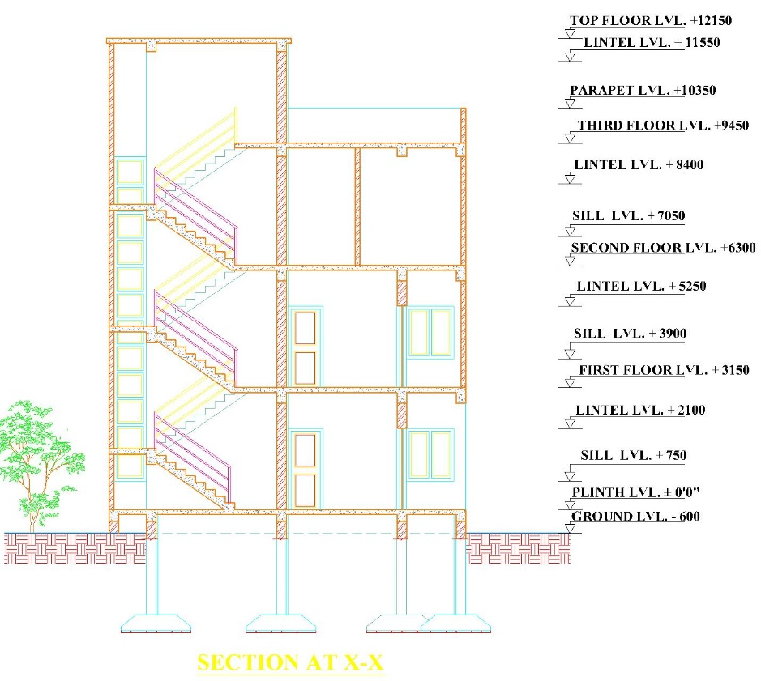
INTRODUCTION
Building:
The two major components of building are:
●Super-structure
●Sub-structure
Super Structure
The super-structure is the part of the building which lies above the ground.
Sub structure
The sub-structure is the part of the building which lies below the ground.
SUPER STRUCTURE
SUB STRUCTURE

Slide 4
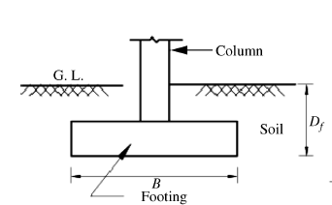
Shallow foundations: this type of foundation is when the structure load is relatively low in comparison to the capacity of the bearing of the surface soil.[1]
Depth of the foundation ≤width of the foundation
If D_{f}/B ≤1
where D_{f} =depth of foundation below ground level, and B =width of foundation (least dimension)
Types of shallow foundation
Isolated/ pad footing
Combined footing
Strap footing
Strip footing
Mat/ Raft foundation
Figure: Shallow foundation
Source:Bhavikati, S. (2010). Basic Civil Engineering. new delhi: New Age International (P) Ltd., Publishers.

Slide 5
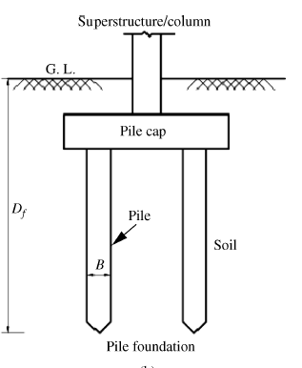
Deep foundations: Deep foundations are used when the surface soil's bearing capacity is not enough to support the structure's loads. This type of foundation allows the loads to transfer to deeper layers of soil that allow for a larger bearing capacity. [1]
Depth of the foundation ≥Width of the foundation
If D_{f}/B ≥ 1
Types of deep foundation
Pile foundation
Pier foundation
Well-foundation
Figure: Deep foundation
Source:Bhavikati, S. (2010). Basic Civil Engineering. new delhi: New Age International (P) Ltd., Publishers.

Slide 6
SOIL EXPLORATION
The process of extracting the overall information of the soil by performing various tests
Soil explorations are done to obtain information about subsurface conditions at the site proposed for construction. Soil exploration consists of determining the profile of the natural soil deposits at the site, taking the soil samples, and determining the engineering properties of soils using laboratory tests as well as in-site testing methods.[6]
The main objective of soil exploration is to extract adequate information about the type and nature of soil at different depths for designing safe, sound and economical foundation. [6]

Slide 7
PURPOSE OF SOIL EXPLORATION
PURPOSE OF SOIL EXPLORATION
Find out the soil
bearing capacity
Assess the most
economical
foundation
Fix the depth of
proposed
foundation
To predict the
chances of
settlement of
foundation
Know the
underground
water level
To know the
suitability of soil
and degree of
compaction

Slide 8
METHODS OF SOIL EXPLORATIONS
Inspection
Test pits
Test piles
Probing
Boring(Auger, Deep, Wash)
Geophysical methods

Slide 9
Methods of soil exploration:
1.Inspection of site
  •Hard, soft, water logged area.
  •Classification of soil by visual examination such as gravel, sand, clay.
  •Drainage condition
  •Unstable sites, slopes, etc.
2.Probing
  •A steel bar of 25-40 mm in dia. Is hammered into the soil until the hard sub-surface is met.
  •Then the nature of the soil sticking to the sides of the bar is observed.
3.Test pit
  •Holes dug for the entry of a person so that he/she can inspect the soil is called test pits.
  •Square in plan with depth up to 3m.

Slide 10
2. Semi-Direct Methods (Boring)
Semi-direct methods of soil exploration basically involve the process of boring to examine the characteristics of the soil sample. [6]
Boring is the process of making or drilling holes in the earth in order to gather soil or rock samples at various depths. [6]
The various types of borings are as follows:
1. Auger Boring
2. Wash Boring
3. Percussion Boring
4. Rotary Boring

Slide 11
3. Indirect methods (Penetration test)
The sounding methods consist of measuring the resistance of the soil with depth by means of a penetrometer under static or dynamic loading. [6]
The penetrometer may consist of a sampling spoon, a cone, or other shaped tool. The resistance to penetration is empirically correlated with some of the engineering properties of soil, such as density index, consistency, bearing capacity, etc. The value of these tests lies in the amount of experience behind them. [6]
These tests are useful for the general exploration of erratic soil profiles, for finding depth to bedrock or stratum, and to have an approximate induction of the strength and other properties of soils, particularly for cohesionless soils, from which it is difficult to obtain undisturbed samples. [6]
The two commonly used tests are the standard penetration test and the cone penetration test. [6]

Slide 12
4. GEOPHYSICAL METHODS
Geo-physical methods are used when the depth of exploration is very large, when the speed of investigation is of primary importance. [6]
It involve the detection of significant differences in the physical properties of geological formations. [6]
The major method of geo-physical investigations are:
  gravitational methods,
  magnetic methods,
  seismic refraction method, and
  electrical resistivity method.
Seismic refraction method and electrical resistivity methods are the most common methods for Civil Engineering purposes. [6]

Slide 13
Seismic Refraction Method of Soil Exploration –
The seismic sound waves that result from an impact or shock at a place on or within the ground propagate through the surrounding soil at speeds according to its elastic characteristics. [6]
The magnitude of the velocity is measured and utilized to characterize the material. [6]
A sledgehammer can be used to hit a strike plate on the ground, or a smaller explosive charge can be detonated at or beneath ground level to propagate seismic sound waves in this method of soil exploration. [6]

Slide 14
Electrical Resistivity Method of Soil Exploration –
Resistivity is every material's property. The electrical resistivity method is based on the principle that resistivity values in rock and soil layers vary adequately to allow that attribute to be applied for recognition. [6]
To assess the resistivity of the soil sample of a location, electrodes are used to induce electrical currents into the ground surface. [6]
Resistivity is typically defined as the resistance between opposing faces of a material's unit cube. [6]
Therefore, each soil has its own resistivity, which is determined by the amount of water present, the degree of compaction, and the soil's composition. [6]

Slide 15
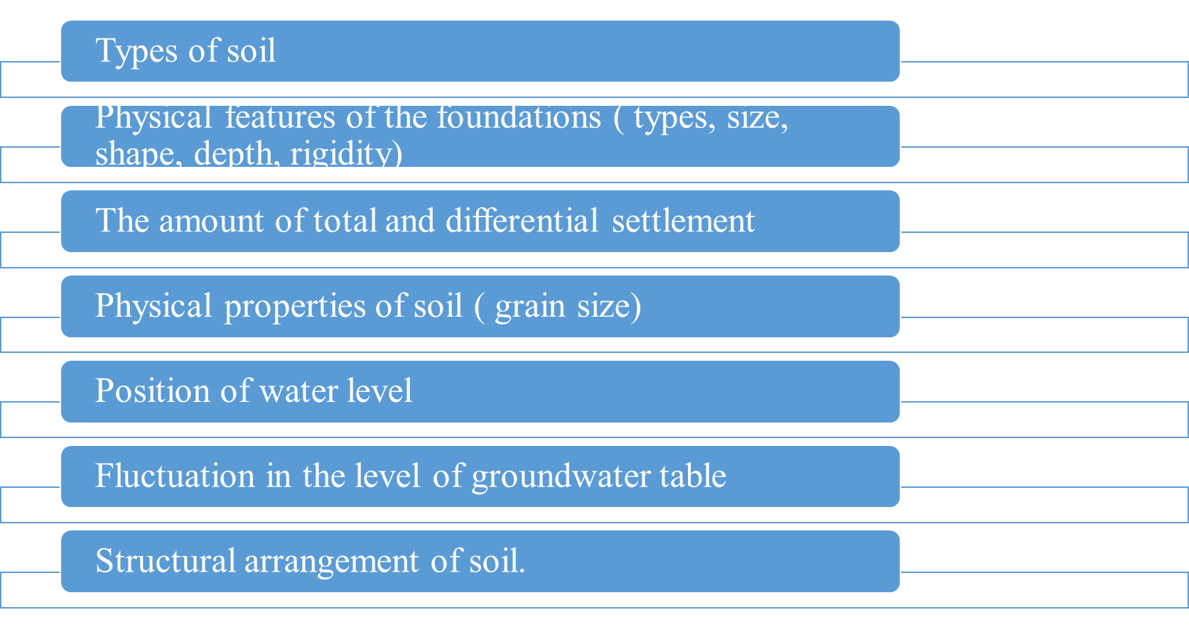
Bearing Capacity:
Maximum load per unit area which the soil carries without yielding.
The bearing capacity of soil are influenced by different factors.
Notes:
Soils support all civil engineering structures, including buildings, dams, and bridges. A foundation is required to transmit the structure's load over a large area of soil. The structure's foundation should be designed in such a way that the soil below does not fail in shear and the structure does not settle excessively.

Slide 16
The process to improve the bearing capacity of soil are:
1. By increasing the depth of the foundation.
2. By undergoing proper compaction
3. By providing sub-surface drainage
4. By treating the soil chemically
5. By grouting
6. By confining the soil

Slide 17
FOUNDATIONS
The sub-structure which transmits the load of super-structure to the ground is known as foundation.
Footing is the part of the foundation which delivers load to the soil and is in direct contact with the soil.
The foundation term includes both the portions below the ground level and the artificial arrangements such as concrete blocks , piles, Grillages , rafts etc upon which the structure stands.[2]

Slide 18
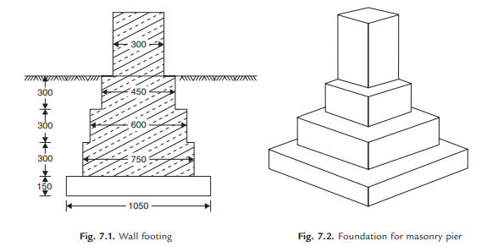
SPREAD FOOTINGS
This type of foundations are commonly used for walls and masonry columns. These foundations are built after opening the trenches to required depth. [2]
Such footings are economical up to a maximum depth of 3 m. As these foundations are suitable depth, they are grouped under shallow foundations. [2]
Figure: Wall footing
Figure: Foundation for masonry pier
Source:Bhavikati, S. (2010). Basic Civil Engineering. new delhi: New Age International (P) Ltd., Publishers.

Slide 19
Before building these footing trenches are opened to the required depth and the soil is rammed well. Then a plain concrete of mix 1: 4: 8 is provided. Its thickness varies from 150 to 200 mm. Over this bed, stone masonry footing is built. It is built in courses each course projecting 50 to 75 mm from the top course and height of each course being 150 to 200 mm. [2]
In the case of wall footing the projections are only one direction while in case of columns, they are in both directions. The projection of bed concrete from the lowest course of foundation masonry is usually 150 mm. [2]

Slide 20
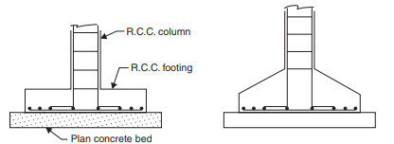
ISOLATED COLUMN FOOTINGS
If separate footings are provided for each column, it is called isolated column footing.
The size of the footing is based on the area required to distribute the load of the columns safely over the soil. [2]
These footings are provided over a 100 to 150 mm bed concrete. Required reinforcements and thickness of footing are found by the design engineers. Thickness may be uniform or varying. [2]
Source:Bhavikati, S. (2010). Basic Civil Engineering. new delhi: New Age International (P) Ltd., Publishers.
Footing with uniform thickness
(b) Sloping footing
Figure: Isolated R.C.C. footing

Slide 21
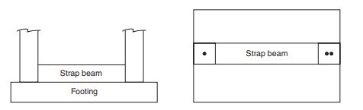
COMBINED FOOTINGS
Common footings may be provided for two columns. This type of footing is necessary when a column is very close to the boundary of the property and hence there is no scope to project footing much beyond the column face. [2]
The footing is to be designed for transferring loads from both columns safely to the soil. The two columns may or may not be connected by a strap beam. [2]
Figure: Combined footing [strap beam may or may not be provided]
Source:Bhavikati, S. (2010). Basic Civil Engineering. new delhi: New Age International (P) Ltd., Publishers.

Slide 22
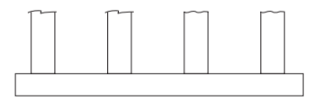
CONTINUOUS FOOTINGS
If a footing is common to more than two columns in a row, it is called continuous footing. This type of footing is necessary, if the columns in a row are closer or if SBC of soil is low. [2]
Figure: Continuous Footing
Source:Bhavikati, S. (2010). Basic Civil Engineering. new delhi: New Age International (P) Ltd., Publishers.

Slide 23
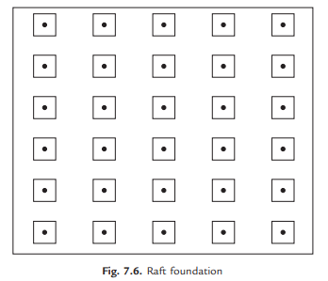
MAT FOOTING/RAFT FOOTING
If the load on the column is quite high (Multistorey columns) or when the SBC of soil is low, the sizes of isolated columns may work out to be to such an extent that they overlap each other. [2]
In such situation a common footing may be provided to several columns . Such footings are known as raft footings. [2]
If the beams are provided in both directions over the footing slab for connecting columns, the raft foundations may be called as grid foundation also. [2]
The added advantage of such footing is, settlement is uniform and hence unnecessary stresses are not produced. [2]
Figure: Raft foundation
Source:Bhavikati, S. (2010). Basic Civil Engineering. new delhi: New Age International (P) Ltd., Publishers.

Slide 24
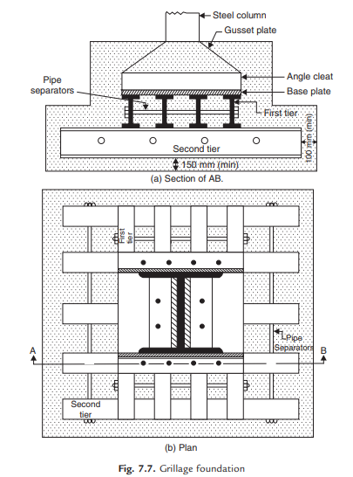
GRILLAGE FOOTING
High rise buildings are built with steel columns encased in concrete. Such columns carry very heavy load and hence they need special foundations to spread the load to a larger area of soil. [2]
Grillage foundation is one such special foundation. It consists of one tier or more tiers of I-sections steel beams. [2]
Top tier consists of less number but large size steel section while lower tier consists of larger number but smaller size steel sections. [2]
Column load is transferred to the top tier through a base plate. The grillage beams are unpainted and are encased in concrete with minimum cover of 100 mm beyond the edges of steel sections. [2]
A minimum clear space of 75 mm should be maintained between the flanges of adjacent grillage beams so that concreting can be made properly. To maintain spacing, pipe separators are used. [2]
Figure :Grillage footing
Source:Bhavikati, S. (2010). Basic Civil Engineering. new delhi: New Age International (P) Ltd., Publishers.

Slide 25
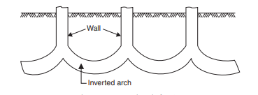
ARCH FOUNDATION
Inverted arch foundations are provided in the places where the SBC of the soil is very poor and the load of the structure is through walls. [2]
In such cases inverted arches are constructed between the walls. [2]
End walls should be sufficiently thick and strong to withstand the outward horizontal thrust due to arch action. [2]
The outer walls may be provided with buttress walls to strengthen them. [2]
Figure: inverted arch footing
Source:Bhavikati, S. (2010). Basic Civil Engineering. new delhi: New Age International (P) Ltd., Publishers.

Slide 26
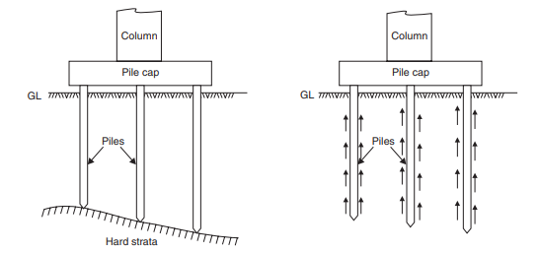
PILE FOUNDATIONS
A pile is a slender column made of wood, concrete or steel.
A pile is either driven into the soil or formed in situ by excavating a hole and then filling it with concrete. [2]
A group of piles are driven to the required depth and are capped with R.C.C. slab, over which super structure is built. [2]
The pile transfer the load to soil by friction or by direct bearing. [2]
This type of foundations is used when top soil is not capable of taking the load of the structure even at 3–4 m depth. [2]
Pile foundations are classified according to the materials used and also on the nature of load transfer. [2]
(b) Frictional pile
(a) Bearing pile
Figure: Pile foundation
Source:Bhavikati, S. (2010). Basic Civil Engineering. new delhi: New Age International (P) Ltd., Publishers.

Slide 27
CLASSIFICATION OF PILES
PILES
Materials Used:
Timber piles
Concrete piles
load transfer
Bearing piles
Steel piles
Composite piles
Friction piles.

Slide 28
Bearing piles rest on hard strata and transfer the load by bearing. Such piles are preferred. These piles are used if the hard strata is available at reasonable depth. [2]
Friction piles transfer the load to the soil by the friction between soil and the pile. Such piles are used if hard strata is not available to a considerable depth. The friction developed is to be properly assessed before deciding the length of the pile. The surface of such piles is made rough to increase the skin friction so that required length of pile is reduced. [2]

Slide 29
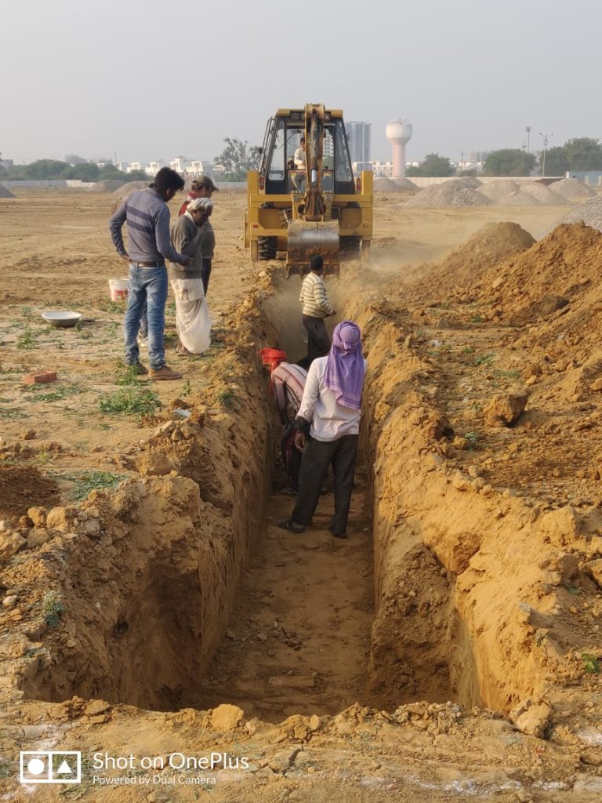
Earthwork excavation for foundations is a critical step in construction, involving the removal of soil and rock to prepare the ground for building support. The specific approach varies depending on the type of soil, rock, or environmental conditions encountered
3. Earthwork excavation of foundations (soft soil, hard rock, wet excavation)
1. Soft Soil Excavation:
•Soft soil, such as clay or silt, requires careful excavation to prevent foundation settling or instability. [3]
•Common techniques include open-cut excavation using heavy machinery like excavators and backhoes. [3]
•Shoring and bracing may be needed to support the excavation walls to prevent cave-ins[3]
•In some cases, soil improvement techniques like compaction or soil replacement may be necessary to enhance load-bearing capacity[4]
Figure: Soft Soil Excavation
https://thetechface.org/how-to-calculate-earth-work-excavation-for-foundation/

Slide 30
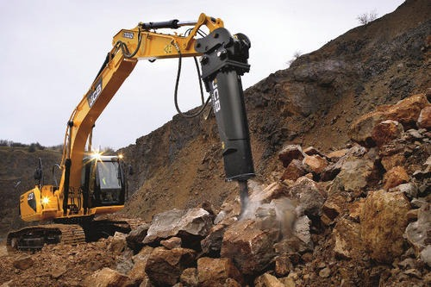
2. Hard Rock Excavation:
•Hard rock excavation involves the removal of solid, unweathered rock formations.
•Rock drills, explosives, or mechanical breakers are used to fracture and loosen the rock.
•Heavy machinery like rock excavators or bulldozers with ripper attachments is employed.
•Precision is crucial to avoid over-excavation and to maintain the desired foundation depth.[5]
Figure: Hard rock Excavation
https://www.snaearthmover.com/rock-excavation-splitting-breaking-work.php

Slide 31
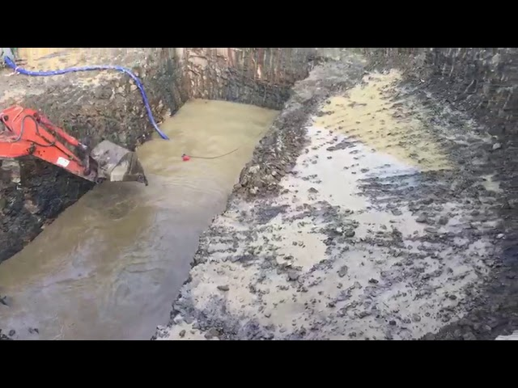
3. Wet Excavation:
•Wet excavation occurs when water is present in the excavation area, either from groundwater or precipitation.[7]
•Pumps are used to dewater the site and keep it dry for safe excavation.[7]
•Specialized equipment like amphibious excavators or dredgers may be used in waterlogged areas.[8]
•Safety measures, such as proper shoring and sloping of excavation walls, are essential to prevent accidents and cave-ins in wet conditions. [8]
Figure: Wet Excavation
https://www.youtube.com/watch?v=Kuh1YjxprPs

Slide 32
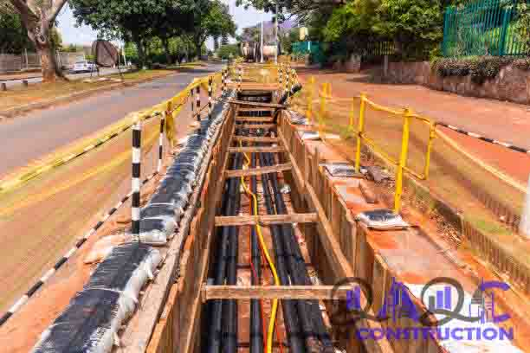
Excavation of trenches for pipes, cables, and other utilities, followed by proper refilling, is a fundamental part of infrastructure development and maintenance
4. Excavation of trenches for pipes, cables etc. and refilling works
1. Excavation of Trenches:
•Excavation is the process of digging narrow, elongated channels or trenches in the ground to accommodate utilities like water pipes, electrical cables, gas lines, or sewage pipes.[9]
•The width and depth of the trench are determined by the specific utility requirements and local regulations. [9]
•Excavation can be done manually using shovels or with heavy machinery like backhoes and trenchers for efficiency. [9]
.
Figure: Excavation of trench for cables
https://www.shutterstock.com/search/cable-trench

Slide 33
2. Safety Measures:
•Safety is paramount during excavation. Proper shoring, sloping, or benching techniques must be used to prevent trench collapses and protect workers. [8]
•Adequate ventilation and testing for hazardous gases (e.g., in gas line trenches) are essential safety precautions [8]
3. Utility Installation:
•After excavation, utilities like pipes or cables are carefully laid within the trench according to engineering specifications. [8]
•Inspections and quality checks are conducted to ensure proper placement and alignment. [8]
4. Backfilling:
•Once utilities are in place, the trench is refilled or backfilled.
•The material used for backfilling must be suitable and compacted in layers to prevent settling or damage to utilities.
•Special attention is given to protecting fragile utilities like fiber-optic cables or electrical lines.

Slide 34
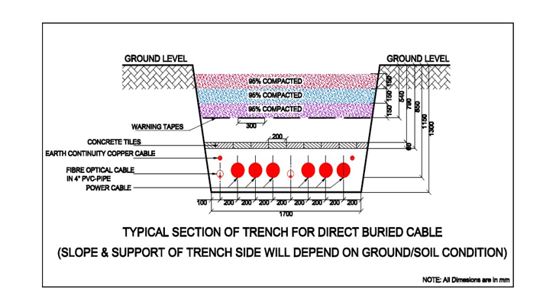
6. Environmental Considerations:
•Minimizing the environmental impact, such as erosion control and sediment management, is an integral part of trenching and refilling operations.[11]
5. Compaction and Restoration:
•Compaction of backfill material is crucial to ensure stability and prevent sinking.
•The surface is restored to its original condition, including paving roads or sidewalks, replanting grass, or reseeding disturbed areas.[10]
Figure: Typical section of trench for direct buried cable
https://methodstatement.store/2021/02/12/trench-preparation-excavation-and-backfill-method-statement-for-electric-underground-cable-laying/

Slide 35
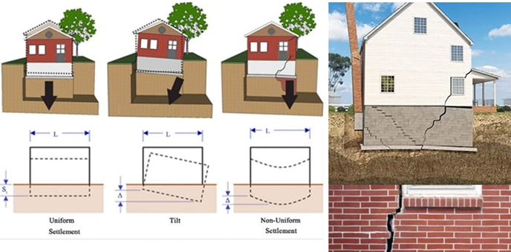
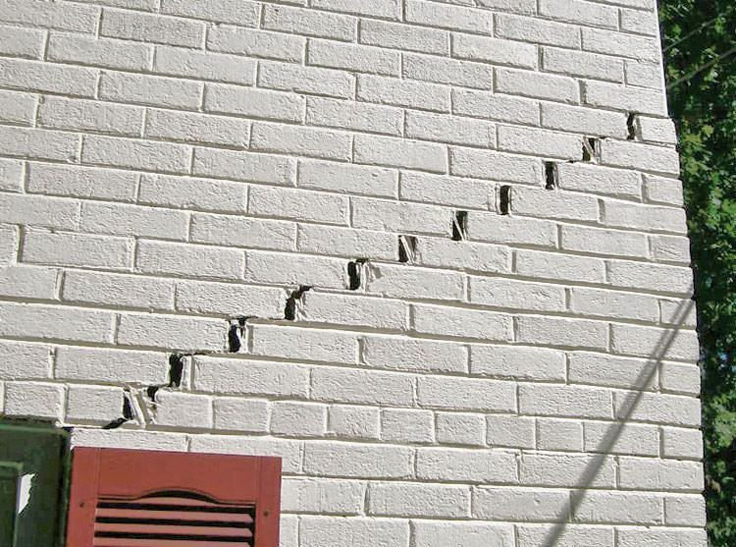
5. Some common problems with existing foundations.
Existing foundations can experience a range of problems over time due to various factors, including soil conditions, construction quality, and environmental changes.
Settlement:
Foundation settlement can result from soil compaction, consolidation, or poor construction practices. It may lead to uneven settling of the structure. [12]
2. Cracks:
Cracks in foundation walls or slabs can occur due to various factors, including soil movement, temperature changes, and structural issues. These cracks can compromise the integrity of the foundation.[13]
Figure: Settlement of foundation
https://www.constructupdate.com/foundation-settlement-causes-types-and-solution/
Figure: Crack on the building
https://www.foundationrepairofca.com/foundation-repair/foundation-problems/settlement-sinking.html

Slide 36
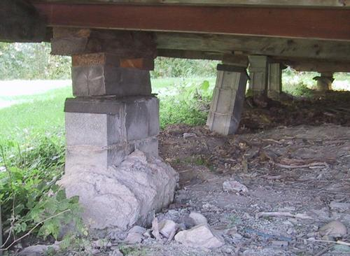
3. Water Damage:
Moisture infiltration, flooding, or poor drainage can result in water-related problems that weaken the foundation over time. This can lead to mold growth and structural issue.
4. Erosion:
Soil erosion around the foundation can undermine its support and stability. This is especially common in regions with inadequate drainage systems
5. Foundation Heaving:
Frost heave in cold climates can cause the foundation to move upward as soil freezes and expands, potentially leading to cracks and structural damage.[3]
Figure: Foundation Heaving
https://woodgears.ca/cottage/foundation.html

Slide 37
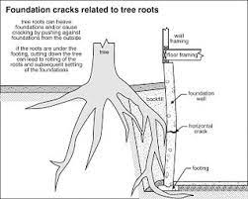
6. Poor Drainage:
Inadequate or blocked drainage systems can result in water accumulation around the foundation, causing hydrostatic pressure that can damage the structure.[14]
7. Soil Shrinkage and Swelling:
Expansive soils can undergo significant volume changes with changes in moisture content, exerting pressure on foundations and causing cracks and movement. .[14]
8. Tree Roots:
Tree roots seeking moisture can invade the soil beneath foundations, leading to soil compaction and potential foundation damage as they grow. [14]
Figure: Tree roots damage of Foundation
http://www.treehusker.com/ian-m.html

Slide 38
9. Corrosion:
Foundations with metal reinforcement may suffer from corrosion due to exposure to moisture and chemicals, which can weaken the structural components.
10. Poor Construction Practices:
Foundations constructed with substandard materials or inadequate techniques may be prone to premature deterioration and structural issues. These common foundation problems can vary in severity and require careful assessment and, if necessary, professional intervention to ensure the safety and longevity of the building.

Slide 39
REFERENCES
[1] Rao, N. S. (2011). Foundation Design: Theory and Practice . 2011 John Wiley & Sons (Asia) Pte Ltd.
[2] Bhavikati, S. (2010). Basic Civil Engineering. new delhi: New Age International (P) Ltd., Publishers.
[3] Tomlinson, M. J., & Woodward, J. (2008). "Foundation Design and Construction.".
[4] : Das, B. M. (2007). "Principles of Geotechnical Engineering."
[5] : Fox, P., & Brown, A. (2000). "Rock Excavation Handbook."
[6]https://testbook.com/civil-engineering/soil-exploration-definition-and-methods
[7] : French, M. H. (2003). "Dewatering and Groundwater Control.")

Slide 40
REFERENCES
[8] OSHA Construction Standard 1926 Subpart P).
[9] American Society of Civil Engineers (ASCE) Manual of Practice No. 37, "Standard Guidelines for the Collection and Depiction of Existing Subsurface Utility Data").
[10] Federal Highway Administration (FHWA) Technical Advisory T 5040.30, "Contractor's Quality Management Plan (CQMP)").
[11] : United States Environmental Protection Agency (EPA) National Pollutant Discharge Elimination System (NPDES) Construction General Permit).
[12] Bowles, J. E. (1997). "Foundation Analysis and Design." McGraw-Hill)
[13] American Concrete Institute (ACI) 302.1R-15 "Guide for Concrete Floor and Slab Construction")
[14] Craig, R. F. (2012). "Soil Mechanics." Wiley

Slide 41
THANK YOU

