Slide 1

COURSE TITLE
BUILDING TECHNOLOGY
Chapter 4 - (Week 4)
Mortars and Masonry works
LECTURE – 4
Mortars and Masonry works
Ar. Ranju Kamal
Lecturer
Advanced college of engineering and management, Nepal
Affiliated to Tribhuvan University
Thailand, Bangkok (photo credit:Abhinay Kushwaha)

Slide 2
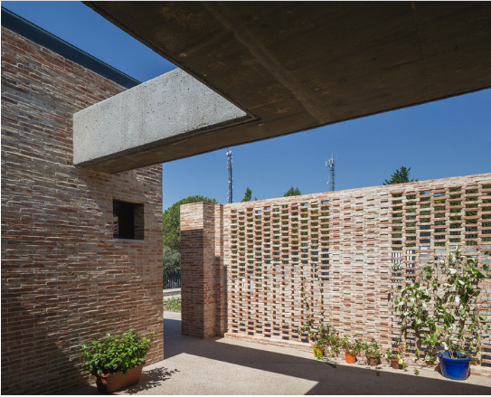
LEARNING OUTCOMES
1. Mortars ( Types, properties, preparation process, )
2. Brick masonry (types, specifications)
3. Stone masonry (random rubble, course rubble, ashlar)
At the end of the session students will get acquainted to:
Figure: Brick Masonry(Source:Dejtiar, 2021:Online)
https://www.archdaily.com/969694/brick-houses-in-spain-modern-masonry-design-for-home-interiors-and-exteriors?ad_source=search&ad_medium=projects_tab&ad_source=search&ad_medium=search_result_all

Slide 3
INTRODUCTION
Mortars:
Paste like substance composed of sand, water and a binding material like cement, lime, etc. that holds building materials like brick or stone together.
Mortar is an intimate mixture of binding material, fine aggregate and water. Mortar is the binding material for the building blocks. [1]
When water is added to the dry mixture of binding material and the inert material, binding material develops the property that binds not only the inert material but also the surrounding stones and bricks. [1]
If the cement is the binding material, then the mortar is known as cement mortar.
Other mortars commonly used are lime mortar and mud mortar. The inert material used is sand. [1]

Slide 4
Properties of Mortar[2]:
Binding the materials properly
Requirements of a good mortar[1]:
Adequate strength
Holding the materials intact
Filling the empty joints, grouts may be used for small joints
Weather resisting layer
Homogeneous mass of the structure
Pointing and plastering
Workability (Plasticity during application)
Water reduction during laying
Adhesion
Bonding
Durable
Good appearance, texture and colour

Slide 5
CEMENT MORTAR
For preparing mortar, first a mixture of cement and sand is made thoroughly mixing them in dry condition. [1]
Water is gradually added and mixed with shovels.
Cement gains the strength gradually with hydration.
Curing normally starts 6–24 hours after mortar is used. Curing is recommended for 28 days. Mixture of cement, sand and water in suitable proportion. [1]
Strongest mortar.
1:3, 1:4, 1:6 are commonly used proportion of cement mortar.
Mostly used for the construction of load bearing walls, columns, etc.
Use of cement mortar on a surface acts as a waterproof layer. [1]
Notes:
It may be noted that in the initial period water requirement is more for hydration and gradually it reduces
Properties of Cement Mortar:
The following are the important properties of cement mortar: 1. When water is added to the dry mixture of cement and sand, hydration of cement starts and it binds sand particles and also the surrounding surfaces of masonry and concrete. 2. A mix richer than 1:3 is prone to shrinkage. 3. Well proportioned mortar provides impervious surface. 4. Leaner mix is not capable of closing the voids in sand and hence the plastered surface is porous. 5. The strength of mortar depends upon the proportion of cement and sand. Strengths obtained with various proportion of cement and sand is shown in Table 2.2.

Slide 6
PREPARATION OF CEMENT MORTARS
HAND MIXING[2]
Generally adopted when small quantity is required.
Ingredients are batched first.
Sand is placed first on a working plate and cement is put on it.
Whole dry mass is mixed until uniform color is obtained.
Then, a volcano depression is made at the center and required water is added.
Dry material from the side is slowly dragged towards the center and wet consistent mixture is made.[2]
MACHINE MIXING[2]
It is prepared by mixing ingredients in mechanical mixture when large quantity is required.
Specified proportion of sand and cement are put into the drum of mixture and water is added immediately before revolving the drum.
Revolve drum for sufficient period to get uniform consistency.[2]

Slide 7
LIME MORTAR
Fat lime and hydraulic limes are used for making lime mortar. If hydraulic lime is used sand mixed is only 2 times the volume of lime. [1]
Lime is prepared by pounding, if quantity required is small or by grinding, if the required quantity is more. [1]
Pounding: For pounding pits are formed in hard grounds.
The size of pit is usually 1.80 m long, 0.4 m wide and 0.5 m deep.
It is provided with lining of bricks or stones.
Lime and sand dry mixed with required proportion is placed in the pit. Small quantity of water is added at intervals. [1]
In each interval the mix is pounded with wooden pounders and mortar is turned up and down. [1]
The process is continued till uniform colour and desired consistency is achieved.
Notes:
If fat lime is used sand mixed is normally 2 to 3 times its volume.

Slide 8
Methods of preparation of lime mortar
1. Manual mixing or pounding method[1]
lime and sand are mixed along with water on a watertight plate form or in a shallow pucca tank.
Two to three times mortar is turned up and down to get fine consistency.
It is not perfectly homogeneous.[1]
2. Mortar mill mixing or grinding[1]
Dry lime and sand is mixed on dry impervious plate form.
Mixture is fed into mortar mill and require amount of water is added.
Mixture is grounded till a uniform consistency is obtained.[1]

Slide 9
Types of special mortars
Mud mortar
Cement-clay mortar
Light & heavy mortars
Decorative mortars
Air-entrained mortar
Fire-resistance mortar
Packing mortar
Sound absorbing mortar
X-ray shielding mortar

Slide 10
MUD MORTAR
Lime-cement mortars
Clay lumps are collected and are wetted with water and allowed to mature for 1 or 2 days.
It is kneeded well until it attains required consistency.
Sometimes fibrous materials like gobber is added in the mix.
It prevents cracks in the plaster.
If plaster is to be used for outer walls, it is sprayed or painted with bitumen.
It is cheap mortar. Its durability is less.
It is normally used for the construction of temporary sheds and cheap houses in rural areas. [1]
Also known as gauged mortar.
Prepared by mixing cement with lime mortar.
Adding cement is know as gauging.
1:1:6,1:2:9,1:3:12 are usual proportion of cement, lime and sand.
It should be used within two hours after cement is added.
It is used in bedding for thick brick walls, as masonry in foundation, plinth and super-structure. [1]

Slide 11
Light weight mortars:
Prepared from light porous sands from pumice and other fine aggregates.
Also prepared by mixing wood powder, saw dust with cement mortar or lime mortar.[2]
Heavy mortars:
Prepared from heavy quartz or other sands.
Have higher density.
Used in load bearing construction.[2]

Slide 12
Decorative mortars:
These mortars are obtained by using color cement or pigment and fine aggregate of appropriate color, texture and surface.[2]
Used to impart a pleasant outer appearance to the surface of structure.
Air-entrained (Plasticized) mortar:
It makes the mortar light weight and a better heat and sound insulator. [2]
Increase the volume of the binder paste and help to fill the voids in the sand. [2]

Slide 13
Fire-resistant mortar:
Packing mortar:
For packing oils, special mortar are required.
Composition of mortar depends on hydro-geologic conditions, and packing method. [2]
Water resistant.
Varieties of packing mortars:
Cement-sand , cement loam and cement-sand-loam .
Prepared by adding aluminous cement to a finely crushed powder of fire bricks. [2]
Used with fire-bricks for lining furnaces, fire places, ovens etc. [2]

Slide 14
Sound absorbing mortar
Uses binding materials such as: cement, lime, gypsum, slag etc.
Aggregate light weight porous materials.
X-ray shielding mortar:
Aggregates are obtained from heavy rock.
To enhance protective property admixtures are added.
Noise level can be reduce.
Used for providing the plastering coat to walls and ceiling of X-ray cabinet.

Slide 15
STONE MASONRY
Masonry means construction of buildings using building blocks like stone, bricks, concrete blocks etc.
Masonry is used for the construction of foundation, plinth, walls and columns.
Types of Stone Masonry
Mainly there are two types of stone masonry:
1. Rubble Masonry
2. Ashlar Masonry.

Slide 16
Stone Masonry
1. Rubble Masonry
2. Ashlar Masonry
Random Rubble Masonry
Coursed
Uncoursed
Square Rubble Masonry
Coursed
Uncoursed
Miscellaneous Types
Flint Rubble Masonry
Polygonal Rubble masonry
Dry Rubble Masonry
Ashlar Fine Masonry
Ashlar Rough Tooled
Ashlar Rock or Quarry Faced
Ashlar Chamfered
Ashlar Block in Course
Ashlar Facing

Slide 17
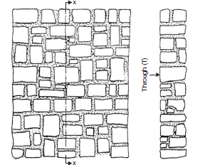
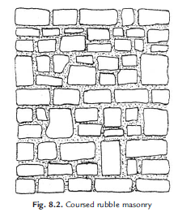
Rubble Masonry:
In this type of constructions stones of irregular sizes and shapes are used.[1]
To remove sharp shapes they may be hammered. The rubble masonry may be coursed or uncoursed . [1]
In uncoursed rubble masonry the wall is brought to level at every 300 mm to 500 mm. The mortar consumed in these construction is more. [1]
Course rubble masonry is used for the construction of public and residential buildings. [1]
Uncoursed rubble masonry is used for the construction of foundations, compound walls, garages, labour quarters etc. [1]
A skilled mason may arrange the facing stones in polygonal shapes to improve the aesthetic of the wall. [1]
Figure: Uncoursed rubble masonry
Figure Source: Bhavikati, S. (2010). Basic Civil Engineering. New Delhi: New Age International (P) Ltd., Publishers
Figure:coursed rubble masonry

Slide 18
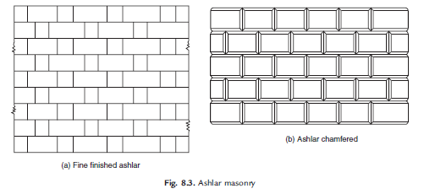
2. Ashlar Masonry:
In this type of masonry stones are dressed to get suitable shapes and sizes.[1]
The height of the stones varies from 250 mm to 300 mm. The length should not exceed three times the height. The dressing of the stone need not be very accurate on all sides. [1]
Usually good dressing is made on facing side. In such construction mortar consumption is less compared to rubble masonry. [1]
There are different types of ashlar masonry depending upon the type of dressing such as Ashlar fine dressed, Ashlar rough dressed, Ashlar rock or quarry faced, Ashlar facing, Ashlar chamfered etc. [1]
Figure Source: Bhavikati, S. (2010). Basic Civil Engineering. New Delhi: New Age International (P) Ltd., Publishers
Figure: Ashlar masonry

Slide 19
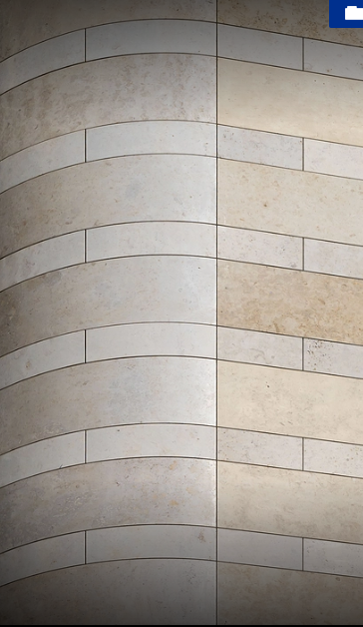
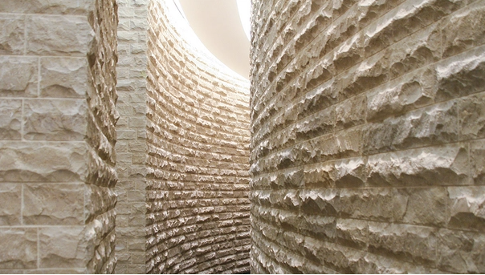
Figure: Ashlar masonry(Source: Archdaily, n.d.:Online)
https://www.archdaily.com/catalog/us/products/21524/wall-covering-cladding-franken-schotter?ad_name=related-products-bottom

Slide 20
The following points should be kept in mind in supervising stone masonry work:[1]
1. Hard and durable stones, free from defects like flaws, cavities veins etc. should be used.
2. Dressing of the stones should be as per the requirement.
3. Stones should be properly wetted before they are used so as to avoid sucking of water from
mortar.
4. Stones should be laid on their natural bed.
5. Facing and backing faces should be laid neatly and levelled and checked with wooden template.
6. The heart of masonry should be filled with stone chips and mortars. To thick mortar joints
should be avoided.

Slide 21
7. Verticality of the wall should be frequently checked with plumb-bob.
8. Mortars with correct proportion of sand and cement should be used.
9. Continuous vertical joints should be avoided.
10. Through stones should be used within 1.5 m distances.
11. The height of masonry should be raised uniformly.
12. Under the beams, trusses, sills etc large flat stones should be used.
13. Before continuing work, the masonry built on previous day should be well cleaned and freed from loose particles.
14. Curing should be done properly for 2 to 3 weeks.

Slide 22
Rubble Masonry and its type
Blocks of stones are used either undressed or roughly dressed.
Has wide joints.
Roughest and cheapest form of stone masonry.
There is no uniform thickness in the joints.[2]
Types of rubble masonry:
Random rubble masonry:
It can be classified as uncoursed and built to courses masonry.
Random rubble-uncoursed masonry
Stones are laid without forming courses.
Used stones are of different sizes.
Used for construction of walls of low height. [2]

Slide 23
b) Random rubble-built to courses
Stones are laid in layers of equal height.
Hammer dressed stones are used.
Used for construction of residential buildings, boundary walls, etc. [2]
2. Square rubble masonry
Face stones are squared on all joints and beds by hammer dressed before their actual laying. [2]
It can be classified as uncoursed and built to courses.
Square rubble-uncoursed
Hammer dressed stones are laid without making courses.
Stones are of different sizes.
Used for the construction of buildings in hilly areas where stones are cheaply available. [2]

Slide 24
b) Square rubble-built to courses
Stones are laid in courses of equal layer.
Used for the construction of public buildings, hospital, schools, etc. where good quality of stone is easily available. [2]
3. Miscellaneous types-polygon walling
The stones are hammer finished on face to an irregular polygon shape.
Stones are bedded in position so that joints runs irregularly in all direction.
Rough picked and close picked are two types of polygonal walls. [2]
4. Dry rubble masonry
Is that rubble masonry made to courses in which mortar is not used.
Cheapest but requires more skills for construction.
Used for constructing walls of height not more than 6m. [2]

Slide 25
Ashlar masonry and its types
Consists of blocks of accurately dressed stones with extremely fine bed and end joints.
It may be ether square or rectangular.
Height of stone varies from 25 to 30cm.
Height of blocks in each courses is kept equal.
Costly type of masonry.
Used for heavy construction like abutments of bridges, high piers, etc. [2]
Types of Ashlar masonry
Fine tooled Ashlar Masonry:
Finest type of stone masonry work.
Each stone is cut to regular and required shape and sizes.
Regular coursed and random coursed are its type. [2]

Slide 26
b) Rough tooled Ashlar Masonry :
Beds and sides of each stone block are finely chisel dressed and rough tooled.
Thickness of joints are uniform, that does not exceed 6mm. [2]
c) Rock or quarry faced Ashlar Masonry :
Same as rough tooled except that there is chisel-drafted margin left rough on the face. [2]
d) Chamfered Ashlar Masonry :
Exposed face is chambered at an angle of 45 by the means of a chisel to a depth of 25mm or more. [2]

Slide 27
e) Block in Course Ashlar Masonry :
Is intermediate between rubble masonry and ashlar masonry.
The faces of each stones are properly dressed. [2]
f) Ashlar facing:
Is provided along with brick or concrete block masonry.
Gives better appearance and are very expensive.
Sides and beds of each block are properly dressed.
Exposed faces of the stones are rough tooled and chambered. [2]

Slide 28
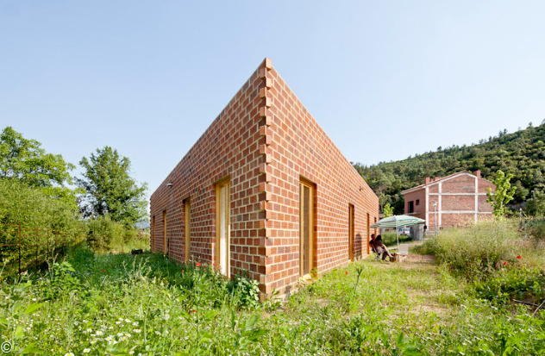
BRICK MASONRY
Brick masonry is built with bricks bonded together with mortar. For temporary sheds mud mortar may be used but for all permanent buildings lime or cement mortars are used.[1]
The various types of bonds generally used in brick masonry are
1. Stretcher bond
2. Header bond
3. English bond and
4. Flemish bond.
Source:Dejtiar, F. (2021, October 15). https://www.archdaily.com/969694/brick-houses-in-spain-modern-masonry-design-for-home-interiors-and-exteriors?ad_source=search&ad_medium=projects_tab&ad_source=search&ad_medium=search_result_all

Slide 29
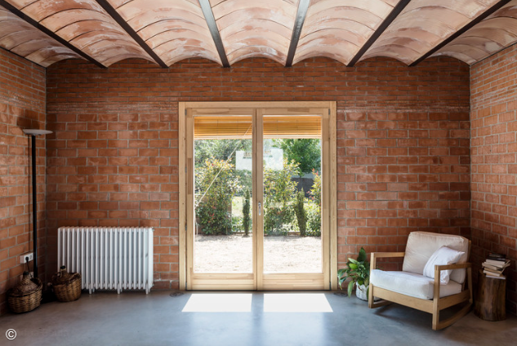
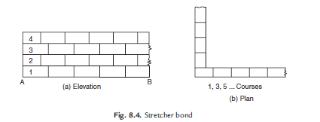
Stretcher Bond:
A stretcher is the longer face of the brick as seen in the elevation. In the brick of size 190 mm × 90 mm × 90 mm, 190 mm × 90 mm face is the stretcher. [1]
In stretcher bond masonry all the bricks are arranged in stretcher courses However care should be taken to break vertical joints. [1]
This type of construction is useful for the construction half brick thick partition wall. [1]
Source:Dejtiar, F. (2021, October 15). https://www.archdaily.com/969694/brick-houses-in-spain-modern-masonry-design-for-home-interiors-and-exteriors?ad_source=search&ad_medium=projects_tab&ad_source=search&ad_medium=search_result_all

Slide 30
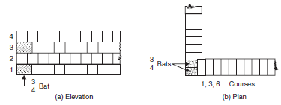
2. Header Bond:
A header is the shorter face of the brick as seen in the elevation. In a standard brick it is 90 mm × 90 mm face. [1]
In header bond brick masonry all the bricks are arranged in the header courses . [1]
This type of bond is useful for the construction of one brick thick walls. [1]
Figure: Header Bond
Figure Source: Bhavikati, S. (2010). Basic Civil Engineering. New Delhi: New Age International (P) Ltd., Publishers

Slide 31
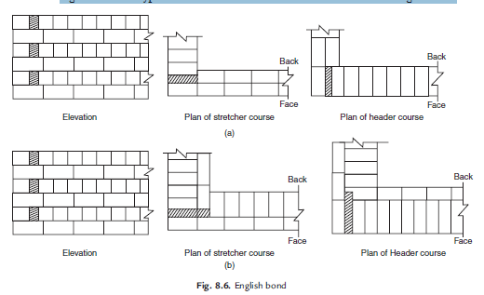
3. English Bond:
In this alternate courses consist of headers and stretchers. This is considered to be the strongest bond. Hence it is commonly used bond for the walls of all thicknesses.
To break continuity of vertical joints a brick is cut lengthwise into two halves and used in the beginning and end of a wall after first header. This is called queen closer.
Figure shows typical one brick and one and half brick thick wall with English bond.
Figure Source: Bhavikati, S. (2010). Basic Civil Engineering. New Delhi: New Age International (P) Ltd., Publishers
Figure: English Bond

Slide 32
4. Flemish Bond:
In this type of bond each course comprises of alternate header and stretcher. Alternate courses start with stretcher and header. To break the vertical joints queen closers are required, if a course starts with header. Every header is centrally supported on the stretcher below it.
Flemish bonds may be further classified as
(a) Double Flemish Bond
(b) Single Flemish Bond.
In case of double flemish bond, both faces of the wall have flemish look, i.e. each course consist
of alternate header and stretcher, whereas single flemish bond outer faces of walls have flemish look whereas inner faces have look of English bond.
Construction of flemish bond needs greater skill. It gives more pleasing appearance. But it is not as strong as English bond. If only pointing is to be used for finished wall, flemish bond may be used to get good aesthetic view.
If plastering is going to be used, it is better to use English bond.

Slide 33
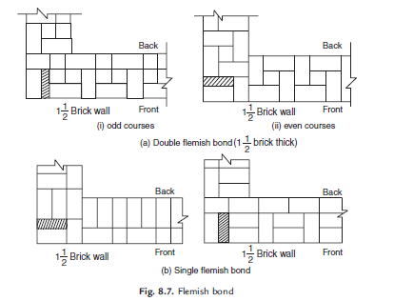
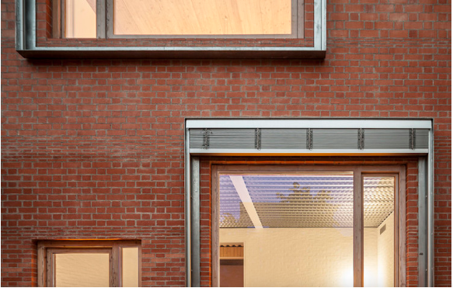
Figure: Flemish Bond:
Source:Dejtiar, F. (2021, October 15). https://www.archdaily.com/969694/brick-houses-in-spain-modern-masonry-design-for-home-interiors-and-exteriors?ad_source=search&ad_medium=projects_tab&ad_source=search&ad_medium=search_result_all
Figure Source: Bhavikati, S. (2010). Basic Civil Engineering. New Delhi: New Age International (P) Ltd., Publishers

Slide 34
The following points should be observed in the construction of brick masonry[1]:
1. Use bricks of good quality with uniform colour, well burnt, with exact shape and size.
2. Before using the bricks in masonry, they should be soaked in water for 2 hours so that bricks
do not absorb water from the mortar.
3. Bricks should be laid with the frog pointing upward.
4. Construction of brick wall should start from the end or corner.
5. Brick courses should be perfectly horizontal.
6. Verticality of the wall should be ensured by frequently checking with plumb-bob.
7. Mortar used should be as per specification.
8. Whenever work is stopped brick masonry should be left with toothed end.
9. Use of brick bats should be avoided.

Slide 35
Principles to be observed in brick masonry construction[1]:
Bricks use should be sound, hard and well burnt with uniform size, shape and color.
Soaked in clear water before use .
Should be laid on a full bed of mortar, slightly pressed while laying to endure proper adhesion.
All the joints should be properly flushed an filled with mortar so that no cavity is left in between.
Raising masonry should be such that all the connected brick work should be carried up in uniform layer at one level.
Iron fixtures like pipes, hold-fast of doors and windows which are to be fixed in the brick wall should be embedded in cement mortar or in cement concrete.

Slide 36
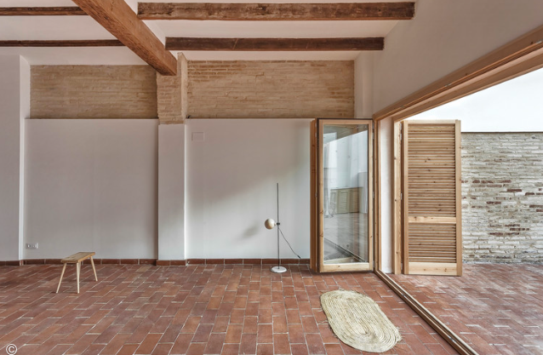
Principles to be observed in brick masonry construction:
Plastering should be done after about 28 days of completion of brick masonry.[1]
Finished masonry should be cured for at least seven days. [1]
When it is desired to increase the length of the wall under construction in future, the wall is stopped with a toothed end. [1]
With an average temperature differences about 100°F ,a brick masonry wall expand by about 10mm in every 30m length of the wall ,hence it is desirable to provide minimum18mm wide expansion joints after every 30m to 45m length of wall. [1]
Source:Dejtiar, F. (2021, October 15). https://www.archdaily.com/969694/brick-houses-in-spain-modern-masonry-design-for-home-interiors-and-exteriors?ad_source=search&ad_medium=projects_tab&ad_source=search&ad_medium=search_result_all

Slide 37
Types of Bonding
Brick Bond
Header bond
Garden Wall bonds
Raking bond
Stretcher bond
English bond
Flemish bond/Dutch Bond
Other types of Bonds
Zig zag bond
Rat Trap Bond
Herring bone bond
Diagonal bond

Slide 38
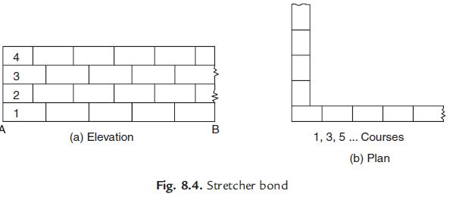
Stretcher bond
Figure Source: Bhavikati, S. (2010). Basic Civil Engineering. New Delhi: New Age International (P) Ltd., Publishers

Slide 39
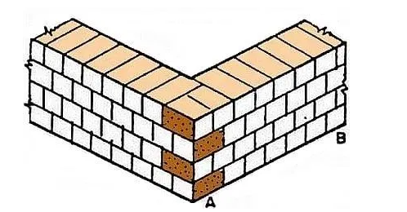
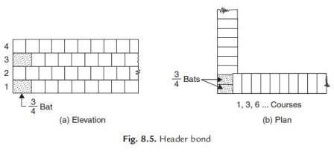
Header bond
Figure Source: Bhavikati, S. (2010). Basic Civil Engineering. New Delhi: New Age International (P) Ltd., Publishers

Slide 40
ADVANTAGES AND DISADVANTAGES OF BRICK MASONRY OVER STONE MASONRY
Advantages:[1]
1. Since shape and size of bricks are uniform, it do not need skilled labour for the construction.
2. Bricks are light in weight and hence handling them is easy.
3. Bricks are easily available around cities and their transportation cost is less because their
weight is less. Stones are to be brought from quarries which are located only at few places.
4. It is possible to use all types of mortar in brick masonry. For unimportant buildings even mud
mortar can be used.
5. Thinner walls can be constructed with bricks but it is not so with stones.
6. It is easy to form openings for doors and windows.
7. Dead load of brick masonry is less.
8. In brick masonry mortar joints are thin and hence construction cost is reduced considerably.
9. Brick masonry has better fire and weather resistance compared to stone masonry.

Slide 41
Disadvantages:[1]
1. Strength of brick masonry is less than that of stone masonry.
2. Durability of brick masonry is less.
3. Brick masonry needs plastering and plastered surface needs colour washing. Stone masonry
don’t need them and hence maintenance cost is more in brick masonry.
4. Brick masonry absorbs water and there are possibility of dampness. There is no such problem
in stone masonry.
5. More architectural effects can be given in stone masonry compared to that in brick masonry.
6. Stone masonry gives massive appearance and hence monumental buildings are built in stone
masonry.

Slide 42
REFERENCES
[1] Bhavikati, S. (2010). Basic Civil Engineering. New Delhi: New Age International (P) Ltd., Publishers.
[2] Giri, O. P. (2018). A textbook of Building Technology. Heritage Publishers and Distributors Pvt Ltd.
[3]Archdaily. (n.d.). Retrieved from Archdaily.com: https://www.archdaily.com/catalog/us/products/21524/wall-covering-cladding-franken-schotter?ad_name=related-products-bottom
[4]Dejtiar, F. (2021, October 15). Archdaily. Retrieved from Archdaily.com: https://www.archdaily.com/969694/brick-houses-in-spain-modern-masonry-design-for-home-interiors-and-exteriors?ad_source=search&ad_medium=projects_tab&ad_source=search&ad_medium=search_result_all

Slide 43
THANK YOU

